Slide 1
Configure Network Access
Topic B: Install and Configure a SOHO Router

Slide 2
SOHO Networks
A SOHO network is a network that provides connectivity and resource sharing for a small office or home office.
Generally limited to fewer than 20 computers or nodes, a SOHO network often facilitates sharing of files and printers, as well as services such as email, faxing, and so forth.
A SOHO network can contain a combination of wired and wireless computer connections, and all of the computing devices in a SOHO network usually share the same physical location.
SOHO networks can range in size, and there is no real consensus as to the maximum number of nodes that can be in a SOHO network.
Some sources cite the maximum as 10 nodes, whereas others say that four or five nodes is the maximum.

Slide 3
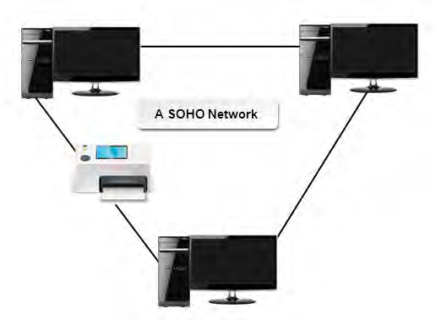

Slide 4
SOHO Routers
A wireless router connects a computer to multiple networks through a wireless connection.
It performs the functions of a wireless access point (WAP) and a router. It enables wired and wireless computers to connect to the Internet.
It can allow multiple users to be connected to a network at the same time. Some wireless routers have a firewall built into them.

Slide 5
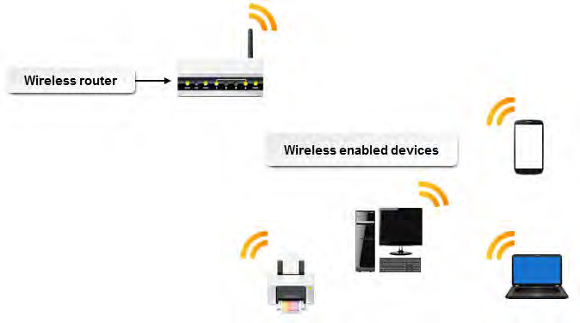

Slide 6
Network Device | Description
Hub | A hub is a networking device that connects multiple computers to form a LAN. The hub broadcasts data in the form of signals to all connected computers. Hubs support transmission speeds of 10 Mbps, 100 Mbps, or both.
Switch | A switch is a small network hardware device that joins multiple computers together within the same LAN. Like hubs, switches also have multiple ports and are responsible for forwarding data from a source to a destination. However, switches forward data packets to only the nodes or segments they are addressed to and reduce the chances of collisions among data packets.
Router | A router is a networking device used to send data among multiple networks that use the same protocol. A protocol is a set of rules used to establish communication between two computers on a network. Routers send data among networks by examining the network addresses contained in the packets they process. A router can be a dedicated device or can be implemented as software running on a node. Although the functions of a router are similar to that of a switch, a router has a comparatively higher data handling capacity and is mainly used in WANs.

Slide 7
Encryption
File encryption is a type of file protection that disguises the data within a file or message so that the specific information included within the file or message cannot be read or understood by unauthorized users.
A key is used to encode the data, and neither the file nor the key contents can be read by anyone who does not have the key.
File encryption can be local, where a file that is on a disk is protected, or it can be used when a file is being transmitted over a network connection.

Slide 8
Encryption (cont.)
Note: In some instances, organizational policies can restrict or require the use of file encryption.
An example of file encryption would be code that substitutes each letter of the alphabet for another letter at a specific distance in the alphabet.
A rule like that was used to encode the following message:
Iloh Hqfubswlrq.
The key to decoding this encrypted message would be a number that shows the distance between the original character and the encoded character. The decryption key, -3, tells you to take each letter in the encrypted message and count back three letters in the alphabet to read the message:
File Encryption.

Slide 9
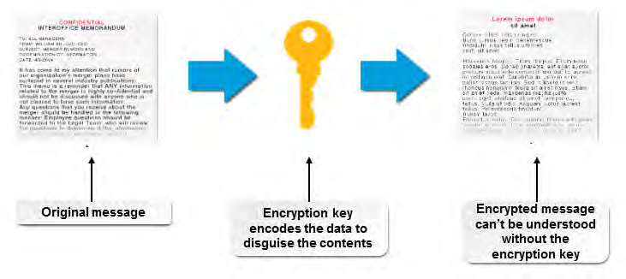

Slide 10
Wireless Encryption Standards
Wireless networks are not as secure as wired networks, as they operate over radio waves instead of physical cables. In an effort to strengthen the security of wireless networks, a number of wireless encryption protocols have been developed

Slide 11
Wireless Encryption Method | Description
WEP | Wired Equivalent Privacy (WEP) is a security protocol for wireless local area networks (WLANs). WEP does not use strong encryption and is therefore considered obsolete. However, some legacy devices may only support WEP.
WPA | Wi-Fi Protected Access (WPA) provides a significantly stronger encryption scheme than WEP, and can use a shared private key, which are unique keys assigned to each user.
WPA2 | Wireless Protected Access 2 (WPA2) replaced WPA encryption in 2006 and is based on the IEEE 802.11i standards. The Institute of Electrical and Electronics Engineers (IEEE) 802.11i standard is the most recent encryption standard that provides improved encryption for wireless networking. The 802.11i standard requires strong encryption key protocols, known as Temporal Key Integrity Protocol (TKIP) and Advanced Encryption Standard (AES). WPA2/802.11i encryption is considered to be the strongest available method of wireless security.

Slide 12
Service Set Identifiers
A Service Set Identifier (SSID) is a 32-bit alphanumeric string that identifies a WAP and all the devices attached to it.
A WAP typically broadcasts an SSID in plaintext.
It is more appropriate to think of an SSID as a network name that is applied to the grouping of the WAP and the devices currently connected to it.
Wireless connectivity devices such as a WAP or other wireless routers come with a default SSID.
Instead of accepting the device's default SSID, you should manually specify an SSID to more clearly identify the device.

Slide 13
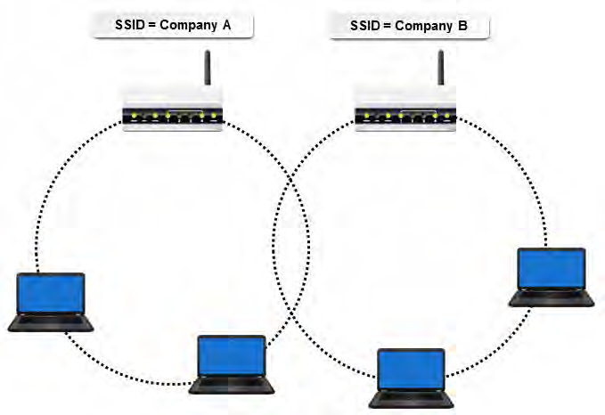

Slide 14
SOHO Router Configuration Options
Most routers available today can be configured for wired and wireless networks.
Depending on the router installation, there are several settings that you can configure to ensure connectivity, security, and access.

Slide 15
Setting | Description
Basics | Basic settings apply to both wired and wireless routers and can include the ability to: • Secure your router or access point administration interface. • Change default administrator passwords (and user names). • Disable remote administration. • Secure/disable the reset switch/function. • Change the default SNMP parameter. • Regularly upgrade the Wi-Fi router firmware to ensure you have the latest security patches and critical fixes.
SSID | When installing a wireless router, change the default Service Set Identifier (SSID) and verify that you are not broadcasting out to the network.
Channels | Change the default channel on wireless routers. By changing the router channel, you can optimize data transmission and reduce interference with other routers in close proximity. If your router is dual channel, then you can easily change from the default channel to the other channel available. To help determine what channel is not being used, you can use one of the utilities available that can scan the local area and display used channels. This can be very helpful in choosing a different less-used channel for your router.

Slide 16
Firmware
Firmware is specialized software that is stored on a hardware device's read-only memory (ROM) whether or not the device is powered.
It is most often written on an electronically reprogrammable chip so that it can be updated with a special program to fix any errors that might be discovered after a computer is purchased, or to support updated hardware components.
Router firmware may need an upgrade from time to time depending on manufacturer updates.
These updates contain security patches, updates to performance, and updates to address any known issues.
The updates can be installed in a number of ways, but most commonly can be downloaded from the manufacturer's website.
Note: Overwriting existing firmware, often through updating, is called flashing.

Slide 17
Router Setup Process
Verify the wired connection, if applicable.
Configure encryption standard (WEP, WPA, or WPA2).
Change SSID from default.
Apply a new wireless password.
Change the admin password for the router.
Connect to the new network.
Verify the Internet connectivity.
Update firmware, if necessary.

Slide 18
How to Install and Configure a
SOHO Router
If you are deploying a wireless router, choose the appropriate 802.11 router for your needs, whether it be 802.11a, b, g, or n.
Choose a location for the router.
  In a wired SOHO network, you must verify that the cables are long enough so that devices can reach the router.
  Wireless routers need to be placed strategically so that all computing devices have an equally strong wireless signal. In some SOHO networks, you may need more than one wireless router.
Connect the router to a power source and turn it on.
Connect the router to a cable or DSL modem via Ethernet or USB cable. After plugging in the cables, you may need to turn the router off and on to verify that the router has recognized the modem.
Connect a computing device to the router. If you are deploying a wireless router, use a cable for the initial router configuration. Once the router configuration is completed, you can remove the cable and connect wirelessly.
Navigate to the router's administrative utility. You may need to refer to the router's user manual, but in most cases you can open an Internet browser and enter http://192.168.1.1.

Slide 19
SOHO Router (cont.)
Enter the information needed to connect the router to the Internet. The exact information will depend on how you are subscribing to an ISP.
  If you are using DSL, then you may need to enter a specific user name and password issued to you by the ISP.
  If you have been asked to use a static IP address, then you may need to enter the address issued to you by the ISP.
Configure the router settings according to your needs.
  For a wired router, change the default user name and password.
  For a wireless router, make sure that you update the SSID and change the default user name and password.
If necessary, create an access control list for the router to control which users or computers can access it.
Verify that you can connect to the Internet by opening a browser and performing a search.
Configure the security settings in the administrative utility.
Connect additional computing devices to the router.

