Slide 1
Managing Worksheets
Lesson 6

Slide 2
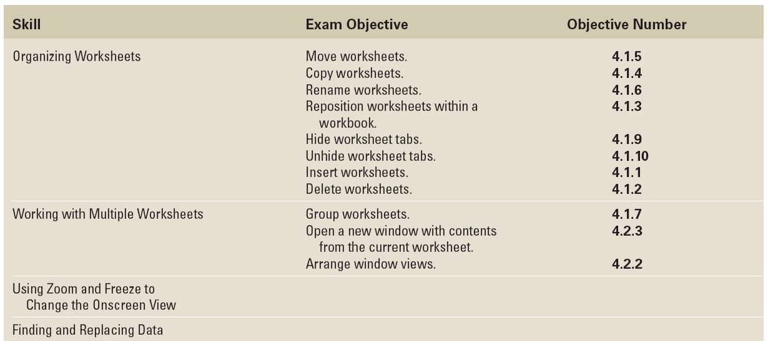
Objectives

Slide 3
Software Orientation: Worksheet Management
An Excel workbook should contain information about a unique subject.
Each worksheet within a workbook should contain a subset of information about that workbook. The number of worksheets that a workbook can contain is limited only by the available memory of your computer.
You can copy worksheets between workbooks, manage and reorganize sheets by hiding and unhiding worksheets, and use Excel’s search tools to find and replace information in a worksheet or workbook. To accomplish these tasks, use commands in the Home tab’s Cells and Editing groups. (See the figure on the next slide.)

Slide 4
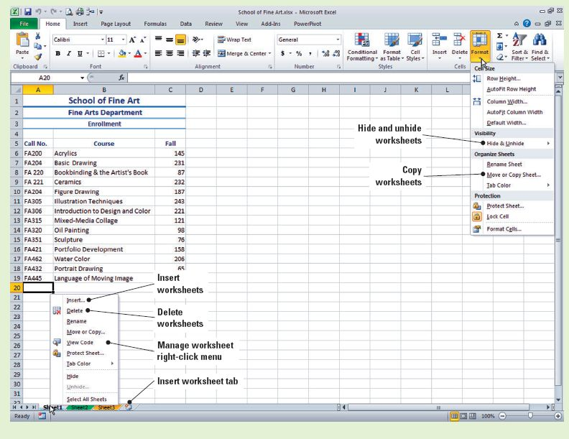
Software Orientation: Worksheet Management

Slide 5
Organizing Worksheets
A new, blank Excel workbook has three worksheets.
You can add to, delete from, and move and copy these worksheets as desired.
You can also rename worksheets and hide and unhide worksheets when you need to do so.
The flexibility to organize worksheets with similar subject matter together in one file enables you to effectively and efficiently manage related data.

Slide 6
Copying a Worksheet
Just as you can copy data from one cell or range in a worksheet to another cell or range, you can copy data from one worksheet to another within a workbook. For example, when a new worksheet will contain information similar to that contained in an existing worksheet, you can copy the worksheet and delete cell contents or overwrite existing data with new data.
When you copy a worksheet, you retain the structure and formatting of the original worksheet so that you don’t need to rebuild it from scratch.
You can copy a worksheet using the Home tab’s Format commands, the mouse, or the shortcut menu.

Slide 7
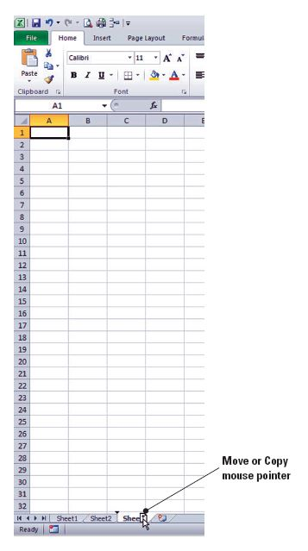
Copying a Worksheet
You can then delete or overwrite the
existing data with new data.
Notice that when you copy a worksheet,
the new sheet is identified as a copy by
a number in parentheses following the
worksheet name.
When you click and hold the left mouse
button on the worksheet tab, the cursor
becomes a new worksheet icon and an
arrow appears next to the active
worksheet tab, as shown in the figure.

Slide 8
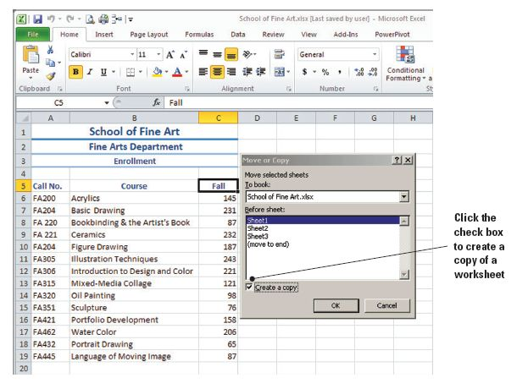
Step-by-Step: Copy a Worksheet
LAUNCH Microsoft Excel 2010.
OPEN the School of Fine Arts data file for this lesson.
With the Sheet1 tab
active, click Format
in the Cells group on
the Home tab.
Click Move or Copy
Sheet. The dialog box
in the figure opens.
Notes:
Another Way: You can also right-click a sheet tab to display the shortcut menu, then click Move or Copy to display the corresponding dialog box.

Slide 9
Step-by-Step: Copy a Worksheet
Sheet1 is selected by default. Select the Create a copy box (refer to the previous figure) and click OK. A copy of Sheet1 is inserted to the left of Sheet1 and is named Sheet1 (2).
Click the Sheet3 tab and hold down the left mouse button. A down arrow appears at the boundary between Sheet2 and Sheet3, and the cursor becomes an arrow pointing to the left of a blank document symbol.
Press and hold Ctrl. A plus sign appears in the cursor document. Move the cursor to the right until the down arrow appears on the right side of Sheet3. Release the mouse button and Ctrl key. The new sheet is named Sheet3 (2).

Slide 10
Step-by-Step: Copy a Worksheet
With Sheet3 (2) active, select cell A2 and key Dramatic Arts Department.
When you use the Format command or the shortcut menu to copy a worksheet, the Move or Copy dialog box (refer to the figure on slide 7) lets you identify the worksheet you want to copy. By default, the copied worksheet is inserted before the sheet you select in the dialog box. You can, however, place the worksheet in other locations by choosing the destination in the Move or Copy dialog box.
Select A6:C18 and press Delete.
Notes:
Another Way: Rather than delete the existing data, you can overwrite it. Select A6 and begin keying new data. Press Tab and key the data for B6. Press Tab and key the data for C6 and press Enter, etc. As you move to the next cell, the existing text is selected and it will be deleted when you enter new text.

Slide 11
Step-by-Step: Copy a Worksheet
Enter the following data for the Dramatic Arts Department, beginning in cell A6:
DRAM321 Acting Studio I: Discover the Actor 106
DRAM322 Naturalism and Realism Techniques 95
DRAM326 Acting Studio: Improvisation 87
DRAM302 Acting Studio: Comedy 69
DRAM301 Fundamentals of Dance 110
DRAM312 Acting Studio: Shakespeare 95
DRAM315 Acting Studio: Iconoclastic Voices 95
DRAM400 Dialects and Accents 95
DRAM401 Advanced Voice and Diction 75
DRAM420 Theatre History 125
DRAM435 Acting for Film and TV 76
DRAM460 Auditioning Techniques 95

Slide 12
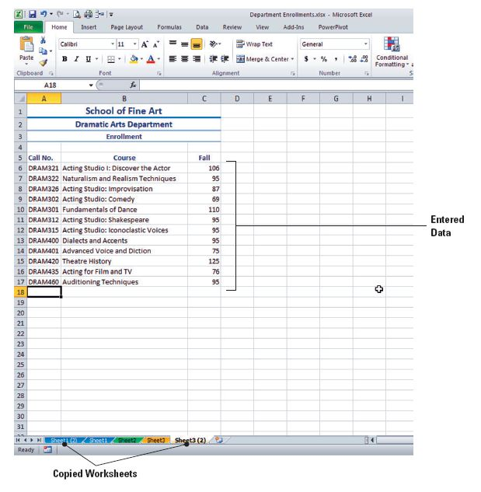
Step-by-Step: Copy a Worksheet
Adjust all column widths
to display all data. (See
the figure.)
Click the File tab and
select Save As. Create a Lesson 6 folder. SAVE the workbook in the folder
as Department
Enrollments.
Notes:
Take Note: Notice that when a worksheet is copied, the tab color is copied as well as the worksheet, contents, and formatting.

Slide 13
Renaming a Worksheet
When a workbook contains multiple worksheets with data, it is helpful to replace the generic names Sheet1, Sheet2, and so on with names that identify the data contained in each sheet.
In the example, each of the worksheets contains information about one department in the School of Fine Arts. Renaming the tabs with department names will allow you to quickly locate enrollment data.
By naming the worksheets, you make it much easier to locate enrollment data for any course in a department. Each worksheet name indicates the type of data contained in the sheet.

Slide 14
Step-by-Step: Rename a Worksheet
USE the workbook you saved in the previous exercise to carry out these steps:
Double-click the Sheet1 (2) tab to select the tab name.
Key Interior Design and press Enter. The new name appears on the worksheet tab.
Key Interior Design Department in A2 of the sheet. Select A6:C19 and press Delete. You will enter data for this department in a later exercise.
Click the Sheet1 tab. Click Format and click Rename Sheet. Key Fine Arts and press Enter.
Notes:
Another Way: You can also right-click the sheet tab to activate the sheet tab drop-down menu.

Slide 15
Step-by-Step: Rename a Worksheet
Click the Sheet2 tab. Rename the sheet Media Studies and press Enter.
Click the Sheet3 tab. Rename the sheet Biomedical Arts and press Enter.
Click Sheet3 (2). Rename the sheet Dramatic Arts and press Enter.
Check each worksheet to ensure that the shortened name on the sheet tab matches the department name in A2.

Slide 16
Repositioning the Worksheets
Now that the worksheets in the Department Enrollments workbook are appropriately named, you can rearrange them in any way you wish.
An alphabetical arrangement is a logical way to organize the worksheets in this workbook.

Slide 17
Step-by-Step: Reposition the Worksheets
USE the workbook from the previous exercise.
Click the Biomedical Arts tab. Click Format in the Cells group.
Click Move or Copy Sheet. The Move or Copy dialog box opens. This sheet should be the first sheet listed in the Before sheet box, so click OK to move Biomedical Arts before Interior Design.
Click the Dramatic Arts tab. Hold down the mouse button and move the worksheet to the left. Release the mouse when the down arrow is on the right side of the Biomedical Arts tab.
Click the Fine Arts tab. Click Format, then click Move or Copy Sheet.

Slide 18
Step-by-Step: Reposition the Worksheets
Click Interior Design in the dialog box. Click OK to move Fine Arts before Interior Design. The Fine Arts sheet is moved to the third position and the sheets are now in alphabetic order.
Click the Dramatic Arts tab. Click Format and then Tab Color. Click Red under Standard Colors. As noted previously, when you copied worksheets, the tab color was copied as well as the contents and formatting. Changing the tab color for the copied worksheets ensures that each tab has a different color.
Right-click the Interior Design tab, click Tab Color, and click Purple under Standard Colors.
SAVE the workbook with the same name.

Slide 19
Hiding and Unhiding a Worksheet
You may hide columns and rows when you want to exclude particular columns or rows from a printout or when you want to hide sensitive or confidential information while you are working with other data in a worksheet.
You can apply the same procedure to hide (make a worksheet invisible) and unhide (make visible again) worksheets. For example, because the Interior Design worksheet does not contain data at this time, you would hide that sheet if you wanted to print the entire workbook.

Slide 20
Hiding and Unhiding a Worksheet
You can hide several worksheets at the same time. To do so, hold down Ctrl and click the tab(s) of the sheet(s) you want to hide.
You cannot, however, select multiple worksheets in the Unhide dialog box; you must unhide worksheets individually.
In the next exercise, you will learn how to hide and unhide worksheets.

Slide 21
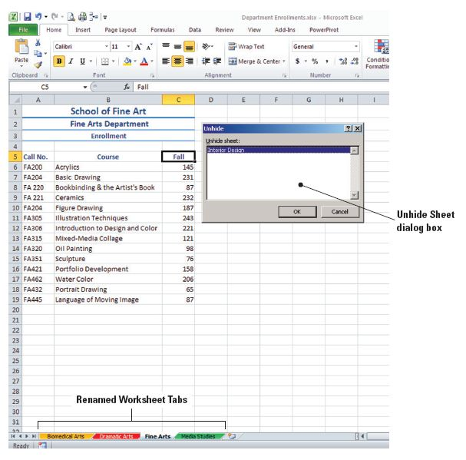
Step-by-Step: Hide and Unhide a Worksheet
USE the workbook from the previous exercise.
Select the Interior Design worksheet. Click Format in the Cells group.
Click Hide & Unhide and
click Hide Sheet. The Interior
Design worksheet is no
longer visible. Click the Fine
Arts tab.
Click Format, click Hide &
Unhide, and then click
Unhide Sheet. The Unhide
dialog box shown in the figure
opens.
Notes:
Note: Right-click any worksheet tab. If worksheets are hidden, the Unhide option will be active on the shortcut menu.

Slide 22
Step-by-Step: Hide and Unhide a Worksheet
Click OK to unhide the Interior Design worksheet. Enter the following enrollment information and SAVE your work:
ID201 Elements of Design I 103
ID205 Interior Design I 106
ID207 History of Interiors 110
ID232 Drawing and Composition 121
ID320 Interior Design II 86
ID322 Architectural Drafting 98
ID325 Elements of Design II 95
ID330 Color Theory 89
ID335 Textiles 121
ID405 CAD I 82
ID432 CAD II 75
ID430 Perspectives in Design 63
ID461 Furniture Design 59
ID465 Lighting Design 49

Slide 23
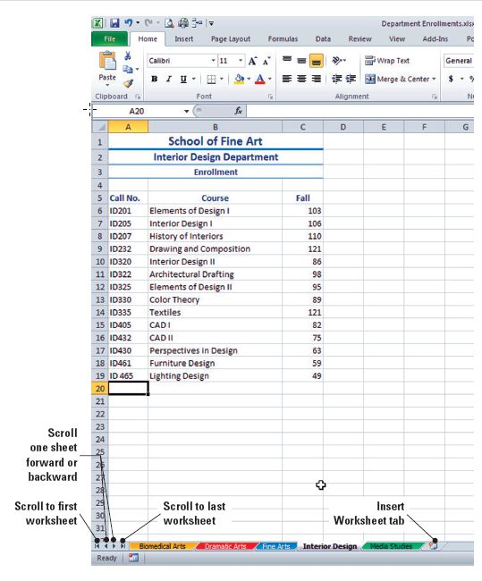
Inserting a New Worksheet
You can insert one or
multiple worksheets into an
existing workbook. The
Insert Worksheet tab (as
shown in the figure) at the
bottom of a worksheet was
introduced in Excel 2007 as
a new feature that allows
you to quickly insert a new
worksheet at the end of the
existing worksheets.

Slide 24
Inserting a New Worksheet
To insert a new worksheet before an existing worksheet, select the worksheet tab before the place where you want to insert the new sheet and use the Insert command in the Cells group.
NOTE: When inserting multiple worksheets at the same time, press and hold Shift, then select the same number of worksheet tabs that you want to insert in
the open workbook. Recall that in the exercise,
when you selected the tabs of two existing
worksheets, clicked Insert, and clicked Insert
Sheet, two new worksheets were inserted.
Notes:
Troubleshooting: When you open the Insert dialog box, multiple Excel files may be shown on the General tab. The listed files represent templates that have been downloaded, created by you, or created by another user.

Slide 25
Step-by-Step: Insert a New Worksheet
USE the workbook from the previous exercise.
Click the Insert Worksheet tab next to the Media Studies tab. A new worksheet (Sheet6) is inserted.
When you insert a new worksheet, it is blank and has the generic Sheet1 title. When you inserted a worksheet before the existing sheets were named, the new sheet was given the next consecutive number, such as Sheet6.

Slide 26
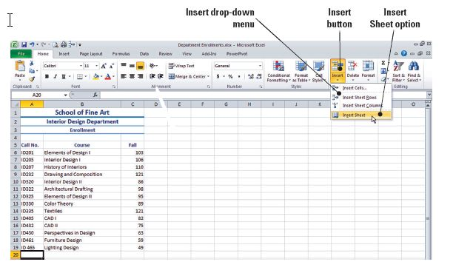
Step-by-Step: Insert a New Worksheet
Click the Biomedical Arts tab and click the Insert arrow in the Cells group to display the options shown in the figure. Click Insert Sheet. A blank sheet (Sheet7) is inserted before the Biomedical Arts worksheet. As more worksheets are added to a workbook, you
may not be able
to see all
worksheet tabs.
When this
happens, use the
scroll arrows to
move through
all worksheets.
Notes:
Troubleshooting: If the Biomedical Arts tab is not visible, use the scroll arrow to move to the first worksheet.

Slide 27
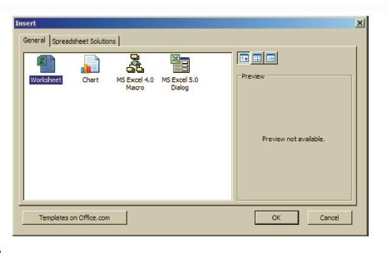
Step-by-Step: Insert a New Worksheet
Double-click the Sheet7 tab, key Advertising, and press Enter.
Click the Dramatic Arts tab and click the Insert arrow in the Cells group. Click Insert Sheet. A new Sheet8 is inserted.
Click Advertising, press and hold Shift, and click Biomedical Arts. You have now selected two sheets.
Click Insert and Insert Sheet.
Based on the previous step’s
selection, two worksheets,
Sheet9 and Sheet10, are
inserted before the Biomedical
Arts worksheet.
Notes:
Another Way: You can right-click a worksheet tab and click Insert on the shortcut menu to insert a worksheet. The Insert dialog box shown in the figure above will open, and you can insert a blank worksheet from the General tab, insert a worksheet based on a template from the Spreadsheet Solutions tab, or insert an online template if you are connected to the Internet.

Slide 28
Deleting a Worksheet
If a workbook contains blank worksheets or worksheets that hold data that is no longer needed, you can delete the unnecessary sheets.
In the next exercise, you will learn how to delete worksheets.

Slide 29
Step-by-Step: Delete a Worksheet
USE the workbook from the previous exercise.
Use the scroll sheets arrow to locate and click Sheet6, then click the Delete arrow in the Cells group.
Click Delete Sheet.
Use the scroll sheets arrow to go back to the beginning of the worksheets. Click the Sheet8 tab, press and hold Ctrl, and click the Sheet9 tab. The selection should include Sheet10 as well as Sheet8 and Sheet9.

Slide 30
Step-by-Step: Delete a Worksheet
Click the Delete arrow, then select Delete Sheet.
SAVE the workbook.
NOTE: You can delete more than one worksheet at a time. To select adjacent sheets, click the first sheet
tab, press and hold the Shift key, and then click the second sheet tab. To select non-adjacent sheets, click the first sheet tab, click and hold the Ctrl key, and
then click all the sheet tabs you want to include.
Notes:
Another Way: You can also right-click the tab of a worksheet you do not need and click Delete. The worksheet will be deleted.

Slide 31
Working with Multiple Worksheets
In Excel, you can group worksheets, a feature that allows you to enter and edit data on several worksheets at the same time or apply formatting to multiple worksheets.
When sheets are grouped, you can enter data in one worksheet and have it appear in multiple worksheets in a workbook.
When multiple worksheets are selected, [Group] appears in the title bar at the top of the worksheet. Be cautious. When you change data in grouped sheets, you may accidentally replace data on other sheets.
In the next exercise, you will learn to work with multiple worksheets by grouping/ungrouping and arranging them.

Slide 32
Step-by-Step: Work with Multiple Worksheets
USE the workbook from the previous exercise.
Right-click any worksheet tab and click Select All Sheets. The title bar now reads Department Enrollments.xlsx [Group].
In cell B20, key Total Enrollment and press Enter. You have just added the contents of cell B20 in all the selected sheets.
Right-click any worksheet tab and click Ungroup Sheets.
Click the View tab and then the Biomedical Arts tab. Next, click New Window in the Windows group.
Click the Dramatic Arts tab and click New Window.
Notes:
Another Way: If you want to group some but not all worksheets within a workbook, press Ctrl and click the tab of each worksheet you want to include in the group.
Note: If you copy a data range from a worksheet to grouped worksheets, the Paste Options button does not appear. Some formatting, such as column width, is not copied.

Slide 33
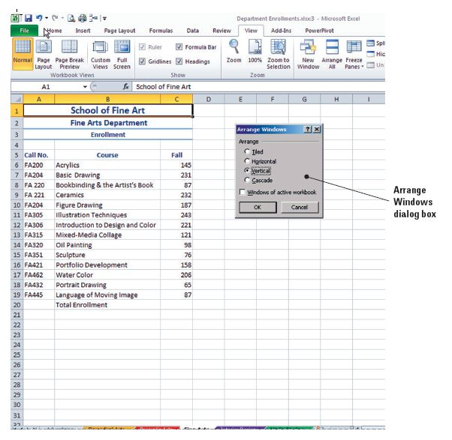
Step-by-Step: Work with Multiple Worksheets
Click the Fine Arts tab
to make the sheet
active and click
Arrange All in the
Windows group. The
Arrange Windows
dialog box opens.
Click Vertical, as
shown in the figure.
Click on Windows of
active workbook.
Notes:
Note: Data that you copy or cut in grouped sheets cannot be pasted on another sheet because the size of the copy area includes all layers of the selected sheets and is therefore different from the paste area in a single sheet. Therefore, make sure that only one sheet is selected before you attempt to copy or move data from a grouped sheet to another worksheet.

Slide 34
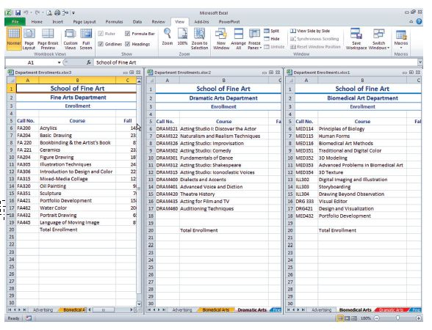
Step-by-Step: Work with Multiple Worksheets
Click OK. Your screen should look like the figure below, with the three worksheets displayed side by side.
Notes:
Note: The New Window and Arrange All options enable you to display worksheets side by side for a quick visual comparison. You can enter and edit data, scroll, and move around in the individual windows just as you would in a “normal” view window. You can also click a cell in any of the displayed worksheets to make changes or to select cells or ranges.

Slide 35
Hiding and Unhiding Worksheet Windows
Any worksheet can be used and viewed in a separate window in the workbook view by applying it to a new window.
These new windows can be arranged so that you can work in them without having to click back and forth on the worksheet tabs. This is an important feature to use when comparing like sheets and data.
If you click Hide in the Window group with one worksheet window open, the entire workbook is hidden. Excel remains open, but the taskbar no long displays the worksheet name. This feature allows you to quickly mask confidential data from view.

Slide 36
Step-by-Step: Hide and Unhide Windows
USE the workbook from the previous exercise.
Click any cell in the Fine Arts window.
Click Hide in the Window group of the View tab. The Fine Arts window is closed; the Dramatic Arts and Biomedical Arts windows remain visible.
Click Unhide. Select the worksheet you want to unhide from the dialog box and click OK.

Slide 37
Step-by-Step: Hide and Unhide Windows
Click the Close button in the upper-right corner of the Fine Arts and Dramatic Arts windows. Restore the Biomedical Arts window to full-screen view.
SAVE and CLOSE the workbook.
NOTE: Do not confuse the Hide and Unhide commands you used in this lesson with those you may have learned in an earlier lesson. The View tab commands in this exercise are used to hide and unhide active windows and window views in a workbook. The Hide and Unhide commands in the Format options, as described in previous exercises, are used to hide and unhide rows, columns, and worksheets. When you hide a sheet with the Format command, other worksheets in the workbook remain visible and accessible. When you use the Hide Window command, you must use the Unhide command to access any worksheet hidden in the workbook.

Slide 38
Using Zoom and Freeze to Change the View
Excel’s Zoom feature allows you to make a worksheet appear bigger or smaller on your screen.
You can use this feature to zoom in on a portion of a worksheet so that it appears larger and the data is easier to read. You can zoom out to get a better perspective of the entire worksheet, making it easier to identify formatting inconsistencies or problematic spacing or alignment.
You can use the Zoom scale on the Status bar to customize magnification. To zoom in (magnify), select a size greater than 100%; to zoom out (shrink), select a size less than 100%.
Notes:
Another Way: Some mouse devices have built-in zooming capabilities. If your mouse has a wheel, hold down Ctrl while you rotate the wheel forward or backward to increase and decrease zoom.

Slide 39
Using Zoom and Freeze to Change the View
The Freeze Panes feature lets you freeze a pane, which means that you keep certain rows or columns visible while the rest of the worksheet scrolls.
You often want to freeze the row that contains column labels and the column that contains row headings so that it is always clear what the data you see represents.
In the next exercise, you will learn to zoom in and out of a worksheet and also freeze and unfreeze panes.

Slide 40
Step-by-Step: Use Zoom and Freeze
OPEN SFA Staff Directory from the data files for this lesson.
Select any cell in the SFA Staff Directory worksheet. Click Zoom to Selection on the View tab. Zoom is increased to 400%.
Click Undo on the Quick Access Toolbar to return to 100% zoom.
Click Zoom on the View tab. In the Zoom dialog box, under Magnification, click 200%. Click OK.
Click Zoom and under Magnification, click Custom. Key 150 in the percentage box and click OK.
Click 100% in the Zoom group.

Slide 41
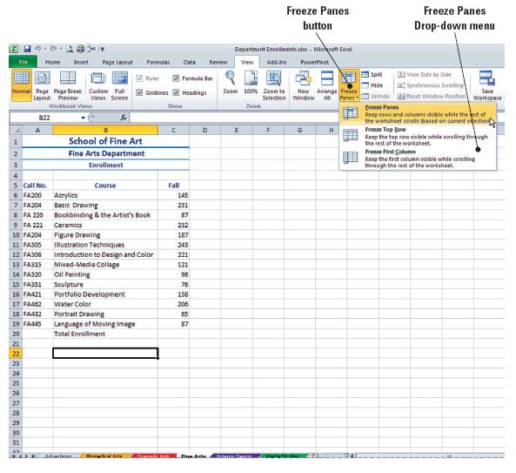
Step-by-Step: Use Zoom and Freeze
Select A5. Click
Freeze Panes in
the Window group
on the View tab.
Click Freeze
Panes in the
drop-down list.
Notes:
Another Way: The Freeze First Column and Freeze Top Row commands shown in Figure 6-11 are quick and easy to use if your worksheet begins with column and row headings, but when the data is preceded by a title and subtitle, you must tell Excel where you want the “freeze” to be located. That is why you need to select the cell below the line that you want to be visible as you move through the worksheet.

Slide 42
Step-by-Step: Use Zoom and Freeze
Press Ctrl+End. Row 4 with the column labels appears at the top of the screen to let you know what each column represents, even when the active cell is the last cell in the data range.
Press Ctrl+Home to return to the top of the data. Click Freeze Panes and select Unfreeze panes.
NOTE: The Freeze Top Row and Freeze First Column commands do not work together. When you want to
freeze the first row and first column at the same
time, locate the “freeze point” and use the
Freeze Panes command.

Slide 43
Finding and Replacing Data
The Find and Replace options let you locate specific data quickly and, if necessary, replace it with new data.
These features are most effective in large worksheets in which all of the data is not visible on the screen, thus saving you the time of scanning through vast amounts of data to find the information you need.

Slide 44
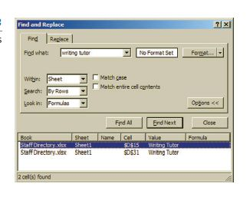
Locating Data with the Find Command
If you want to locate a particular item of data that isn’t immediately visible, you can scan the worksheet visually to look for the needed data. A much easier and quicker way is to use the Find & Select commands.
When you enter the text or number that you want to find and click Find All, Excel locates all occurrences of the search string and lists them at the
bottom of the dialog box, as shown
in in the figure. A string is any
sequence of letters or numbers in
a field.

Slide 45
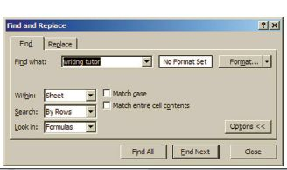
Locating Data with the Find Command
The Options button on the Find tab allows you to set additional parameters for the search.
As shown in the figure, the default
is to search the active worksheet,
but you can also search an entire
workbook. You can locate
instances in which only the case
(capitals or lowercase) matches
the search string you key or the entire cell contents match the search string—more precise search strings create more concise search results.

Slide 46
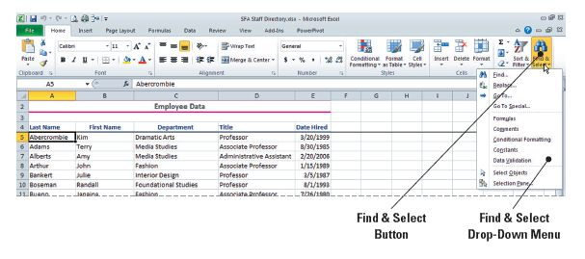
Step-by-Step: Use the Find Command
USE the workbook from the previous exercise.
Click Find & Select in the Editing group on the Home tab. (See the figure below.)
Click Find. The Find and Replace dialog box opens with the Find tab displayed.

Slide 47
Step-by-Step: Use the Find Command
Key tutor in the Find what box. It does not matter whether you key the text in uppercase or lowercase; Excel will find each instance of the word.
Click Find All. The box is expanded to list all occurrences of “tutor” in the worksheet. You see that the search results lists both academic and writing tutors, so you need to refine the search criteria. If you click Find Next after you key the search string, Excel selects the cell in which the first occurrence of the string is found. You can edit the cell or click Find Next and continue to browse through the worksheet. The cursor will stop at each cell where the search string is located.
Notes:
Troubleshooting: If you had selected the Match case check box when you searched for tutor, the search would not have found any data because the word tutor is capitalized each time it occurs in the worksheet. Therefore, a data match would not be found if you searched for a lowercase word. When the search was completed, a dialog box would have informed you that Excel could not find the data you requested.
Another Way: You can also open the Find and Replace dialog box with the keyboard shortcut Ctrl+F.
Note: It does not matter which cell is currently the active cell when you enter a search string. If you do not select a range of cells, Excel will search the entire worksheet.

Slide 48
Step-by-Step: Use the Find Command
Key writing tutor in the Find what box and click Find All. The worksheet contains data for two individuals whose title is Writing Tutor.
Click Options on the dialog box to view the default settings for the Find feature.
CLOSE the dialog box.

Slide 49
Replacing Data with the Replace Command
To look for specific data and replace it with other data, you can use the Replace tab on the Find and Replace dialog box.
You can quickly find and replace all or some occurrences of a character string in a worksheet.
Replacing data with the click of a button can save you the time of finding occurrences of the data and repeatedly keying replacement data.
The Replace All command allows you to quickly change the contents of multiple cells.

Slide 50
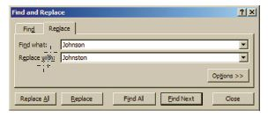
Step-by-Step: Use the Replace Command
USE the workbook from the previous exercise.
Click Find & Select in the Editing group.
Click Replace. The Find and Replace dialog box opens with the Replace tab displayed.
In the Find what box, key Johnson.
In the Replace with box, key
Johnston, as shown in the figure.
In the Search box, click By Columns, then click Find Next. The first occurrence of Johnson is not the one you are looking for, so click Find Next until you locate the entry for Tamara Johnson.
Notes:
Another Way: To display the Replace dialog box without using the Find & Replace feature, press Ctrl+H.
Troubleshooting: If the Find and Replace dialog box obstructs your view of column A where the search data will be located, click the dialog box title bar and drag the box to the right so that you have a clear view of columns A and B.

Slide 51
Step-by-Step: Use the Replace Command
Click Replace and click Close.
Click Find & Select and then click Replace. Key Advertising in the Find what field and key Advertising and Graphic Arts in the Replace with field.
Click Replace All. A dialog box tells you that Excel made nine replacements. Click OK, then click Close to close the dialog box.
SAVE your workbook in the Lesson 6 folder. Name the file Staff Directory.
Notes:
Troubleshooting: Use discretion when deciding whether to use Replace All or Find Next when looking for specific data. For instance, when you needed to correct the spelling of the last name of a specific individual, you did not know whether there were other entries with the last name Johnson. Therefore, as a precaution, you needed to find each entry and decide whether to replace it with the corrected spelling. If you had chosen Replace All, you would have incorrectly changed two other last names in the directory.

Slide 52
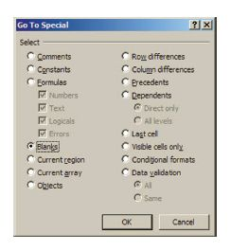
Navigating Data with the Go To Command
As you learned in an earlier lesson, you can key a cell location in the Name box, press Enter, and Excel makes the designated cell active. Another method of moving to a specific cell is to use the Go To feature.
The Find & Select and Go To features are most effective in large worksheets where it can take a significant amount of time to scan numerous rows and/or
columns to find the data you need.
In the next exercise, you will use the Go
To feature to navigate the worksheet and
enter new data and to unhide the first
worksheet row.
Notes:
Take Note: As you experienced in the preceding exercises, the Find & Select features allow you to find and, if necessary, quickly replace existing data. The Go To feature is a fast way to move to specific cell references, especially in a large worksheet.

Slide 53
Step-by-Step: Use the Go To Command
USE the workbook you saved in the previous exercise.
If necessary, on the View tab, click Freeze Panes and select Unfreeze Panes. This removes the freeze so you can display all rows.
Click Find & Select, then click Go To. The Go To dialog box is displayed.
Key A1 in the Reference box and click OK. Column headers A through E become highlighted. A1 is still hidden.
Notes:
Take Note: The Reference box is not case sensitive. Entering A1 or a1 will have the same effect.

Slide 54
Step-by-Step: Use the Go To Command
In the Cells group, click Format, click Hide & Unhide, and click Unhide Rows. Row 1 is displayed.
Click Find & Select, then click Go To. Key E67 in the Reference box and click OK.
Key 5/15/06 in E67 as the date on which Professor Young was hired. Press Enter.
Click Find & Select and click Go To Special.
In the Go To Special dialog box, click Blanks and select OK. The blank cells within the data range are highlighted.

Slide 55
Step-by-Step: Use the Go To Command
Press Tab three times until E13, the first blank cell in the Date Hired column, is the active cell. Enter 6/8/87 and press Tab to move to the next blank cell. Enter the following dates. Press Tab after each entry:
Gronchi 12/8/05
Hasselberg 10/20/00
Kahn 11/2/03
Liu 6/5/07
Male 7/10/00
Vande Velde 3/1/01
Wadia 6/1/02
Yang 6/1/02
SAVE the Staff Directory workbook and CLOSE the workbook.
CLOSE Excel.
Notes:
Another Way: Ctrl+G is the keyboard command to display the Go To dialog box.
Troubleshooting: The reason you needed to tab three times to reach E13 is the blank cells in the heading rows. Remember that when cells are merged, entries in the merged cells are considered to be in the upper-left cell. Therefore, Excel considers the remaining cells in the merge to be blank.

Slide 56
Lesson Summary

