Slide 1
Identifying Computer
Hardware
Part A: Types of Computers

Slide 2
LESSON OBJECTIVES
In this lesson, you will identify computer hardware. You will:
Identify various types of computing devices used in today’s workplace.

Slide 3
Topic A: Identify Types of Computing Devices
There is a wide variety of computer types in use today. Some of these you won’t interact with directly, others might be too small or underpowered for your needs, while some might be overpowered and too bulky for your needs. Somewhere out there, is the right computing device to meet your needs. You might also have different needs at work or school than you do for home and recreation.
In this topic, you will explore a variety of computing devices from pocket to room-sized and everything in between.

Slide 4
Computing Device
A computing device is an electronic machine that uses binary data to automatically perform calculations.
These calculations might be as simple as adding 1+1 and giving you the result of 2; as complex as calculating the trajectory of an unmanned rocket into space; or scanning your face to allow you into a locked room.
These tools come in a variety of sizes and abilities. Some are small enough to fit in your pocket and some require a room to house them.

Slide 5
Personal Computers
A personal computer, or PC, is a computing device designed to be used by one person at a time. These computing devices are found in offices, schools, and homes. PCs are used to run commercial software applications, access the Internet, communicate with other people over email, create new applications in any one of a number of programming languages, play games, do research, and much more. PCs are limited only by your imagination and your computer’s computing power.

Slide 6
Desktop Computer
A desktop computer is a computing device designed to be placed on or near a user’s desk. Its size and its need to be plugged in to a power source mean it typically needs to be placed where it will be used and not be moved.
Desktop computers are usually tall, narrow rectangles that can be placed on or under the user’s desk. The size varies greatly, but often is between 4 and 8 inches wide, about 10 to 16 inches tall, and about 14 to 20 inches front to back.

Slide 7
Desktop (cont.)
Desktop computers are composed of easily replaceable modular components inside the case.
Peripherals are connected to the desktop computer to allow users to view and enter data or information. Peripherals are the computer components that can be attached to a computer.
The peripherals typically attached to a desktop computer include a monitor, keyboard, mouse, and printer. Some of these components connect via wired connections to the computer while others use a transmitter and receiver to wirelessly connect to the computer.

Slide 8
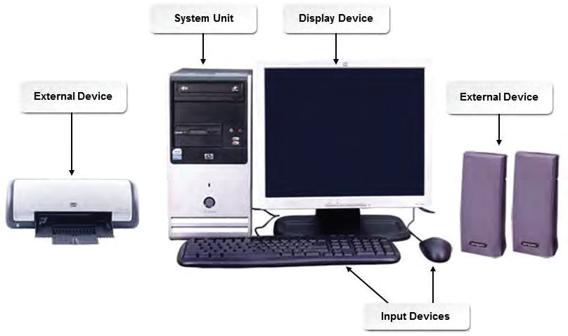
Desktop Diagram

Slide 9
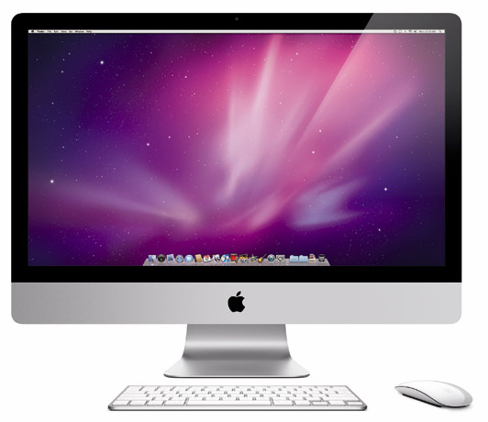
All-In-One Desktop
Some computers have the monitor and the computing components all in one physical device which will hence referred to as all-in-one computers.
These computers take up less desk space than traditional desktop computers. The keyboard and mouse are separate peripherals, usually connected wirelessly to the computer.

Slide 10
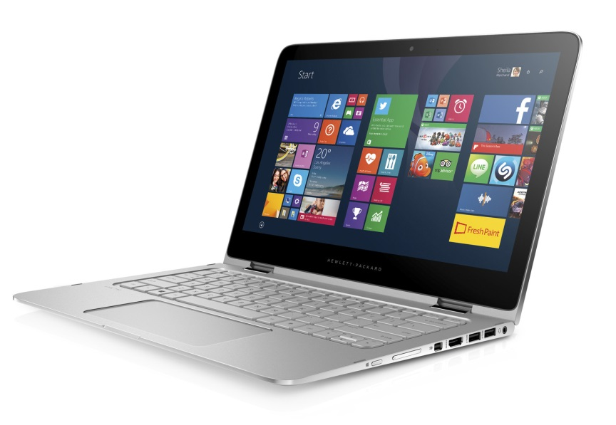
Laptop Computers
A laptop is a complete computer system that is small, compact, lightweight, and portable.
All laptops have specialized hardware designed especially for use in a smaller portable system, use standard operating systems, can run on battery or alternating current (AC) power, and can connect to other devices.
Smaller models are referred to as notebooks or sub-notebooks and typically have fewer features.

Slide 11
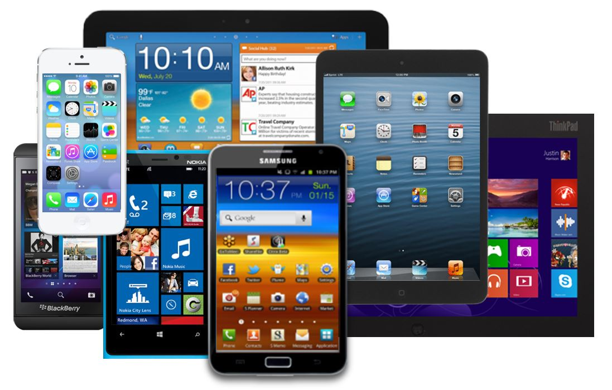
Mobile Devices
Mobile devices that fall into the tablet PC category range in size from larger tablets that look like a traditional laptop but have a touchscreen to small notebook-sized mobile devices that operate similarly to a smartphone, but are a bit larger and have more computing power.

Slide 12
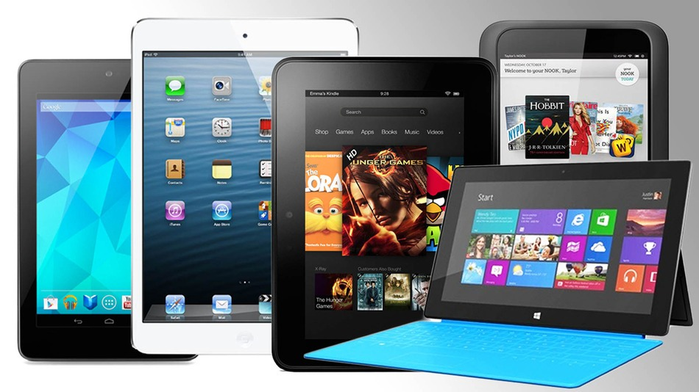
Tablets
Just like smartphones, tablet PCs can run a number of different operating systems depending on the manufacturer
Tablets can connect to the Internet over wireless (Wi-Fi) connections. Some tablets can also connect to the Internet via cellular service just like a cell phone does.
Some laptops can be used as tablets. In some cases, the laptop hinges allow the keyboard to be folded behind the screen so the user can tap the surface of the display to make selections. On other laptops that convert into tablets, the keyboard is removed, leaving the user with just the display to use as a tablet.

Slide 13
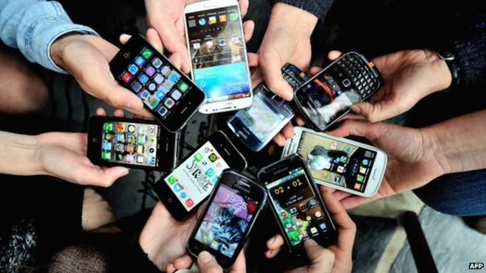
Smartphones
Smartphones are high-end mobile devices that provide users with a wide range of functions, such as:
  portable media players
  video cameras
  GPS
  high-resolution touchscreens
  high-speed Wi-Fi
  web browsers
  mobile broadband
  phone service.
Although Android and iOS dominate the smartphone device marketplace, there are many other technologies and devices available.

Slide 14
bbcertfiles.wixsite.com/bbcertfiles

Slide 15
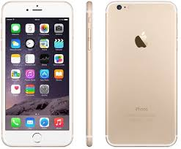
Apple iPhone
iPhones run on the iOS operating system that are a combination of phone, Internet gadget, and wide screen iPod. The common features of an iPhone include telephone, music player, camera, and games. The latest iPhone includes features such as video conferencing and Siri—a voicecontrolled software assistant to perform various tasks and run other applications through a multitouch interface.
iPhone applications utilize innovative iOS technology to facilitate Wi-Fi Internet connectivity with General Packet Radio Service (GPRS), an intuitive user interface, GPS, the accelerometer, audio, video and graphic capabilities, as well as other advanced features.

Slide 16
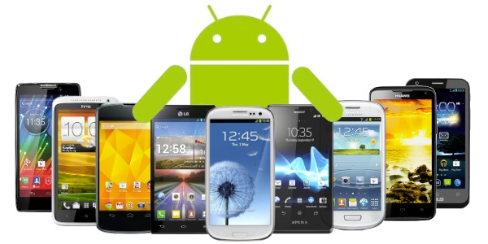
Android Smartphones
Android-based smartphones have similar functions to the iPhone, except that the Android OS allows multiple applications to run simultaneously without interruption.
Popular Android-based smartphone producers:
  Samsung
  Motorolla
  HTC
  LG
  Google

Slide 17
Blackberry and Windows
Blackberry
  BlackBerry phones are primarily used by professionals to conduct business operations and tasks. The BlackBerry OS directly supports corporate business requirements with functions such as synchronizing with MicrosoftR Exchange, IBMR LotusR DominoR, or NovellR GroupWiseR emails, contacts, and tasks by maintaining a high level of security.
Windows
  Windows smartphones run on the Windows Phone OS, which is maintained and developed by Microsoft. Features include a suite of MicrosoftR Office applications, Outlook Mobile, web browsing, Windows MediaR Player, and other advanced features.

Slide 18
Servers
A server is a network computer that shares resources with and responds to requests from computers, devices, and other servers on the network.
Servers provide centralized access as well as storage for resources such as hardware and services that include such things as: applications, files, printers, and email.
A server can be optimized and dedicated to one specific function, or it can serve general needs.
Multiple servers of various types can coexist on the same network.

Slide 19
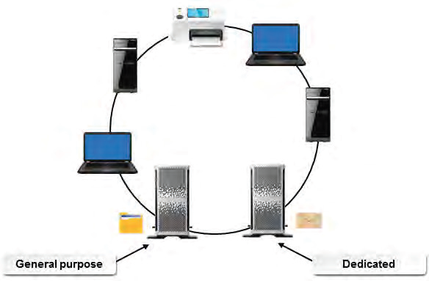
Server Diagram

Slide 20
Other Computing Devices
A supercomputer is the fastest and the most expensive computer among all types of computers.
  Supercomputers are often used in research and simulations by hospitals, universities, and governments to accomplish a single, specialized task.
A mainframe is a large computer that might serve a large organization. It is used to process and store information for many users at once; therefore, it requires much more processing power and storage capacity than other computers.
  Users access the mainframe through terminals. A terminal consists of a typewriter-style keyboard and a display screen, or monitor. Mainframe computers cost hundreds of thousands of dollars.

Slide 21
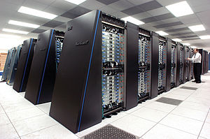
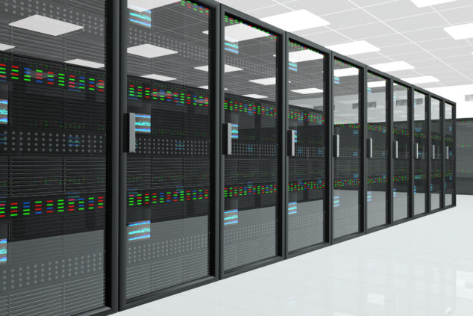
Supercomputer and Mainframe
Supercomputer
Mainframe

Slide 22
Other Computing Devices
An eBook reader is a device used to read electronic books, or eBooks. Some of these devices do nothing besides allow you to download and read eBooks. Other eBook readers include a browser to access the World Wide Web and to read email.
A personal digital assistant (PDA) is a mobile hand-held device that provides computing, information storage, and information retrieval capabilities for personal or business use. PDAs are primarily used for keeping schedules, calendars, and address book information handy. Many people now use their smartphones in place of the more traditional PDA.
A multimedia player is a handheld device that enables you to play digitally recorded audio, video, and combination audio/ video files. Most players provide synchronization and transfer capabilities and some provide Wi-Fi connectivity as well.

