Slide 1
Using Basic Formulas and Functions
Lesson 8

Slide 2
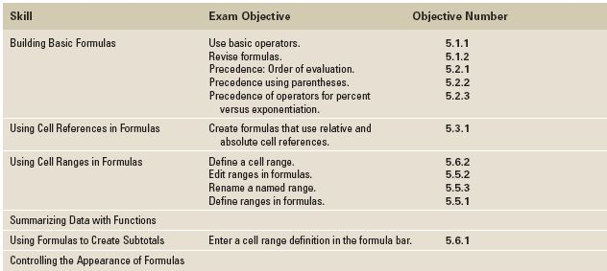
Objectives

Slide 3
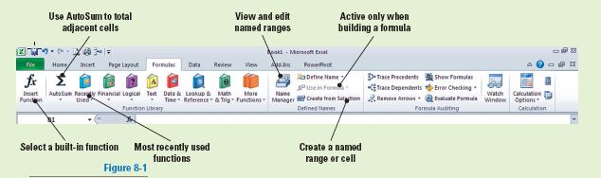
Software Orientation: Formulas Tab
In this Lesson, you’ll use command groups on the Formulas tab, as shown in the figure. These commands are your tools for building formulas and using functions in Excel.
Use this illustration as a reference throughout this lesson as you become familiar with the command groups on the Formulas tab and use them to create formulas.

Slide 4
Building Basic Formulas
The real strength of Excel is its ability to perform common and complex calculations.
A formula is an equation that performs calculations, such as addition, subtraction, multiplication, and division, on values in a worksheet.
When you enter a formula in a cell, the formula is stored internally and the results are displayed in the cell.
Formulas give results and solutions that help you assess and analyze data.

Slide 5
Creating a Formula that Performs Addition
A formula consists of two elements: operands and mathematical operators.
  Operands identify the values to be used in the calculation. An operand can be a constant value, a cell reference, a range of cells, or another formula. A constant is a number or text value that is entered directly into a formula.
  Mathematical operators specify the calculations to be performed. To allow Excel to distinguish formulas from data, all formulas begin with an equal sign (=).
In the next exercise, you will learn how to create basic formulas that perform mathematical computations and apply the formulas using various methods.
Notes:
Take Note: You can begin a formula with a + or − as the beginning mathematical operator, but Excel changes it to = when you press Enter.

Slide 6
Creating a Formula that Performs Addition
When you build a formula, it appears in the formula bar and in the cell itself.
When you complete the formula and press Enter, the value displays in the cell and the formula displays in the formula bar.
You can edit a formula in the cell or in the formula bar the same way you can edit any data entry.

Slide 7
Step-by-Step: Create a Formula for Addition
Before you begin these steps, LAUNCH Microsoft Excel and OPEN a blank workbook.
Select A1 and key =25+15. Press Tab. Excel calculates the value in A1, and displays the sum of 40 in the cell.
In B1, key +18+35. Press Tab. The sum of the two numbers, 53, appears in the cell.
NOTE: Formulas should be keyed without spaces, but if you key spaces, Excel eliminates
them when you press Enter.

Slide 8
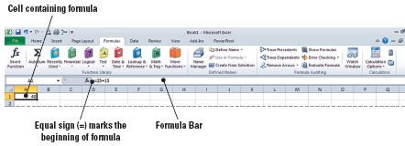
Step-by-Step: Create a Formula for Addition
Select B1 to display the formula for that cell in the formula bar. As illustrated in the figure below, although you entered + to begin the formula, when you pressed Enter, Excel replaced the + with = as the beginning mathematical operator. This is the Excel formula auto correct feature.

Slide 9
Step-by-Step: Create a Formula for Addition
Select A3. Click the formula bar and key =94+89+35. Press Enter. The sum of the three numbers, 218, appears in the cell.
Select A3 and click the formula bar. Select 89 and key 98. Press Enter. Notice that your sum changes to 227.
LEAVE the workbook open to use in the next exercise.

Slide 10
Creating a Formula that Performs Subtraction
The same methods you used to create a formula to perform addition can be used to create a formula to perform subtraction.
When you create a subtraction formula, enter = followed by the positive number and then enter a minus sign to indicate subtraction. When you create a subtraction formula, the minus sign must precede the number to be subtracted.
In the next exercise, you practice creating a formula that performs subtraction.

Slide 11
Creating a Formula that Performs Subtraction
When you enter a formula to subtract 125 from 189, you could enter =189−125 or = −125+189. Either formula yields a positive 64. If the positive number is entered first, it is not necessary to enter a plus sign.
If you find that you’ve made a mistake in your formula (such as returning the negative number mentioned earlier), you can select the cell with the erroneous function, press F2 to take you to the formula bar, and edit your function. Once you’ve made your corrections, press Enter to revise.
Notes:
Take Note: When you have a cell selected, pressing F2 will always activate the formula bar for that cell.

Slide 12
Step-by-Step: Create a Formula for Subtraction
USE the workbook from the previous exercise.
Select A5. Key =456−98. Press Enter. The value in A5, 358, appears in the cell.
Select A6 and key =545−13−8. Press Enter. The value in A6 should be 524.
In A8, create a formula to subtract 125 from 189. The value in A8 should be 64.
LEAVE the workbook open to use in the next exercise.
Notes:
Troubleshooting: If your formula returned a negative value (i.e., –64), you reversed the order in which the numbers should have been entered.

Slide 13
Creating a Formula that Performs Multiplication
The formula to multiply 33 by 6 is =33*6.
If a formula contains two or more operators, operations are not necessarily performed in the order in which you read the formula.
The order is determined by the rules of mathematics, but you can override standard operator priorities by using parentheses.
Operations contained in parentheses are completed before those outside parentheses.
In the next exercise, you learn to create formulas that perform multiplication.

Slide 14
Step-by-Step: Create a Formula for Multiplication
USE the workbook from the previous exercise.
Select D1. Key =125*4 and press Enter. The value that appears in D1 is 500.
Select D3 and key =2*7.50*2. Press Enter. The value in D3 is 30.
Select D5 and key =5*3. Press Enter. The value in D5 is 15.
Select D7 and key =5+2*8. The value in D7 is 21.
Select D9 and key =(5+2)*8. The value in D9 is 56.
LEAVE the workbook open to use in the next exercise.

Slide 15
Creating a Formula that Performs Division
The forward slash is the mathematical operator for division.
When a calculation includes multiple values, you must use parentheses to indicate the part of the calculation that should be performed first.

Slide 16
Creating a Formula that Performs Division
Excel does not necessarily perform the operations in the same order that you enter or read them in a formula, which is left to right. Excel uses the rules of mathematics to determine which operations to perform first when a formula contains multiple operators. This is also known as the order of evaluation in Excel. The order is:
  negative number (−)
  percent (%)
  exponentiation (ˆ)
  multiplication (*) and division (/)
  addition (+) and subtraction (−)

Slide 17
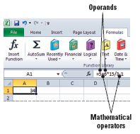
Creating a Formula that Performs Division
For example, consider the following equation:
5 + 6 * 15 / 3 −1 = 34
Following mathematical operator priorities,
the first operation would be 6 multiplied by
15 and that result would be divided by 3.
Then 5 would be added and finally,
1 would be subtracted. The figure
illustrates the formula entered
into Excel.

Slide 18
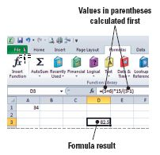
Creating a Formula that Performs Division
When you use parentheses in a formula,
you indicate which calculation to perform
first, which overrides the standard operator
priorities. Therefore, the result of the
following equation would be significantly
different from the previous one. The figure
illustrates the Excel formula.
Here is the mathematical
formula:
(5 + 6) * 15 / (3 −1) = 82.5

Slide 19
Step-by-Step: Create a Formula for Division
USE the workbook from the previous exercise.
Select D7 and create the formula =795/45. Press Enter. Excel returns a value of 17.66667 in D7.
Select D7. Excel applied the number format to this cell when it returned the value in step 1. Click the Accounting Number Format ($) button, on the Home tab in the Numbers group, to apply accounting format to cell D7. The number is rounded to $17.67 because two decimal places is the default setting for the accounting format.
Notes:
Take Note: The results of the formula calculation rounded the value 17.66667 after the seventh digit (eighth character) because the standard column width is 8.43. In other words, the value was rounded at that number of places only because of the column width.

Slide 20
Step-by-Step: Create a Formula for Division
Select D9 and create the formula =65−29*8+97/5. Press Enter. The value in D9 is −147.6.
Select D9. Click in the formula bar and place parentheses around 65–29. Press Enter. The value in D9 is 307.4.
CLOSE but do not save the workbook.
LEAVE Excel open to use in the next exercise.

Slide 21
Using Cell References in Formulas
A cell reference in a formula identifies a cell or a range of cells on a worksheet and tells Excel where to look for the values you want it to calculate in the formula.
Using cell references (cell names; A1, B1, and so on) enables you to re-use the formulas you write, by updating the data in the formulas, rather than rewriting the formulas themselves.
With references, you can use values contained in different parts of a worksheet in one formula or use the value from one cell in several formulas. You can also refer to cells on another worksheet in the same workbook, as well as to other workbooks.
Excel recognizes two types of cell references—relative and absolute.

Slide 22
Using Relative Cell References in a Formula
A cell reference identifies a cell’s location in the worksheet, based on its row number and column letter.
When you include a relative cell reference in a formula and copy that formula, Excel changes the reference to match the column or row to which the formula is copied. A relative cell reference is, therefore, one whose references change “relative” to the location where it is copied or moved.
You use relative cell references when you want the reference to automatically adjust when you copy or fill the formula across rows or down columns in ranges of cells. By default, new formulas use relative references.
In the next exercise, you practice creating and using relative cell references in formulas.

Slide 23
Using Relative Cell References in a Formula
You are about to learn two methods for creating formulas using relative references:
  By keying in an equal sign to mark the entry as a formula and then keying the formula directly into the cell; and
  By keying an equal sign and then clicking a cell or cell range included in the formula (rather than keying cell references).
The second method is usually quicker and eliminates the possibility of typing an incorrect cell or range reference.
When you complete the formula and press Enter, the value displays in the cell and the formula displays in the formula bar.

Slide 24
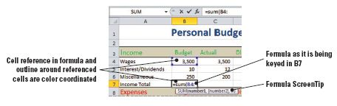
Step-by-Step: Use Relative Cell References
LAUNCH Microsoft Excel if it is not already open.
OPEN the Personal Budget data file for this lesson.
Select B7 and key =sum(B4: (colon). As shown in the figure, cell B4 is outlined in blue, and the reference to B4 in the formula is also blue. The ScreenTip below the formula identifies B4 as the first number in the formula. The reference to B4 is based on its relative position to B7, the cell that contains the formula.

Slide 25
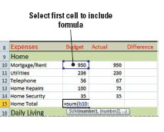
Step-by-Step: Use Relative Cell References
Key B6 and press Enter. The total of the cells, 3,760, appears in B7.
Select B15. Key =sum( and click B10.
As shown in the figure, B10 appears in the formula bar and a flashing marquee appears around B10. Excel now knows that you are selecting this
cell to be used in the formula.

Slide 26
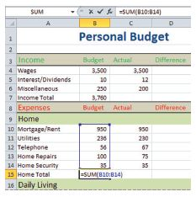
Step-by-Step: Use Relative Cell References
Click and drag the flashing marquee
to B14. As shown in the figure, the
formula bar reveals that values within
the B10:B14 range will be summed
(added). Note, this step
allows you to input a range of
cells in the formula by
highlighting instead of typing
the formula in the cell.
Notes:
Take Note: You can use either uppercase or lowercase when you key a cell reference in a formula. For example, it would not matter whether you keyed B4 or b4 in the formula you entered.

Slide 27
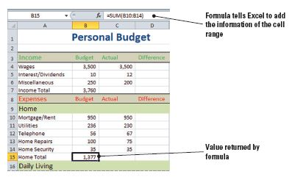
Step-by-Step: Use Relative Cell References
Press Enter to accept the formula. Select B15. As illustrated in the figure, the value is displayed in B15 and when you click on the cell the formula is displayed in the formula bar. Take note that each cell reference is the cell’s unique name. No matter what numeric value is assigned in the cell, the cell
reference (B1, C10,
etc.) never changes.

Slide 28
Step-by-Step: Use Relative Cell References
The goal of this step is to create a simple formula. Select D4 and key =. Click B4 and key −. Click C4 and press Enter. By default, when a subtraction formula yields no difference (a zero answer), Excel enters a hyphen.
Select D4 again. Click and drag the fill handle to D7 to select this range of cells. You are now copying the formula from the previous step into a new range of cells.
Use the fill handle to copy the formula in B7 to C7. Notice that the amount in D7 changes when the formula is copied. When you copied the formula to C7, the position of the cell containing the formula changed, so the reference in the formula changed to C7 instead of B7.
Notes:
Take Note: Open the Format Cells dialog box to change the way Excel displays “no difference” results. On the Numbers tab, you can choose to display 0, for example.

Slide 29
Step-by-Step: Use Relative Cell References
Select D7 and click Copy. Select D10:D15 and click Paste. Your formula is copied to the range of cells and Excel has automatically adjusted the cell references accordingly. Note that D7 is still highlighted by the flashing marquee.
Select D17:D21 and click Paste. Your formula from D7 is now copied to the second range of cells and the references are adjusted. Note that the flashing marquee is still surrounding D7. You have the ability to copy one formula into multiple locations without having to recopy it.
Create a Lesson 8 folder and SAVE your worksheet as Budget.
LEAVE the workbook open to use in the next exercise.
Notes:
Another Way: You can select a cell and click the formula bar to key a formula.

Slide 30
Using Absolute Cell References in a Formula
Sometimes you do not want a cell reference to change when you move or copy it. For example, when you review your personal budget, you might want to know what percentage of your income is budgeted for each category of expenses.
Each formula you create to calculate those percentages will refer to the cell that contains the total income amount.
The reference to the total income cell is an absolute cell reference—a reference that does not change when the formula is copied or moved.

Slide 31
Using Absolute Cell References in a Formula
Absolute cell references include two dollar signs in the formula.
The absolute cell reference $B$7 in this exercise, for example, will always refer to cell B7 because dollar signs precede both the column (B) and row (7).
When you copy or fill the formula across rows or down columns, the absolute reference will not adjust to the destination cells.
By default, new formulas use relative references, and you must edit them if you want them to be absolute references.

Slide 32
Using Absolute Cell References in a Formula
You can also create a mixed reference in which either a column, or a row, is absolute or the other is relative. For example, if the cell reference in a formula were $B7 or B$7, you would have a mixed reference in which one component is absolute and one is relative.
The column is absolute and would remain unchanged in the formula, and the row is relative if the reference is $B7, changing as the mixed reference is copied to $B7, $B8, and so on.

Slide 33
Using Absolute Cell References in a Formula
If you copy or fill a formula across rows or down columns, the relative reference automatically adjusts, and the absolute reference does not adjust. For example, if you copied or filled a formula containing the mixed reference $B7 to a cell in column C, the formula in the destination cell would be =$B8.
The column reference would be the same because that portion of the formula is absolute.
The row reference would adjust because it is relative.

Slide 34
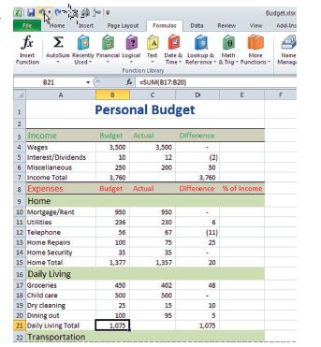
Step-by-Step: Use Absolute Cell References
USE the workbook from the previous exercise.
Select B15. Use the fill handle to the right to copy the formula to C15. You have just extended the formula to cell C7 to calculate the information in the
range of cells above C7.
Select B21. Key =sum( and select
B17:B20. Press Enter. You have
just created a formula to calculate
the range of cells selected as
illustrated in the figure. Note that
the formula you copied and applied
to D21 was automatically
calculated when you pressed Enter.
Notes:
Take Note: It is not necessary to key the closing parenthesis when you complete the selection for a formula. Excel supplies it when you press Enter.

Slide 35
Step-by-Step: Use Absolute Cell References
Select B21 and drag the fill handle to C21. You have copied the formula to the adjacent cell.
Select E10. Key = and click B10. Key / and click B7. Press Enter. You now have a decimal value of .253 as your formula result.

Slide 36
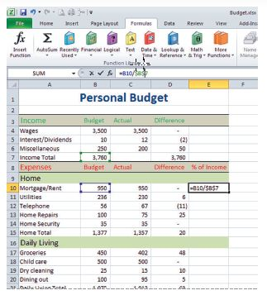
Step-by-Step: Use Absolute Cell References
Select E10 again. On the formula bar,
click in front of B7 to edit the formula;
change B7 (relative cell reference)
to $B$7 (absolute cell reference).
The edited formula should read
=B10/$B$7 as in the figure. Press
Enter. An absolute reference should
be understood to be a value that you
never want to change in your formula.
By default, Excel will copy a formula
into selected ranges as a relative cell
reference unless you instruct it to do otherwise. Once you apply the absolute reference, Excel recognizes it and the program will not try to modify it to a relative reference again.
Notes:
Troubleshooting: When you enter a formula that will yield a result less than a whole number, be sure the cell is formatted for decimals. If the cell is formatted for whole numbers, the cell will display 0 or 1 rather than the expected value.

Slide 37
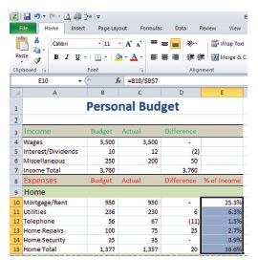
Step-by-Step: Use Absolute Cell References
Select E10 and drag the fill handle to E15. You have now applied the formula with the absolute reference $B$7 to each of the cells in the range.
With E10:E15 still selected, click
the Percent Style button (%) in the
Number group on the Home tab.
Click Increase Decimal. The values
should display with one decimal
place and a % (see figure).
SAVE your workbook.
LEAVE the workbook open to use in the next exercise.

Slide 38
Referring to Data in Another Worksheet
As mentioned earlier, cell references can link to the contents of cells in another worksheet within the same workbook.
You might need to use this strategy, for example, to create a summary of data contained in several worksheets.
The principles for building these formulas are the same as those for building formulas referencing data within a worksheet.
In the next exercise, you practice building and using formulas that contain references to data in other worksheets. You will also learn how to refer to cells and ranges of cells outside of your active worksheet.

Slide 39
Step-by-Step: Refer to Data in Another Worksheet
USE the workbook you saved in the previous exercise.
Click Sheet2 to make it the active sheet.
Select B4. Key = to indicate the beginning of a formula. Click Sheet1 and select B7. Press Enter. The value of cell B7 on Sheet1 is displayed in cell B4 of Sheet2. The formula bar displays =Sheet1!B7.
With Sheet2 still the active sheet, select B4 and drag the fill handle to D4. The values from Sheet1 row 4 are copied to Sheet2 row 4.

Slide 40
Step-by-Step: Refer to Data in Another Worksheet
On the Home tab, click Format and click Rename Sheet. As you recall, you renamed worksheet tabs in previous exercises.
Key Summary and press Enter.
Make Sheet1 active. Click Format and click Rename Sheet.
Key Expenses and press Enter. Both worksheet tabs are now renamed.

Slide 41
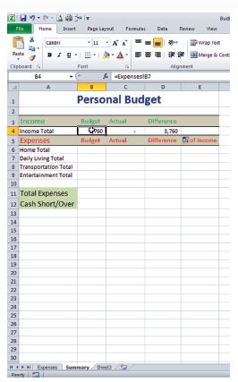
Step-by-Step: Refer to Data in Another Worksheet
Make the Summary sheet active and
select B4. The formula bar now
shows the formula as
=Expenses!B7. See the figure.
SAVE your workbook.
LEAVE the workbook open to use
in the next exercise.

Slide 42
Referencing Data in Another Worksheet
An external reference refers to a cell or range on a worksheet in another Excel workbook, or to a defined name in another workbook.
Although external references are similar to cell references, there are important differences.
You normally use external references when working with large amounts of data and complex formulas that encompass several workbooks.
In the next exercise, you will learn how to refer to data in another workbook.

Slide 43
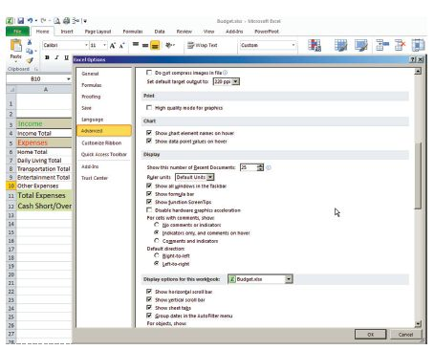
Step-by-Step: Reference Data in Another Worksheet
USE the workbook you saved in the previous exercise.
Click the File tab and
click Options.
On the Options window,
click Advanced.
Scroll to find Show all
windows in the Taskbar,
if it isn’t already
selected, select it and
click OK. See the figure.
Notes:
Troubleshooting: If your system administrator has disabled the Show all windows in the Taskbar option, you will need to use the Switch Windows command in the Windows group on the View tab to move between the two workbooks.

Slide 44
Step-by-Step: Reference Data in Another Worksheet
You are still in the Summary worksheet. In A10, key Other Expenses and press Tab.
OPEN the Financial Obligations data file for this lesson. This is the source workbook. The Budget workbook is the destination workbook.
Switch to the Budget workbook, and with B10 still active, key = to indicate the beginning of a formula. Change to the Financial Obligations workbook and select B8. A flashing marquee will identify this cell reference.

Slide 45
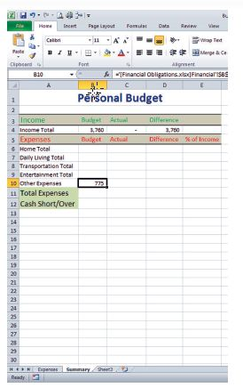
Step-by-Step: Reference Data in Another Worksheet
Press Enter to complete the external
reference formula. Select B10. Your
external reference has now been
copied to this cell as illustrated in the
figure. The formula bar displays
square brackets around the name of
the source workbook, indicating that
the workbook is open. When the
source is open, the external reference
encloses the workbook name in
square brackets, followed by the
worksheet name, an exclamation point (!), and the cell range on which the formula depends.

Slide 46
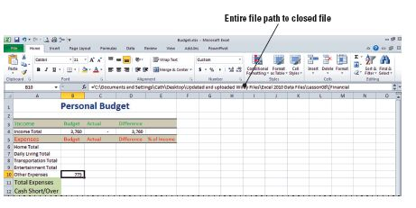
Step-by-Step: Reference Data in Another Worksheet
CLOSE the Financial
Obligations workbook.
When the source
workbook is closed, the
brackets are removed
and the entire file path
is shown in the formula.
The formula bar in the Budget worksheet now displays the entire path for the source workbook as in the figure because the source file is now closed.
SAVE the destination workbook.
LEAVE the workbook open to use in the next exercise.

Slide 47
Using Cell Ranges in Formulas
You can simplify formula building by naming ranges of data and using that name in selections and formulas rather than keying or selecting the cell range each time.
In the business environment, you will often use a worksheet that contains data in hundreds of rows and columns.
After you name a range, you can select it from the Name box and then perform a variety of functions, such as cutting and pasting it to a different workbook as well as using it in a formula.
By default, a named range becomes an absolute reference in a formula.

Slide 48
Naming a Range
A name is a meaningful and logical identifier that you apply in Excel to make it easier to reference the purpose of a cell reference, cell range, constant, formula, or table.
Naming a range clarifies the purpose of the data within the range of cells. Naming ranges or an individual cell according to the data they contain is a time-saving technique, even though it may not seem so when you work with limited data files in practice exercises.
A good example could be to name a range such as B7:B17 as Total Items so that in future formula construction and reference, you only need to key Total Items and Excel will recognize the range to which you are referring.

Slide 49
Naming a Range
You must select the range of cells you want to name before you use the Name box to create a named range.
When you create a name using the Define Name command, you have the opportunity to select the range after you enter the name. This option is not available when you use the Name box.
All names have a scope, either to a specific worksheet or to the entire workbook. The scope of a name is the location within which Excel recognizes the name without qualification.

Slide 50
Naming a Range
For example, in step 1 in the next exercise, when you create the name Income_Total for cell B7, the New Name box identifies the scope as part of the workbook. This means the named cell can be used in formulas on the Expenses and the Summary worksheets in this workbook.
In this exercise, you will use three methods to name cells and ranges of cells. You will create the names by:
  Clicking Define Name on the Formulas tab and selecting the cell or range to be included in the name.
  Selecting a cell or range and entering a name in the Name box next to the formula bar.
  Selecting a cell or range that includes a label and clicking the Create from Selection button on the Formulas tab.
Notes:
Take Note: There are several syntax rules for creating names. For example, the first character must be a letter, an underscore character (_), or a backslash (\). You cannot use a C, c, R, or r as a defined name, and you must use the underscore or period as word separators rather than spaces.

Slide 51
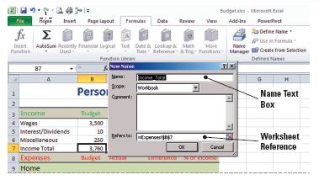
Step-by-Step: Name a Range
USE the workbook you saved in the previous exercise.
Select B7 on the Expenses worksheet and click Define Name in the Name Manager group on the Formulas tab. The New Name dialog box shown in the figure opens with Excel’s suggested name for the range.

Slide 52
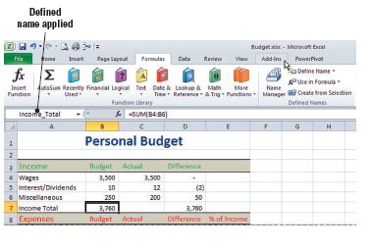
Step-by-Step: Name a Range
Click OK to accept
Income_Total as the name
for B7. Note that the
Income_Total name appears
in the name box instead of
the default cell reference of
B7. See the figure.
Select B36. Click Define Name. In the New Name dialog box, with the Name box highlighted for entry, key Total Expenses. Accept the default in the Scope box.
Click the Collapse Dialog button and proceed to select the range that makes up total expenses.
Notes:
Another Way: You can name a range using the shortcut menu. Select the range and right-click. Click Name a Range to open the New Name dialog box.

Slide 53
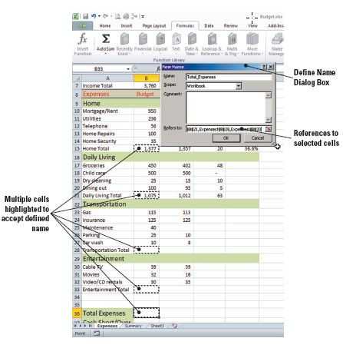
Step-by-Step: Name a Range
With the text already selected
by default in the Refers to
box, press Ctrl and click B15,
B21, B28, and B33, release
Ctrl, and then click the
Expand Dialog button. You
have just selected cells that
have the Expenses defined
named copied and applied to
them as seen in the figure.
Click OK to close the New Name dialog box. Some of the selected cells are blank. In the following exercises, you will use the names you just created to fill them.
Notes:
Troubleshooting: If, in the process of naming a range, you receive a message that the name already exists, display the Name Manager (discussed later in this lesson) and edit the existing name or delete it and begin again.

Slide 54
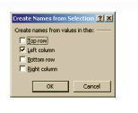
Step-by-Step: Name a Range
Select B23:B27 and click in the Name box to the left of the formula bar. Key Transportation and press Enter.
Select B30:B32 and click Define Name. Key Entertainment in the Name box on the dialog box. Click OK.
Select A15:B15. Click Create from Selection. The left column will be selected. Click OK. The dialog box closes. While naming this range doesn’t change the
current worksheet, you will use the
range you just named in a later
exercise. Your worksheet should
resemble the figure.
LEAVE the workbook open to use in the
next exercise.

Slide 55
Changing the Size of a Range
If you need to change the parameters of a named range, you can easily redefine the range by using the Name Manager on the Formulas tab.
The Name Manager contains all the information about named ranges. It allows you to view summaries of the names you have applied in the worksheet.
In the next exercise, you will edit the range for Home_Total.

Slide 56
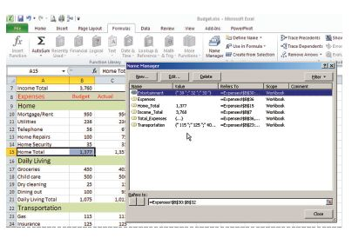
Step-by-Step: Change the Size of a Range
USE the workbook from the previous exercise.
Click Name Manager on the
Formulas tab. From the
Name Manager window (see
the figure), click to select
Home_Total and click Edit.
The Edit Name dialog box
opens. You will change the
scope (size) of the range rather than the name.
The Home_Total range is identified in the Refers To box at the bottom of the dialog box. Click Collapse Dialog and select B10:B14.
Notes:
Take Note: Home_Total is the range you named in the Name a Range exercise earlier in this lesson, using the Create from Selection command.

Slide 57
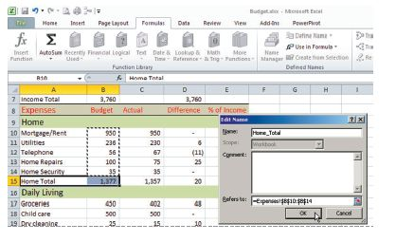
Step-by-Step: Change the Size of a Range
Click Expand Dialog to view
the dialog box as shown
in the figure. Click OK to
accept your changes and
close the dialog box.
Click Close to close the
Name Manager dialog box.
SAVE the workbook.
LEAVE the workbook open to use in the next exercise.

Slide 58
Keeping Track of Ranges
Use the Name Manager dialog box to work with all of the defined names in the workbook. From this dialog box you can also add, change, or delete names.
You can use the Name Manager as a convenient way to confirm the value and reference of a named reference or to determine its scope.

Slide 59
Step-by-Step: Keep Track of Ranges
USE the workbook from the previous exercise.
Click Name Manager on the Defined Names group on the Formulas tab. You will use the Name Manager to modify previously created names and create new ones.
Select Income_Total and click Edit.
Select _Total in the Name field and press Delete. Click OK to accept your changes and close the dialog box.

Slide 60
Step-by-Step: Keep Track of Ranges
Click New. Key Short\Over in the Name box. Be sure to use the backslash. You are specifying the name of a new range you will create in the next step. If you accidently key a forward slash, you will get an error dialog box. Click OK and return to the name and fix the error.
In the Refers To box, key =Income–Expenses. Click OK. You have now used names to create a formula.
Click Close to close the Name Manager dialog box. SAVE the workbook.
LEAVE the workbook open to use in the next exercise.
Notes:
Troubleshooting: You will receive an error message if you use the forward slash in a name. Although the forward slash is used in the Short/Over label on the worksheets, you can use only the underscore or the backslash as a word divider in a named range.

Slide 61
Creating a Formula to Operate on a Named Range
You have created several named ranges in the previous exercises, which you will use in the next exercise to fill cells on the worksheets in your Budget workbook.

Slide 62
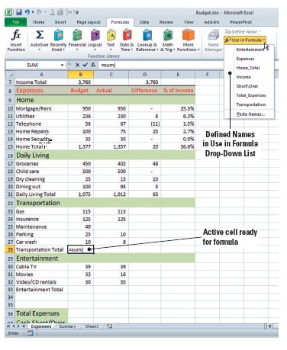
Step-by-Step: Create a Formula for a Named Range
USE the workbook from the previous exercise.
On the Expenses worksheet,
select B28. Key =sum(. Click
Use in Formula in the Defined
Names group on the Formulas
tab. The Use in Formula drop-
down list appears. It contains
all the Defined names that you
created as seen in the figure.

Slide 63
Step-by-Step: Create a Formula for a Named Range
Click Transportation on the drop-down list. Key the closing parenthesis in the formula and press Enter. You have now defined the Transportation name for use in formulas for the selected range.
Select B33. Click the formula bar and key the following formula =sum(Entertainment), and press Enter.
On the Summary worksheet, select B11. Key the formula =sum( and click Use in Formula. Select Total Expenses from the list of named cells and ranges. Press Enter. SAVE the workbook.
LEAVE the workbook open to use in the next exercise.

Slide 64
Summarizing Data with Functions
A function is a predefined formula that performs a calculation.
Excel’s built-in functions are designed to perform all sorts of calculations—from simple to complex.
When you apply a function to specific data, you eliminate the time involved in manually constructing a formula.
Using functions ensures the accuracy of the formula’s results.

Slide 65
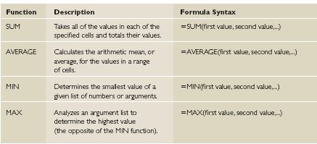
Summarizing Data with Functions
A function consists of a
function name and function
arguments and
specified syntax.
See the table for
a list of the most
commonly used
Excel functions.
The arguments are
enclosed in parentheses in the formula. This lets Excel know where the formula begins and where it ends.

Slide 66
Summarizing Data with Functions
The arguments are in logical format from the left of the formula to the right in the parenthesis; (argument1, argument2, …) and are performed in that order, from left to right.
Depending on the function, an argument can be a constant value, a single-cell reference, a range of cells, or even another function.
If a function contains multiple arguments, the arguments are separated by commas.

Slide 67
Using SUM
Adding a range of cells is one of the most common calculations performed on worksheet data.
You can use the SUM function to easily and accurately select the cells to be included in a calculation.
The AutoSum function makes that even easier, by calculating (by default) the total from the active cell to the first nonnumeric cell.
In previous exercises, you created a formula to perform addition by keying or selecting the cells to include and connected them with the plus sign.

Slide 68
Using SUM
Using the SUM or AutoSum function is a much easier way to achieve the same result.
AutoSum is a built-in feature of Excel that recognizes adjacent cells in rows and columns as the logical selection to perform the AutoSum.
In the next exercise, you will use the most commonly used functions, beginning with the SUM function.

Slide 69
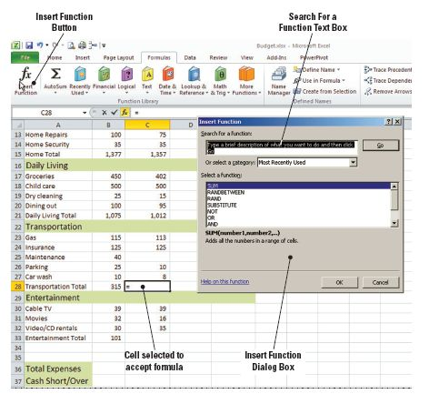
Step-by-Step: Use SUM
USE the workbook from the previous exercise.
On the Expenses
worksheet, select C28.
Click Insert Function in the
Function Library group on
the Formulas tab. The
Insert Function dialog box
shown in the figure opens.
SUM is selected by default.
Click OK. The Functions
Arguments box for SUM
opens.

Slide 70
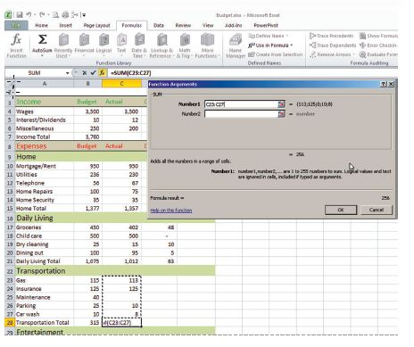
Step-by-Step: Use SUM
In the Function
Arguments box, the
default range shown
is C26:C27. Click the
Collapse Dialog button
in the Number1 field
and select the cell
range C23:C27. This
has now applied the
SUM function and its
arguments to the
selected cell range as illustrated in the figure.
Notes:
Troubleshooting: AutoSum, by default, calculates the total only from the active cell to the first nonnumeric cell. Because C25 is blank, you need to manually select the range to be calculated.

Slide 71
Step-by-Step: Use SUM
Click the Expand Dialog button and click OK.
Select C33 and click AutoSum in the Function Library group.
Press Enter to accept C30:C32 as the range to sum. SAVE the workbook.
LEAVE the workbook open to use in the next exercise.
NOTE: Because it is used so frequently, AutoSum is available on the Formulas tab in the Function Library group and on the Home tab
in the Editing group.

Slide 72
Using COUNT
Statistical functions, such as SUM and COUNT, are used to compile and classify data to present significant information.
Use the COUNT function to count the number of numeric entries in a range. For example, in a worksheet used to calculate wages, you can apply the COUNT function to determine how many of the employees have worked over 40 hours in a work week.
You will apply the COUNT function in the following exercise.

Slide 73
Step-by-Step: Use COUNT
USE the workbook from the previous exercise.
On the Expenses worksheet, select A39 and key Expense Categories. Press Tab.
Click Insert Function in the Function Library group on the Formulas tab. The Insert Function dialog box opens.
On the Insert Function dialog box, key COUNT in the search for function text box and click Go. The function will appear at the top of the function list and be selected by default in the Select a Function window. Click on COUNT and click OK. You want to count only the expenses in each category and not include the category totals.
Click the Collapse Dialog button for Value1.

Slide 74
Step-by-Step: Use COUNT
Select B10:B14 and press Enter. You have selected the range of cells for Value1 and Home_Total is now entered in the Value1 text box instead of the cell range.
Click Collapse Dialog for Value2 and select B17:20. Press Enter. B17:B20 now appears in the Value2 text box. You have selected the range of cells for Value2.
Collapse the dialog box for Value3. Select B23:B27 and press Enter. The identified range is one you named in a previous exercise. That name (Transportation) appears in the Value3 box rather than the cell range, and the values of the cells in the Transportation and Entertainment named ranges appear to the right of the value boxes.
Notes:
Take Note: As you add arguments, the Value fields on the Function Arguments dialog box expand to allow you to enter multiple arguments.

Slide 75
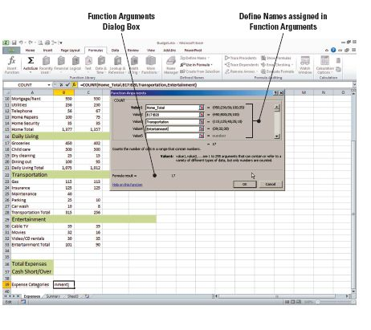
Step-by-Step: Use COUNT
In the Value4 box, key
Entertainment. You have
now manually applied the
name Entertainment for
Value4. Your entries in the
Function Arguments dialog
box should look similar to
those shown in the figure.
Click OK to accept the
function arguments. Excel
returns a value of 17 in B39. SAVE the workbook.
LEAVE the workbook open to use in the next exercise.
Notes:
Take Note: Text or blank cells are ignored in a COUNT formula. If a cell contains a value of 0 (zero), the COUNT function will recognize it and count it as a cell with a number.

Slide 76
Using COUNTA
Use the COUNTA function to count the number of cells in a range that are not empty.
COUNTA counts both text and values in a selected data range.
You can use this formula to count the number of entries in a particular worksheet or range of cells.
You will use this formula in the next exercise.

Slide 77
Using AVERAGE
The AVERAGE function adds a range of cells and then divides by the number of cell entries.
It might be interesting to know the average difference between what you budgeted for expenses and the amount you actually spent during the month.
Before you can calculate the average, however, you will need to finish calculating the differences.

Slide 78
Step-by-Step: Use AVERAGE
USE the worksheet from the previous exercise.
Select D21 and right-click. Click Copy. You are copying the formula in D21 for the next step.
Select D23, right-click and click Paste. You have just pasted the formula into cell D23.
Use the fill handle in cell D23 to copy the formula to the range D24:D28.
Copy the formula in D28 and paste it to D30.
Use the fill handle in cell D30 to copy the formula to D31:D33.

Slide 79
Step-by-Step: Use AVERAGE
In A41, key Average Difference and press Tab.
Click Recently Used in the Function Library group and click AVERAGE. If AVERAGE does not appear in your recently used function list, key AVERAGE in the Search for a function box and click Go. The function will appear at the top of the function list and be selected by default. Click OK. You are applying the AVERAGE formula to cell A42.
Click Collapse Dialog in Value1. Press Ctrl and select the category totals (D15, D21, D28, and D33). Notice that the arguments are separated by a comma.

Slide 80
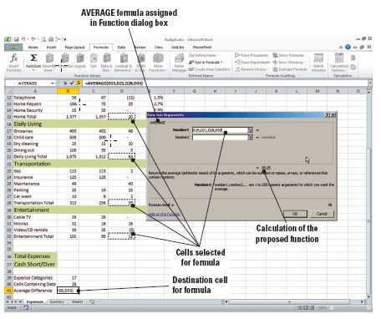
Step-by-Step: Use AVERAGE
Click Expand Dialog. Click
OK. Your screen should
resemble the screenshot
in the figure. There is a
$38 average difference
between the amount
budgeted and the amount
you spent in each category.
SAVE and CLOSE the
Budget workbook.
LEAVE Excel open to use in the next exercise.
Notes:
Take Note: The exact value returned for the AVERAGE formula was 38.25. Because column B is formatted for zero decimals, the value returned by the formula is 38.

Slide 81
Using MIN
The MIN formula returns the smallest number in a set of values. For example, a professor would use the MIN function to determine the lowest test score; a sales organization would determine which sales representative earned the lowest commission or which employee earns the lowest salary.
Maximum values are usually calculated for the same set of data.
You will learn to apply the MIN function in the next exercise.

Slide 82
Step-by-Step: Use MIN
OPEN the Personnel data file for Lesson 8.
Select A22 and key Minimum Salary. Press Tab.
Click the Recently Used button in the Function Library group on the Formulas tab. The MIN function is not listed. Key =min in cell B22 and double-click on MIN when it appears on the drop-down list below cell B22. Excel inputs the MIN command and an opening parenthesis is added to your formula.
Notes:
Another Way: You can display the Insert Function dialog box by clicking the Insert Function button on the Formula bar.

Slide 83
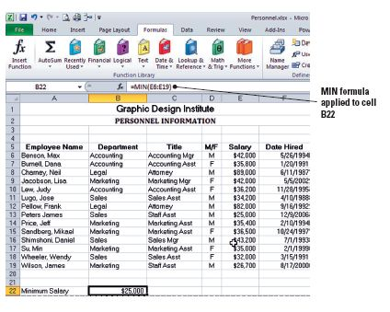
Step-by-Step: Use MIN
Select E6:E19 and press
Enter. You have now
finished creating the
formula arguments and
applied the MIN function.
Excel returns a value of
$25,000 as the minimum
salary for the personnel.
See the figure.
SAVE the workbook as Analysis.
LEAVE the workbook open to use in the next exercise.

Slide 84
Using MAX
The MAX function returns the largest value in a set of values.
Minimum values are usually calculated for the same set of data.

Slide 85
Step-by-Step: Use MAX
USE the worksheet from the previous exercise.
In A23, key Maximum Salary and press Tab.
Click Insert Function in the Function Library group and key MAX in the Search for a function box and click Go. When the MAX function appears, it will be selected by default, click OK.
Click the Collapse Dialog button in Number1 text box and select E6:E19.
Click the Expand Dialog button and click OK. Excel applies and calculates the function on the range and returns the maximum salary value of $89,000 in cell A24.
SAVE and CLOSE the workbook.
LEAVE Excel open to use in the next exercise.

Slide 86
Using Formulas to Create Subtotals
You can calculate subtotals using the SUBTOTAL function, but it is generally easier to create a list by using the Subtotal command in the Outline group on the Data tab.
After the subtotal list has been created, you can edit it using the SUBTOTAL function.

Slide 87
Selecting Ranges for Subtotaling
Groups are created for subtotaling by sorting the data. Data must be sorted by groups to insert a SUBTOTAL function.
Subtotals are calculated with a summary function, and you can use the SUBTOTAL function to display more than one type of summary function for each column.

Slide 88
Step-by-Step: Select Ranges for Subtotaling
OPEN the Personnel data file for this lesson.
Select A5:F19 (the data range and the column labels). Click Sort in the Sort & Filter group on the Data tab.
On the Sort dialog box, select Department as the sort by criterion. Select the My data has headers check box if it is not selected. Click OK. The list is sorted by department.
With the data range still selected, click Subtotal in the Outline group on the Data tab. The Subtotal dialog box opens.
Select Department in the At each change in box. Sum is the default in the Use function box.
Notes:
Troubleshooting: If you do not include the labels in the data selection, Excel will prompt you to include the labels so that you can sort by label rather than the column heading.

Slide 89
Step-by-Step: Select Ranges for Subtotaling
Select Salary in the Add subtotal to box. Deselect any other column labels. Select Summary below data if it is not selected. Click OK. Subtotals are inserted below each department with a grand total at the bottom.
With the data selected, click Subtotal. On the dialog box, click Average in the Use function box.
Click Replace current subtotals to deselect it. Click OK.
SAVE the workbook as Dept Subtotals.
LEAVE Excel open to use in the next exercise.
Notes:
Take Note: Subtotals are calculated with a summary function, such as SUM, COUNT, or AVERAGE. You can display more than one type of summary function for each column. Grand totals, on the other hand, are derived from the detail data, not from the values in the subtotals. Therefore, when you used the AVERAGE summary function, the grand total row displayed an average of all detail rows in the list, not an average of the values in the subtotal rows.

Slide 90
Modifying a Range in a Subtotal
You can change the way data is grouped and subtotaled by modifying the subtotal range using the SUBTOTAL function.
This option is not available when you create subtotals from the Data tab commands.

Slide 91
Step-by-Step: Modify a Range in a Subtotal
USE the worksheet you saved in the previous exercise.
Insert a row above the Grand Total row.
Key Sales/Marketing Total in B29.
Copy the subtotal formula from E47 to E49.
In the Formula bar, change the function 9 (which includes hidden values) to 109 (which ignores hidden values) to exclude the sum and average subtotals for the individual departments within the data range. Otherwise, the formula result will include the average salary and the total salaries as well as the actual salaries for individual employees.

Slide 92
Step-by-Step: Modify a Range in a Subtotal
Replace the range in the Formula bar with E21:E45 and press Enter. The salaries for the sales and marketing departments combined are $310,000, which are now entered into the cell.
SAVE the workbook as Dept Subtotals Revised. CLOSE the workbook.
LEAVE Excel open to use in the next exercise.

Slide 93
Building Formulas to Subtotal and Total
In the previous exercise, you copied and modified a formula to create a subtotal for a combined group.
You can accomplish the same result by using the SUBTOTAL function to build a formula and add subtotals to data that you cannot or do not want to sort into one category in order to use the built-in function in the Data tab’s subtotal function.

Slide 94
Step-by-Step: Build to Subtotal and Total
OPEN the Personnel data file for this lesson.
Insert a row above row 11.
Select E11 and click Recently Used in the Formula Library group on the Formulas tab. The Recently Used formula drop-down list appears. Note that the SUBTOTAL function is not there. Click on the Insert Function option. Key SUBTOTAL in the Search for a function box and click Go. When the SUBTOTAL function appears, it will be selected by default, click OK.
Key 9 in the Function_num box on the Function Arguments dialog box.

Slide 95
Step-by-Step: Build to Subtotal and Total
Click Collapse Dialog in Ref1 and select E6:E10. You are inputting your first reference.
Click Expand Dialog and click OK to accept your changes and close the dialog box.
Select B11 and key Support Staff Total.
Select B21 and key Sales and Marketing Total.
Select E21 and click Recently Used. Click SUBTOTAL. Use the same procedure in step 4 to create a subtotal for the values in E12:E20. You are creating another subtotal formula. Format the subtotal for currency and expand the column to accommodate the data.

Slide 96
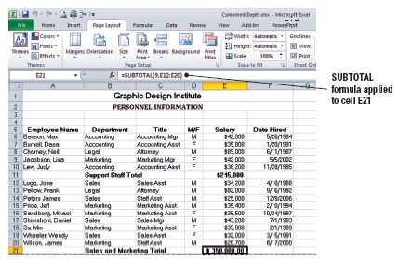
Step-by-Step: Build to Subtotal and Total
Press Ctrl and select row
11 and row 21. Click Bold
on the Home tab to
emphasize the subtotals.
Compare your worksheet
to the figure.
SAVE the workbook as
Combined Depts.
LEAVE the workbook open to use in the next exercise.
Notes:
Take Note: If the workbook is set to automatically calculate formulas, the Subtotal command recalculates subtotal and grand total values automatically when you edit the detail data.

Slide 97
Controlling the Appearance of Formulas
When you work with extremely large worksheets that contain numerous formulas, you sometimes need to see all formulas to audit the calculations in the worksheet.
You can display and print the worksheet with all formulas visible.

Slide 98
Displaying Formulas on the Screen
When you create a formula, the result of the calculation is displayed in the cell and the formula is displayed in the Formula bar.
You may need to see all formulas on the screen in order to audit them.
As you learn in this lesson, you can click the Show Formulas command to display the formula in each cell instead of the resulting value.

Slide 99
Step-by-Step: Display Formulas on the Screen
With the workbook Combined Depts already open, perform the following steps:
Click Show Formulas in the Formula Auditing group on the Formulas tab. All worksheet formulas are displayed.
Click Show Formulas. Values are displayed.
SAVE and CLOSE the workbook. When you open the workbook again, it will open values displayed.
LEAVE Excel open to use in the next exercise.
Notes:
Another Way: You can also press Ctrl+` (grave accent) to switch between formulas and their values. The accent is located to the left of the number 1 key on most keyboards.
Cross Reference: For security reasons, you may want to hide formulas from other workbook users. This and other security issues will be presented in Lesson 11.

Slide 100
Printing Formulas
When you audit the formulas in a large worksheet, you may find it useful to print the worksheet with the formulas displayed.
To gain maximum benefit from the printed copy, print gridlines and row and column headers.
In the next exercise, you will display formulas for printing and adjust the print settings.

Slide 101
Step-by-Step: Print Formulas
OPEN Budget from your Lesson 8 folder. This is the exercise you saved earlier.
Click Show Formulas in the Formula Auditing group on the Formulas tab. The formulas appear in the spreadsheet.
Click the Page Layout tab and click Print in Gridlines and Print in Headings in the Sheet Options group.
Click Orientation in the Page Setup group and click Landscape.
Click the File tab. Click on Print and view the Print Preview.
Click the Page Setup link at the bottom of the print settings to open the Page Setup dialog box.

Slide 102
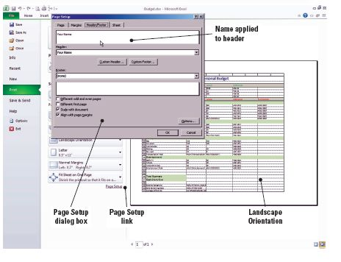
Step-by-Step: Print Formulas
On the Page tab of the
dialog box, click Fit to:
and leave the defaults
as 1 page wide by 1 tall.
Click the Header/Footer
tab. Click Custom
Header and key your
name in the left section.
Click OK to accept your
changes and close the
Page Setup dialog box.
Refer to the figure.

Slide 103
Step-by-Step: Print Formulas
Click the Print button at the top-left corner of the Backstage view window. When prompted, click OK to print the document.
SAVE the workbook with the same name. CLOSE the workbook.
CLOSE Excel.

Slide 104
Lesson Summary

