Slide 1
Working with Data
Lesson 7

Slide 2
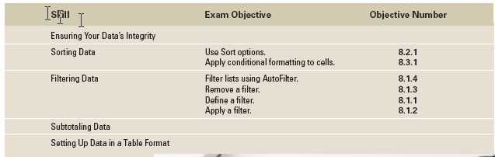
Objectives

Slide 3
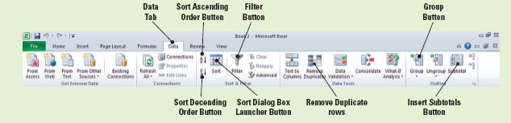
Software Orientation: Excel’s Data Tab
The command groups on Excel’s Data tab, shown in the figure below, enable you to sort and filter data, convert text to columns, ensure valid data entry, conduct what-if analyses, and outline data. You can also get external data into Excel by using Data commands.
In this lesson, you will learn many ways to use the command groups on Excel’s Data tab to manage spreadsheet data. Use this figure as a guide to these powerful commands.

Slide 4
Step-by-Step: Restrict Cell Entries to Data Types
Before you begin these steps, be sure to LAUNCH Microsoft Excel. Click the File tab in the upper-left corner of the Ribbon.
OPEN the Employee Data data file for this lesson.
Select the cell range D3:D50.
On the Data tab, in the Data Tools group, click Data Validation. You will now begin to set your validation criteria.
On the Settings tab of the Data Validation dialog box, select Whole number in the Allow box. This sets the number format for your validation.

Slide 5
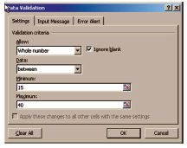
Step-by-Step: Restrict Cell Entries to Data Types
Key 15 in the Minimum box and 40 in the
Maximum box. You have now set your
whole number range. The Data Validation
dialog box should look like the figure.
Click the Error Alert tab in the dialog box.
Be sure the Show error alert after invalid data is entered check box is selected. Key Invalid Entry in the Title box. This will display an alert when an invalid entry has been made to the cell.

Slide 6
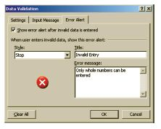
Step-by-Step: Restrict Cell Entries to Data Types
Key Only whole numbers can be entered
in the error message box as shown in
the figure. This will display the error
message that you want the user to see.
Click the Input Message tab and in the
Input Message box, key Enter a whole number between 15 and 40. Click OK. This will create the message for the user to follow to correct their error.

Slide 7

Step-by-Step: Restrict Cell Entries to Data Types
Select cell D6, key 35.5, and press Enter.
The Invalid Entry dialog box (see the figure)
opens, displaying the error message you created.
Click Retry to close the error message; key 36, and press Enter.
Use the following employee information to key values in row 29. Patricia Doyle was hired today as a receptionist. She will work 20 hours each week.
Create a Lesson 7 folder and SAVE the file as Contoso Data.
LEAVE the workbook open to use in the next exercise.

Slide 8
Step-by-Step: Allow Specific Values in Cells
USE the workbook from the previous exercise.
Select E3:E29. Click Data Validation in the Data Tools group on the Data tab.
Click the Settings tab, in the Allow box, select List. The In-cell drop-down check box is selected by default.
In the Source box, key Yes, No. Click OK to accept the settings. An arrow now appears to the right of the cell range.
Click E3. Click the arrow to the right of the cell. You now see the list options you created in the previous step.

Slide 9
Step-by-Step: Allow Specific Values in Cells
If the value in column D is 30 or more hours, from the newly created drop-down list, choose Yes. If it is less than 30 hours, select No.
Continue to apply the appropriate response from the list for each cell in E4:E29.
SAVE the workbook.
LEAVE the workbook open to use in the next exercise.

Slide 10
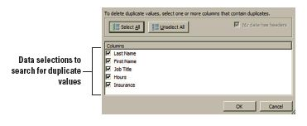
Step-by-Step: Remove Duplicates
USE the workbook from the previous exercise.
Select A3:E29. In the Data
Tools group, click Remove
Duplicates. The Remove
Duplicates dialog box shown
in in the figure opens.
Remove the check from Hours and Insurance. You will identify duplicate employee data based on last name, first name, and job title.

Slide 11
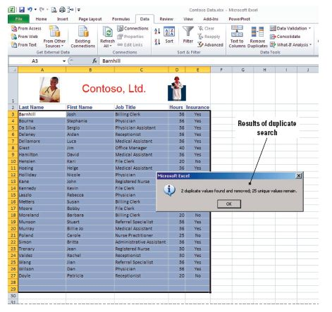
Step-by-Step: Remove Duplicates
My data has headers is
selected by default.
Click OK. Duplicate rows
are removed and the
confirmation box shown
in the figure appears
informing you that two
duplicate values were
found and removed.
Click OK. SAVE the
workbook.
LEAVE the workbook open to use in the next exercise.
Notes:
Take Note: Because you are permanently deleting data, it is a good idea to copy the original range of cells to another worksheet or workbook before removing duplicate values. You saved the file at the end of the previous exercise; therefore, you have a backup if you inadvertently remove data that you do not intend to remove. Later in this lesson you will to learn to filter data. You can filter for unique values first to confirm that the results of removing duplicate values will return the result you want.
Take Note: You are working with a relatively small amount of data in the practice exercises, and it would not take a great deal of time to review the data and identify duplicate entries. However, if a company has hundreds of employees, you can see the benefit of this Excel feature.

Slide 12

Step-by-Step: Sort Data on a Single Criterion
USE the workbook from the previous exercise.
Before you begin, Delete the contents of row 1 from your worksheet.
Select D2:D27 (column heading and data in column D).
On the Data tab, click the Sort button.

Slide 13
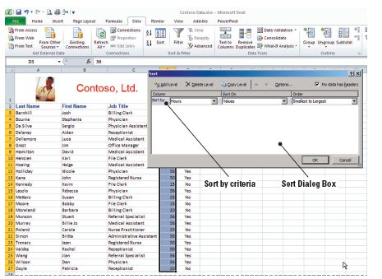
Step-by-Step: Sort Data on a Single Criterion
A Sort Warning message appears and by default prompts you to expand the data selection. Click Expand the selection option and click the Sort button. The Sort dialog box opens. Excel will automatically organize your column information. It
recognizes the header,
understands the numeric values, and gives you the sort options. You will accept
what Excel has selected.
See the figure. Click OK
to accept the first single
sort criteria.

Slide 14

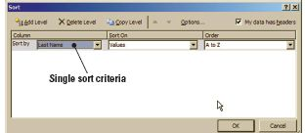
Step-by-Step: Sort Data on a Single Criterion
Select any cell in column A and click the Sort A to Z
button. Data is sorted by last name. You have chosen your second single criteria of sorting alphabetically from A–Z.
Select A2:E27 and click the Sort button to launch the Sort dialog box shown in the figure below.

Slide 15
Step-by-Step: Sort Data on a Single Criterion
In the Column section’s Sort By box, click the arrow to activate the drop-down list and select Job Title. Click OK. You have selected the third single sort criteria. Note that your worksheet is now sorted by Job Title.
Click the Sort button in the Sort and Filter group; the data range is automatically selected and the Sort dialog box opens. Select Hours in the Column section’s Sort By box. Change the order options to smallest to largest. Click OK. You have now selected you last single sort criteria. Note that your worksheet is once again sorted by the data in the Hours column.
LEAVE the workbook open to use in the next exercise.
Notes:
Take Note: Sort and Filter commands are in the Editing group on the Home tab as well as the Sort & Filter group on the Data tab.

Slide 16
Step-by-Step: Sort Data on Multiple Criteria
USE the workbook from the previous exercise.
Select the range A2:E27, if it isn’t already selected.
Click Sort in the Sort and Filter group on the Data tab to open the dialog box.
Select Job Title in the Column section’s Sort By box and A to Z in the Order box.
Click the Add Level button in the dialog box to identify the second sort criteria. A new criterion line is added to the dialog box.

Slide 17
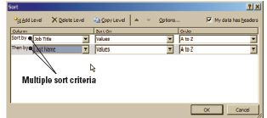
Step-by-Step: Sort Data on Multiple Criteria
In the Then By box in the Column section select Last Name as the second criterion. A to Z should be the default in the Order box as shown in the figure.
Click OK. You have now sorted
using multiple criteria; first by
job title and then alphabetically
by last name.
SAVE the workbook.
LEAVE the workbook open to use in the next exercise.
Notes:
Take Note: In Excel, you can sort by up to 64 columns. For best results, the range of cells that you sort should have column headings.

Slide 18
Step-by-Step: Sort Using Conditional Formatting
USE the workbook from the previous exercise.
On the Home tab, click Find & Select in the Editing command group, and click Conditional Formatting in the drop-down menu. A message is returned that no cells in the worksheet contain conditional formatting. Click OK to close the message box. This step is to make sure there are no conditional formatting rules in place.
Notes:
Cross-Reference: You learned about applying conditional formatting in Lesson 4, Formatting Cells and Ranges.

Slide 19
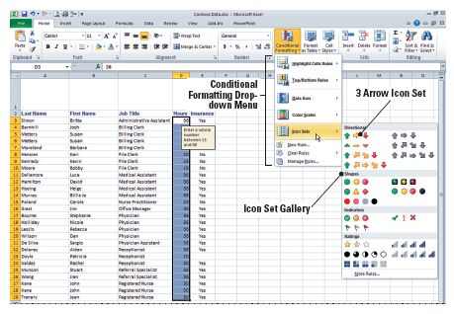
Step-by-Step: Sort Using Conditional Formatting
Select D3:D27. Click Conditional Formatting in the Styles group, and then open the Icon Sets gallery. See the figure below.

Slide 20
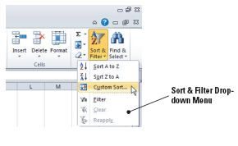
Step-by-Step: Sort Using Conditional Formatting
Click the 3 Arrows icon set. Each value in the selected column now has an arrow that represents whether the value falls within the high, middle, or low range of your data.
Select A3:E27. On the Home tab,
click Sort & Filter and then click
Custom Sort (see the figure); the
Sort dialog box opens.

Slide 21
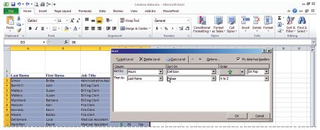
Step-by-Step: Sort Using Conditional Formatting
Select Hours in the Sort
By box. Select Cell Icon
in the Sort On section’s
drop-down list. Click the
green arrow under Order
(see the figure).
Select Hours in the Then by box. Select Cell Icon under Sort On and accept the yellow arrow and On top in the Order field. Click OK. Data sorts by icon set. The criteria caused the data to sort first by the Green arrow Icon and then by the Yellow.
SAVE your workbook as Contoso Icons. CLOSE the workbook.
LEAVE Excel open to use in the next exercise.
Notes:
Troubleshooting: This sort will result in the green arrows (highest values) on top. However, the medium and low range values are not sorted. You need to implement a multiple-criteria sort.

Slide 22
Step-by-Step: Sort Data Using Cell Attributes
OPEN the MA Assignments data file for this lesson.
Select the entire data range (including the column headings). On the Data tab, click Sort.
In the Sort dialog box, accept Last Name in the Sort By box. Under Sort On, select Cell Color.
Under Order, select Pink and On Top.
Click the Add Level button in the dialog box and select Last Name in the Sort By box. In the Sort On section, select Cell Color. Select Yellow and On Top in the Order section.
Notes:
Take Note: Excel also allows you to sort by font color. To do this, in the Sort On section, you would select Font Color instead of Cell Color.

Slide 23
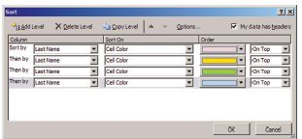
Step-by-Step: Sort Data Using Cell Attributes
Using the same method you used
in step 4, add a level for Green
and then add a level for Blue. You
should have a criterion for each
color as illustrated in the figure.
Click OK.
SAVE the workbook in your Lesson 7 folder as MA Assignments.
LEAVE the workbook open to use in the next exercise.
Notes:
Troubleshooting: When a worksheet contains unevenly sized merged cells, if you do not select data before you open the Sort dialog box, you will receive an error message that tells you a sort requires merged cells to be identically sized. The MA Assignments worksheet contained two rows with merged cells. Therefore, you had to select the data range (including column labels) the first time you sorted the worksheet. If you performed additional sorts, Excel would remember the data range and you would not need to select it again.

Slide 24
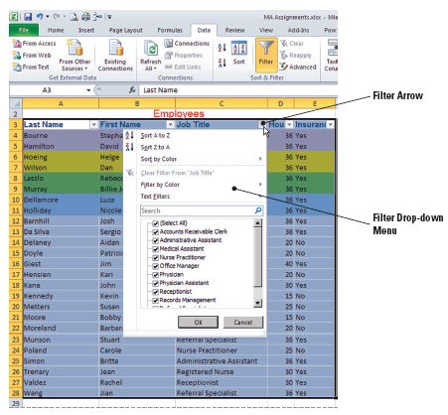
Step-by-Step: Use AutoFilter
USE the workbook from the previous exercise.
Select A3:E28. Click
Filter on the Data tab in
the Sort & Filter group; a
filter arrow is added to
each column heading.
Click the filter arrow in
the Job Title column.
The AutoFilter menu
shown in the figure is
displayed.
Notes:
Troubleshooting: To make the AutoFilter menu wider or longer, click and drag the grip handle at the bottom

Slide 25
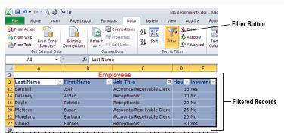
Step-by-Step: Use AutoFilter
Currently the data is not filtered, so all job titles are selected. Click Select All to deselect all titles.
Click Accounts Receivable
Clerk and Receptionist. Click
OK. Data for six employees
who hold these titles is
displayed. All other
employees are filtered out.
See the figure.
LEAVE the workbook open with the filtered data displayed to use in the next exercise.

Slide 26
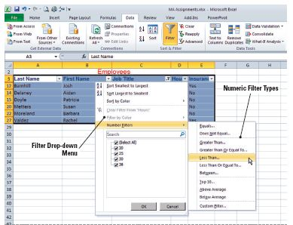
Step-by-Step: Create a Custom AutoFilter
USE the workbook from the previous exercise.
With the filtered list displayed, click the filter arrow in column D. In the
AutoFilter menu, point
to Number Filters.
As shown in the figure,
the menu expands to
allow you to customize
the filter.

Slide 27
Step-by-Step: Create a Custom AutoFilter
Select Less Than on the expanded menu and key 30 in the amount box. Click OK. The AutoFilter menu closes and the filtered list reduces to four employees who work fewer than 30 hours per week.
Click the Filter button in the Sort & Filter group on the Data tab to display all data. With the data range still selected, click Filter again.
Click the filter arrow in column D to open the AutoFilter menu. Point to Number Filters and select Greater Than. Key 15 and press Tab twice to move to the second comparison operator criteria box.

Slide 28
Step-by-Step: Create a Custom AutoFilter
Click the arrow for the comparison operator drop-down list and select is less than as the second comparison operator and press Tab. Key 30 and click OK. The list should be filtered to six employees.
Click the Filter button to once again display all data.
SAVE and CLOSE the workbook.
LEAVE Excel open to use in the next exercise.
Notes:
Take Note: To remove a filter from a set of data (and see all the data in the worksheet again), you click on the Filter button again. This will make all the data visible again.

Slide 29
Step-by-Step: Filter Using Conditional Formatting
OPEN Conditional Format from the data files for this lesson.
Select A3:E32. On the Data tab, click Filter.
Click the filter arrow in column D. Point to Filter by Color in the AutoFilter menu that appears. Click the green flag under the Filter by Cell icon. Data formatted with a green flag (highest number of work hours) is displayed.
Click the filter arrow in column D. Point to Filter by Color. Click the red flag under the Filter by Cell icon. The data formatted by a green flag is replaced in the worksheet by data formatted with a red flag (lowest number of work hours).
Click Filter to remove the filter arrows.
LEAVE the workbook open to use in the next exercise.

Slide 30
Step-by-Step: Filter Data Using Cell Attributes
USE the workbook from the previous exercise.
Select any cell in the data range and click the Filter button in the Sort & Filter group on the Data tab.
Click the arrow next to the Title header (Contoso, Ltd.) and point to Filter by Color. Click More Font Colors. A dialog box opens that displays the font colors used in the worksheet.

Slide 31
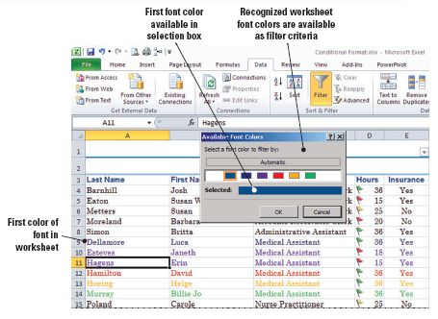
Step-by-Step: Filter Data Using Cell Attributes
As in the figure below, the first color appears in the Selected field. Click OK. The heading rows are displayed. These are the colors in the Office theme that was applied to this worksheet.

Slide 32
Step-by-Step: Filter Data Using Cell Attributes
Click the filter arrow next to the Title header again and click Clear Filter From “Contoso, Ltd.”
Click the Title header filter arrow again and point to Filter by Color. Select Purple in the Filter by Font Color drop-down menu (3rd selection). Data for Dr. Blythe (new physician) and his two medical assistants is displayed because you chose the Purple font in your sort criteria.
Click the Filter button to clear the filter arrows.
CLOSE the file. You have not made changes to the data, so it is not necessary to save the file.
LEAVE Excel open to use in the next exercise.

Slide 33
Step-by-Step: Group and Ungroup for Subtotaling
OPEN the Salary data file for this lesson.
Select any cell in the data range. Click Sort on the Data tab.
In the Sort dialog box, sort first by Job Category in ascending order.
Add a sort level, sort by Job Title in ascending order, and click OK.

Slide 34
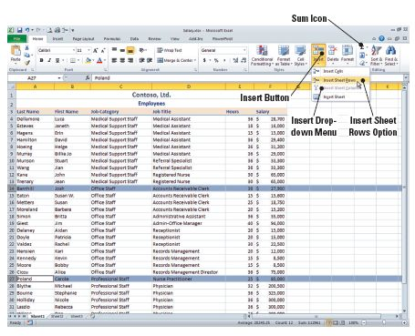
Step-by-Step: Group and Ungroup for Subtotaling
Select row 14, press
Ctrl, and select row 27.
On the Home tab, click
the Insert arrow in the
Cells group and click
Insert Sheet Rows from
the drop-down menu
that appears. This step
inserts rows to separate
the job categories.
Refer to the figure.

Slide 35
Step-by-Step: Group and Ungroup for Subtotaling
In C14, key Subtotal. Select F14 and click the Sum icon (also shown in the figure on the previous slide). The values above F14 are selected. Press Enter and Excel subtotals the category.
In C28, key Subtotal. Select F28 and click Sum. Press Enter.
In C36, key Subtotal. Select F36 and click Sum. Press Enter.
In C37, key Grand Total. Select F37 and click Sum. The three subtotals are selected. Press Enter.

Slide 36
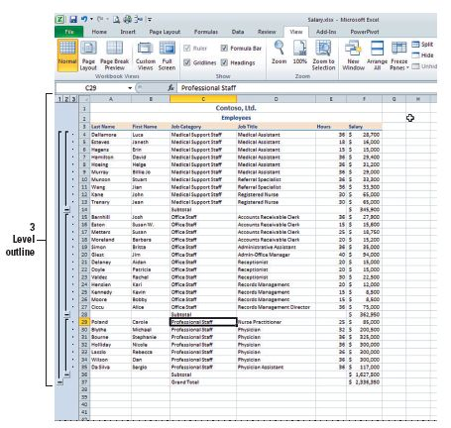
Step-by-Step: Group and Ungroup for Subtotaling
Select a cell in the data
range. On the Data tab,
click the Group arrow in the
Outline group, and then
click Auto Outline from the
drop-down menu. A three-
level outline is created. The
figure shows your worksheet
complete with subtotals and
grand total. To view your
worksheet as in the figure,
adjust your zoom to 75%.
LEAVE the workbook open to use in the next exercise.

Slide 37
Step-by-Step: Subtotal Data in a List
USE the worksheet from the previous exercise.
In the Outline group on the Data tab, click the Ungroup arrow and then click Clear Outline.
Select rows 14, 28, 36, and 37, right-click and Delete all selected rows. Remember, to select nonadjacent rows, click the first row then press and hold the Ctrl key and proceed to click the additional rows you wish to select.
Select the data range (A3:F33), including the column labels in the selection.
Click Subtotal in the Outline group on the Data tab. The Subtotal dialog box is displayed.
Select Job Category in the At Each Change in box.

Slide 38
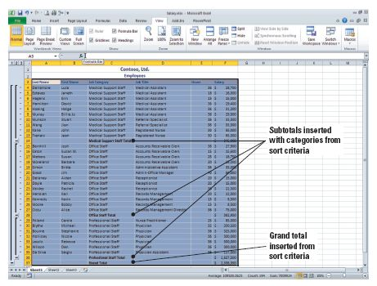
Step-by-Step: Subtotal Data in a List
Under Add Subtotal To,
Salary should already be
checkmarked. Click OK to
accept the remaining
defaults. Subtotals are
inserted for each of the
three job categories, and a
grand total is calculated at
the bottom of the list. The
figure has the outline groups with subtotals and grand total.
SAVE the workbook as Salaries.
CLOSE the workbook, but LEAVE Excel open for the next exercise.
Notes:
Take Note: If the workbook is set to automatically calculate formulas, the Subtotal command recalculates subtotal values automatically as you edit the detail data.

Slide 39
Step-by-Step: Format a Table with a Quick Style
OPEN Salary from the data files for this lesson.
Select any cell in the data. Click Sort on the Data tab.
In the Sort dialog box, sort first by Job Category in ascending order.
Add a sort level and sort by Job Title in ascending order. Click OK. Your data has been sorted first by Job Category and then by Job Title.
On the Home tab, click Format as Table in the Styles Group. The Table styles gallery opens.

Slide 40

Step-by-Step: Format a Table with a Quick Style
Mouse over the Table styles to Table Style Medium 5 from the gallery. The Format as Table dialog box opens.
Click the hide dialog box icon in the Where Is the Data for Your Table? box to collapse the Format as Table dialog box so you can select the data to be included in the table.

Slide 41
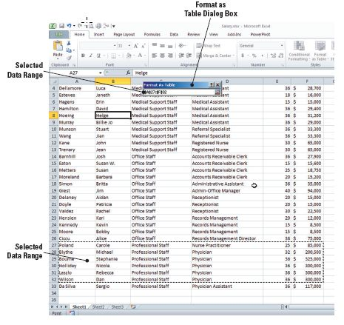
Step-by-Step: Format a Table with a Quick Style
Select A27:F32 as
shown in the figure and
press Enter. The Create
Table dialog box
appears. Your table
does not have headers,
so click OK. The Table
Style Medium 5 format
is applied and filtering
column headers are
inserted as illustrated
in the figure on the
next slide.

Slide 42
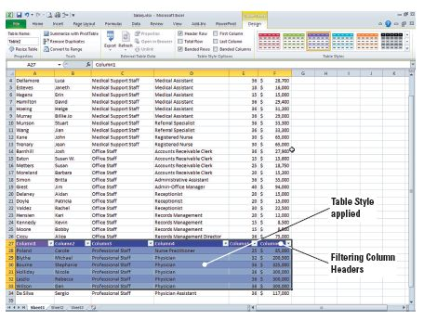
Step-by-Step: Format a Table with a Quick Style
SAVE the workbook as Table in the Lesson 7 folder.
LEAVE the workbook open to use in the next exercise.
Notes:
Take Note: Because the data selected for the table did not have headers, default names (i.e., Column1) are displayed above the table.

Slide 43
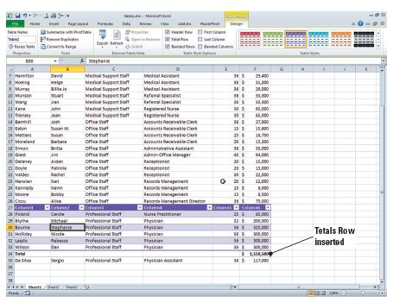
Step-by-Step: Use the Total Row Command
USE the workbook from the previous exercise.
Select a cell inside the
table and click the Total
Row command box in
the Table Style Options
group on the Design
tab. A row is inserted
below the table and the
salaries in column F of
the table are totaled.
This is illustrated in the
figure.

Slide 44
Step-by-Step: Use the Total Row Command
Click any blank cell to deselect the table. Adjust the column width to display the total amount if necessary. Click on any cell inside the table.
SAVE the workbook.
LEAVE the workbook open to use in the next exercise.
Notes:
Another Way: You can also right-click on a table row or column to open the shortcut menu. Point to Insert and options to insert rows or columns.

Slide 45
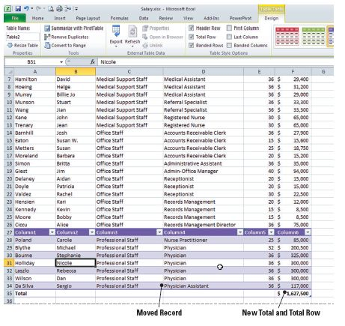
Step-by-Step: Add and Remove Rows or Columns
USE the workbook from the previous exercise.
On the Design tab, in the Properties group, click Resize
Table. The Resize Table dialog box opens.
Collapse the Resize Table dialog
box by clicking the collapse
dialog box button, and select
A27:F35. Press Enter to accept
the new range of cells. Click OK
to accept the change to the table
and apply the new settings. The
physician assistant data is
moved above the total line, and
the total is recalculated. Refer to
the figure.

Slide 46
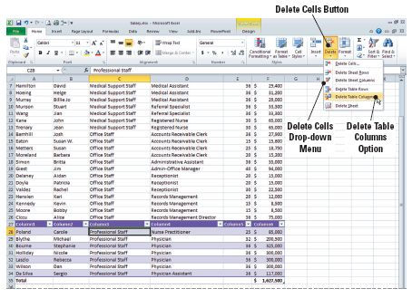
Step-by-Step: Add and Remove Rows or Columns
Select C28. On the Home
tab, click the Delete arrow
in the Cells group, and
click Delete Table Columns
from the drop-down menu
that appears. Column C is
deleted. Refer to the figure
for the drop-down menu.
Click the Column1 heading
and key Last Name. Press Tab to move to the Column 2 heading. Key First Name in that column heading and press Tab to advance to the next heading. Key Job Title in the column 4 heading and press Tab.

Slide 47
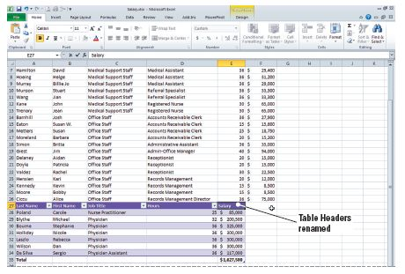
Step-by-Step: Add and Remove Rows or Columns
Key Hours in column 5.
Press Tab. In the Invalid
Entry dialog box that
displays, click Yes to
continue. Clicking Yes
here will override the
data restrictions and
dismiss the Invalid
Entry dialog box. Key
Salary in the column 6 heading and press Enter. Your table headings should appear as illustrated in the figure.

Slide 48
Step-by-Step: Add and Remove Rows or Columns
If necessary, adjust the column E width to display the total salary amount.
In the Properties group on the Design tab, select the text in the Table Name box and key Schedule and press Enter. This table represents the individuals with whom patients schedule appointments.
SAVE the file and then CLOSE the file.
CLOSE Excel.

Slide 49
Lesson Summary

