Slide 1
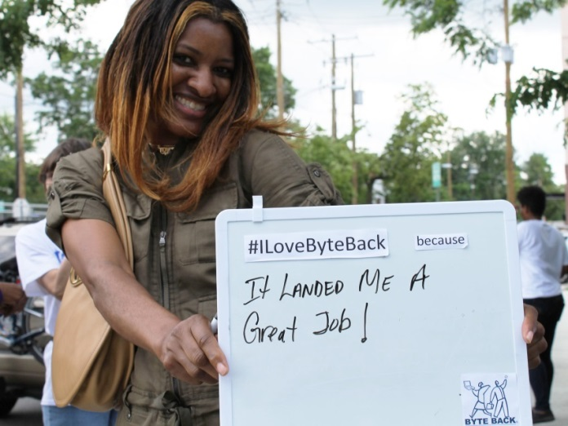
HDI Desktop Support Technician Training
Quiz 3 Review

Slide 2
What is the main objective of self-healing technologies?:
To Identify issues and restore functionality to systems
Automatically upgrade systems
Provide instant access to user accounts
Communicate information without human intervention
Competency 4.9.1: The objectives of automated remediation are:
Provide instantaneous (24/7/364) response to issue minimizing impact of any service failures
Identify when an issue has occurred and initiate remedial or corrective action to restore a system to a functioning state

Slide 3
Which of the following is an example of a cloud service?
Desktop-as-a-Service (DaaS)
Hardware-as-a-Service (HaaS)
Management-as-a-Service(MaaS)
Network-as-a-Service (NaaS)
Competency 4.1.1: Cloud Service technologies-public private, hybrid models
Application-as-a-Service
Infrastructure-as-a-Service
Platform-as-a-Service
Software-as-a-Service
Storage-as-a-Service
IMPORTANT NOTE: This is kind of a trick question. While Network-as-a-Service is actually a cloud service, the HDI model does not yet recognize it. So Desktop-as-a-Service is the answer.

Slide 4
Which telephony metric is used to develop a company’s staffing/scheduling model?
Average Speed to Answer
Average Handle Time
Average Talk Time
Abandon Before Answer
Competency 4.2.8: Average Handle Time is: Talk Time + After Call Work (ACW) + Hold Time; and is used to develop staffing and scheduling model
NOTE: While all metrics are important, the Average Handle Time is the overarching metric that covers the entire time a customer goes through from calling in to having the issue resolved.

Slide 5
Which is an example of a telephony system?
Automated customer care system
Real-time monitoring system
Voice over Internet Protocol (VoIP)
Digital Whiteboard
Competency 4.1.1: Telephony Systems:
Automated call distribution (ACD)
Automatic Voice Recognition (AVR)
Interactive Voice Response (IVR)
Voice-over Internet Protocol (VoIP)
Computer Telephony Integration (CTI)
NOTES:
Automated Customer Care system is a type of management tool
A Digital White Board is an example of a collaboration tool.
Real-Time monitoring system is an example of a Monitoring and Alerting Tool

Slide 6
What is a challenge of integrating Computer Telephony Integration (CTI)?
Integration can be costly and complicated
Customers may receive the screen pop
Decreased customer satisfaction
Integration is boring
Competency 4.3.5: Challenges of CTI include
Integration may be complex and costly
Can result in longer Average Speed to Answer (ASA) times if not implement properly
May required customers to enter information such as their ID in order to facilitate routing.

Slide 7
Social Media can best be used to increase value of Desktop Support in an organization by:
Facilitating knowledge sharing between customers
Ensuring repeatable and consistent procedures that meet governance and regulatory requirements
Performing file clean up
Allowing customers to update contact information and reset passwords
Competency 4.10.2: Social media is used in the support center to:
Customers and employees can create, search, and update posts facilitating knowledge sharing between each other
Community members share knowledge with each other via various platforms
Personalized communication via customer preferred channels
Easily customer push/pull channels for communication
Customers share experience with each other and the service provided
Data mining for product/service improvement

Slide 8
An automated call distributor can:
Track agent availability
Send and receive Instant Messages (IMs)
Update the knowledge-based
Respond to any customer inquiries
Competency 4.2.3: AN ACD system is a system that distributes incoming contact to support analysts.
NOTE: Using critical thinking, the ACD needs to have the ability to track if an agent is available or not, otherwise it might route customers to busy users, while other users are free.

Slide 9
What support involves a desktop support user going to the customer’s location?
Telephone Support
Desktop Support
Electronic Support
Walk-up Support
Competency 4.4.1: Assisted service examples-
Telephone support
Desktop Support (onsite)
Walk-Up Support
Electronic Support
  Remote control, E-mail, Instant Message (IM), Social Media
NOTE: The standards don’t review the difference, but while Telephone and electronic are straightforward, it’s important to know the difference between Desktop/Deskside Support and Walkup Support. Desktop/Deskside support in considered when the DST travels to the customer’s location to address an issue, like when a company sends a dispatch to your location. Walk-Up support is when the customer travels to the DST, like at the Apple Store.

Slide 10
Which type of service is generally 24/7/365?
Automated Remediation
Desktop Support
Walk Up Support
Telephone Support
Competency 4.9.1: Automated remediation technology-
Is intended to provide instantaneous (24.7.265) response to issue.
Identifies when an issue has occurred and initiates remedial or corrective action
Should link/correlate to incident, request, problem, and change management
NOTE: Since automated remediation is computer based, it can always be running. Telephone support needs to be staffed, so it’s not always 24/7/365, since there are holidays and closing hours.

Slide 11
If you wanted to provide predictable and equitable calls to your customers, you would likely install which telephony tool?
Automatic Call Distributor (ACD)
Voice-over Internet Protocol (VoIP)
Automatic Voice Recognition (AVR)
Interactive Voice Response (IVR)
Competency 4.2.3: The purpose of an ACD is to distribute incoming call/contact to a specific group of individuals/agents based od a set of predefined routing strategy. ACD’s are used where incoming calls need to interact with osmone, but not a specific individual.

Slide 12
Which type of support requires the most attention to body language, personal appearance?
Desktop Support
Remote Support
E-mail Support
Telephone Support
NOTE: Similar to the above question, though not a competency, this is an application of critical thinking. Body language and personal appearance would relate to in person interactions, and onl desktop support meets that.

Slide 13
Which of the following are telephony metrics? [3 Correct Answers]
Average Talk Time
Abandon Before Answer
Mean Time to Restore Service
Average Handle Time
Busy Time
Competency 4.2.8: Telephony Metrics:
Average Speed to Answer
Hold Time
Abandon Before Answer
Average Handle Time
Average Talk Time
Availability

Slide 14
You would install Interactive Voice Response (IVR) to:
Route customers effectively
Act as a knowledge-base to solve problems for customers
Report suspicious activity to the authorities
Update incorrect information within the knowledgebase
Competency 4.2.6: The purpose of an IVR system is to collect, validate, and route customer information efficient to support analysts.

Slide 15
What program is most appropriate to use for backup storage purposes?
Cloud Services
Monitoring Systems
Automated Remediation
Service Management Systems
Competency 4.11.4: Benefits of Cloud Service include:
Enhanced capacity manage capabilities
Reduced spending on infrastructure costs
Facilitates faster deployment of new services

Slide 16
A benefit of Instant messaging for an IT company is:
The ability to seek coworker advice while resolving an incident
Increase focus on the customer
Speak with your manager when you have a problem
Chat with friends when you're bored
Competency 4.7.1: Instant Message (IM) and Chat enables interactive communication between customers and support staff. IT also allows support staff to quickly access in-house experts for assistance to eliminate/reduce further escalations.

