Slide 1
Creating Charts and Pivot Tables
Lesson 10

Slide 2
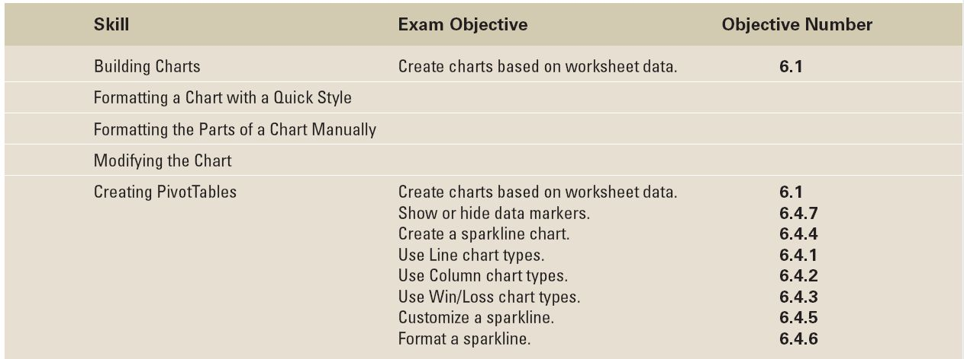
Objectives

Slide 3
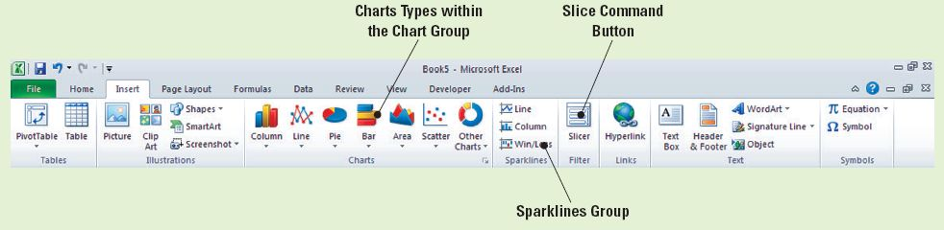
Software Orientation: The Insert Tab
The Insert tab contains the command groups you’ll use to create charts in Excel (see the figure).
To create a basic chart in Excel that you can modify and format later, start by entering the data for the chart on a worksheet. Then, you can select that data and choose a chart type to graphically display the data.

Slide 4
Software Orientation: The Insert Tab
Simply by choosing a chart type, a chart layout, and a chart style—all of which are within easy reach on the Insert tab’s ribbon—you will have instant professional results every time you create a chart.
Use the illustration on the previous slide as a reference throughout this lesson as you become familiar with and use Excel’s charting capabilities to create attention-getting illustrations that communicate an analysis of your data.

Slide 5
Step-by-Step: Select Data to Include in a Chart
Before you begin these steps, LAUNCH Microsoft Excel.
OPEN the Financial History file for this lesson.
Select B4:B10 (the 2004 data) on the Sales History worksheet.
On the Insert tab, in the Charts group, click the Pie button. Click the first 2-D Pie chart. A color-coded pie chart with sections identified by number is displayed and the Chart Tools tabs (Design, Layout, and Format) become available, with the Design tab active. This chart, however, doesn’t work: It includes the column label (2004) and total sales amount as its two largest portions, and these amounts should not be included in an analysis of sales for 2004.

Slide 6
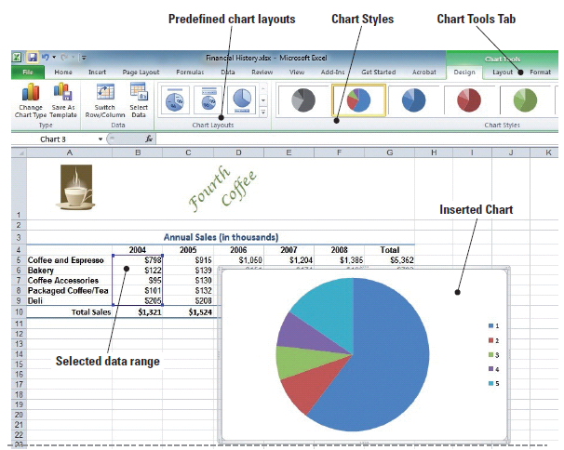
Step-by-Step: Select Data to Include in a Chart
Click in the chart’s white
space and press Delete.
The chart is now deleted
and the Chart Tools tab
disappears.
Select B5:B9, click the
Insert tab, click Pie in the
Charts group, and click
the first 2-D Pie chart.
The correct data is
displayed, but the chart is difficult to interpret with only numbers to identify the parts of the pie as in the figure.
Notes:
Troubleshooting: When you insert a chart into your worksheet, the Chart Tools tabs (Design, Format, and Layout) become available in Excel’s Ribbon with the Design tab active by default. You must select the Insert tab on the Ribbon each time you want to insert a chart.

Slide 7
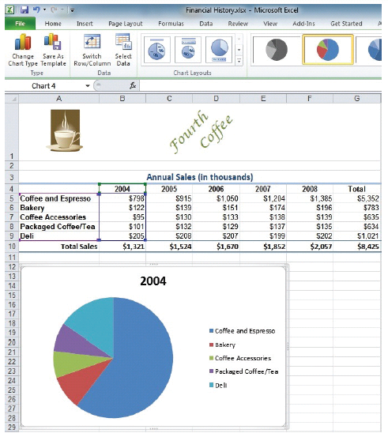
Step-by-Step: Select Data to Include in a Chart
Click in the chart’s white space
and press Delete.
Select A4:B9, click the Insert
tab, and click Pie in the Charts
group. Click the first 2-D Pie
chart. As in the figure, the data
is clearly identified with a title
and a label for each pie section.
Create a Lesson 10 folder and
SAVE the workbook as Building
Charts.
LEAVE the workbook open to use in the next exercise.

Slide 8
Step-by-Step: Choose a Chart for Your Data
USE the workbook from the previous exercise.
On the Sales History worksheet, click on the pie chart’s white space and press Delete to delete the pie chart.
Select A4:F9, click the Insert tab, and click Column in the Charts group on the Insert tab. Click 3-D Clustered Column on the drop-down list (first subtype under 3-D Column). The column chart illustrates the sales for each of the revenue categories for the five-year period. The Chart Tools tab appears with the Design tab active.
Anywhere on the chart, click, hold and drag the chart below the worksheet data and position it at the far left.
Click outside the column chart to deselect it. Notice that the Chart Tools tab disappears.
Notes:
Troubleshooting: To delete a chart, click in the white space then press the Delete key on your keyboard. If you click on the graphic or another chart element and press Delete, only the selected element will be deleted.

Slide 9
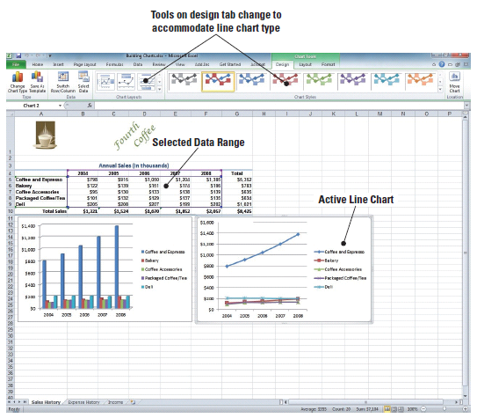
Step-by-Step: Choose a Chart for Your Data
Select A4:F9, click the
Insert tab, and click Line in
the Charts group. Click 2-D
Line with Markers (first
chart in the second row).
Position the line chart next
to the column chart. The
Chart Tools tab is on the
Ribbon with the Design tab
active. Refer to the figure.
SAVE the workbook with the same name, Building Charts.
LEAVE the workbook open to use in the next exercise.

Slide 10
Step-by-Step: Create a Bar Chart
USE the workbook from the previous exercise.
Click the Expense History workbook tab.
Select A4:F9. Click the Bar icon in the Charts Group on the Insert tab.
Click the Clustered Bar in 3-D subtype. The data is displayed in a clustered bar chart and the Design tab is active on the Chart Tools tab.
NOTE: A ScreenTip displays the chart type name when you rest the mouse pointer over a
chart type or chart subtype.

Slide 11
Step-by-Step: Create a Bar Chart
Position the clustered bar chart on the left below the worksheet data.
Deselect the chart by clicking anywhere on the worksheet; select A4:F9. On the Insert tab, click the Bar icon in the Charts group.
Click Stacked Bar in 3-D.
Position the stacked bar graph next to the 3-D bar graph.
SAVE and CLOSE the workbook.
LEAVE Excel open to use in the next exercise.

Slide 12
Step-by-Step: Format with a Quick Style
LAUNCH Microsoft Excel if it is not already open.
OPEN the Financial History file for this lesson.
On the Expense History worksheet tab, select A4:A9. Press Ctrl and select F4:F9. You have selected two non-adjacent ranges to use for your chart.

Slide 13
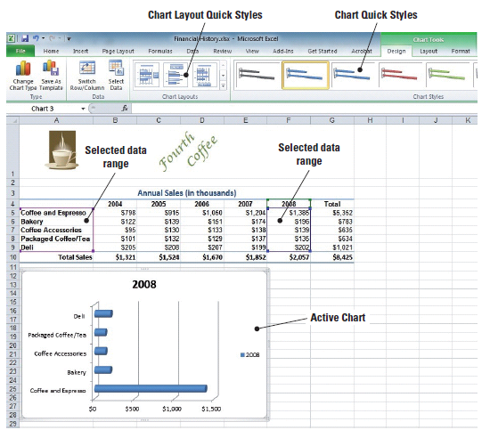
Step-by-Step: Format with a Quick Style
On the Insert tab, click Pie
in the Charts group and
click Pie (the first option on
the left) under 2-D. The
2008 data is displayed on
the chart and the Design
tab is active (see the figure).

Slide 14
Step-by-Step: Format with a Quick Style
In the Chart Layouts group on the Design tab, click Layout 1. The pie chart now displays the percentage that each sales category contributes to total sales. When you apply Layout 1 and Style 4 to the expense chart, additional information is added to the chart and the appearance changes.
In the Chart Styles group, click Style 4. The chart’s color scheme is changed. Position the chart below the data. You have just applied a Quick Style.
On the Sales History worksheet, select A4:A9. Press Ctrl and select F4:F9. You have again selected non-adjacent cell ranges to use in the next chart.

Slide 15
Step-by-Step: Format with a Quick Style
Click Bar in the Charts group and click Clustered Horizontal Cylinder (third row). The clustered bar chart appears on the worksheet.
Drag the chart below the worksheet data.
Click Layout 2 in the Chart Layouts group on the Design tab. Click Style 4 in the Chart Styles group. You have applied your second Quick Style.
SAVE the workbook as Chart Styles.
LEAVE the workbook open to use in the next exercise.
Notes:
Take Note: To see all predefined styles, click the More arrow in the Chart Styles Group.

Slide 16
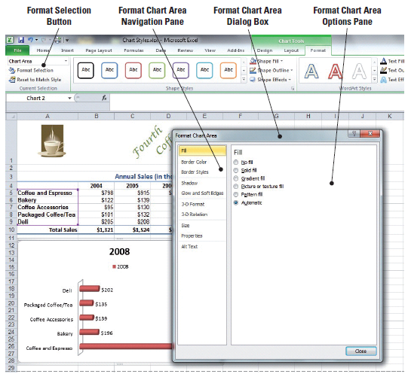
Step-by-Step: Change the Fill Color or Pattern
USE the workbook from the previous exercise.
Click in the chart area of
the Clustered Horizontal
Cylinder chart on the Sales
History worksheet to
display the Chart Tools on
the Ribbon.
Click the Format tab and
click Format Selection in
the Current Selection
group. The Format Chart
Area dialog box opens.
See the figure.
Notes:
Take Note: To display the Chart Tools, you must select the chart. If a worksheet cell is active, the Design, Layout, and Format tabs are not available.

Slide 17
Step-by-Step: Change the Fill Color or Pattern
Select Solid fill. Click the Color arrow and click Olive Green, Accent 3, Lighter 40%. A light green fill has been added to the entire background chart area.
Select Picture or texture fill. Click the Texture arrow and click Newsprint (center of selection options). The textured format replaces the color fill as the background in the chart area.
Click Close to close the dialog box.

Slide 18
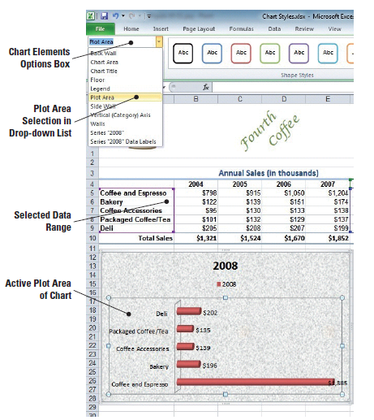
Step-by-Step: Change the Fill Color or Pattern
In the Current Selection group,
click the arrow in the Chart
Elements selection box and
click Plot Area. The plot area
in the chart becomes active
as illustrated in the figure.
Click the More arrow next to
the colored outlines window in
the Shape Styles group. The
Outline Colors Style Gallery
opens.

Slide 19
Step-by-Step: Change the Fill Color or Pattern
Mouse over the Outline Style gallery to locate and click Subtle Effect – Blue, Accent 1. This applies a light blue gradient style to the plot area.
In the Current Selection group, click the arrow in the Chart Elements selection box and click Legend. This action makes the legend inside the chart active. Press Delete.
SAVE your workbook.
LEAVE the workbook open to use in the next exercise.
Notes:
Take Note: Legend keys appear to the left of legend entries and identify the color-coded data series. Because this chart contains only one data series, the legend is unnecessary.

Slide 20
Step-by-Step: Change the Chart’s Border Line
USE the workbook you saved in the previous exercise.
In the Current Selection group, click the arrow in the Chart Elements selection box and click Chart Area. The chart area section on the chart becomes active.
Click the more arrow next to the colored outlines window in the Shape Styles group. The Outline Colors Style Gallery opens.
Scroll through the outline styles to locate and click Colored Outline – Blue, Accent 1. The chart is outlined with a light blue border.
In the Current Selection group, click the arrow in the Chart Elements selection box and click Plot Area.

Slide 21
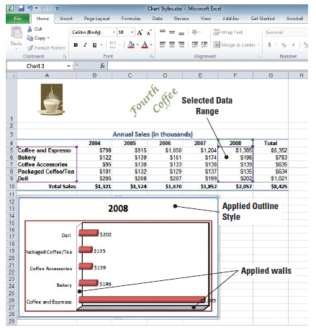
Step-by-Step: Change the Chart’s Border Line
Mouse over the Outline Style gallery to locate and click Colored Outline – Red, Accent 2. A red border is put around the plot area.
In the Current Selection group, click
the arrow in the Chart Elements
selection box and click Walls. This
activates the walls inside your chart.
Mouse over the Outline Style gallery
to locate and click Colored Outline –
Black, Dark 1. Your chart will
resemble the figure.
SAVE your workbook.
LEAVE the workbook open to use in
the next exercise.

Slide 22
Step-by-Step: Format the Data Series
USE the workbook you saved in the previous exercise.
Select the chart on the Sales History worksheet. Click the arrow in the Chart Elements selection box and select Series “2008”. This makes the cylinders in the chart active.
In the Shape Styles group, click Shape Fill. The color gallery opens.
Point to Texture. Click Denim. Your chart cylinders have now had the Denim texture applied.
Click the arrow in the Chart Elements selection box and click Series “2008” Data Labels. The data labels in your chart are now active.

Slide 23
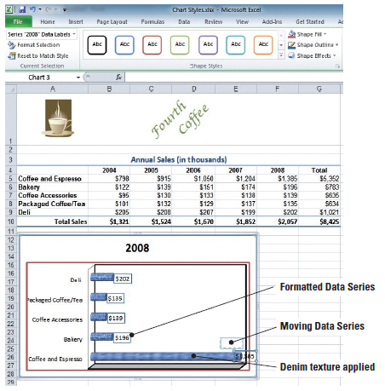
Step-by-Step: Format the Data Series
Click Shape Outline in the Shape Styles group.
This opens the color gallery.
Click Blue under Standard
Colors.
Mouse over the data series for
coffee and espresso on the
bottom cylinder to activate the
crosshair cursor. Click and hold
the left mouse button to drag
the data series above the bar
so that the label is completely
visible. See the figure.

Slide 24
Step-by-Step: Format the Data Series
Click the Expense History worksheet tab. In the Chart Elements selection box click Chart Title. Place your insertion point behind the 8 and key Expenses at the end of the existing text. You have edited the chart title, and it should read 2008 Expenses.
SAVE the workbook. CLOSE the workbook.
LEAVE Excel open to use in the next exercise.
NOTE: The data series is the most important element of the chart. Use formatting tools to call attention
to the graphic and the label.

Slide 25
Step-by-Step: Modify a Chart’s Legend
OPEN the Financial History file for this lesson.
On the Sales History worksheet, select the cell range A4:F9.
Click Column in the Charts group on the Insert tab; the Column chart options menu appears.
Select Stacked Column in 3D from the Column chart menu; the chart is inserted and the Chart Tools tabs become available.
Click the more arrow at the bottom right of the Chart Layouts group When the Layout gallery opens, click Layout 4. The legend has moved and appears below the plot area.
Notes:
Take Note: When you applied Layout 4 to the column chart, the legend was placed at the bottom of the chart. You can click the legend border and move it to any location on the chart. All other elements of the quick layout will remain the same.

Slide 26
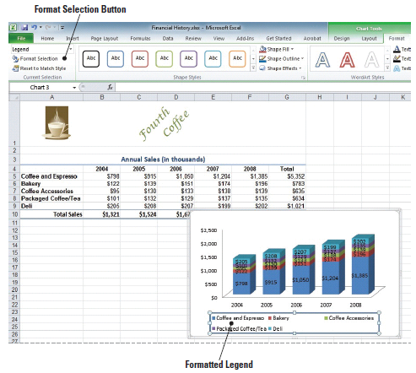
Step-by-Step: Modify a Chart’s Legend
Click to select the
chart’s legend and in
the Outline styles, click
the Colored Outline –
Blue, Accent 1 style.
This will enclose the
legend in a light blue
border as illustrated in
the figure.

Slide 27
Step-by-Step: Modify a Chart’s Legend
With the legend still selected right-click to display the shortcut menu. Click Font; the Font dialog box appears.
In the Font dialog box, select Small Caps in the Effects option area and click OK. This applies the small capital letter format to the text in the legend.
Place your mouse cursor directly on the text for Coffee and Espresso in the legend; right-click to display the shortcut menu and click Font. The Font dialog box opens.
In the Font dialog box, click the Font color button, and then click Green from the drop-down color palette. Click OK to apply the color to the Coffee and Espresso legend text and close the dialog box.

Slide 28
Step-by-Step: Modify a Chart’s Legend
Repeat step 9 for each legend item and apply the following font colors:
  Bakery: Red
  Coffee Accessories: Orange
  Packaged Coffee/Tea: Light Blue
  Deli: Blue
SAVE the file as Chart 1.
LEAVE the workbook open to use in the next exercise.

Slide 29
Step-by-Step: Add Elements to a Chart
USE the workbook from the previous exercise.
With the chart still active click the Layout tab.
Click Axis Titles in the Labels group, then point to the Primary Vertical Axis Title in the drop-down menu that appears; the Primary Vertical Axis Title options list is displayed.
Click Vertical Title. An Axis title text box appears in the chart. Select the Axis Title text, and key (In Thousands) in the title text box.
Click Chart Title in the Labels group. Click Above Chart in the drop-down menu that appears. A text box displaying Chart Title is inserted above the columns.

Slide 30
Step-by-Step: Add Elements to a Chart
Select the text and replace it with Sales History.
Click Data Labels in the Labels group. Click None. The Labels are removed from each column in the chart. Click on Data Labels again to restore the labels showing the dollar amount of sales in each category.
Click Gridlines in the Axes group. Point to Primary Horizontal Gridlines and click Major Gridlines.
In the Labels group, click Axis Titles then and point to Primary Horizontal Axis Title. The drop-down menu appears.
Click Title Below Axis.
Notes:
Take Note: Because of the chart size, the data labels are difficult to read. You will correct this in a subsequent exercise.

Slide 31
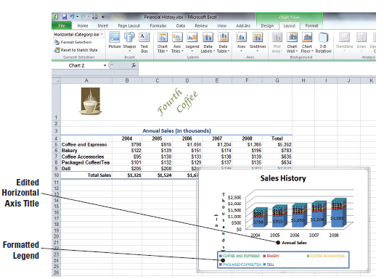
Step-by-Step: Add Elements to a Chart
Key Annual Sales in
the Axis Title text box
as illustrated in the
figure.
SAVE the workbook
with the same name.
LEAVE the workbook
open to use in the next
exercise.
Notes:
Another Way: Rather than select and replace the text in the text boxes, you can key the new text in the formula bar. When you press Enter, the new text replaces the generic text in the title boxes.

Slide 32
Step-by-Step: Delete Elements from a Chart
USE the workbook from the previous exercise.
On the Layout tab in Chart Design tools, click Axis Titles and point to Primary Horizontal Axis Title. Click None. There is now no horizontal axis in the chart.
Click Gridlines in the Axes group, point to Primary Vertical Gridlines. Click None. There are now no gridlines in the chart.

Slide 33
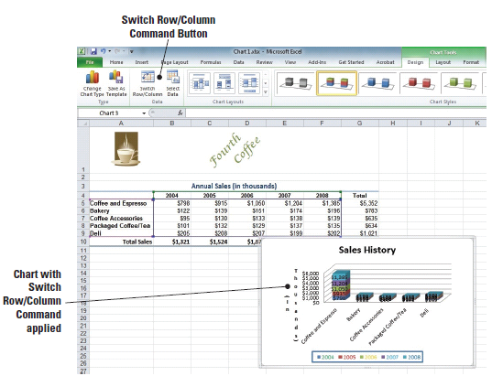
Step-by-Step: Delete Elements from a Chart
Click the Design tab and
click Switch Row/Column.
The data display is
changed to have all sales
for one category stacked
as illustrated in the figure.
Click Switch Row/Column
to Undo.
SAVE the workbook.
LEAVE the workbook open
to use in the next exercise.
Notes:
Another Way: You can also delete a chart element by right-clicking on the element and pressing Delete.
Take Note: It is important to remember that whether the chart is embedded in the worksheet or located on a chart sheet, the chart is linked to the worksheet data. Any changes in the worksheet data will be reflected in the chart. Likewise, if the worksheet data is deleted, the chart will be deleted as well.

Slide 34
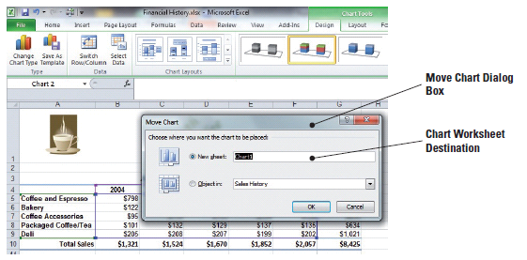
Step-by-Step: Move a Chart
USE the workbook from the previous exercise.
Click a blank area in the Sales History chart to deselect any previous actions.
Mouse over the chart to activate the move pointer (crosshairs). Click, hold and drag the chart to center it in columns B to G.
The chart remains selected. Click the Design tab.
Click Move Chart in the
Location group. The Move
Chart dialog box shown in
the figure opens, with the
default setting—New
Sheet—selected. This setting
places the chart as an object
in a new worksheet.

Slide 35
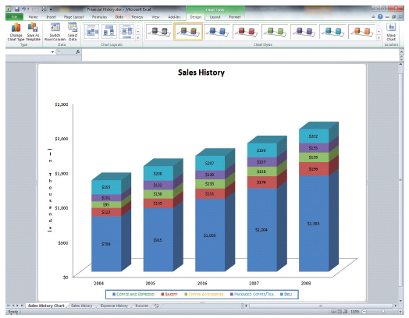
Step-by-Step: Move a Chart
The New Sheet
selection option is
selected in the
dialog box, key
Sales History Chart
in the text box.
Click OK. A chart
sheet is inserted
before the Sales
History sheet. The
chart sheet
becomes the active sheet, and the Chart Tools tabs are displayed as illustrated in the figure.

Slide 36
Step-by-Step: Move a Chart
On the Layout tab, in the Labels group, click Legend. Click Show Legend at Right; the legend moves to the right side of the chart in the chart sheet, which makes the elements in the chart easier to read.
SAVE and CLOSE the workbook.
LEAVE Excel open to use in the next exercise.
NOTE: The Chart Tools that you used on the Design, Layout, and Format tabs can be applied to the chart sheet. The data series amounts were difficult to read when you applied them to the embedded chart. They are easy to read and can be used for analysis when the chart is moved to a chart sheet.

Slide 37
Step-by-Step: Resize a Chart
LAUNCH Microsoft Excel if it is not already open.
OPEN the Financial History 2 file for this lesson.
Click a blank area in the chart on the Expense History worksheet to make the chart active and display the Chart Tools tabs.
Click the top-left sizing handle and drag the left edge of the chart to the bottom of row 9 at the left edge of the worksheet. You are using the sizing handles to resize the chart.
Click the top-right sizing handle and align the right edge of the chart with the column G right boundary.

Slide 38
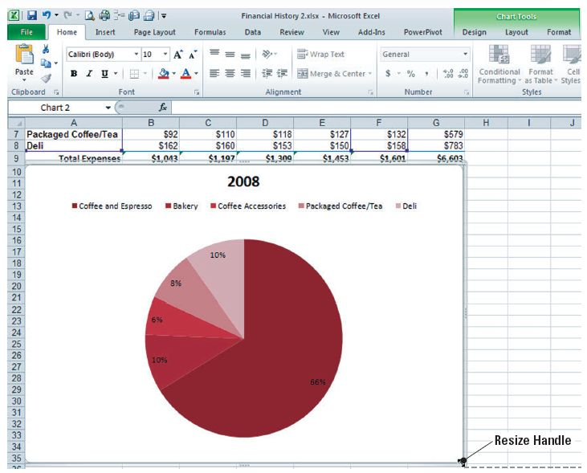
Step-by-Step: Resize a Chart
Click the bottom-center sizing handle and drag the chart boundary to the bottom of row 35 as shown in the figure.

Slide 39
Step-by-Step: Resize a Chart
Click the Sales History worksheet tab to make the Sales History worksheet active. Click a blank area in the chart. Click the Format tab.
In the Size group, click the Shape Height up arrow until the height is 3.5.
In the Size group, click the Shape Width down arrow until the width is 4.0.
SAVE the workbook as Chart 2. CLOSE the workbook.
LEAVE Excel open to use in the next exercise.
Notes:
Another Way: Rather than select and replace the text in the text boxes, you can key the new text in the formula bar. When you press Enter, the new text replaces the generic text in the title boxes.

Slide 40
Step-by-Step: Choose a Different Chart Type
LAUNCH Microsoft Excel if it is not already open.
OPEN the Financial History file for this lesson.
On the Expense History worksheet, select A4:F9.
On the Insert tab, click Bar and click Stacked Bar in 3-D. This inserts the stacked bar in a 3-D chart into your worksheet. The Design tab becomes active as soon as the chart is inserted into the worksheet.
Click Layout 2 in the Charts Layout group.
Select the chart title text box and key Expense History.

Slide 41
Step-by-Step: Choose a Different Chart Type
On the Design tab, click Change Chart Type.
Click Stacked Horizontal Cylinder in the Change Chart type dialog box. Click OK.
On the Sales History worksheet, select A4:B9. On the Insert tab, click Pie. Click Pie under Pie 2D.
Click Layout 1 on the Design tab.
Click Change Chart Type and click Exploded Pie in 3-D. Click OK.
SAVE the workbook as Chart 3. CLOSE the workbook.
CLOSE Excel.

Slide 42
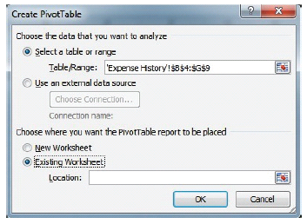
Step-by-Step: Add Data from Another Worksheet
USE the workbook from the previous exercise.
On the Expense History worksheet, select cells A4:G9.
On the Insert tab, click the PivotTable
icon then Click PivotTable. The Create
PivotTable dialog box opens. Click the
Existing Worksheet radio
button as shown in
the figure.

Slide 43
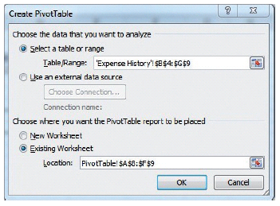
Step-by-Step: Add Data from Another Worksheet
Click on the PivotTable worksheet
and highlight cells A8:F9. These cells
should now be visible in the Create
PivotTable dialog box as seen in
the figure. Click OK. A new
PivotTable with the data from
the Expense History worksheet
has now been inserted into the
PivotTable worksheet.

Slide 44
Step-by-Step: Add Data from Another Worksheet
Your data from the Expense History sheet is now viewable in the PivotTable sheet.
Format the data to the worksheet by selecting the check boxes for the years 2004–2008 and Total in the PivotTable Field List. Click, hold and drag Total to the Report filter box.
SAVE the workbook as Sales vs. Expenses PivotTable.
LEAVE the workbook open for the next exercise.

Slide 45
Step-by-Step: Add a Chart to the PivotTable
USE the workbook from the previous exercise.
On the PivotTable worksheet, select cells A3:F4.
On the Insert tab, in the Charts group, click Column, 2D, Clustered Column. You have inserted the Clustered Column chart to reflect the data from the Expenses PivotTable.
Click, hold, and drag the chart to the left side, aligning the top with Row 12. You have moved the chart for better viewing.
Select cells A8:F9. Click on the Insert tab, in the Charts group, click Bar, 2D, Clustered Bar. You have inserted the Clustered Bar chart to reflect the data from the Expenses PivotTable. You will be able to differentiate the data easier by having unlike charts on the worksheet.

Slide 46
Step-by-Step: Add a Chart to the PivotTable
Click, hold, and drag the Bar chart to be adjacent below the first chart (Row 29).
Click on the Column chart to activate. In the Chart Layout group, click Layout 1. The new layout has changed the style of the chart.
In the Chart Styles group, choose and apply Style 4. Note that the style of the chart has changed.
Edit the Chart Title to read Sales History. You have retitled the chart.
Click on the Bar chart to activate. In the Chart Layout group, click Layout 2. Note that the style of the chart has changed.

Slide 47
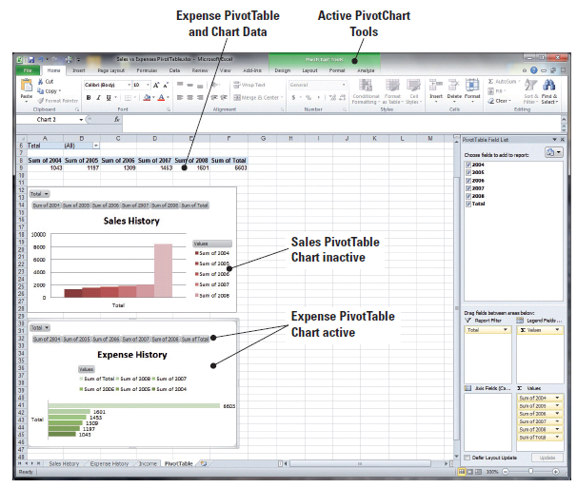
Step-by-Step: Add a Chart to the PivotTable
In the Chart Styles group,
choose and apply Style 5.
The new layout can be
seen applied in the
workbook.
Edit the Chart Title to read
Expense History. Your
completed charts are
visible in the figure.
SAVE the workbook as
Sales_Expenses_Charts.
LEAVE the workbook open for the next exercise.

Slide 48
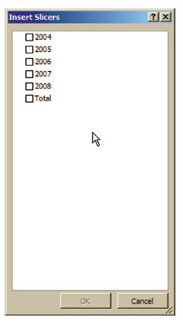

Step-by-Step: Use Slicer to Bring Data Forward
USE the workbook from the previous exercise.
The PivotTable worksheet is still active. Click on
cell A4 to select it.
Click on the Insert tab and click on the Slicer
icon. The Insert Slicers dialog box appears
as shown in the figure.
In the Insert Slicers dialog box is a check box
list of the data from the PivotTable. Click to select the Total check box and click OK. The slicer is now inserted in the worksheet and the Slicer Tools tab on the Ribbon is now active.

Slide 49
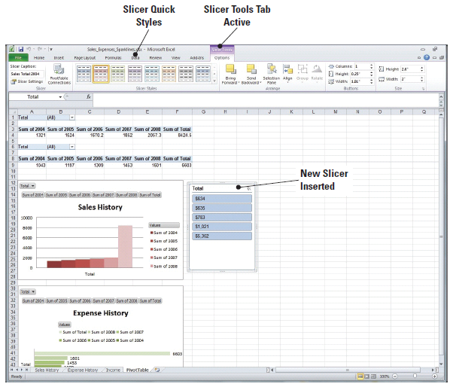
Step-by-Step: Use Slicer to Bring Data Forward
To move the Slicer, click,
hold, and drag it next to
the Sales History chart in
column G as shown in the
figure.
Right-click on the Slicer
to access the short-cut
menu. Click Slicer
Settings. The Slicer
Settings dialog box opens.
The insertion point appears in the Name text box. Key Sales Slicer. Press Tab twice.

Slide 50
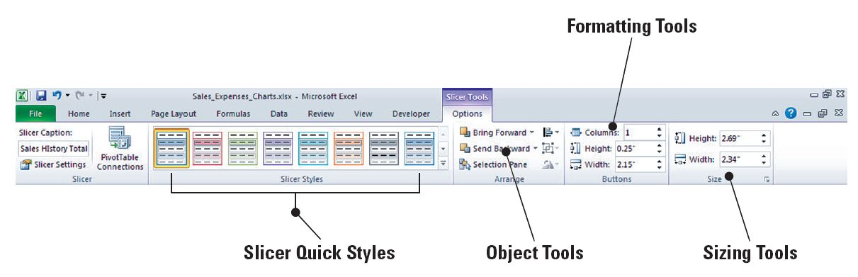
Step-by-Step: Use Slicer to Bring Data Forward
The insertion point is now in the Caption text box. Key Sales Total 2004 and click OK.
On the Slicer Tools Options tab on the Ribbon, in Slicer Styles, choose Slicer Style Light 2. The toolbar should resemble the figure.

Slide 51
Step-by-Step: Use Slicer to Bring Data Forward
Click to activate cell A9.
Repeat steps 2 through 7, substituting Expenses Slicer and Expenses Total 2004, and move it next to the Expense History chart.
In Slicer Styles, choose and apply Slicer Style Light 3. The slicer’s styles have been formatted to match their respective charts.
SAVE the workbook as Sales_Expense_Slicers.
LEAVE the workbook open for the next exercise.

Slide 52
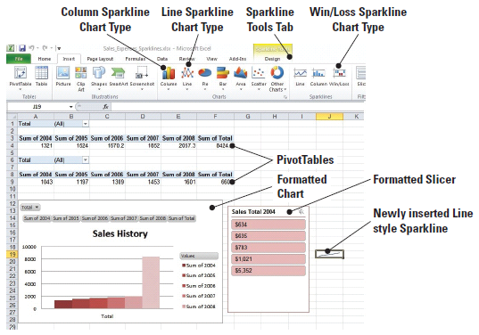
Step-by-Step: Add Sparklines to a PivotTable
USE the workbook from the previous exercise.
In the PivotTable worksheet, highlight cells A4:E4.
On the Insert tab, in the Sparklines group, click the Line icon. The Create Sparklines dialog box appears. This will allow you to insert a Sparkline Line chart into the destination cell.
Click cell J19 to add the
cell to the Location Range
as shown in the figure.
Click OK. The newly created
sparkline is inserted into
the worksheet. The Sparkline
Tools Design tab is now
active on the Ribbon.
Notes:
Take Note: There are three types of Sparkline charts in Excel 2010—line, column, and win/loss.

Slide 53
Step-by-Step: Add Sparklines to a PivotTable
Right-click on the column J header to format the width to a size of 35.
Right-click on the Row 19 header and format to the height of 45. Click on J19 to make it active. It was deselected when you formatted the column and row.
On the Sparklines Design tab, in the Show group, place checkmarks in all 6 options. These options are for data settings on the sparkline itself. They Show: high point, low point, negative point, first point, last point, and markers. If you do not select any of these show points, then you will just have a basic line in the cell. As you activate these options, you will see the sparkline change with each click as well as your sparkline itself.

Slide 54
Step-by-Step: Add Sparklines to a PivotTable
In the Sparkline Style group, choose and apply Sparkline Style Accent 2, Darker 50%. The style of the sparkline has now been formatted.
In cell J19, key Sales History Trend. Press Enter.
Click on the Sparkline. From the Home tab, center the text and decrease the font to size 8. Sparklines allow text to be entered into the background as labels. You have just added a label, aligned it, and resized it.

Slide 55
Step-by-Step: Add Sparklines to a PivotTable
Repeat steps 1 through 7 to create a second sparkline using the following criteria:
  Sparkline type: Column
  Data from cells: A9:E9
  Location cell: J38
  Row 38 height: 45
  Show group: all options
  Sparkline style: Sparkline Style Accent 3, Darker 50%
  Cell text: Expense History Trend, centered, size 8, top-aligned

Slide 56
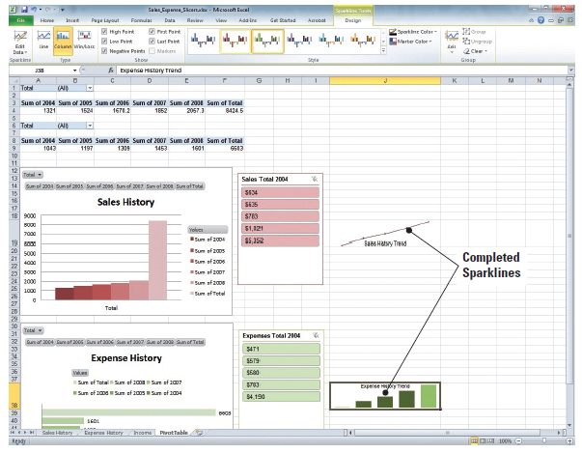
Step-by-Step: Add Sparklines to a PivotTable
Your completed
sparklines should
resemble the image
in the figure.
SAVE the workbook
as Sales_Expenses_
Sparklines. CLOSE
the workbook.
LEAVE Excel open for
the next exercise.

Slide 57
Step-by-Step: Create a PivotChart Report
OPEN the Financial History PivotTable you created earlier in this lesson.
Click on cell B20. This will be the cell where your PivotChart will be inserted.
On the Insert tab, click the PivotTable down arrow icon and then click Insert PivotChart in the drop-down menu that appears. The Create PivotTable with PivotChart dialog box opens with the Select a Table or Range option selected by default.

Slide 58
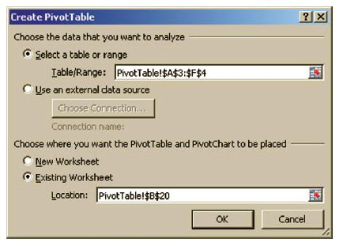
Step-by-Step: Create a PivotChart Report
In your worksheet, highlight cells A3:F4; the reference to these cells appears in the Table/Range text box, indicating that the data in these cells is to be
analyzed. In the Location text box at the
bottom of the dialog box, a reference to
cell B20 appears, as in the Existing
Worksheet Location: box (see the figure).
Click OK. The PivotChart appears in your
worksheet, accompanied by PivotChart
report filters in the chart area so that you
can sort and filter the essential data of the PivotChart report. The PivotChart Tools tab becomes active with the Design, Layout, Format, and Analyze tabs.

Slide 59
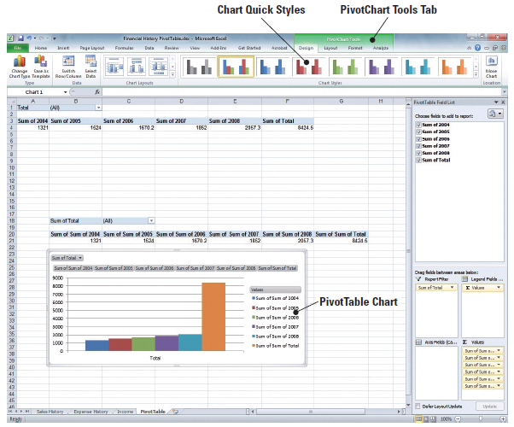
Step-by-Step: Create a PivotChart Report
Just as you chose data in the previous exercise for the PivotTable, you will place check marks in all the boxes for the data in the PivotTable Field list and click, hold, and drag Sum of Total to the Report Filter.
Click, hold, and drag your
new PivotChart below the
Data as shown in the figure.
SAVE the PivotChart as
Sales_Expense_PivotChart.
CLOSE the workbook.
CLOSE Excel.

Slide 60
Lesson Summary

