Slide 1
Formatting Worksheets
Lesson 5

Slide 2
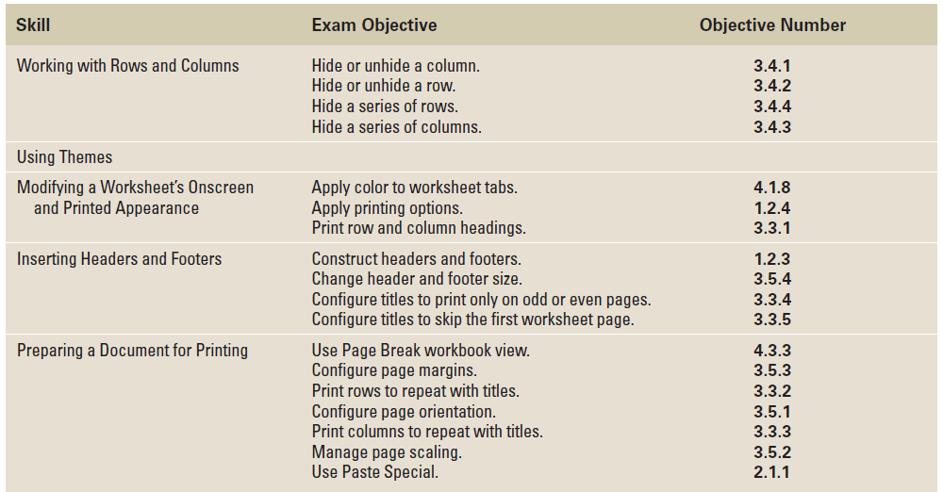
Objectives

Slide 3
Software Orientation: Page Layout Commands
One of the easiest ways to share information in a worksheet or workbook is to print copies for others to review.
To prepare worksheets for printing and distribution, you will continue to use some of the Home tab command groups, but you will primarily use the Page Layout command groups shown in the figure on the next slide.
Applying formatting options from these command groups will ensure that your printed worksheets are more useful, more readable, and more attractive.

Slide 4
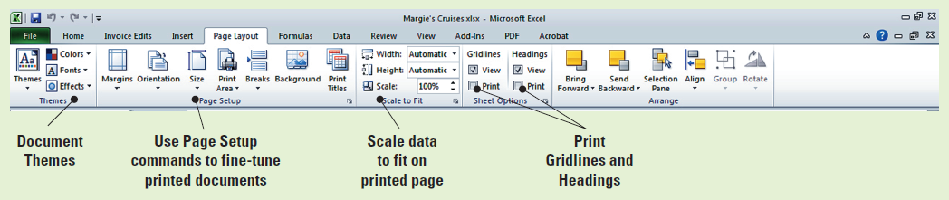
Software Orientation: Page Layout Commands

Slide 5
Working with Rows and Columns
When you open a new worksheet, the columns and rows in that worksheet are uniform. However, uniformity rarely fits the data you want to include in a worksheet or workbook.
For some columns, you might need only two or three characters; for others, you will need to increase the column width to accommodate more data than will fit in the default column width of 8.43 characters.

Slide 6
Inserting or Deleting a Row or Column
To insert a row, select the row or a cell in the row below which you want the new row to appear. The new row will then be inserted above the selected cell or row.
Inserting columns works the same way. If you want to insert a column to the left of column D, click any cell in column D. Columns are inserted to the left of the selected cell, and by default, the inserted column is formatted the same as the column to the left.
The same principles apply when you need to delete a row or column. In the following exercise, you will delete an entire row from a worksheet.
Notes:
Take Note: It does not matter which column you use to select cells when you want to insert rows or which row you select when you want to insert columns.

Slide 7
Step-by-Step: Insert or Delete a Row or Column
Locate the Lesson 5 folder to access the exercise files. Then follow these steps:
OPEN the Margie’s Cruises data file. The Home tab will be active.
Select any cell in row 12; then press Ctrl and select a cell in row 17. Click the arrow next to Insert in the Cells group and click Insert Sheet Rows.
Select any cell in column A. Click the arrow under the Insert cells button in the Cells group, then click Insert Sheet Columns.
In A5, key Destination.

Slide 8
Step-by-Step: Insert or Delete a Row or Column
Select A6:A11. Click Merge & Center in the Alignment group.
Select A13:17. Click Merge & Center.
Select A19:23. Click Merge & Center.
Label the merged cells Mexico (A6), Hawaii (A13), and Alaska (A19).
Select A6:A23. Click the Middle Align button in the Alignment group and Bold in the Font group.
Select any cell in row 2. Click the arrow under the Delete button in the Cells group and click Delete Sheet Rows.

Slide 9
Step-by-Step: Insert or Delete a Row or Column
Click the row header for the new row 2. Right-click the highlighted row and click Delete.
LEAVE the workbook open to use in the next exercise.
ANOTHER WAY: After you insert a row or column, you can select the location where you want to insert another row or column and press Ctrl+Y.

Slide 10
Modifying Row Height and Column Width
By default, all columns in a new worksheet are the same width and all rows are the same height.
In most worksheets, you will want to change some column or row defaults to accommodate more or less data.
Changes can be made using the Format commands in the Cells group on the Home tab.
Modifying row height and column width can make a worksheet’s contents easier to read and increase its visual appeal.

Slide 11
Modifying Row Height and Column Width
You can set a row or column to a specific height or width, change the height or width to fit the contents, or change the height or width by dragging the boundary, or the line between rows or columns.

Slide 12
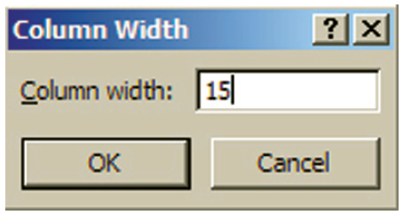
Step-by-Step: Modify Row
Height and Column Width
USE the workbook from the previous exercise to perform these steps:
Click the heading for column D. Press and hold the mouse button and drag to select column E. Release the mouse button.
Click Format in the Cells group.
Under Cell Size, click Column Width on the options list.
In the Column Width dialog box
(shown here), key 15. Click OK.
You have adjusted the column
width to the specific size of 15.

Slide 13
Step-by-Step: Modify Row
Height and Column Width
Select column C. Click Format, then click AutoFit Column Width. This command adjusts the column width to fit the longest entry in the column.
Click the right boundary of column G and drag to the right until the ScreenTip says Width: 17.00.
Click any cell in column A. Click Format in the Cells group.
Under Cell Size, click Column Width.
In the Column Width dialog box, key 16. Click OK.
Set the width for column B to 30 characters.
Select row 3 and click Format. Click Row Height and key 25 in the Row Height dialog box. Click OK.
Notes:
Another Way: When formatting rows and columns, you can press Enter instead of clicking the OK button in the dialog box.

Slide 14
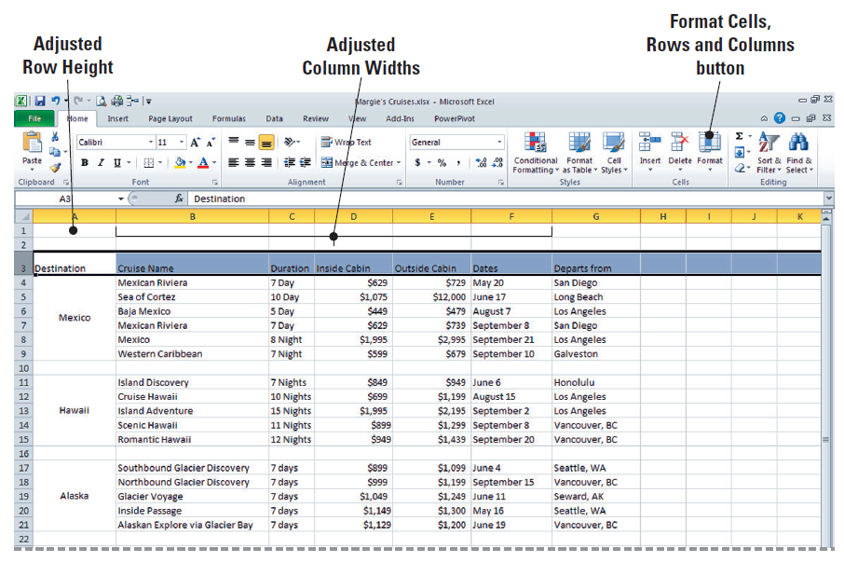
Step-by-Step: Modify Row
Height and Column Width
The workbook should now look like the workbook shown here.
Create a
Lesson 5
folder and
SAVE the
workbook.
LEAVE the
workbook
open to use
in the next
exercise.
Notes:
Take Note: In previous lessons, when you double-clicked the right column boundary, you were utilizing the AutoFit Column Width option.

Slide 15
Modifying Row Height and Column Width
You can set a row or column to a specific height or width, change the height or width to fit the contents, or change the height or width by dragging the boundary, or the line between rows or columns.
Row height, or the top-to-bottom height of a row, is measured in points; one point is equal to 1/72 inch.
The default row height is 15 points, but you can specify a row height of 0 to 409 points.
Although you can specify a column width of 0 to 255 characters, the default column width is 8.43 characters (based on the default font and font size).

Slide 16
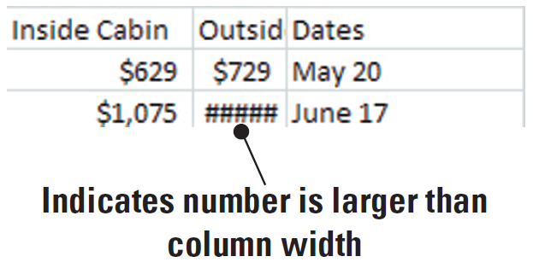
Modifying Row Height and Column Width
If a column width or row height is set to 0, then the corresponding column or row is hidden.
As you learned in Lesson 2, when the text you enter exceeds the column width, the text overflows to the next column, or it is truncated when the next cell contains data.
Similarly, if the value entered in a column exceeds the column width, the ####
symbols (shown in this
figure) indicate the number
is larger than the column
width.
Notes:
Another Way: To quickly autofit the entries in all rows on a worksheet, click Select All, then double-click one of the column boundaries.

Slide 17
Modifying Row Height and Column Width
Depending on the alignment of the data in your columns, worksheet data may appear crowded when you use the AutoFit Column Width option because this option adjusts column width to the exact width of the longest entry in the column.
Therefore, after using this option, you may want to use the mouse to drag the right column boundary when a column with right-aligned data is adjacent to one with left-aligned data, as shown in Figure 5-6 on the next slide.

Slide 18
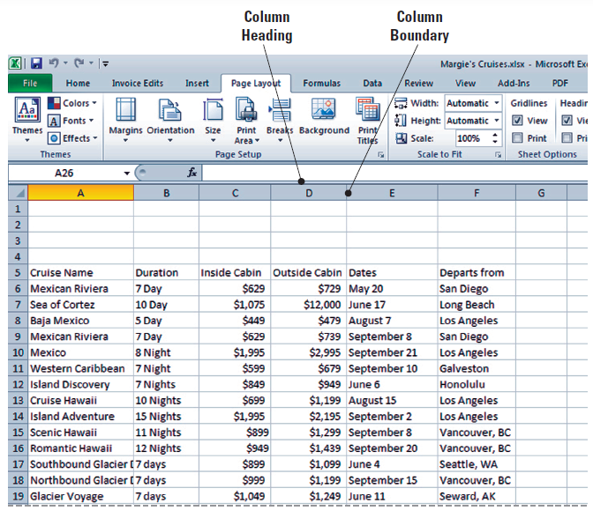
Figure 5-6: Separate Right-Aligned and Left-Aligned Columns

Slide 19
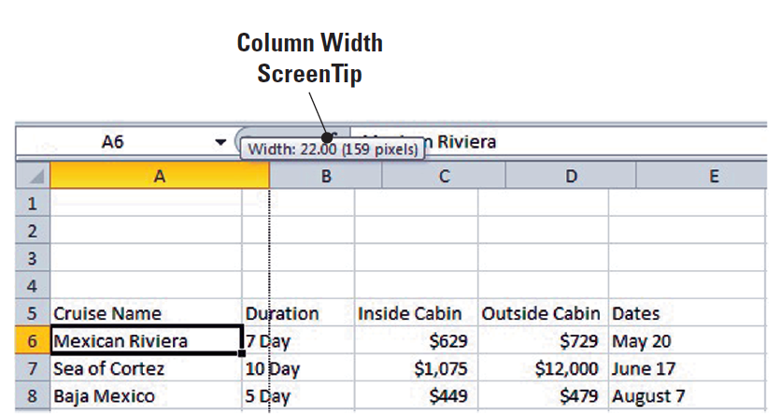
Modifying Row Height and Column Width
When you drag the boundary, the width of the column in characters and pixels appears in a ScreenTip above the column headings (as shown in this figure).
Notes:
Another Way: You can also use the Format Painter to copy the width of one column to other columns. To do so, select the heading of the first column, click the Format Painter, and then click the heading of the column or columns to which you want to apply the column width.

Slide 20
Modifying Row Height and Column Width
In Excel, you can change the default width for all columns on a worksheet or a workbook. To do so, click Format; then, under Cell Size, click Default Width. In the Standard Width dialog box, key a new default column measurement.
Note that when changing the default column width or row height, columns and rows that contain data or that have been previously formatted will retain their formatting.
TAKE NOTE: When you are more familiar with the ways to modify rows and columns, you will likely use one method consistently.

Slide 21
Formatting and Entire Row or Column
To save time, achieve a consistent appearance, and align cell contents in a consistent manner, you often want to apply the same format to an entire row or column.
To apply formatting to a row or column, click the row heading or column heading (its identifying letter or number) to select it, then apply the appropriate format or style.
Formatting rows and columns rather than applying formatting to the range of cells that contain data has an advantage: Later, when you insert rows or columns or add additional data to a worksheet, it will be formatted correctly.

Slide 22

Step-by-Step: Format and Entire Row or Column
USE the workbook from the previous exercise to perform these steps:
Select A1:G1, then click Merge & Center. With A1 selected, click Cell Styles in the Styles group and click Heading 1 under Titles and Headings.
Key Margie’s Travel and press Enter.
With A1 selected, click Increase Font Size until the font size is 20 points.

Slide 23
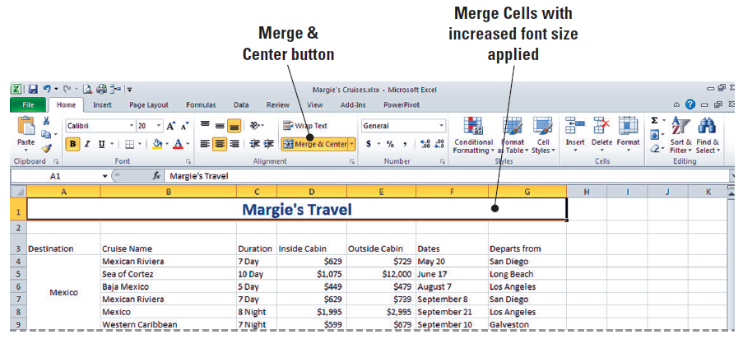
Step-by-Step: Format and Entire Row or Column
Notice (as shown in this figure) that the height of row 1 increased to
accommodate the
larger font size.
Merge and center
A2:G2. Apply the
Heading 2 style.
Key Cruise Options, Prepared for Fabrikam, Inc. and press Enter.
Click on the newly merged A2 and increase the font size to 16 points. Note that the period after Inc. is highlighted in light blue. Please include this when you key the heading.
Notes:
Troubleshooting: If you select row 1 rather than the data range and apply the style, the bottom border style effect will extend to the end of the row (cell XFD1).

Slide 24

Step-by-Step: Format and Entire Row or Column
Select A3:G3 and apply Heading 3 style to the column labels. Increase the font size to 12 points.
Select row 3. Click Middle Align and Center in the Alignment group.
Select columns D and E. Click the Number Format box and click Accounting. Refer to Figure 5-9 on the next slide to view the formatting changes in your worksheet.
TAKE NOTE: The Accounting format will be applied to any number you enter in column C or D, even if, for example, you enter the number as currency.

Slide 25
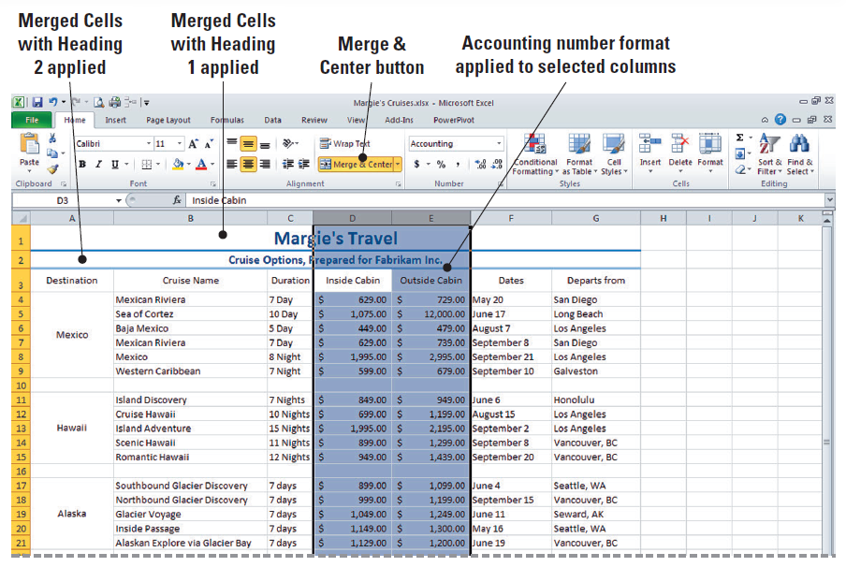
Figure 5-9: Heading, Alignment and Font Size Applied

Slide 26
Step-by-Step: Format and Entire Row or Column
Select rows 4–9 and click the Font Color arrow in the Font group. This activates the font colors option box.
Click Green under Standard Colors.
Select rows 11–15. Click the Font Color arrow and click Purple under Standard Colors.
Select rows 17–21. Click the Font Color arrow and click Red under Standard Colors.
Refer to Figure 5-10 on the next slide to see your final formatting changes.

Slide 27
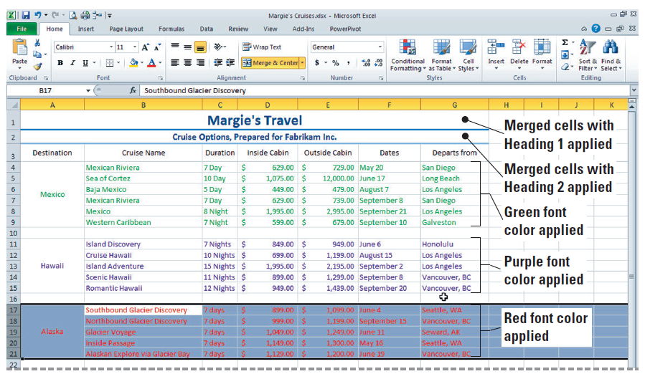
Step-by-Step: Format and Entire Row or Column
SAVE the workbook.
LEAVE the workbook open to use in the next exercise.

Slide 28
Hiding or Unhiding a Row or Column
You may not want or need all rows and columns in a worksheet to be visible all the time, particularly if the worksheet contains a large number of rows or columns.
You can hide a row or a column by using the Hide command or by setting the row height or column width to zero.
When rows are hidden, they do not appear onscreen or in printouts.

Slide 29
Step-by-Step: Hide or Unhide a Row or Column
USE the workbook from the previous exercise to perform these steps:
Click the column D header to select the entire column. Click Format in the Cells group.
Mouse over Hide & Unhide and click Hide Columns in the Visibility group. This process will hide column D from view. A thick line appears when you have hidden the column.
Click the row 11 header, press Shift, and click the row 15 heading. Click Format in the Cells group. This has selected all five rows.
Notes:
Another Way: You can also hide a column by setting the column width to zero.

Slide 30

Step-by-Step: Hide or Unhide a Row or Column
Mouse over Hide & Unhide and click Hide Rows in the Visibility group. A thick line has once again appeared to show your action of hiding the rows.
Click Quick Print on the Quick Access Toolbar.
As shown in Figure 5-11 on the next slide, you can recognize when rows or columns are hidden because numbers are skipped in the row headings or letters are skipped in the column headings. When you view your printed worksheet, note that it does not show the hidden rows or column.

Slide 31
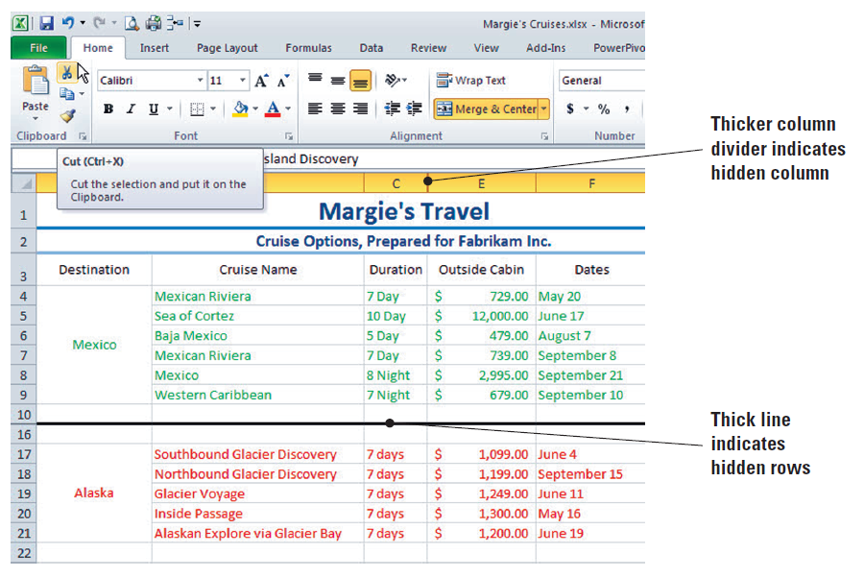
Figure 5-11: Hidden Column and Rows

Slide 32
Step-by-Step: Hide or Unhide a Row or Column
Select columns C and E (which are columns on each side of the hidden column).
Click Format, mouse over Hide & Unhide, and click Unhide Columns in the Visibility group. Column D is again visible.
Select row 10, press Shift, and select row 16. Click Format. Point to Hide & Unhide and click Unhide Rows in the Visibility group. As a result of this action, your worksheet returns to its original state from before beginning the exercise.
SAVE the workbook.
LEAVE the workbook open to use in the next exercise.
Notes:
Take Note: You must click the row or column heading to select the entire row or column when you want to display a hidden row or column. Selecting the data in the rows or columns will not release the hidden rows or columns. Troubleshooting: When you select rows 10 and 16 to unhide the hidden rows, you must select them in a way that includes the hidden rows. Press Shift when you select row 16 or select row 10 and drag to include row 16. If you select row 10, press Ctrl, and click row 16, the rows will not unhide.

Slide 33
Using Themes
A document theme is a predefined set of colors, fonts, lines, and fill effects that can be applied to an entire workbook or to specific items within a workbook, such as charts or tables.
Document themes were introduced in Excel 2007, and you can use them to quickly and easily format an entire document and give it a fresh, professional look.
Themes can be shared across other Office applications, such as Word and PowerPoint.
Because document themes can be shared, this feature enables you to give all your Office documents a uniform look in terms of colors, fonts, and effects.

Slide 34
Choosing a Theme for a Worksheet
Excel has several predefined document themes.
When you apply a theme to a worksheet or workbook, the colors, fonts, and effects contained within that theme replace any styles that were already applied to cells or ranges.
In the following exercise, you will apply two document themes so that the owner of Margie’s Travel can select the one that will be used on all company documents.
By saving both themes, the owner can compare the differences between the two and then choose which theme to use.
Notes:
Troubleshooting: If you or another user has customized one or more document themes, those themes will appear at the top of the list, and you may have to scroll down to see all of Excel’s built-in themes.

Slide 35
Choosing a Theme for a Worksheet
Because themes are consistent in all Microsoft Office 2010 programs, all of the company documents for Margie’s Travel can have a uniform appearance.
Many companies create a customized document theme and use it consistently. You can experiment by applying various predefined themes until you decide on the “look” that appeals to you, or you can design a customized theme, as you will do in the next exercise.

Slide 36
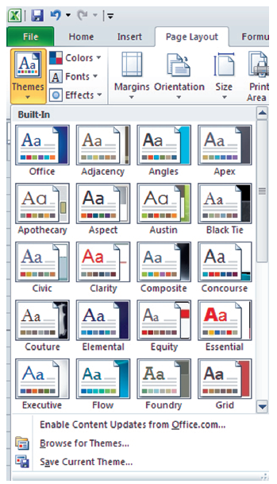
Step-by-Step: Choose a Theme for a Worksheet
USE the workbook from the previous exercise to perform these steps:
Click the Page Layout tab to make it active.
Click Themes. As shown in this figure, the
first 20 built-in themes are displayed in a
preview window. Mouse over each theme
and observe the changes in the title lines
of your worksheet.
Scroll down and click Verve to apply that
style to your worksheet.

Slide 37
Step-by-Step: Choose a Theme for a Worksheet
Click the File tab to access Backstage. Click Save As and save the workbook in the Lesson 5 folder as Verve Theme.
Here, you changed the default document theme by selecting another predefined document theme. As you can see, document themes that you apply immediately affect the styles that have already been applied in your document.
Click Themes and click Opulent. The appearance of your document is significantly changed.
Click Save As and save the workbook in the Lesson 5 folder. Name your workbook Opulent Theme.
LEAVE the workbook open to use in the next exercise.
Notes:
Take Note: Because you increased the font size after you applied Heading 1 to the title, the font size remains at 20 points. If you had changed the font size before applying the heading style, the title would be displayed in 14 points, because that is the default font size for themes.

Slide 38
Choosing a Theme for a Worksheet
The figure shown on Slide 36 shows 20 built-in themes for Excel 2010. Scroll down to see all the built-in themes.
The styles that you applied in the previous exercises were the styles associated with the default Office theme.
When you opened the styles gallery, the colors, fonts, and effects that were displayed were those from the Office theme.
Remember, styles are used to format specific cells or ranges within a worksheet; document themes are used to apply sets of styles (colors, fonts, lines, and fill effects) to an entire document.
All of the default Office theme styles you applied to the titles in a previous exercise were changed when you applied a different theme.

Slide 39
Customizing a Theme
You can create a customized theme by making changes to one or more of an existing theme’s components—colors, fonts, or line and fill effects.
The changes you make to one or more of a theme’s components immediately affect the styles that you have applied in the active document.

Slide 40
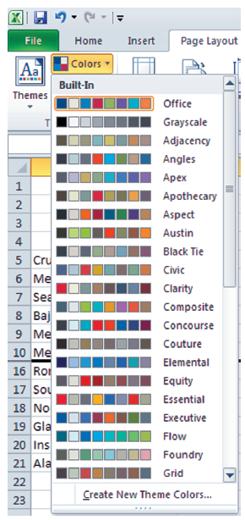
Step-by-Step: Customize a
Theme by Selecting Colors
USE the Opulent Theme workbook, which should be open from the previous exercise, to complete the following steps:
On the Page Layout tab, in the Themes
group, click Colors.
This figure illustrates the color array for
some of the built-in themes. Remember,
you have to scroll through the entire list
to see them all. Each theme has an array
of accent colors that are the same as the
accents in the Styles group.
Notes:
It’s easy to create your own theme that can be applied to all of your Excel workbooks and other Office 2010 documents. You can choose any of the color combinations shown in this figure, which represent the built-in themes, or you can create your own combination of colors.

Slide 41
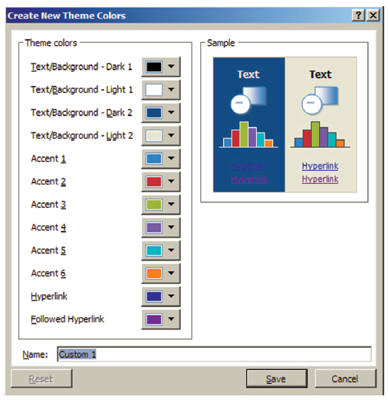
Step-by-Step: Customize a
Theme by Selecting Colors
Click Create New Theme Colors. The Create New Theme Colors dialog box opens (see the figure), showing the colors used in the Opulent
theme that is currently
applied to the worksheet.
Move the dialog box so that
you can see the worksheet
titles and column labels.
Click the
Text/Background – Dark 2
arrow. The current color is
highlighted under Theme
Colors. Click Accent 6 to change the color to orange.
Notes:
The Theme colors shown above contain four text and background colors, six accent colors, and two hyperlink colors. You can change any or all of these when you customize a theme.

Slide 42
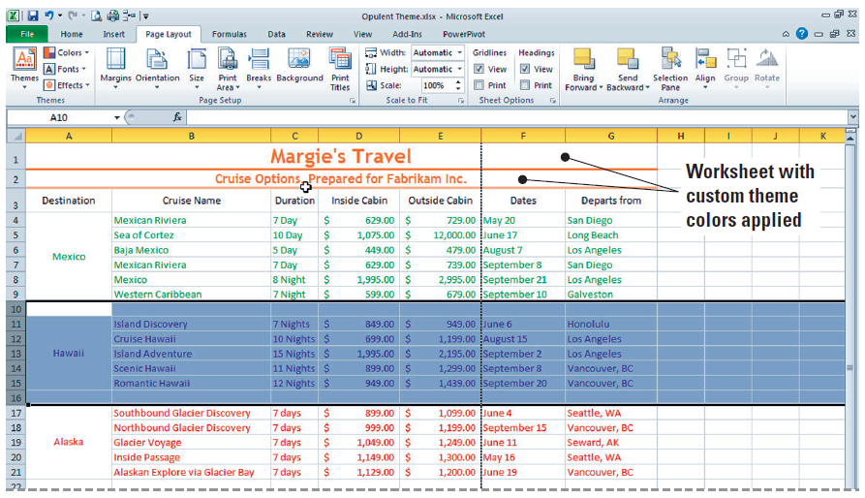
Step-by-Step: Customize a
Theme by Selecting Colors
Click the arrow next to Accent 1 in the dialog box and click Accent 6 under Theme Colors. In the Name box, key My Colors. Click Save.
The font and line
color in the
worksheet titles
reflect the
customized theme
colors. Refer to this
figure to see the
worksheet with
custom theme colors.
LEAVE the workbook open to use in the next exercise.
Notes:
Take Note: To return all theme color elements to their original colors, click the Reset button in the Custom Colors dialog box before you click Save.

Slide 43
Customizing a Theme by
Selecting Fonts and Effects
Now that you have customized the color of your themes, you are ready to choose the font for your theme.
Use fonts and effects that create a unique image for your documents.
Themes contain a heading font and a body font. When you click the Theme Fonts button, you see the name of the heading font and the body text font that is used for each theme.

Slide 44
Customizing a Theme by
Selecting Fonts and Effects
You can customize any of the built-in themes by changing the attributes of the theme. For example, if you like the colors in the Verve theme but you want to use a different font, first apply the Verve theme, then click Theme Fonts and apply the font of your choice.
You can then save the resulting theme and apply it to other documents.
You cannot change the built-in theme effects, but you can apply a different built-in effect to modify the appearance of the theme you are editing which can include changing the shading, beveling, or other effects.

Slide 45
Step-by-Step: Customize a
Theme by Selecting Fonts and Effects
USE the workbook from the previous exercise to complete the following steps:
On the Page Layout tab, click Fonts in the Themes group.
Click Create New Theme Fonts. In the Heading font box, click Bookman Old Style.
In the Body font box, click Poor Richard. The sample is updated with the fonts that you selected.
TROUBLESHOOTING: If your customized theme font is not automatically applied, click Cell Styles and click the customized heading font to apply it.

Slide 46
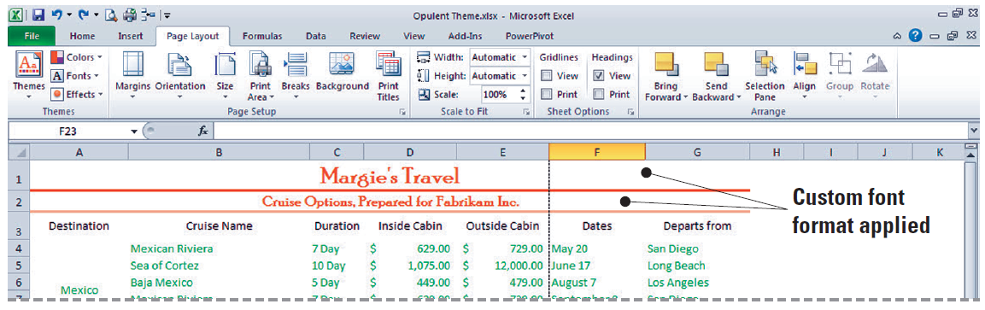
Step-by-Step: Customize a
Theme by Selecting Fonts and Effects
In the Name box, key My Fonts as the name for the new theme fonts. Click Save.
Your customized theme fonts will be available for you to use to customize any of the built-in themes or to use the next time you click Cell Styles on the Home tab. (See the figure)

Slide 47
Step-by-Step: Customize a
Theme by Selecting Fonts and Effects
In the Themes group, click Themes. Click Save Current Theme.
In the File name box, key My Theme. Click Save. Your customized document theme is saved in the Document Themes folder, and it is automatically added to the list of custom themes that now appears at the top of the themes preview window.
Click on Themes. Your theme is now viewable in Custom themes.
On the Page Layout tab, in the Themes group, click Effects. Theme effects are sets of lines and fill effects. See the figure on the next slide.

Slide 48
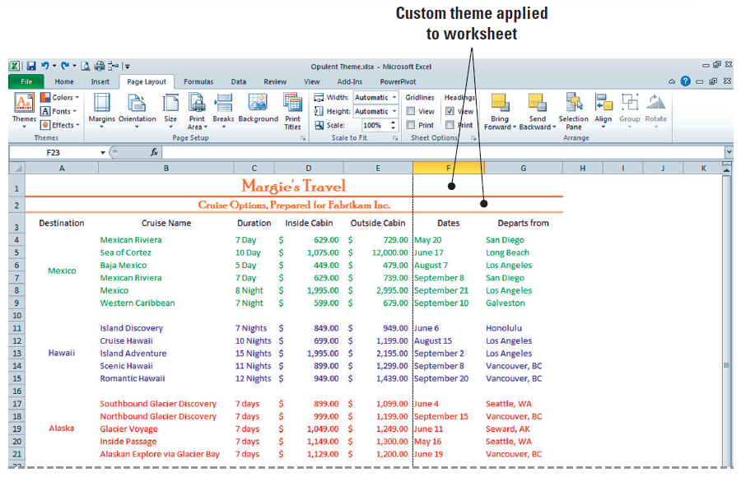
Step-by-Step: Customize a
Theme by Selecting Fonts and Effects
Mousing over the effects will show subtle changes in the cells.
Click the Aspect
effect to apply it to
the workbook. Click
Undo in the Quick
Access Toolbar to
undo the theme
effect. Do not save
the workbook.
LEAVE the workbook open to use in the next exercise

Slide 49
Modifying a Worksheet’s
Onscreen and Printed Appearance
You can draw attention to a worksheet’s onscreen appearance by displaying a background picture.
You can also add color to worksheet tabs. Gridlines (the lines that display around worksheet cells), row headings, and column headings also enhance a worksheet’s appearance.
Onscreen, these elements are displayed by default, but they are not printed automatically.

Slide 50
Formatting a Worksheet Background
You can use a picture as a sheet background for display purposes only.
A sheet background is saved with your worksheet, but it is not printed and it is not retained in a worksheet or as an item that you save as a web page.
Because a sheet background is not printed, it cannot be used as a watermark.
Say that the owner of Margie’s Travel often uses worksheets in presentations to clients and also provides clients with printed copies. You can increase the effectiveness of these worksheet presentations by adding an appropriate background picture and adding color to worksheet tabs.
Notes:
Take Note: It is best to remove gridlines when a sheet background is used, but printing gridlines makes printed worksheets easier to read. Printing column and row headings can also help identify the location of data during discussions.

Slide 51
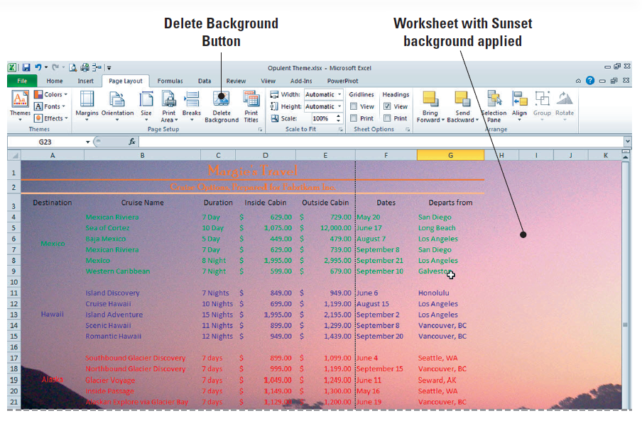
Step-by-Step: Format a Worksheet Background
USE the workbook from the previous exercise to complete the following steps:
On the Page Layout tab, in the Page Setup group, click Background.
Click the Sunset
image from the
student data files
and then click
Insert. The picture
is displayed behind
the text and fills the
sheet (see figure).

Slide 52
Step-by-Step: Format a Worksheet Background
In the Sheet Options group, click View to remove the gridlines.
Select A1:G21, click the Home tab, and click the Fill Color arrow. To improve readability, click Lavender Background 2, Darker 25% to add solid color shading to cells that contain data.
The higher the percentage of the fill color, the darker the fill that will be applied. Before you apply fill colors, you can mouse over them to preview in the worksheet.
Click anywhere in the worksheet. Click the Page Layout tab. In the Page Setup group, click Delete Background. The background is removed, but the shading remains.

Slide 53
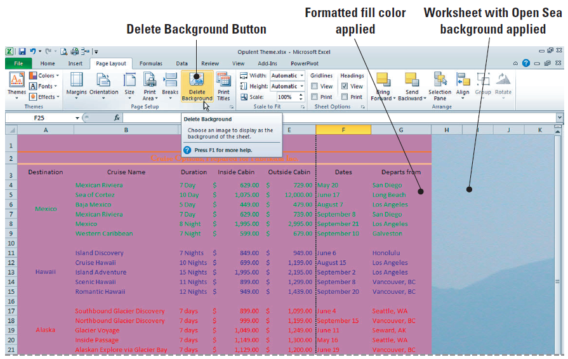
Step-by-Step: Format a Worksheet Background
On the Page Layout tab, in the Page Setup group, click Background and select the Open Sea image from the student data files. Click Insert. (See the figure)

Slide 54
Step-by-Step: Format a Worksheet Background
SAVE the file in the Lesson 5 folder as Background. The background will be saved with the worksheet.
Click Delete Background in preparation for the next exercise.
Select A1:G21. Right-click the selected cells, click the arrow on the fill button in the Mini-toolbar, and select No fill.
LEAVE the workbook open to use in the next exercise.

Slide 55
Changing the Color of a Worksheet Tab
By default, a new workbook contains three blank worksheets identified as Sheet1, Sheet2, and Sheet3.
You often use more than one worksheet to enter related data because it is easier to move between sheets than to scroll up and down through large amounts of data.
Adding color to the worksheet tabs makes it easier to locate needed information.
The original workbook contained data about cruises to three destinations all in a single worksheet. In the following exercise, you will separate the data so that data related to each destination will be on a separate worksheet in the workbook.

Slide 56
Step-by-Step: Change the Color of a Worksheet Tab
USE the workbook from the previous exercise to complete the following steps:
Right-click the Sheet1 tab and mouse over Tab Color. Under Standard Colors, click Green.
Right-click the Sheet2 tab and mouse over Tab Color. Click Purple.
Right-click the Sheet3 tab and mouse over Tab Color. Click Red.
Click the Sheet1 tab. Select A1:A3. Click Copy.
Click Sheet2. Select A1 and click Paste.

Slide 57
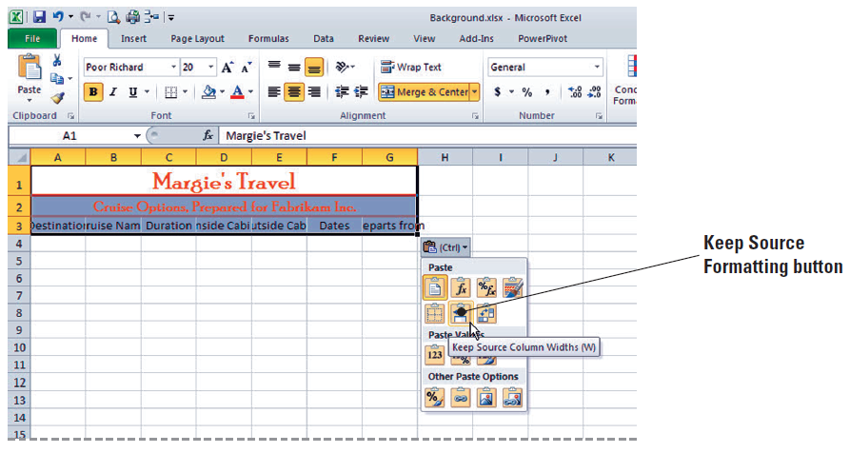
Step-by-Step: Change the Color of a Worksheet Tab
Click the Paste Options button and click Keep Source Column Widths.
(See the figure)
Click Sheet3.
Select A1 and
click Paste.
Click the Paste
Options button
and click Keep
Source Column Widths.
On the Sheet1 worksheet, select A11:G15 and click Cut.

Slide 58
Step-by-Step: Change the Color of a Worksheet Tab
On the Sheet2 worksheet, select A4 and click Paste.
Cut the Alaska data from Sheet1 and paste it to A4 on Sheet3. Note that each worksheet tab is color coded to match the font format in that worksheet.
LEAVE the workbook open to use in the next exercise.

Slide 59
Viewing and Printing a Worksheet’s Gridlines
You can have gridlines visible on your work surface or work without them.
By default, gridlines are present when you open a worksheet.
You can also choose whether gridlines are printed.
A printed worksheet is easier to read when gridlines are included.
TAKE NOTE: Worksheets print faster if you print without gridlines.

Slide 60
Step-by-Step: View and
Print a Worksheet’s Gridlines
USE the workbook from the previous exercise to complete the following steps:
Click the Sheet1 tab. On the Page Layout tab, in the Sheet Options group, remove the check mark from the View option in the Gridlines section.
In the Page Setup group, click Orientation, then click Landscape. In the Scale to Fit group, click 1 page in the Width box.
Click Quick Print on the Quick Access Toolbar. Gridlines should not be present on the work surface or in the printout.

Slide 61
Step-by-Step: View and
Print a Worksheet’s Gridlines
Click the Sheet2 tab to make it the active worksheet. Click the Print check box under Gridlines. Click Orientation, then click Landscape.
Each worksheet has its own properties. When you access orientation for Sheet2, you will notice that Portrait is the default.
In the Scale to Fit group, click 1 page in the Width box. Click . Although gridlines are not present on the work surface, they are included on the printout.
With Sheet3 as the active worksheet, check View and Print under Gridlines. Click Orientation and Landscape.
Click Quick Print. Gridlines are present on both the work surface and the printout.
LEAVE the workbook open to use in the next exercise.

Slide 62
Step-by-Step: View and
Print Column and Row Headings
USE the workbook from the previous exercise to complete the following steps:
Click Sheet1. On the Page Layout tab, in the Sheet Options group under Headings, click View to remove the check. Column and row headings no longer display.
Check the View box again. Headings are restored. Then, click the Print check box under Headings.
Click the View tab and click Page Layout in the Workbook Views group. Column and row headings now appear in the worksheet as it will be printed.
Remember, Page Layout view allows you to see a worksheet exactly as it will appear on a printed page. You can use this view to see where pages begin and end.
LEAVE the workbook open to use in the next exercise

Slide 63
Inserting Headers and Footers
A header is a line of text that appears at the top of each page of a printed worksheet.
Footers are lines of text that appear at the bottom of each page.
You can add headers or footers to your worksheets to provide useful information about the worksheet, such as who prepared it, the date it was created or last modified, the page number, and so on.
Headers and footers are visible in Page Layout view and appear on printouts.
You can add predefined header or footer information to a worksheet; insert elements such as page numbers, date and time, and filename; or add your own content to a header or footer.

Slide 64
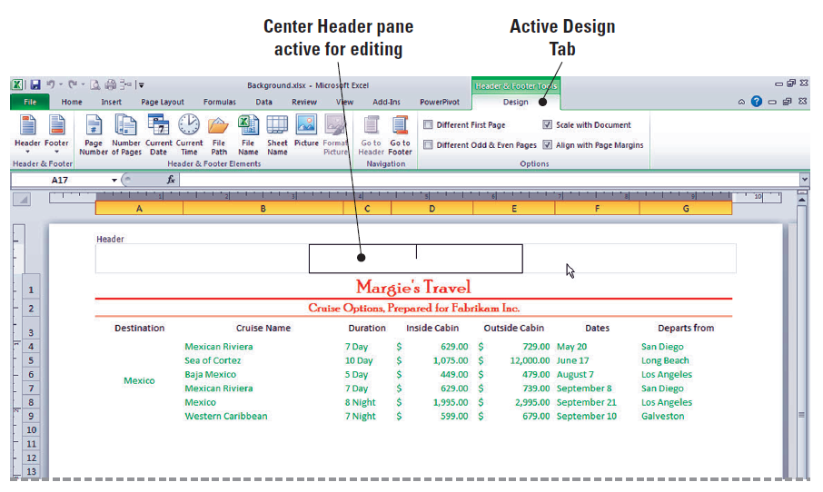
Adding Page Numbers to a Worksheet
To add or change a header or footer, click the Insert tab, then click Header & Footer in the Text group. The worksheet displays in Page
Layout view, a
Design tab (shown
here) is added to
the Ribbon, and
the Header &
Footer Tools
command groups
are displayed.
Notes:
Take Note: The addition of the Design tab illustrates one advantage of Excel’s Ribbon interface. With the Ribbon, instead of every command being available all the time, some commands appear only in response to specific user actions.

Slide 65
Step-by-Step: Add Page
Numbers to a Worksheet
USE the workbook from the previous exercise to complete the following steps:
With Sheet1 active, click the Insert tab, then click the Header & Footer button in the Text group. The worksheet is now displayed in Page Layout view.
Note that the center Header text box is active and the Design tab is added to the Ribbon. The Header & Footer Design tab command groups are thus available for you to use in the worksheet.
By default, your cursor will appear in the center Header section. Press Tab to move to the right pane in the Header section of the worksheet.

Slide 66
Step-by-Step: Add Page
Numbers to a Worksheet
Click Page Number in the Header & Footer Elements group. The code &[Page] appears in the text box. This symbol (&) indicates that the appropriate page number will be added to each page of the printed worksheet.
Click the Go to Footer button in the Navigation group.
Click the left text box in the footer and click Sheet Name in the Header & Footer Elements group. Press Tab twice to go to the right footer pane.
Click Current Date in the Header & Footer Elements group. Then click anywhere in the worksheet outside the header and footer to close the Design tab.
SAVE the workbook in the Lesson 5 folder as Cruises.

Slide 67
Inserting a Predefined Header or Footer
On the Design tab, the Header & Footer group contains predefined headers and footers that allow you to automatically add text to the header or footer, such as the date, page number, number of pages, name of the sheet, and so on.
Many of Excel’s predefined headers and footers combine one or more elements.
In the following exercise, you will insert a combined entry by clicking it. You can then customize the appearance of your header or footer in Page Layout view. Within this view, once you have the header or footer selected, you can edit the text it contains using the Font group on the Home tab. In this way, you can change font type or size, add special effects, or add other options to your text.

Slide 68
Step-by-Step: Insert a Predefined
Header or Footer
USE the workbook from the previous exercise to complete the following steps:
Click the Sheet3 worksheet. Click the View tab.
Click Page Layout view in the Workbook Views group.
Click the center Header pane. Click on the Header & Footer Tools Design tab now that it has become active. Click Sheet Name in the Header and Footer Elements group. &Tab appears in the pane.
Click Go to Footer in the Navigation group. Click the left footer pane.

Slide 69
Step-by-Step: Insert a Predefined
Header or Footer
Click Footer in the Header & Footer group and click the last option in the list, which combines Prepared by, Current Date, and Page Number.
Because the footer is wider than the left pane, the majority of the footer is moved to the center pane, and the page number appears in the right pane.
LEAVE the workbook open to use in the next exercise.
ANOTHER WAY: You can access the Header and Footer text boxes by clicking Page Layout view on the right side of the status bar.

Slide 70
Adding Content to a Header or Footer
Excel’s predefined headers and footers will not always meet your needs. When this happens, you can simply key text into any of the header or footer text boxes.
Text isn’t the only type of content you can add to a header or footer. For instance, you may be familiar with the watermark functionality that is available in Microsoft Word. You cannot insert a watermark in Excel, but you can mimic one by displaying a graphic in a header or footer. This graphic will appear behind the text, and it will display and print in the style of a watermark.

Slide 71
Step-by-Step: Insert Text and Graphics into a Header or Footer
USE the workbook from the previous exercise to complete the following steps:
With Sheet3 still active, click the center Header pane and delete the existing header.
Key For Presentation to Client in the center pane. Then press Tab to move to the right Header pane.
Click the Design tab if it is not already active. Click Picture in the Header and Footer Elements group. Select the Sailing image from student data files for Lesson 5 and click Insert.
Click Format Picture on the ribbon.

Slide 72
Step-by-Step: Insert Text and Graphics into a Header or Footer
In the Format Picture dialog box, under Size and rotate, set the height to 8.5” and press Tab. Notice the width changes automatically. This happens because Lock aspect ratio is checked. Press OK.
Click anywhere on the worksheet to deselect Headers & Footers editing. The image now appears behind the header and footer text.
SAVE the workbook.
LEAVE the workbook open for the next exercise.

Slide 73
Using Headers to Print Titles
Using the Headers in Excel will allow you to customize the title printing options and how they appear on the printed page.
You can use these options to skip printing first page titles and print to odd pages only.
In the following exercise, you will apply these printing options to your worksheet.

Slide 74
Step-by-Step: Use a Header to
Print Titles on Specific Pages
USE the workbook from the previous exercise to complete the following steps:
Click the Insert tab on the Ribbon. In the Text group, click Header & Footer. By default Excel will open the Header in the Center pane for editing.
Key Margie’s Client List for Printing.
On the Headers & Footers Design tab, in the Options group, select the Different Odd & Even Pages check box. This will allow you to specify that the headers and footers on odd-numbered pages should be different from those on even-numbered pages.

Slide 75
Step-by-Step: Use a Header to
Print Titles on Specific Pages
Again on the Design tab, in the Options group, select the Different First Page check box. This option allows you to ignore the header title on the first page. You will not have a title because you will be leaving the center Header text box blank.
Click on the File tab to enter Backstage. Click on Print. You will now be able to view the title printing options that you selected for both the first page and odd and even pages.
Do not save the worksheet.
CLOSE Excel.

Slide 76
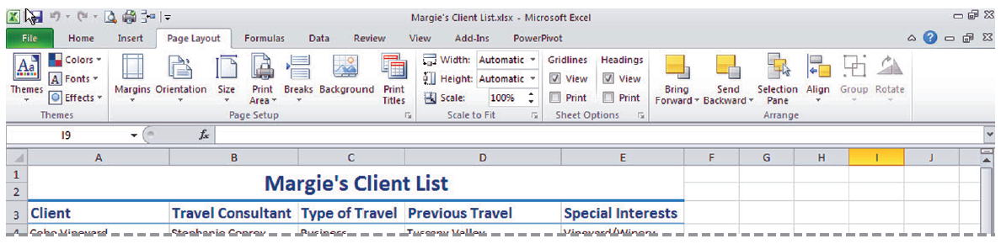
Preparing a Document for Printing
When worksheet data prints on more than one page, you can use the Page Break Preview command to control the page breaks.
In the following exercises, you will use Page Layout view on the View tab to view headers and footers, change page breaks, and change page margins at the top, sides, and bottom of a worksheet (see the figure).

Slide 77
Adding and Moving a Page Break
The Print Preview window displays a full-page view of a worksheet just as it will be printed. With Print Preview, you can check the format and overall layout of a worksheet before actually printing it. You cannot make changes to the document in Print Preview, however.
A page break is a divider that breaks a worksheet into separate pages for printing. Excel inserts automatic vertical page breaks (shown as a broken line) based on paper size, margin settings, scaling options, and the positions of any manual page breaks (shown as a solid line) that you insert.

Slide 78
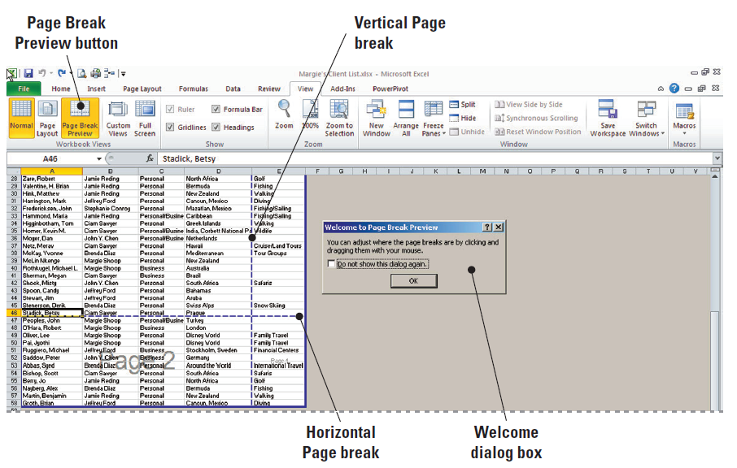
Adding and Moving a Page Break
In the Page Break Preview window (see the figure), you can quickly adjust automatic page breaks to achieve a more desirable printed
document.
As you learned in
Lesson 2, all
printing options
in Excel 2010 are
now organized in
Backstage view.

Slide 79
Step-by-Step: Add or Move a Page Break
OPEN the Margie’s Client List workbook from the student data files in the Lesson 5 folder and follow these steps:
On the View tab, click Page Break Preview if necessary. If a dialog box welcoming you to the view is displayed, read its contents and click OK to continue. (Refer to the figure on the previous slide.) Note that an automatic page break occurs after row 46, and another automatic page break occurs between columns D and E.
Click and hold the horizontal page break (as seen in Figure 5-23) and drag it upward so it is now below row 40. The automatic page break is now a manual page break represented by a solid blue line.

Slide 80
Step-by-Step: Add or Move a Page Break
Click cell A22, then click the Page Layout tab. In the Page Setup group, click Breaks and then Insert Page Break. A horizontal page break is added above row 22. Press Ctrl+Home to move to cell A1.
LEAVE the workbook open to use in the next exercise.
TAKE NOTE: When you move an automatic page break, it becomes a manual page break.
Notes:
Use manual page breaks to control page break locations. You can drag an automatic page break to a new location to convert it to a manual page break.

Slide 81
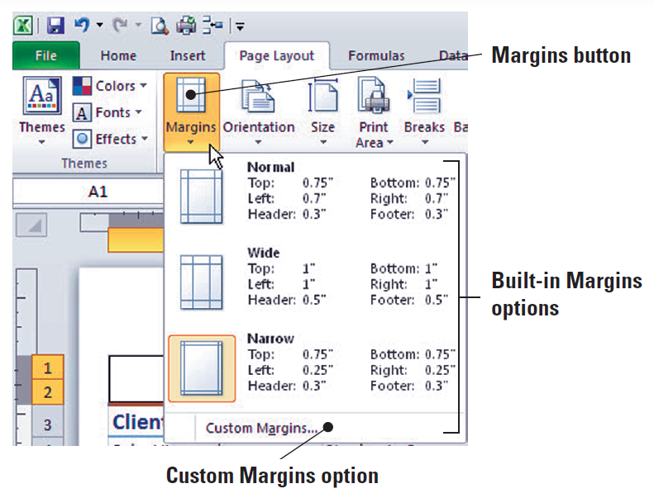
Setting Margins
Margins are an effective way to manage and optimize the white space on a printed worksheet.
Achieving balance between data and white space adds significantly to the readability and appearance of a worksheet.
In Excel, you can choose
one of three built-in
margin sets (shown in this
figure) or you can create
customized margins
using the Page Setup
dialog box.

Slide 82
Setting Margins
The Normal margin setting is the default for a new workbook.
Worksheets that do not fill an entire page can be centered vertically and horizontally, thereby evenly distributing the page’s white space. Use the Margins tab of the Page Setup dialog box for this function.
TAKE NOTE: You can also alter the margins in Page Layout view by clicking the top or bottom border on the margin area in the ruler. When a vertical two-headed arrow appears, drag the margin to the size you want.

Slide 83
Step-by-Step: Set Margins
USE the workbook from the previous exercise and follow these steps:
Click the View tab on the Ribbon. In the Workbook Views group, click the Page Layout button.
Click the Page Layout tab. In the Page Setup group, click the arrow on the Margins button, then click Narrow.
Mouse over the Zoom slider on the right corner of the status bar and increase the zoom to 100% if necessary.
Depending on whether this feature has been previously used, the zoom might be set to a different value. The Zoom slider allows you to zoom out or in, depending on how you need to view a worksheet’s contents.

Slide 84
Step-by-Step: Set Margins
Click Page Break Preview on the Status bar. The margin adjustment has moved the vertical page break to between columns E and F. Again the Page Break welcome dialog box appears. Click OK to continue.
Click Margins, then click Custom Margins. In the Page Setup dialog box, change the left and right margins to 0.5. Click OK.
Click cell A22, click Breaks in the Page Setup group, then click Remove Page Break.
Click the vertical page break line and drag it to the right of column E.

Slide 85
Step-by-Step: Set Margins
Click the File tab. Click Print and Print Preview.
The worksheet will now print on two pages, with all columns fitting to one page wide.
Print the worksheet or click on the Home tab to leave Backstage and Print Preview without printing.
CLOSE the workbook without saving any changes.

Slide 86
Setting a Worksheet’s Orientation
Printed worksheets are easiest to read and analyze when all of the data appears on one piece of paper.
Excel’s orientation and scaling features give you control over the number of printed pages of worksheet data.
You can change the orientation of a worksheet so that it prints either vertically or horizontally on a page.
A worksheet that is printed vertically uses the Portrait orientation and looks like the document shown on the next slide. Portrait orientation is the default setting.
A worksheet printed horizontally uses the Landscape orientation, also shown on the next slide.

Slide 87
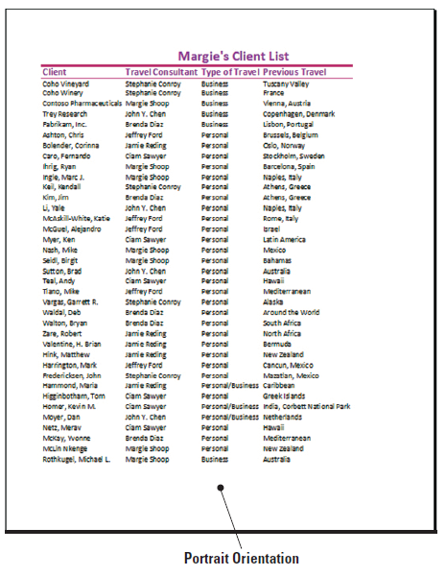
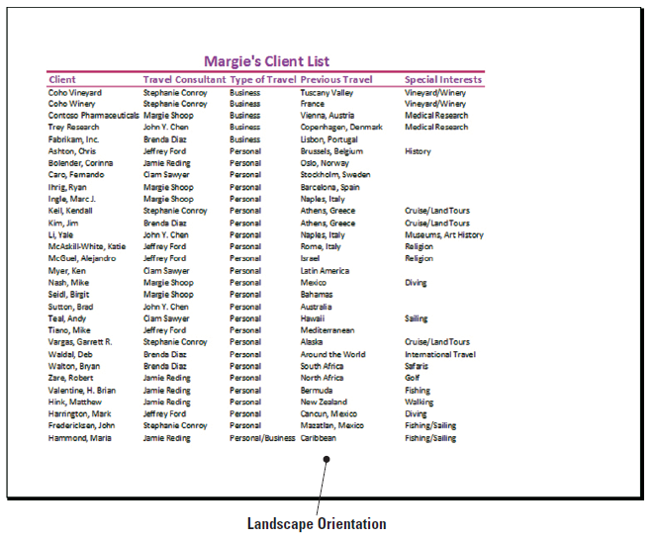
Figure 5-25: Portrait and Landscape Orientation

Slide 88
Step-by-Step: Set a Worksheet’s Orientation
OPEN Margie’s Client List again from the student data files and follow these steps:
Click the Page Layout tab.
Click Orientation in the Page Setup group and click Landscape. Scroll through the document to see that it will now print on two pages with each page containing all columns.
In the Page Setup group, click Print Titles. The Page Setup dialog box opens. Click the Collapse dialog box icon next to Rows to repeat at top.

Slide 89
Step-by-Step: Set a Worksheet’s Orientation
Click row 3 (the column labels). Row 3 data is identified in the dialog box. Press Enter. Click OK to accept the changes and close the dialog box.
Click the File tab, click Print, and view the Print Preview. Click the Next Page arrow at the bottom of the Print Options window to advance to page 2 in the Print Preview. Notice that the column labels appear on page 2 of the document.
Click on the Home tab.
LEAVE the workbook open to use in the next exercise.

Slide 90
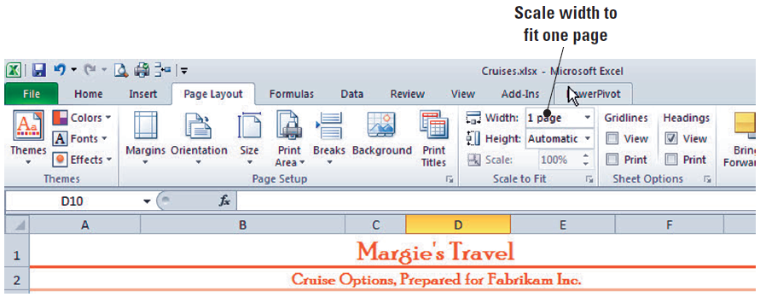
Scaling a Worksheet to Fit on a Printed Page
Scaling refers to shrinking or stretching printed output to a percentage of its actual size.
One use for scaling is to resize a document so that it fits on a single page.
Before changing the scaling for a worksheet’s output, set the maximum width and height to “Automatic” (see figure).

Slide 91
Step-by-Step: Set a Worksheet’s Orientation
USE the workbook from the previous exercise and follow these steps:
On the Page Layout tab, click Orientation, then click Portrait. Notice that column E no longer fits on the same page with columns A–D.
In the Scale to Fit group, click the Width arrow and click 1 page. Then click the Height arrow and select 1 page. The scale of the worksheet is reduced so that all columns and rows fit on the same page.
Click the File tab, then click Print.

Slide 92
Step-by-Step: Set a Worksheet’s Orientation
View the Print Preview pane to the right. Notice that all columns appear on the page, and the height is one page as well. When output is reduced, it shrinks the height and width proportionally.
SAVE the workbook as Client List and CLOSE the workbook.
CLOSE Excel.
TAKE NOTE: Remember that width and height must be set to automatic if you want to specify a scale, such as 75%.

Slide 93
Using Paste Special to Copy Special Data
You may not always want to copy everything from source cells to your destination cells.
For example, you may want to copy only the current values of formulas rather than the formulas themselves. In such cases, you can use Paste Special to perform irregular cell copying.
When you paste data, Excel normally copies all the information in the range of cells you selected. However, there are times when you only need to paste formula results or the formatting of a cell rather than all of the cell’s content. This is where Excel's Paste Special command comes into play.

Slide 94
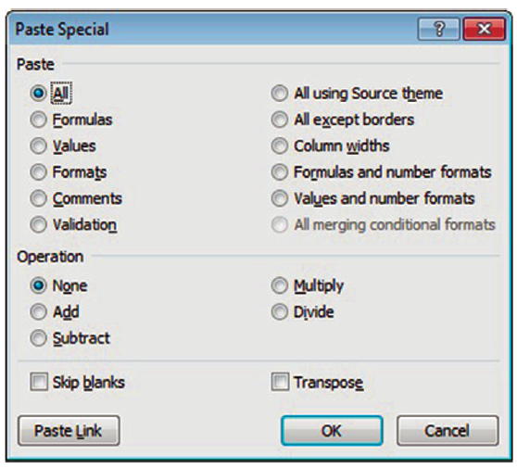
Using Paste Special to Copy Special Data
You can use this command to specify a number of options, such as pasting only cell contents without formatting or only formatting without cell contents.
To paste particular parts of a cell selection, on the Home tab, click the arrow below the
Paste button. Then, click Paste
Special on the drop-down menu
to open the Paste Special
dialog box shown here.
Table 5-1 (shown on the next
slide) describes each option in
the Paste group.

Slide 95
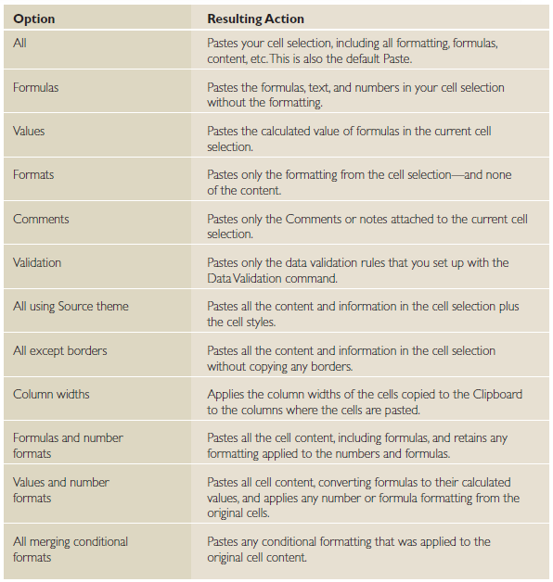
Table 5-1: Paste Group Options

Slide 96
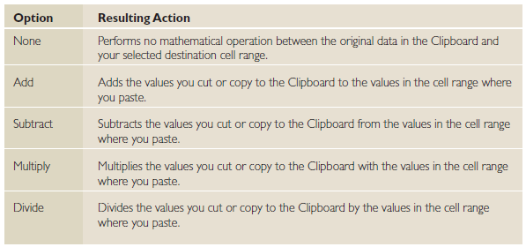
Table 5-2: Operation Group Options
You can also perform an arithmetic operation on values in the destination range. Table 5-2 explains the options in the Operation group of the Paste Special dialog box.
Notes:
Take Note: The new Paste with Live Preview feature is also available with Paste Special. If you mouse over the Paste options in either the right-click menu, or the paste menu in the Clipboard group, you will be able to view your changes before actually implementing them.

Slide 97
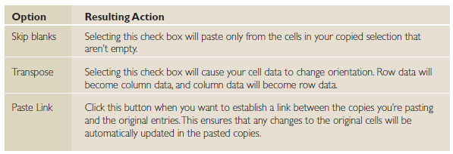
Table 5-3: Additional Options
Finally, there are a few more options available at the bottom of the Paste Special dialog box, as shown in Table 5-3 below.

Slide 98
Lesson Summary

