Slide 1
Using Basic Formulas
Microsoft Excel 2013
Lesson 4

Slide 2
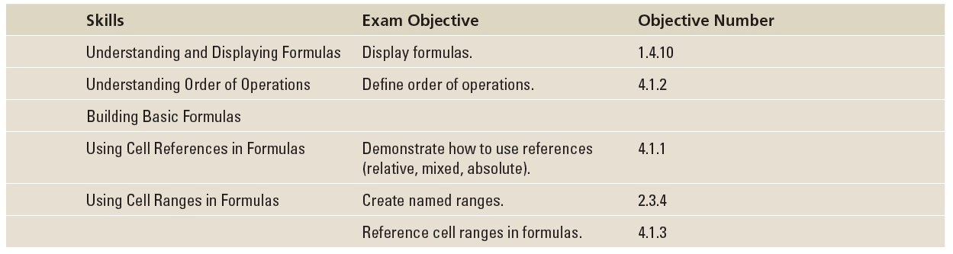
Objectives

Slide 3
Software Orientation
Excel lets you create many formulas by simply typing in a cell or using your mouse pointer to select cells to include in a formula. For example, you can create basic formulas for addition, subtraction, multiplication, and division using these methods.
However, as you have discovered in previous lessons, the user interface offers tools that make it easier to work with data. In this lesson, you use a few command groups on the FORMULAS tab to display formulas and name ranges to be used in formulas.

Slide 4
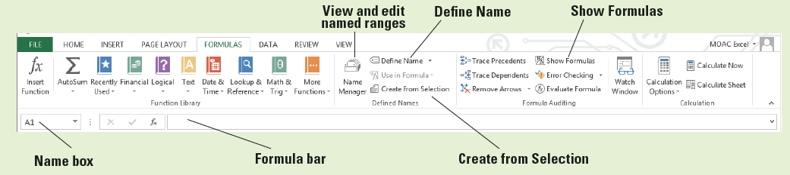
Software Orientation
Use the figure below as a reference throughout this lesson as you become familiar with some of the command groups on the FORMULAS tab and use them to work with formulas. You learn more about commands on the FORMULAS tab in the next lesson, which addresses functions.

Slide 5
Understanding and Displaying Formulas
The real strength of Excel is its capability to perform common and complex calculations.
The formula is one of the essential elements of Excel, which lets you add, subtract, multiply, and divide numbers.
When you enter a formula in a cell, the formula is stored internally and the results are displayed in the cell. You can view the underlying formula in the formula bar when the cell is active, when you double-click the cell to edit it, and by using the FORMULAS tab.

Slide 6
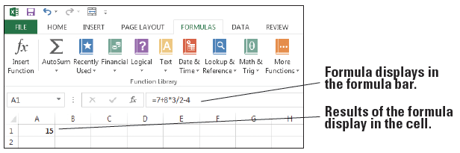
Step by Step: Display Formulas
GET READY. Before you begin these steps, LAUNCH Microsoft Excel and OPEN a new blank workbook.
  Click cell A1.
  Type =7+8*3/2-4 and press Enter. You just entered a formula.
  Click cell A1. Notice that the result of the formula displays in the cell, but the formula itself appears in the formula bar (below).
Notes:
Take Note: Formulas should be typed without spaces, but if you type spaces, Excel eliminates them when you press Enter.

Slide 7
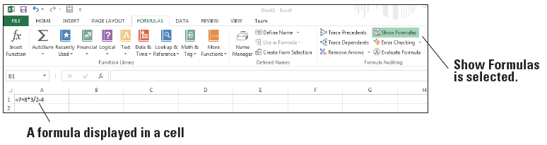
Step by Step: Display Formulas
  Double-click cell A1. The formula appears in both the active cell and the formula bar. You can edit the formula in this mode.
  Press Enter.
  On the FORMULAS tab, in the Formula Auditing group, click Show Formulas. The formula in cell A1 displays (below).
Notes:
Take Note: While you are displaying formulas, you will not see the results of those formulas.

Slide 8
Step by Step: Display Formulas
  Click Show Formulas again to turn off formula display.
  SAVE the workbook as 04 Formula Practice Solution.
PAUSE. LEAVE the workbook open to use in the next exercise.
A formula is an equation that performs calculations, such as addition, subtraction, multiplication, and division, on values in a worksheet.
In Excel, a value can be a number, a cell address, a date, text, or Boolean data, but is usually a number or cell address in terms of formulas. A formula consists of two elements: operands and calculation operators.

Slide 9
Step by Step: Display Formulas
Operands identify the values to be used in the calculation. An operand can be a constant value, or a variable such as a cell reference, a range of cells, or another formula.
A constant is a number or text value that is entered directly into a formula.
A variable is a symbol or name that represents something else, which can be a cell address, a range of cells, and so on.
Calculation operators specify the calculations to be performed.
Notes:
Take Note: You can begin a formula with a plus (+) sign or a minus (−) sign as the beginning calculation operator, but Excel changes it to an equal sign when you press Enter. Excel doesn’t recognize a construct like 3+4= as a legitimate formula. Excel treats it like an ordinary string of characters.

Slide 10
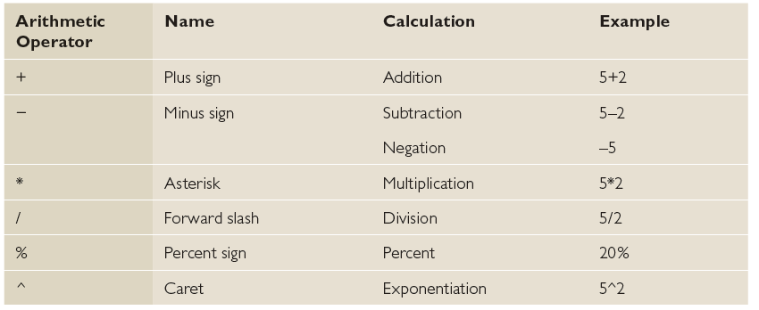
Step by Step: Display Formulas
To allow Excel to distinguish formulas from data, all formulas begin with an equal sign (=).
Excel uses four types of calculation operators: arithmetic, comparison, text concatenation, and reference. The arithmetic operators are listed in the table below.
When you build a formula, it appears in the formula bar and in the cell itself.

Slide 11
Step by Step: Display Formulas
When you complete the formula and press Enter, the value displays in the cell and the formula displays in the formula bar.
You can edit a formula in the cell or in the formula bar the same way you can edit any data entry.
When you click the Show Formulas button on the FORMULAS tab, all formulas in your worksheet display.
Click the Show Formulas button again to toggle off display of formulas.

Slide 12
Understanding Order of Operations
If you use more than one operator in a formula, Excel follows a specific order—called the order of operations—to calculate the formula.
Parentheses play an important role in controlling the order of operations.

Slide 13

Step by Step: Understand Order of Operations
GET READY. USE the worksheet from the previous exercise.
  Click cell A1 to make it the active cell.
  Click in the formula bar.
  Insert parentheses around 7 + 8.
  Insert parentheses around 3 / 2.
  Insert parentheses around (7 + 8) * (3 / 2), as shown below. Press Enter. The result in A1 changes to 18.5.

Slide 14
Step by Step: Understand Order of Operations
  SAVE the workbook as 04 Order of Operations Solution and CLOSE it.
PAUSE. LEAVE Excel open to use in the next exercise.
Excel applies the rules of mathematics to determine how formulas are calculated. The following is the order in which arithmetic operators are applied:
Negative number (−)
Percent (%)
Exponentiation (ˆ)
Multiplication (*) and division (/) (left to right)
Addition (+) and subtraction (−) (left to right)

Slide 15
Step by Step: Understand Order of Operations
For example, consider the original equation:
7 + 8 * 3 / 2 − 4 = 15
Following arithmetic operator priorities, the first operation is 8 multiplied by 3 and that result is divided by 2. Then 7 is added and 4 is subtracted.
You can use parentheses in a formula to override the standard order of operations. Excel performs calculations on formulas inside parentheses first.

Slide 16
Step by Step: Understand Order of Operations
Parentheses inside of parentheses are called nested parentheses. Calculations are performed on formulas in the innermost set of parentheses first, and from left to right if nested parentheses are at the same level.
Therefore, the result of the following equation with parentheses is different from the previous one:
((7 + 8) * (3 / 2)) − 4 = 18.5
Following arithmetic operator priorities, the first operation is the sum of 7 + 8 multiplied by the quotient of 3 divided by 2. Then, 4 is subtracted.
Notes:
Troubleshooting: While modifying a complex formula, if you decide to revert back to the original formula and start over, just press Esc. If you’ve already pressed Enter, you’ll need to click the Undo button on the Quick Access Toolbar.

Slide 17
Building Basic Formulas
You do basic math in your head or using scratch paper every day. Excel is handy for performing basic calculations also.
Although you probably won’t use Excel to add or subtract a few numbers, it’s important to learn how to create simple formulas in Excel, which serve as the building blocks for more complex calculations.
You can add two or more numbers in Excel using the plus sign between each number. To use proper Excel format, you must include the equal sign at the beginning of the formula.

Slide 18
Building Basic Formulas
Subtraction works the same way as addition, except that you enter a minus (–) sign rather than a plus (+) sign between the values in the formula.
Multiplication not only uses the values in cells, but other numbers that you enter. The symbol for multiplication is the asterisk (*).
Division works the same way as multiplication, except that the symbol for division is the forward slash (/).

Slide 19
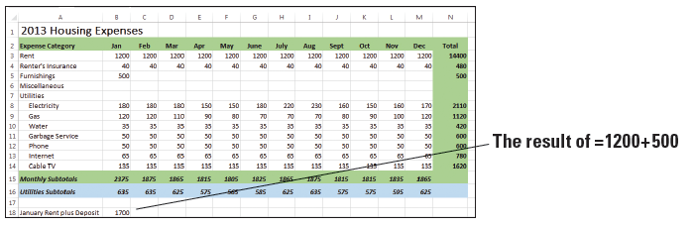
Step by Step: Create a Formula that Performs Addition
GET READY. LAUNCH Microsoft Excel if it is not already open.
  OPEN the 04 Budget Start data file for this lesson.
  In cell A18, type January Rent plus Deposit and press Enter.
  In cell B18, type the equal (=) sign, type 1200+500, and press Enter. This is the simplest way to enter an addition formula. Excel adds the values and displays the result, 1700, which is your first month’s rent plus a $500 deposit (below).
  SAVE the workbook as 04 Budget Basic Formulas.
PAUSE. LEAVE the workbook open to use in the next exercise.

Slide 20
Step by Step: Create a Formula that Performs Addition
When entering formulas that perform addition, if a positive number is entered first, it is not necessary to enter a plus sign.
If you make a mistake in your data entry, you can select the cell with the erroneous function, press F2 to enter cell editing mode, and edit your function. Once you make your corrections, press Enter to revise.

Slide 21
Step by Step: Create a Formula that Performs Subtraction
GET READY. USE the worksheet you modified in the previous exercise.
  Double-click cell A18.
  Click after the word “Deposit,” type , minus Discount, and press Enter.
  Right-click cell A18, select Format Cells, click the Alignment tab, select the Wrap text check box, and click OK. Now you can see all of the new text added to A18.
  Click cell B18 to make it the active cell.
  Click in the formula bar.

Slide 22
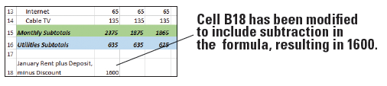
Step by Step: Create a Formula that Performs Subtraction
  Position the cursor immediately after =1200+500, type -100, and press Enter. Your landlord gave you a $100 discount for moving into your rental home early, so you are subtracting $100 from your first month’s rent. The value in cell B18 changes to 1600 (below).
  SAVE the workbook.
PAUSE. LEAVE the workbook open to use in the next exercise.
When you modified the formula to subtract 100 from 1700, you could have entered =1200+500−100 or = −100+1200+500. Either formula yields a positive 1600.

Slide 23
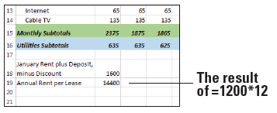
Step by Step: Create a Formula that Performs Multiplication
GET READY. USE the worksheet you modified in the previous exercise.
  In cell A19, type Annual Rent per Lease and press Enter.
  In cell B19, type =1200*12 and press Enter. The result displays in cell B19, which is the total amount of rent you will pay in one year (below).
  SAVE the workbook.
PAUSE. LEAVE the work-
book open to use in the
next exercise.

Slide 24
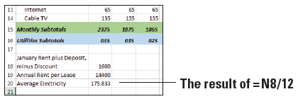
Step by Step: Create a Formula that Performs Division
GET READY. USE the worksheet you modified in the previous exercise.
  In cell A20, type Average Electricity and press Enter.
  In cell B20, type =N8/12 and press Enter. The result displays in cell B20, which is the average amount of money you will pay for electricity in one year (below).
  SAVE the workbook
  as 04 Budget Basic
  Formulas Solution and
  CLOSE it.
PAUSE. LEAVE Excel open to use in the next exercise.

Slide 25
Using Cell References in Formulas
Each cell in an Excel worksheet has a unique identifier indicating its column and row, such as A1 (column A, row 1) or E4 (column E, row 4).
When you create a formula, you can reference a cell’s identifier rather than typing the number that appears in that cell.
A cell reference identifies a cell’s location in the worksheet, based on its row number and column letter.

Slide 26
Using Cell References in Formulas
Using a cell reference rather than the data displayed in a cell gives you more flexibility in your worksheet. If the data in a cell changes, any formulas that reference the cell change as well. For example, if cell E1 contains the number 12 but is later changed to 15, any formula that references cell E1 changes automatically.
The same principle applies to a cell that contains a formula and is referenced in another formula.

Slide 27
Using Relative Cell References in a Formula
A relative cell reference is one that adjusts the cell identifier automatically if you insert or delete columns or rows, or if you copy the formula to another cell.
A relative cell reference is, therefore, one whose references change “relative” to the location where it is copied or moved.

Slide 28
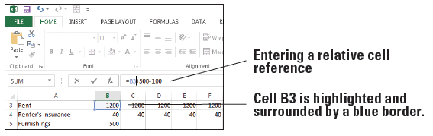
Step by Step: Use Relative Cell References in a Formula
GET READY. USE the workbook named 04 Budget Cell References.
  Click cell B18.
  Click in the formula bar and replace 1200 with cell B3. Notice that cell B3 is highlighted and surrounded by a blue border while you’re modifying the formula (below).
  Press Enter. The formula in cell B18 now uses a relative cell reference to cell B3.
Notes:
Take Note: You can use either uppercase or lowercase when you type a cell reference in a formula. For example, it does not matter whether you type B4 or b4 in the formula you enter.

Slide 29
Step by Step: Use Relative Cell References in a Formula
  Copy cell B18 to cell B21. The displayed result changes to 400.
  Notice in the formula bar that the formula in cell B21 is =B6+500-100, but the formula you copied is =B3+500-100. That’s because the original cell reference of cell B3 changed to cell B6 when you copied the formula down three cells, and cell B6 is blank. The cell reference is adjusted relative to its position in the worksheet.
  An alternate way to use a cell reference is to click the cell being referenced while creating or modifying a formula. With cell B21 still active, click in the formula bar and select cell B6.

Slide 30
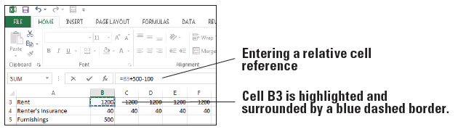
Step by Step: Use Relative Cell References in a Formula
  Click cell B3. Cell B3 becomes highlighted and surrounded by a blue dashed border, and cell B3 appears in the formula bar rather than cell B6 below). Press Enter.
  SAVE the workbook.
PAUSE. LEAVE the workbook open to use in the next exercise.

Slide 31
Step by Step: Use Relative Cell References in a Formula
You use relative cell references when you want the reference to automatically adjust when you copy or fill the formula across rows or down columns in ranges of cells.
By default, new formulas in Excel use relative references.
You can use two methods for creating formulas using relative references:
By typing the formula directly into the cell
By clicking a cell to include in the formula rather than typing the cell reference
The second method is usually quicker and eliminates the possibility of typing an incorrect cell identifier, especially if you need to create a formula with many cell references.

Slide 32
Step by Step: Use Relative Cell References in a Formula
For example, it might be easy to make a mistake typing =D2+D7+D9+D12+D14 rather than just clicking each cell to add it to the formula.
You can also reference a range of cells in a formula, which you learn about later in this lesson.
Cell referencing raises another important point about Excel. When you perform math on a series of numbers on paper, they’re usually right next to each other in a column or a single row.
In a worksheet, the numbers don’t have to be adjacent: You can create formulas that reference cells anywhere in the worksheet.
Notes:
Take Note: When constructing a worksheet, plan on using relative cell references unless you know there will be a reason not to adjust the cell identifier when you insert or delete columns and rows.

Slide 33
Step by Step: Use an Absolute Cell Reference in a Formula
GET READY. USE the worksheet you modified in the previous exercise.
  Click cell B18.
  Click in the formula bar and insert dollar signs in the B3 cell reference so it looks like $B$3.
  Press Enter. The formula in cell B18 now uses an absolute cell reference to cell B3.
  Copy cell B18 to cell B21. The displayed result is 1600, which matches B18.
  Copy cell B21 to cell C21. The displayed result is still 1600.

Slide 34
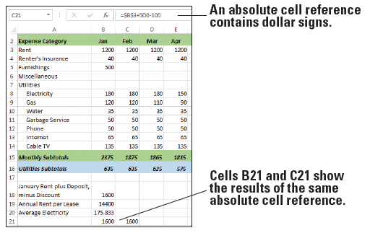
Step by Step: Use an Absolute Cell Reference in a Formula
  Notice in the formula bar that the formulas in cells B21 and C21 are both =$B$3+500-100. The figure below shows the formula for cell C21. Regardless of where you copy the formula in the worksheet, the formula still refers to cell B3.
  SAVE the workbook.
PAUSE. LEAVE the
workbook open to use in
the next exercise.

Slide 35
Step by Step: Use an Absolute Cell Reference in a Formula
An absolute cell reference refers to a specific cell or range of cells regardless of where the formula is located in the worksheet.
Absolute cell references include two dollar signs in the formula, preceding the column letter and row number.
The absolute cell reference $B$3, for example, refers to column (B) and row (3).
When you copy the formula to any other cell in the worksheet, the absolute reference will not adjust to the destination cells.

Slide 36
Using Mixed Cell References in a Formula
You can also create a mixed reference in which a column or a row is absolute, and the other is relative.
For example, if the cell reference in a formula is $A5 or A$5, you would have a mixed reference in which one component is absolute and one is relative.

Slide 37
Step by Step: Use a Mixed Cell Reference in a Formula
GET READY. USE the worksheet you modified in the previous exercise.
  Click cell B21.
  Click in the formula bar and delete the dollar sign before 3 in the formula so it looks like $B3.
  Press Enter. The formula in cell B21 now uses a mixed cell reference.

Slide 38
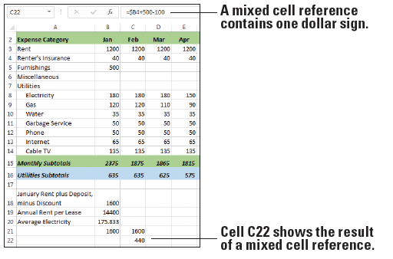
Step by Step: Use a Mixed Cell Reference in a Formula
  Copy cell B21 to cell C22. The displayed result is 440, which is different from the result in B21. That’s because the formula in C22 references cell B4 (see below). The dollar sign before the B in the formula is absolute, but the row number is relative.
  Delete the contents of cell B21, cell C21, and cell C22.
  SAVE the workbook.
PAUSE. LEAVE the
workbook open to use in
the next exercise.

Slide 39
Step by Step: Use a Mixed Cell Reference in a Formula
A mixed cell reference is a cell reference that uses an absolute column or row reference, but not both.
In the exercise, the column portion of the cell reference is absolute and remains unchanged in the formula regardless of where the formula is copied.
The row portion of the formula is relative (no dollar sign precedes the row number of 3), so that part of the cell reference changes when the cell is copied.

Slide 40
Step by Step: Use a Mixed Cell Reference in a Formula
If you copy a formula across rows or down columns, the relative reference automatically adjusts, and the absolute reference does not adjust.
For example, when you copied the formula containing the mixed reference $B3 to a different cell in column C, the reference in the destination cell changed to $B4.
The column reference remained the same because that portion of the formula is absolute. The row reference adjusted because it is relative.

Slide 41
Using External Cell References
You can also refer to cells in another worksheet in the same workbook or to another workbook entirely.
References to cells located in a separate workbook are considered external references.
Unless you specify another worksheet or workbook, Excel assumes your cell references are to cells in the current worksheet.
An external reference refers to a cell or range in a worksheet in another Excel workbook, or to a defined name in another workbook.
You might need to use this strategy, for example, to create a summary of data in one worksheet based on data in another worksheet.
The basic principles for building these formulas are the same as those for building formulas referencing data within a worksheet.

Slide 42
Step by Step: Refer to Data in Another Worksheet
GET READY. USE the worksheet you modified in the previous exercise.
  Click the Summary sheet tab in the 04 Budget Cell References workbook.
  Click cell D8. You want the average payment for electricity to appear in this cell, similar to the content that appears in B20 in the Expense Details worksheet. However, your formula must reference the Expense Details worksheet to gather the data.

Slide 43
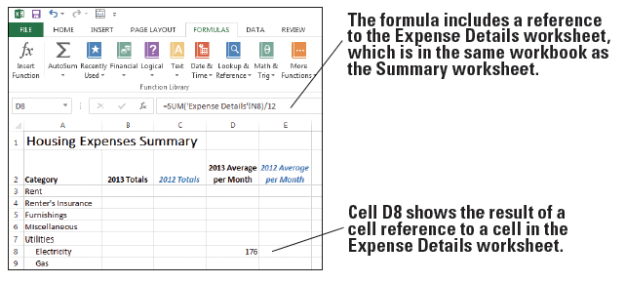
Step by Step: Refer to Data in Another Worksheet
  Type =SUM('Expense Details'!N8)/12 and press Enter. This formula divides the value of cell N8 in the Expense Details worksheet by 12. The result is 176, rounded due to cell formatting applied to the worksheet (see below).
  SAVE the workbook.
PAUSE. LEAVE the
workbook open to
use in the next
exercise.

Slide 44
Step by Step: Refer to Data in Another Worksheet
The general format of a formula that references a cell in a different worksheet is SheetName!CellAddress. That is, you enter the external worksheet name followed by an exclamation point, and then the cell address in the external worksheet.
or worksheet names that include one or more spaces, you need to enclose the name in single quotation marks, similar to 'Sheet Name'!CellAddress.
You can also refer to a range of cells in an external worksheet.

Slide 45
Step by Step: Refer to Data in Another Worksheet
For example, in the exercise, you can use a similar formula, =SUM('Expense Details'!B8:M8)/12, to accomplish the same task. The portion B8:M8 is called a range, as you learned in Lesson 2.
This formula adds the values in the range B8:M8 and then divides them by 12 to produce the average payment for electricity over one year. You see how to work with cell ranges after the next section.
Microsoft calls references to cells in another worksheet or in another workbook links because you are essentially linking to data in those remote locations.
Excel provides several functions to help you create formulas more easily. One of the most common functions, SUM, adds the values in a series of cells specified in a range. The construct =SUM(D2:D5) is the same as specifying =D2+D3+D4+D5.

Slide 46
Referencing Data in Another Workbook
The procedure for referencing data in another workbook is nearly the same as referencing data in another worksheet in the same workbook.
The difference is that, when creating a reference to cells in another workbook, you must enclose the other workbook name in square brackets ([ ]) and both workbooks must be open.

Slide 47
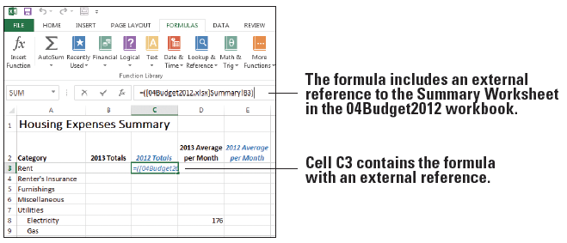
Step by Step: Reference Data in Another Workbook
GET READY. USE the worksheet you modified in the previous exercise.
  Open a second
  workbook file
  named
  04Budget2012.
  In 04 Budget Cell
  References, on the
  Summary sheet, click cell C3.
  Type =([04Budget2012.xlsx]Summary!B3), as shown in Figure 4-14, and press Enter. The formula links to cell B3 on the Summary sheet in the workbook named 04Budget2012.

Slide 48
Step by Step: Reference Data in Another Workbook
  SAVE the workbook as 04 Budget Cell References Solution and CLOSE it.
  CLOSE 04Budget2012.
PAUSE. LEAVE Excel open to use in the next exercise.
The paired brackets [ ] identify the name of the workbook file, and Summary! identifies the worksheet within that file.
If the data in the referenced cell in the 04Budget2012 worksheet changes, so will the data in the corresponding cell on the Summary worksheet in 04 Budget Cell References. This holds true even if you save 04 Budget Cell References under a different file name.

Slide 49
Step by Step: Reference Data in Another Workbook
If you don’t have the external workbook open when creating the formula, the Update Values dialog box appears. You must navigate to the location of 04Budget2012.xlsx, select the file, and click OK.
If you close both workbooks and reopen only 04 Budget Cell References, the full path to the 04Budget2012 workbook displays in the formula bar (see Figure 4-15).
If you close and then reopen the workbook that contains the cell reference to the external workbook, a message appears prompting you to update your links (see Figure 4-16).

Slide 50
Using Cell Ranges in Formulas
In Excel, groups of cells are called ranges. The cell groups are either contiguous or non-contiguous.
You can name (define) ranges, change the size of ranges after you define them, and use named ranges in formulas.
The Name box and the Name Manager help you keep track of named ranges and their cell addresses.
You can also use the Paste Names command to create a list of named ranges and their addresses in a worksheet.

Slide 51
Naming a Range
When you refer to the same cell range over and over, it might be more convenient to give it a name. Excel recognizes the name as the cell range, and uses the values in those cells to do what you specified.
For instance, if you have a series of sales figures in a column, instead of referring to them as the range C4:C10, you can name them SalesQ3. Any time you use the name SalesQ3 in a formula, Excel would then use the values in those cells.

Slide 52
Step by Step: Name a Range of Cells
USE the workbook named 04 Budget Ranges.
  Click the Expense Details sheet tab.
  Select B3:B14. These are the cells to be named.
  Click in the Name box, to the left of the formula bar.

Slide 53
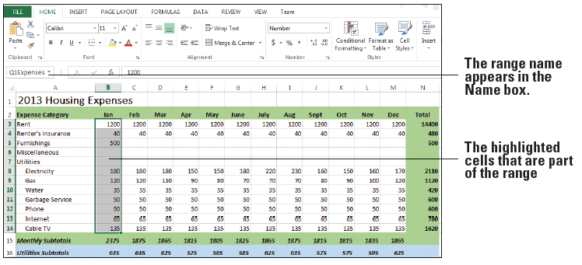
Step by Step: Name a Range of Cells
  Type a one-word name for the list, such as Q1Expenses, and press Enter. The range name appears in the Name box (see below). Excel saves this name and uses it in any subsequent reference to this range. (Don’t worry about the apparent misnaming of the range. You modify this range to include additional months in an exercise later in this lesson.)
Notes:
Troubleshooting: When naming a range, if a message appears stating that the name already exists, display the Name Manager (discussed in the “Changing the Size of a Range” section) and edit the existing name or delete it and enter a different name.

Slide 54
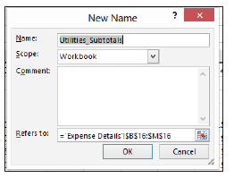
Step by Step: Name a Range of Cells
  An alternative way to name a range is to use the New Name dialog box. Select B16:M16.
  On the FORMULAS tab,
  in the Defined Names
  group, click Define Name.
  The New Name dialog
  box appears (right).

Slide 55
Step by Step: Name a Range of Cells
  Excel uses the row heading as the range name, shown in the Name text box. You can change the name if you like. For this exercise, leave the default name.
  Open the Scope drop-down list. Your options are Workbook, Expense Details, and Summary. The last two entries correspond to individual sheets in the workbook. Close the drop-down list, leaving Workbook selected.
  Enter comments in the Comments text box, if you like.
  Leave the cell address that appears in the Refers to text box. This is the range you selected. Notice that the sheet name is also included automatically.
  Click OK. The name Utilities_Subtotals is saved for the range B16:M16.

Slide 56
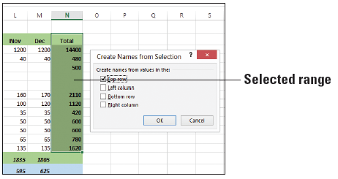
Step by Step: Name a Range of Cells
  A third way to name a range is to use the Create Names from Selection dialog box. Select N2:N14. This selection includes the column heading label.
  On the FORMULAS tab, in the Defined Names group, click Create from Selection. The Create Names from Selection dialog box appears (below).

Slide 57
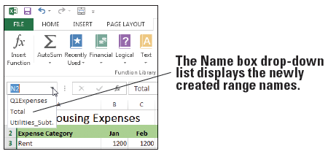
Step by Step: Name a Range of Cells
  Excel determines that you want to use the column heading label as the range name. Click OK. The range is saved with the name Total.
  Open the Name box drop-down list (below). You have three named ranges from which to select.
  SAVE the workbook.
PAUSE. LEAVE the
workbook open to use
in the next exercise.

Slide 58
Step by Step: Name a Range of Cells
A range is a group of adjacent cells that you select to perform operations on all of the selected cells. You refer to a cell range by separating the first and last cell in the range by a colon, such as B1:B9 and D4:G9. The totals and subtotals in 04 Budget Working use cell ranges in their formulas.
A named range is a group of cells, and occasionally a single cell, with a designated name. The most common reason to name a range is to refer to it in formulas and functions.
Naming ranges or an individual cell according to the data they contain is a time-saving technique, even though it might not seem so when you work with limited data files in practice exercises.

Slide 59
Step by Step: Name a Range of Cells
However, naming a range in a large or complex worksheet lets you go to the location quickly, like a bookmark.
After selecting a range of cells, you can name the range using three different methods:
By typing a name in the Name box next to the formula bar
By using the New Name dialog box
By using the Create Names from Selection dialog box
Rules and guidelines for naming ranges include the following:
Range names can be up to 255 characters in length.

Slide 60
Step by Step: Name a Range of Cells
Range names may begin with a letter, the underscore character (_), or a backslash (\). The rest of the name may include letters, numbers, periods, and underscore characters, but not a backslash.
Range names may not consist solely of the letters "C", "c", "R", or "r", which are used as shortcuts for selecting columns and rows.
Range names may not include spaces. Microsoft recommends you use the underscore character (_) or period (.) to separate words, such as Fruit_List and Personal.Budget.
Range names cannot be the same as a cell reference, such as A7 or $B$3.

Slide 61
Step by Step: Name a Range of Cells
All names have a scope, either to a specific worksheet or to the entire workbook.
The scope of a name is the location within which Excel recognizes the name without qualification.
Excel requires that a name must be unique within its scope, but you can use the same name in different scopes.
In the New Name dialog box, if you select a worksheet name from the Scope list, the scope is at the local worksheet level. If you select Workbook, the scope is at the global worksheet level.

Slide 62
Step by Step: Name a Range of Cells
If you defined a named range after you entered a cell reference in a formula, you might want to update the existing cell reference to the defined name.
Select an empty cell, click the arrow next to Define Name, and click Apply Names. In the Apply Names dialog box, click one or more names, and click OK.
After creating named ranges, you can select a name in the Name box drop-down list to select the named range on the worksheet.
Notes:
Take Note: You can use the same name for equivalent ranges in other worksheets within a workbook. Include the name of the worksheet in brackets before the range name to identify which worksheet you’re referring to.

Slide 63
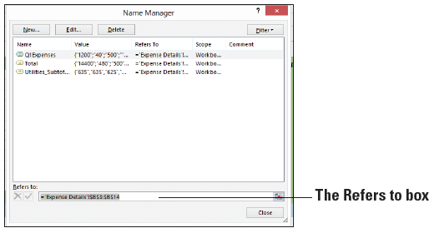
Step by Step: Change the Size of a Range
USE the worksheet you modified in the previous exercise.
  Click the Expense Details sheet, if it’s not already active.
  On the FORMULAS tab, in the Defined Names group, click Name Manager.
  Select Q1Expenses
  in the list.
  Highlight everything
  in the Refers to box
  at the bottom of the
  dialog box (right).

Slide 64
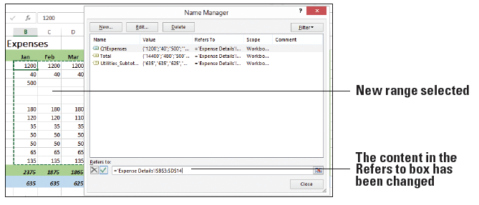
Step by Step: Change the Size of a Range
  In the Expenses Details worksheet, select B3:D14. The content in the Refers to box in the Name Manager dialog box reflects the new range (below).

Slide 65
Step by Step: Change the Size of a Range
  Click Close, and then click Yes when asked if you want to save your changes.
  SAVE the workbook.
PAUSE. LEAVE the workbook open to use in the next exercise.
To change the parameters of a named range, you can easily redefine the range by using the Name Manager on the FORMULAS tab. The Name Manager contains all the information about named ranges.

Slide 66
Step by Step: Create a Formula that Operates on a Named Range
USE the worksheet you modified in the previous exercise.
  In the Expense Details sheet, click A21.
  Type First Quarter Expenses and press Enter.
  In B21, type =SUM(.
  On the FORMULAS tab, in the Defined Names group, click Use in Formula.

Slide 67
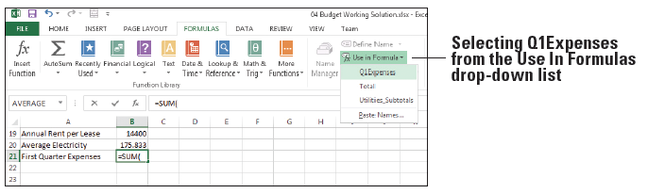
Step by Step: Create a Formula that Operates on a Named Range
  Select Q1Expenses from the list (see below), type ) to close the equation, and press Enter. The total amount of expenses for January through March appears in B21.
  SAVE the workbook.
PAUSE. LEAVE the workbook open to use in the next exercise.
Notes:
Another Way: You can just enter the formula and range name, such as =sum(Q1Expenses) directly into the cell.

Slide 68
Keeping Track of Named Ranges
As you’ve seen, the Name box drop-down list contains a list of named ranges for the current worksheet.
When you select a named range from the Name box, the range is highlighted in the worksheet.
The Name Manager dialog box lets you work with all of the defined names in the workbook.
The Paste Names command lets you maintain a list of named ranges and their cell addresses as data in a worksheet.

Slide 69
Step by Step: Keep Track of Named Ranges
USE the worksheet you modified in the previous exercise.
  Open the Name box drop-down list. The names of all named ranges available in that workbook display.
  To verify your change to the size of the Q1Expenses range in a previous exercise, select Q1Expenses. The range B3:D14 appears highlighted.
  On the FORMULAS tab, in the Defined Names group, click Name Manager. Each named range is listed in the dialog box. You can use Name Manager to create a new range, rename a range, delete a range, and verify the scope of a range, among other tasks.

Slide 70
Step by Step: Keep Track of Named Ranges
  Click Close to close the Name Manager.
  To display range names and their cell ranges as data in the worksheet, select a cell with blank cells to the right and below it, such as cell P2.
  On the FORMULAS tab, in the Defined Names group, click Use in Formula and then select Paste Names. The Paste Name dialog box opens.

Slide 71
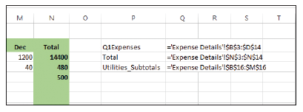
Step by Step: Keep Track of Named Ranges
  Click Paste List. Widen the width of column P to display all range names fully. Range names display in column P and their cell ranges display in column Q (below).
  SAVE the workbook as 04 Budget Ranges Solution and CLOSE it.
CLOSE Excel.

Slide 72
Step by Step: Keep Track of Named Ranges
You can use the Name Manager as a convenient way to confirm the value and reference of a named range or to determine its scope. In addition, you can add, change, or delete names.
It is easier to remember names than to memorize cells and cell ranges. You can create a list of defined names in a workbook using the Paste List command. Doing so makes it simpler to keep track of your data.

Slide 73
Skills Summary

