Slide 1
Overview
Lesson 1

Slide 2
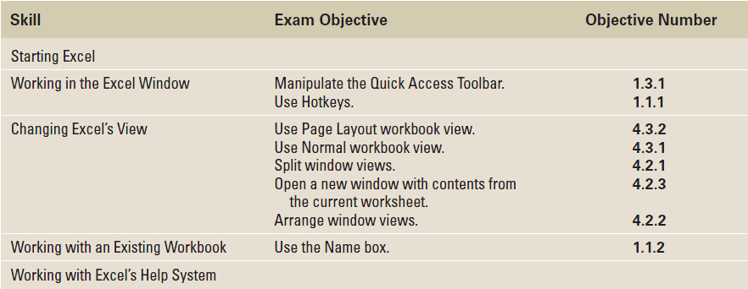
Objectives

Slide 3
Step-by-Step: Start Excel
Click the Start menu, and then click All Programs.
On the list of programs, click Microsoft Office 2010.
Click Microsoft Office Excel 2010. A blank workbook will open, and the worksheet named Sheet1 will be displayed.

Slide 4
Step-by-Step: Use Onscreen Tools
Place the cursor at the bottom of each command on the Quick Access Toolbar and read the description that appears as a ScreenTip.
Click the drop-down arrow at the right side of the Quick Access Toolbar. From the drop-down list, select Open. The Open icon is added to the Quick Access Toolbar. Click the down arrow again and select Quick Print from the drop-down list (see Figure 1-2).

Slide 5
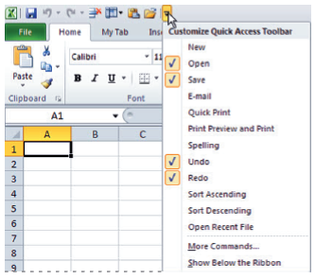
Figure 1-2: Customizing the
Quick Access Toolbar
Notes:
If you want to add a command to the Quick Access Toolbar, you can also right-click any icon on the Ribbon and then click Add to Quick Access Toolbar.

Slide 6
Step-by-Step: Use Onscreen Tools
Next, right-click the toolbar, then select Show Quick Access Toolbar Below the Ribbon.
Right-click the Home tab and click Minimize the Ribbon; now, only the tabs remain on display, increasing your workspace.
Click the drop-down arrow on the right side of the Quick Access Toolbar to produce a menu of options, then select Minimize the Ribbon to turn off the option and make the Ribbon commands visible.

Slide 7
Step-by-Step: Use Onscreen Tools
Right-click the Quick Access Toolbar again and choose Show Quick Access Toolbar Above the Ribbon from the pop-up menu.
Right-click the Open command, and select Remove from Quick Access Toolbar.
NOTE: If you want to add commands to the Quick Access Toolbar that don’t appear in the drop-down list, click More Commands on the drop-down list. The Excel Options dialog box will open. You can also right-click the Quick Access Toolbar or any Ribbon tab and select Customize Quick Access Toolbar to open the Excel Options window.

Slide 8
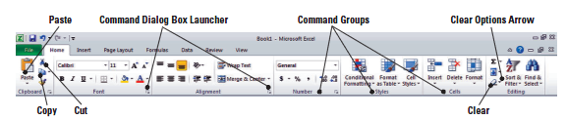
Step-by-Step: Navigate the Ribbon
With the Home tab active, click cell A1; your screen should look similar to the one shown below.

Slide 9
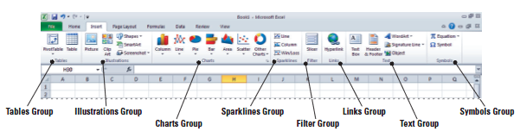
Step-by-Step: Navigate the Ribbon
Click the Insert tab; your screen should now look similar to the one shown below. Commands on the Insert tab enable you to add charts and illustrations and to perform other functions that enhance your Excel spreadsheets.

Slide 10
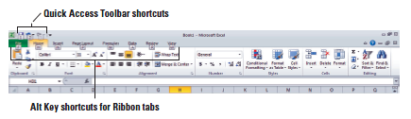
Step-by-Step: Navigate the Ribbon
Click the Home tab.
Press and release the Alt key to produce onscreen Keytips that show keyboard shortcuts for certain commands (see Figure 1-6).
Press the Esc key or press the Alt key again to turn off the Keytips.
Notes:
Keyboard shortcuts enable you to issue commands in Excel without using the mouse (so you don’t have to take your hands from the keyboard). Keyboard shortcuts are used by pressing the key shown in the Keytip while also pressing and holding the Alt key. When you press and release the Alt key by itself, Excel displays the shortcuts for the Quick Access Toolbar.

Slide 11
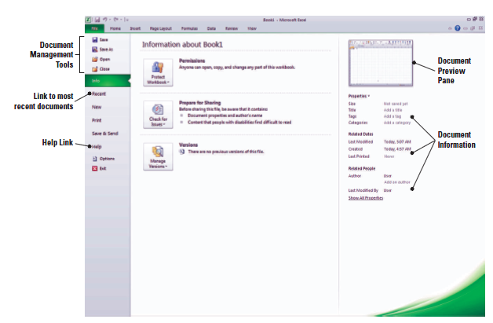
Step-by-Step: Access Backstage
Click the File Tab. This opens Backstage view:
Notice that the view is green. Office 2010 uses customized colors for each application you use.
Notes:
The use and tools of Backstage are covered in depth in Lesson 2.

Slide 12
Step-by-Step: Use the File Tab to Open Backstage View and Create a New Workbook
Click the File tab to open Backstage view.
Click Close in the navigation bar; your workbook disappears, but Excel remains open.
Click the File tab again, then click New; the Available Templates pane opens (see the figure on the next slide).

Slide 13
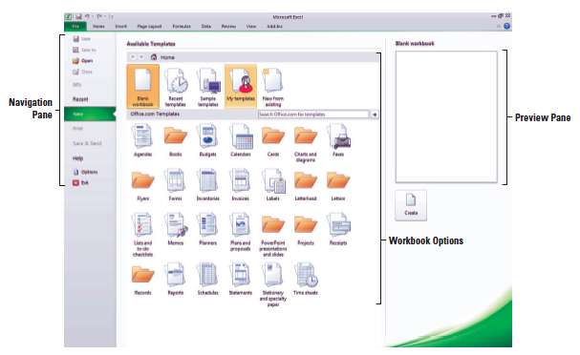
Step-by-Step: Use the File Tab to Open Backstage View and Create a New Workbook
Click Blank Workbook in the Available Templates pane, and then click Create. A new blank workbook is opened.

Slide 14
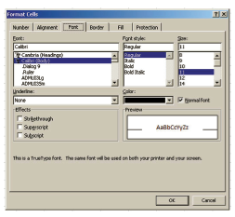
Step-by-Step: Change Excel’s View
The Home tab should be active. If not, click the Home tab.
Select cell A1 to make this cell active. Then type 456 and press Tab.
Click the Dialog Box Launcher arrow in the lower-right corner of the Font group of commands. The Format Cells dialog box (shown below) opens.

Slide 15
Step-by-Step: Change Excel’s View
Notice that the Font tab of the dialog box is active. Change the font to Arial, then click OK.
Cell B1 should now be the active cell in your worksheet. Key 456 in this cell, then press Tab. Notice the difference in size and appearance between this number and the one you keyed in cell A1.
Click the View tab.
Click Page Layout view. Your workbook should look like Figure 1-10 (shown on the next slide). In this view, you can see the margins, and you can add a header or footer.
Notes:
Another way to change a font is by typing the first few letters of the name of the font you’re searching for; Excel will locate it on the font list. You can also scroll through the list and choose your font type.

Slide 16
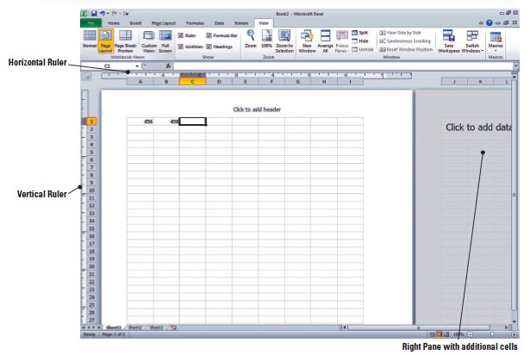
Figure 1-10: Page Layout View

Slide 17
Step-by-Step: Split a Window
Press Ctrl+Home to make cell A1 active.
With the View tab active, click the Split command in the Window group.
Choose the lower-right quadrant by clicking any cell in that area, then scroll down to Row 30.
Key 235 in cell H30 and press Enter. The data you entered in cells A1 and B1 should be visible along with what you just entered in cell H30, as shown in Figure 11-1 on the next slide.

Slide 18
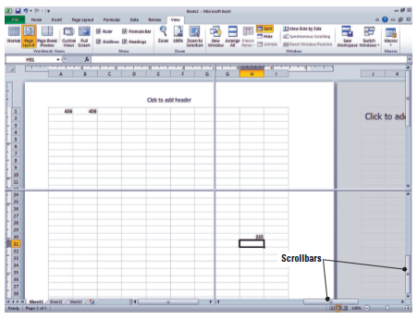
Step-by-Step: Split a Window
Click Split to remove the split. The data in cell H30 is no longer visible. However, if you click the Split command once more, you will again see all the data in this worksheet.
Notes:
The Split command is especially useful when you need to compare various portions of a long worksheet.

Slide 19
Step-by-Step: Open a New Window
Make A1 the active cell.
With the View tab active, click New Window in the Window group. A new window titled Book2:2 opens.
Scroll down in the window until cell H30 is visible, as shown in Figure 1-12. Although cell A1 is not visible, it is still the active cell. It is important to note that you have opened a new view of the active worksheet—not a new worksheet.

Slide 20
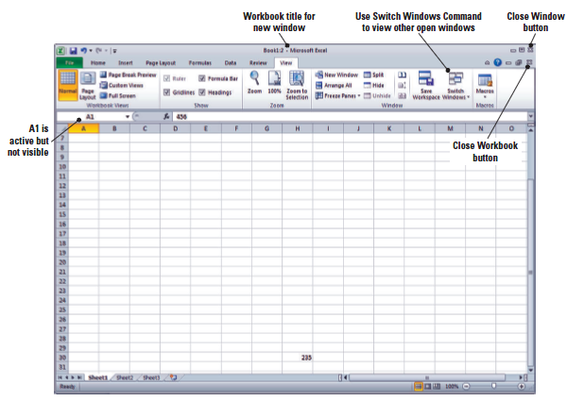
Figure 1-12: A New Window

Slide 21
Step-by-Step: Open a New Window
Click Switch Windows; a drop-down list of all open windows appears. Book2:2 is checked, indicating it’s the active window.
Click Book2:1. You will now see the original view of the worksheet with cell A1 active.
Click Switch Windows and make Book2:2 active.
Click the Close Window button (in the upper-right corner of the workbook window) to close Book2:2. The window closes, and the title Book2 tells you that you are now looking at the only open view of this workbook.
Click the File tab and then click Close.
When asked to save the changes to Book2, click No.
Notes:
Step 7 Note: Clicking the Close Window button will close only the new window opened at the beginning of this exercise. If you use the Close command in the Microsoft File tab, you will close the entire workbook.

Slide 22
Step-by-Step: Open an Existing Workbook
Within Excel, click the File tab. Documents you recently created or edited will appear on the right side in the Recent Documents area.
Click Open. The Open dialog box will appear.
In the Recent Workbooks area, click the name of the data files for this lesson.
Select Contoso Employee Info from the listed files, and then click Open. The file opens, as shown in Figure 1-13, with the workbook name displayed in the title bar.
Notes:
Step 2 Note: By default, the Open dialog box lists only the files that were created in the program you are using—in this case, Excel. To see files created in other programs, you can select All Files in the Files of type box at the bottom of the Open dialog box.

Slide 23
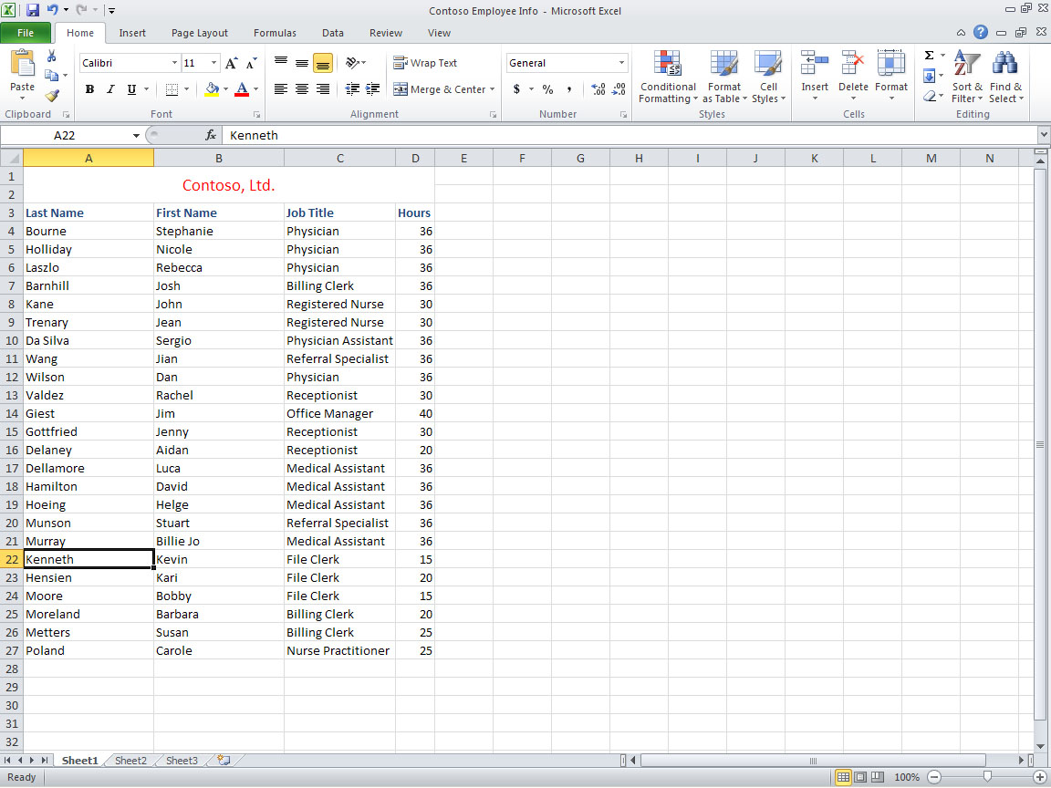
Figure 1-13: Opening an Existing Worksheet

Slide 24
Step-by-Step: Navigate a Worksheet
Press Ctrl+Home to move to the beginning of the document (cell A1).
Press Ctrl+End to move to the end of the document (cell D27).
Click cell A27 to make it the active cell, and press Page Up. The cursor moves to cell A1.
Click cell A3 to make it active, then press Ctrl+Page Down to go to the last row of data (cell A27).
Press Ctrl+Right Arrow. The cursor moves to D27, the last column in the range of data. The unused cells below the data are considered a range.

Slide 25
Step-by-Step: Navigate a Worksheet
Press Ctrl+Down Arrow. The cursor moves to the last possible row in the worksheet.
Press Ctrl+Home.
Press Scroll Lock while you press the Right Arrow key. This moves the active column one column to the right.
Use the vertical scrollbar (refer to Figure 1-11) to navigate from the beginning to the end of the data.
If your mouse has a wheel button, roll the wheel button forward and back to quickly scroll through the worksheet.
NOTE: Ctrl+Arrow allows you to move to the start and end of ranges of data. The title, which spans all the columns, is not considered part of the worksheet’s data range.
Notes:
If you’d like to refer to Figure 11-1, it’s shown in Slide 28.
Step 8 Note: When Scroll Lock is on, scroll lock is displayed on the left side of the Status bar. If you want to use the arrow keys to move between cells, you must turn off Scroll Lock. Some keyboards come equipped with an onboard scroll lock key, while others do not. This is an option not a necessity.

Slide 26
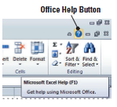
Step-by-Step: Use the Help System
Position your mouse pointer over the Help button in the upper-right corner of your Excel screen. A ScreenTip appears, telling you that this button enables you to access Excel’s Help features, as shown in the figure below.

Slide 27
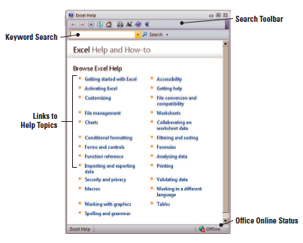
Step-by-Step: Use the Help System
Click the Help button; the Help window opens, as shown in the figure below.

Slide 28

Step-by-Step: Use the Help System
In the Help window, click on the Getting started with Excel hyperlink. The next screen gives you additional hyperlinked subcategories.
Navigate through 3 of the subtopics in the Help window.
Click the Office Help Connection Status button in the bottom-right corner of the Help window. This displays the Connection Status dialog box (shown below), which enables you to choose whether the Help window displays online or offline Help content.
Notes:
Step 5 Note: Even if Excel is set to work offline, you can still search for help online. To do so, instead of clicking the Search button, click the drop-down arrow next to it. When the menu appears, click the Content from Office Online link. The choice will affect only the current search, not Excel’s overall settings.

Slide 29
Step-by-Step: Use the Help System
CLOSE the Help window.

Slide 30
Lesson Summary

