Slide 1
Configure Network Access
Topic D: Sharing and Storage Methods

Slide 2
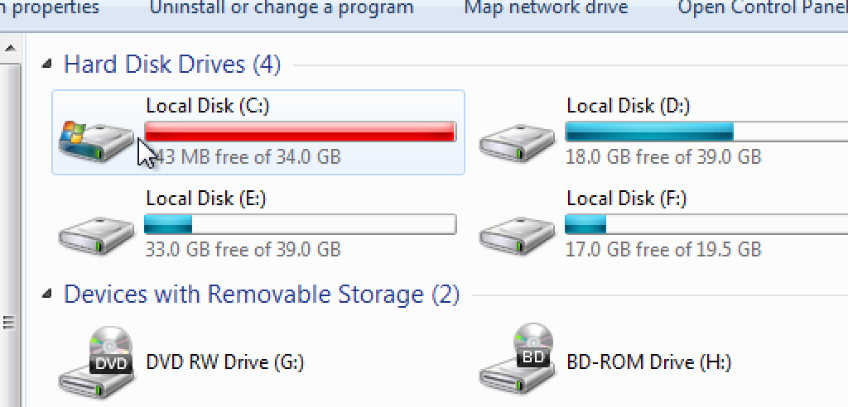
Local vs. Hosted Storage
Traditionally, network services have included at least file and print sharing.
One of the main requirements for file sharing is accessible storage.
Local storage refers to any storage media that is directly attached to the computer that uses it.
This can include direct-attached storage such as hard drives over Serial ATA (SATA) connections, as well as external hard drives that use ports such as USB to plug in to computers.
Local storage often has the advantage of speed and accessibility.
These solutions are ideal for individual users who need to access, modify, and delete files quickly without relying on other machines to do the hosting for them.
Because comparatively few users can access them, local storage media offer security guarantees that networked storage does not.
However, local storage makes it more difficult to work collaboratively because there is not necessarily one authoritative file in one location.

Slide 3
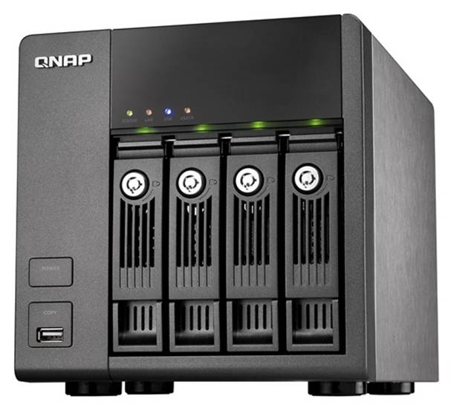
Hosted Storage
Hosted storage, or networked storage, places data on specialized devices that serve files to clients in a network based on each client's need.
Networked drives are available to groups of users who share access.
One solution that uses networked drives is a network-attached storage (NAS) device.
NAS devices are ideal for small-to-mid-size companies because they can combine multiple drives into one storage pool for easy access over the network.
NAS devices are relatively inexpensive and typically allow administrators to easily create backups in case of failure.
Other than in-house solutions, another method of hosted storage is cloud-based storage such as Microsoft OneDrive, Amazon Cloud Services, and Google Cloud Platform. Cloud companies provide a number of services, such as storage space and collaborative applications over the Internet.
This enables users and businesses to offload processing overhead onto a cloud provider.
One disadvantage to using cloud storage is that you're not necessarily in complete control of your information, and you may not be able to guarantee its security.

Slide 4
Peer-to-Peer Networking
A peer-to-peer network is a network in which resource sharing, processing, and communications control are completely decentralized.
All clients on the network are equal in terms of providing and using resources, and users are authenticated by each individual workstation.
Peer-to-peer networks are easy and inexpensive to implement.
However, they are practical only in very small organizations, due to the lack of central data storage and administration.
In a peer-to-peer network, user accounts must be duplicated on every workstation from which a user accesses resources.

Slide 5
Such distribution of user information makes maintaining peer-to-peer networks difficult, especially as the network grows.
Consequently, peer-to-peer networks should not exceed 10 computers.
You can set up and use peer-to-peer networks by using several different methods:
  Direct link allows you to physically connect each PC to every other PC to form the peer-to-peer network.
  Local ad hoc networks allow peers to connect to each other and share files without needing to set up extra networking equipment such as routers or access points. Each node (a laptop, for instance) simply transmits wirelessly to other nodes without an intermediary device. This can be done by using standards such as Wi-Fi and Bluetooth.
  Online networks allow clients to connect to other peers over the Internet. BitTorrent is an example of a protocol that enables peer-to-peer file sharing over the Internet.
In Microsoft Windows operating systems, computers in a SOHO environment can join peer-to-peer networks called workgroups and homegroups.
In a workgroup, typically no more than 20 peers are all connected on the same network.
Homegroups are similar, but require each peer to input a password when first connecting to the group. Homegroups make it easier for peers to share files and printing services.

Slide 6
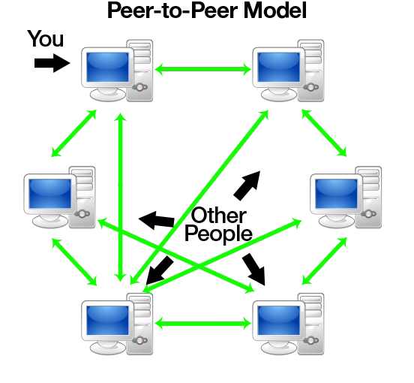
Peer-to-Peer Network

Slide 7
HTTP and HTTPS
HyperText Transfer Protocol (HTTP) is the TCP/IP service that enables clients, such as a web browser application, to connect and interact with websites.
It defines how messages are formatted and transmitted and the actions web servers and a client's browser should take in response to different commands.
An HTTP request includes the address of the requested web page, instructions on how and where the requested data will be stored on the client computer, protocols supported by the browser, the type of request being made, the version of HTTP supported by the browser, and so on.
HyperText Transfer Protocol Secure (HTTPS) is a secure version of HTTP that supports web commerce by providing a secure connection between web browsers and servers.
HTTPS uses Secure Sockets Layer/Transport Layer Security (SSL/TLS) to encrypt data. Virtually all web browsers and servers today support HTTPS. An SSL/TLS-enabled web address begins with the protocol identifier https://.
Sharing data through HTTP and HTTPS comes in the form of browser-based file downloads.
The user will connect to a web server and likely select a link that will enable that user to download or directly open a file from the browser.
When using this form of sharing data, you need to be careful that you're downloading files from a reputable site.
There are many malicious websites using HTTP that try to trick users into thinking they are legitimate, and some even convincingly spoof legitimate websites such as banks and social media sites.
Always look for the HTTPS in the site's URL to verify that your browser trusts it.

Slide 8
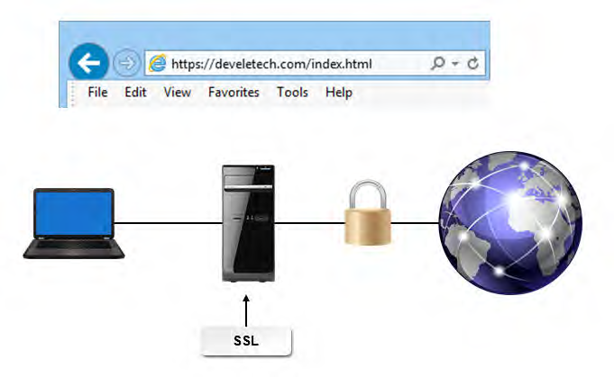

Slide 9
FTP
File Transfer Protocol (FTP) is used to transfer files across a TCP/IP network, such as the Internet.
FTP is intended to enable file transfers, independent of the operating system. However, computers
on the network must have the FTP software installed. Operating systems that support TCP/IP
almost always include some form of FTP, though you can also use an external client. FTP is the
protocol that web developers use to upload web pages to a remote server. Other common uses of
FTP include uploading images to photo sites, and audio and video files to media sites.

Slide 10
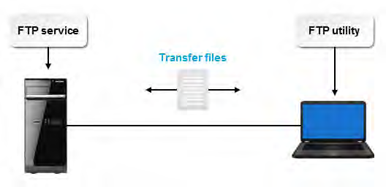

Slide 11
Protocol | Description
Simple File Transfer Protocol (SFTP) | This protocol was an early unsecured file transfer protocol that has since been declared obsolete.
FTP over SSH | Also called Secure FTP, FTP over SSH is a secure version of FTP that uses an SSH tunnel as an encryption method to transfer, access, and manage files. Secure FTP is used primarily on Windows systems.
File Transfer Protocol Secure (FTPS) | This protocol, also known as FTP-SSL, combines the use of FTP with additional support for SSL/TLS.

Slide 12
Printing
Printers can connect to computers by using a variety of connection types.
Some printers connect locally to individual PCs over USB.
A network printer, on the other hand, is a shared printing device that can be used simultaneously by multiple users on a network.
These printers can be wired over Ethernet, but more commonly network printers offer wireless capabilities that allow users to print without being physically connected to the device.
These wireless printers use standards such as Bluetooth and Wi-Fi.
Networked printers are much more useful than local printers if used in an office setting, but multiple users printing from the same device may cause delays.
Wireless printers are even more convenient, but they are susceptible to interference issues associated with wireless communication in general.

Slide 13
