Slide 1
Identifying Computer Software
Topic B: Identify Application Software

Slide 2
Identify Application Software
Application software enable you to accomplish specific tasks, such as writing a letter, creating a slide presentation, or surfing the web.
There are literally thousands of different applications out there to choose from, so being able to identify common types of application software, along with their uses, will help you to identify the specific software applications that will meet your needs or the needs of the users you are supporting.

Slide 3
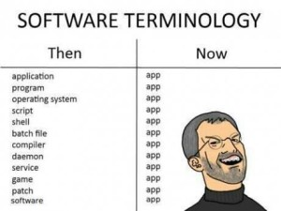
Application Software
Application software is a program that provides specific functionality such as word processing, graphics creation, or database management.
It is generally written to run on a specific operating system.
Application programs may come pre-installed on a computer system or may need to be purchased and installed on the system.

Slide 4
Application Platforms
Application software can be designed to run on multiple platforms.
"Mobile" refers to the devices such as laptops, smartphones, iPads, and other tablet devices.
"Desktop" is the traditional CPU and monitor with all the peripherals.
Applications that users access and use through a web browser are known as "web-based."

Slide 5

Types of Productivity Software
Productivity software is a broad term that describes applications that range from those used to create documents to those used to manage your projects and organize your time.

Slide 6
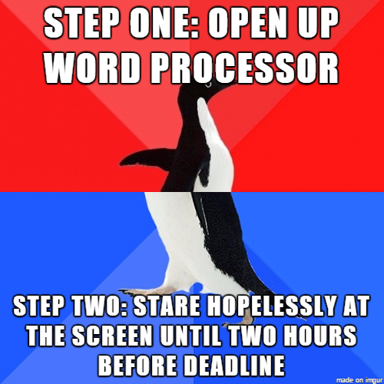

Productivity Software:
Word Processing
Word processing software is used to create and work with typed documents.
Examples include Microsoft Word and Apple iWork Pages.

Slide 7
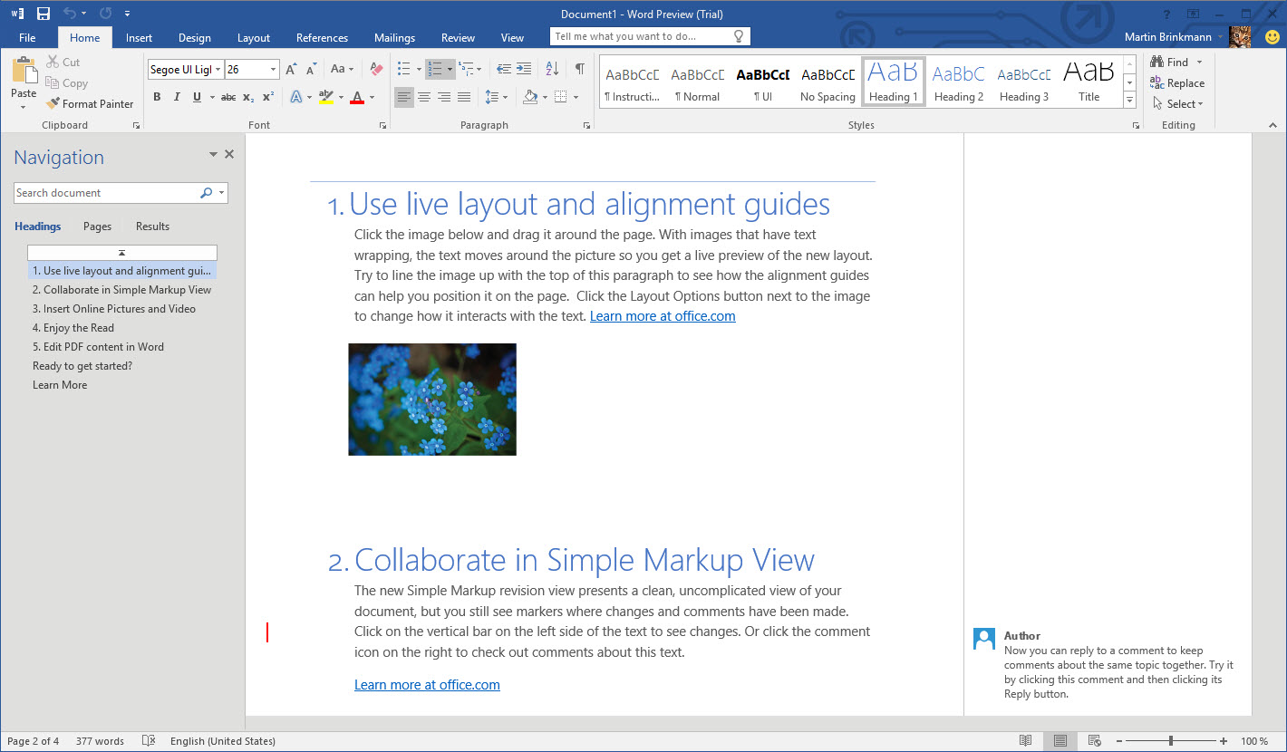
Word Processing Software

Slide 8


Productivity Software: Spreadsheets
  Spreadsheet software is used to calculate and analyze tables of numbers. Examples include Microsoft Excel and Apple iWork Numbers.

Slide 9


Productivity Software: Email
  Email software is used to communicate with others.
  Examples include Microsoft Outlook and Gmail.

Slide 10


Productivity Software: Database
  Basic database software is used to manage large volumes of lists and records.
  Examples include Microsoft Access and FileMaker Pro.

Slide 11
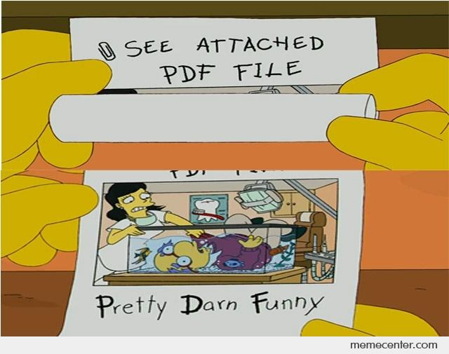

Productivity Software: PDF
  PDF software is used to view, create, and work with PDF documents.
  Examples include Adobe Acrobat and Foxit PhantomPDF.

Slide 12
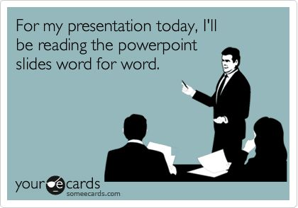

Productivity Software: Presentation
  Presentation software is used to create and work with slide shows.
  Examples include Microsoft PowerPoint and Apple iWork Keynote.

Slide 13
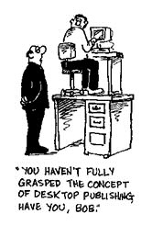
Productivity Software:
Desktop Publishing
  Desktop publishing software is used to work with page layouts and typography in documents and publications.
  Examples include Adobe InDesign and Microsoft Publisher.

Slide 14


Slide 15

Productivity Software:
Personal Information Manager
  Personal information managers (PIM) are used to manage your contacts and schedules.
  Examples include Windows Contacts and Google Calendar.

Slide 16
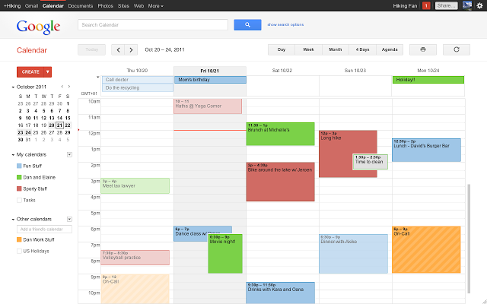

Slide 17
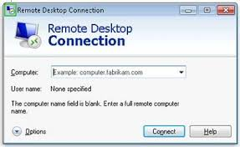
Productivity Software:
Remote Desktop
Remote desktop software is used to access another desktop to provide troubleshooting assistance.
Examples include Windows Remote Desktop Protocol (RDP) and Virtual Network Computing (VNC).

Slide 18

Collaboration Software
Collaboration software is designed to facilitate sharing data and resources between users in a variety of locations and using a variety of computing devices.

Slide 19
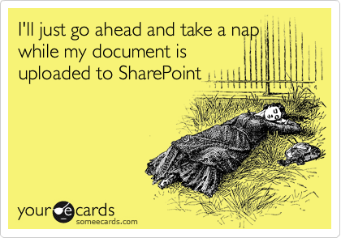

Collaboration Software: Online Workspace
Online workspace enables users to work with common files in a shared space on the web.
Examples include Microsoft SharePoint.

Slide 20
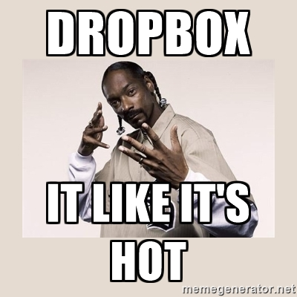

Document storage / sharing
Document storage/sharing provides a repository to store and share files between users in various locations.
Examples include OneDrive and Dropbox.

Slide 21
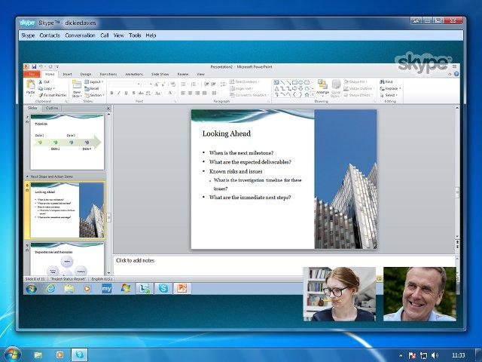
Collaboration Software: Screen Sharing
Screen sharing software enables users to see each other's desktops from remote locations.
Examples include Windows Remote Assistance and TeamViewer.

Slide 22


Video Conferencing
Video conferencing software enables users to communicate with audio and video functionality from diverse locations.
Examples include Skype and Google Hangouts.

Slide 23
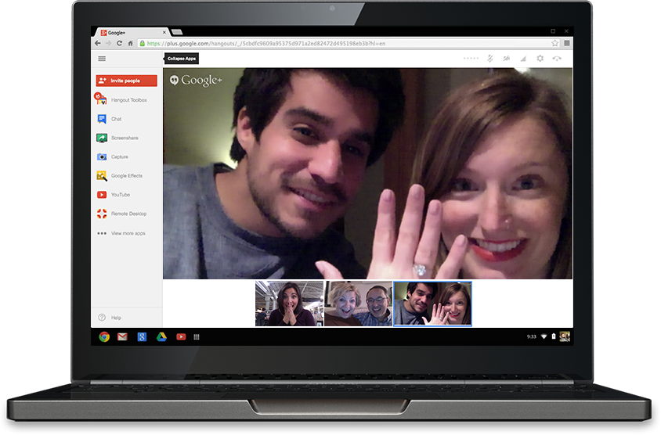

Slide 24
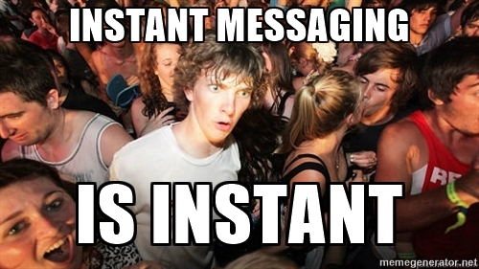

Instant Messaging
Instant messaging software enables users to exchange short notes, or chat, online in real time.
Examples include Microsoft Lync and AOL Instant Messenger (AIM).

Slide 25
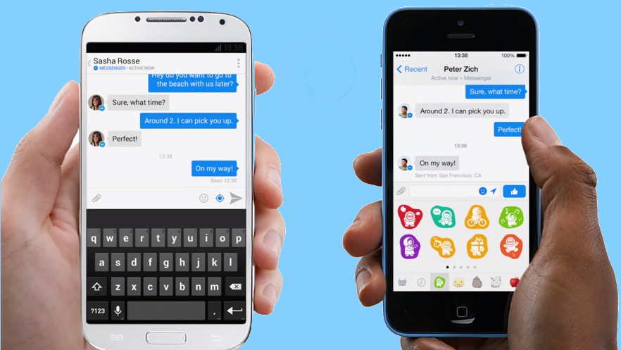

Slide 26
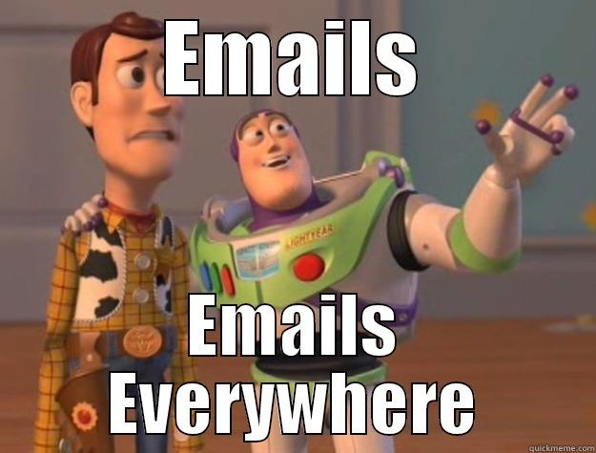
Email
Email software also allows users to share contact and calendar information.

Slide 27
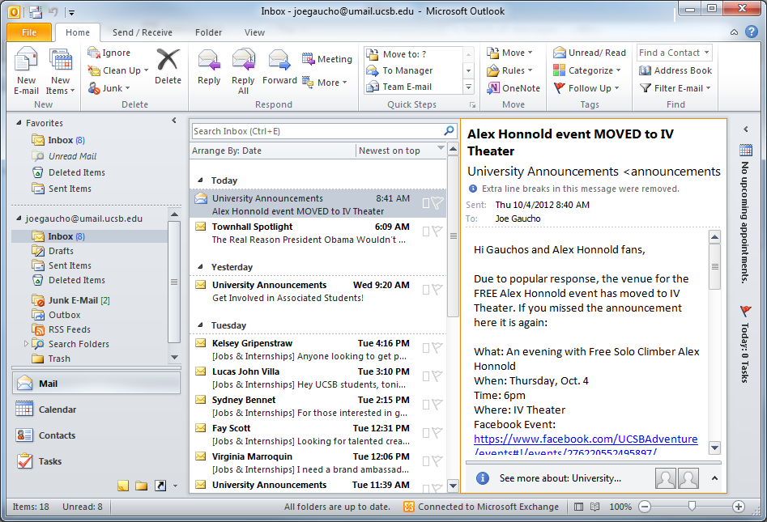

Slide 28
Utility Software
Every operating system comes with a host of utilities designed to help you diagnose and troubleshoot problems and simplify tasks.
If you are considering an IT career in computer support, knowledge of these tools will help you maintain equipment and troubleshoot issues with the operating system.

Slide 29


Utility Software: Antimalware
Antimalware detects and eliminates malicious software that resides on a computer.
Examples include Windows Defender and Malwarebytes Anti-Malware.

Slide 30
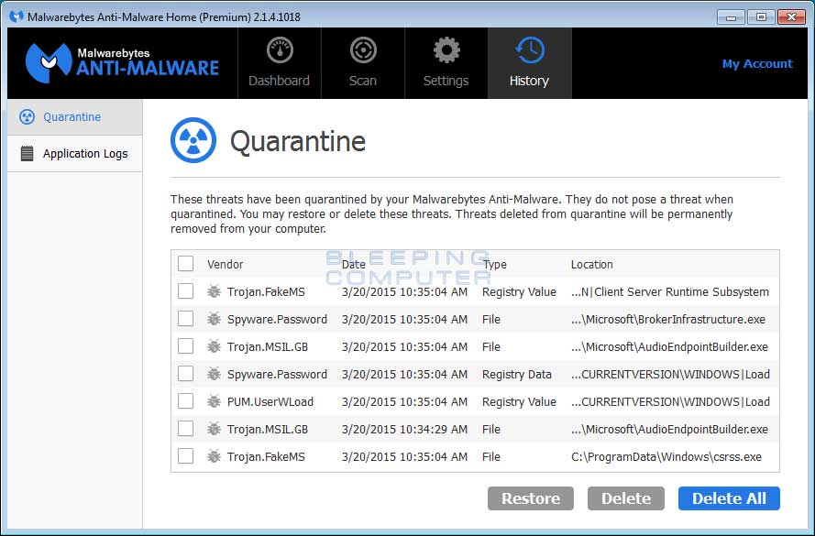

Slide 31

Utility Software: Software Firewalls
Software firewalls filter incoming or outgoing network traffic depending on how they are configured.
Examples include ZoneAlarm and Comodo Internet Security (CIS).

Slide 32
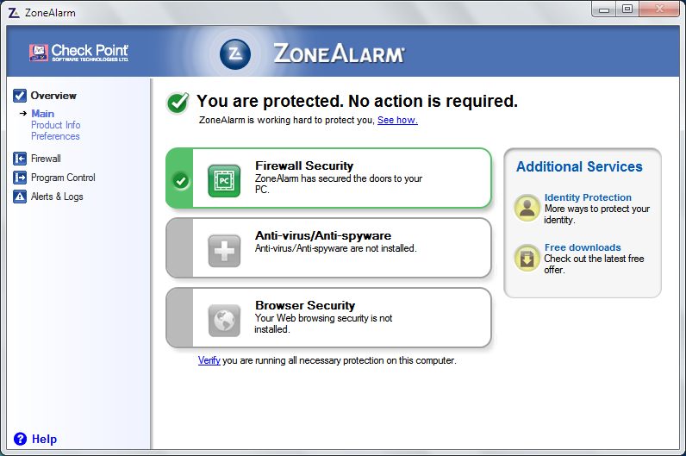

Slide 33

Utility Software:
Diagnostic / Maintenance
Diagnostic/maintenance software reports on any problems or issues that a computer may be experiencing.
Examples include Windows Action Center and PC-Doctor.

Slide 34
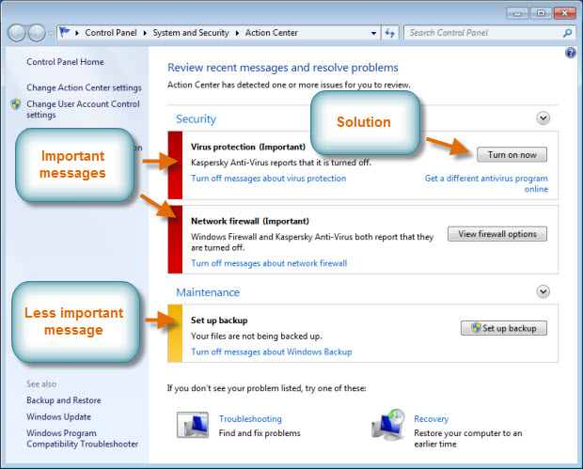

Slide 35

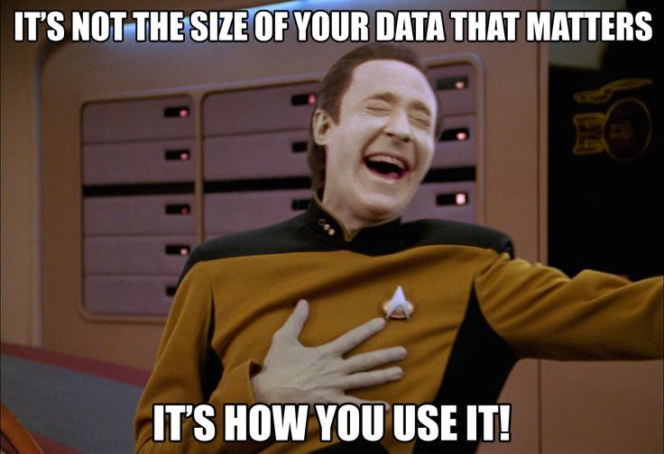
Utility Software: Compression
Compression software reduces the size of files so that they can be stored and transmitted more easily.
Examples include WinZip and 7-Zip.

Slide 36
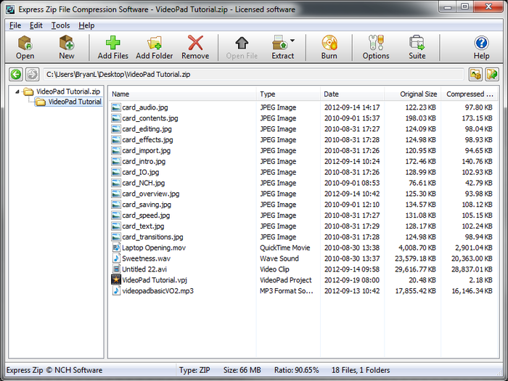

Slide 37
Specialized Software
The specialized software category contains all of the other types that do not fit in the first three.
Companies in architectural, engineering, medical, and financial fields require software applications that are specific for the documents and files that they need to create and use.

Slide 38

Specialized Software:
Computer-Aided Design
Computer-aided design (CAD) software is used to create design specifications for electronics, mechanical objects, animation, and other products.
Examples include AutoCAD and SketchUp.

Slide 39
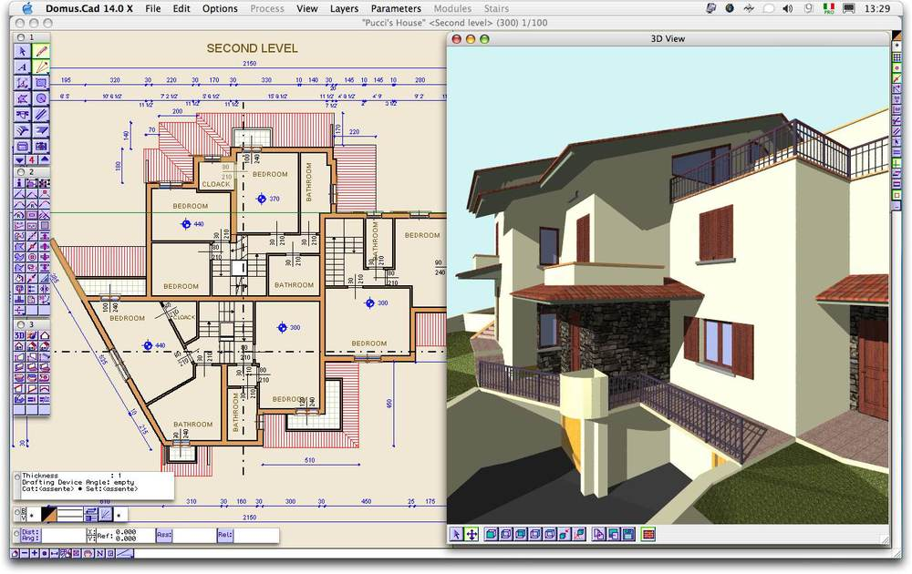
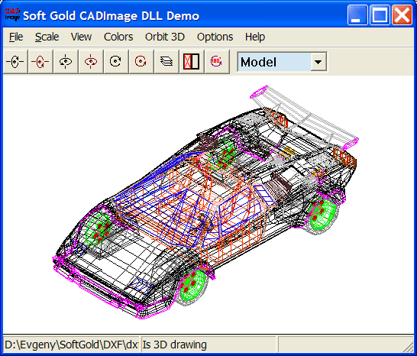
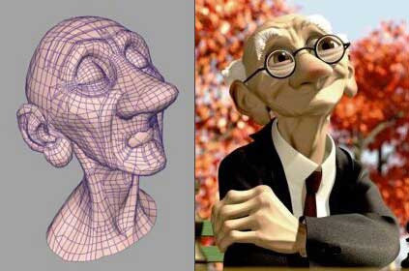

Slide 40
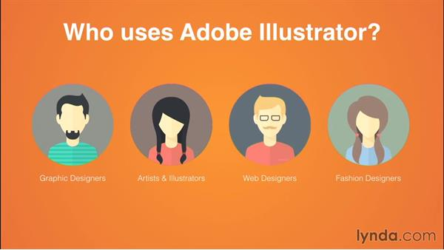

Specialized Software:
Graphic Design
Graphic design software is used to create visual representations of concepts and ideas.
Examples include Adobe Illustrator and CorelDRAW.

Slide 41
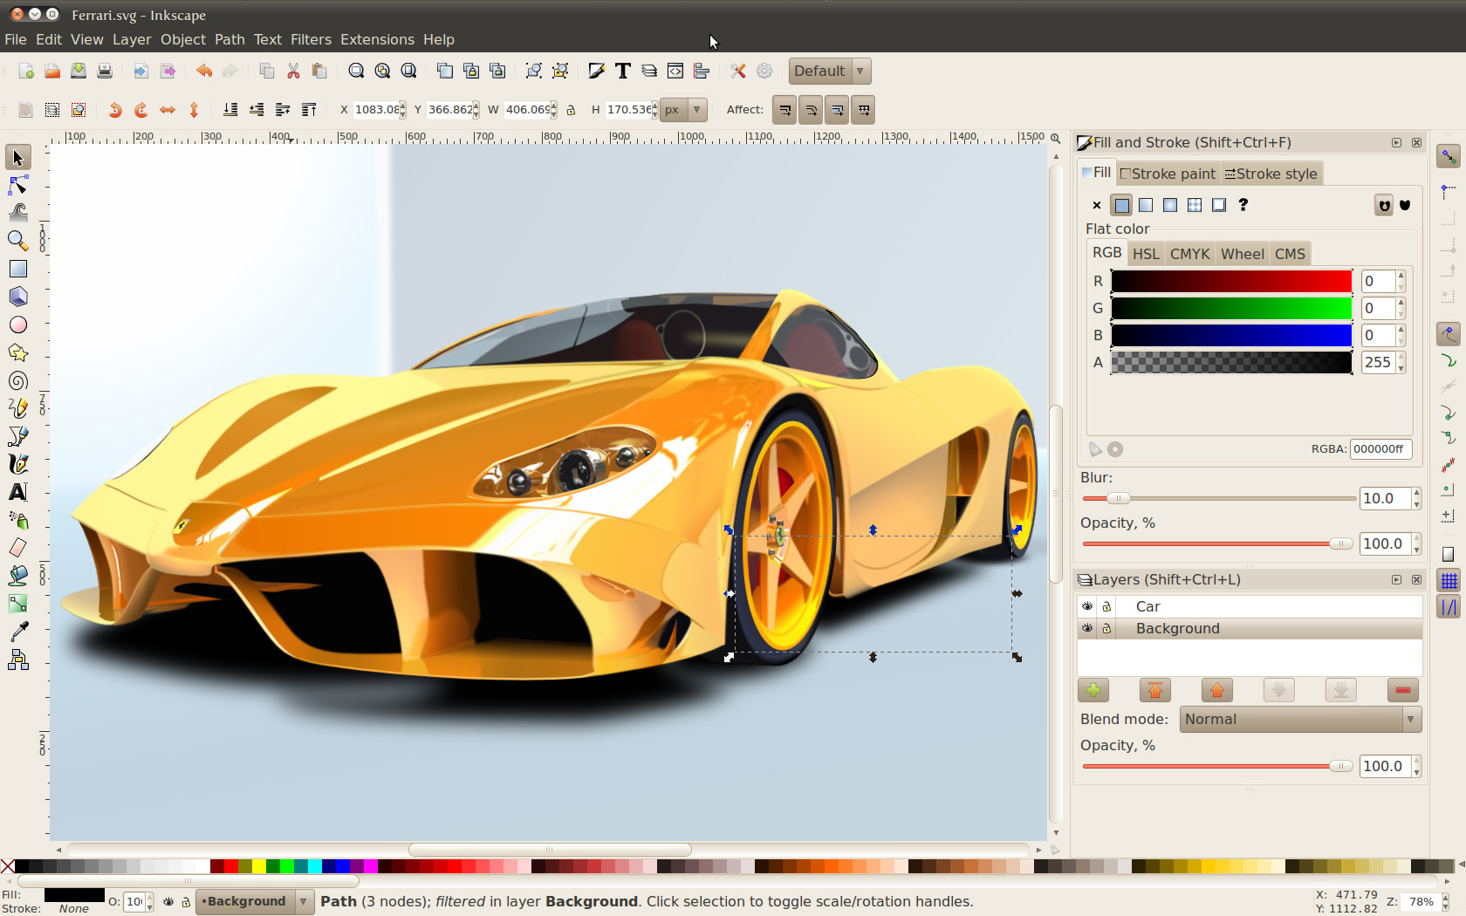

Slide 42


Specialized Software: Medical
Medical software that is used to collect, analyze, and present data related to medical information.
Examples include Kareo and athenaCollector.

Slide 43
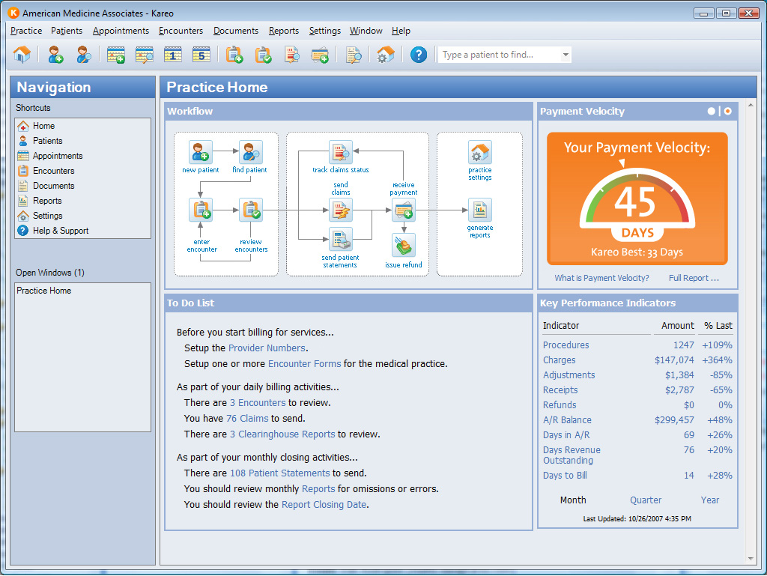

Slide 44


Specialized Software: Scientific
Scientific software is used to collect, analyze, and present data used in experiments.
Examples include LISREL and Sage.

Slide 45
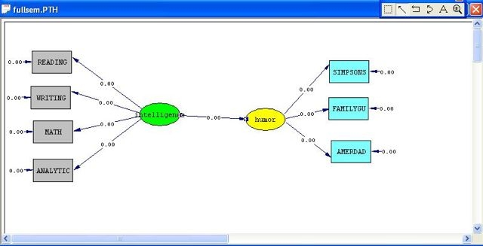

Slide 46


Specialized Software: Financial
Financial software is used to keep track of expenses, maintain a budget, file taxes, and manage other financial information.
Examples include Quicken and Microsoft Dynamics.

Slide 47
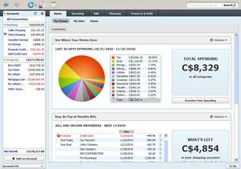

Slide 48


Specialized Software: Gaming
Gaming software enables you to purchase, collect, and play video games on a computer.
Examples include Steam and Origin.

Slide 49
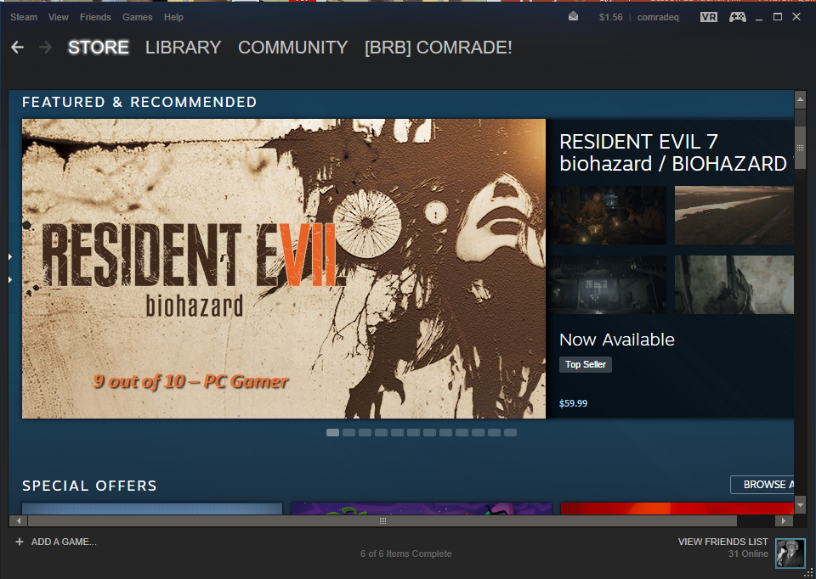

Slide 50


Specialized Software: Entertainment
Entertainment software enables you to purchase, collect, and experience entertainment media such as music and movies on a computer.
Examples include Google Play and iTunes.

Slide 51
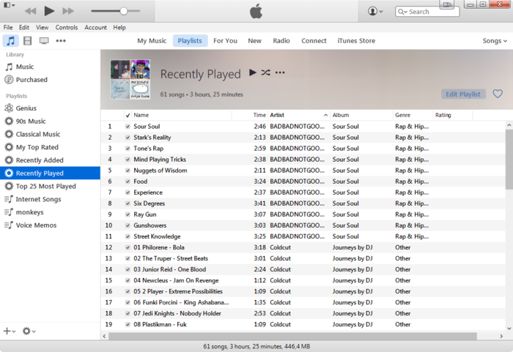

Slide 52
Common File Types and Extensions
Standard file extensions that follow the names of files can indicate whether a particular file is a
program file or a data file. If it is a data file, the extension can indicate the application category that
might be used to edit the file. Many common file extensions are three characters long, although
there is no longer a strict character limit for the file name or extension in most modern operating
systems. A period separates the extension from the file name itself.
The following table lists a number of common file types and extensions.

Slide 53
Documents
.txt
  A plain text file that contains no formatting other than spaces and line breaks. You can open files that have a .txt extension in any text editing program, such as Notepad, or word processing programs, such as Microsoft Word
.rtf
  Rich Text Format (RTF), or a text file that includes a limited amount of formatting such as bold and italic. You can open files that have the .rtf extension in various applications, such as common word processors or Microsoft's WordPad accessory

Slide 54
Documents
.doc / .docx
  A data file created in a word processing program, such as Microsoft Word or WordPad. You might also see .docx, which is the Office 2007, 2010, and 2013 format.
.xls / .xlsx
  Data files created in Microsoft Excel. Files® created in Office 2007, 2010, and 2013 are indicated by the .xlsx file extension.
.ppt / .pptx
  Data files created in Microsoft PowerPoint® . Files created in Office 2007, 2010, and 2013 are indicated by the .pptx file extension.
.pdf
  The versatile Portable Document Format (PDF) file format can be read by any computer with a free reader application, such as Adobe Reader.

Slide 55
Audio
.aac
  The Advanced Audio Coding file format.
.flac
  The Free Lossless Audio Codec file format.
.m4a
  The Apple Lossless Audio Codec file format used for digital music files.
.mp3
  The Moving Picture Experts Group Layer 3 format used to store and play audio files in digital audio players.
.wav
  An audio file in the Waveform Audio File format that was developed by Microsoft and IBM.

Slide 56
Images
.bmp
  The Microsoft Windows bitmap image file format.
.gif
  The Graphics Interchange Format image file format.
.jpg/.jpeg
  The Joint Photographic Experts Group image file format that is commonly used in photographs.
.png
  The Portable Network Graphic image file format.
.tif/.tiff
  The Tagged Image File format.

Slide 57
Video
.avi
  The Microsoft Audio Video Interleaved file format that contains audio and video data.
.flv
  The Adobe Flash video file format used for delivering videos over the Internet.
.mp4
  The Moving Picture Experts Group Layer 4 (MP4) format used to store and play video files.
.mpg/.mpeg
  The Moving Picture Experts Group file format for audio and video files.
.wmv
  The Microsoft Windows Media video file format.

Slide 58
Executables
.app
  The application program executable file format used by Apple.
.bat
  A batch file; a small text file containing a list of system commands that execute in a batch rather than requiring the user to enter each command in succession.
.com
  A command file or compiled application file.
.exe
  Windows executable file that launches programs and applications.

Slide 59
Executables
.msi
  A Windows Installer package; a file that can specify installation parameters for an application.
.scexe
  A Linux self-extracting executable file.

Slide 60
Compression
.iso
  An optical disc image of a file system that is commonly used for archiving.
.dmg
  A password-protected, compressed Apple Disk Image file format used by Mac OS X.
.gzip/.gz
  The free file compression file format developed for the GNU Project.
.jar
  A Java archive file format used to distribute Java class files and associated metadata files.

Slide 61
Compression
.rar
  Developed by Eugene Roshal, this archive file format supports compression, among other features.
.7zip/.7z
  The open archive file format that uses compression.
.tar
  A compressed file created with the XZ compression format.
.zip
  A file compression format that has built-in support in most operating systems.

