Slide 1
Setting Up a Basic Workstation
Topic D: Configure Accessibility Options

Slide 2
Configure Accessibility Options
So far in this lesson, you have connected hardware, installed and configured an operating system, and installed and configured application software.
To complete the basic setup of the workstation, you can configure options that help make it easier to get to and use the information on the workstation.
In this topic, you will configure accessibility options. As an IT support technician, you will discover that each user has a unique set of needs.
Some users‘ needs are based on what they intend to accomplish with their workstations, while other needs are directly connected to the abilities of the users themselves.
By configuring accessibility options, you can ensure that users who have differing access requirements can retrieve and use the data stored on their workstations.

Slide 3
Accessibility
Accessibility is the use of assistive technology to make computers available and easier to use.
For example, users with impaired or limited vision can configure their computers to narrate the screen text and they can also increase the size of the screen components to make them easier to see.
Accessibility features can be built-into the operating system or provided through specially designed applications and software.

Slide 4
Windows 8.1 Accessibility Options
The Ease of Access menu provides a way to make your computer more accessible through assistive
technology.
With Ease of Access, you can have the Narrator feature read aloud the text on your screen, increase the size of the page for readability, turn on an on-screen keyboard, or access other functions that offer alternative methods of making things easier to see and use.

Slide 5
Ease of Access Menu Choice
Narrator
  Narrator will read aloud what is on the screen, including the text that you are typing, the contents of the active window, and menu options. This option is very helpful for the visually impaired. Narrator may not work with all applications.
Magnifier
  Magnifier will enlarge the whole screen, or portions of the screen, to make viewing easier.
On-Screen Keyboard
  Places a virtual keyboard on the screen. Useful for touchscreen PCs or when a keyboard is not available.
High Contrast
  Provides a darker background to make text and images stand out for better viewing.
Sticky Keys
  Sometimes two or more keys must be pressed at the same time to start an action, such as pressing Ctrl+Alt+Del to display Task Manager or to cause the computer to reboot. With the Sticky Keys feature turned on, you can press the keys in the combination one at a time.
Filter Keys
  Filter Keys tells the PC how long to respond when a key is pressed and to ignore repeated keystrokes. This is helpful for users who shake, or who have difficulty pressing and lifting their fingers off of keys quickly enough when typing.

Slide 6
Narrator
The Narrator Settings dialog box contains a variety of configuration options that enable you to control how Narrator starts, how it looks on screen, and how it behaves and interacts with you.
Use the Commands category to define the specific keyboard shortcuts to start, stop, and repeat the reading; navigate to read different items on the screen; and adjust the voice volume.
The Voice category enables you to choose between several different voices as well as control its speed, volume, and pitch.

Slide 7
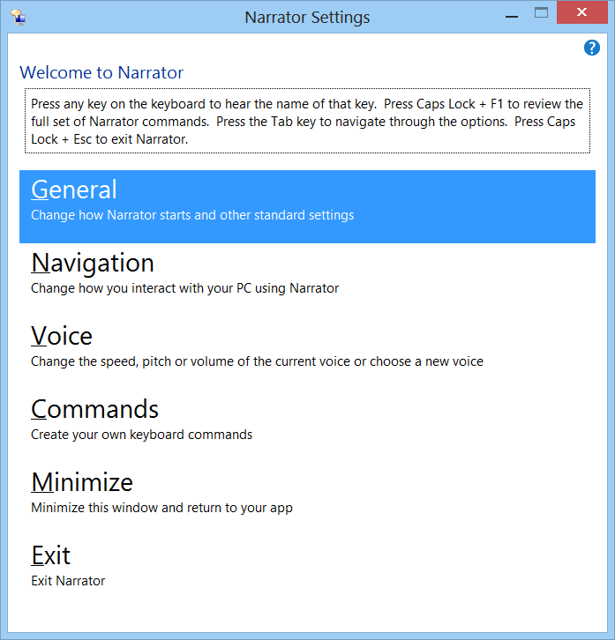
Narrator

Slide 8
Magnifier
When running, the Magnifier toolbar is displayed and provides buttons for controlling the zoom level, what is affected, and the available options.
The Views button contains the following choices:
  By default, the Full Screen is affected by the zoom level.
  Lens increases only the portion of the screen that's visible within the lens boundary.
  Docked displays the active portion of the screen in a separate window at the top of the screen.

Slide 9
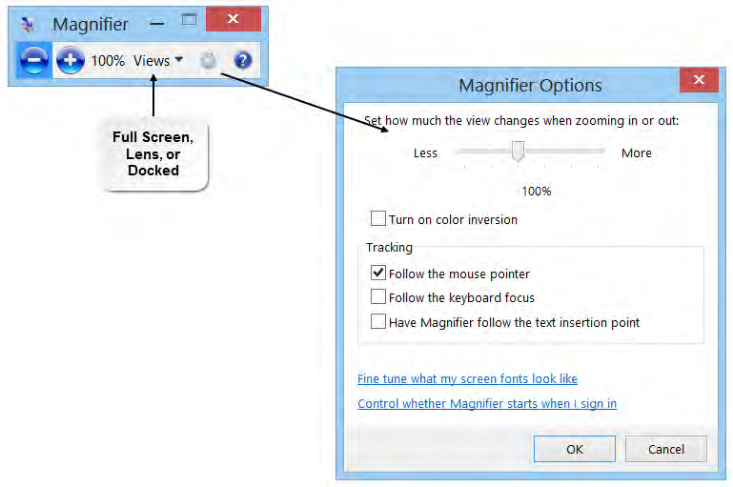
Magnifier

Slide 10
Mac OS X Accessibility Options
VoiceOver screen reader explains what is on the screen as well as reading screen text to you.
Zoom and Cursor Size enable you to magnify the full screen or a selected portion and the cursor.
Dictation enables you to input text by speaking instead of typing.
Invert Colors provides a high-contrast display to make it easier to see screen elements.
Closed Captions provide close captioning text when watching videos, movies, and podcasts.
Screen Flash flashes the screen to indicate that an app needs your attention.
Mono Audio plays both stereo channels in both ears.

Slide 11
Mac OS X Accessibility (cont.)
Switch Control enables manipulating on-screen keyboards, menus, and the dock by using scanning.
Slow Keys adjusts the sensitivity of the keys.
Sticky Keys enables you to press keyboard shortcut combinations (such as Command+S) one at a time instead of simultaneously.
Speakable Items uses speech recognition to navigate within your Mac and applications, such as opening apps, switching between apps, closing windows, navigating menus, starting screen savers, and so on.
Simple Finder reduces the Dock to three folders.
Text to Speech converts highlighted text to audio.

Slide 12
Chrome OS Accessibility Features
ChromeVOX screen reader provides voice explanation and feedback to visually impaired users.
Accessibility settings enables you to configure the display (cursor size, highcontrast mode, screen magnifier) and other features (sticky keys and the onscreen keyboard).

Slide 13
Android OS Accessibility Options
TalkBack screen reader describes the results of actions.
Explore by Touch works with TalkBack to provide spoken feedback on the item that is being touched on screen.
Accessibility settings enables you to configure the display and sound options.

Slide 14
Other Adaptive Technologies
Adaptive technology includes tools that are designed to ensure that people with disabilities are able to use the software. Sometimes, the distinction is made that adaptive technology is used only by people with disabilities, whereas assistive technology tools are used by everyone.
A variety of adaptive products are available on the market today. Many provide hands-free capabilities. A few examples of adaptive technologies include:
  Braille translation software converts text documents to Braille and vice versa.
  Eye-tracking devices that enable you to input by using eye movements instead of typing on a keyboard.
  Tobii EyeMobile enables you to control a Windows 8 tablet with your eyes.
For more information, you can go to the website of the non-profit organization Assistive Technology Industry Association (ATIA) and some of its partner organizations, such as the Alliance for Technology Access (ATA).
Both of these sites contain information and links to a variety of companies offering products and services that help make technology accessible for all

Slide 15
Use Narrator
Open the Control Panel.
Select Ease of Access Center.
Select Start Narrator.
Specify the desired settings in the General, Navigation, Voice, and Commands categories.
Select Save Changes.
To stop Narrator, select Exit and confirm.

Slide 16
Use Magnifier
Open the Control Panel.
Select Ease of Access Center.
Select Start Magnifier.
On the Magnifier toolbar, use the Zoom Out and Zoom In buttons to change the zoom level.
Use the Views button to change the portion of the screen to be affected.
Select Options to configure the Magnifier settings.
Select the Close button in the upper-right corner to close.

