Slide 1
Identifying Computer Hardware
Topic D: Identify Common Peripheral Devices

Slide 2
Peripheral Devices
A peripheral is a device that connects to a computer to expand the computer’s functionality. This includes devices that enable the user to input, output, store, and share data.
You can enhance the functionality of practically any personal computer by connecting different types of external devices to the system unit.
Also called peripheral devices, external devices can provide alternative input or output methods or additional data storage. You connect external devices to the system unit via cable or a wireless connection.
Some devices have their own power source, whereas others draw power from the system.
Common examples of external devices include keyboards, mice or other pointing devices, microphones, cameras, scanners, printers, and external drives.

Slide 3
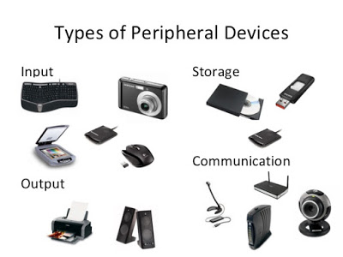

Slide 4
Input Device
Computers need user input, such as directions or commands, and user interaction with the programs that are included in order to produce something of use.
Keyboards and pointing devices are the standard input devices for personal computers these days, but there is an ever-growing number of input devices available for the user to interact with in a variety of ways.
As a technician, part of your responsibilities will include installing and configuring all types of input devices.

Slide 5

Keyboards: Standard Keyboard
Standard keyboards are rectangular in shape and have 84, 101, or 104 keys.
  The original PC keyboard, the XT, has 84 keys. A numeric pad is integrated to the right of the alphabetical keys. Function keys are along the left side of the keyboard.
  The AT keyboard also has 84 keys and is very similar to the original PC keyboard. However, on the AT keyboard, the numeric pad is separate from the alphabetical keys.
  The AT Enhanced keyboard has 101 keys. The function keys are integrated across the top. Arrow keys have been added, as well as a set of six keys—Insert, Delete, Home, End, Page Up, and Page Down. There are also additional command keys such as Esc and Ctrl.
  The Windows 104-key keyboard is similar to the AT Enhanced keyboard, but adds two Windows keys and a Menu key. The Windows keys are analogous to clicking the Windows Start button and the Menu key performs the same functions as right-clicking the mouse.

Slide 6
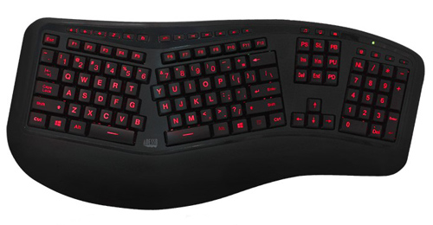
Keyboards: Ergonomic
Natural or ergonomic keyboards usually split the keyboard in half so each hand can comfortably use its own set of keys.
Built-in wrist rests are common, and some ergonomic keyboards also have an integrated pointing device such as a trackball or touch pad.

Slide 7
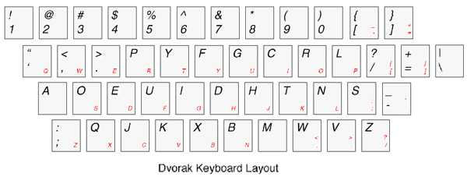
Keyboards: Dvorak
Dvorak keyboards rearrange the keys into a more efficient arrangement that makes faster typing possible for users who have become familiar with it.

Slide 8
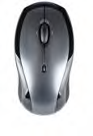
Pointing Devices: Mouse
A mouse is a small object that runs across a flat surface and has at least one, but typically two or three, buttons that send electronic signals to the graphical user interface (GUI).
Its name is derived from its appearance—a small rounded rectangle shape with a single cord attached at one end.
Mice can be:
  Mechanical—A ball on the underside runs along a flat surface. Mechanical rollers detect the direction the ball is rolling and move the screen pointer accordingly.
  Optical—A laser detects the mouse's movement. Optical mice have no mechanical moving parts, and they respond more quickly and precisely than other types of mice.

Slide 9
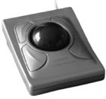
Pointing Devices: Trackball Mouse
A trackball is basically an upside down mouse.
The ball is mounted on the top of the case instead of the bottom and signals are sent to the computer by moving the ball with your thumb, fingers, or palm instead of by rolling the ball across a flat surface.
Like a mouse, a trackball has at least one button that is used to send electronic signals to the computer.

Slide 10
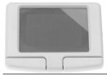
Pointing Devices: Touch Pad
A touch pad is a small, touch-sensitive pad where you run your finger across the surface to send electronic signals to the computer to control the pointer on the screen.
Touch pads can have buttons like a mouse or trackball, or the touch pad can be configured to detect finger taps on its surface and process those signals like button clicks.

Slide 11

Pointing Devices: Trackpoint
A trackpoint, or pointing stick, is most commonly found on laptops.
Located in the center of the keyboard, the trackpoint is a small joystick-like button that responds to user force in all directions in order to move the mouse pointer on screen.

Slide 12
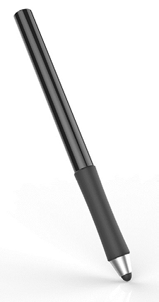
Pointing Devices: Stylus Pen
A stylus or stylus pen is most often used with tablets, or on a drawing tablet connected to a computer.
The stylus might or might not have buttons that act as mouse buttons.
Some styli are pressure sensitive, creating a broader, darker line when used for drawing.
When used on a touch-sensitive display, the stylus is used to select text, buttons, and icons.

Slide 13
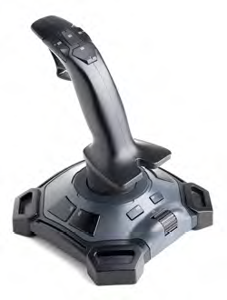
Pointing Device: Joystick
A joystick is a pivoting stick or lever attached to a base that is used to control movement on a device.
It typically also includes push buttons, toggles, or switches that control other actions associated with the program or device that the input is controlling.
The joystick inputs the angle and direction of a desired movement.
Joysticks are most commonly used to control video games or other computer programs, but are also used to control machines and devices such as cranes and unmanned vehicles.
Legacy joysticks connected to a computer via a game port, a device port designed specifically for connecting this input device.
Most modern joysticks connect to the device via a USB connection.

Slide 14
Output Devices: Printer
Output devices enable the user to get information and data out of the computer. Typical examples include printers, speakers, and displays.
A printer is a device that produces text and images from electronic content onto physical media such as paper, photo paper, and labels. A printer is one of the most popular peripheral devices in use in most computing environments.
Printers employ a range of technologies; the quality of the print output varies with the printer type and generally in proportion to the printer cost. A printer output of electronic documents is often referred to as “hard copy.” Printers can connect to computers by using a variety of connection types, with the most popular methods being USB, networked, and wireless.

Slide 15
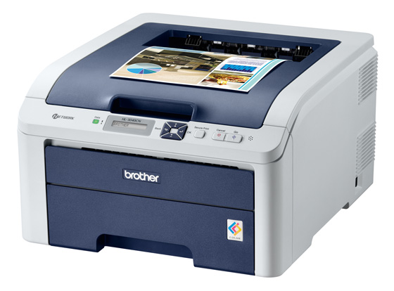
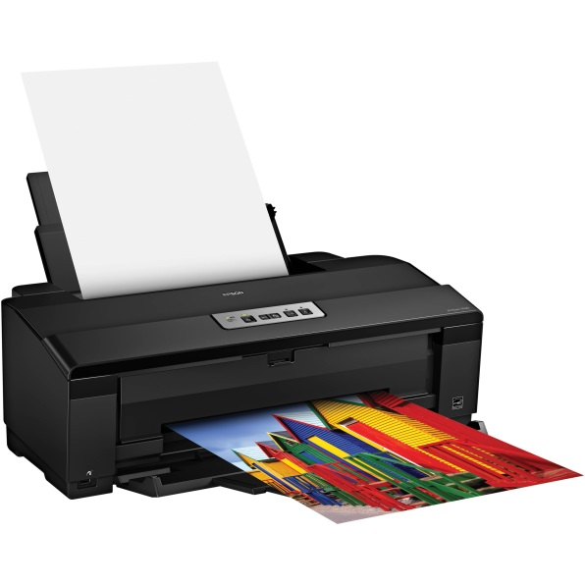
Printers
Laser Printer
  A laser printer is a printer that uses a laser beam to form images and toner to print the images on a printing medium, such as paper or photo paper
Inkjet Printer
  An inkjet printer is a printer that forms images by spraying liquid ink from an ink cartridge out of nozzles aimed carefully on the printer. Inkjet printers have a self-cleaning cycle and will park the printhead when not in use. The printer can use heat or vibrations to release the ink.

Slide 16
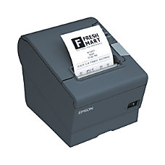
Printers
Thermal Printer
  A thermal printer is a general term for any printer that uses a heating element to create the image on the paper with dye, ink from ribbons, or directly with pins while the feed assembly moves the media through the printer. There are several types of thermal printers that use significantly different technologies and are intended for different uses. The most sophisticated types of thermal printers can produce professional photo-quality images. There are also thermal printers for everyday office use and for special-purpose applications. Most thermal printers will require special thermal paper that contain chemicals designed to react and change color as it is heated by the heating element within the printer to create images. These printers are commonly used with cash registers to print receipts.

Slide 17
Display Devices
A display device allows you view content accessible through your computer. This is typically in the form of a monitor. As the technology has changed for home television, so too has monitor technology. Display devices have a variety of connection types, including HDMI, DVI, and DisplayPort.

Slide 18
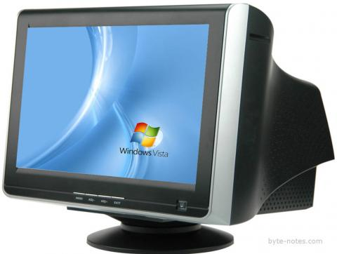
Display Device: CRT
Cathode ray tube (CRT) displays use electron beams within a vacuum tube to create images on a fluorescent screen. The intensity of three electron beams, one for each primary color (red, blue, and green), are manipulated to display the image on the screen.
CRT monitors are larger, heavier, and boxier than their more modern counterparts due to the components used to build them, especially the thick glass used for the screen. The screen may be curved or flat, but CRTs are not considered flatscreen monitors.
CRT monitors have for the most part been replaced by more modern and efficient displays like LCD, LED, or plasma screens, though many may still be in use in organizations who have yet to upgrade their devices.

Slide 19
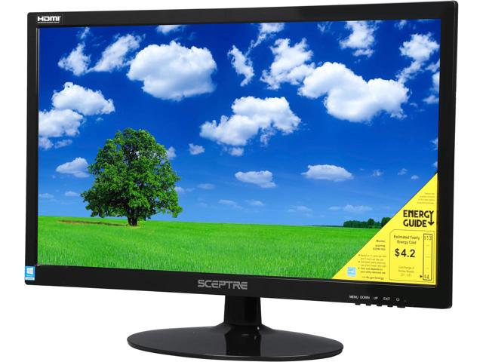
Display Device: LCD
Liquid crystal display (LCD) flatscreen displays are a compact, lightweight alternative to traditional CRT displays.
LCDs consume much less energy than CRTs and do not emit nearly as much electromagnetic radiation as CRTs do. LCD monitors use a cold cathode fluorescent lamp (CCFL) as the backlight source. CCFLs use electrodes and mercury vapor to create ultraviolet light that is used as the light source.
Depending on the LCD screen, the user may need to sit directly in front of the screen to see the display properly.
A unique feature of LCD displays is that the screen auto centers. There is typically no center alignment needed.

Slide 20
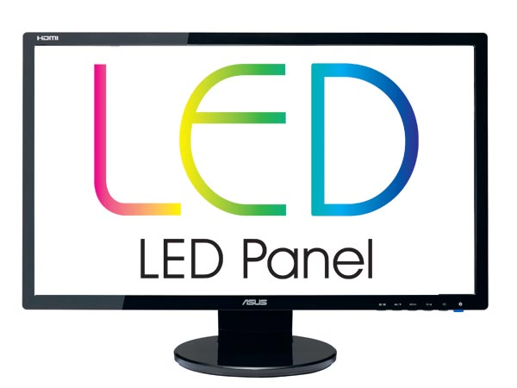
Display Device: LED
Light-emitting diode (LED) displays utilize the same screen as an LCD display, but use a different backlighting technique/technology. Instead of the CCFLs used in LCD, LED screens use one of two types of light emitting diodes as a backlighting source: dynamic RGB LEDs, which are located behind the panel; or white edge-LEDs, which are located around the edge of the screen and use a diffusion panel to evenly distribute the light source.
LED displays consume even less power than LCD displays. However, LED displays are currently more expensive to purchase.

Slide 21
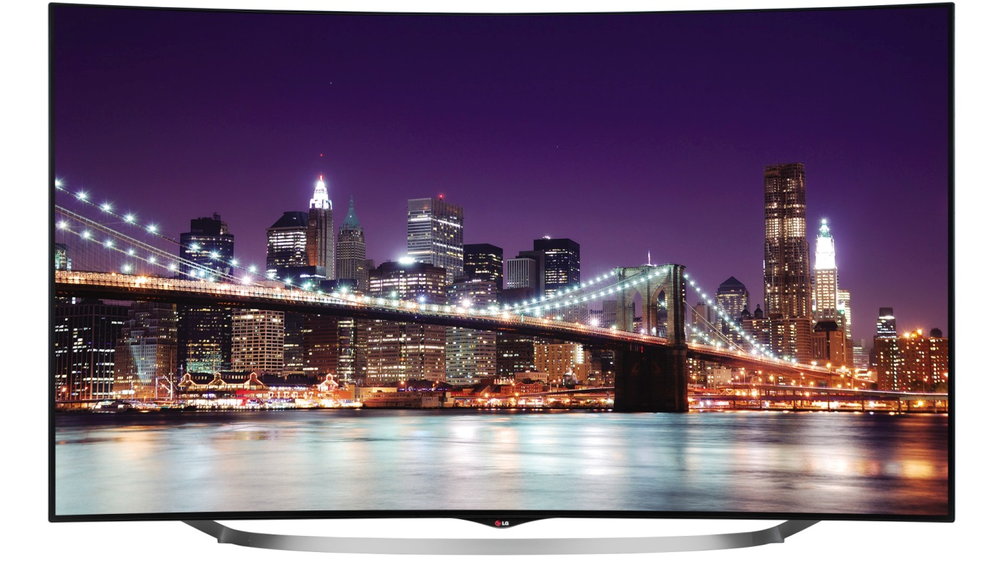
Display Device: OLED
Organic light emitting diode (OLED) displays utilize the same technology as LED displays, but use organic compounds that emit light when subjected to an electric current as the light source.

Slide 22
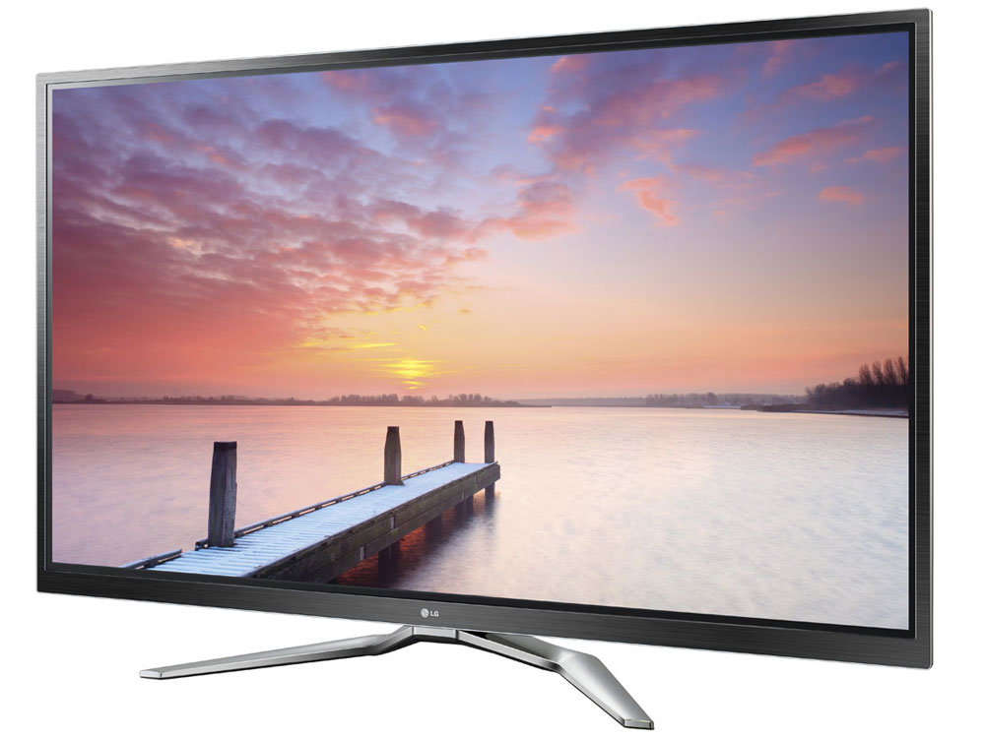
Display Device: Plasma
Plasma displays use xenon and neon rays and a flat panel of glass to provide visuals with high contrast, brightness, and vibrant colors that can be viewed from a multitude of angles.
However, plasma displays can suffer from image burn-in from repeated, long-term use. They are currently available only in very large dimensions, typically 40 inches or more, and are mostly marketed and utilized as television displays.
They can also be incredibly heavy and cumbersome due to the technology.

Slide 23
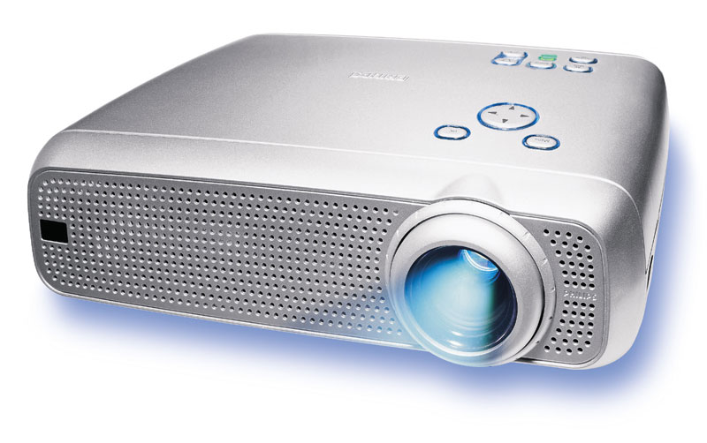
Display Device: Projector
Video projectors are often used to display the video output onto a whiteboard or other surface so that a larger audience can see it.

Slide 24
Speakers
Speakers can be attached to the device to play the audio out loud, without the need for headphones. Speakers are connected to the line out port or jack on the sound card. Some speaker sets are permanently connected to each other.
Other speaker sets are connected by the user to each other or to a subwoofer. A cable runs from one of the speakers to the line out port to connect both speakers to the computer. If the card is color-coded, the speaker port will be lime. The port might be labeled as Line Out, Out, Spkr, or Speaker, or it may have an image with an arrow indicating the direction of the audio (out). Speakers typically have a 1/8-inch phono plug built into the attached cable.

Slide 25
Devices that Perform Both Input and Output Functions
Some devices provide both input and output functionality. This includes devices such as fax devices, external storage devices, and touchscreen devices.
  Fax device functionality might be built into a card inserted in an expansion slot in your computer case, or it might be built into a printer. Printers with fax capabilities are referred to as multifunction devices. A multi-function device (MFD) is a piece of office equipment that performs the functions of a number of other specialized devices. MFDs typically include the functions of a printer, scanner, fax machine, and copier. However, there are MFDs that do not include fax functions. Although the multifunction device might not equal the performance or feature sets of the dedicated devices it replaces, multi-function devices are powerful, can perform most tasks adequately, and are an economical and popular choice for most home or small-office needs.
  There is a wide variety of external storage devices. Some are portable; others require access to network cabling.

Slide 26
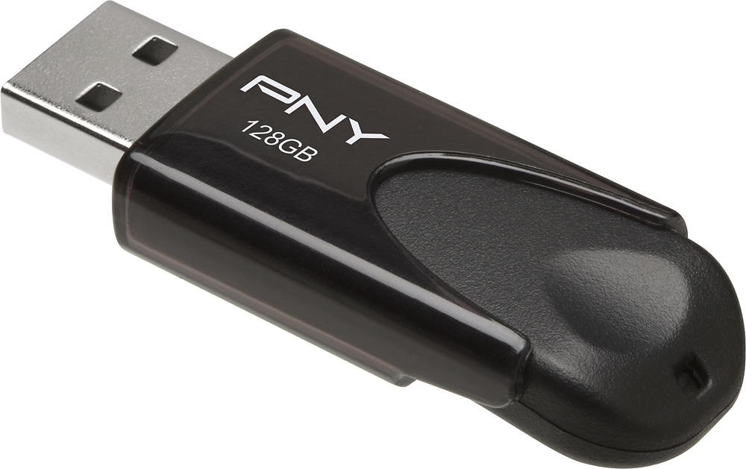
External Storage Device: Flash Drive
A flash drive is portable, with most being about 1/2-inch wide, 1/4- inch deep, and 3-inches long.
These typically connect to a USB port on your computer.

Slide 27
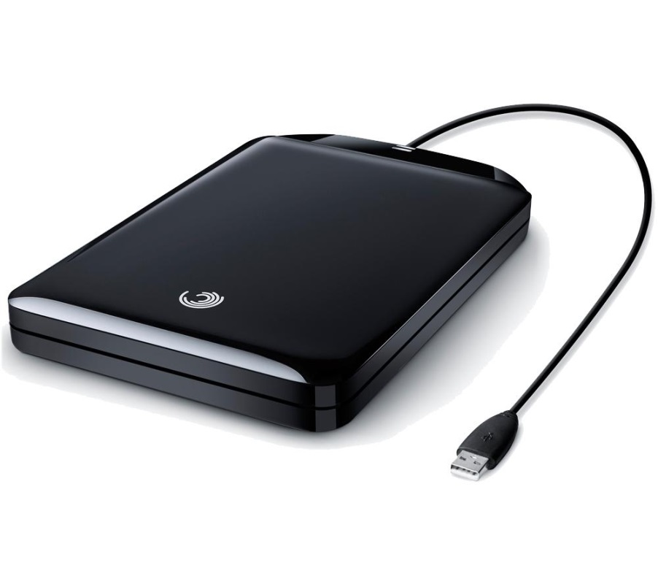
External Storage Device:
External Hard Drive
An external hard drive might connect to your computer via USB or FireWire. Some external hard drives come encased in an enclosure and others use an internal hard drive, placed in a docking unit.

Slide 28
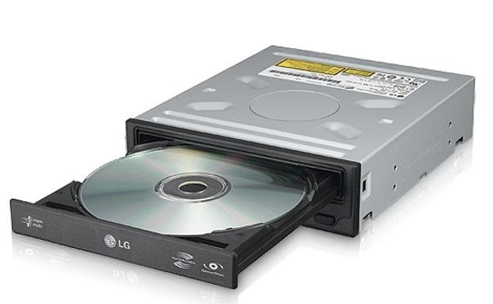
External Storage Device:
Optical Discs and Drives
CD, DVD, and Blu-ray discs that are capable of being written to fall into the category of being both input and output devices. The drive can be internal to the system or connected via USB or FireWire. The disc can be written on one computer and then read by any other computer.

Slide 29
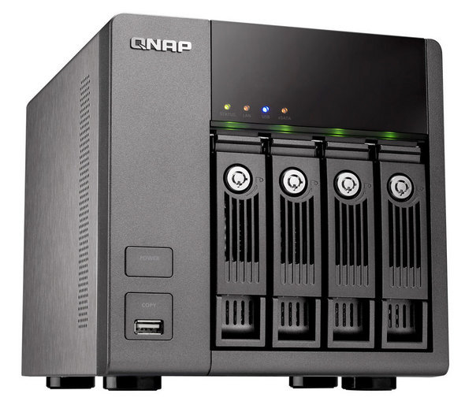
External Storage Device:
Network Attached Storage
A network attached storage (NAS) device is a hard drive that connects directly to the network cabling rather than to a specific computer. You can control which computers can access the NAS device.

Slide 30
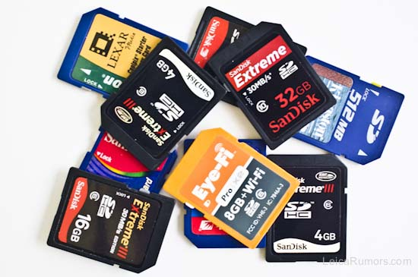
External Storage Device: Memory Card
The memory card used in your music player, camera, or smartphone can be connected to your computer to read and transfer images and data from the portable device to your computer. You can also write to the memory card while it is in your computer and then access the images or data on your music player, camera, or smartphone.

Slide 31
External Storage Device: Mobile Media
In addition to having memory cards in cameras and smartphones, there is memory built into the device on which images and data can be stored. In order to transfer the images and data from the internal mobile media memory to your computer, you will need to be able to connect the mobile device to your computer by using either a cable or a wireless networking protocol such as Bluetooth®.

Slide 32
External Storage Device: Smartphone
Smartphones typically use a USB connection to connect to a wall charger or to a computer. Connecting the smartphone to the computer allows you to read from and write to the internal memory or the memory card in the phone.

Slide 33
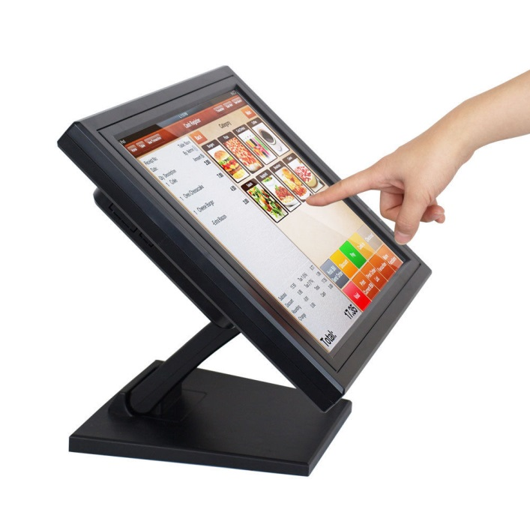
Touchscreen Monitors
Touchscreen monitors enable input by touching images on the screen. The screen also acts as the display for the computing device.
This technology is used in bank ATMs, some point-of-sale terminals at fast food restaurants, and other situations in which a separate keyboard for input is not appropriate. Touchscreens are also found on many smartphones, tablets, and laptops sold for general public use.

