Slide 1
Configure Network Access
Topic C: Network and Alternative Technologies

Slide 2
Virtualization
In a computing context, virtualization software allows for one physical device, such as a server operating system, to host multiple logical operating systems.
These logical systems are called virtual machines.
For instance, a single physical server can host several virtual servers using one hardware
platform. Server, storage, and network virtualization allow for greater efficiency among fewer
devices, which lowers equipment and power costs

Slide 3
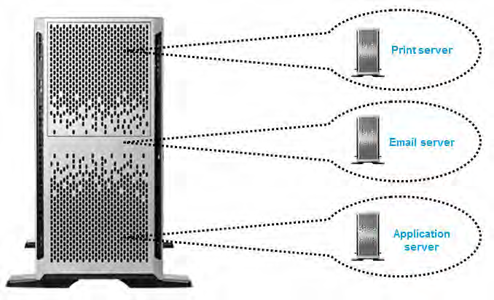

Slide 4
Cloud Computing
Cloud computing is a computing infrastructure in which resources, such as storage and applications, are hosted in a distributed fashion by a third party over the Internet.
The "cloud" is a metaphor for the Internet and the complexity of its infrastructure.
Cloud computing is an approach that allows companies to improve their efficiency by paying for only the resources used—much like paying for utilities.
Since client companies no longer need to require the hardware necessary to host these services internally, less equipment and power is needed.
Also, companies that provide computing resources locally typically need to provide enough to handle peak usage, which results in underutilization during non-peak workloads. Cloud computing solves this problem.

Slide 5
Cloud Computing (cont.)
Streaming is an example of a cloud service in which media files are transmitted by a provider over the Internet and viewed by the end user in real time.
Since the media is provisioned as needed, the end user transfers most of the processing responsibility onto the provider, and merely needs to maintain a strong Internet connection.
However, a major concern with cloud computing is the security of data.
Since the data is hosted by a third party, there are issues involving data ownership, backup, and confidentiality.

Slide 6
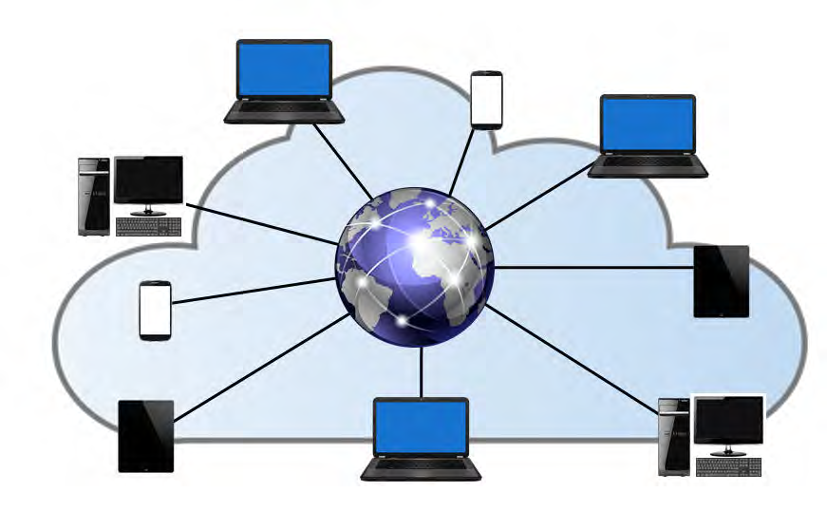

Slide 7
Web Applications
Web applications are software applications that are installed on web servers and delivered to users through the Internet.
End users interact with these applications through their web browsers.
This allows them to work with applications without having to install them on their systems.
Such services depend on network bandwidth for efficient use as the data transfer happens in real time.
An example of a web application is Google Docs, which offers word processing, spreadsheet, and presentation programs online.

Slide 8
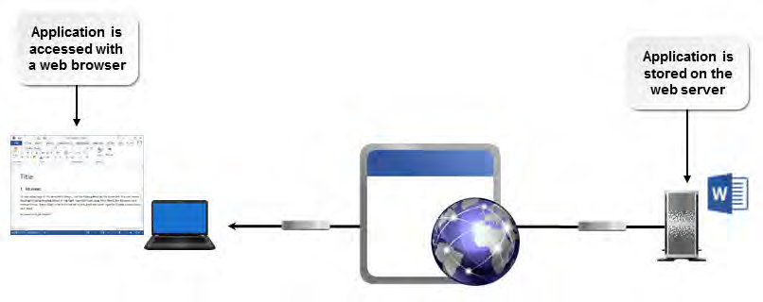

Slide 9
VOIP
Voice over IP (VoIP) is the transmission of voice communications over IP networks, such as the Internet.
The emergence of virtual meetings, which participants can attend remotely, is fueled by VoIP and screen-sharing technologies. Some applications even support the transmission of video and voice over the Internet.
This is a significant enabler for employee telecommuting, as it often replaces traditional telephone systems.
VoIP can help a business save money as well as energy and resources for the following reasons:
  Training sessions can be done remotely; no travel is needed.
  Remote offices can collaborate without being in the same physical location.
  VoIP is very cost efficient and bypasses long-distance charges.
Voice data files are larger in size when compared to text, so upgrading to a VoIP service requires high bandwidth.
You can also better support VoIP by configuring Quality of Service (QoS) on your Internet connection so that voice data will be preferred over other forms of network traffic.
QoS is typically implemented on the routers or switches.
By configuring QoS, you can improve the quality of voice data over the network.

Slide 10
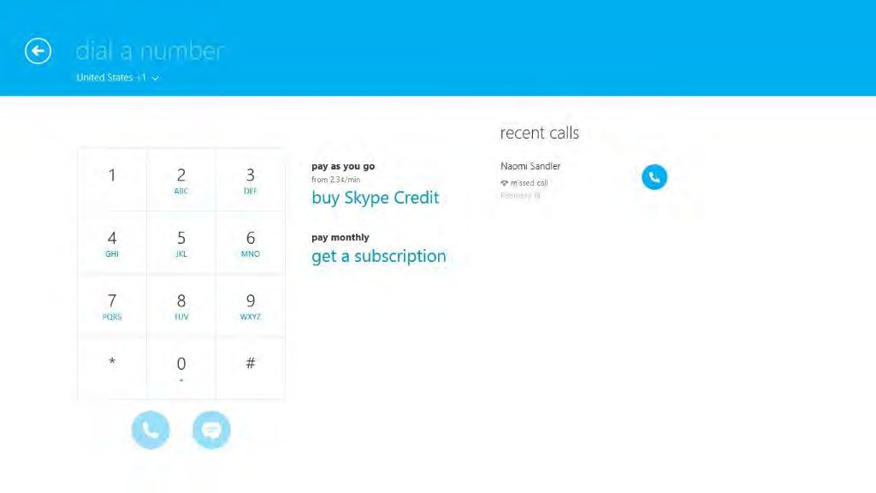

Slide 11
Telepresence
Telepresence is the technology that allows a person to feel as though they are present in a location different from the one they are in by including stimuli to encourage that feeling of presence.
Telepresence equipment requires video, audio, and manipulation capabilities.
Combining video teleconferencing equipment and mobile devices can provide some telepresence functions.
Automated robots with a connected mobile computing device (tablet, laptop, or iPad) can move around freely to simulate an absent person's presence.
Additionally, the ability to manipulate an object in a remote location can be accomplished by the use of robotic arms.

Slide 12
