Slide 1
Lesson 3: Setting Up a Basic Workstation
Topic A: Connect Hardware

Slide 2
Connect Hardware
In this lesson, you will set up a basic workstation. To start, you need to ensure that all of the physical components are properly attached to each other.
In this topic, you will connect hardware.
Even the most basic workstation usually needs to have a few external components connected to it, and as user needs become more complex, the number and variety of hardware components required to build a workstation also increases.
Connecting hardware together into a basic workstation enables you to meet the needs of your users.

Slide 3
Workstation Setup Process
Gather and connect hardware components. At a minimum, you will probably need to plug in cables for a monitor, keyboard, and mouse. But, if you have additional hardware—a printer, speakers, and a webcam, for example—you should connect them to the desktop computer, too.
Power on the computer.
If necessary, run the operating system setup utility.
If necessary, configure the peripherals. In some cases, this might be accomplished during the operating system installation.
Configure and verify the Internet connection. In some cases, this might be accomplished during the operating system installation.
Install security software.
Identify which applications should be on the workstation, and install or uninstall applications as necessary.
Update operating system, security, and application software as needed to ensure that all software is up to date.
Configure user accounts as needed.
Perform basic cable management to reduce clutter and enhance physical safety.

Slide 4
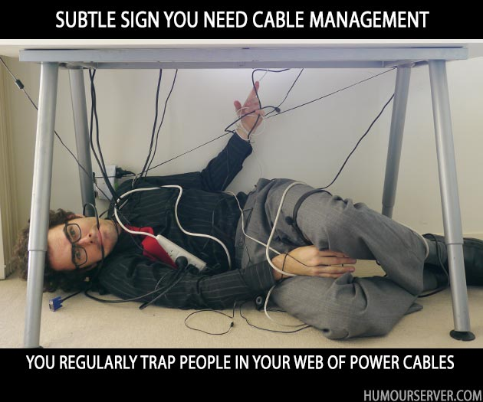
Cable Management
In office environments where there are many computers, there can be many cables and power cords. If these cords and cables are lying on the floor, they could possibly cause a tripping hazard.
Even with only one or a few computers, the cables that connect peripherals to computers and computers to networks can quickly become disorganized and unsightly.

Slide 5
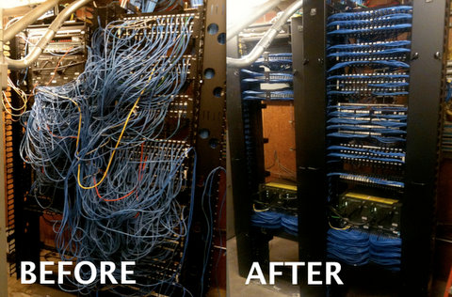
Cable Management
You can use some simple cable management techniques and tools to group and organize cables together to keep them out of the way and hidden from the general working space. Here are a few tips for managing cables:
  If cords and cables must traverse a floor area where people need to walk, it is recommended that cord protectors be used to shield the cords and cables from being damaged by pedestrian traffic, as well as to minimize the chance of someone tripping on the cords and cables.
  You can use Velcro® strips, twist ties, or even large binder clips to gather a computer's cables together so that they take up less space in your work area. Avoid using tie wraps, as they would need to be cut and replaced any time that you replace a cabled component.

Slide 6
Connect a Monitor
Turn off the computer, and unplug the monitor from the computer and the power source.
Locate the monitor port on the computer. It will likely be a 15-pin VGA adapter, a 29-pin DVI adapter, or a USB port.
Align the pins on the monitor cable connector with the holes in the adapter port, and plug in the monitor.
Secure the monitor to the port by tightening the screws on each side of the connector.
Plug the monitor power cord into an electrical source.
Turn on the computer.
Turn on the monitor.
Verify that the monitor works.
  Check that the power light is on, that it is green, and that it is not blinking.
  Make sure the colors are displayed correctly (that the colors are not washed out or wrong).
  Make sure there are no lines or distortions n the image displayed on the monitor, and that there is no waviness on the display.

Slide 7
Connect a Keyboard
Identify the type of keyboard you have. There are two types of keyboards available: PS/2 and USB.
Identify the port that suits the type of keyboard you have. The port will either be at the back of your computer or at the front if your computer has USB ports.
Insert the connector into the appropriate port (PS/2 or USB).
Start the computer and verify that no keyboard error is displayed during the boot process.
If necessary, install device drivers for the new input device.

Slide 8
Connect a Mouse
Identify the type of mouse you have. There are two types of mouse devices available: PS/2 and USB.
Identify the port that suits the type of mouse you have. Some computers have front USB ports; other ports may be at the back.
Insert the connector into the appropriate port (PS/2 or USB).
Start the computer, and verify that no mouse error is displayed during the boot process.
If necessary, install device drivers for the new input device.

Slide 9
Connect Audio Devices
If necessary, install a sound card.
  Shut down the computer, unplug the power cord, and open the computer case.
  Locate an available expansion card slot.
  Remove the slot cover.
  Insert the sound card into the open slot.
  Secure the sound card to the system unit with either the screw or the clip.
  Restart the computer, and install the device driver if you are prompted to do so.
Connect the speakers to the jack on the sound card marked for speakers. Some speakers use an external AC adapter for power, some are powered by the computer, some use batteries, and some include a standard electrical plug. If necessary, connect the speakers to their power source.

Slide 10
Connect Audio Devices
Connect any external input devices to the jack marked Line In.
Connect a microphone to the jack marked MIC.
Test the components by powering on the system and using each device.
Verify that Mute is not checked in the Volume Mixer.
  Select the Search charm, and type control
  Select Control Panel→Hardware and Sound.
  Under the Sound icon, select the Adjust system volume link.
  Verify that none of the Mute options are selected. If they are, select them again to unmute them.
  Close the Volume Mixer dialog box.

Slide 11
Connect Audio Devices
Configure audio devices.
  In the Hardware and Sound Control Panel, under the Sound icon, select the Manage audio devices link.
  On the Playback tab, you can select a playback device and view its properties by using the Properties button or configure the device by using the Configure button. If multiple playback devices are installed, you can use the Set Default button to select which device to use automatically.
  On the Recording tab, you can configure and view the properties of your microphones, and you can select which to use by default.
  On the Sounds tab, you can assign various sounds for different Windows operations.
  On the Communications tab, you can configure how Windows should adjust sound volumes when you send or receive a phone call on your computer.
  Select OK to save configuration changes and close the Sound dialog box, or select Apply to save configuration changes and leave the Sound dialog box open.
Close the Hardware and Sound Control Panel.

Slide 12
Connect a Web or Digital Camera
Identify the type of port your camera supports. Webcams and other digital cameras are manufactured in three different variants: USB, Ethernet, or Wi-Fi.
Insert the cable's connector into the port present in the camera.
Insert the other end of the cable into the appropriate port present in the computer or network device.
Install the driver and software provided by the manufacturer.
Verify that the device is working.

Slide 13
Connect a Plug-and-Play
Printer / Scanner
Place the printer/scanner closer to the computer in a convenient position. Laser printers should be positioned slightly away from the computer. The heat generated by laser printers can damage the internal components of a computer.
Shut down the computer.
Inspect the connectors at both ends of the printer/scanner cable.
Attach the correct end of the cable to the corresponding port on the computer. Do not force the cable. The cable will fit only in one way. If the cable is not fitting in the port, check the alignment of the pins and then plug it in.
Tighten the screws around the connector securely. Do not over tighten.
Insert the other end of the cable into the printer's/scanner's port.

Slide 14
Connect a Plug-and-Play
Printer / Scanner
Place the printer/scanner closer to the computer in a convenient position. Laser printers should be positioned slightly away from the computer. The heat generated by laser printers can damage the internal components of a computer.
Shut down the computer.
Inspect the connectors at both ends of the printer/scanner cable.
Attach the correct end of the cable to the corresponding port on the computer. Do not force the cable. The cable will fit only in one way. If the cable is not fitting in the port, check the alignment of the pins and then plug it in.
Tighten the screws around the connector securely. Do not over tighten.
Insert the other end of the cable into the printer's/scanner's port.

Slide 15
Connect a Plug-and-Play
Printer / Scanner
Verify that the power supply LED on the printer/scanner is on.
Use the printer interface in the computer's operating system to verify that the device's drivers were installed automatically. For example, in most versions of Windows, check whether the device appears in the Printers folder.
Perform a test print or test scan.
Note: Almost all popularly used operating systems, such as Microsoft® Windows® and Mac OS®, come with built-in drivers. They will install the drivers automatically for all the popular printer/scanner models. If a printer model is launched after the operating system release, it is possible that the operating system will not recognize the printer/scanner. In such cases, the user may have to use the CD-ROM provided by the manufacturer to install the drivers, or download a driver from the manufacturer's website.

Slide 16
Install a Local Printer
Verify that the printer you have chosen is compatible with your operating system and applications.
It is possible to install printer software in Windows without attaching a physical printer. However, if you do have a print device, prepare the device for installation:
  Check with your printer vendor's documentation to see if the vendor recommends installing the latest device drivers before connecting the device, so that the plug-and-play auto-detect function works with the latest device definitions.
  Verify that the printer is properly connected and configured and that the printer power is on.
Log on to the computer.
If the system detects the printer and launches the New Hardware wizard automatically, follow the steps in the wizard to install the printer.
If the system does not detect the printer or if there is no printer attached, and if you have downloaded drivers or an installation disc from the printer manufacturer, follow the manufacturer's instructions to install the printer from the installation files.
Otherwise, open Control Panel.
Open Devices and Printers.

Slide 17
Install a Local Printer
Select the Add a printer button to start the Add Printer wizard.
If the Add Printer wizard detects the new printer, select it and select Next. Otherwise, select The printer that I want isn't listed.
Select Add a local printer or network printer with manual settings and then select Next.
From the Use an existing port drop-down list, select the port to which your printer is connected, and then select Next.
On the Install the printer driver page:
  Below Manufacturer, select the manufacturer of the printer.
  Below Printers, select the printer model.
  Select Next.
In the Printer name text box, type a name for the printer, and verify that the Set as the default printer check box is checked.
Select Next.
Select the Print a test page button to print a test page.
Select Close to close the information box.
Select Finish.
Close the Printers window.

Slide 18
Share an Existing Local Printer
Open Control Panel→Network and Internet.
Open the Network and Sharing Center.
On the left side of the Network and Sharing Center, select Change advanced sharing settings.
If necessary, select the chevron to expand the current profile.
In the File and printer sharing section, select Turn on file and printer sharing.
Select Save changes. If necessary, provide the administrator password or other confirmation.
In the Network and Sharing Center, select Control Panel Home.
Select Devices and Printers.
Display the context menu for the printer you want to share, and then select Printer properties.
Select the Sharing tab, and check Share this printer.
Select OK.
Close the Devices and Printers Control Panel.

Slide 19
Install a Network Printer
Open Control Panel→Devices and Printers.
Select Add a printer.
Select Add a network, wireless, or Bluetooth printer. Windows will search for available printers.
Select the shared printer that you want to install, and then select Next.
Select the printer you want to install and select Next.
In the Printer name text box, type a name for the printer and select Next.
Select Finish.

