Slide 1
Using Office Backstage
Microsoft Excel 2013
Lesson 3

Slide 2
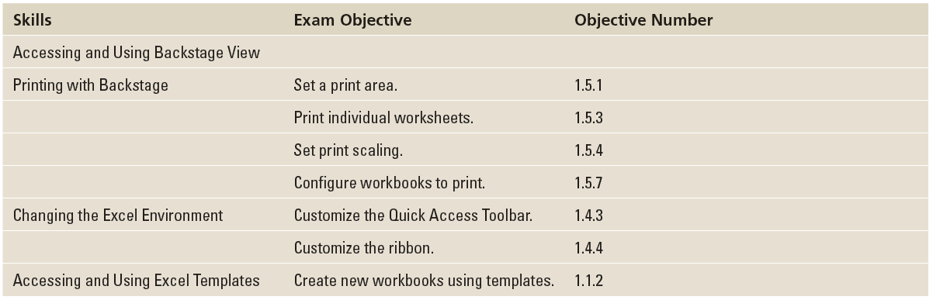
Objectives

Slide 3
Software Orientation
The ribbon is a visual interface that allows you to work in a file and perform tasks such as changing fonts, creating charts, and formatting numbers. The Backstage view, on the other hand, is a visual interface that lets you use and master Excel's file management features—functions that allow you to do things to a file rather than in a file.

Slide 4
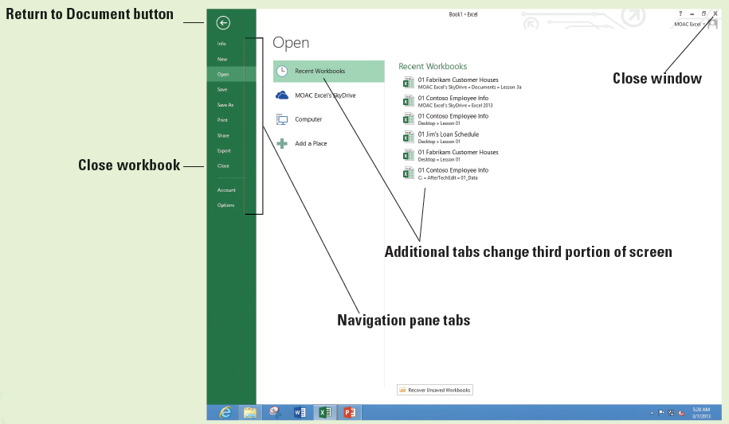
Software Orientation
Backstage view's left-side navigation pane (below) gives you access to workbook and file-related commands through a series of tabs, including Info, New, Open, Save, Save As, Print, Share, Export, Close, Account, and Options.

Slide 5
Software Orientation
Some of the tabs give you additional tabs. Other tabs allow you to select from many different options or settings. Finally, some tabs accomplish a task and return you to the workbook.
Notes:
Take Note: The Exit command is no longer available in Office 2013, at least in the same way it was available in prior versions. In this case, the Close tab in Backstage view closes the workbook. The Close (X) button in the upper right corner of the Excel 2013 window closes Excel.

Slide 6
Accessing and using Backstage View
In the Excel 2013 window, you see the green FILE tab in the upper left corner. This is your access to Backstage view.
When you click the FILE tab to access Backstage view, you see the navigation pane containing many of the same commands that can be accessed through the Microsoft Office button in previous versions of Excel.

Slide 7
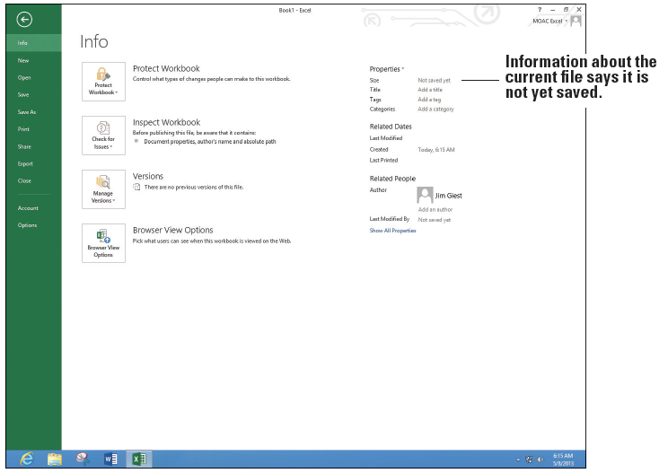
Step by Step: Access Backstage View
GET READY. LAUNCH Excel and OPEN a blank workbook.
  Click the FILE tab to display Backstage view with the Open tab selected.
  In the upper left corner
  of Backstage view, click
  the Return to
  document button.
  In cell A1, type abc
  and press Enter.
  Click the FILE tab.
  Backstage view, like
  the ribbon, is context-
  sensitive and changes to the Info tab (above).
Notes:
Another Way: You can also press Alt + F to select FILE and go to the Backstage view.

Slide 8
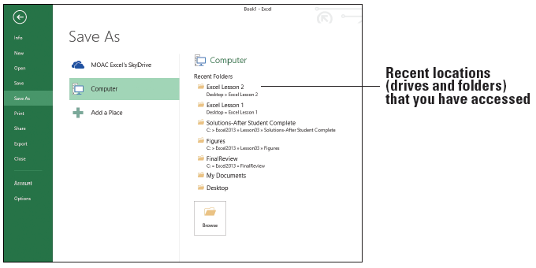
Step by Step: Access Backstage View
  Click the Save tab. Notice that there are additional tabs depending on your setup. In this case, SkyDrive, Computer, and Add a Place appear.
  Click the Save As tab. Notice that this looks identical to the Save tab. This is how it looks the first time you save the file.
  Click Computer and notice that the Recent Folders section where you last saved your previous workbooks appears (below).

Slide 9
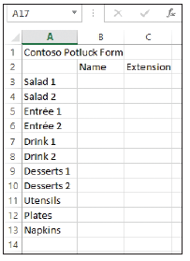
Step by Step: Access Backstage View
  Click Browse, in the File name box, type Temp, and then click Save.
  Click FILE. Notice the Info tab appears.
  Click Save. Notice that you do not
  see the options shown at right (and
  Step 5 previously), but that you return
  directly to the workbook.
  Click FILE and click Close. This action
  closes the workbook, but not Excel.
  Click FILE and the Open tab appears.
  In the list of Recent Workbooks, select Temp and your workbook returns.
PAUSE. EXIT Excel.

Slide 10
Printing with Backstage
Backstage view contains Excel's Print commands and options.
You can use the Print settings to manipulate workbook elements such as margins, orientation, paper size, and so on.
Backstage view includes a Print tab with a Print Preview pane so you can preview your workbook as you click Print options.
Print options are a series of settings that allow you to change how a document prints.
You can print the document so it is horizontal or vertical, display gridlines on the page, scale the text to make it fit on a single page, and select from many other options.

Slide 11
Step by Step: Print and Preview a Document
GET READY. LAUNCH Microsoft Excel 2013.
  Create a new workbook, enter the
  worksheet data shown at right, and
  save it as 03 Contoso Potluck.
  EXIT Excel.
  LAUNCH Excel again and notice
  that 03 Contoso Potluck Solution
  appears in your Recent list. Click
  the file to bring it back up.
Notes:
Another Way: Another way to create a new workbook is with the Ctrl + N keyboard shortcut.

Slide 12
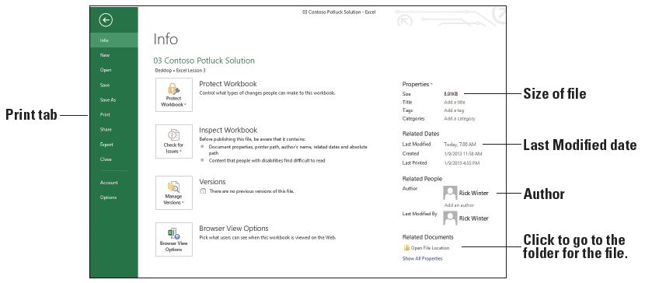
Step by Step: Print and Preview a Document
  Click the FILE tab to automatically display the Info tab. As shown below, the Properties area shows the size of the file, when it was last modified, and who the author is.

Slide 13
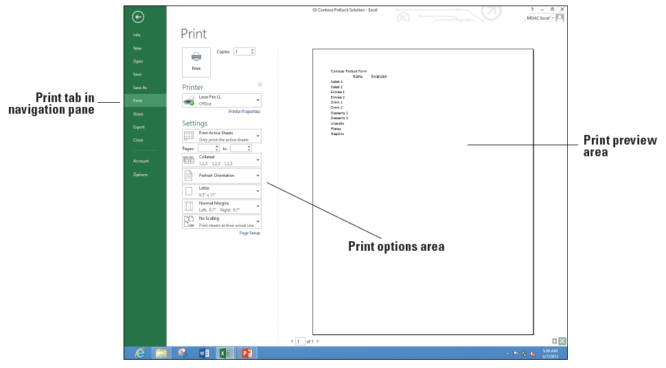
Step by Step: Print and Preview a Document
  Click the Print tab. Note that this displays the Print options in Backstage view. Take a moment to preview the workbook in the Print Preview section in the right pane and read through the Print options listed in
  the center section of
  the page (right).
  To print your work-
  sheet, at the top of
  the Print screen,
  click the Print
  button.
PAUSE. LEAVE the
workbook open for the
next exercise.
Notes:
Another Way: You can also activate Backstage view and access Print options by pressing Ctrl + P.

Slide 14
Using Quick Print to Print a Worksheet
Use the Print tab in Backstage view when you need to review a draft of a worksheet before you are ready to print the final workbook.
If you click the Quick Print icon on the Quick Access Toolbar, the worksheet is sent directly to the printer.
The Quick Print command on the Quick Access Toolbar is useful because worksheets are frequently printed for review and editing or distribution to others.

Slide 15
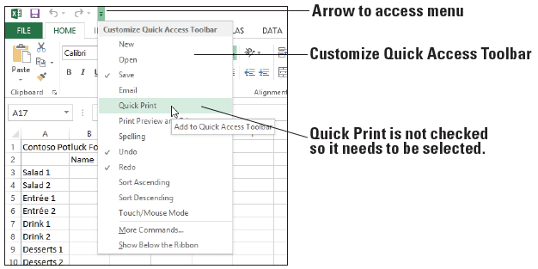
Step by Step: Use Quick Print to Print a Worksheet
GET READY. USE the open workbook from the previous exercise or open 03 Contoso Potluck Solution.
  On the Quick Access Toolbar, if you do not see the Quick Print button, click the Customize Quick Access Toolbar arrow at the end of the toolbar, and select Quick Print (below).
Notes:
Take Note: Discuss with your instructor whether you can print in the classroom. If you cannot, view all the documents in preview mode to see how the document print whenever printing is mentioned in this book.

Slide 16

Step by Step: Use Quick Print to Print a Worksheet
  On the Quick Access Toolbar, click Quick Print (below).
  Retrieve the printed copy of the worksheet from your printer.
  Click the FILE tab, and then click Print. The preview pane should match what was printed.

Slide 17
Step by Step: Use Quick Print to Print a Worksheet
  Click the Return to document arrow.
  Notice that a dotted vertical line appears in the middle of the screen. The line shows the right edge of the printed page. The line displays the first time you print or preview a page.
PAUSE. LEAVE the workbook open for the next exercise.

Slide 18
Setting the Print Area
You can use the Print options in Backstage view to print only a selected portion, or print area, of an Excel workbook.
You print just the list of items and have a couple of people verify that these are items you should have people bring to the potluck.

Slide 19
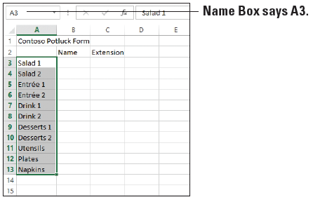
Step by Step: Set the Print Area
GET READY. USE 03 Contoso Potluck Solution that is already open or create the workbook shown on slide 11.
  Click the PAGE LAYOUT tab.
  In the Page Setup group,
  point to the Print Area
  button. Note the ScreenTip
  that displays and defines the
  task to be completed.
  On the worksheet, click cell
  A3, hold the mouse button,
  and drag to cell A13. Your cell range should be highlighted in gray (above).

Slide 20
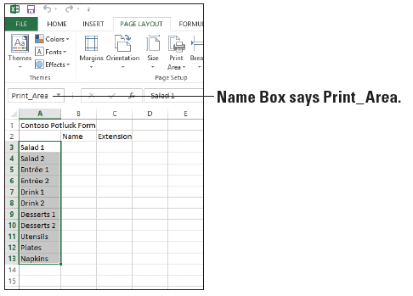
Step by Step: Set the Print Area
  With these cells highlighted, click the Print Area drop-down arrow and click Set Print Area from the menu that appears. You have now set the print area. While the area is still selected, note that the Name Box now says “Print_Area” (right).
  Click the FILE tab to
  access Backstage view.

Slide 21
Step by Step: Set the Print Area
  Click Print and notice in the Print Preview pane that you can see only the list of items to bring and not the text in rows 1 and 2 and columns B and C.
  Click the Return to document button. You will not print at this time.
PAUSE. SAVE the workbook with the current name
03 Constoso Potluck Solution and CLOSE Excel.

Slide 22
Step by Step: Print Selected Worksheets
GET READY. LAUNCH Excel 2013, and then perform these steps:
  OPEN 03 Contoso Potluck Depts. This is a modified version of the potluck workbook you created previously. In this case, there are three different worksheets for three different departments.
  Click each of the three worksheet tabs: HR, Operations, and Finance. Notice that the title in C1 shows the department name and there are a different number of items to bring to each potluck depending on the size of the department. Click the HR tab.

Slide 23
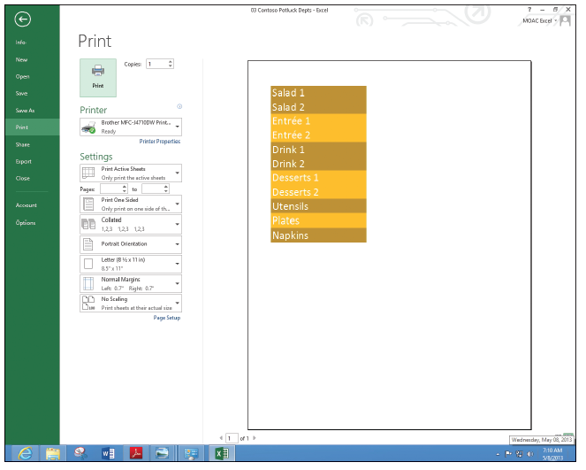
Step by Step: Print Selected Worksheets
  Press Ctrl + P to display
  the Print options in the
  Backstage view. In the
  Print Preview pane, the
  entire worksheet does
  not display (right). This is
  because of the selected
  print area.
  Press Esc or click the
  Return to document
  button.
  Click the PAGE LAYOUT tab, click Print Area, and then Clear Print Area.

Slide 24
Step by Step: Print Selected Worksheets
  Click the FILE tab and click Print. Notice that the entire worksheet for HR appears. Also notice that the page number shows 1 out of 1 indicating that only one of the worksheets will print, and it will all fit on one page.
  In the Settings section of the center pane in Print options, click the Print Active Sheets drop-down arrow. In the drop-down menu that appears, as shown in Figure 3-12, you can select several printing options for your workbook or worksheet.

Slide 25
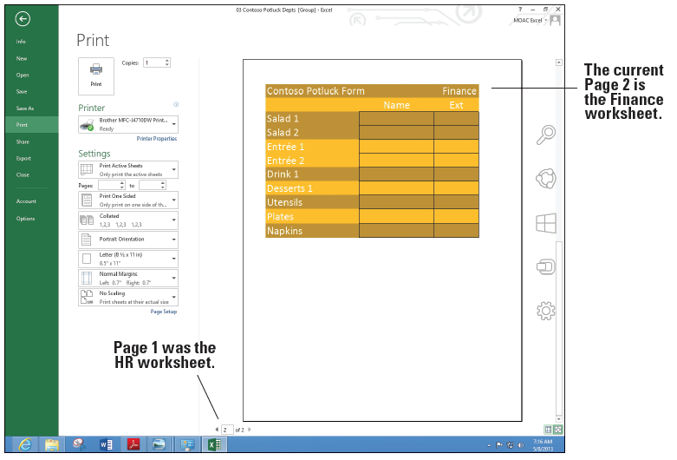
Step by Step: Print Selected Worksheets
  Click the Return to document button.
  While the HR worksheet is
  active, hold down Ctrl and
  click on the Finance tab.
  Now both the HR and
  Finance worksheets are
  selected.
  Click the FILE tab and click
  Print. Now in the Print
  Preview area, the bottom
  of the screen shows 1 of 2
  with the HR worksheet preview. Click the right arrow to go to the second page and notice that the Finance worksheet previews (above).

Slide 26
Step by Step: Print Selected Worksheets
  Click the Return to document button to return to the workbook without printing.
PAUSE. CLOSE the workbook without saving. LEAVE Excel open for the next exercise.

Slide 27
Printing Selected Workbooks
In most scenarios in business, workbooks are composed of multiple worksheets.
It is much easier to print an entire workbook than to print the workbook’s worksheets individually.

Slide 28
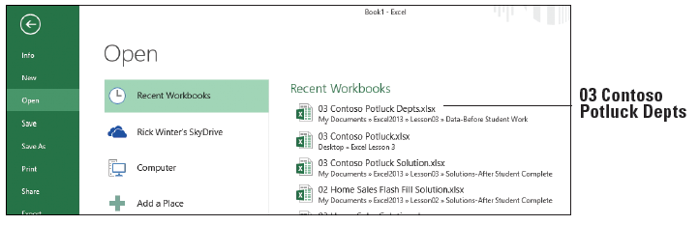
Step by Step: Print Selected Workbooks
GET READY. With Excel open from the previous exercise, perform the following steps.
  Click the FILE tab and click Open if it is not selected. Because you just used the 03 Contoso Potluck Depts workbook, it should be at the top of the list of the Recent Workbooks (below).
  Click 03 Contoso Potluck Depts to open it.
  Click the FILE tab and click Print.

Slide 29
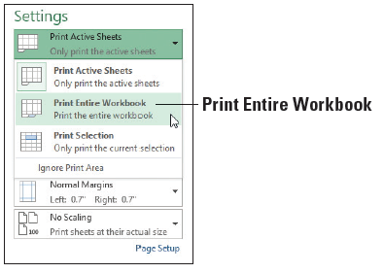
Step by Step: Print Selected Workbooks
  Notice that the complete worksheet for HR does not display. This is because you did not save the workbook after you cleared the print area. Clear the print area as you did in Step 5 of the previous section and return to the Print tab of Backstage view.
  In the Print window’s Settings
  options, click the Print Active
  Sheets drop-down arrow and
  click Print Entire Workbook
  (right). You will not print at this
  time.
PAUSE. EXIT Excel and do not
SAVE the workbook.

Slide 30
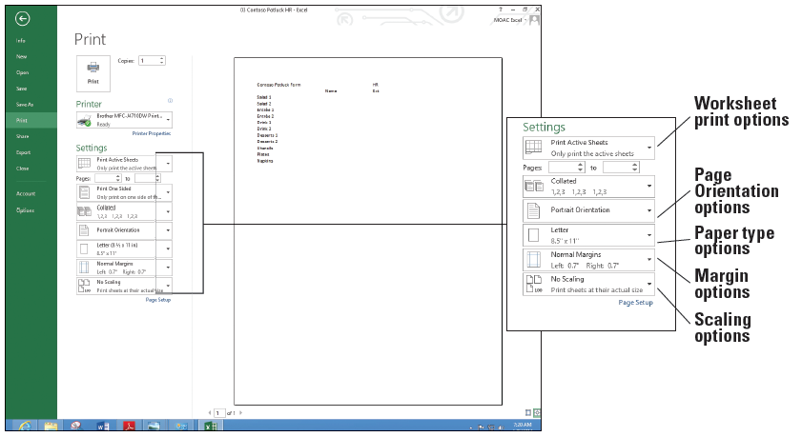
Step by Step: Apply Print Options
GET READY. LAUNCH Excel, OPEN 03 Contoso Potluck HR, and make sure the HR-P1 worksheet is selected.
  Click the FILE tab and select Print (below). Notice that the worksheet is small and it might be nice to have lines for people to write in on a printed page.

Slide 31
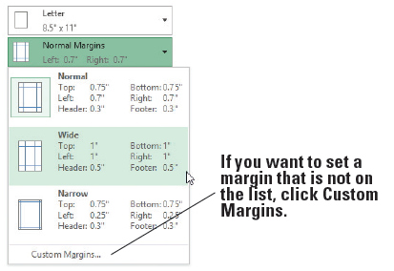
Step by Step: Apply Print Options
  In the Settings section of the Print window, click the Margins drop-down and click Wide (below). The new margins will allow the worksheet to be hole-punched and put in a binder.

Slide 32
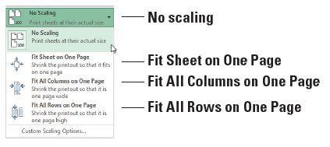
Step by Step: Apply Print Options
  Click the Scaling drop-
  down and see the
  choices below (right).
  The scaling options
  ensure that all columns,
  rows, or the entire
  worksheet fit on one page.
Current choice is No scaling, so the document prints the same size as the screen.
If you want to fit everything that is on the worksheet on one page, select Fit Sheet on One Page.
If there are just a couple of columns extra, click Fit All Columns on One Page. If there are just a couple of rows extra, click Fit All Rows on One Page.

Slide 33
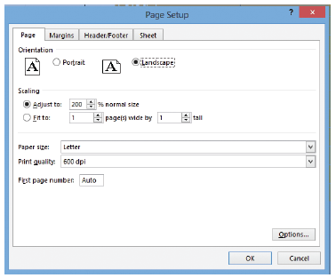
Step by Step: Apply Print Options
  In this case, you make the text larger without changing the font. Click Custom Scaling Options. The Page Setup dialog box opens.
  Make sure that the Page tab is
  selected and select Landscape
  so the page prints horizontally.
  In the Scaling area, type 175
  for the % normal size (right).
  Click the Sheet tab and in the
  Print section, select the Gridlines box.
Notes:
Another Way: You can customize the workbook settings and options from the PAGE LAYOUT tab in the Page Setup, Scale to Fit, and Sheet Options groups.

Slide 34
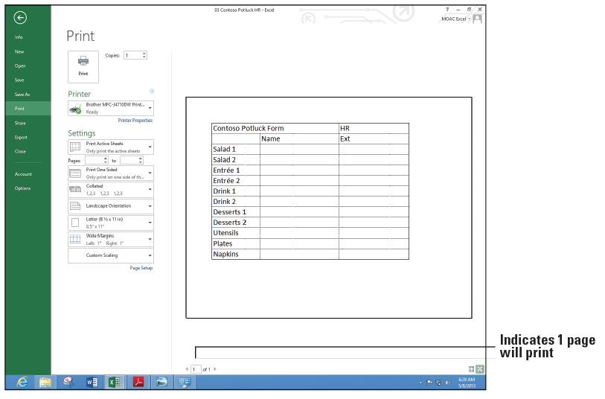
Step by Step: Apply Print Options
  Click OK to return to Backstage view. Notice that the bottom of the screen still says, "1 of 1," meaning that only one page will print and notice that Print Preview shows larger text with boxes around each cell (below).

Slide 35
Step by Step: Apply Print Options
  Without printing the document, click the Return to document button and then click the HR-P2 worksheet.
  Press Ctrl + P to go to the Print tab of the Backstage view and notice that the bottom of the screen indicates that the document will print on two pages.

Slide 36
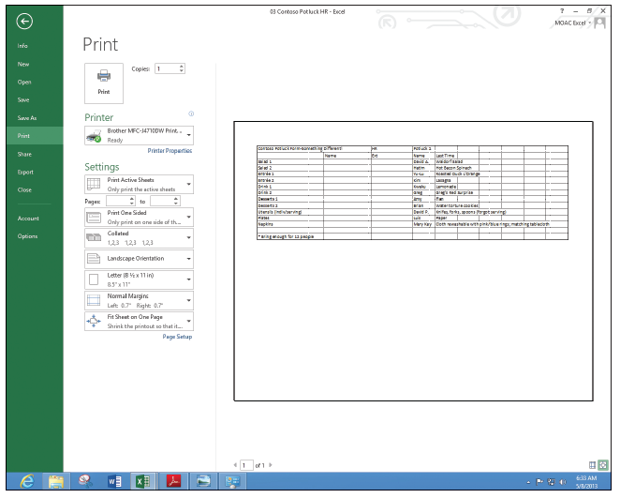
Step by Step: Apply Print Options
  Change the Settings to print Landscape, to Fit Sheet on One Page, and add gridlines based on the previous steps in this section. Print Preview
  should look like the
  figure at right.
  SAVE the workbook as
  03 Contoso Potluck HR
  Print Ready Solution.
PAUSE. LEAVE the workbook
open for the next exercise.

Slide 37
Changing a Printer
In many business settings, you print documents on multiple printers.
Some of the printers allow you to print documents with color. Other printers might have special options such as large paper sizes. Some printers print quickly for large standard jobs of many pages.
You change the selected printer using Backstage view.
Notes:
Take Note: If you use multiple printers in your office, make sure you understand the costs associated with printing for each printer; some printers can print for around a penny per page, whereas others can be almost a dollar per page. Other Print options allow you to send a document by e-mail (see Lesson 11) or to a shared location (see Lesson 1).

Slide 38
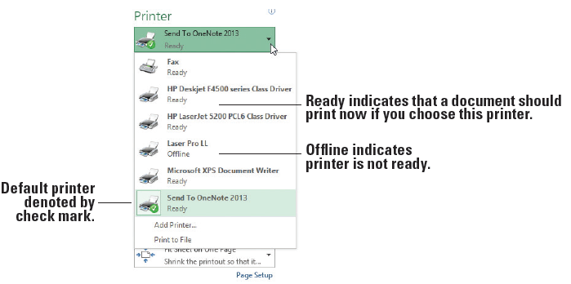
Step by Step: Change a Printer
GET READY. Continue with the previous workbook or if necessary, open 03 Contoso Potluck HR Print Ready Solution.
  Press Ctrl + P to
  display the Print tab
  of the Backstage view.
  Your current default
  printer is displayed
  in the Printer options
  section of the Print
  tab. Click the Printer
  drop-down arrow to produce a menu of installed printers, similar to the one shown above. Your printers will be either Ready or Offline.

Slide 39
Step by Step: Change a Printer
  Click on a printer (other than your default printer) in the printer list. This printer should now be visible as your active printer. Should you attempt to print at this time with an inactive printer, you will get an error.
  Once again, click the drop-down arrow for the printer, and select your default printer (the one with the checkmark).
PAUSE. CLOSE your workbook and don't save if prompted.
Notes:
Troubleshooting: To change a default printer in Windows 8, click the Start button, type change default printer, click the Settings button (1 item should match your search), click the Change default printer button, right-click your printer, and select Set as default printer.

Slide 40
Changing the Excel Environment
Backstage view also offers a number of commands and options for changing the Excel work environment.
You can manipulate various elements of the Excel environment, such as the ribbon, Quick Access Toolbar, Excel default settings, and workbook properties.
Default settings are pre-set settings that predetermine how Excel will behave when performing an action. For example, a default printer is the one your documents always print to unless you change it.
By default, there is one worksheet in a workbook and the font is 11 points—but you can change those settings too.

Slide 41
Customizing the Quick Access Toolbar
You can’t change the size of the Quick Access Toolbar, but you can customize it by adding and removing command buttons.
You customize the Quick Access Toolbar by adding commands for functions you use most frequently in Excel, and by organizing the command buttons on the toolbar to best suit your working needs and style.
Notes:
Take Note: After you change the Excel environment in these exercises, you return it to the defaults in the Resetting Default Settings exercise.

Slide 42
Step by Step: Customize the Quick Access Toolbar
GET READY. OPEN a blank workbook in Excel.
  Click the FILE tab to access Backstage view.
  In the navigation pane, click the Options tab. The Excel Options dialog box opens.

Slide 43
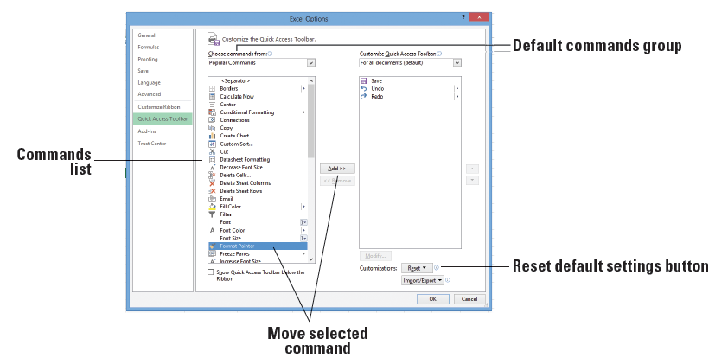
Step by Step: Customize the Quick Access Toolbar
  In the left pane of the dialog box, click Quick Access Toolbar to display the Quick Access Toolbar options (below). In the right pane, the list on the left includes the commands that you can add to the toolbar. The list on the right shows the commands that are currently included on the toolbar.

Slide 44
Step by Step: Customize the Quick Access Toolbar
  In the list on the left, scroll down and click Format Painter, and then click the Add button in the center of the two lists to add the Format Painter to the Quick Access Toolbar.
  Using the same process, move five more commands you use often to the Quick Access Toolbar. When you are done, click OK to apply your changes (the changes don't take effect until you click OK).

Slide 45
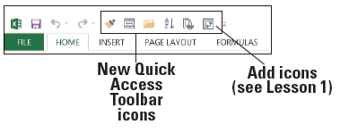
Step by Step: Customize the Quick Access Toolbar
  Your Quick Access Toolbar should now include additional command buttons, much like the example shown below. Similarly, you can remove any command that you added to the toolbar. At any time, you can reset the toolbar to its default settings. See the Reset button on slide 43.
PAUSE. CLOSE Excel.
Notes:
Another Way: You can right-click on any button on the ribbon and select Add to Quick Access Toolbar to instantly add it to the Quick Access Toolbar.

Slide 46
Customizing the Ribbon
The ribbon is a visual interface that allows you to manipulate items on your worksheet. You can add a new ribbon tab, add a group on any ribbon tab, and add commands within a group.
A group of commands on the default ribbon tabs are related in functionality. For example, on the HOME tab, the Font group allows you to change the font, font size, add bold, italic, or underline, or change the color of the cell or font.
The Excel Options dialog box also offers selections for customizing the ribbon. You can add and remove commands, and you can change the location of ribbon commands to make accessing those you use most frequently more convenient.

Slide 47
Step by Step: Customize the Ribbon
GET READY. OPEN a blank workbook in Excel.
  Click the FILE tab to access Backstage view.
  Click the Options tab in the navigation pane.

Slide 48
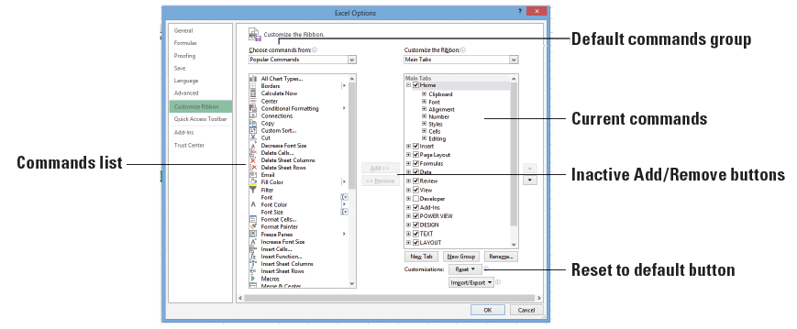
Step by Step: Customize the Ribbon
  In the Excel Options dialog box, click Customize Ribbon. The Customize the Ribbon options appear (below). By default, Popular Commands is selected in the Choose Commands From drop-down box. The list of Popular Commands appears in the list below the drop-down box. Also, by default, the Main Tabs option appears in the Customize the Ribbon box on the right, with the ribbon’s main tabs listed below.

Slide 49
Step by Step: Customize the Ribbon
  In the list of Popular Commands, click Format Painter. Note the Add button in the center of the dialog box is now active.
  In the Customize the Ribbon list on the right, click the + preceding Home to expand the list of command groups within the Home tab if it isn't already expanded. You can use this method to display the current groups available on a Ribbon tab.

Slide 50
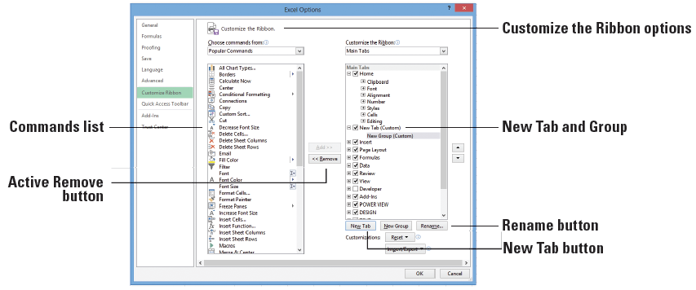
Step by Step: Customize the Ribbon
  Under the Customize the Ribbon options, click the New Tab button (below) to insert a new blank tab into the Customize the Ribbon list. When you create a New Tab, New Group is automatically created inside that New Tab.

Slide 51
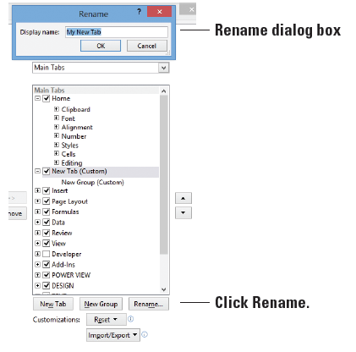
Step by Step: Customize the Ribbon
  Click the New Tab
  (Custom) list item on
  the right to select it,
  and then click the
  Rename button. In the
  Rename dialog box that
  appears, type My New
  Tab (right), and then
  click OK.

Slide 52
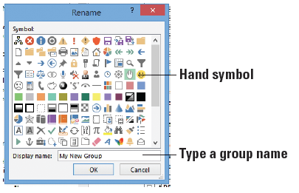
Step by Step: Customize the Ribbon
  Under your new tab,
  click New Group
  (Custom) to select it.
  Click the Rename
  button again. This time,
  the Rename dialog box
  allows you to select a
  symbol (right). Select
  the hand symbol, in the Display name box, type My New Group, and then click OK. You see the New Group renamed.

Slide 53
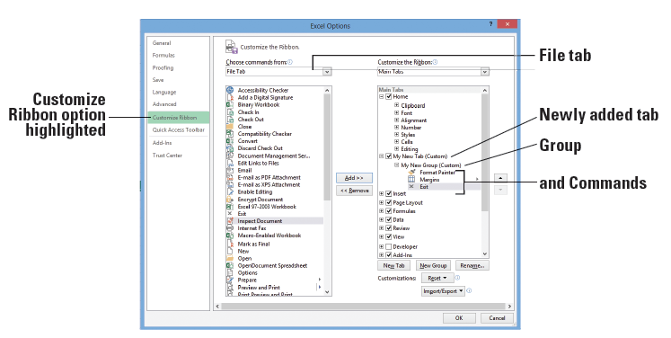
Step by Step: Customize the Ribbon
  In the Customize the Ribbon list on the right, click the My New Group list item. In the command list on the left, click on a command of your choice, and then click the Add button. The command appears on your new ribbon tab. In the Choose commands from list, select All Commands and then add another command from this list. In the Choose commands from list, select File Tab and then add another command. Your screen should look similar to the figure below.

Slide 54
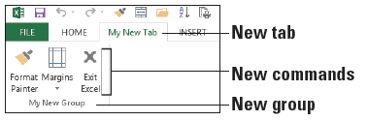
Step by Step: Customize the Ribbon
  Click OK to close the Excel Options dialog box. When you exit, you see your tab named My New Tab on the ribbon.
  Click the My New Tab tab. Your commands display in the tab’s My New Group (below).
PAUSE. LEAVE the workbook open for the next exercise.

Slide 55
Customizing the Excel Default Settings
The Excel Options dialog box commands also enable you to modify the default settings in Excel.
These defaults can include worksheet properties, printer settings, font style and size, and much more.
By default, for example, Excel 2013 opens with one worksheet displayed in a new workbook and a default font size of 11pt.
You change Excel's default settings using Backstage view.

Slide 56
Step by Step: Customize the Excel Default Settings
GET READY. Continue with a blank workbook from the previous exercise.
  Click on the FILE tab to access Backstage view.
  In the navigation pane, click Options. By default, the Excel Options dialog box opens with the General options displayed.

Slide 57
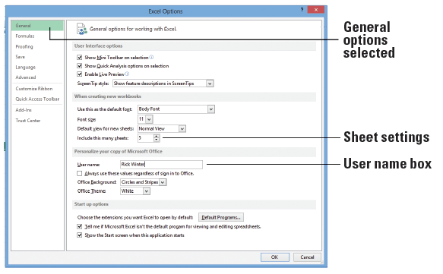
Step by Step: Customize the Excel Default Settings
  In the When creating new workbooks section, click in the Include this many sheets text box and type 5 to change the number of worksheets that appear by default in new workbooks.
  In the Personalize your
  copy of Microsoft Office
  section, click the User
  name box and type [your
  first and last name] in the
  text box (right). Click OK.

Slide 58
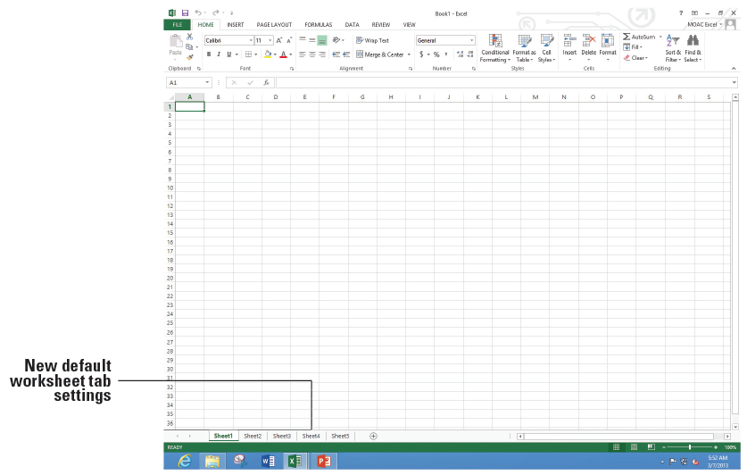
Step by Step: Customize the Excel Default Settings
  EXIT and RESTART Excel and select Blank workbook. Note that instead of one worksheet tab, you now have five in your workbook (below).
PAUSE. LEAVE
the workbook
open for the
next exercise.

Slide 59
Step by Step: Reset Default Settings, Ribbon, and Quick Access Toolbar
GET READY. Continue with a blank workbook from the previous exercise.
  Click the FILE tab, and click Options.
  On the General tab, in the When creating new workbooks section, in the Include this many sheets box, type 1.
  Click the Customize Ribbon tab.
  In the bottom right of the dialog box, click the Reset button and then click Reset all customizations.

Slide 60
Step by Step: Reset Default Settings, Ribbon, and Quick Access Toolbar
  In the Confirmation dialog box, click Yes to clear all ribbon and Quick Access Toolbar customizations for this program.
  Click OK to return to the workbook.
PAUSE. LEAVE the workbook open for the next exercise.
Notes:
Take Note: The ribbon and Quick Access Toolbar changes are immediate, but you need to open a new, blank workbook to notice the change for the number of displayed workbooks.

Slide 61
Accessing and Using Excel Templates
Excel has several templates that are available when you start Excel or when you click the FILE tab and select New, and many more templates for which you can search.
Templates are files that already include formatting and formulas complete with designs, tools, and specific data types.

Slide 62
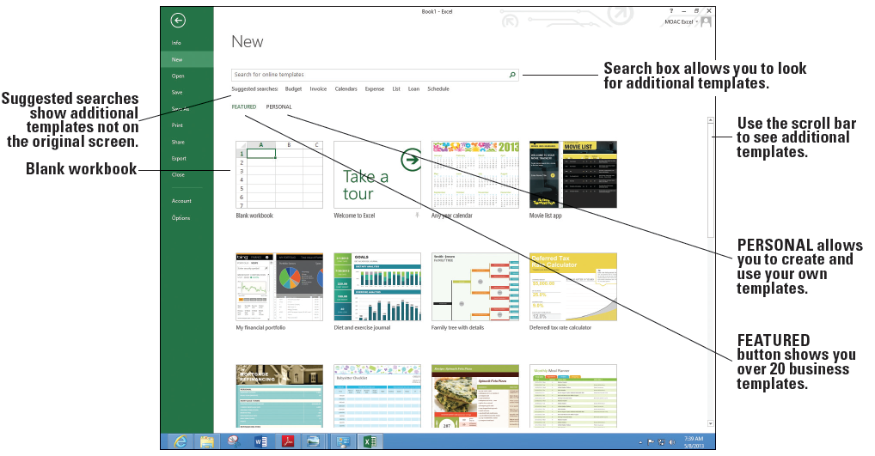
Step by Step: Select a Template from the New Tab
GET READY. If necessary, OPEN a blank workbook.
  Click the FILE tab and click New. The New window displays as shown below, with a series of featured templates. You already used the Blank workbook template in this book.

Slide 63
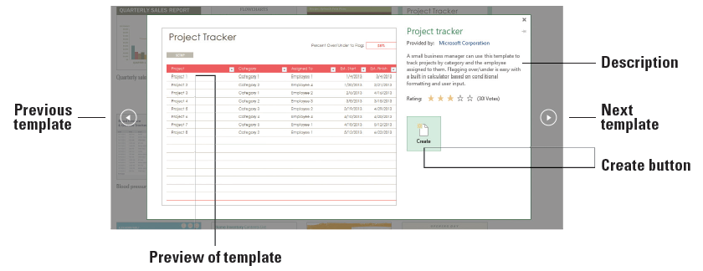
Step by Step: Select a Template from the New Tab
  Scroll down if necessary, and click on the Project Tracker icon. The figure below shows a larger window with a larger picture and description of the template.

Slide 64
Step by Step: Select a Template from the New Tab
  Click the Create button. Excel might take a moment to download the workbook.
  Notice that there are two worksheets in this workbook: Project Tracker with the sample data you can change and Setup that allows you to input a list of categories and employees. When you are finished looking at this template, click FILE and click Close. If prompted, do not save changes.

Slide 65
Step by Step: Select a Template from the New Tab
  Click the FILE tab, click New, and scroll to the bottom of the templates list.
  Click the Any year calendar template and click the Create button.
  Click cell M3 and type [the current year].
  On the bottom of the screen, select the current month’s tab.

Slide 66
Step by Step: Select a Template from the New Tab
  Print the month's worksheet and put on your wall, if desired.
  SAVE the workbook as 03 My Calendar Solution.
  Click the FILE tab and click New. Notice that the Any year calendar template appears as the third item on your list of templates because it was recently used.
PAUSE. CLOSE the workbook and LEAVE Excel open for the next exercise.
Notes:
Take Note: You can modify this new workbook with your name, company name, favorite pictures for each month to personalize your calendar and make it your own, or use as a gift for others.

Slide 67
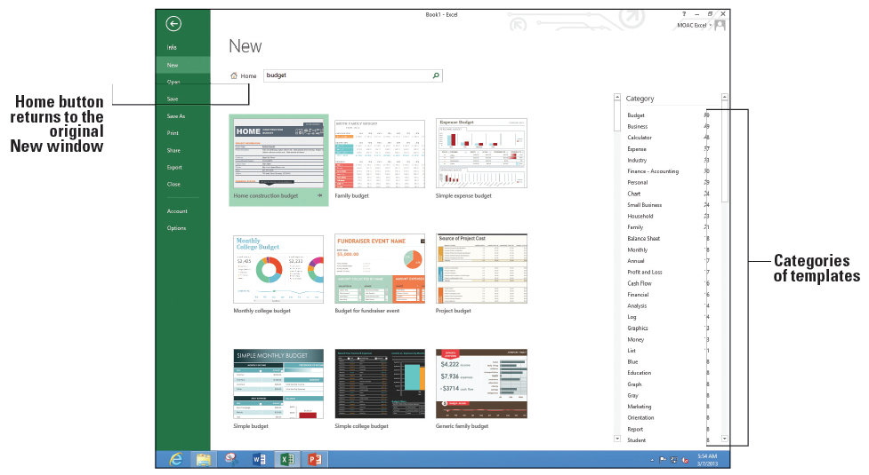
Step by Step: Search for Additional Templates
GET READY. If necessary, OPEN a blank workbook.
  Click the FILE tab and click New. Notice the Suggested searches and Search for online templates box.
  Click Budget on the Suggested searches row. As shown below, the New window changes to show templates specifically related to working with budgets.

Slide 68
Step by Step: Search for Additional Templates
  Scroll to the bottom of the window and click on a few templates to see their descriptions.
  Scroll back to the top of the New window and click Home to return to the original templates screen.
  In the Suggested Searches row, click Calendars.
  In the Category pane to the right, click Student.
  Scroll to the Student assignment planner and read the description. Close the template description window.

Slide 69
Step by Step: Search for Additional Templates
  In the Search box, type College and press Enter. Scroll through the list of suggested templates for college students and open the Weekly college schedule template.
  Type in [Monday's date] in B1 and play with the workbook.
  SAVE the workbook as 03 My Weekly Schedule Solution. Click Yes when prompted to save this as a macro-free workbook.
PAUSE. EXIT Excel.

Slide 70
Skills Summary

