Slide 1
Lesson 7: Securing Computing Devices
Topic A: Identify Common Security Threats

Slide 2
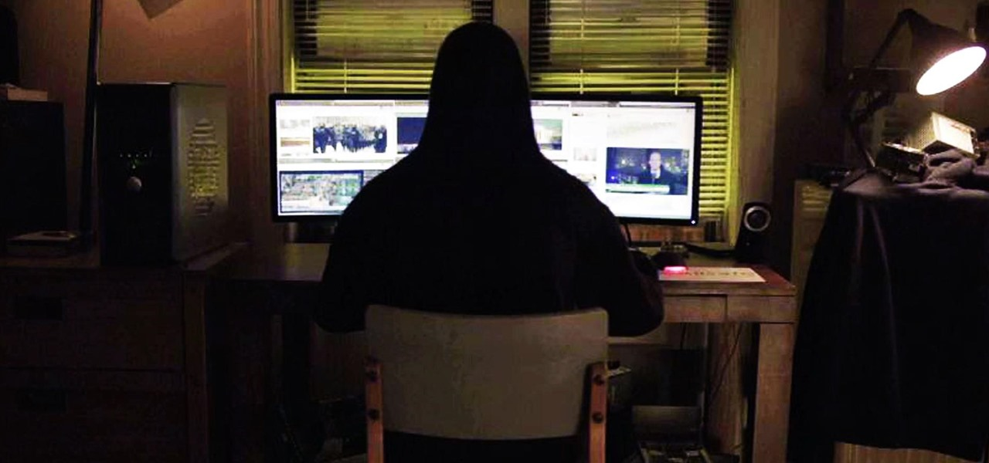
Hackers and Attackers
Hackers and attackers are related terms for individuals who have the skills to gain access to computer systems through unauthorized or unapproved means.
Originally, a hacker was a neutral term for a user who excelled at computer programming and computer system administration.
Hacking into a system was a sign of technical skill and creativity that also became associated with illegal or malicious system intrusions.
Attacker is a term that always represents a malicious system intruder.

Slide 3

Hackers and Attackers (cont.)
White hats and black hats get their names from characters in old Western movies: The good guys always wore white hats and the bad guys wore black hats.
A white hat is a hacker who discovers and exposes security flaws in applications and operating systems so that manufacturers can fix them before they become widespread problems.
The white hat often does this professionally, working for a security organization or a system manufacturer. This is sometimes called an ethical hack.
A black hat is a hacker who discovers and exposes security vulnerabilities for financial gain or for some malicious purpose.
Although the black hats might not break directly into systems the way attackers do, widely publicizing security flaws can potentially cause financial or other damage to an organization.
People who consider themselves white hats also discover and publicize security problems, but without the organization's knowledge or permission.
They consider themselves to be acting for the common good. In this case, the only distinction between a white hat and a black hat is one of intent.
There is some debate over whether this kind of unauthorized revelation of security issues really serves the public good or simply provides an avenue of attack.

Slide 4
Malware
Malware is any unwanted software that has the potential to damage a system, impede performance,or create a nuisance condition.
The software might be introduced deliberately or inadvertently and might or might not be able to propagate itself to other systems.
Many malicious code attacks fall into the general malware category.
Having a good antivirus program installed and running prevents most of these types of attacks from affecting you, your files, and your computer

Slide 5
Malware Type | Descriptions
Virus | A piece of code that spreads from one computer to another by attaching itself to other files. The code in a virus executes when the file it is attached to is opened. Frequently, viruses are intended to enable further attacks, send data back to the attacker, or even corrupt or destroy data.
Worm | A piece of code that spreads from one computer to another on its own, not by attaching itself to another file. Like a virus, a worm can enable further attacks, transmit data, or corrupt or erase files.
Trojan Horse | An insidious type of malware that is itself a software attack and can pave the way for a number of other types of attacks. There is a social engineering component to a Trojan horse attack since the user has to be fooled into executing it.
Logic Bomb | A piece of code that sits dormant on a target computer until it is triggered by a specific event, such as a specific date. Once the code is triggered, the logic bomb detonates, and performs whatever actions it was programed to do. Often, this includes erasing and corrupting data on the target system.

Slide 6
Malware Type | Descriptions
Spyware | Surreptitiously installed malicious software that is intended to track and report the usage of a target system, or to collect other data the author wishes to obtain. Data collected can include web browsing history, personal information, banking and other financial information, and user names and passwords.
Adware | Software that automatically displays or downloads advertisements when it is used. Although not all adware is malicious, many adware programs have been associated with spyware and other types of malicious software. Also, it can reduce user productivity by slowing down systems and simply by creating annoyances.
Rootkit | Code that is intended to take full or partial control of a system at the lowest levels. Rootkits often attempt to hide themselves from monitoring or detection, and modify low-level system files when integrating themselves into a system. Rootkits can be used for non-malicious purposes such as virtualization; however, most rootkit infections install backdoors, spyware, or other malicious code once they have control of the target system.

Slide 7
Malware Type | Descriptions
Spam | Spam is an email-based threat that presents various advertising materials, promotional content, or get-rich-quick schemes to users. The messages can quickly fill a user's inbox and cause storage issues. Spam can also carry malicious code and other types of malware.
Ransomware | Ransomware is malicious software that prevents you from using your computer. It usually displays a message stating that you must pay a fee or face some other penalty before you can access your files and computer again. Paying the ransom doesn't necessarily mean that you will regain access to your files or computer.

Slide 8
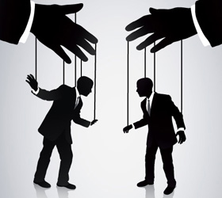
Social Engineering
A social engineering attack is a type of attack that uses deception and trickery to convince unsuspecting users to provide sensitive data or to violate security guidelines.
Social engineering is often a precursor to another type of attack.
Because these attacks depend on human factors rather than on technology, their symptoms can be vague and hard to identify.
Social engineering attacks can come in a variety of methods: in person, through email, or over the phone.
Social engineering typically takes advantage of users who are not technically knowledgeable, but it can also be directed against technical support staff if the attacker pretends to be a user who needs help.
Social engineering attacks can be prevented with effective user education.

Slide 9
Social Engineering Type | Description
Shoulder Surfing | This is a human-based attack where the goal is to look over the shoulder of an individual as he or she enters password information or a PIN. Shoulder surfing can happen in an office environment, a retail environment, at an ATM or at the entryway of a secure physical facility. When you are setting up workstations, the monitors should be placed so that they are not facing hallways or windows and giving passersby an opportunity to view information on the screen. This also applies to employees who work from home. Their equipment should not be accessible by other family members or visible to people walking past their homes.
Spoofing | This is a human-based or software-based attack where the goal is to pretend to be someone else for the purpose of identity concealment. Spoofing can occur in Internet Protocol (IP) addresses, network adapter's hardware (Media Access Control [MAC]) addresses, and email. If employed in email, various email message headers are changed to conceal the originator's identity.

Slide 10
Social Engineering Type | Description
Impersonation | This is a human-based attack where an attacker pretends to be someone he is not. A common scenario is when the attacker calls an employee and pretends to be calling from the help desk. The attacker tells the employee he is reprogramming the order-entry database, and he needs the employee's user name and password to make sure it gets entered into the new system.
Hoax | This is an email-based or web-based attack that is intended to trick the user into performing undesired actions, such as deleting important system files in an attempt to remove a virus. It could also be a scam to convince users to give up important information or money for an interesting offer.

Slide 11
Social Engineering Type | Description
Phishing | This is a common type of email-based social engineering attack. In a phishing attack, the attacker sends an email that seems to come from a respected bank or other financial institution. The email claims that the recipient needs to provide an account number, Social Security number, or other private information to the sender in order to verify an account. Ironically, the phishing attack often claims that the account verification is necessary for security reasons. Individuals should never provide personal financial information to someone who requests it, whether through email or over the phone. Legitimate financial institutions never solicit this information from their clients. A similar form of phishing called pharming can be done by redirecting a request for a website, typically an e-commerce site, to a similar-looking, but fake, website.
Vishing | This is a human-based attack where the goal is to extract personal, financial, or confidential information from the victim by using services such as the telephone system and IP-based voice messaging services (Voice over Internet Protocol [VoIP]) as the communication medium. This is also called voice phishing.

Slide 12
Social Engineering Type | Description
Whaling | This is a form of phishing that targets individuals who are known to possess a good deal of wealth. It is also known as spear phishing. Whaling targets individuals that work in Fortune 500 companies or financial institutions whose salaries are expected to be high.
Spam and Spim | Spam is an email-based threat that presents various advertising materials, promotional content, or get-rich-quick schemes to users. The messages can quickly fill a user's inbox and cause storage issues. Spam can also carry malicious code and other types of malware. Spam can also be categorized as a type of social engineering because it can be used within social networking sites such as Facebook and Twitter. Spim is an Internet messaging (IM)-based attack similar to spam that is propagated through IM instead of through email.

Slide 13
Social Engineering Type | Description
Dumpster Diving | Most people and companies are environmentally aware and recycle papers that they are done using. If that piece of paper contains company confidential information, be sure that it is shredded and placed in a secure recycle bin. Attackers are not above jumping into a Dumpster or large recycling location in an attempt to obtain information they can use or sell. Outdated hardware should never be thrown in the trash. The hardware contains heavy metals that could contaminate the soil. Also, hard drives and other storage devices might contain sensitive information. It is not uncommon to find thieves searching for such hardware in the hopes of finding valuable information on the devices. By properly disposing of paper and hardware, you can protect your organization from Dumpster divers.

Slide 14
Password Cracking
A password attack is any type of attack in which the attacker attempts to obtain and make use of passwords illegitimately.
The attacker can guess or steal passwords or crack encrypted password files.
A password attack can show up in audit logs as repeatedly failed logons and then a successful logon, or it can show as several successful logon attempts at unusual times or locations.
Hackers use several common categories of password attacks.
Creating complex passwords can increase the amount of time it takes for an attack to succeed

Slide 15
Password Attack Type | Description
Guessing | A guessing attack is the simplest type of password attack and involves an individual making repeated attempts to guess a password by entering different common password values, such as the user's name, a spouse's name, or a significant date. Most systems have a feature that will lock out an account after a specified number of incorrect password attempts.
Stealing | This is an email-based or web-based attack intended to trick the user into performing undesired actions, such as deleting important system files in an attempt to remove a virus. It could also be a scam to convince users to give up important information or money for an interesting offer.
Dictionary Attack | A dictionary attack automates password guessing by comparing encrypted passwords against a predetermined list of possible password values. Dictionary attacks are successful against only fairly simple and obvious passwords, because they rely on a dictionary of common words and predictable variations, such as adding a single digit to the end of a word.
Brute Force Attack | In a brute force attack, the attacker uses password-cracking software to attempt every possible alphanumeric password combination.
Hybrid Password Attack | A hybrid password attack utilizes multiple attack vectors including dictionary, brute-force, and other attack methodologies when trying to crack a password.

Slide 16
Physical Security Issues
Threat / Vulnerability | Description
Internal | It is important to always consider what is happening inside an organization, especially when physical security is concerned. For example, disgruntled employees may be a source of physical sabotage of important network security-related resources
External | It is impossible for any organization to fully control external security threats. For example, an external power failure is usually beyond a network technician's control because most organizations use a local power company as their source of electrical power. However, risks posed by external power failures may be mitigated by implementing devices such as an uninterruptible power supply (UPS) or a generator.

Slide 17
Physical Security Issues (cont.)
Threat / Vulnerability | Description
Natural | Although natural threats are easy to overlook, they can pose a significant risk to the physical security of a facility. Buildings and rooms that contain important computing assets should be protected against likely weather-related problems including tornadoes, hurricanes, snow storms, and floods.
Man-Made | Whether intentional or accidental, people can cause a number of physical threats. Man-made threats can be internal or external. For example, a backhoe operator may accidentally dig up fiber optic cables and disable external network access. Alternatively, a disgruntled employee may choose to exact revenge by deliberately cutting fiber optic cables.

Slide 18
Environmental Threats and Vulnerabilities
Environmental Threat | Effects and Mitigations
Fire | Fire, whether natural or deliberately set, is a serious network environment security threat because it can destroy hardware and therefore the data contained in it. In addition, it is hazardous to people and systems. You need to ensure that key systems are installed in a fire-resistant facility, and that there are high-quality fire detection and suppression systems on-site so that the damage due to fire is reduced.
Hurricanes and Tornadoes | Catastrophic weather events such as hurricanes and tornadoes are major network security threats due to the magnitude of the damage they can cause to hardware and data. You need to ensure that your information systems are well-contained and that your physical plant is built to appropriate codes and standards so that damage due to severe weather is reduced.

Slide 19
Environmental Threats and Vulnerabilities (cont.)
Environmental Threat | Effects and Mitigations
Flood | A flood is another major network security threat that can cause as much damage as fire can. Your organization should check the history of an area to see if you are in a flood plain before constructing your physical plant, and follow appropriate building codes as well as purchase flood insurance. When possible, construct the building so that the lowest floor is above flood level; this saves the systems when flooding does occur. Spatial planning together with protective planning in concurrence with building regulations and functional regulations are precautionary measures that should be looked into as well.

Slide 20
Environmental Threats and Vulnerabilities (cont.)
Environmental Threat | Effects and Mitigations
Extreme Temperature | Extreme temperatures, especially heat, can cause some sensitive hardware components to melt and degrade, resulting in data loss. You can avoid this threat by implementing controls that keep the temperature in your data center within acceptable ranges.
Extreme Humidity | Extreme humidity can cause computer components, data storage media, and other devices to rust, deteriorate, and degrade, resulting in data loss. You can avoid this threat by ensuring that there is enough ventilation in your data centers and storage locations, and by using temperature and humidity controls and monitors.

Slide 21
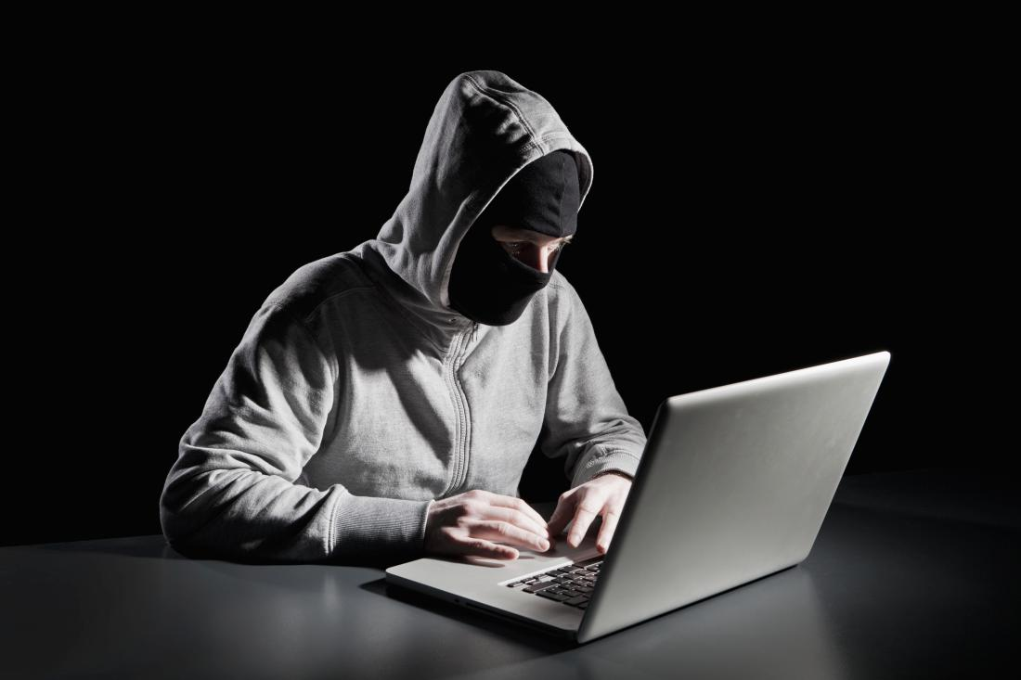
Theft
You must find a way to prevent theft of both data and hardware.
The items most often stolen are portable devices such as laptops, tablets, and smartphones.
These pieces of hardware often have highly valuable data on them.
You can physically secure laptops and tablets by using a cable, but determined thieves will cut through a cable.
You can install software and encrypt the information on all of these portable devices to make it more difficult for the thieves to access the information contained on the devices.
Another type of theft is theft of software and licensing.
Most software has a software license agreement that allows the user to install and use the software on a single computer.
Unless the license explicitly states that the software can be used on more than one computer, installing it on additional computers is illegal.
Also, be sure that you are buying legitimate copies of the software and not bootlegged copies.

