Slide 1
Working with Excel
Microsoft Excel 2013
Lesson 2

Slide 2
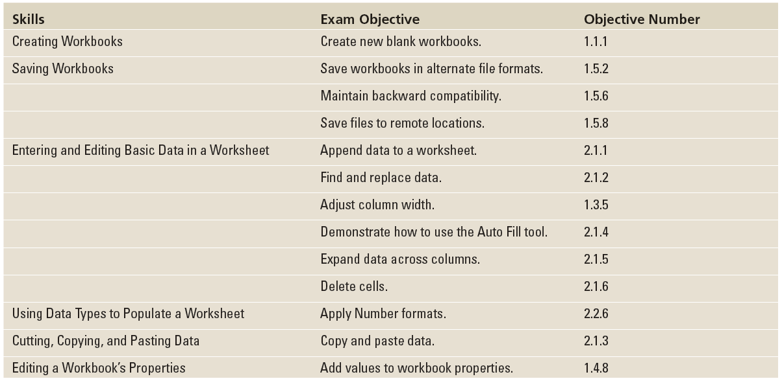
Objectives

Slide 3
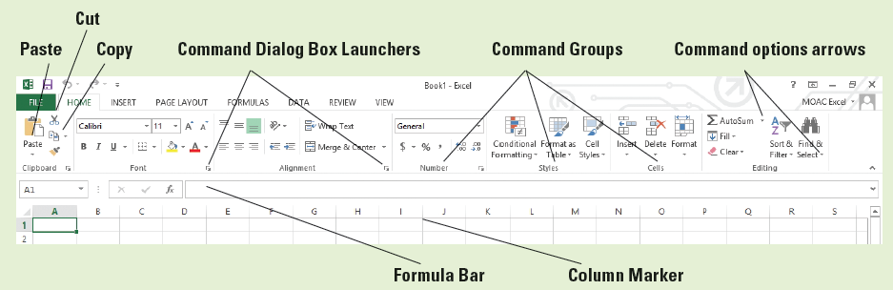
Software Orientation
The ribbon in Microsoft Office Excel 2013 is made up of a series of tabs, each related to specific kinds of tasks.
The HOME tab, shown below, contains the commands people use the most when creating Excel documents.
Having commands visible on the work surface lets you see at a glance most tasks you want to perform. Each tab contains groups of commands related to specific tasks or functions.

Slide 4
Software Orientation
Some commands have an arrow associated with them. In the figure on the previous slide, you see the option arrows associated with AutoSum and Find & Select. This indicates that in addition to the default task, other options are associated with the task.
Similarly, some of the groups have Dialog Box Launchers associated with them. Clicking these displays additional commands not shown on the ribbon.
In the figure on the previous slide, the Clipboard, Font, Alignment, and Number groups have associated dialog boxes, whereas Styles, Cells, and Editing do not.

Slide 5
Creating workbooks
There are three ways to create a new Microsoft Excel workbook:
You can open a new, blank workbook using the FILE tab to access Backstage view or when you launch Excel.
You can open an existing Excel workbook, enter new or additional data, and save the file with a new name, thus creating a new workbook.
You can also use a template to create a new workbook. A template is a model that has already been set up to display certain kinds of data, such as sales reports, invoices, and so on.

Slide 6
Creating a Workbook from Scratch
To create a new workbook, launch Excel and select a blank workbook or another type of template.
If you are working in Excel and want to begin a new workbook, click the FILE tab, click New, and then click Blank workbook.
Worksheets often begin with text that describes the content of the worksheet.

Slide 7
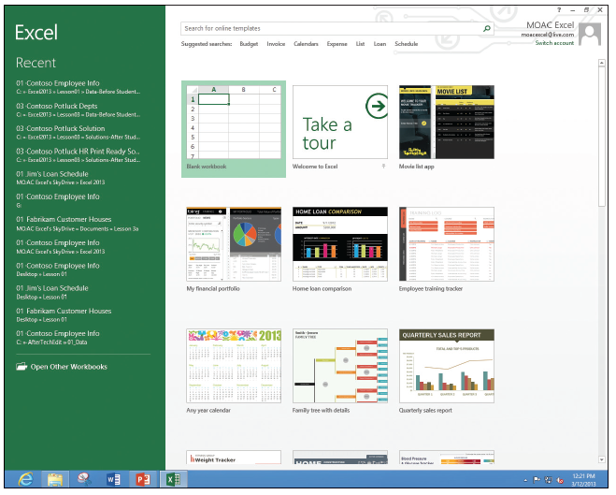
Step by Step: Create a Workbook from Scratch
GET READY. LAUNCH Excel. Excel gives you options for starting a blank workbook, taking a tour, or using templates (right).

Slide 8
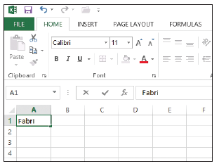
Step by Step: Create a Workbook from Scratch
  Click Blank workbook. If you have just launched Excel, Book1 – Excel appears in the title bar at the top of the window. A blank workbook opens with A1 as the active cell.
  In cell A1, type Fabrikam
  Inc. This cell is the primary
  title for the worksheet.
  Note that as you type, the
  text appears in the cell and
  in the formula bar
  (see figure).

Slide 9
Step by Step: Create a Workbook from Scratch
  Press Enter. The text is entered into cell A1, but appears as if it flows into cell B1.
  In cell A2, type 123 Fourth Street and press Enter.
  In cell A3, type Columbus, OH 43204 and press Enter.
  Sometimes you need a quick work area to complete another task while you are in the middle of a workbook. You can open another workbook as a scratch area. Click the FILE tab, and in the left pane, click New. The templates available appear.
  In the Backstage area, click Blank Workbook. A second Excel workbook opens and Book2 appears in the title bar.
  In cell A1, type Phone Calls and press Enter.
  In cell A2, type David Ortiz UA flight 525 arriving 4:30 pm and press Enter.
PAUSE. LEAVE both Excel workbooks open for the next exercise.
Notes:
Another Way: When you work in Excel, you can open a blank workbook with the shortcut combination Ctrl + N.

Slide 10
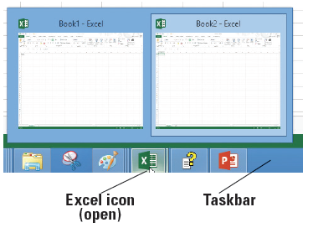
Step by Step: Switch Between Open Workbooks
GET READY. Both temporary workbooks with the address and phone message should be open. The Phone Call workbook is the current workbook in this case.
  To return to the company
  address, click the Excel icon
  on the taskbar (see figure).
  Each of the open workbooks
  appears in a preview window.
  When you move the mouse
  pointer over each workbook,
  it previews on the screen.
  Click Book1 - Excel. The unsaved company address becomes the active workbook.
Notes:
Another Way: You can also switch between two recent active workbooks with Ctrl + Tab.
Take Note: Unlike previous versions, Excel now displays each workbook in a separate window.

Slide 11
Saving Workbooks
When you save a file, you can save it to a folder on your computer's hard drive, a network drive, disc, CD, USB drive, SkyDrive, or other storage location.
You must first identify where the document is to be saved. The remainder of the Save process is the same, regardless of the location or storage device.
When you save a file for the first time, you are asked two important questions: Where do you want to save the file? What name will you give to the file?
By default in all Office applications, documents are saved to the My Documents folder.

Slide 12
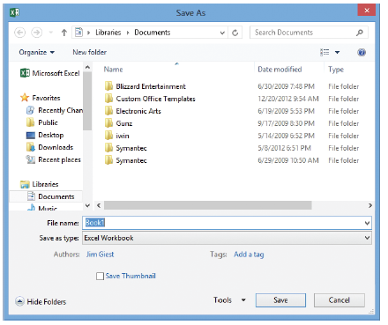
Step by Step: Name and Save a Workbook
GET READY. USE the workbook from the previous exercise or type your name and address in a new workbook.
  Click the FILE tab to open
  Backstage view. In the left
  pane, click Save As to
  display the save options.
  Double-click Computer
  to open the Save As dialog
  box (see figure).
Notes:
Another Way: You can also save the workbook with Ctrl + S.

Slide 13
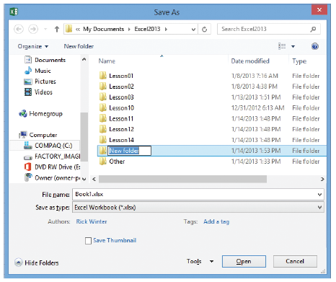
Step by Step: Name and Save a Workbook
  From the left-hand navigation pane, in the Save As dialog box, click Desktop. The Desktop becomes the new destination of your saved file.
  In the Save As dialog box,
  click New folder. A folder
  icon appears with the words
  “New folder” selected
  (see figure).
  Type Excel Lesson 2 and
  press Enter.
  Click the Open button.

Slide 14
Step by Step: Name and Save a Workbook
  In the File Name box, type 02 Fabrikam Address Solution.
  Click the Save button.
PAUSE. LEAVE the workbook open to use in the next exercise.
Notes:
Take Note: Save your workbook often and especially before opening another workbook, printing, or after you enter information.

Slide 15
Saving to Your SkyDrive
SkyDrive is a cloud-based application that allows you to store your files so you can retrieve them anywhere and share them with other people if desired.
SkyDrive is also a great place to store backup files of important documents.
SkyDrive comes with Windows 8 or you can install the free desktop app on Windows 7 and Windows Vista.

Slide 16
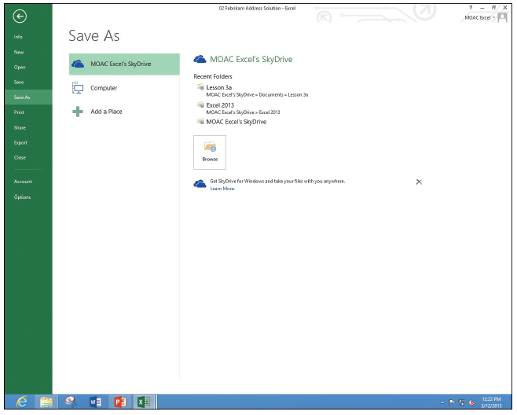
Step by Step: Save to Your SkyDrive
GET READY. USE the workbook from the previous exercise or type your name and address in a new workbook.
  Click the FILE tab and then click Save As.
  In the Backstage area,
  under Save As, click
  [Your name]
  SkyDrive (see figure).
  You may need to sign
  in to SkyDrive if you
  haven't already.
  Click the Browse
  button.
  Click the New folder
  button.

Slide 17
Step by Step: Save to Your SkyDrive
  In the New folder text box, type Excel Lesson 2 to also have a folder for this lesson on your SkyDrive and press Enter.
  Double-click the Excel Lesson 2 icon to move to that folder.
  Keep the file with the same name (or type 02 Fabrikam Address Solution in the File name box), and then click the Save button.
PAUSE. LEAVE the workbook open to use in the next exercise.

Slide 18

Step by Step: Save a Workbook Under a Different Name
GET READY. USE the workbook from the previous exercise or type Fabrikam Inc. in cell A1.
  In cell A2, type
  87 East Broad Street.
  In cell A3, type
  Columbus, OH 43215.
  Click the FILE tab, and
  in the left pane, click
  Save As. The Backstage
  view shows that the
  Current Folder (see
  figure 2-8) is Excel
  Lesson 2 on your
  SkyDrive, because it was the folder that was last used to save a workbook.

Slide 19
Step by Step: Save a Workbook Under a Different Name
  Click on Computer to return to the drive you used before.
  In the right pane, double-click Excel Lesson 2.
  Click in the File name box, click after Fabrikam, and type Broad so the name reads 02 Fabrikam Broad Address Solution.
  Click Save. You created a new workbook by saving an existing workbook with a new name.

Slide 20
Step by Step: Save a Workbook Under a Different Name
  Click the FILE tab, click Save As in the left pane, and click Browse.
  In the File Name box, type 02 Fabrikam Address Template Solution.
  In the Save As Type box, click the drop-down arrow and choose Excel Template. Click the Save button.
PAUSE. EXIT Excel. Do not save the phone message workbook.
Notes:
Take Note: Templates are automatically saved in another location so they can be opened with the FILE, New option.

Slide 21
Step by Step: Save a Workbook Under a Different Name
Creating a template to use for each new workbook based on the example file eliminates the possibility that you might lose data because you might overwrite a file after you enter new data.
To use the template, you choose FILE > New > Personal and select the template you saved.
When you exit, you are prompted to save the file with a new name.

Slide 22
Saving a Workbook in a Previous Excel Format
Files created in earlier Excel versions can be opened and revised in Excel 2013. However, if some of your users do not have the latest version or use other applications, they might not be able to open your file.
You can save a copy of an Excel 2013 workbook (with the .xlsx file extension) to a version that is compatible with Excel 97 through Excel 2013 (with the .xls file extension) versions.

Slide 23
Saving a Workbook in a Previous Excel Format
The program symbol displayed with the filenames will be different, but it is a good idea to give the earlier edition file a different name. It is also a good idea to check which issues might be lost with Excel's compatibility checker.

Slide 24
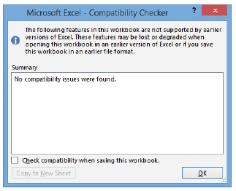
Step by Step: Save a Workbook in a Previous Excel Format
GET READY. LAUNCH Excel.
  Click the FILE tab, and then click Open.
  In the Backstage Recent Workbooks pane, click 02 Fabrikam Broad Address Solution.
  First check for compatibility issues.
  Click the FILE tab, click Info, click
  Check for Issues, and then click
  Check Compatibility. The
  Microsoft Excel – Compatibility
  Checker dialog box at right opens.

Slide 25
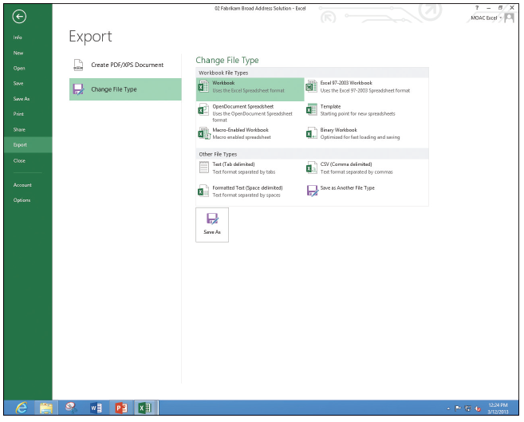
Step by Step: Save a Workbook in a Previous Excel Format
  Read the information in the Compatibility Checker dialog box and click OK.
  Click the FILE tab,
  click Export, and
  then click Change
  File Type. The
  Backstage window
  shows the different
  file types (right).
  Click Excel
  97-2003
  Workbook (*.xls)
  and click Save As.

Slide 26
Step by Step: Save a Workbook in a Previous Excel Format
  In the File name box, click before Solution and type 97-03, and then click Save.
  Click the FILE tab, and then click Open. The Recent Workbooks pane in Backstage shows the last set of documents that have been saved.
  Click 02 Fabrikam Broad Address Solution.
PAUSE. LEAVE the workbook open to use in the next exercise.

Slide 27
Saving in Different File Formats
You can save an Excel 2013 file in a format other than .xlsx or .xls.
The file formats listed as options in the Save As dialog box or on the FILE tab depend on what type of file format the application supports.
When you save a file in another file format, some of the formatting, data, and features might be lost.

Slide 28
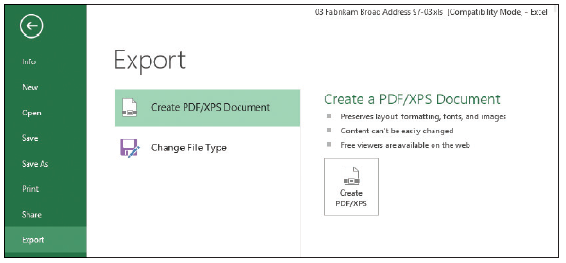
Step by Step: Save in Different File Formats
GET READY. USE the workbook from the previous exercise or type your name and address in a new workbook.
  Display Backstage view, click the FILE tab, and then click the Export button.
  Click the Change File Type button. Excel explains the different file types.
  Click the Create
  PDF/XPS Document
  option (right).
  Click the
  Create PDF/XPS
  button in the right pane.

Slide 29

Step by Step: Save in Different File Formats
  In the left navigation pane, click Desktop.
  Double-click Excel Lesson 2 to move to that folder.
  The file name gives the last name with a PDF extension.
  Click Publish.
  The Reader application
  opens with the PDF file
  displayed (right).

Slide 30
Step by Step: Save in Different File Formats
  Close the Reader. Right-click in a blank area, and then click More, Close file.
  If necessary, press Alt+Tab to return to the Excel file.
PAUSE. CLOSE all open workbooks and LEAVE Excel open to use in the next exercise.
Notes:
Take Note: Adobe PDF (Portable Documents Format) ensures that your printed or viewed file retains the formatting that you intended, but the file cannot be easily changed. You can also save your workbooks in a Web page format for use on websites with Single File Web Page or Web Page options. To import data into another format and the other program does not accept Excel worksheets, you can also try Text (Tab delimited) or CSV (Comma delimited) formats. All of these options are available from the Save As type drop-down menu on the FILE tab.

Slide 31
Entering and Editing Basic Data in a Worksheet
You can type data directly into a worksheet cell or cells. You can also copy and paste information from another worksheet or from other programs.
Copy takes the information from one location and duplicates it.
You use Paste to put this information in another location.
To enter data in a cell within a worksheet, you must make the desired cell active and then type the data. To move to the next column after text is entered, press Tab.
Continue to press Tab to go to the next column.
When you finish typing the entries in a row, press Enter to move to the beginning of the next row.
You can also use the arrow keys to move to an adjacent cell or click on any cell to make that cell active. Press Enter to accept the entry.

Slide 32
Step by Step: Enter Basic Data in a Worksheet
GET READY. If necessary LAUNCH Excel and OPEN a new workbook.
  Click cell A1, type Fabrikam Inc., and press Enter. Notice that the active cell moves to the next row, to cell A2.
  In cell A2, type Employee List and press Enter.
  Click cell A4, type Name, and press Tab. Notice that the active cell moves to the next column, to cell B4.
  Type Extension and press Enter. Notice that the active cell moves to the first cell in the next row.
  Type Richard Carey and press Tab.
  Type 101 and press Enter. Richard Carey looks cut off.
Notes:
Troubleshooting: If you type the wrong data, you can click the cell and retype the entry. In the following sections, you see how to edit text.

Slide 33
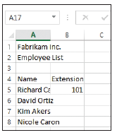
Step by Step: Enter Basic Data in a Worksheet
  Click cell A5 and notice that the complete entry for Richard Carey appears in the formula bar.
  Click cell A6, type David Ortiz, and
  press Enter.
  Type Kim Akers and press Enter.
  Type Nicole Caron and press Enter.
  SAVE the workbook in the Computer’s
  Excel Lesson 2 folder as 02 Fabrikam
  Employees Solution. Your file should
  look like the figure at r ight.
PAUSE. LEAVE the workbook open for the next lesson.
Notes:
Take Note: Text is stored in only one cell, even when it appears to extend into adjacent cells. If an entry is longer than the cell width and the next cell contains data, the entry appears in truncated form. To edit the data, you need to go to the cell where the text starts and not in the adjacent cells.

Slide 34
Changing the Column Width
In Excel, column width is established based on the existing data.
When you add an entry in a column that extends beyond the column’s width, it is necessary to adjust the column width to accommodate the entry.

Slide 35
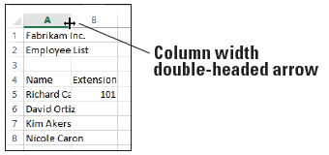
Step by Step: Change the Column Width
GET READY. Use the 02 Fabrikam Employees Solution file from the previous exercise.
  Move the mouse pointer between columns A and B, to the column markers at the top of the worksheet (below). The mouse pointer changes to a double-headed arrow.
  Double-click the
  column marker
  between A and B.
  The width of the
  column changes to
  the widest entry in
  column A. In this
  case, it is Employee list and Richard Carey's name.
Notes:
Take Note: To change the column width manually, point to the column marker between columns A and B and drag the pointer left or right instead of double-clicking.

Slide 36
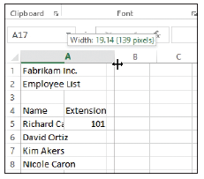
Step by Step: Change the Column Width
  Drag the double-headed arrow mouse pointer between columns B and C until the ScreenTip shows Width: 12.00 (89 pixels) or something close to this amount (below).
  SAVE the 02 Fabrikam
  Employees Solution file. This
  overwrites your previous
  version without the column
  width change.
PAUSE. CLOSE the workbook and
LEAVE Excel open for the next
exercise.
Notes:
Take Note: When you type text that is longer than the cell’s width, the text appears as if it extends into the next cell. However, when you type in the next cell, the overflow text does not display. The text is still there. It is often easier to proof your work if you have the column widths match the longest text. You can double-click on the column markers to automatically adjust to the widest entry or drag the column marker to adjust the column width to your desired width.

Slide 37
Editing a Cell’s Contents
To edit information in a worksheet, you can make changes directly in the cell or edit the contents of a cell in the formula bar, located between the ribbon and the worksheet.
When you enter data in a cell, the text or numbers appear in the cell and in the formula bar. You can also enter data directly in the formula bar.
Before changes can be made, however, you must select the information that is to be changed.
Selecting text means that you highlight the text to be changed. You can select a single cell or a portion of the cell's text in the formula bar before you make changes. You can also double-click in a cell to position the insertion point for editing.

Slide 38
Step by Step: Edit a Cell’s Contents
GET READY. OPEN a blank workbook.
  Click cell A1, type Fabrikam, and press Enter. The insertion point moves to cell A2 and nothing appears in the formula bar.
  Click cell A1. Notice that the formula bar displays "Fabrikam."

Slide 39
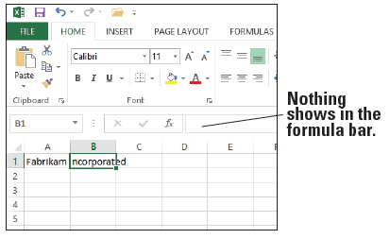
Step by Step: Edit a Cell’s Contents
  Click after Fabrikam in the formula bar, type a space, type Incorporated, and press Tab. The insertion point moves to cell B1 and nothing appears in the formula bar (right).
  Click cell A1 and
  double-click on
  Incorporated in the
  formula bar to select it.
  Type Inc. and press
  Enter.
  Type Sales and
  press Enter.

Slide 40
Step by Step: Edit a Cell’s Contents
  Click cell A2 and click after Sales. The insertion point moves to the formula bar.
  Press Home. The insertion point moves to the beginning of the formula bar.
  Type Monthly and then press the spacebar. Press Enter.
  In cell A3, type January and press Enter.
Notes:
Take Note: While you are editing in the formula bar, you can press Home to move to the beginning, End to move to the end, or the left or right arrow keys to move one character at a time. Press Delete to delete characters after the insertion point. Press Backspace to delete characters before the insertion point.

Slide 41
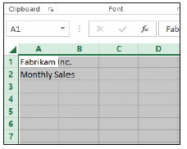
Step by Step: Edit a Cell’s Contents
  Click cell A3, type February, and press Enter. Cell A3's original text is gone and February replaces January.
  Click cell A3 and press Enter. The entry in A3 is removed.
  Above row 1 and to the left of column A, click the Select All button (below). All cells on the worksheet are selected.

Slide 42
Step by Step: Edit a Cell’s Contents
  Press Enter. All entries are removed.
PAUSE. CLOSE the workbook without saving and LEAVE Excel open for the next exercise.
You can edit a cell by double-clicking the cell and then type the replacement text in the cell. Or, you can click the cell and then click in the formula bar.
Notes:
Another Way: You can right-click a cell or a selected range of cells and choose Delete from the shortcut menu that appears.
Take Note: If you edit a cell's contents and change your mind before you press Enter, press Esc and the original text will be restored. If you change the content of a cell and then do not want the change, click the Undo button on the Quick Access Toolbar or press Ctrl + Z. The deleted text will be restored.

Slide 43
Step by Step: Edit a Cell’s Contents
When you are in Edit mode:
The insertion point appears as a vertical bar and most commands are inactive.
You can move the insertion point by using the left and right arrow keys.
Use the Home key on your keyboard to move the insertion point to the beginning of the cell, and use the End key to move the insertion point to the end of the cell. You can add new characters at the location of the insertion point.

Slide 44
Step by Step: Edit a Cell’s Contents
To select multiple characters while in Edit mode, press Shift while you press the arrow keys. You also can use the mouse to select characters while you are editing a cell. Just click and drag the mouse pointer over the characters that you want to select.
As in the preceding exercises, there are several ways to modify the values or text you enter into a cell:
Erase the cell’s contents.
Replace the cell’s contents with something else.
Edit the cell’s contents.

Slide 45
Deleting and Clearing a Cell’s Contents
To erase the entire contents of a cell, click the cell and press Delete. This deletes what is in the cell rather than the cells themselves.
To erase the contents of more than one cell, select all the cells that you want to erase and then press Delete. Pressing Delete removes the cell’s contents, but does not remove any formatting (such as bold, italic, or a different number format) that you might have applied to the cell.

Slide 46
Step by Step: Delete and Clear a Cell’s Contents
GET READY. OPEN a blank workbook.
  In cell A1, type 1 and press Enter.
  Type 2 and press Enter.
  Type 3 and press Enter.
  Type 4 and press Enter.
  Highlight cells A1 through A4 (containing the numbers 1 through 4).
  Press Delete. All the cells are erased.
  On the Quick Access Toolbar, click the Undo button to return the cell entries.
Notes:
Another Way: You can right-click a cell or a selected range of cells and choose Delete from the menu that appears.

Slide 47
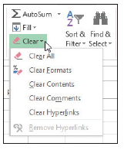
Step by Step: Delete and Clear a Cell’s Contents
  Click cell B5, type $275,000, and press Enter. The value and format are placed into the cell.
  Click cell B5 and press Enter.
  Type 225000 without the dollar sign and comma and press Enter. Notice that $225,000 is formatted. Although the text is gone, the cell retains the revious format when you press Delete.
  Click cell B5 and on the HOME tab, in the
  Editing group, click Clear (right).
  Click Clear Formats. 225000 displays
  without the dollar sign and comma.
PAUSE. CLOSE the workbook without saving
and LEAVE Excel open for the next exercise.
Notes:
Take Note: Clear displays a number of options. To remove both the entry and the format, choose Clear All.

Slide 48
Using Data Types to Populate a Worksheet
You can enter three types of data into Excel: text, numbers, and formulas.
Text entries contain alphabetic characters and any other characters that do not have a purely numeric value.
The strength of Excel is its ability to calculate and analyze numbers based on the numeric values you enter.

Slide 49
Entering Labels and Using AutoComplete
Labels are used to identify numeric data and are the most common type of text entered in a worksheet. Labels are also used to sort and group data.
If the first few characters that you type in a column match an existing entry in that column, Excel automatically enters the remaining characters.
This AutoComplete feature works only for entries that contain text or a combination of text and numbers.

Slide 50
Step by Step: Enter Labels and Use AutoComplete
GET READY. OPEN a blank workbook.
  In cell A1, type Fabrikam Inc. and press Enter.
  Type Monthly Sales.
  Click cell A4 and type Agent and press Tab.
  In cell B4, type Last Closing Date and press Tab.
  In cell C4, type January and press Enter.
  Click cell A5, type Richard Carey, and press Enter.
  In cell A6, type David Ortiz and press Enter.
  In cell A7, type Kim Akers and press Enter.
  Type Nicole Caron and press Enter.
Notes:
Troubleshooting: To verify that AutoComplete is enabled, click the FILE tab accessing Backstage, click Options, and then click Advanced in the navigation pane. In the Editing options section, click the Enable AutoComplete for cell values check box if it is not already checked. Click OK.

Slide 51
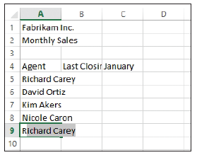
Step by Step: Enter Labels and Use AutoComplete
  Click cell A9 and type R. As shown below, AutoComplete is activated when you type the R because it matches the beginning of a previous entry in this column. AutoComplete displays the entry for Richard Carey.

Slide 52
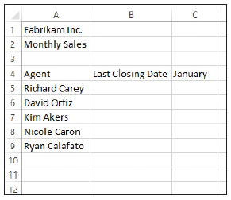
Step by Step: Enter Labels and Use AutoComplete
  Type y. The AutoComplete entry disappears. Finish typing the entry for Ryan Calafato and press Enter.
  Type R. Notice that no AutoComplete entry appears this time. Type i and notice that the AutoComplete entry shows Richard Carey.
  Press Esc to undo the entry.
  Increase the column widths for
  columns A and B so you can see
  the entries in row 4 and below
  (right).
PAUSE. LEAVE the workbook open to
use in the next exercise.
Notes:
Take Note: Excel bases the list of potential AutoComplete entries on the text in the rows above the current row. If different rows start with the same character, you might have to type more than one character for the AutoComplete entry to display.

Slide 53
Step by Step: Enter Labels and Use AutoComplete
To accept an AutoComplete entry, press Enter or press Tab.
When you accept AutoComplete, the completed entry matches the pattern of uppercase and lowercase letters of the existing entry.
To delete the automatically entered characters, press Backspace.
Entries that contain only numbers, dates, or times are not automatically completed.
If you do not want to use the AutoComplete option, the feature can be turned off by selecting FILE > Options > Advanced > Editing options section > Enable AutoComplete for cell values.

Slide 54
Entering Numeric Values
Numeric values are the foundation for Excel’s calculations, analyses, charts, and graphs. Numbers can be formatted as currency, percentages, decimals, and fractions.
By default, numeric entries are right-justified in a cell. Applying formatting to numbers changes their appearance but does not affect the cell value that Excel uses to perform calculations.
The value is not affected by formatting or special characters (such as dollar signs) that are entered with a number.
The true value is always displayed in the formula bar.

Slide 55
Step by Step: Enter Numeric Values
GET READY. USE the workbook from the previous exercise.
  Click cell C5, type $275,000, and press Enter.
  Click cell C5 and notice that 275000 appears in the formula bar and the formatted value appears in the cell.
  Click cell C6, type 125,000, and press Enter. Be sure to include the comma in your entry. The number is entered in C6 and C7 becomes the active cell. The number appears in the cell with the comma and no dollar sign (unlike the entry in C5); however, the formula bar displays the true value and disregards the special characters.

Slide 56
Step by Step: Enter Numeric Values
  Type 209000 and press Enter. The number is entered with no dollar sign and no comma.
  Type 258,000 and press Enter.
  Type 145700 and then click cell C5. Figure 2-22 illustrates how your spreadsheet should look with the values you just typed.
PAUSE. LEAVE the workbook open to use in the next exercise.

Slide 57
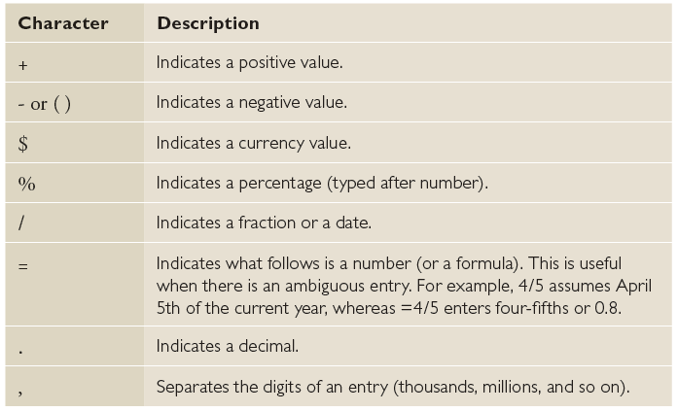
Step by Step: Enter Numeric Values
Special characters that indicate the type of value can also be included in the entry. The table below illustrates special characters that can be entered with numbers.

Slide 58
Entering Dates
Dates are often used in worksheets to track data over time.
Like text, dates can be used as row and column headings. However, dates are considered serial numbers, which means that they are sequential and can be added, subtracted, and used in calculations.
Dates can also be used in formulas and in developing graphs and charts. The way a date is initially displayed in a worksheet cell depends on the format in which you type the characters.
In Excel 2013, the default date format uses four digits for the year. Also by default, dates are right-justified in the cells.

Slide 59
Step by Step: Enter Dates
GET READY. Use the workbook from the previous exercise.
  Click cell B5, type 1/4/2014, and press Enter.
  Click cell B6, type 1/25/14, and press Enter. The date is entered in C6 as 1/25/2014 and B7 becomes the active cell.
  Type 1/17 and Press Enter. 17-Jan is entered in the cell. Click cell B7, and notice that 1/17/20XX (with XX representing the current year) appears in the formula bar.
  If the year is not 2014, click cell B7 and press F2. Change the year to 2014 and press Enter.
  In cell B8, type 1/28/14 and press Enter.

Slide 60
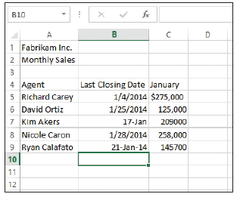
Step by Step: Enter Dates
  Type January 21, 2014 and press Enter. 21-Jan-14 appears in the cell. If you enter a date in a different format than specified or had already entered something in the cell and deleted it, your worksheet might not reflect the results described.
  The date formats in column B
  is not consistent (right).
  You apply a consistent date
  format in the next section.

Slide 61
Step by Step: Enter Dates
  In cell B9, type 1/1/10 and press Enter. Notice that the value changes but the formatting remains the same.
  Click the Undo button to return to the workbook shown at right.
PAUSE. LEAVE the workbook
open to use in the next exercise.
Notes:
Another Way: Ctrl + ; (semicolon) enters the current date into a worksheet cell; Ctrl + : (colon) enters the current time.

Slide 62
Step by Step: Enter Dates
Excel interprets two-digit years from 00 to 29 as the years 2000 to 2029; two-digit years from 30 to 99 are interpreted as 1930 to 1999. If you enter 1/28/28, the date will be displayed as 1/28/2028 in the cell. If you enter 1/28/37, the cell will display 1/28/1937.
If you type January 28, 2020, the date will display as 28-Jan-20. If you type 1/28 without a year, Excel interprets the date to be the current year. 28-Jan will display in the cell, and the formula bar will display 1/28/ followed by the current year. In the next section, you learn to apply a consistent format to a series of dates.
Regardless of the date format displayed in the cell, the formula bar displays the date in month/day/four-digit-year format because that is the format required for calculations and analyses.
Notes:
Take Note: When you enter a date into a cell in a particular format, the cell is automatically formatted even if you delete the entry. Subsequent numbers entered in that cell will be converted to the date format of the original entry.

Slide 63
Filling a Series with Auto Fill
Excel provides Auto Fill options that automatically fill cells with data and/or formatting.
To populate a new cell with data that exists in an adjacent cell, use the Auto Fill feature either through the command or the fill handle.
The fill handle is a small green square in the lower-right corner of a selected cell or range of cells.
A range is a group of adjacent cells that you select to perform operations on all of the selected cells. When you refer to a range of cells, the first cell and last cell are separated by a colon (for example, C4:H4).

Slide 64
Filling a Series with Auto Fill
To use the fill handle, point to the lower-right corner of the cell or range until the mouse pointer turns into a +. Click and drag the fill handle from cells that contain data to the cells you want to fill with that data, or have Excel automatically continue a series of numbers, numbers and text combinations, dates, or time periods, based on an established pattern.
To choose an interval for your series, type the first two entries, select them, and then use the fill handle to expand the series using the pattern of the two selected cells.

Slide 65
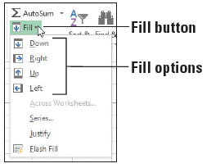
Step by Step: Fill a Series with Auto Fill
GET READY. USE the workbook from the previous exercise or type the text in Figure 2-23.
  Select the range C4:H4. January is in the first cell.
  On the HOME tab, in the
  Editing group, click the Fill
  button. The Fill menu appears
  (right).
  From the menu, click Right.
  The contents of C4 (January)
  are filled into all the cells.
  Click the Undo button.

Slide 66
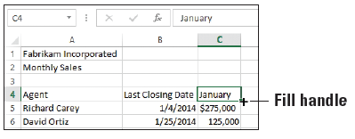
Step by Step: Fill a Series with Auto Fill
  Select the range C9:C13 and click the Fill button. Choose Down. The content of C9 is copied into the four additional cells.
  Click the Undo button.
  Click cell C4, point to the fill handle in the lower-right corner of the cell (below), and drag it to E4 and release. The Auto Fill Options button appears, and January through March are displayed.
Notes:
Another Way: To quickly fill a range of cells with the contents of the first cell, select the range, and then press Ctrl + D (cells below) or Ctrl + R (cells to the right).

Slide 67
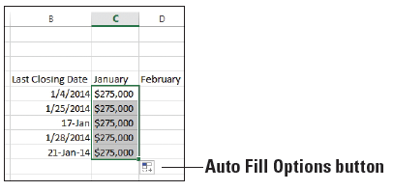
Step by Step: Fill a Series with Auto Fill
  Click cell C5, point to the
  fill handle, and drag it to
  C9 and release. All the
  numbers turn to $275,000
  in column C. The Auto Fill
  Options button appears in
  D10 (right).
  Click the Auto Fill Options button, and choose Fill Formatting Only from the list that appears. All the numbers return to their values and are formatted with dollar signs and commas.
  Repeat Step 9 for the range B5:B9.
  Click cell A9, and then drag the fill handle down to A15. Ryan Calafato's name is repeated.

Slide 68
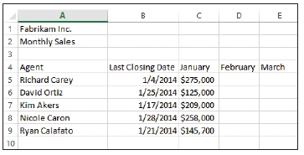
Step by Step: Fill a Series with Auto Fill
  Click the Undo button to return the spreadsheet to what is shownbelow.
  SAVE the workbook as 02 Fabrikam Sales Solution.
PAUSE. EXIT Excel.
Notes:
Take Note: When Excel recognizes a series, the default fill option is to complete the series. When you use the fill handle and a series is not present, the default is to copy the cell contents. The Fill Options button also allows you to fill formatting only or to fill without formatting.

Slide 69
Step by Step: Fill a Series with Auto Fill
After you fill cells using the fill handle, the Auto Fill Options button appears so that you can choose how the selection is filled. In Excel, the default option is to copy the original content and formatting.
With Auto Fill, you can select how the content of the original cell appears in each cell in the filled range.
Excel recognizes January as the beginning of a natural series and completes the series as far as you take the fill handle. A natural series is a formatted series of text or numbers that are in a normal sequence such as months, weekdays, numbers, or times.
Notes:
Take Note: When you type sufficient data for Excel to recognize a series, the fill handle will do the rest. For example, to record daily sales, you might want to have consecutive columns labeled with the days of the week. If you type Monday in the first cell, you can fill in the rest of the days by dragging the fill handle from the Monday cell to complete the series.

Slide 70
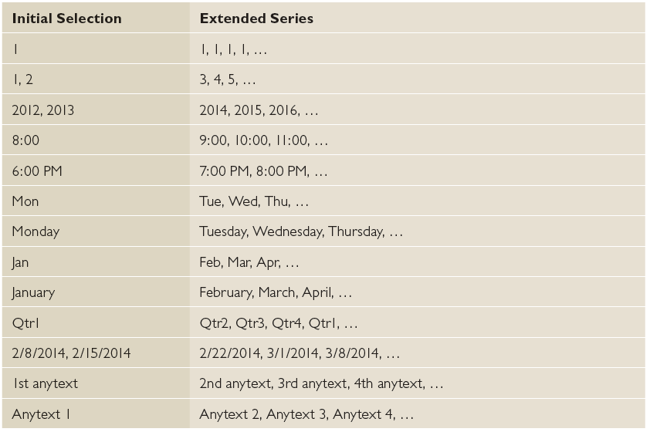
Step by Step: Fill a Series with Auto Fill
For example, a natural series of numbers could be 1, 2, 3, or 100, 200, 300, or a natural series of text could be Monday, Tuesday, Wednesday, or January, February, March. For different natural series, see table.
Notes:
Take Note: Note that you might have to select two cells rather than one to continue some of the previous patterns. To create your own custom list, go to FILE>Options> Advanced> General section> Create lists for use in sorts and fill sequences> Edit Custom Lists.

Slide 71
Filling Cells with Flash Fill
Flash Fill, new in Excel 2013, is like Auto Fill, but Excel does more work.
When Excel recognizes a pattern based on other information in your workbook, it will use the pattern.
This is helpful in an example where you have typed first and last names in one column and later decide that you want to sort by last name and then first name.
You can create two more columns to separate the names. After you start typing the first names, Excel completes the column. You can repeat with the last name column.

Slide 72
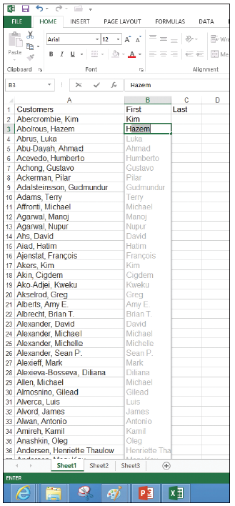
Step by Step: Fill Cells with Flash Fill
GET READY. Before you begin these steps, LAUNCH Microsoft Excel.
  Open the 02 Customers file.
  Click cell B1, type First, and press Tab.
  Click cell C1, type Last, and press Enter.
  Click cell B2, type Kim, and press Enter.
  In cell B3, type H. Notice that Hazem
  shows in the rest of the cell and the
  other first names of the customers
  appear (right).
  Press Enter.

Slide 73
Step by Step: Fill Cells with Flash Fill
  Click cell C2, type Abercrombie, and press Enter.
  In cell C3, type A and notice that Abercrombie is repeated with AutoComplete. Continue typing bol and notice that the last names all appear. Press Enter.
  Double-click the right border of columns B and C to set the column width.
  Scroll down and notice that the entire worksheet is filled in.
  SAVE the file as 02 Customers Solution.
PAUSE. EXIT Excel.

Slide 74
Cutting, Copying, and Pasting Data
You can use Excel’s Cut, Copy, and Paste commands to copy or move entire cells with their contents, formats, and formulas.
You can also copy specific contents or attributes from the cells. For example, you can copy the format only without copying the cell value, or copy the resulting value of a formula without copying the formula itself.
You can also copy the value from the original cell but retain the formatting of the destination cell.

Slide 75
Cutting, Copying, and Pasting Data
Cut, copy, and paste functions can be performed in a variety of ways by using:
The mouse
Ribbon commands
Shortcut commands, such as Ctrl + C (copy), Ctrl + X (cut), and Ctrl + V (paste)
The Office Clipboard pane

Slide 76
Copying a Data Series with the Mouse
By default, drag-and-drop editing is turned on so that you can use the mouse to copy (duplicate) or move cells.
Select the cell or range of cells you want to copy and hold down Ctrl while you point to the border of the selection. When the pointer becomes a copy pointer (arrow with a plus), you can drag the cell or range of cells to the new location.
As you drag, a scrolling ScreenTip identifies where the selection will be copied if you release the mouse button.

Slide 77
Step by Step: Copy a Data Series with the Mouse
GET READY. Before you begin these steps, LAUNCH Microsoft Excel.
  Open the 02 Customer Houses file.
  Select the range A12:A22.
  Press Ctrl and hold the mouse button down as you point to the right border of the selected range. The copy pointer is displayed.
  With the copy pointer displayed, hold down the left mouse button and drag the selection to the right, until H12:H22 appears in the scrolling ScreenTip next to the selection.
  Release the mouse button and then release Ctrl. The data in A12:A22 also appears in H12:H22.
PAUSE. LEAVE the workbook open to use in the next exercise.
Notes:
Troubleshooting: Be sure to hold down the Ctrl key the entire time you are dragging a data series for copying with the mouse, or you will move the series instead of copying it.

Slide 78
Moving a Data Series with the Mouse
Data can be moved from one location to another within a workbook in much the same way as copying.
To move a data series, select the cell or range of cells and point to the border of the selection.
When the pointer becomes a move pointer, you can drag the cell or range of cells to a new location.
When data is moved, it replaces any existing data in the destination cells.

Slide 79
Step by Step: Move a Data Series with the Mouse
GET READY. USE the 02 Customer Houses workbook from the previous exercise.
  Select E12:E22.
  Point to the right border of the selected range. The move pointer is displayed.
  With the move pointer displayed, hold down the left mouse button and drag the selection to the right, until I12:I22 appears in the scrolling ScreenTip beside the selected range.
  Release the mouse button. In your worksheet, the destination cells are empty; therefore, you are not concerned with replacing existing data. The data previously in E12:E22 is now in I12:I22.

Slide 80
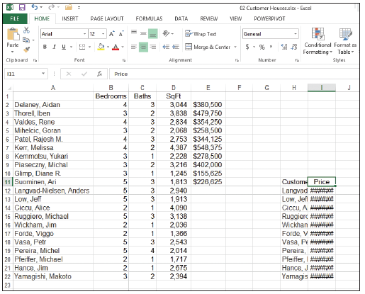
Step by Step: Move a Data Series with the Mouse
  Drag A1 to H12. Note that a dialog box warns you about replacing the contents of the destination cells.
  Click Cancel.
  Drag A1 to H11.
  Drag E1 to I11. Your
  worksheet should look
  like the one shown
  at right.
PAUSE. LEAVE the workbook
open to use in the next exercise.
Notes:
Take Note: When you attempt to move a selection to a location that contains data, a caution dialog box opens. “There’s already data here. Do you want to replace it?” is a reminder that moving data to a new location replaces the existing data. You can click OK or cancel the operation.

Slide 81
Copying and Pasting Data
The Office Clipboard collects and stores up to 24 copied or cut items that can be used in the active workbook, in other workbooks, and in other Microsoft Office programs.
You can paste (insert) selected items from the Clipboard to a new location in the worksheet.
Cut (moved) data is removed from the worksheet but is still available for you to use in multiple locations. If you copy multiple items and then click Paste, only the last item copied will be pasted.
To access multiple items, you must open the Clipboard pane.

Slide 82
Step by Step: Copy and Paste Data
GET READY. USE the 02 Customer Houses workbook from the previous exercise.
  On the HOME tab of the ribbon, click the Clipboard Dialog Box Launcher. The Clipboard pane opens on the left side of the worksheet. The most recently copied item is always added at the top of the list in this pane, and it is the item that will be copied when you click Paste or a shortcut command.
  Select A1:E22 and press Delete.
  Select H11:I22 and in the Clipboard group, click the Copy button. The border around the selected range becomes a moving border.
Notes:
Another Way: To copy, you can use Ctrl + C or right-click and chose Copy. To paste, you can use Ctrl + V or right-click and choose Paste.

Slide 83
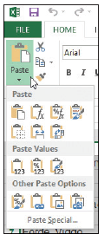
Step by Step: Copy and Paste Data
  Select A1 and click the Paste button. The moving border remains active around H11 through I22. A copied range does not deactivate until you type new text, issue another command, or double-click on another
  cell or you can press Esc.
  Select A20 and click the down arrow on
  the Paste button. The Paste options
  menu appears (right).

Slide 84
Step by Step: Copy and Paste Data
  Select the first option under Paste Values. Notice that the values in column B are no longer formatted.
  Click the Undo button.
  Select H11:I22 and press Delete.
  Press Ctrl + Home to return to the top of the workbook.
  SAVE the workbook as 02 Customer Houses Solution.
PAUSE. LEAVE the workbook open to use in the next exercise.
Notes:
Take Note: Paste with Live Preview was new as of Office 2010. If you point to the Paste options in either the shortcut menu, or the Paste command options in the Clipboard group, you will be able to view your changes before actually implementing them.

Slide 85
Cutting and Pasting Data
Most of the options for copying and pasting data also apply to cutting and pasting.
The major difference is that data copied and pasted remains in the original location as well as in the destination cell or range.
Cut and pasted data appears only in the destination cell or range. In this exercise, you cut and paste cell contents.

Slide 86
Step by Step: Cut and Paste Data
GET READY. USE the 02 Customer Houses Solution workbook from the previous exercise.
  Select A1:B12 to highlight the Customer House Prices table.
  In the Clipboard group, click the Cut button. The contents of A1:B12 are displayed in the Clipboard pane.
  Click the + New sheet button on the bottom of the worksheet.
  You create Sheet2 and cell A1 is active.
  Click Paste to move the former contents of Sheet1 to cell A1 into Sheet2.
PAUSE. EXIT Excel and do not save the workbooks if requested.
Notes:
Another Way: To cut, you can use Ctrl + X or right-click and choose Cut.
Take Note: When you delete text, it is not stored on the Clipboard. To remove data and use the text later, use Cut rather than Delete. By using the Cut feature, you are able to access the data or information from the Clipboard if needed. Deleted text can be restored only with Undo.

Slide 87
Editing a Workbook’s Properties
The workbook has a number of properties that make managing it easier. The properties include items that you indirectly change such as file size and last edit date.
The workbook properties also include items you directly change such as keywords.
Assigning keywords to the document properties makes it easier to organize and find documents.
You can also add more notes to your file for classification and document management.

Slide 88
Assigning Keywords
If you work for Fabrikam, Inc., you might assign the keyword sales to worksheets that contain data about revenue.
You can then search for and locate all files containing information about sales.
You can assign more than one keyword to a document.

Slide 89
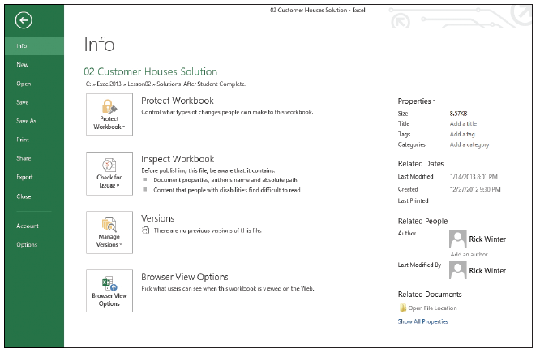
Step by Step: Assign Keywords
GET READY. Before you begin these steps, LAUNCH Microsoft Excel.
  OPEN the 02 Customer Houses Solution file you worked with in the previous exercises.
  Click FILE. The Backstage window displays current properties on the right side of the window (below).

Slide 90
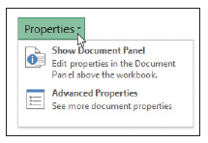
Step by Step: Assign Keywords
  Click the Properties button at
  the top of the right pane. The
  Properties drop-down menu
  shows two options (right).
  Click Show Document Panel.
  Click the Keywords field and type Customer, Sq Ft, Price.
  Click the Category field and type Revenue.
  Click the Author field and type your name.
  Above the Author field, click the Document Properties drop-down arrow, and then click Advanced Properties. The Properties dialog box opens.
  Click the Summary tab in the dialog box to see the properties you entered.

Slide 91
Step by Step: Assign Keywords
  Click the Statistics tab to see the date you modified the file.
  Click OK to close the Properties dialog box.
  At the top right corner of the Document Information panel, click the Close button.
  SAVE the workbook as 02 Customer Houses Prop Solution.
PAUSE. EXIT Excel.
After a file is saved, the Statistics tab records when the file was accessed and when it was modified. It also identifies the person who last saved the file.
After a workbook is saved, the Properties dialog box title bar displays the workbook name and location.

Slide 92
Skills Summary

