Slide 1
Identifying Computer Hardware
Topic C: Common Computer Connector Types

Slide 2
Common Computer Connector Types
A personal computer is made up of many different components
All of these components need to be able to communicate with each other for the computer to function properly
As personal computers have evolved, many connection technologies have been implemented to provide communication among computer components.
Identifying the different methods that are used to connect devices to a computer will enable you, a computer technician, to install, upgrade, and replace computer components quickly and effectively.

Slide 3
Ports
A port is a hardware interface that you can use to connect devices to a computer. The port transfers electronic signals between
the device and the system unit. The port is either an electrically wired socket or plug, or it can be a wireless transmission device.
Ports can vary by: shape; color according to coding standards; the number and layout of the pins or connectors contained
within the port; the signals the port carries; and the port’s location. Ports exist for both internal and external devices. External
ports often have a graphical representation of the type of device that should be connected to it, such as a small picture of a
monitor adjacent to the video port.

Slide 4
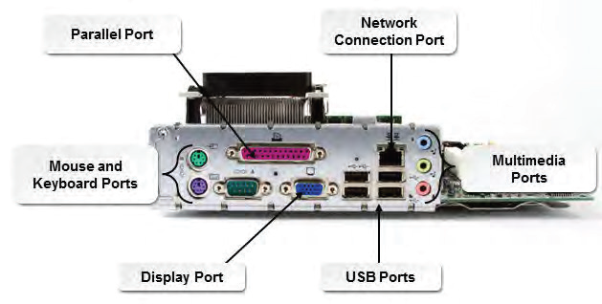
Ports

Slide 5
Genders
Most ports and the cables that connect to them have genders.
For example, most computer ports are jacks into which you plug in the matching cable.
The computer jacks are most often the female connectors and the cable plug is most often the male connector.
You can always look directly at the innermost electrical connections on the connectors to determine the gender.
The one with the protruding pins is the male and the one with the holes to accept the pins is the female.

Slide 6
Port Shapes
Ports can have different physical shapes, such as round, rectangular, square, and oblong, although there is some standardization of physical properties and functions. Most connectors are keyed in some way to restrict connecting devices into the wrong port.

Slide 7
Connections
Computer connections are the physical access points that enable a computer to communicate with internal or external devices.
They include the ports on both the computer and the connected devices, plus a transmission medium, which is either a cable with connectors at each end or a wireless technology.
Personal computer connections can be categorized by the technology or standard that was used to develop the device.

Slide 8
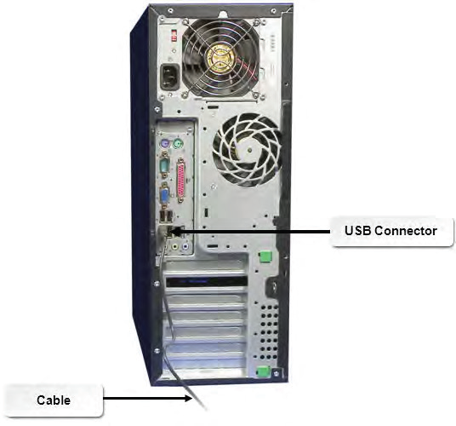
Connections

Slide 9
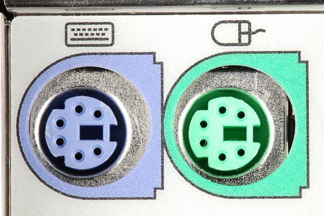
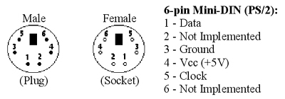
PS/2 Ports and Connectors
The round 6-pin port, also referred to as a mini-Din connector or PS/2 port, is an interface located on the motherboard.
The Din-6 port is the larger 13.2 mm port. Older keyboards and mice use PS/2 ports to connect to the motherboard.
To avoid confusion between the identical-looking keyboard and mouse ports, PS/2 ports are often color-coded to match the end of the cable on the device: purple for the keyboard and green for the mouse. Alternatively there may also be a sticker with a picture of a mouse and keyboard near the connectors.
Note: Newer mice and keyboards primarily use USB connectors, but some older systems may still use PS/2 technology.

Slide 10
Serial Ports and Connectors
A serial connection is a personal computer connection that transfers data one bit at a time over a single wire.
Serial connections support two-way communications and were typically used for devices such as fax cards or external modems.
These legacy serial ports have either 9-pin (DB-9) or 25-pin (DB-25) male connectors.
A legacy serial cable ends with a female connector to plug into the male connector on the system unit. On system units that have color-coded ports, the serial port is teal- colored.
Serial connections that are seen today are used to attach printers, scientific devices (such as telescopes), networking hardware (such as routers and switches), and industrial products. Modern computers usually don’t have serial ports so you’ll need to connect a device with a serial connection through a serial-to-USB adapter.

Slide 11
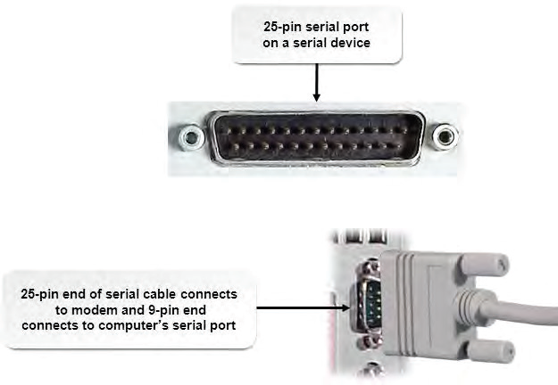
Serial Ports and Connectors

Slide 12
Serial Port Naming
Serial ports are typically called COM1, COM2, COM3, and COM4, where “COM” is short for communications port.
This port has been almost completely phased out in favor of USB. You’ll probably find many systems with no serial ports at all.

Slide 13
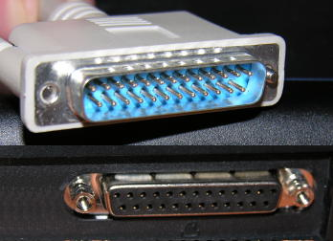
Parallel Ports and Connectors
A parallel connection is a computer connection that transfers data eight or more bits at a time over eight or more wires.
Any components connected by multiple data pathways may be considered to have a parallel connection.
The term is generally used to refer to a standard legacy parallel port that uses eight data wires, and it is typically used to connect a printer to a system unit.
Parallel connections in older personal computers support only one-way or unidirectional communications. Newer computers have parallel ports that support bidirectional communications. Standard parallel ports have 25-pin female connectors. A parallel cable has a 25-pin male connector to plug into the system unit and a 36-pin male Centronics connector at the other end to attach to the external device.

Slide 14
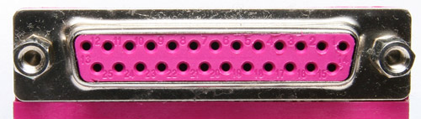
Parallel Ports
On system units that have color-coded ports, the parallel port is burgundy or dark pink.
Note: The standard parallel port has been phased out in favor of USB, so you may find many systems with no parallel ports at all.

Slide 15
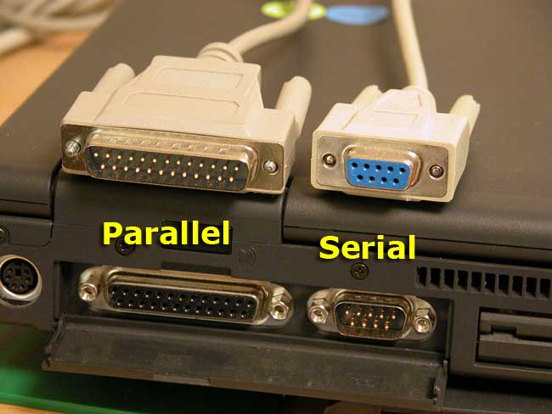
Parallel vs Serial Ports
Male Parallel
Female Serial
Female Parallel
Male Serial

Slide 16
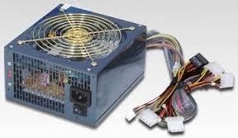
Power Connections and Connectors
Almost every device in a computer uses one of several types of power connectors to get electrical power from the computer’s power supply.

Slide 17
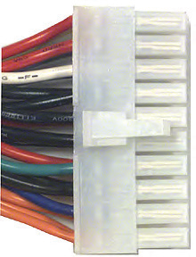
Power Connector:
Main Power Connector
ATX Connectors (20-pin or 24-pin)
Supply power to the motherboard

Slide 18
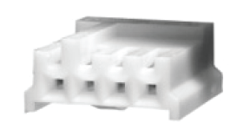
Power Connector: Berg
Berg connectors are used to supply power to floppy disk drives and some tape drives.

Slide 19
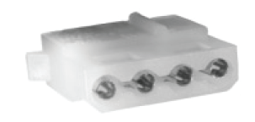
Power Connector: Molex
Molex connectors are used to supply power to Parallel Advanced Technology Attachment (PATA) drives, optical drives, and SCSI drives.

Slide 20
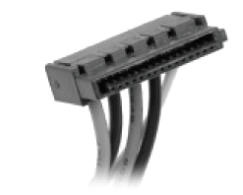
Power Connector: SATA Power Connector
Serial Advanced Technology Attachment (SATA) power connectors are used to supply power to SATA drives (i.e. hard disk drives)

Slide 21
USB Ports and Connectors
A universal serial bus (USB) connection is a computer connection that enables you to connect multiple peripherals to a single port with high performance and minimal device configuration.
USB connections support two-way communications.
All modern PC systems today have multiple USB ports and can, with the use of USB hubs, support up to 127 devices per port.
USB connections transfer data serially, but at a much faster throughput than legacy serial connections.
USB devices also incorporate Plug-and-Play technology that allows devices to self-configure as soon as a connection is made.

Slide 22
USB Ports and Connectors
USB cables may have different connectors at each end.
The computer end of the cable ends in a Type A connector. The device end of the cable commonly ends in a Type B connector, or may also end in a Mini-A, Mini-B, Micro-AB, or Micro-B connector.
The mini connectors are typically used for portable devices such as smartphones.
The size of the connector varies depending on the device.

Slide 23
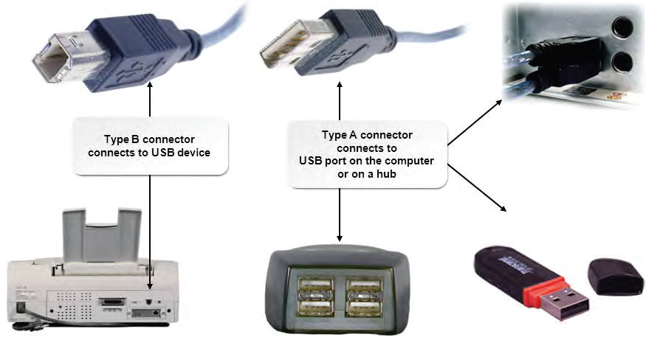
USB Ports and Connectors

Slide 24
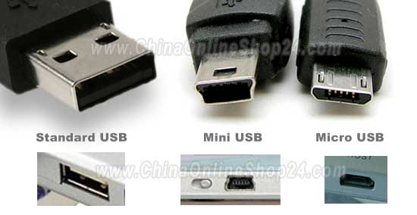
USB Ports and Connectors

Slide 25
USB Standards
USB 2.0, released in April 2000, is the most commonly implemented standard.
It can communicate at up to 480 Mbps. The original USB 1.1 standard is still commonly found in devices and systems. It can communicate at up to 12 Mbps.
A USB 2.0 device connected to a USB 1.1 hub or port will communicate at only USB 1.1 speeds, even though it might be capable of faster speeds.
Generally, the operating system will inform you of this when you connect the device.
USB 3.0, also called SuperSpeed USB, is the latest USB standard released in November 2008.
It features a maximum transfer rate of 5.0 Gbps. It is 10 times faster than the USB 2.0 standard, has enhanced power efficiency, and is backward compatible with USB-enabled devices currently in use.
USB cables have a maximum distance before performance suffers. To work around this, one or more hubs can be used to create a chain to reach the necessary cable length.
USB 1.1 has a maximum cable length of 3 meters, while USB 2.0’s maximum length is 5 meters. In each case, a maximum of five hubs can be used to extend the cable length. The maximum cable length is not specified in the USB 3.0 specification.

Slide 26
USB Standard Comparisons
Standard | Transfer Rate | Max Cable Length | Notes
USB 1.1 | 12 Mbps | 3 meters / 3.28 yards | Original standard
USB 2.0 | 480 Mbps | 5 meters / 5.47 yards | Most commonly implemented standard
USB 3.0 | 5.0 Gbps | Not specified | 10 times faster than the USB 2.0 standard, has enhanced power efficiency, and is backward compatible with USB-enabled devices currently in use.

Slide 27
Firewire Ports and Connectors
A FireWire connection is a computer connection that provides a high-speed interface for peripheral devices that are designed to use the Institute of Electrical and Electronic Engineers (IEEE) 1394 standard.
Apple was the primary vendor to promote the IEEE 1394 implementation included in its Macintosh systems
FireWire can support up to 63 devices on one FireWire port.
FireWire 400 transmits at 400 Mbps and uses either a 6-pin, bullet-shaped, powered connector or a 4-pin square-shaped, unpowered connector.
FireWire 800 transmits at 800 Mbps and uses a 9-pin connector.

Slide 28
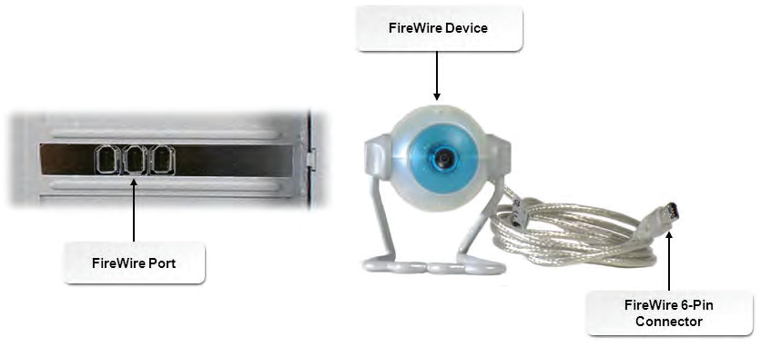
Firewire Ports and Connectors

Slide 29
Firewire vs USB
FireWire predated USB and was faster than the original USB 1.1 standard. USB 2.0, with its increased speed, largely superseded FireWire. Although USB 2.0 is faster by the numbers than FireWire, FireWire is actually faster on throughput, making it ideal for video/audio file transfers and external storage devices. A file transfer of 100 separate documents might be slightly faster on USB than FireWire, but a file transfer of a single 2 GB video file will be much faster in FireWire. Also, whereas USB provides a device up to 5 V power, FireWire provides up to 12 V power on the wire.

Slide 30
Firewire vs USB
Even with the release of USB 3.0 and the latest FireWire S3200, the performances will still vary. USB 3.0 is 10 times faster than USB 2.0 and will remain the popular standard used for most devices. The FireWire S3200 standard, however, still has considerable advantages over USB. For example, FireWire uses much less CPU power and provides more power over a single cable connection.
Similar to USB, FireWire has maximum distance restrictions. However, FireWire’s distances are greater than USB’s. A FireWire chain, created with cables and repeaters, can reach up to 237 feet from device to host, whereas USB 2.0 can reach 30 meters (just under 100 feet).

Slide 31
Thunderbolt Ports and Connectors
Thunderbolt is an input/output connection developed by Apple and Intel. It carries data and display signals on a single cable.
It also can be used to power peripherals with 10 watts of power. It is a dual-protocol technology that works with PCI Express and DisplayPort technologies. The data transfer rate of Thunderbolt is approximately 10 Gbps.
Peripherals can be daisy-chained together so that multiple peripherals require only one port on the computer.
Thunderbolt was originally designed to use fiber-optic cabling, but is currently using multiple copper wires in the cable. Future plans include moving the technology to fiber-optic cabling, which provides the ability to have longer cables.

Slide 32
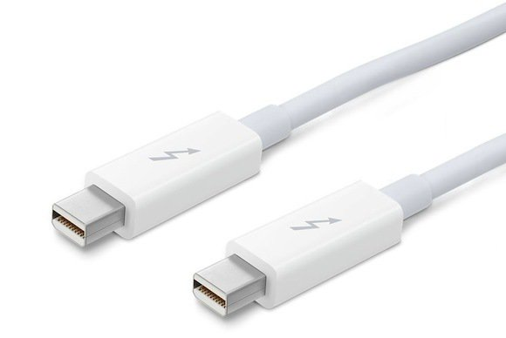
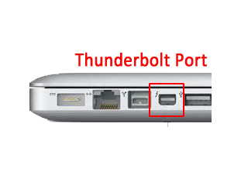
Thunderbolt Ports and Connectors

Slide 33
Audio Ports and Connectors
There are a number of audio/video connectors that are used to connect a wide variety of devices, including PCs, DVD and Blu-ray players, surround-sound systems, stereo equipment, projectors, and HDTVs.
In addition to HDMI and DVI, common audio/video cable and connectors include those described in the following slides

Slide 34
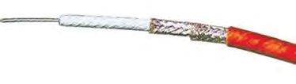
Audio Ports and Connectors:
Single-Core / Shielded Cable
The single core wire is the positive, and the shield is the negative.
This type of cable is used for unbalanced audio signals. Generally, unbalanced audio cables are short, because noise is less of an issue.

Slide 35
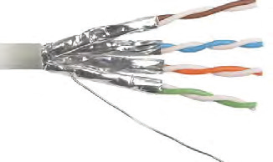
Audio Ports and Connectors:
One pair / shielded cable
Uses a pair (white and red) of cores with one wire being the positive, and the other wire being the negative.
The shield acts as a ground. This type of cable is used for balanced audio signals. Balanced audio is a method for minimizing noise and interference in audio cables.

Slide 36
Audio Ports and Connectors:
TS and TRS Connectors
The most common connectors used in unbalanced audio cables are the 1/4-inch tip- sleeve (TS) or tip-ring-sleeve (TRS) and RCA connectors, which are typically used with high- end audio equipment.
The 1/8-inch tip-sleeve is used with smaller audio devices such as Apple iPods. TS and TRS connectors are also referred to as phone jacks, phone plugs, audio jacks, and jack plugs.
Traditionally, TS connectors are used for mono and TRS connectors are used for stereo. Some connectors can carry more signals; these are often used with camcorder, laptops, and other devices. Stereo connectors can also carry a single, balanced signal.

Slide 37
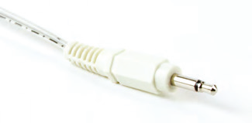
TS and TRS Connectors
Wiring configurations for TRS connectors include:
  For unbalanced mono, the tip carries the signal, the ring is not connected, and the sleeve acts as ground.
  For balanced mono, the tip is positive, the ring is negative, and the sleeve acts as ground.
  For stereo, the tip carries the left channel, the ring carries the right channel, and the sleeve acts as ground.

Slide 38
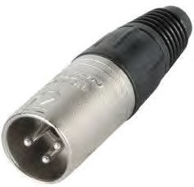
Audio Ports and Connectors:
3-Pin XLR Connectors
The standard connector for balanced audio is the 3-pin XLR.
The most common wiring configuration is:
  Pin 1: Shield (ground)
  Pin 2: Positive (hot)
  Pin 3: Negative (cold)

Slide 39
Video Ports and Connectors
Display devices such as monitors, projectors, or digital TVs can use several different types of cables

Slide 40
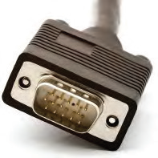
Video Ports and Connectors:
Video Graphics Array (VGA)
The DB-15 high-density VGA connector is the most common cable used for LCD monitors.
It contains three rows of five pins. Pins 4, 11, 12, and 15 receive information from the device; pins 1, 2, 3, 13, and 14 send information to the display.
Mini-VGA is used on smaller devices, such as laptops, in place of the standard full-sized cables.

Slide 41
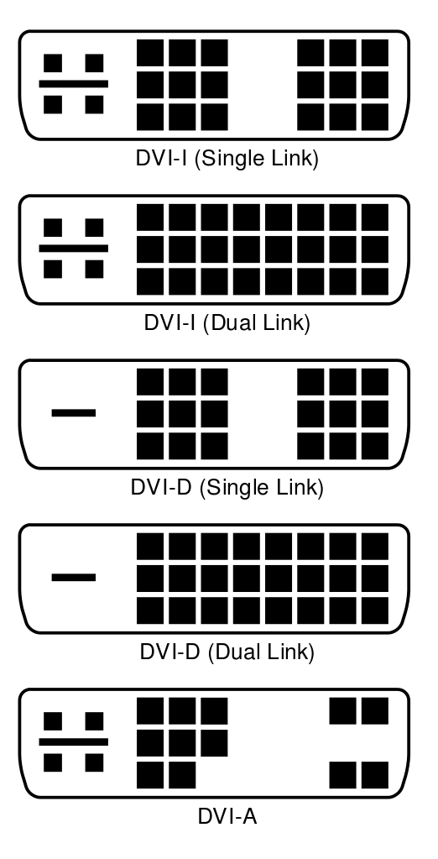
Video Ports and Connectors:
Digital Video Interface (DVI)
DVI cables keep data in digital form from the computer to the display. There is no need to convert data from digital information to analog information. LCD monitors work in a digital mode and support the DVI format.

Slide 42
DVI Subtypes
DVI-analog (DVI-A) is an analog-only format. It requires a DVI-A supported interface. The connector does not support dual link technology. It is commonly used to connect CRT or VGA devices to a computer by using a DVI-A adapter.
DVI-digital (DVI-D) is a digital-only format. It requires a video adapter with a DVI-D connection and a monitor with a DVI-D interface. The connector contains 24 pins/ receptacles in three rows of eight above or below a flat blade, plus a grounding slot for dual-link support. For single-link support, the connector contains 18 pins/receptacles.
DVI-integrated (DVI-I) supports both digital and analog transmissions. This gives you the option to connect a monitor that accepts digital input or analog input. In addition to the pins/receptacles found on the DVI-D connector for digital support, a DVI-I connector has four additional pins/ receptacles to carry an analog signal. For single-link support, the connector contains 18 pins/receptacles, and 4 additional pins for analog transmissions.

Slide 43
Video Ports and Connectors:
High Definition Multimedia Interface (HDMI)
HDMI is the first industry-supported uncompressed, all-digital audio/video interface.
HDMI uses a single cable composed of copper wires to provide an interface between any audio/video source, such as a set-top box, DVD player, or A/V receiver and an audio and/or video monitor, such as a digital television (DTV).
The connector is made up of 19 pins and can support a number of modes such as High Definition TV (HDTV), Standard Definition TV (SDTV), and Enhanced Digital TV (EDTV) and can run to 50 feet or more in length.
HDMI has largely superseded DVI and is compatible with the DVI standard. It can be used with PC systems that support DVI.

Slide 44
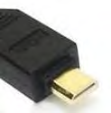
Video Ports and Connectors:
Mini-HDMI
Mini-HDMI is similar to the full size HDMI connector, except that it is specified for use with portable devices.
The connector is a smaller version of the full size with same number of pins.
The difference between the full size and the mini is that some of pins have different transmission functions.

Slide 45
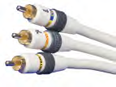
Video Ports and Connectors: Component / RGB
Component video is a type of analog video information that is transmitted or stored as two or more separate signals.
Analog video signals (also called components) must provide information about the amount of red, green, and blue to create an image.
The simplest type, RGB, consists of three discrete red, green, and blue signals sent down three coaxial cables.

Slide 46
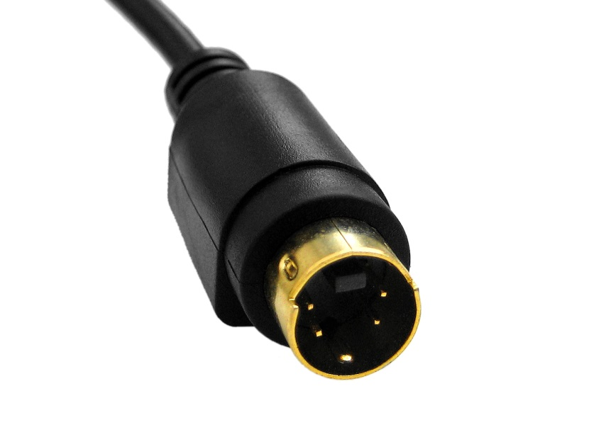
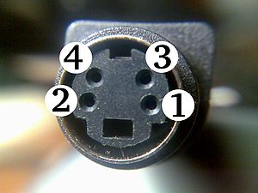
Video Ports and Connectors:
Separate Video (S-Video)
S-Video is an analog video signal that carries the video data as two separate signals (brightness and color).
S-Video works in 480i or 576i resolution.
Note: A resolution of 480i indicates a vertical frame resolution of 480 interlaced lines that contain picture information, while a resolution of 576i indicates a vertical frame resolution of 576 interlaced lines that contain picture information.

Slide 47

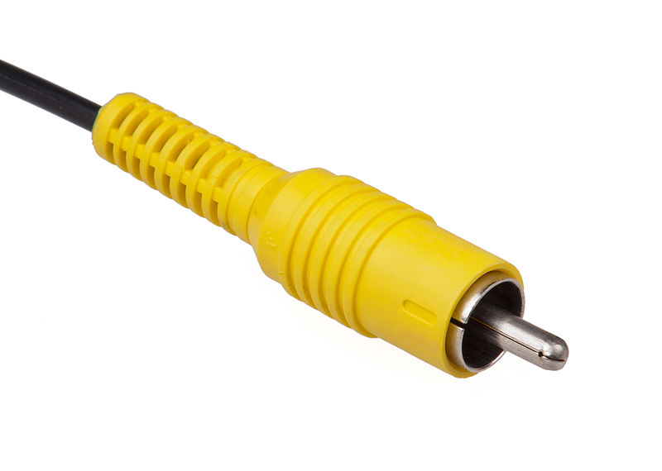
Video Ports and Connectors:
Composite Video
Composite video is the format of an analog (picture only) signal before it is combined with a sound signal and modulated onto a radio frequency (RF) carrier.

Slide 48
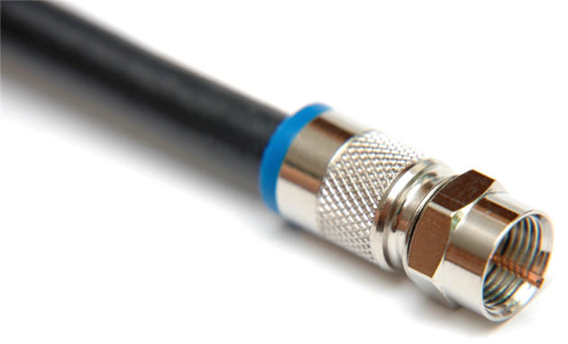
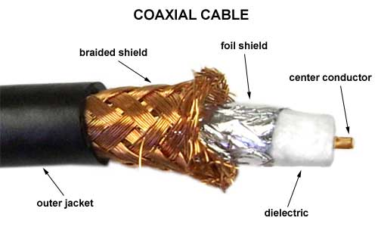
Video Ports and Connectors: Coaxial
A coaxial cable, or coax, is a type of copper cable that features a central conducting copper core surrounded by an insulator and braided or foil shielding.
An insulator separates the conductor and shield, and the entire package is wrapped in an insulating layer called a jacket.
The data signal is transmitted over the central conductor. The outer shielding serves to reduce electromagnetic interference.

Slide 49
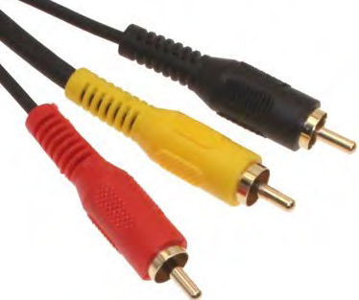
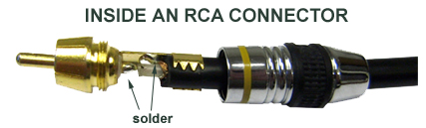
Video Ports and Connectors:
Radio Corporation of America (RCA)
RCA cables and connectors are used to carry audio and video transmissions to and from a variety of devices such as TVs, digital cameras, and gaming systems.
In some cases, the RCA cable may also be used as a power cable, a loudspeaker cable, and to carry digital audio.
The female jacks on the devices are colored to provide a guide as to what type of connector can be attached. Common colors found are:
  Yellow for various composite connections.
  Red for the right channel of the audio transmission.
  White or black for the left channel of audio transmission.

Slide 50
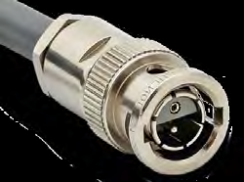
Video Ports and Connectors:
Bayonet Neill-Concelman (BNC)
The BNC connector is used with coaxial cable to carry radio frequencies to and from devices.
The BNC cable can be used to connect radio equipment, aviation electronics, and to carry video signals (i.e. closed circuit tv systems)
The actual BNC connectors come in two versions. The connector will be either 50 or 75 ohms, depending on the specific cable that is attached.

Slide 51
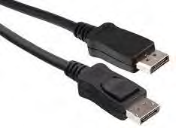
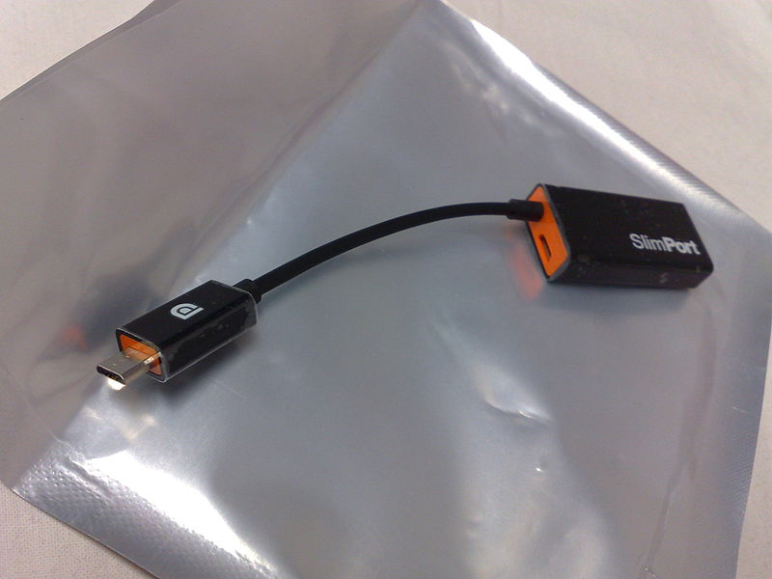
Video Ports and Connectors: DisplayPort
DisplayPort is a digital display standard that aims to replace DVI and VGA standards.
DisplayPort is not normally backward compatible with DVI and HDMI (but there are adapters) and is a royalty-free standard.
However, by using special dual-mode ports and suitable adapters, it may be possible to use DVI and HDMI signals with DisplayPort.
Similar to Peripheral Component Interconnect Express (PCIe), DisplayPort also supports high-quality gaming and other applications that use high-end graphics.

Slide 52
Ethernet and Displays
Some display devices such as the Apple Thunderbolt display include an Ethernet port for connection directly to a network.

Slide 53
DVI Single Link Vs. Dual Link
DVI cables use a technology called Transition Minimized Differential Signaling (TMDS) to transmit serial data over a high-speed connection.
Single link cables use a single TMDS transmitter to carry data, while double-link uses two.
Therefore, dual link cables can transmit larger images at higher speeds than single link.

Slide 54
Wireless A/V Connections
Wireless connections are being used in conference rooms to connect computers to display boards.
This is not a common method of connection yet, but as more people want to avoid cluttering their work areas with wires, it might become more popular.
A wireless audio/visual adapter needs to be attached to the display monitor in order for the display to receive a signal from the device that is projecting to it.

Slide 55
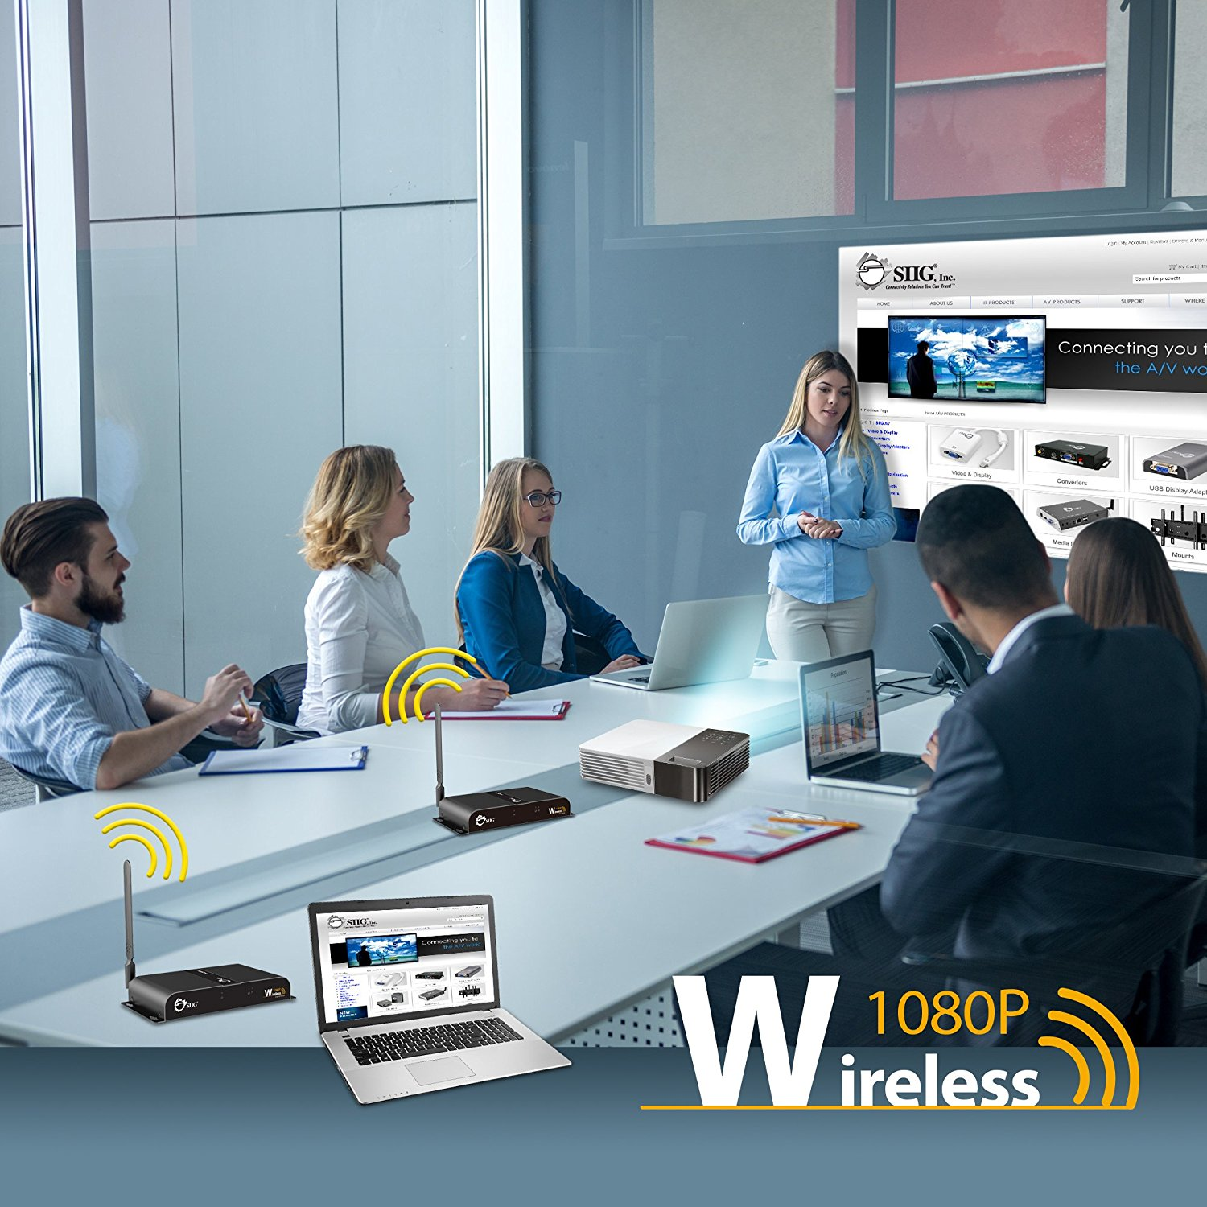
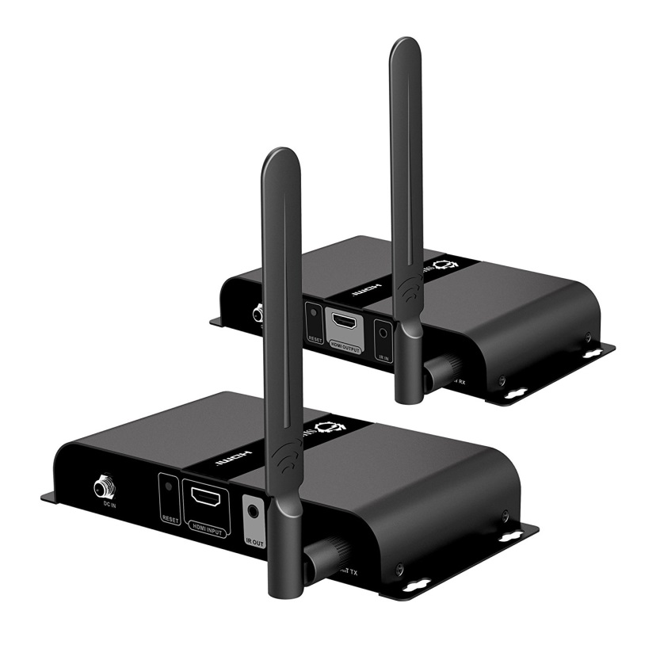
Wireless A/V

Slide 56
eSATA Connectors
External SATA (eSATA) is an external interface for SATA connections.
Like USB and FireWire, it provides a connection for external storage devices.
eSATA connections provide fast data transfers without having to translate data between the device and the host computer.
eSATA interfaces do require an additional power connector to function. You can provide eSATA functionality by installing eSATA cards in systems.

Slide 57
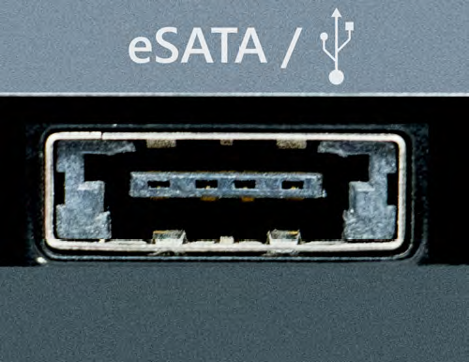
eSATA Connectors
The eSATA port shown in the following graphic also allows USB peripherals to connect to the same port.
This combination port allows either eSATA or USB devices to be plugged in.
It is technically an eSATAp port, or a powered eSATA port.

Slide 58
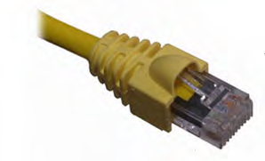
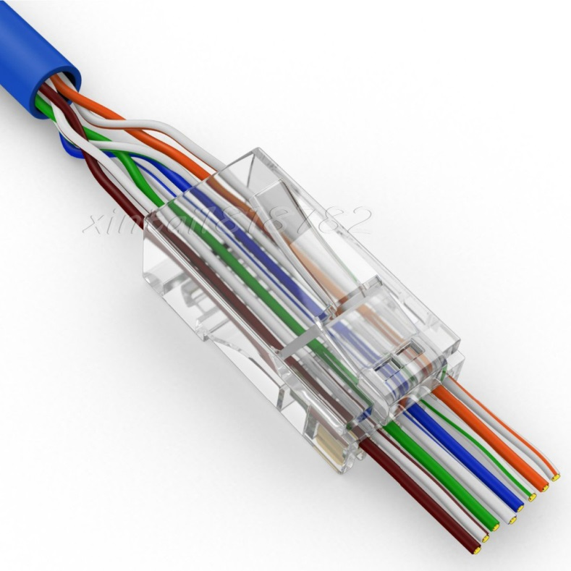
RJ-45 Ports and Connectors
The RJ-45 connector is used on twisted pair cable. RJ-45 is an eight-position connector that uses all four pairs of wires.
Be careful not to confuse the RJ-45 connector with the similar, but smaller, RJ-11 connector.
The RJ-11 connector is a six-position connector that uses just one pair of wires. It is used in telephone system connections and is not suitable for network connectivity.
The RJ in RJ-11 or RJ-45 is an abbreviation for “registered jack.”

Slide 59
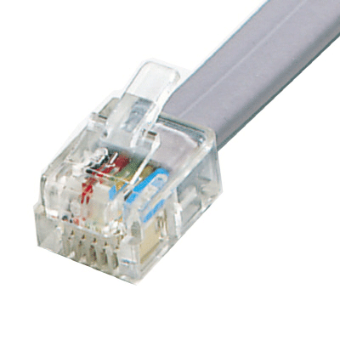
RJ-11 Ports and Connectors
The RJ-11 connector is used with Category 1 cables in telephone system connections and is not suitable for network connectivity.
However, because the RJ-11 connector is similar in appearance to the RJ-45 connector, they are sometimes confused.
RJ-11 connectors are smaller than RJ-45 connectors and have either four or six pins.

Slide 60
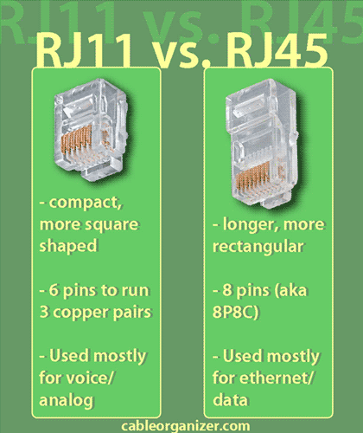
RJ-11 vs RJ-45

