Slide 1
Formatting Cells and Ranges
Lesson 4

Slide 2
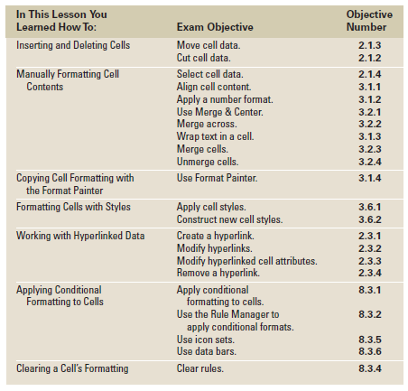
Objectives

Slide 3
Step-by-Step: Insert a New Cell in a Worksheet
LAUNCH Excel. The Home tab will be active on the Ribbon.
OPEN the Contoso Patient Visits data file.
Select cell F5, then click Insert in the Cells group. F5 is now blank and the cells in the range F5:F8 have shifted down one row.
Key 604 and press Enter.
Select cell J4.
Click the Insert arrow, then click Insert Cells. The Insert dialog box opens.
Click Shift cells right, then click OK. A blank cell is inserted and the data is shifted to the right.
Notes:
Another Way: You can also select a cell or range, right-click on the selection, and then click Insert to open the Insert dialog box. In that dialog box, you can click the direction in which you want to shift the cells.

Slide 4
Step-by-Step: Insert a New Cell in a Worksheet
With cell J4 still active, key 580 and press Enter.
Select K7:L7 and click the Insert arrow.
Click Insert Cells.
Click Shift cells right and click OK.
Select cell K7, key 475, and press Tab.
Key 611 and press Enter.
Select N3:N9. Click the Insert arrow and click Insert Cells.
The Shift cells right option is already selected; click OK. Cells are inserted so that November’s data can be entered later. (See Figure 4-3 on next slide)
PAUSE. SAVE the workbook as Contoso Patient 1.

Slide 5
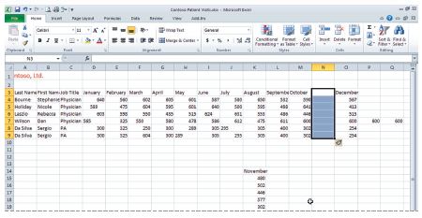
Figure 4-3: Group of Cells Moved and Aligned

Slide 6
Step-by-Step: Delete a Cell from a Worksheet
Select C3:C9. Click Delete in the Cells group. The Job Title data is removed from the worksheet, and the remaining columns are shifted left.
Select A9:N9 and click Delete. The duplicate entry of data is removed.
Select K13:K18 and click Cut in the Clipboard group.
Select M3 and click Paste. The November data is now pasted into the space you made when you shifted cells in the previous exercise. Your worksheet should now resemble the one shown in Figure 4-6 on the next slide.
SAVE your workbook.

Slide 7
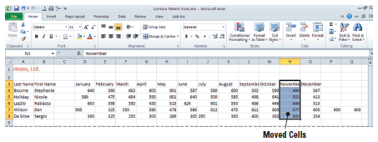
Figure 4-6: Completed Paste of a Cell Group
As shown, you can click Delete in the Cells group to eliminate cells from a worksheet. Any data to the right of the deleted cell or cells will automatically shift left.
If you want to shift cells up rather than left, click the arrow next to Delete, then click Delete Cells to open the Delete dialog box.
Notes:
Another Way: You can also right-click your selected cells and then choose Delete on the shortcut menu to open the Delete dialog box.
NOTE: Remember that when you use the Delete command, the cells themselves are deleted. In contrast, when you use the Cut command or press Delete on the keyboard, only the cell contents are deleted; the cells and any formatting remain.

Slide 8
Step-by-Step: Select Cells and Ranges
Select cell A3. Hold down the left mouse button and drag to B8 to select the range, then release the mouse button.
Click the Row 3 heading to select the entire row.
Click the column C header, press and hold Ctrl, and click E, G, and I to select nonadjacent columns.
Click the File tab, then click Save As.
When the Save As dialog box opens, create a Lesson 4 folder.
SAVE your workbook in the folder and name it Patient Visits.

Slide 9
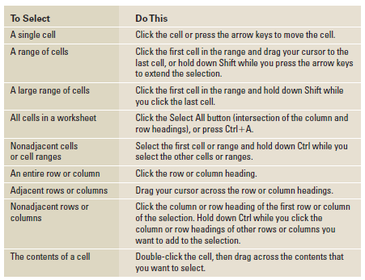
Table 4-1: Making Selections in Excel

Slide 10
Step-by-Step: Align Cell Contents
Select A3:N3.
In the Alignment group, click Center. The column labels are now horizontally centered.
Click C4, press Shift, and click N8. The cell range containing the values is selected. Release the Shift key and click Align Text Right. All cells containing values are now right-aligned.

Slide 11
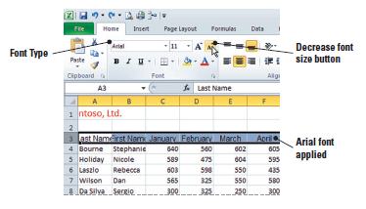
Step-by-Step: Choose Fonts and Font Sizes
Select the column labels in row 3.
Click the Font arrow. Scroll up the list of font names and click Arial. As shown in the figure below, the font size is unchanged (still 11 point), but Arial is larger than the default Calibri font.

Slide 12
Step-by-Step: Choose Fonts and Font Sizes
With row 3 still selected, click Decrease Font Size. The number 10 appears in the Font Size box, and the labels now fit within the column width.
SAVE the workbook.

Slide 13
Step-by-Step: Apply Special Character Attributes
Select A4. Hold down the left mouse button and drag to B8. Click Bold in the Font group.
Click cell A3. Press Shift and click N3 to select the column labels. Click Italic in the Font group, then click Bold.
SAVE the workbook.

Slide 14
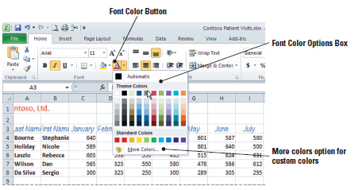
Step-by-Step: Change Font Color
Select the column labels if they are not already selected. Click the Font Color arrow.
Click Blue in the list of standard colors (see the following figure).
Select A4:B8. Click the Font Color arrow, then click Red in the standard colors.
SAVE the workbook.

Slide 15
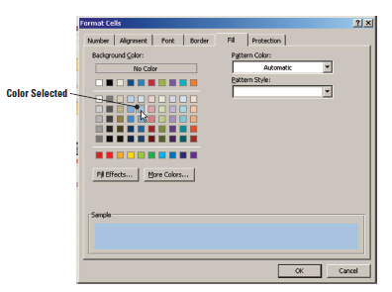
Step-by-Step: Fill Cells with Color
Select A3:N3.
Click the Font Dialog Box Launcher.
Click the Fill tab.
In the Background Color section, click the light blue color (second box) in column 5, as shown below.

Slide 16
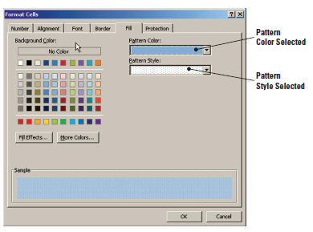
Step-by-Step: Fill Cells with Color
Add a second color in the Pattern Color box. Click the arrow and click the third box in column 5.
Click the Pattern Style arrow and click the pattern at the end of the first row. As shown below, at the bottom of the dialog box, you can see how the pattern and color will look in the selected cells.
Notes:
After Step 2, students might need to adjust column widths to the appropriate size to accommodate their data.

Slide 17
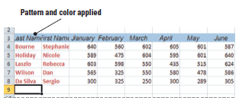
Step-by-Step: Fill Cells with Color
Click OK to apply the color and the fill pattern. Click in any empty cell to deselect your heading row. Your headings should resemble those shown below.
SAVE and CLOSE the Patient Visits workbook.

Slide 18
Step-by-Step: Apply Number Formats
OPEN Contoso Revenue. Click the Sheet1 tab if necessary to make it the active worksheet.
Select B4:D10 and click the Accounting Number Format ($) button in the Number group. The selected data is reformatted to monetary values, the decimal points are aligned, and the column width is increased to accommodate the selected number format.
With the text still selected, click the Decrease Decimal button in the Number group twice. The data is rounded to whole dollars.

Slide 19
Step-by-Step: Apply Number Formats
Select B10:D10. Click Comma Style (,) then click Decrease Decimal twice to show whole numbers. Row 10 data relates to the number of patients, not monetary values. Accounting style was inappropriately applied to this data.
Click the Sheet2 tab.
Select B7:B11. Click the Number Dialog Box Launcher.
Click Number in the Category area. Key 0 in the Decimal places box and place a checkmark the Use 1000 Separator box. Click OK.
Format B6 with Accounting and zero decimals.
Select C7:C11. Click the Number Dialog Box Launcher.

Slide 20
Step-by-Step: Apply Number Formats
The Number tab is active. Click Date in the Category area. Then click the 03/14/01 date style. Click OK. By doing this, you are formatting blank cells to accept data at a later date without having to reformat.
SAVE the workbook as Revenue.

Slide 21
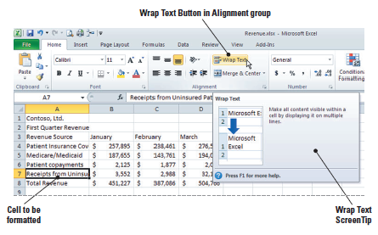
Step-by-Step: Wrap Text in a Cell
Select Sheet1. Select cell A7 and click Wrap Text in the Alignment group. As shown below, the row height is adjusted and the cell’s full text is displayed on two lines.
Notes:
NOTE: If you format a cell for text wrapping and all wrapped text is not visible, it may be because the row is set to a specific height. You will learn to modify row height in Lesson 5.

Slide 22
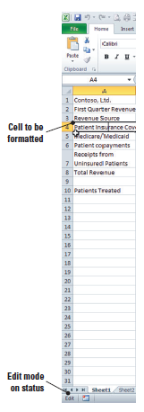
Step-by-Step: Wrap Text in a Cell
Double-click cell A4. As shown in this
figure, the Status bar displays Edit,
indicating that the cell is in edit mode.
Click to place your cursor just to the left
of the word Coverage and press
Alt+Enter. A manual line break is
inserted. Press Enter to accept the
change. You have manually wrapped
the cell text.
SAVE the workbook.
Notes:
NOTE: Remember that you can edit a cell in the formula bar as well as in the cell itself.

Slide 23
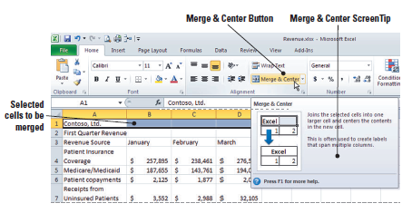
Step-by-Step: Merge and Split Merged Cells
Select A1:D1. Click Merge & Center in the Alignment group. As shown below, the content previously in cell A1 is now centered across columns A, B, C, and D.
Select A2:D2. Click Merge & Center.

Slide 24
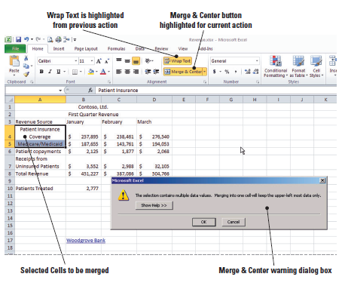
Step-by-Step: Merge and Split Merged Cells
Select A4:A5 and click Merge & Center. A dialog box opens (see below) to remind you that the data in A5 will be deleted in the merge.

Slide 25
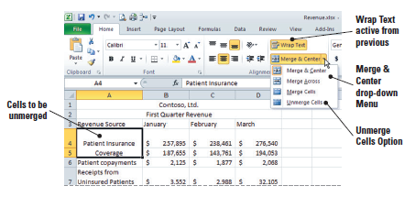
Step-by-Step: Merge and Split Merged Cells
Click OK. Cells A4 and A5 are merged, and the data originally in A4 is centered in the merged cell.
Click the arrow next to Merge & Center and click Unmerge Cells. The cells are unmerged, but note that the data from cell A5 has been deleted.
Select A5, key Medicare/Medicaid, and press Enter (see figure).
Notes:
Another Way: Whereas Merge & Center combines cells and centers the content, the Merge Across button in the Alignment group will merge cells and align the text flush left.

Slide 26
Step-by-Step: Merge and Split Merged Cells
Select A4:A5 and click Align Text Left in the Alignment group.
SAVE the workbook.
Notes:
Another Way: With a merged cell active, you can click Merge & Center to unmerge the cells.

Slide 27
Step-by-Step: Place Borders Around Cells
Select cell A1 and click the arrow next to
Bottom Border in the Font group on the Ribbon.
Click More Borders. The Format Cells dialog box opens with the Border tab displayed.
Under Line, click the Style displayed in the lower-right corner.
Click the Color arrow, then click Red.
Under Presets, click Outline. The red border is previewed in the Border box.
Click OK. The dialog box closes and the border is applied to A1.

Slide 28
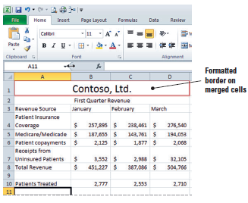
Step-by-Step: Place Borders Around Cells
With A1 selected, click Increase Font Size until the value in the Font Size box is 20 points. Click on cell A11. Your border should resemble the border shown below.
SAVE the workbook.

Slide 29

Step-by-Step: Copy Cell Formatting with the Format Painter
With A1 active, click Format Painter.
A flashing border appears around A1, indicating this is the formatting to be copied.
Click cell A2.
With A2 selected, right-click to display the Mini toolbar. Click the Font Size arrow and choose 14. The font size of the subtitle is reduced.
Select A1:A2 and click Format Painter.
Click the Sheet2 tab and select A1:A2. The formatting from the Sheet1 titles have been applied to the Sheet2 titles.
Click the Sheet1 tab.
SAVE the workbook.
Notes:
Another Way: The Format Painter is available on the Mini toolbar as well as in the Clipboard group.

Slide 30
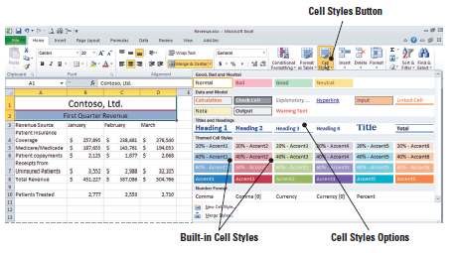
Step-by-Step: Apply a Cell Style
With cells A1:A2 already selected, click Cell Styles in the Styles group. The Cell Styles gallery opens (see figure).
Click 20% - Accent4 under Themed Cell Styles. The themed shading is applied to A1 and A2. The style changes the font size as well as the cell shading.

Slide 31
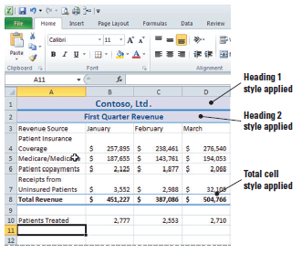
Step-by-Step: Apply a Cell Style
Select A1 and click Cell Styles.
Click Heading 1 under Titles and Headings.
Select A2 and click Cell Styles.
Click Heading 2 under Titles and Headings.
Select A8:D8 and click Cell Styles.
Click Total under Titles and
Headings. This heading style is
now applied to the range of cells.
Then click cell A12. Your
worksheet should
resemble this.
SAVE the workbook.

Slide 32
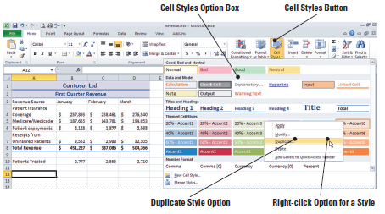
Step-by-Step: Modify a Cell Style
With A12 active, click Cell Styles in the Styles group. The Cell Styles gallery opens.
Right-click 20% - Accent6 under Themed Cell Styles. Click Duplicate (see figure below). The Style dialog box opens.
Key Accent Revised
in the Style name box.
Click Format. Click the
Font tab.
Click Italic in the
Font style box.
Click 12 in the Size box.

Slide 33
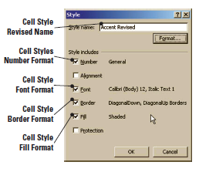
Step-by-Step: Modify a Cell Style
Click the Border tab and click your choice of a broken line in the Line Style box.
Click the two diagonal borders below the Border box. Click OK. Your formatting modifications will be shown in the Style dialog box (see figure).
Click OK to close the dialog box.
Click Cell Styles in the Styles
group. Your Accent Revised cell
style should be the first style in
the Custom section. Click Accent
Revised to apply the style to A12.

Slide 34
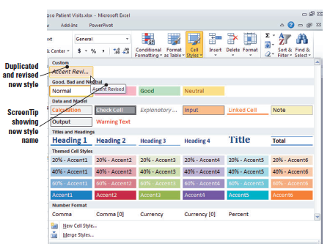
Step-by-Step: Modify a Cell Style
Use the Format Painter to apply your style to B12:D12. Double-click on cell A15. Your changes should resemble those shown in
the figure here.
SAVE the
workbook.

Slide 35
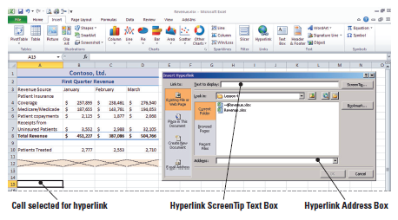
Step-by-Step: Place a Hyperlink in a Cell
With cell A15 active, click the Ribbon’s Insert tab.
Click Insert Hyperlink in the Links group. The Insert Hyperlink dialog box opens (see figure below).

Slide 36
Step-by-Step: Place a Hyperlink in a Cell
In the Text to display box, key Microsoft. This is the blue, underlined text that will appear in A15.
Click ScreenTip. The Set Hyperlink ScreenTip dialog box opens.
Key Go to Microsoft’s Help and Support Center. Click OK. The text you keyed will replace the default ScreenTip.
In the Address box, key www.support.microsoft.com and click OK. The hyperlink text appears in A15. Click on cell B15.

Slide 37
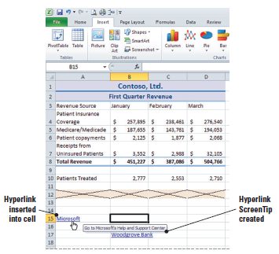
Step-by-Step: Place a Hyperlink in a Cell
Point to the cell containing the hyperlink. Notice the customized ScreenTip displays. The newly inserted hyperlink and ScreenTip are shown below.
Click the left mouse button
to open the hyperlink. The
web browser opens and
connects to Microsoft’s Help
and Support.
Click the Excel button on the
taskbar to return to your
workbook.

Slide 38
Step-by-Step: Place a Hyperlink in a Cell
Key your email address in A17 and press Enter. If you do not have an email address, key someone@example.com.
SAVE the workbook.

Slide 39
Step-by-Step: Remove a Hyperlink from a Cell
Right-click the link in D17.
Click Clear Contents on the shortcut menu. The hyperlink and text are removed.
Right-click B17 and click Remove Hyperlink. The hyperlink is removed and the text remains in the cell.
SAVE and CLOSE the Revenue workbook.

Slide 40
Step-by-Step: Use the Rule
Manager to Apply Conditional Formats
OPEN the Patient Visit Data file. Then, do the following:
Click the Home tab if it is not active. Select A1:N1. Merge and center the range and apply the Heading 1 style. (Refer to the Merge & Split Cells and the Apply a Cell Style exercises as a reference if needed.)
Select A2:N2. Merge and center the range and apply the Heading 2 style.
Select C4:N8 and click Conditional Formatting in the Styles group.
Click Highlight Cells Rules and click Greater Than.

Slide 41
Step-by-Step: Use the Rule
Manager to Apply Conditional Formats
In the Greater Than dialog box, key 600 and click OK. the highlighted data represents the months in which the doctors were seeing more than the ideal number of patients.
With the range still selected, click Conditional Formatting.
Mouse over Highlight Cells Rules and click Less Than.
In the Less Than dialog box, key 560. In the With box, select Green Fill with Dark Green Text and click OK.

Slide 42
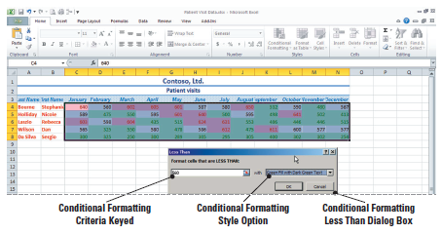
Step-by-Step: Use the Rule
Manager to Apply Conditional Formats
The highlight now contrasts the months in which the patient load was less than expected. Refer to the Conditional Formatting dialog box in Figure 4-32.
Click Conditional Formatting and mouse over Top/Bottom Rules.

Slide 43
Step-by-Step: Use the Rule
Manager to Apply Conditional Formats
Click Top 10%. In the dialog box, accept 10% and click Yellow Fill with Dark Yellow Text. Click OK.
Click Conditional Formatting and click Manage Rules at the bottom of the list.
In the Show formatting rules for box, click This Worksheet. The three conditional formatting rules you have applied are displayed. Position the Conditional Formatting Rules Manager dialog box below the worksheet data so you can view the data and the conditional formatting rules.

Slide 44
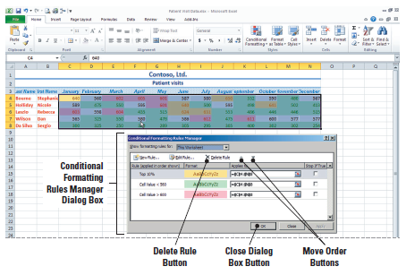
Step-by-Step: Use the Rule
Manager to Apply Conditional Formats
Notice that the first and third rules apply to overlapping data, so if a cell value exceeds 600 and that value also falls within the top 10%, the 10% formatting will be applied (see figure below).

Slide 45
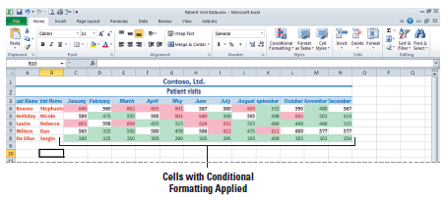
Step-by-Step: Use the Rule
Manager to Apply Conditional Formats
Click the Cell Value > 600 rule and click the up arrow twice to move the rule to the top of the list. Click Apply and then click OK. Click the Close button to close the Conditional Formatting dialog box. Click any empty cell to deselect the range. All values greater than 600 are now formatted with the dark red font. Click any empty cell. See the figure below.
SAVE the workbook in the Lesson 4 folder.

Slide 46
Step-by-Step: Apply Multiple
Conditional Formatting Rules
USE the workbook from the previous exercise:
Click on the Column C header to highlight the entire column. Click on the arrow below the Insert Rows button then click Insert Sheet Columns. A new column is inserted. The Format Painter button emerges with your new column. Click on it and accept the first option (default) of Format Same as Left.
Click on C3 and key Job Title, then press Enter.
In cell C4, key Physician, then press Enter. Click C4 again to activate it, then click and hold and drag the contents to C7.

Slide 47
Step-by-Step: Apply Multiple
Conditional Formatting Rules
Click C8 and key PA. You have now reentered the data that was removed in a previous exercise.
Select D8:O8. Click Conditional Formatting and click Highlight Cells Rules.
Click Less Than. Key 300 in the value box and click Red Text. Click OK.
Click Conditional Formatting, then click Manage Rules. In the Show formatting rules for box, click This Worksheet. Although the last rule has the highest precedence, it applies only to the PA’s schedule, so it doesn’t conflict with any of the rules that apply to the physicians’ schedules.

Slide 48
Step-by-Step: Apply Multiple
Conditional Formatting Rules
Click the Close button to close the dialog box. You will not apply any changes in the Conditional Formatting Manager dialog box. Click on any empty cell to view your changes.
SAVE the workbook.

Slide 49
Step-by-Step: Apply Multiple
Conditional Formatting Rules
USE the workbook from the previous exercise:
Click Conditional Formatting.
Mouse over Clear Rules and then click Clear Rules from Entire Sheet. All conditional formatting is cleared from the data.
Select D4:O8. Click Conditional Formatting.
Mouse over Data Bars and click Blue Data Bar in the Gradient Fill section (first choice). Data bars show that the longer the dark blue portion of the bar is, the higher the value is in relation to other cells in the data range.

Slide 50
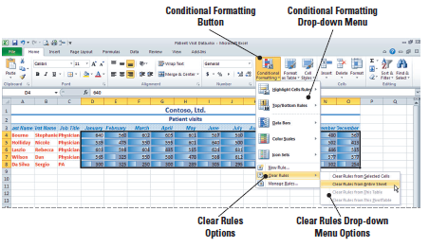
Step-by-Step: Apply Multiple
Conditional Formatting Rules
Repeat Steps 1 and 2 to clear the Data Bars. (See the figure below.) The data range will still be selected.

Slide 51
Step-by-Step: Apply Multiple
Conditional Formatting Rules
Click Conditional Formatting. Mouse over Color Scales and click the Red-Yellow-Green Color Scale (first option in the second column). The darker colors indicate the lower values.
Once again refer to Steps 1 and 2 to clear the Formatting Rules. Refer to Figure 4-36 if necessary. Click Conditional Formatting. Mouse over Icon Sets and then click the 3 Flags set in the Indicators group.
SAVE the workbook as Patient Visits with Icons.

Slide 52
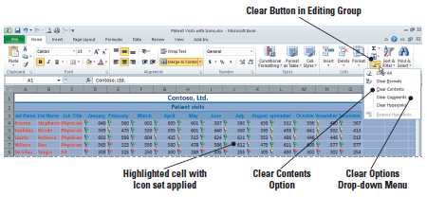
Step-by-Step: Clear a Cell’s Formatting
USE the workbook from the previous exercise:
Press Ctrl+A to select the entire worksheet.
Click the Clear button in the Editing group.
Click Clear Formats. All formatting is cleared from the data. If you selected Clear All, the data would be removed as well as the formatting. (See the figure below.)
Notes:
NOTE: If you select Clear All, contents and formatting are removed. Selecting Clear Contents removes the data within the selected range, but the formatting remains.

Slide 53
Lesson Summary

