Slide 1
Lesson 6: Configuring and Using Wireless Devices
Topic A: Configure Wireless Devices

Slide 2

Congrats on Top 3 Scores!
Regina Young
LaVon Higgins
Xenia Castro

Slide 3
Configure Wireless Devices
Certain basic functions and features are common to all wireless computing devices.
What differs is how you set up those functions and features to optimize your use of the device.
Configuring your wireless device enables you to take advantage of its features and functions.

Slide 4
Wireless Device Configuration Options
There are virtually thousands of options that you can configure on a typical wireless device.
Most of these, however, fall into the following general categories:
  Security
  Sharing
  Communication
  Data management

Slide 5
Basic Security Configuration Settings
Securing a mobile device is a necessary task that should be required and enforced by any employer or user.
You can implement several security methods to provide the right level of security while still providing access to desired resources and applications.

Slide 6
Enable Screen Lock and Passcode Settings
Consider enabling the screen lock option on all mobile devices, and make sure that you require a passcode.
In addition, consider specifying strict requirements on when the device will be locked.
You can specify how long the device is active before it locks, which typically ranges from 1
minute to 5 minutes.
Once the device is locked, you can access it only by entering the passcode that has been set up by the user. This security control prevents access to the device if it is misplaced or stolen.
On some devices, you can configure the passcode settings to erase all data stored on the device after a certain number of failed logon attempts.
Often, enabling screen lock is a requirement in an organizational security policy, no matter if the mobile device is provided by the employer or the individual.
Pattern passcodes require a user to complete a specific action on the touchscreen to activate the device.
Most of the time, the smudge pattern is visible on the surface and can be re-created to gain access to the device. Using a numeric PIN or a password is considered more secure.

Slide 7
Bluetooth
Bluetooth® is a wireless technology that facilitates short-range wireless communication between devices.
Both voice and data information are exchanged among these devices at 2.4 GHz within a range of approximately 30 feet.
You can connect up to eight Bluetooth devices to each other at a time; this connection of two to eight Bluetooth-enabled devices is known as a piconet.
Bluetooth devices operate at very low power levels of approximately 1 milliwatt (mW).
Bluetooth is predominantly used in wireless personal area networks to transfer information between two computers or other devices.
Other common uses include:
  In mobile headsets for hands-free communication with mobile phones.
  For computer peripherals such as the mouse, keyboard, and printer.
  For Bluetooth-enabled devices such as gaming consoles and global positioning system (GPS) receivers.

Slide 8
Bluetooth Pairing
Bluetooth enables mobile devices to connect wirelessly to devices such as headsets, "carputers,“ laptops, MP3 players, and gaming consoles.
Newer computers come with a Bluetooth radio built right into the system, while older computers require an adapter, such as a USB-enabled Bluetooth adapter.
Devices in discovery mode will transmit their Bluetooth-friendly name, which is usually the manufacturer's name.
Once the name has been transmitted, the device can be paired with any other device that is also transmitting a signal.
By using Bluetooth technology, mobile devices can establish a connection through a process called pairing.
When two devices pair, they share a secret key to establish a wireless connection and then begin data transfer.

Slide 9
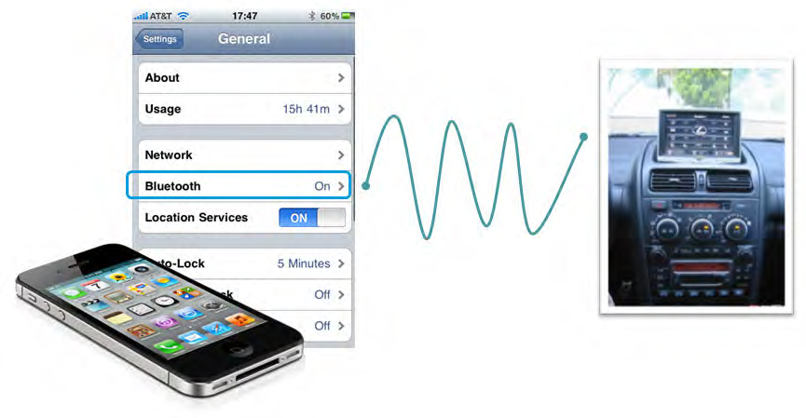

Slide 10
1. Enable Bluetooth on the mobile device through system settings.
2. Enable pairing on the device.
3. On your mobile device, find a device for pairing.
4. Once the device is found, it will ask for a PIN code.
5. Depending on the type of device, the PIN code will be sent via a text, or it will be a standard
code such as “0000” used for wireless headsets.
6. Verify that a connection message has been displayed.
7. Test the connection by using the two devices together to either make a phone call, transfer data,
or play music.

Slide 11
Near Field Communication
Near Field Communication (NFC) is a standard of communication for mobile devices, such as smartphones and tablets, that are in very close proximity, usually when touching or being only a few inches apart from each other.
NFC is most often used for in-person transactions or data exchange.
Aside from having a shorter range of operation, NFC cannot transfer as much data as Bluetooth.
On the other hand, it is faster and easier to establish NFC communication compared to Bluetooth.
The Google Nexus smartphone running a version of the Android operating system is an example of an NFC-enabled device.

Slide 12
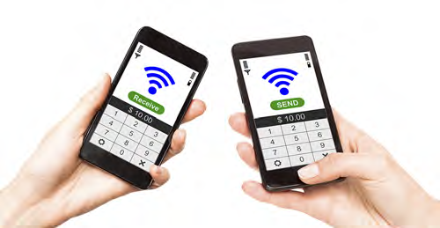

Slide 13
The Wireless Connection Setup Process
1. Verify that wireless capabilities are available.
2. If necessary, turn on Wi-Fi on the wireless device.
3. Locate and select the SSID for the WAP.
4. If necessary, enter the password for the wireless network.
5. Verify that your wireless device can connect to the Internet.

Slide 14
Email Configuration
Once you've established a network connection with your mobile device, you can set up and configure email.
You can configure mobile devices to automatically update your email account information and manage mail.
Mobile devices support many different email providers, such as Yahoo! Mail, Microsoft Exchange, Windows Live, Gmail, and Hotmail/Outlook.
On a mobile device, you can access email in one of two ways: web-based or client-based.
  To use web-based access, install the email provider's app, which is available in the mobile device's app store.
  You will need to enter your user name and password to access the web-based email application.
  Client-based email access is a bit more complicated and requires more information to access email services. Microsoft Exchange is a client-based email system that allows mobile devices to sync with the server.
Before you can set up your mobile device's email, you need to determine the type of email account you will be configuring.

Slide 15
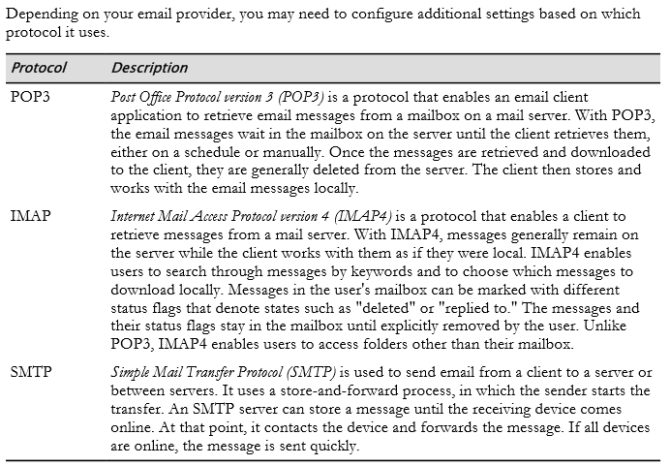
Email Protocols

Slide 16




IMAP
SMTP
SMTP

Slide 17
Synchronization of Wireless and Other Devices
Data synchronization is the process of automatically merging and updating common data that is stored on multiple devices.
For example, users can access their email contact lists from both their mobile devices and laptop computers.
Synchronization can begin when the devices are connected via a cable, wirelessly, or over a network connection.
In some cases, you may need to install synchronization software on the devices you choose to synchronize.
You can control the synchronization rate, and you can limit the synchronization process to allow and restrict push and pull notifications from the cloud over the Internet. The types of data that you can synchronize include:
  Contacts
  Programs
  Email
  Pictures
  Music
  Videos

Slide 18
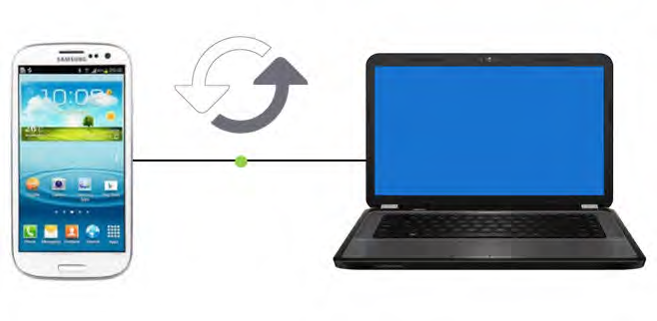

Slide 19
Exchange ActiveSync
Microsoft has its own synchronization protocol called Exchange ActiveSync (EAS) that enables mobile devices to connect to an Exchange Server to access mail, calendars, and contacts.
Exchange administrators can limit what devices can connect and synchronize with the server and can control which ones are blocked.

Slide 20
Synchronization Requirements
Synchronization requirements will vary and will be specific to each mobile device.
Factors to consider when enabling data synchronization on a mobile device include:
  You might need to use a specific system account to enable synchronization.
  You might require an email account.
  If you are using Microsoft Exchange, then control may be given to the admin.
  Organizations may have specific requirements to synchronize data.
  Certain devices might require additional software to enable synchronization.

Slide 21
How to Configure Wireless Devices
There are many ways to set up and configure different functions on a mobile device.
The procedures will differ depending on the particular mobile operating system your device is running.
Always check the manufacturer's website or documentation for additional procedures and help in configuring your device.

Slide 22
Pair an iPhone with a Bluetooth-Enabled Device
1. Move both the iPhone and the Bluetooth device so that they are within a few feet of one
another.
2. Use the manufacturer's set up information to put the Bluetooth device in discoverable mode.
3. Open the Settings app from the home screen of your iPhone. Tap to open the General settings
option.
4. Verify that the Bluetooth setting is On. If it is not, then tap the Bluetooth option and tap the
OFF setting to switch to ON.
5. After the iPhone's search is complete, tap the Bluetooth device in the list
6. If a passcode is required, enter the correct passcode either provided from the manufacturer or
sent from the device you are connecting to.
7. Test the pairing by using the devices.

Slide 23
Pair an Android Mobile Device with Bluetooth-Enabled Device
1. Move both the mobile device and the Bluetooth device so that they are within a few feet of one
another.
2. Use the manufacturer's set up information to put the Bluetooth device in discoverable mode.
3. Open the mobile device Settings.
4. Tap to open Wireless→Networks→Bluetooth settings.
5. Tap to turn on the Bluetooth setting.
6. After searching, tap the Bluetooth device in the list.
7. If a passcode is required, enter the correct passcode either provided from the manufacturer, or
sent from the device you are connecting to.
8. Test the pairing by using the devices.

Slide 24
Configure Email on an iPhone
1. Open the Settings app from the home screen of your iPhone.
2. Tap Mail, Contacts, Calendars.
3. Tap Add Account.
4. Tap to choose the email account type you are configuring.
5. Enter your email account authentication information and tap Next.
6. If using a Microsoft exchange email account:
a. Tap Microsoft Exchange
b. Enter your email account authentication information in the Email, Username, and
Password fields and tap Next.
c. If the iPhone cannot find your account automatically, then you may need to enter your
Exchange ActiveSync server name by logging into the Outlook web application and locating
the server name from Options→See All Options→Account→My Account→Settings for
POP, IMAP, and SMTP access.
d. Locate the POP settings to view the server name.
7. Once the iPhone loads your account, tap to choose the options you want synchronized and then
tap Save.

Slide 25
Configure Email on an Android Mobile Device
1. Open the Email application from the Android Home screen.
2. On the Your Accounts page, tap Next.
3. Enter your email address and password information.
4. Select the appropriate email protocol setting.
5. Enter the incoming mail settings and tap Next.
6. Enter the outgoing mail settings and tap Next.
7. Verify that SSL is selected and tap Next.
8. Customize the settings as needed and close the application.

