Slide 1
Identifying Computer Software
Topic A: Compare Functions and Features of Common Operating Systems

Slide 2

Introduction
Besides troubleshooting and maintaining hardware, IT support reps and PC service techs install, configure, maintain, and troubleshoot operating systems

Slide 3
Operating Systems
An operating system (OS) is a software package that enables a computer to function.
It performs basic tasks, such as recognizing the input from a keyboard, sending the output to a display screen or monitor, and controlling peripheral devices such as disk drives and printers.
It creates a user-friendly environment that enables users to use a computer efficiently without having to know the underlying technologies.
Depending upon the version and manufacturer, the features of the user interface and functionality vary.

Slide 4
Operating System Functions
Provides the user-friendly environment to work with system features and applications.
Converts a user's input and sends it to the monitor or other display device.
Controls peripheral devices such as disk drives and printers.
Provides the structure for files and folders.
Monitors the operating system's health and functionality.

Slide 5

Licensing
A software license is a legal document used to control the distribution and use of software.
There are five main types of software licenses

Slide 6
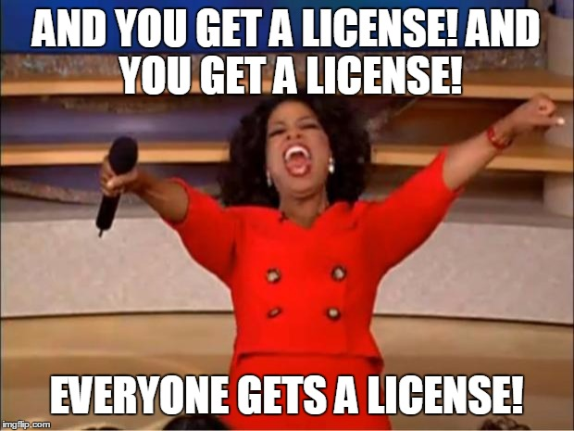
Open Source
Open source software enables users to access its source code and gives them the right to modify it. Open source licensing ensures that free and legal redistribution of the software is possible.

Slide 7

Freeware
Freeware applications can be downloaded from the Internet directly and used without any restrictions.

Slide 8

Commercial License
A commercial software application is sold to users.
As the name suggests, it is intended to meet commercial needs.
Many commercial software publishers ask their users to register their copies within a specified period of time.
This type of software does not allow users to access the source code or modify it.

Slide 9

Copyleft
Copyleft is the method of ensuring that all original work, and all the derivative works created from it, are kept free and open.
The term “copyleft” is used to define a concept that is essentially the opposite of “copyright.” Software developer Richard Stallman proposed this concept to create a licensing arrangement under which software can be freely used, modified, and copied by others.
The Free Software Foundation (FSF) recommends that all free software be copylefted and released under General Public License (GPL).

Slide 10

Shareware
Shareware applications are free applications that a user can download from the Internet directly.
The only difference between a freeware and shareware application is that the shareware is usually provided on a trial basis. That is, the user will have to purchase the full version of the software once the trial period expires.
Some shareware applications have restricted features. Users can use these features only once they purchase the full version.

Slide 11

Software Registration
It is always good practice to register the software you use.
Registering your copy of a software application helps prevent software piracy.
By registering the software, a user becomes eligible to receive regular updates, upgrades, and technical support.

Slide 12
Types of Operating Systems for Workstations
Operating system software is written to work in the background to create the working environment for a computer.
The operating system software sets the rules for how a system and application work together, how security is handled, and in what format the data is stored in disk drives.

Slide 13
Windows
Microsoft® Windows® is the single most popular and widely deployed operating system on both desktop computers and server systems in the world today.
The various versions of Windows all feature a graphical user interface (GUI), support for a wide range of applications and devices, a minimum of 32-bit processing, native networking support, and a large suite of built-in applications and accessories such as the Internet Explorer® browser.
Windows currently comes pre-installed on many personal computers sold commercially.
There have been several versions of Windows since its inception. The most current version is often deployed on personal and professional computers.

Slide 14
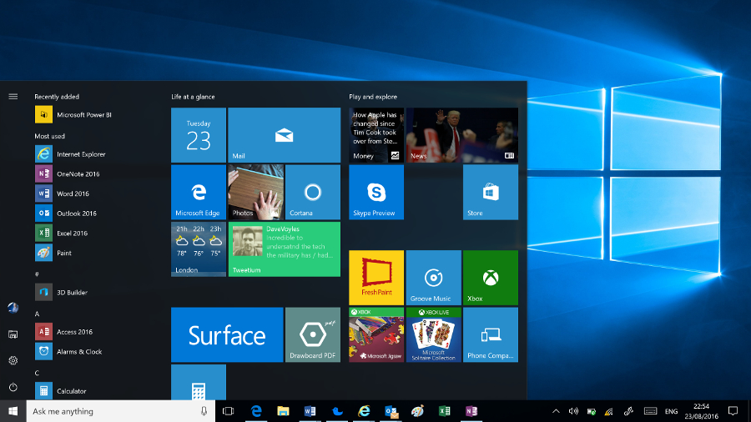
Windows 10

Slide 15
Mac OS X
OS X® is the operating system developed by Apple Computing, Inc. OS X is a Linux® derivative, and consists of UNIX-based operating systems and GUIs.
This proprietary operating system is included on all Macintosh computer systems.
OS X features include:
  Multiple user support.
  Integrated Mac, Windows, and UNIX server, file, and printer browsing in the Finder.
  The Safari® web browser.
  Native TCP/IP networking.
  Many file- and network-level security features.
  Comprehensive hardware device support with a unique Macintosh computer system design.

Slide 16
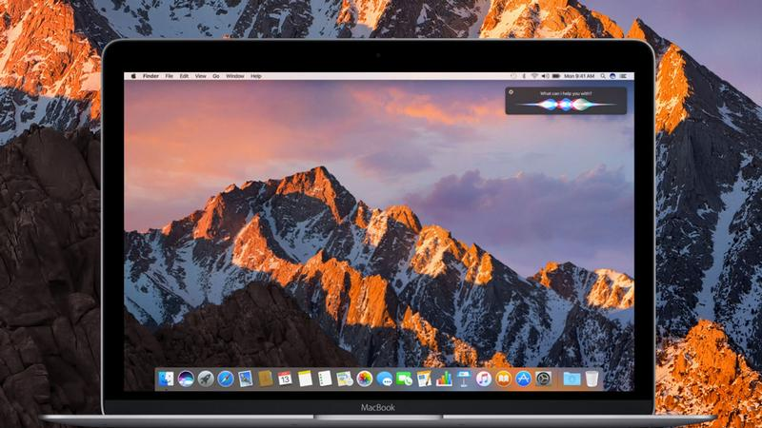
macOS Sierra (Mac OS 10.12)

Slide 17
Linux
Linux is an open-standards UNIX derivative originally developed and released by a Finnish computer science student named Linus Torvalds.
The Linux source code was posted publicly on a computing newsgroup, and the code was developed and tested cooperatively all over the world.
Because the source code is open, it can be downloaded, modified, and installed freely.
However, many organizations prefer to purchase and implement a Linux distribution.
A Linux distribution is a complete Linux implementation, including kernel, shell, applications, utilities, and installation media, that is packaged, distributed, and supported by a software vendor.

Slide 18
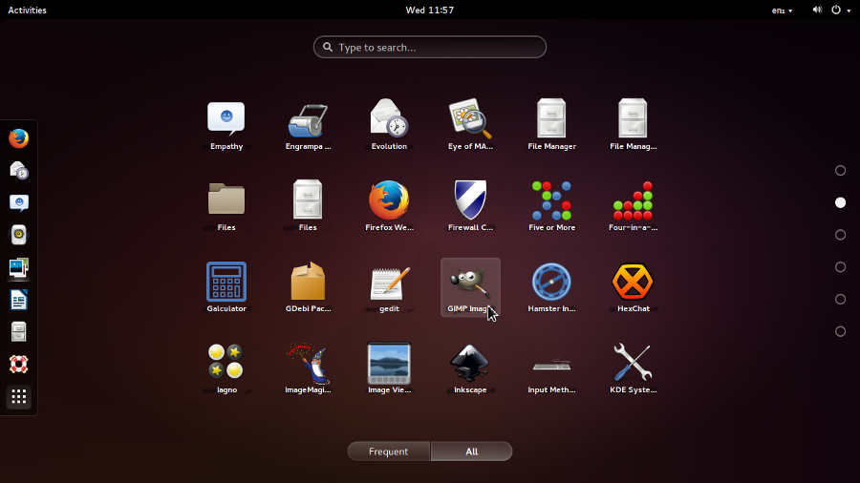
Linux

Slide 19
Chrome OS
Built on the open source Chromium OS, the Chrome operating system was developed by Google as its commercial OS.
With manufacturing partners, the Chrome OS is installed on laptop computers that are known as Chromebooks.

Slide 20
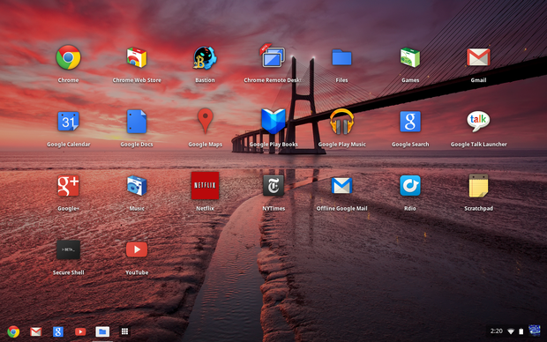
Chrome OS

Slide 21
Types of Operating Systems for Mobile Devices
Some operating systems are designed specifically to work with mobile devices such smartphones and tablets.

Slide 22
Apple iOS
iOS is the base software that allows all other applications to run on an iPhone®, iPod touch®, or iPad®. The iOS user interface supports direct touch, multitouch, and using the accelerometer.
Interface control elements consist of switches, buttons, and sliders.
The response to user input is immediate and provides a fluid interface that includes swiping, tapping, pinching, and reverse pinching, all of which have specific definitions within the context of the iOS operating system and its multitouch interface.

Slide 23
Android OS
Android™, on the other hand, is a layered environment built on the Linux kernel foundation that includes not only the operating system, but middleware, which provides additional software for the operating system and additional built-in applications.
The Android OS was developed by the Open Handset Alliance and is owned by Google.
It supports open-source–developed applications and functions and comes with basic operating system services, message passing, and so on.
The major difference between Android and iOS is that iOS runs on Apple products only, whereas the Android OS is used by many different mobile device manufacturers and is more widespread across a number of different mobile devices.
Android also enables manufacturers to overlay a suite of applications that they support.

Slide 24
Operating System Compatibility Issues
If you are upgrading an existing computer to a different version of Microsoft Windows, you will need to ensure that the existing computer hardware is compatible with the target operating system.
To do so, you can either run the Upgrade Assistant tool available on Microsoft's website, or you can download a third party utility that will scan your computer and generate a compatibility report.
Note: The Windows Upgrade Assistant is available online at http://windows.microsoft.com/en-us/windows-8/upgrade-assistant-download-online-faq.
Another significant compatibility issue concerns the architecture of your OS and your computer.
Modern operating systems are usually 64-bit. This means that they can take advantage of processors with larger memory addresses, which affords greater performance.
However, older operating systems, and some still supported today, are 32-bit. The differences between these architectures can cause a number of conflicts

Slide 25
Hardware
The 32-bit and 64-bit OS architectures have different hardware requirements.
The latter tends to require more random access memory (RAM) and storage space, or it may not function properly. Most important, however, is its processor.
A 32-bit OS can usually run on a 64-bit processor, but a 64-bit OS cannot run on a 32-bit OS.

Slide 26
Application
Applications designed to run on 64-bit operating systems are not compatible with 32-bit OSs. The reverse is not necessarily true, as 64-bit OSs can usually run 32- bit applications. However, there still may be compatibility issues, and the application may not run as intended.
You may be able to select an appropriate application compatibility mode for the application after you have upgraded the operating system. For example, Windows 8.1 will allow you to emulate Windows 7 and earlier operating systems when you go to run an older application.

Slide 27
Drivers
A driver is specialized software that controls a device attached to a computer.
A 64-bit driver will not work with a 32-bit OS, and this is also true vice versa.

