Slide 1
Lesson 7: Securing Computing Devices
Topic B: Apply Security Best Practices

Slide 2
Types of User Accounts
User Account | Provides
Administrator | Complete administrative access to a computer. This is the most powerful account on a computer and should be protected with a strong password. In some situations, you might also consider renaming this account.
Standard User | Access to use most of the computing software on the computer. However, higher permission is required to uninstall or install software and hardware. This account also limits the configuration of security settings, operational settings, and deletion of necessary system files. This account is sometimes referred to as a non-privileged user account.
Guest | Limited computer access to individuals without a user account. By default, the Guest account is disabled when you install the operating system. You enable this account only if you want to permit users to log on as a guest.

Slide 3
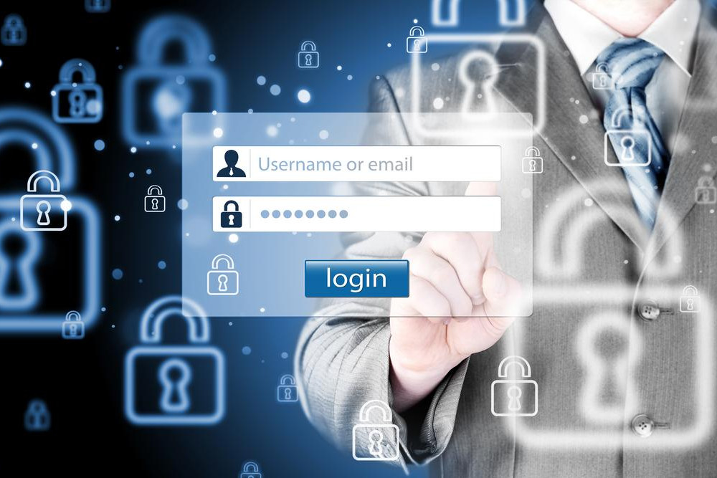
Authentication
User authentication is a network security measure in which a computer user or some other network component proves its identity in order to gain access to network resources.
There are many possible authentication methods; one of the most common is a combination of a user name and a password.
There are three phases in the user access process that a person or system must perform in order to gain access to resources:
  Identification: The claim of identity made by the user when entering a user name and password.
  Authentication: The verification of that claim.
  Authorization: The action taken as a result of verifying the claim.

Slide 4
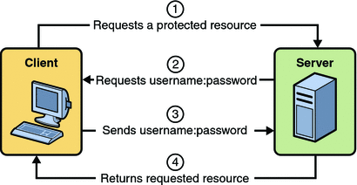

Slide 5
Authentication Factors
Most authentication schemes are based on the use of one or more authentication factors.
You can combine these authentication factors for multi-factor authentication. The factors include:
  Something you know, such as a password.
  Something you have, such as a key or an ID card.
  Something you are, including physical characteristics, such as fingerprints.
Multifactor authentication is any authentication scheme that requires validation of two or more authentication factors.
It can be any combination of who you are, what you have, what you know, where you are or are not, and what you do.
Requiring a physical ID card along with a secret password is an example of multi-factor authentication.
A bank ATM card is a common example of this.
Keep in mind that multi-factor authentication requires the factors to be different, not just the specific objects or methods.

Slide 6
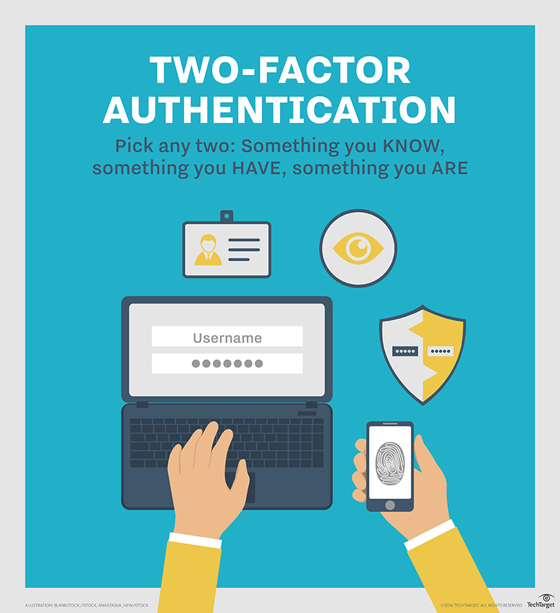

Slide 7
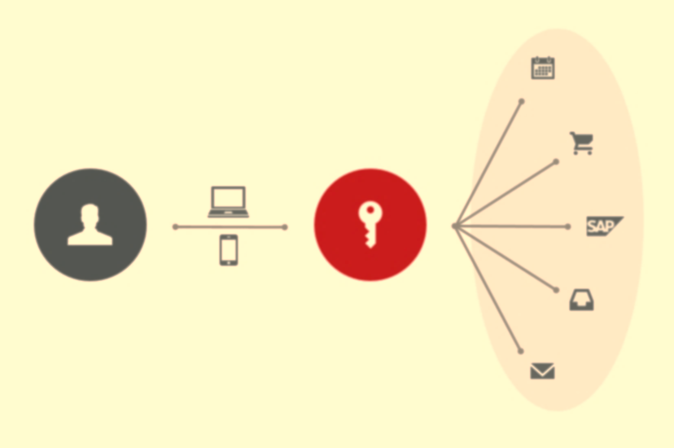
Single Sign-On
Single sign-on (SSO) is an access control property that you can use to provide users with one-time authentication to multiple resources, servers, or sites.
Users log in once with a single user name and password to gain access to a number of different systems, without being asked to log in at each access point.
Different systems may use different mechanisms for user authentication, so SSO has to use different credentials to perform authentication.
With the widespread use of SSO, it is important to ensure that user authentication is strong for the login; with one potential user name and password providing access to a host of systems, it is critical that this single access point is being properly secured.

Slide 8
Password Management Best Practices
You should always change any default passwords to strong passwords to protect your computer and data. A strong password is one that cannot be easily guessed by others and is often referred to as a complex password.
To create a strong password:
  Use at least seven characters.
  Use a combination of uppercase letters, lowercase letters, numbers, and symbols.
  If you are replacing a previously created password, make sure that your new password is significantly different from the last one.
  Do not use common words, your name, your user name, or other words that people migh associate with you, such as a pet's name.

Slide 9
Password Management (Cont.)
A password is your access to your computer, and it should be protected so that the information on your computer is safe and inaccessible to others.
To protect your password, make sure that you:
  Do not write it down or share it with others.
  Do not use your network password for other purposes.
  If you are a computer administrator, create a new administrator account other than the normal login for security purposes.
  Do not re-use passwords.
  Change your password at least every 60 to 90 days, especially if your account is not configured so that the password expires automatically.
  Always use password protection whenever you're given the option.
  Change your password if you suspect that it has been compromised.
  Do not save your password on the computer.

Slide 10
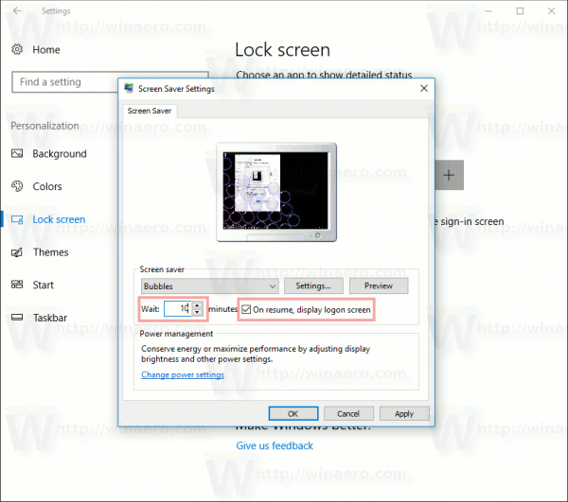
Password-Protected Screen Savers
Setting a password to your screen saver is a security measure that prevents unauthorized access to confidential information and passwords associated with your user account.
This can be enabled by checking the On resume, display logon screen check box in the Screen Saver Settings dialog box.

Slide 11

Device Hardening Best Practices
One important risk mitigation technique is device hardening.
Device hardening is a collection of security tasks used to reduce the scope of the device's vulnerability and attack surface.
There are many technologies included with today's devices, some of which you use often, some that you need to use only occasionally, or some that you never use.
You might not always be in front of your device and attackers might take advantage of an unattended device to illicitly access information on the device or the network to which it is connected.
Disabling features you don't regularly use is one way you can harden your device against attack.
Making sure you lock the screen on unattended devices is another prudent method of hardening devices against unwanted intruders.

Slide 12

Device Hardening Techniques
Timeouts and Lockouts
Software Firewall
Antimalware
Disable Bluetooth
Disable NFC
Encryption Options

Slide 13
Device Hardening Technique: Timeouts and Lockouts
User accounts should be configured so that after a specified number of incorrect login attempts, the account is locked.
The account can be configured to remain locked until an administrator unlocks it for the user, or it can be configured to remain locked for a specified amount of time.
The lockouts and timeouts are a common method used to prevent attackers from breaching a user account by trying to guess the user’s password.

Slide 14
Device Hardening Technique: Software Firewall
Although most desktop and server operating systems ship with a preconfigured software firewall, today's mobile devices still do not have any such protection.
Firewalls use administrator-defined rules to inspect traffic flowing in and out of a device. They look for and block malicious packets.
A firewall can inspect each packet individually (stateless packet filtering) or watch whole conversations between the device and some other node on the network (stateful packet filtering).

Slide 15
Software Firewalls (cont.)
Firewall rules can be based around any of the following criteria:
  IP addresses
  Domain names
  Protocols
  Ports
  Keywords/phrases
  Types of files (such as executables or images)
A good firewall should offer the following services:
  Packet filtering: Stateless inspection of each packet against a predefined rule set.
  Stateful inspection: Monitoring of an entire session of Transmission Control Protocol (TCP), from handshake to teardown, or User Datagram Protocol (UDP), through requested and opened ports.
  Content filtering: Permit or block specified attachment and payload types, keywords, and file formats.
  Proxying: Placing the client session on hold while retrieving content on behalf of the client and caching the content for later use.

Slide 16
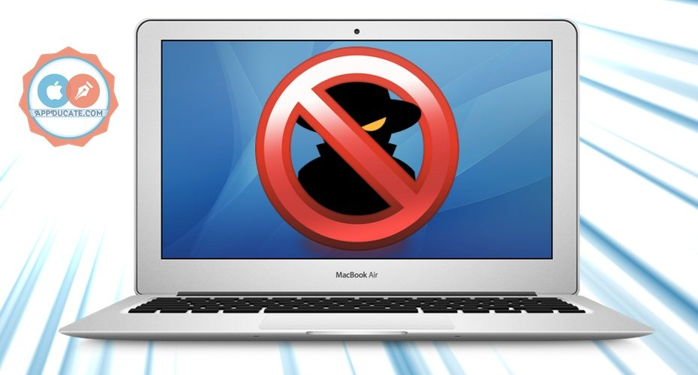
Device Hardening Technique: Antimalware
Make sure that a good antivirus program is installed on your system.
Make sure the virus definitions are kept up-to-date.
You might install ad blocking software.
Be sure to use antivirus software on desktop, laptop, tablet, and smartphone devices.

Slide 17
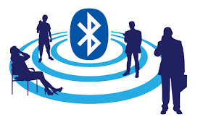
Device Hardening Technique: Disable Bluetooth
Bluetooth technology connects headsets and audio headphones, keyboards, and even printers to computing devices, especially mobile devices.
It is rarely secured; these devices are potentially subject to bluejacking and bluesnarfing as their communications and data can be accessed easily.
If you don't use Bluetooth devices, or only use them occasionally, you should consider disabling the service so it isn't used to compromise your system.

Slide 18

Bluejacking
Bluejacking is a method used by attackers to send out unwanted Bluetooth signals from mobile phones and laptops to other Bluetooth-enabled devices.
Because Bluetooth has a 30-foot transmission limit, this is a very close-range attack.
With the advanced technology available today, attackers can send out unsolicited messages along with images and video.
These types of signals can lead to many different types of threats.
They can lead to device malfunctions or even propagate viruses, including Trojan horses.
Users should reject anonymous contacts and configure their mobile devices to the non-discoverable mode.

Slide 19
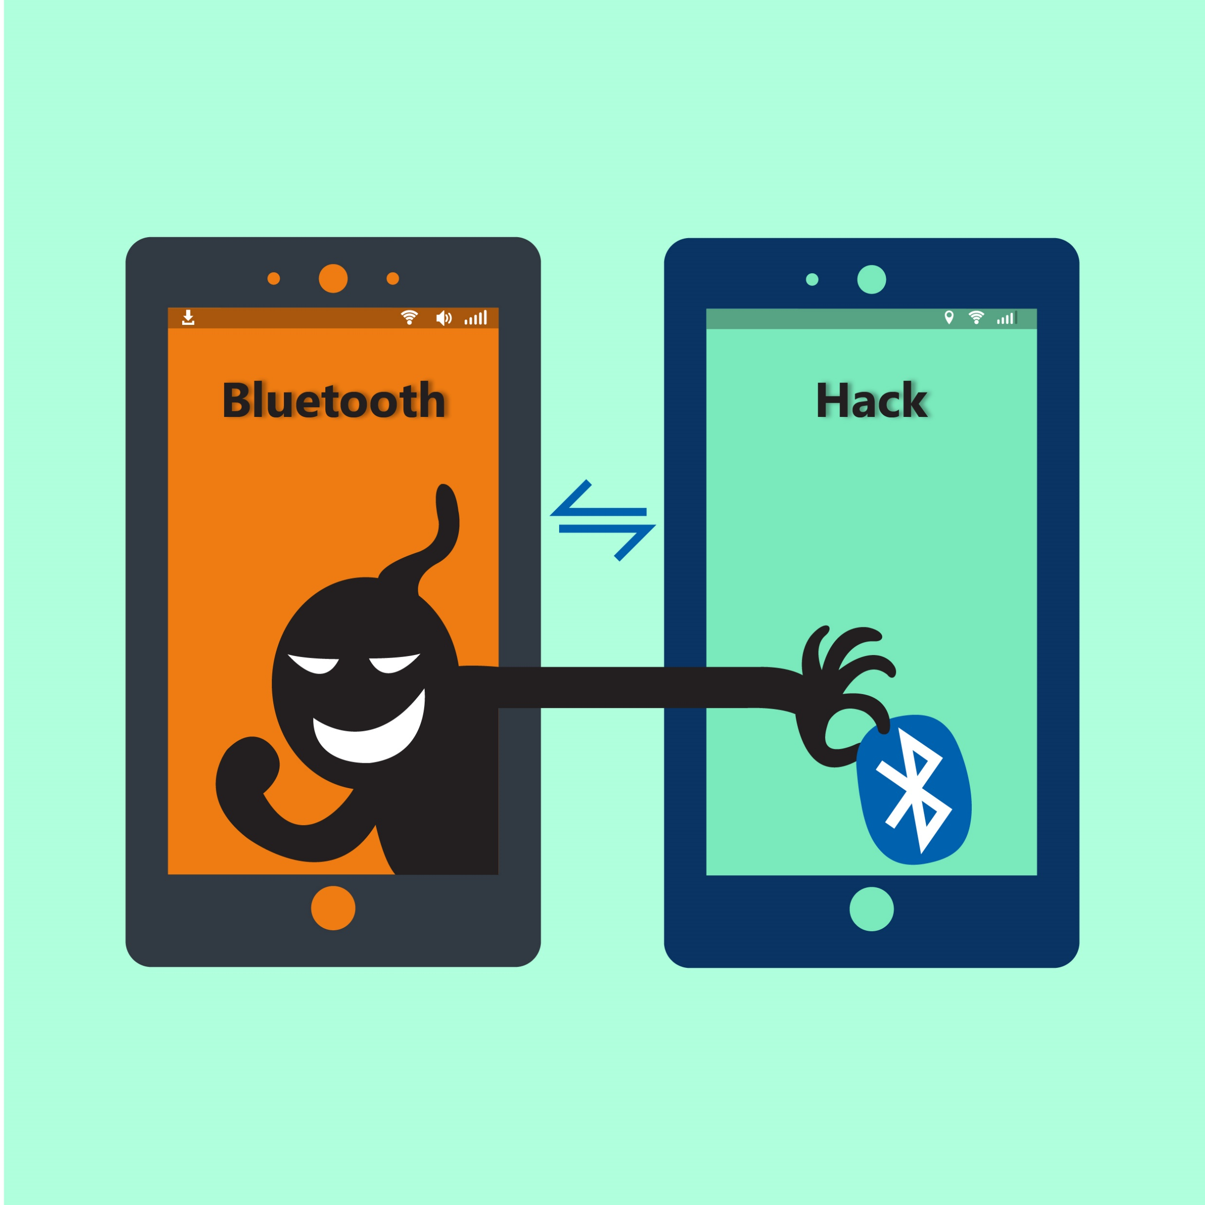
Bluesnarfing
Bluesnarfing is a method in which attackers gain access to unauthorized information on a wireless device by using a Bluetooth connection within the 30-foot Bluetooth transmission limit.
Unlike bluejacking, access to wireless devices such as mobile phones and laptops by bluesnarfing can lead to the exploitation of private information including email messages, contact information, calendar entries, images, videos, and any data stored on the device.

Slide 20
Device Hardening Technique: Disable NFC
Near Field Communications (NFC) is used on smartphones and other mobile devices to enable radio communication when the devices touch each other or are a few centimeters apart.
Any time you don't need to use this feature, turn it off to prevent intruders from accessing your phone or mobile device.

Slide 21
Device Hardening Technique: Encryption Options
Encryption is the process of converting data into a form that is not easily recognized or understood by anyone who is not authorized to access the data.
Only authorized parties with the necessary decryption information can decode and read the data.
Encryption can be one-way, which means the encryption is designed to hide only the cleartext and is never decrypted, or it can be two-way, in which the encryption can be decrypted back to cleartext and read.

Slide 22
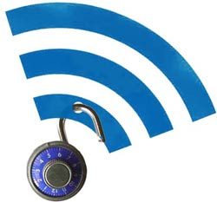
Wireless Networking and Security
Whenever possible, use a secured wireless network rather than an open wireless network.
Open wireless networks are a major security risk when accessed directly.
Because they are insecure, attackers can perform any number of attacks on the network, as well as compromise every user’s communications.
The protocols used on a secure wireless network help protect your data from attack.

Slide 23
Email Best Practices
Signs a compute’s security has been jeopardized:
  Noticeable changes to an email account, such as an excess amount of spam
  Emails sent from the account that the email account owner was unaware
Avoid selecting links in emails whenever possible.
Sometimes an email message looks like it came from a legitimate source with the correct logos, but look for misspellings and bad grammar.
If the email address doesn't seem to match the content, then delete the message.
If you don't know the sender, do not open any attachments to the email message.
Even if you do know the sender, be careful of opening attachments that you weren't expecting to receive.
Someone may have hacked the sender's account and the message could easily contain malware.
If you discover that your email account has been compromised, the first thing to do is change your password and alert the network administrator.
You should also perform a complete scan of your system with antivirus software to locate and remove any malware that might have been introduced onto your system.

Slide 24

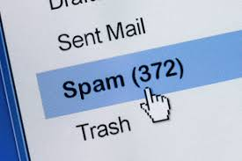
Spam
An email-based threat where the user's inbox is flooded with emails that act as vehicles carrying advertising material for products or promotions for get-rich-quick schemes and can sometimes deliver viruses or malware.
Spam can harbor malicious code in addition to filling up your inbox.
Spam can also be utilized within social networking sites such as Facebook and Twitter.

Slide 25
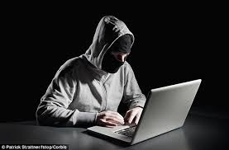
Hijacked Email
An account that has been accessed by an attacker and is being used by the attacker to send and receive emails.
An attacker can read, edit, and send email messages from an account.
In a corporate environment, a hijacked email account can result in unauthorized data access

Slide 26
Cloud Storage Best Practices
Cloud storage has become a very popular method for backing up data and for sharing data.
Some of the most popular include Microsoft's OneDrive, Google’s GoogleDrive, Apple's iCloud, and Dropbox.
You will need to research to see which one provides the amount of storage and access you are seeking and how much it will cost.
Some things to consider when deciding to use cloud storage include:
  Which data do you feel comfortable storing in the cloud?
  How much encryption will you place on content stored in the cloud?
  Will the cloud be your primary backup location?
  What other backup locations will you need?
As with any other service that has user names and passwords, make sure not to share your credentials.

Slide 27
Security Software Alerts
As fast as software companies update and patch vulnerabilities in their software, attackers come up with new ways to breach the software.
This includes operating system software as well as application software and mobile apps.
You might see alert boxes pop up on your display letting you know that new patches and updates are available for your software.
Be sure to apply them in a timely manner.
In some organizations, users are not allowed to install the updates themselves.
This is usually because the IT department needs to test the patch before deploying it throughout the organization.
The patch might cause issues with features that you use in the software or with how the application interacts with other applications on your system.
You might see pop-up messages saying that you need to install updates to your software, but it is for
software that you don't actually have installed on your device.
This is often the case for alerts from antivirus software that you don't have installed.
If you see such an alert for an application that you don't have installed, but sure not to select the link for the update.
Having conflicting antivirus software applications on your system can prevent either of them from trapping attacks on your system.

Slide 28
Guidelines for Applying Security Best Practices
An effective security policy clearly states the organization's policies on how best to protect hardware and software from unauthorized access.
To apply security best practices and prevent unauthorized access to your systems and data, use these guidelines:
  Disable or rename default user accounts.
  Use the Administrator account only when necessary, and use a regular user account the rest of the time.
  Safeguard your authentication credentials by not sharing them with anyone or posting them where they are visible. Consider using multi-factor authentication methods.
  Consider using SSO so that signing in to the device also signs you in to the applications or services you use on the device.
  Make sure passwords are not dictionary words, are easily remembered but not easily cracked, and are never shared.

Slide 29
Guidelines for Applying Security Best Practices
Harden devices by:
  Implementing lockouts and timeouts when the wrong password is entered after a specified number of times.
  Configuring a software firewall to protect mobile device data.
  Disabling Bluetooth and NFC when not in use.
  Installing antivirus software and keeping it up to date.
  Encrypting data.
  Avoid connecting to unsecured wireless networks.
  Be aware of suspicious email messages that aren't from who they say that they are from. Be sure that you change your password if your account has been compromised.
  When using cloud storage, be sure the data is encrypted.
  Install patches and updates to applications as soon as possible to address security alerts. Most patches are designed to protect you from security holes in the application.

