Slide 1
Using Function
Microsoft Excel 2013
Lesson 5

Slide 2
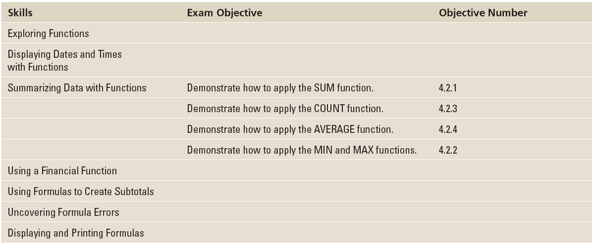
Objectives

Slide 3
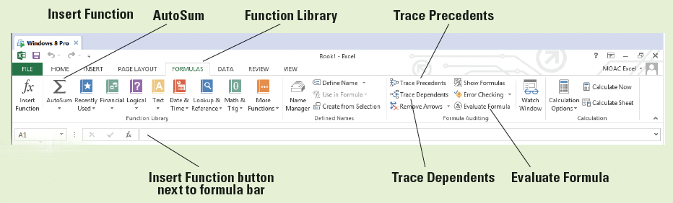
Software Orientation
The FORMULAS tab in Excel 2013, shown below, provides access to a library of formulas and functions.
On this tab, you can use commands for quickly inserting functions, inserting totals, and displaying a visual map of cells that are dependent on a formula.

Slide 4
Exploring Functions
A function is a predefined formula that performs a calculation. Excel’s built-in functions are designed to perform different types of calculations—from simple to complex.
When you apply a function to specific data, you eliminate the time involved in manually constructing a formula. Using functions ensures the accuracy of the formula’s results.
You can type functions directly into Excel or use the tools on the FORMULAS tab to help you fill in formulas with the correct syntax.

Slide 5
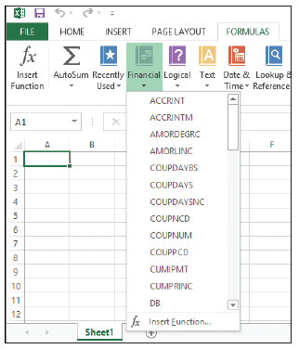
Step by Step: Explore Functions
GET READY. LAUNCH Excel and open a new, blank workbook.
  To become familiar with the tools
  available to build formulas and insert
  functions, click the FORMULAS tab.
  Excel arranges functions by category
  in the Function Library group, such as
  Financial, Logical, Text, and so on.
  Click the Financial button arrow to
  display a drop-down list of functions
  (right). If you create a financial function,
  you can simply scroll through the list
  and select the function you want.

Slide 6
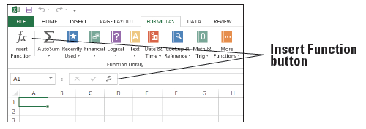
Step by Step: Explore Functions
  You can also find a function using the Insert Function dialog box. On the FORMULAS tab or on the formula bar, click the Insert Function button. The buttons are shown below.

Slide 7
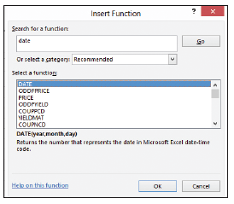
Step by Step: Explore Functions
  In the Insert Function dialog
  box, type a description of
  what you want to do. For
  example, type date and
  click Go. Excel returns a list
  of functions that most
  closely match your
  description (right).
  With DATE selected in the
  Select a function list, click OK. The Function Arguments dialog box opens.

Slide 8
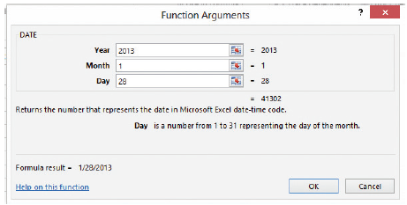
Step by Step: Explore Functions
  Enter the current year, the number of the current month, and the number of the current day (below). Click OK. The date is entered into the worksheet in cell A1.
  SAVE the workbook as 05 Practice.
PAUSE. Leave the workbook open to use in the next exercise.

Slide 9
Step by Step: Explore Functions
Functions are a simplified way of entering formulas. The parameters of a function are called arguments.
Each function name is followed by parentheses, which let Excel know where the arguments begin and end.
Arguments appear within the parentheses and are performed from left to right. Depending on the function, an argument can be a constant value, a single-cell reference, a range of cells, or even another function. If a function contains multiple arguments, the arguments are separated by commas.

Slide 10
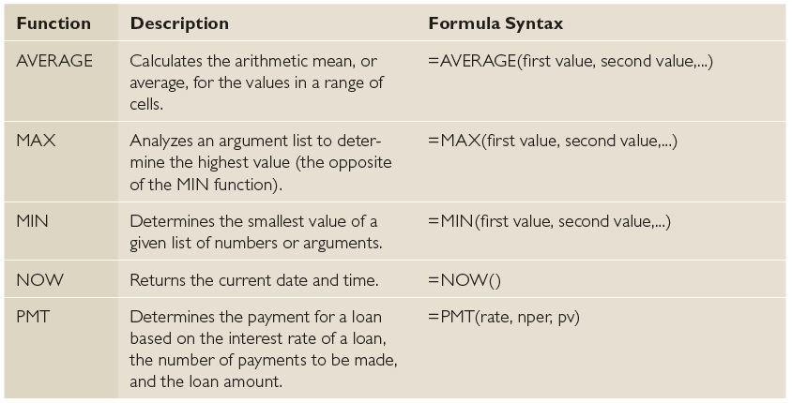
Step by Step: Explore Functions
Even functions that require no arguments must still have parentheses following the name, as in =TODAY(). The table below lists common Excel functions.

Slide 11
Displaying Dates and Times with Functions
When you see a date in a worksheet, it’s actually a numeric value formatted to look like a date. The same principle applies to time.
Two functions display the current date and/or time in a worksheet: NOW and TODAY. NOW returns the current date and time, whereas TODAY returns the current date but not the time.
Neither of these functions uses arguments, so you insert blank parentheses after them. With NOW and TODAY, you can create automatically updated dates and times in worksheets that you frequently revisit and update.

Slide 12
Exploring Dates
Excel stores dates as sequential serial numbers. By default, January 1, 1900, is serial number 1, and January 2, 1900, is serial number 2, and so on.
Each date is a number that represents the number of days that have elapsed since January 1, 1900.
You can add, subtract, multiply, and divide using a date, just as you can with any other number. How the date is displayed depends on the format you assign to it.

Slide 13
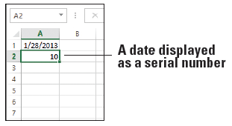
Step by Step: Explore Dates
GET READY. USE the workbook you created in the previous exercise.
  In cell A2, type 1/10/1900 and press Enter.
  Select cell A2.
  On the HOME tab, in the
  Number group, open the
  Number Format menu
  and select General. The
  value in A2 changes to 10
  (right). When you enter a
  date manually into Excel, the format of the cell automatically changes to Date. Because the date 1/10/1900 is the tenth day after (and including) January 1, 1900, the value is 10. Excel’s Date format displays the value as a date, and the General format displays the value as a number.

Slide 14
Step by Step: Explore Dates
  With A2 still selected, change the number format to Short Date using the Number Format menu. The cell displays 1/10/1900.
  In cell A3, type 40000 and press Enter. Because the cell is formatted as General, the value appears as a number.
  Click cell A2.
  On the HOME tab, in the Clipboard group, click the Format Painter, and then click cell A3. The formatting of A2 is copied to A3. The value in A3 now appears as a date: 7/6/2009.
  In cell A4, type =A3-A2 and press Enter. The result is 39990, which is the number of days between the two dates.
  SAVE the workbook.
PAUSE. Leave the workbook open to use in the next exercise.

Slide 15
Using TODAY
The TODAY function returns the current date in a worksheet.
The value returned by the TODAY function automatically updates every time you change the worksheet. To specify a date that doesn’t change, enter the date you want to use manually.

Slide 16
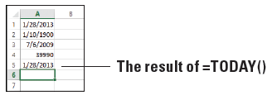
Step by Step: Use the TODAY Function
GET READY. USE the workbook you modified in the previous exercise.
  In cell A5, type =TODAY() and press Enter. The current date displays (below).
  SAVE the workbook.
PAUSE. Leave the workbook open to use in the next exercise.

Slide 17
Step by Step: Use the TODAY Function
The default format for the TODAY function is mm/dd/yyyy, but you can have it appear in any date format.
You can also use TODAY to calculate an interval. For example, you can enter a formula to calculate the number of years you have lived by creating a formula to subtract your birth date from today’s date, like this: =YEAR(TODAY())-1993.

Slide 18
Using NOW
The NOW function returns today’s date and the current time, in the default format of mm/dd/yyyy hh:mm.
You can apply any date or time format to values returned by the NOW function.

Slide 19
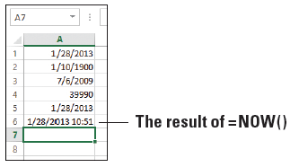
Step by Step: Use the NOW Function
GET READY. USE the workbook you modified in the previous exercise.
  In cell A6, type =NOW() and press Enter. The column width automatically expands, and the current date and time display (see below).
  Copy cell A6 to A7.
  Select cell A7.

Slide 20
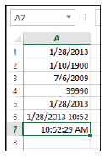
Step by Step: Use the NOW Function
  On the HOME tab, in the Number group,
  select Time from the Number Format
  menu. The current time without the date
  appears in A7 (right).
  SAVE the workbook as 05 Practice
  Solution and CLOSE it.
PAUSE. Leave Excel open to use in the
next exercise.

Slide 21
Step by Step: Use the NOW Function
Like TODAY, the NOW function also updates automatically every time you change the worksheet.
Because it also reports the time, its value changes every time you save the worksheet, even if that is several times during a single day.
In addition to simply displaying the current date and time, you might use the NOW function in a calculation that requires a value based on the current date and time.

Slide 22
Summarizing Data with Functions
Functions provide an easy way to perform mathematical work on a range of cells, quickly and conveniently. Basic functions in Excel include SUM, COUNT, COUNTA, AVERAGE, MIN, and MAX.
Adding a range of cells is one of the most common calculations performed on worksheet data. The SUM function totals all of the cells in a range, easily and accurately.
AutoSum makes that even easier by calculating (by default) the total from the adjacent cell through the first nonnumeric cell, using the SUM function in its formula.
SUM is usually the first function most people learn how to use in Excel.

Slide 23
Summarizing Data with Functions
Statistical functions, such as SUM and COUNT, compile and classify data to present significant information. Use the COUNT function when you want to determine how many cells in a range contain a number.
The COUNTA function returns the number of cells in the selected range that contain text or values, but not blank cells.
The AVERAGE function adds a range of cells and then divides by the number of cell entries, determining the mean value of all values in the range.
The MIN function allows you to determine the minimum value in a range of cells.
The MAX function returns the largest value in a set of values. The MAX function works the same way as MIN, except MAX determines the maximum value in a range of cells.

Slide 24
Step by Step: Use the SUM Function
GET READY. LAUNCH Excel if it is not already running.
  OPEN the 05 Budget Start data file for this lesson. Click Enable Editing, if prompted. This workbook is similar to the 04 Budget workbook created in Lesson 4, but with modifications to accommodate the current lesson.
  In cell B7, type =SUM(B3:B6) and press Enter. The result, 2140, is the sum of January nonutility expenses.
Notes:
Troubleshooting: If you get an error message when entering a basic Excel formula, remember that all formulas must start with an equal sign (=). A function is simply a predefined formula, so you must use the equal sign.

Slide 25
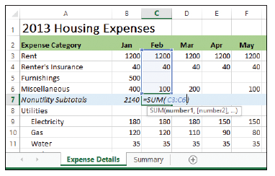
Step by Step: Use the SUM Function
  Click in cell C7. Click the FORMULAS
  tab and then click the top part of the
  AutoSum button. The SUM function
  appears with arguments filled in, but
  only C6 is included. Type C3: before
  C6 to correct the range (right). Press
  Enter. The result, 1340, is the sum of February nonutility expenses.
  Copy cell C7 to D7:M7 to enter the remaining subtotals.
  Copy cell N6 to N7 to enter the total nonutility expenses.
  SAVE the workbook as 05 Budget Math.
PAUSE. Leave the workbook open to use in the next exercise.

Slide 26
Step by Step: Use the SUM Function
The alternative to the SUM function is to create an addition formula using cell references for every cell value to be added, such as the following:
=B7+C7+D7+E7+F7+G7+H7+I7+J7+K7+L7+M7
The easier way to achieve the same result is to use the SUM function or AutoSum. AutoSum is a built-in feature of Excel that recognizes adjacent cells in rows and columns as the logical selection to perform the AutoSum.

Slide 27
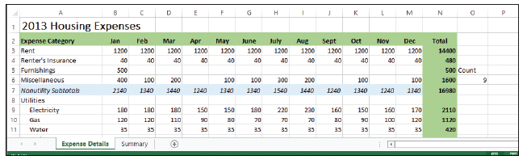
Step by Step: Use the COUNT Function
USE the workbook you modified in the previous exercise.
  In cell O5, type Count and press Enter. This is the label identifying the formula you will enter in the next step.
  In cell O6, type =COUNT(B6:M6) and press Enter. The result, 9, is the number of months in which you budgeted for miscellaneous expenses (see below).
  SAVE the workbook.
PAUSE. Leave the workbook open to use in the next exercise.

Slide 28
Step by Step: Use the COUNT Function
In this exercise, you could have included the row heading—Nonutility Subtotals—in the formula range, along with the data in cells B6 through M6. The COUNT function disregards A6 because it doesn’t contain a number, and the function disregards blank cells. You’ll see this effect using COUNTA in the next exercise.

Slide 29
Step by Step: Use the COUNTA Function
GET READY. USE the workbook you modified in the previous exercise.
  In cell P5, type CountA and press Enter. This is the label identifying the formula you will enter in the next step.
  In cell P6, on the formula bar, click the Insert Function button.
  In the Insert Function dialog box, in the Search for a function text box, type counta and then click Go.

Slide 30
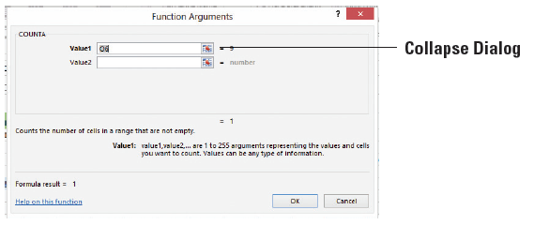
Step by Step: Use the COUNTA Function
  Select COUNTA in the results list and click OK. The Function Arguments dialog box opens.
  Click Collapse Dialog (see below). The box collapses to a single entry box.
  Select A6:M6. The new range appears in the dialog box.

Slide 31
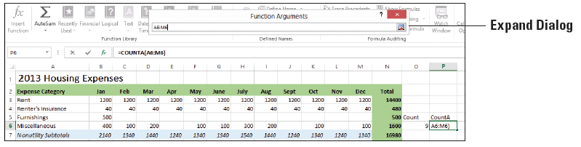
Step by Step: Use the COUNTA Function
  Click Expand Dialog shown below, and click OK to close the dialog box. The result, 10, is the number of non-blank cells in the range.
  SAVE the workbook.
PAUSE. Leave the workbook open to use in the next exercise.

Slide 32
Step by Step: Use the AVERAGE Function
GET READY. USE the workbook you modified in the previous exercise.
  In cell O8, type Average and press Enter.
  In cell O9, type =AVERAGE(B9:M9) and press Enter. The result, 175.8333, is your average expected monthly electricity bill.

Slide 33
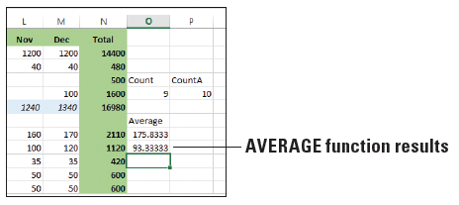
Step by Step: Use the AVERAGE Function
  In cell O10, type =AVERAGE(B10:M10) and press Enter. The result, 93.33333, is your average expected monthly gas bill (below).
  SAVE the workbook.
PAUSE. Leave the workbook open to use in the next exercise.

Slide 34
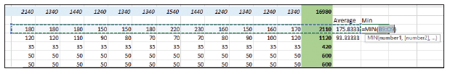
Step by Step: Use the MIN Function
GET READY. USE the workbook you modified in the previous exercise.
  In cell P8, type Min and press Enter.
  Click in cell P9 and then click the FORMULAS tab.
  Click the AutoSum button arrow, and then select Min from the menu. The range B9:O9 is automatically selected (below). This range is incorrect, so you need to edit it.

Slide 35
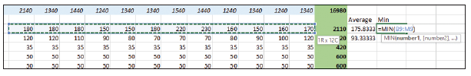
Step by Step: Use the MIN Function
  Click cell B9, hold down the Shift key, and click cell M9. The range B9:M9 appears in the function, which now looks like =MIN(B9:M9). See below. Press Enter. The result, 150, appears, which is the lowest expected electricity bill for the year.
  Copy cell P9 to cell P10. The result, 70, is the lowest expected gas bill for the year.
  SAVE the workbook.
PAUSE. Leave the workbook open to use in the next exercise.

Slide 36
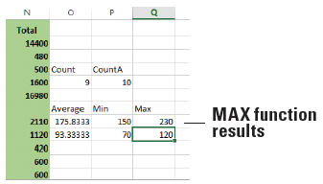
Step by Step: Use the MAX Function
GET READY. USE the workbook you modified in the previous exercise.
  In cell Q8, type Max and press Enter.
  In cell Q9, type =MAX(B9:M9) and press Enter. The result, 230, is the highest monthly electricity bill that you expect to receive.
  Copy cell Q9 to Q10. The result, 120, is the highest monthly gas bill that you expect to receive (see below).
  SAVE the workbook
  as 05 Budget Math
  Solution and CLOSE it.
PAUSE. Leave Excel open to
use in the next exercise.

Slide 37
Using a Financial Function
Functions provide a wide variety of pre-determined calculations for you to choose from, allowing you to easily perform a complex calculation and use it in your worksheet. Financial functions, in contrast, are designed specifically for various finance tasks that you might want to work on.

Slide 38
Use PMT
The PMT function requires a series of inputs regarding interest rate, loan amount (principal), and loan duration, and then calculates the resulting loan payment.

Slide 39
Step by Step: Use the PMT Function
GET READY. LAUNCH Excel if it is not already running.
  OPEN the 05 Budget PMT data file for this lesson.
  In cell R2, type Electronics and press Enter.
  In cell R3, type Interest and press Enter.
  In cell R4, type Years and press Enter.
  In cell R5, type Loan Amt and press Enter.
  In cell R6, type Payment and press Enter.

Slide 40
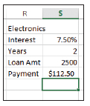
Step by Step: Use the PMT Function
  In cell S3, type 7.5% and press Enter. This is the interest rate on the loan.
  In cell S4, type 2 and press Enter. This is the number of years in which the loan will be repaid.
  In cell S5, type 2500 and press Enter. This is the loan amount, which will cover the total cost of the equipment.
  In cell S6, type =–PMT(S3/12,S4*12,S5)
  and press Enter. The result, $112.50, is your
  calculated monthly payment (right).
  SAVE the workbook as 05 Budget PMT
  Solution and CLOSE it.
PAUSE. Leave Excel open to use in the next exercise.

Slide 41
Step by Step: Use the PMT Function
The PMT function calculates a loan payment and uses the syntax =PMT(rate, nper, pv, [fv], [type]). The three required arguments for the PMT function are:
Rate: The interest rate charged per period (for example, per month)
Nper: The total number of payments for the loan
Pv: The present value of the loan—in other words, how much you owe; also known as the principal
Optional arguments include the future value (fv), which is a cash balance you want to attain after the last payment is made, and type, which indicates when payments are due using the number 1 (due at the beginning of a period) or 0 (due at the end of a period).

Slide 42
Step by Step: Use the PMT Function
When functions take more than one argument, you enter them in a single set of parentheses, separated by commas.
For the purposes of your budget, you include the negative sign (–) at the beginning of the PMT function (=–PMT(S3/12, S4*12,S5)) because the function calculates a payment as a negative value by default. By including the negative sign, the payment appears as a positive number. This follows a basic rule of mathematics: the negative of a negative is a positive.
You divide the first set of values by 12 because 7.5% is the annual interest rate, and dividing it by 12 gives you the monthly interest rate. You multiply the second set of values by 12 to convert the loan term from years to months.

Slide 43
Using Formulas to Create Subtotals
Many Excel veterans use formulas to create subtotals. Subtotaling lets you more easily analyze large sets of data.
You can specify ranges for subtotals even if the ranges are not contiguous. In this section, you learn how to use the SUBTOTAL function applied to cell ranges and named ranges.

Slide 44
Step by Step: Select and Create Ranges for Subtotaling
GET READY. LAUNCH Excel if it is not already running.
  OPEN the 05 Budget Subtotals data file for this lesson.
  Select B7:M7.
  On the FORMULAS tab, in the Defined Names group, click the Define Name button. The New Name dialog box opens.

Slide 45
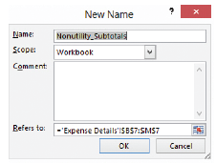
Step by Step: Select and Create Ranges for Subtotaling
  In the Name text box, verify
  that Nonutility_Subtotals
  appears (right). Click OK. This
  names a range for the
  nonutility subtotal figures.
  SAVE the workbook.
PAUSE. Leave the workbook open
to use in the next exercise.

Slide 46
Building Formulas for Subtotaling
You can calculate subtotals using the SUBTOTAL function, which returns a subtotal for a list.
This function recognizes values, cell references, ranges, and named ranges, and totals values created using SUM, AVERAGE, COUNT, and many other functions..

Slide 47
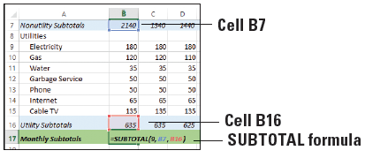
Step by Step: Build Formulas to Subtotal
GET READY. USE the workbook you modified in the previous exercise.
  In cell B17, type =SUBTOTAL(9,B7,B16), as shown below. Press Enter. This formula adds the nonutility subtotal and utility subtotal for January.
  Copy cell B17 to C17:M17. All monthly subtotals are entered.

Slide 48

Step by Step: Build Formulas to Subtotal
  In cell N17, type =SUBTOTAL(9,B7:M7,B16:M16), as shown at right. Press Enter. This
  formula adds all nonutility and
  utility expenses for the year.
  SAVE the workbook.
PAUSE. Leave the workbook open to use in the next exercise.
The SUBTOTAL function uses the syntax =SUBTOTAL(function_num,ref1,[ref2],...).

Slide 49
Step by Step: Build Formulas to Subtotal
As you enter the SUBTOTAL function, Excel, displays a list of the function numbers for the first argument. The function number for SUM is 9. You can learn the function numbers for other functions, such as AVERAGE, COUNT, and COUNTA, when entering the SUBTOTAL function or by searching for SUBTOTAL in Excel Help.
Ref1 is the first cell reference, cell range, or named range you want to subtotal. You can include additional cells or ranges by separating them with commas.
In the exercise, you also used the SUBTOTAL function to calculate the total for the budget in cell N17. Creating a total is a standard bookkeeping technique, and allows you to track and adjust subtotals while keeping the final total current.

Slide 50
Modifying Ranges for Subtotaling
Once you create a range in a subtotal, you can easily modify it by editing the range in the formula.
You can also modify ranges that are already used in formulas that include the SUBTOTAL function.

Slide 51
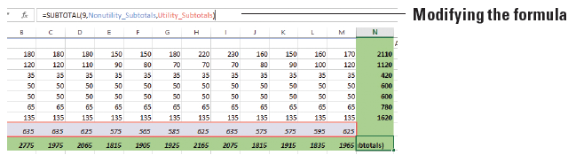
Step by Step: Modify Ranges for Subtotaling
GET READY. USE the workbook you modified in the previous exercise.
  In cell N17, notice that the result of the current formulas is 24,230.
  Use the formula bar to modify the formula in N17 like this: =SUBTOTAL(9,Nonutility_Subtotals,Utility_Subtotals). See below. Press Enter. This formula replaces the cell ranges with named ranges to add all nonutility and utility expenses for the year, and the result remains the same at 24,230.

Slide 52
Step by Step: Modify Ranges for Subtotaling
  Click in cell B19 and then click in the formula bar. Change the formula from =SUM(Q1Expenses) to =SUBTOTAL(9,Q1Expenses). This cell sums the named range Q1Expenses. Because the named range includes monthly data and subtotals, you need to correct the range to include only subtotal figures.
  On the FORMULAS tab, in the Defined Names group, click Name Manager.

Slide 53
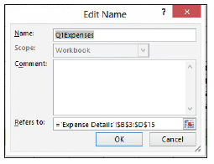
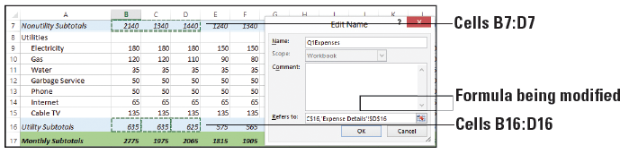
Step by Step: Modify Ranges for Subtotaling
  Select Q1Expenses in the list and click Edit.
  The Edit Name dialog box opens (right).
  Highlight everything in the Refers to text box
  and press Backspace to delete it.
  Click cell B7, press and hold the Shift key,
  and click D7. The range B7:D7 is highlighted.
  Press and hold the Ctrl key while clicking cells B16, C16, and D16. The selections are shown below.

Slide 54
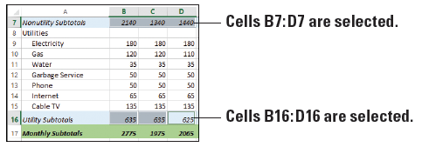
Step by Step: Modify Ranges for Subtotaling
  In the Edit Name dialog box, click OK.
  In the Name Manager dialog box, click Close.
  To verify that you selected the proper ranges for the Q1Expenses range, open the Name box drop-down list (to the left of the formula bar) and select Q1Expenses. The ranges B7:D7 and B16:D16 are selected (below).
  Create named ranges for Q2Expenses (E7:G7, E16:G16), Q3Expenses (H7:J7, H16:J16), and Q4Expenses (K7:M7, K16:M16).

Slide 55
Step by Step: Modify Ranges for Subtotaling
  Copy the formula from cell B19 to B20:B22. Edit the formulas in cells B20, B21, and B22 to use the appropriate named range. For example, the formula in cell B20 should be =SUBTOTAL(9,Q2Expenses).
  SAVE the workbook as 05 Budget Subtotals Solution and CLOSE it.
PAUSE. Leave Excel open to use in the next exercise.

Slide 56
Uncovering Formula Errors
Because of the sometimes-complex mathematics behind them, formulas are prone to errors when you enter them manually.
Excel provides easy-to-use tools to find and correct problems.
The best way to resolve an error is to analyze, or audit, the error message Excel provides.
A warning icon appears to the left of cell errors, and clicking that icon provides a pop-up menu with formula evaluation and formula editing commands, and access to Excel Help.

Slide 57
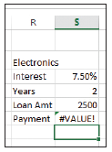
Step by Step: Review an Error Message
GET READY. LAUNCH Excel if it is not already running.
  OPEN the 05 Budget Error data file for this lesson.
  Click in cell S6.
  Edit the formula to change S3 to R3 and
  press Enter. The first cell reference in the
  PMT formula now points to the wrong cell.
  A #VALUE! error displays in cell S6 (right).

Slide 58
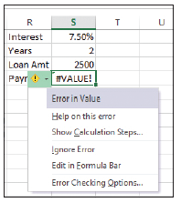
Step by Step: Review an Error Message
  Click in cell S6. Click the small, yellow
  warning icon to the left of the cell. A
  pop-up menu appears (right). The first
  item tells you that there is a value error
  in the function.
  Select Help on this error in the menu.
  Excel Help opens to a page on
  information regarding formula errors. Browse the help topics to see if any of the potential solutions apply to your situation.

Slide 59
Step by Step: Review an Error Message
  Close the Excel Help window.
  SAVE the workbook.
PAUSE. Leave the workbook open to use in the next exercise.
Notice the small green triangle in the upper-left corner of cell S6. This means there is a submenu for the cell in which you can click.

Slide 60
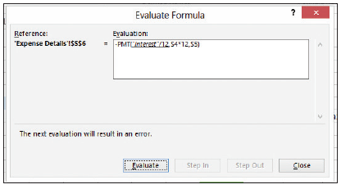
Step by Step: Review an Error Message
To evaluate the error in the formula,
select the Show Calculation Steps option
from the pop-up menu that appears
after you click the warning icon. The
Evaluate Formula dialog box, shown
at right, indicates the first part of the
function is incorrect. In this case, the
reference to cell R3 points to a cell containing text. The cell reference should be S3, which contains the interest figure.
Once you know how to correct an error, you can click the warning icon and select Edit in Formula Bar from the pop-up menu. Make the necessary corrections directly to the formula.

Slide 61
Tracing and Removing Trace Arrows
It’s not always easy to resolve a formula error, even using the Show Calculation Steps command, the Evaluate Formula dialog box, and Excel Help.
Another method is to use trace arrows, which show the relationship between formulas and the cells they refer to.

Slide 62
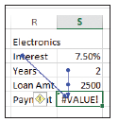
Step by Step: Trace a Formula and Remove Trace Arrows
GET READY. USE the workbook you modified in the previous exercise.
  Select cell S6 if it’s not already selected.
  On the FORMULAS tab, in the Formula
  Auditing group, click Trace Precedents.
  Two arrows appear (right). One arrow
  extends from cell R3 to cell S6, and another (combined) arrow extends from cells S4 and S5 to S6. The arrows indicate that the formula in cell S6 refers to cells R3, S4, and S5, referred to as precedent cells.

Slide 63
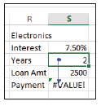
Step by Step: Trace a Formula and Remove Trace Arrows
  On the FORMULAS tab, in the Formula Auditing group, click Remove Arrows. The trace arrows disappear from the worksheet.
  Click in cell S4. On the FORMULAS tab,
  in the Formula Auditing group, click
  Trace Dependents. One arrow appears
  from cell S4 to cell S6 (right). The arrow
  indicates that cell S4 is part of the formula in cell S6.

Slide 64
Step by Step: Trace a Formula and Remove Trace Arrows
  SAVE the workbook as 05 Budget Error Solution and CLOSE it.
PAUSE. Leave Excel open to use in the next exercise.
You can use trace precedents and trace dependents for formulas that reference cells in another workbook. However, the external workbook must be open before you use the trace commands.

Slide 65
Displaying and Printing Formulas
When you audit the formulas in a worksheet, you might find it useful to print the worksheet with the formulas displayed.

Slide 66
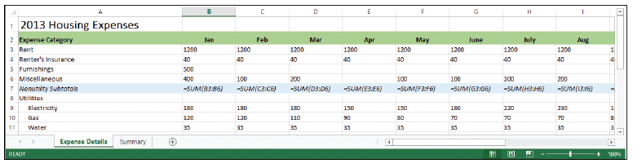
Step by Step: Print Formulas
GET READY. LAUNCH Excel if it is not already running.
  OPEN 05 Budget Print from your Lesson 5 folder.
  On the FORMULAS tab, in the Formula Auditing group, click Show Formulas. The formulas appear in the worksheet (below).
Notes:
Another Way: You can also display formulas in the worksheet by pressing Ctrl + ` (the grave accent mark). The grave accent mark is usually located on a key on the upper-left part of the keyboard.

Slide 67
Step by Step: Print Formulas
  Click the FILE tab. Click Print and view the Print Preview.
  Click the Portrait Orientation button and select Landscape Orientation.
  Click the Page Setup link at the bottom of the print settings to open the Page Setup dialog box.

Slide 68
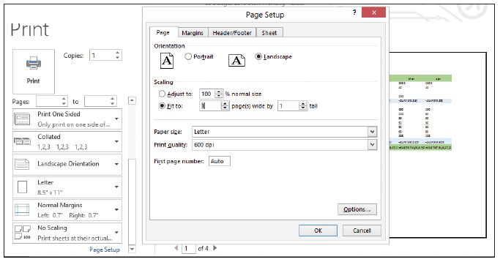
Step by Step: Print Formulas
  On the Page tab of the dialog box, click Fit to: and leave the defaults as 1 page(s) wide by 1 tall (below). Click OK to close the dialog box.
  Click the Print button at the top-left corner of the Backstage view window to print the worksheet with formulas displayed.

Slide 69
Step by Step: Print Formulas
  On the FORMULAS tab, in the Formula Auditing group, click Show Formulas again to stop displaying formulas in the worksheet.
  SAVE the workbook as 05 Budget Print Solution and CLOSE it.
CLOSE Excel.

Slide 70
Skills Summary

