Slide 1
Overview
Microsoft Excel 2013
Lesson 1

Slide 2
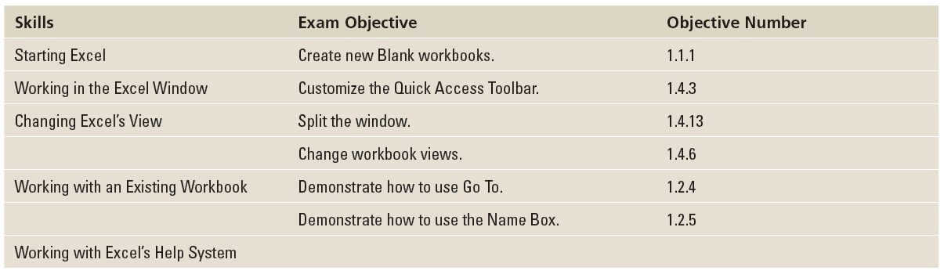
Objectives

Slide 3
Software Orientation
Microsoft Office Excel 2013 provides powerful tools to organize, analyze, manage, and share information.
The foundation of Excel and locations where you do your work are cells, rows, and columns within a worksheet, and worksheets as part of a workbook.
The tools you use to help you with these locations are within a broad band, called the ribbon, running across the top of the window. The ribbon is organized into task-oriented command tabs.
Each tab is divided into task-specific command groups appropriate to the work being performing. The tabs and groups, introduced in Excel 2010, replace the menus and multiple tools that were present in Excel 2007 and earlier versions.

Slide 4
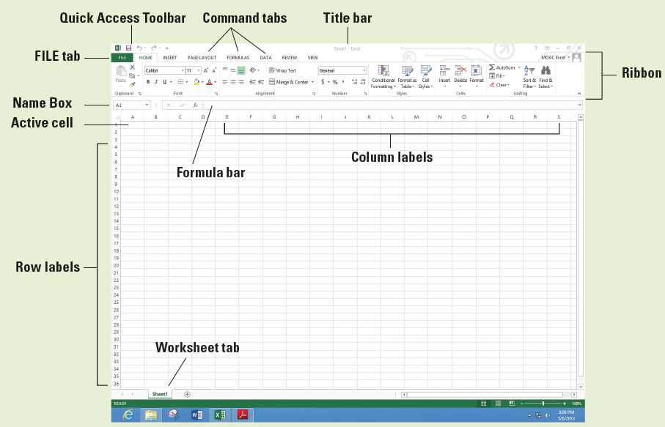
Software Orientation
Because you can customize the ribbon and new options might appear such as the DEVELOPER, ADD-IN, and POWERPIVOT tabs depending on your setup, your screen might appear differently.

Slide 5
Starting Excel
You can open Microsoft Excel 2013 in Windows 8 by moving to the bottom left corner of your screen, clicking on Start, right-clicking a blank area of the Start screen, clicking All apps, and clicking Excel 2013.
Excel opens to a list of templates and in most cases you choose Blank workbook or open a previous file.
A workbook, or spreadsheet file, is shown on the previous slide. Think of a workbook as a physical book with many pages.

Slide 6
Starting Excel
The filename (Book1) and the program name (Excel) appear in the title bar at the top of the screen. Book1 (or Book2, Book3, and so on.) is a temporary title for your workbook until you save it with a name of your choice.
The new workbook contains one worksheet (Sheet1) by default—similar to the first page in a book—where you enter information.
If a workbook has more pages (or worksheets), you use the sheet tabs just above the Status bar, identified as Sheet1, Sheet2, and Sheet3.
You can rename worksheets to identify their content and add worksheets with the New sheet (+) button as needed.

Slide 7
Step by Step: Start Excel
  GET READY. To complete this exercise, make sure your computer is running and Microsoft Excel is installed. Then, perform the following steps:
  If the Windows desktop is displayed, click the Start charm in the bottom left corner of the Windows 8 screen.
  Right-click in a blank area of the screen and click All apps.
  In the list of applications under Microsoft Office 2013, click Excel 2013.
Notes:
Another Way: You can also use the Windows logo key or with a touch screen, swipe in from the right edge of your screen and tap the Start charm.
Another Way: While in the Start window, you can also begin typing Excel and the icon appears.

Slide 8
Step by Step: Start Excel
  A window opens to recent Excel files you've opened and examples of templates you can use (see Figure 1-2).
  Click Blank workbook. A blank workbook opens, and the worksheet named Sheet1 will be displayed as shown previously.
  PAUSE. LEAVE the workbook open for the next exercise.
Notes:
Take Note: If you use Excel repeatedly, you will want to pin your application to the Start screen. From the All Apps screen, right-click the app, and choose Pin to Start. You can also choose Pin to taskbar to allow you to click the icon on the bottom of the Windows Desktop screen to start Excel.

Slide 9
Step by Step: Start Excel
A worksheet is a grid composed of rows, columns, and cells.
Each worksheet column starts at the top of the worksheet and goes to the bottom of the worksheet and is identified by a letter.
Each row starts at the left edge of the worksheet and continues to the right and is identified by a number.
Each box, or cell, on the grid is identified by the intersection of a column and a row. Thus, the first cell in an open worksheet is A1.
You enter information by typing it into the selected or active cell, which is outlined by a bold rectangle. This is also called the current or highlighted cell.

Slide 10
Working in the Excel window
When you launch Excel and click Blank workbook, the program opens a new workbook and displays a blank worksheet.
The Quick Access Toolbar gives you fast and easy access to the tools you use most often in any given Excel session. It appears on the left side of the title bar, above the ribbon (although you can move the toolbar below the ribbon if you want it closer to your work area).
You can add and remove commands to and from the toolbar so that it contains only those commands you use most frequently.

Slide 11
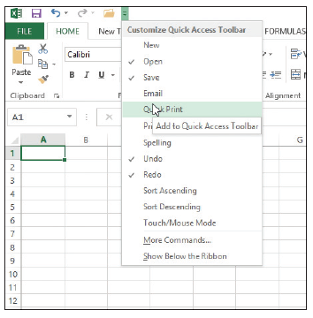
Step by Step: Start Excel
  GET READY. USE the blank workbook you opened in the previous exercise to perform these steps:
  Point to each icon on the Quick Access Toolbar and read the description that appears as a ScreenTip.
  Click the drop-down arrow at the
  right side of the Quick Access Tool
  bar. From the drop-down list,
  select Open. The Open icon is
  added to the Quick Access
  Toolbar. Click the down arrow
  again and select Quick Print
  from the drop-down list
  as shown at right.
Notes:
Take Note: Use ScreenTips to remind you of a command's function. Enhanced ScreenTips display in a larger rectangle that contains more descriptive text than a ScreenTip. Most Enhanced ScreenTips contain a link to a Help topic.

Slide 12
Step by Step: Start Excel
  Next, right-click anywhere on the Quick Access Toolbar, and then select Show Quick Access Toolbar Below the Ribbon.
  Right-click the HOME tab and click Collapse the Ribbon. Now, only the tabs remain on display, increasing the workspace area.
  Right-click the HOME tab again and choose Collapse the Ribbon to uncheck the option and make the ribbon commands visible again.
Notes:
Another Way: To add a command to the Quick Access Toolbar, you can also right-click any icon on the ribbon and then click Add to Quick Access Toolbar.

Slide 13
Step by Step: Start Excel
  Click the drop-down arrow on the right side of the Quick Access Toolbar to produce a menu of options. Click Show Above the Ribbon from the pop-up menu.
  Right-click the Open command, and select Remove from Quick Access Toolbar.
  Click the drop-down arrow on the right side of the Quick Access Toolbar and click Quick Print to remove the checkmark from the menu and thus remove the Quick Print icon from the Quick Access Toolbar.
  PAUSE. LEAVE the workbook open for the next exercise.
You can customize the Quick Access Toolbar so that it contains the commands you use most often.
Do not, however, remove the Undo and Redo commands. These commands are not available on the ribbon's command tabs.
Notes:
Take Note: To add commands to the Quick Access Toolbar that do not appear in the drop-down list, click More Commands on the drop-down list. The Excel Options dialog box will open. You can also right-click the Quick Access Toolbar or any ribbon tab and select Customize Quick Access Toolbar to open the Excel Options dialog box.

Slide 14
Navigating the Ribbon
The ribbon organizes tools and commands into an intuitive and useful interface.
Having commands visible on the work surface lets you work quickly and efficiently and is especially helpful for new users.
The ribbon in Microsoft Office Excel 2013 is made up of a series of tabs, each related to specific kinds of tasks that users perform.
Pressing and releasing the Alt key reveals Keytips, or small badges displaying keyboard shortcuts for specific tabs and commands on the ribbon and Quick Access Toolbar.
Notes:
Take Note: Keytips are sometimes also referred to as hotkeys. Note, however, that when you use the Microsoft Office 2013 Help, no reference is listed for hotkeys. Only Keytips is referenced.

Slide 15
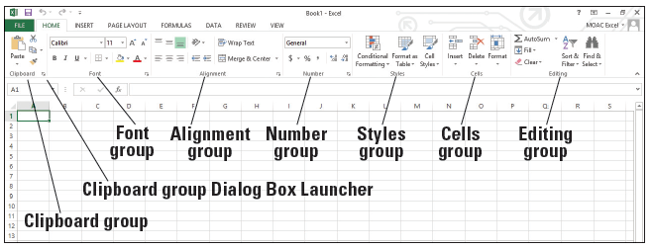
Navigating the Ribbon
Within each tab on the ribbon, commands are organized into related tasks called command groups, or just groups, as shown below.
When the HOME tab is displayed, you see the Clipboard group, which contains the command buttons to cut, copy, and paste data.
These commands allow you to revise, move, and repeat data within a worksheet.
You can use commands in the Editing group to fill adjacent cells, sort and filter data, find specific data within a worksheet, and perform other tasks related to editing worksheet data.

Slide 16
Navigating the Ribbon
Some of the commands have an options arrow that displays additional options for the command.
Some command groups have icons in the bottom right corner of the group. These Dialog Box Launchers open a dialog box and give more options than display on the ribbon.

Slide 17
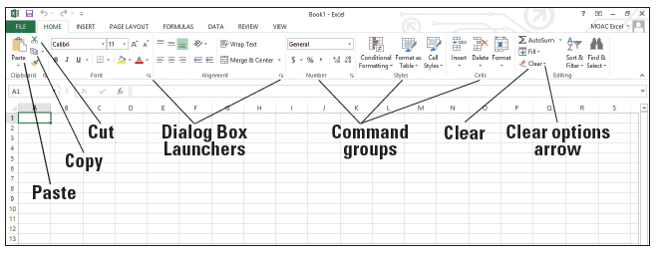
Step by Step: Navigate the Ribbon
  GET READY. LAUNCH Excel if necessary and open any workbook.
  Click the HOME tab to make it active and click cell A1. Your ribbon should look similar to the one shown below.
  In the Alignment group, click the Dialog Box Launcher to display the Alignment tab in the Format Cells dialog box.
  Click the Cancel button to close the dialog box.

Slide 18
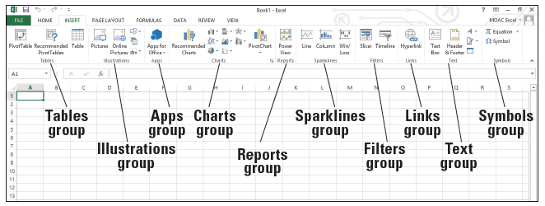
Step by Step: Navigate the Ribbon
  Click the INSERT tab. Your screen should now look similar to Figure 1-6. Commands on the INSERT tab enable you to add charts and illustrations and perform other functions that add items to enhance your Excel worksheets.
  Click the HOME tab.

Slide 19
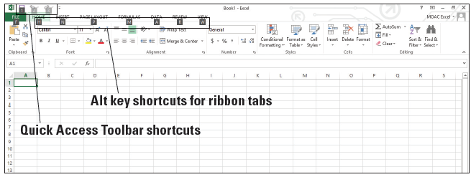
Step by Step: Navigate the Ribbon
  Press and release the Alt key to display onscreen Keytips that show keyboard shortcuts for certain commands (below).

Slide 20
Step by Step: Navigate the Ribbon
  Type W to display the VIEW tab and then type Q to display the Zoom dialog box.
  Click Cancel or press Esc to close the Zoom dialog box.
  Press Alt + H to return to the HOME tab.
  Press Alt to turn off the Keytips.
  In the Editing group, click the Clear arrow to display the Clear options.
  Press Esc to turn off the options.
  PAUSE. CLOSE Excel.

Slide 21
Introducing Office Backstage
The most noticeable new feature in Microsoft Office 2010 and 2013 is Backstage.
The Backstage view shows you behind-the-scenes options to manage files such as opening, saving, printing, and documenting files. Backstage view is covered in more depth in Lesson 3, but you need to know how to access it for simple commands in this lesson.

Slide 22
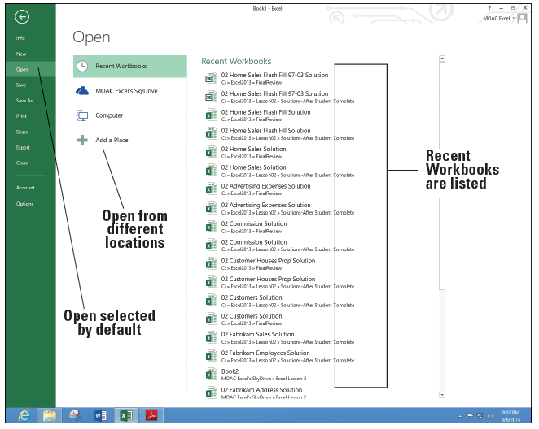
Step by Step: Office Backstage
  GET READY. You should not have Excel running for this exercise.
  LAUNCH Excel and click
  Blank workbook to
  start a new workbook.
  Notice that Book1
  displays in the title bar
  at the top of the screen.
  Click the FILE tab. This
  opens Backstage view
  (see right).

Slide 23
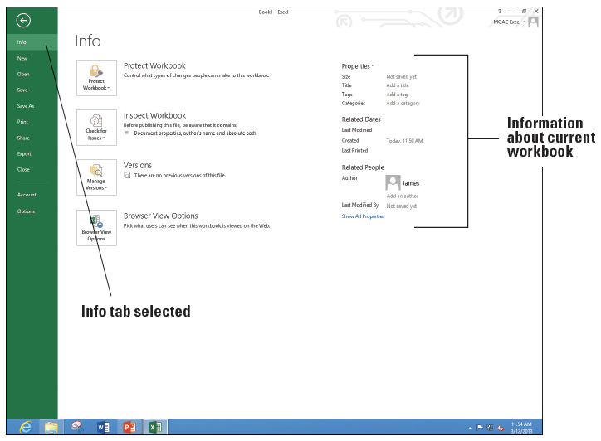
Step by Step: Office Backstage
  Notice that the Excel
  Backstage view and
  Excel icon on the
  taskbar is green. The
  Office suite has
  customized colors
  to designate which
  application you are
  using.
  The commands are
  on the left pane of the screen. Click Info and the right pane changes (above).
  PAUSE. CLOSE Excel for the next exercise.
Notes:
Troubleshooting: Backstage defaults to different commands depending on what you're doing. When you are working in a blank workbook or with no workbooks opened, Backstage defaults to the Open command, which shows different options for opening files. If you have started typing in a document, Backsage defaults to Info.

Slide 24
Using the Microsoft Office FILE Tab and Backstage View
In Microsoft Office 2013, clicking the FILE tab takes you to Backstage view, with its navigation bar of commands extending down the left side of the Excel window.
Backstage view helps you access and use file management features, just as the ribbon offers commands that control Excel's authoring features.

Slide 25
Step by Step: Use the Microsoft Office FILE Tab and Backstage View
  GET READY. LAUNCH Excel and open a new blank workbook.
  Click the FILE tab to open Backstage view.
  Click Close in the left pane. Your worksheet disappears, but Excel remains open.
  Click the FILE tab again, and then click New. The right pane shows the available options, which are the same as when you launch Excel.
  Click Blank workbook. A new blank workbook is opened.
  PAUSE. CLOSE Excel.
A new blank workbook in Excel 2013 contains one worksheet. You can enter data in the first worksheet and click the New sheet button to create another.
Excel saves the worksheets together in one workbook, rather than as separate documents.

Slide 26
Changing Excel’s View
On the ribbon, The VIEW tab holds commands for controlling the appearance of the displayed document.
You can also open and arrange new windows and split windows for side-by-side views of different parts of your document.
Some groups on the ribbon tabs have an arrow in their lower right corner, called a Dialog Box Launcher.
Clicking the arrow opens a dialog box or a window containing more options for that particular group of commands.
You use the VIEW tab commands (including those you access through the Dialog Box Launcher) to change Excel's view.

Slide 27
Step by Step: Change Excel’s View
  GET READY. LAUNCH Excel and start a new workbook.
  If necessary, click the HOME tab to activate it.
  Select cell A1 to make it active. Then type 456 and press Tab.
  In the lower-right corner of the Font group, click the Dialog Box Launcher arrow. The Format Cells dialog box shown in Figure 1-10 opens. In most cases, your default font in Excel will be Calibri, 11 point, without bold or italics.

Slide 28
Step by Step: Change Excel’s View
  Notice that the Font tab of the dialog box is active. Scroll down in the Font list, click Arial, and then click OK.
  Cell B1 should now be the active cell in your worksheet. Type 456 in this cell, and then press Tab. Notice the difference in size and appearance between this number and the one you entered in cell A1.
  Click the VIEW tab.

Slide 29
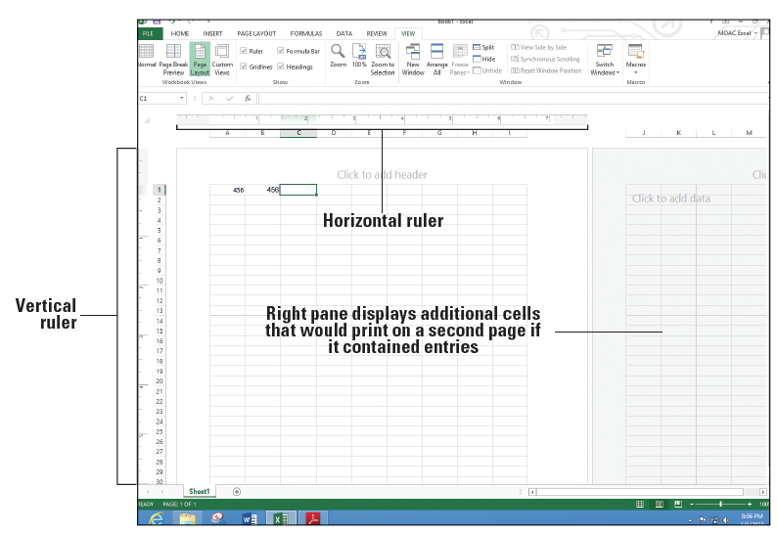
Step by Step: Change Excel’s View
  In the Workbook Views group, click Page Layout. Your worksheet should look like the figure below. In this view, you can see the margins,
  where pages break,
  and you can add a
  header or footer.
  In the Workbook Views
  group, click Normal to
  return the worksheet
  to the view that no
  longer shows rulers,
  headers, footers, or
  page breaks.
  PAUSE. LEAVE the workbook open for the next exercise.
Notes:
Another Way: You can also change the view among Normal, Page Layout, Page Break Preview, and Zoom by using the icons in the status bar at the bottom of the screen.

Slide 30
Step by Step: Change Excel’s View
You can preview your printed worksheet by clicking the ribbon's VIEW tab, and then clicking Page Layout in the Workbook Views group (first section). This view lets you fine-tune pages before printing.
You can change your worksheet’s layout and format in both this view and Normal view. You can also use the rulers to measure the width and height of your window and determine whether you need to change its margins or print orientation.

Slide 31
Splitting the Window
When a worksheet contains a lot of data, you can see only a small portion of the worksheet in Excel's Normal and Page Layout views.
The Split command lets you viewing the worksheet in two panes or four quadrants.
After issuing this command, you can use the scroll bars on the right and at the bottom of the window to display different sections of the worksheet at the same time so that you can more easily compare or contrast data or see what effect a change in one part of the worksheet might have on a distant part of the worksheet.

Slide 32
Step by Step: Split the Window
  GET READY. USE the worksheet you left open in the previous exercise or type 456 in cells A1 and B1 in a new workbook.
  Click cell F1 to make it active.
  On the VIEW tab, click Split. Notice that the screen is split vertically in two different panes.
  In the horizontal scroll bar of the right pane, hold down the right arrow until you see cell AA1. Notice that you can still see cells A1 and B1 in the left pane.
  Click Split again. The screen is no longer split.

Slide 33
Step by Step: Split the Window
  Click in cell A17 and click Split. The screen is split horizontally in two different panes.
  Click Split again. The screen is no longer split.
  Click in cell F14 and click Split. The screen is split into four panes this time.
  Choose the lower right quadrant by clicking any cell in that pane, and then scroll down to display row 40.

Slide 34
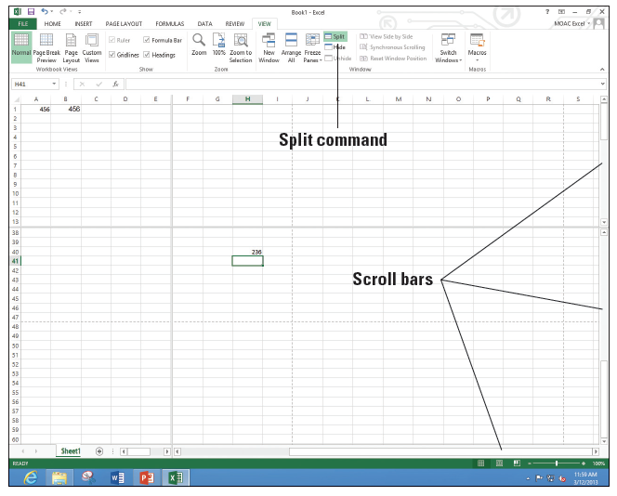
Step by Step: Split the Window
  Type 236 in cell H40 and press Enter. The data you entered in cells A1 and B1 should be visible along with what you just entered in cell H40
  (right).
  Click Split to remove
  the split. The data in cell
  H40 is no longer visible.
  PAUSE. LEAVE the
  workbook open to use
  in the next exercise.
Notes:
Take Note: The Split command is especially useful when you need to compare various portions of a long worksheet.

Slide 35
Step by Step: Split the Window
When you use a worksheet that contains a small amount of data, it is easy to scroll through it and focus on specific cells. As you become experienced with Excel you might find yourself working on much larger worksheets.
The ability to view more than one section of a worksheet at the same time by using split windows is especially useful when you need to compare different sections of data.

Slide 36
Opening a New Window
You can also view two sections of a worksheet by using the New Window command.
You use the New Window command on the VIEW tab to open a new window in Excel.
You use the Switch Window command to change the active window.

Slide 37
Step by Step: Open a New Window
  GET READY. USE the worksheet you left open in the previous exercise or type 456 in cells A1 and B1and 236 in cell H40 in a new workbook.
  Press Ctrl + Home to make A1 the active cell.
  With the VIEW tab active, in the Window group, click New Window. A new window titled Book1:2 opens. If you have opened a different number of new workbooks, your title bar might show a different book number. The colon and then 2 (:2) indicates that there are two windows of the same workbook open.

Slide 38
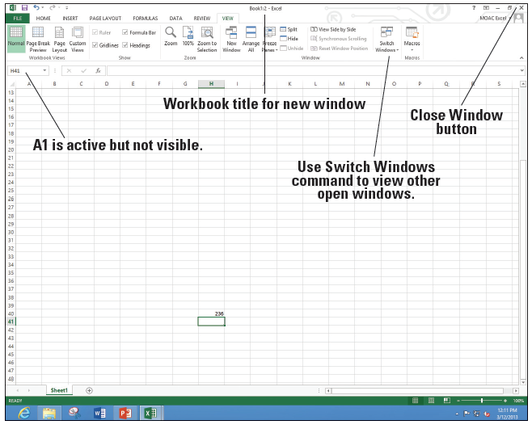
Step by Step: Open a New Window
  Scroll down in the window
  until cell H40 is visible
  (right). Although cell A1
  is not visible, it is still the
  active cell. It is important
  to note that you have
  opened a new view of the
  active worksheet—not a
  new worksheet.
  Click Switch Windows. A
  drop-down list of all open
  windows appears. Book 1:2 is checked, which indicates that it is the active window.

Slide 39
Step by Step: Open a New Window
  Click Book 1:1. You now see the original view of the worksheet with cell A1 active.
  Click Switch Windows and make Book1:2 active.
  Click the Close Window button (in the upper-right corner of the workbook window) to close Book1:2. The window closes, and Book1 in the title bar tells you that you are now looking at the only open view of the workbook.
  Click the FILE tab and then click Close.
  When asked if you want to save the changes in Book1, click Don’t Save.
  PAUSE. LEAVE Excel open for the next exercise.
Notes:
Take Note: Clicking the Close Window button closes only the new window opened at the beginning of this exercise. If you use the Close command on the FILE tab, you will close the entire workbook.
Another Way: You also can use the Arrange All command on the VIEW tab to display open windows side by side so that you can compare various parts of a large worksheet. Use the View Side by Side and Synchronous Scrolling to have both windows scroll together.

Slide 40
Working with an Existing Workbook
Many workbooks require frequent updating. Workers frequently open an existing workbook, update information, and then save the workbook to be revised again later.
Often, files are created by one person, and then used and/or updated by others. Filenames should reflect the type of data contained in the file. A descriptive filename lets you locate and retrieve files quickly.
Filenames can be up to 255 characters long, including the filename extension. However, most workers use short descriptive filenames that clearly identify the content of the workbook.

Slide 41
Opening an Existing Workbook
When you save an Excel 2013 file, the program automatically adds the .xlsx extension to the end of the file's name. This extension identifies the program in which the file can be opened (for example, .xlsx is the file extension used in Excel).
To open a file, you must also identify the location (such as network or SkyDrive), drive, and folder that contain the file. In your local computer environment, your local drive is usually designated as C:. Network, or flash drives can have other letters such as E: or S:.

Slide 42
Step by Step: Open an Existing Workbook
  GET READY. In this exercise, you use commands on the FILE tab to find and open an existing workbook.
  In Excel, click the FILE tab and click Open. Documents you recently created or edited appear in the right pane, in the Recent Workbooks area.
  Click Computer and then click Browse.
Notes:
Another Way: To display the Open options in Backstage without using the FILE tab, press Ctrl+O. To display the Open dialog box, press Ctrl+F12.
Take Note: Throughout this book, you see information that appears in brackets, such as [your e-mail address]. The information contained in the brackets is intended to be directions specific for you rather than something you actually type word for word. It instructs you to perform an action or substitute text. Do not type the actual text that appears within brackets.

Slide 43
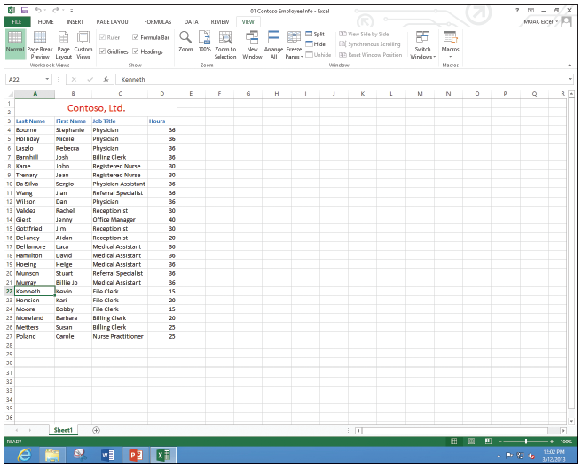
Step by Step: Open an Existing Workbook
  In the Open dialog box, choose the location for the WileyPLUS files.
  Select 01 Contoso
  Employee Info
  from the listed
  files, and then
  click Open. The file
  opens as shown
  at right, with the
  workbook name
  displayed in the
  title bar.
Notes:
Take Note: By default, the Open dialog box lists only the files that were created in the program you are using—in this case, Excel. To see files created in other programs, you can select All Files in the Files of type box (next to the File name box) at the bottom of the Open dialog box.

Slide 44
Step by Step: Open an Existing Workbook
  Click the FILE tab, and then click Close to close the Employee workbook.
  PAUSE. LEAVE Excel open for the next exercise.
If you are familiar with Microsoft Word, you know that when you open a file, the program places your cursor and screen display at the beginning of the document.
When you open an Excel workbook, however, the active cell is the same one that was active when you last saved the file.
Notes:
Another Way: You can press Alt+F4 to close the current file and Excel at the same time.

Slide 45
Opening a Workbook from Your SkyDrive
SkyDrive is a Microsoft feature that allows you to work with files in the Cloud—a location that is available from any computer in the world as long as you have an Internet connection.
When Office 2013 is installed, you have an option of installing SkyDrive or you can go to the Microsoft.com site, search for SkyDrive download, and install it at a different time.

Slide 46
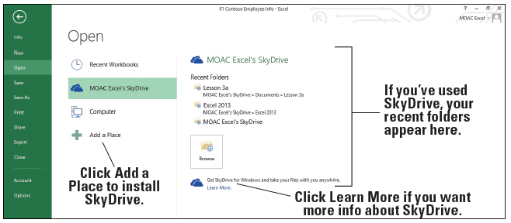
Step by Step: Open a Workbook from Your SkyDrive
  GET READY. Excel should be open. You need to have a SkyDrive account for this section.
  Clicks the FILE tab.
  If it is not selected, click Open.
  If you do not have SkyDrive installed, click + Add a Place (below), click SkyDrive, and go through the steps on the screen.

Slide 47
Step by Step: Open a Workbook from Your SkyDrive
  Click [Your Name] SkyDrive and then click Browse.
  If you have folders on the SkyDrive, double-click the folder where the file is located.
  If there are subfolders, double-click on the subfolder.
  Continue to navigate to the folder where the file is located and click on the file name.
  Click Open. The file will be displayed.
  CLOSE the file and LEAVE Excel open for the next exercise.

Slide 48
Navigating a Worksheet
An Excel worksheet can contain more than one million rows and more than sixteen thousand columns.
There are several ways to move through worksheets that contain numerous rows and columns.
You can use the arrow keys, the scrollbars, or the mouse to navigate through a worksheet.
Notes:
Take Note: A worksheet can be very large or quite small depending on your needs. Available columns go from A through XFD, and available rows can go from 1 through 1,048,567.

Slide 49
Step by Step: Navigate a Worksheet
  GET READY. Click the FILE tab, and then click Open. In the Recent Workbooks area, click 01 Contoso Employee Info or go to the class folder and open this file.
  Press Ctrl + End to move to the end of the document (cell D27).
  Press Ctrl + Home to move to the beginning of the document (cell A1).
  Click in the Name Box, type A3, and press Enter to make the cell active.
  Press Ctrl + Down Arrow to go to the last row of data (cell A27).
  Press Ctrl + Right Arrow. Cell D27, the last column in the range of data, becomes the active cell.

Slide 50
Step by Step: Navigate a Worksheet
  Press Ctrl + Down Arrow. The last possible row in the worksheet displays.
  Press Ctrl + Home.
  Press Scroll Lock. Then press the Right Arrow key. This moves the active column one column to the right, and the whole worksheet moves.
  Use the vertical scroll bar to navigate from the beginning to the end of the data.
  If your mouse has a wheel button, roll the wheel button forward and back to quickly scroll through the worksheet.
  PAUSE. Press Scroll Lock again to turn it off. LEAVE the workbook open for the next exercise.
Notes:
Take Note: When Scroll Lock is on, SCROLL LOCK is displayed on the left side of the Status bar. To use the arrow keys to move between cells, you must turn off Scroll Lock. Some keyboards come equipped with an onboard scroll lock key, whereas others do not. This is an option, not a necessity.

Slide 51
Navigating Data with the Go To Command
The workbook used in these exercises is neither long nor particularly complicated. When you begin dealing with much larger databases, or longer sets of workbooks, you might wish you had some easier means to get around the data than just scrolling.
The Name Box indicates the current cell you are in and gives you the opportunity to name the cell or a range.
The Go To command can take you to particular points in a worksheet, including cells and cell ranges that you name yourself.

Slide 52
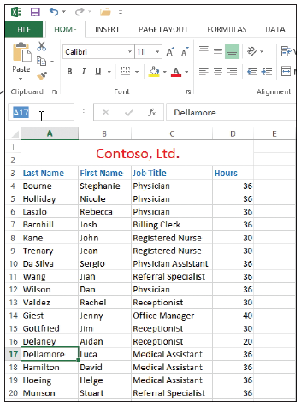
Step by Step: Navigate Data with the Go To Command
  USE the 01 Contoso Employee Info workbook from the previous exercise.
  Select cell A17.
  In the Name Box to the left of
  the formula bar, select cell A17,
  as indicated t right.
  Delete A17, type MedAssts,
  and press Enter.
  Select cell M11.

Slide 53
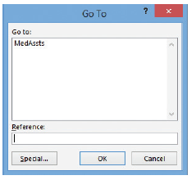
Step by Step: Navigate Data with the Go To Command
  Click Find & Select in the
  Editing group of the HOME
  tab. Click Go To in the menu.
  The Go To dialog box appears
  (right).
  In the Go to list, click
  MedAssts, then click OK.
  Cell A17 becomes the active
  cell.
  Click Find & Select again, and then click Go To Special in the menu. The Go To Special dialog box appears (see Figure 1-18).
  In the Go To Special dialog box, click Last cell.

Slide 54
Step by Step: Navigate Data with the Go To Command
  Click OK. Cell D27 becomes the active cell. The last cell is the lower rightmost cell in the worksheet with contents or formatting.
  CLOSE the workbook and do not save. LEAVE Excel open for the next exercise.

Slide 55
Working with Excel’s Help System
The Help system in Excel 2013 is rich in information, illustrations, and tips that can help you complete any task as you create worksheets and workbooks.
When you install Excel, you automatically install hundreds of help topics on your computer.
Excel can also access thousands of additional help topics online.
Finding the right information in Excel’s Help system is easy: You can pick a topic from popular searches, see what's new, get training, or perform keyword searches by entering terms that best describe the task you want to complete.
Notes:
Take Note: If you aren’t sure what an onscreen tool does, just point to it. Once the mouse pointer rests on a tool, a box called a ScreenTip appears. A basic ScreenTip displays the tool’s name and shortcut key (if a shortcut exists for that tool). Some of the ribbon’s tools have enhanced ScreenTips, which also provide a brief description of the tool.

Slide 56
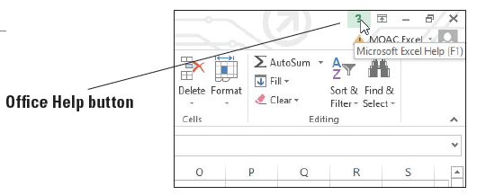
Step by Step: Use the Help System
  GET READY. OPEN a new workbook for this exercise.
  Position your mouse pointer over the Help button, as shown at right, in the
  upper-right corner of
  the Excel window. A
  ScreenTip appears,
  telling you that this
  button lets you access Excel’s Help features and that you can click the button or press F1.

Slide 57
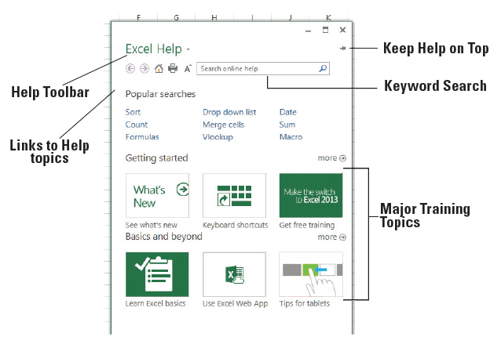
Step by Step: Use the Help System
  Click the Help button; the Help window opens, as shown at right.
  In the Help window,
  click the What's New
  icon. The next screen
  gives you additional
  hyperlinked sub-
  categories.
  Navigate through
  three of the subtopics
  in the Help window.
  In the Help window
  toolbar, click the Home button to return to the first screen.
Notes:
Another Way: You can also press F1 to open the Help window.

Slide 58
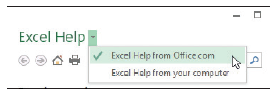
Step by Step: Use the Help System
  Click the drop-down arrow after Excel Help. This displays the Connection Status options
  shown at right. This feature lets
  you choose whether the Help
  window displays content from
  files installed on your computer or from Office.com on the Internet.
  Click in the workbook behind the Help window. Notice that the Help window is hidden and the workbook becomes the top window.
  Click the Help button on the taskbar to display the Help window again.

Slide 59
Step by Step: Use the Help System
  Click the Keep Help on Top pin button.
  Now click the workbook and notice that you can still see the Help window.
  CLOSE the Help window.
  CLOSE your workbook.
Excel’s Help window is set up like a browser, with links to specific categories and topics, and it features some of the same tools you find in your web browser, including:
Back: Jumps to the previously opened Help topic.
Notes:
Another Way: You can also press Ctrl+T to keep the Help window as the top window.

Slide 60
Step by Step: Use the Help System
Forward: Jumps to the next opened Help topic.
Home: Returns to the initial Help window.
Print: Allows you to print the current Help topic.
Use Large Text: Shows larger text in the Help window.
You can find help in other ways. For example, you can click one of the links under Popular searches or click a topic listed under Getting started or Basics and beyond.
Notes:
Take Note: Many Excel dialog boxes contain a Help button. When you click it, a Help window opens with information about that dialog box.

Slide 61
Step by Step: Use the Help System
You can also type a keyword or phrase in the Search box, and then press Enter. When you do this, related help topics appear in the Help window.
When you click the arrow next to Excel Help at the top of the Help window, the resulting menu lets you choose between searching help topics that are available online and just those topics installed on your computer (referred to as offline help).

Slide 62
Step by Step: Use the Help System
If your computer has an “always on” connection to the Internet, such as a cable modem or LAN connection, you might want to select Excel Help from Office.com, which is Microsoft’s online-based built-in Help system.
If your computer uses a dial-up modem, or if you simply choose not to access online help information, choose the Excel Help from your computer option to access the topics installed on your computer.

Slide 63
Skills Summary

