Slide 1
Using Advanced Formulas and Securing Workbooks
Lesson 9

Slide 2
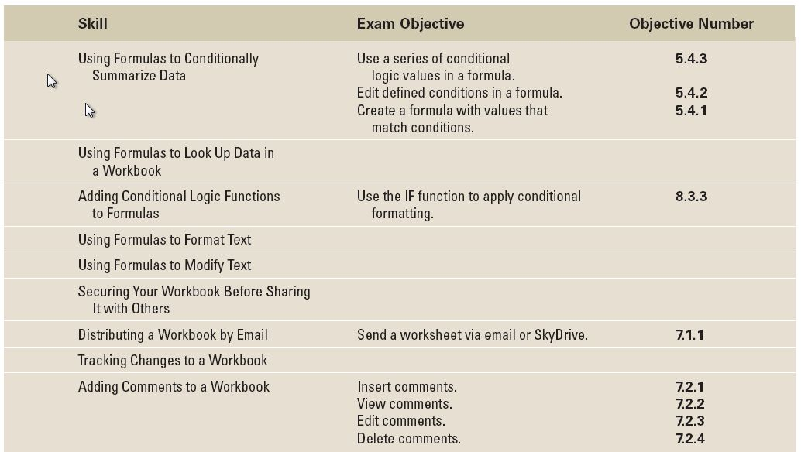
Objectives

Slide 3
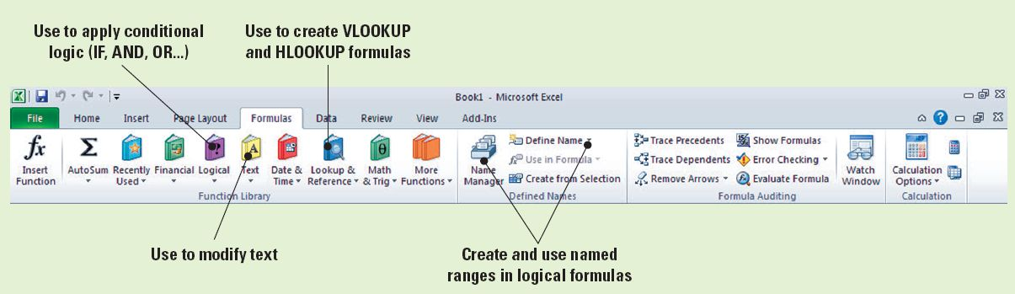
Software Orientation
In this lesson, you will use commands on the Formulas tab to create formulas to conditionally summarize data, look up data, apply conditional logic, and format and modify text.
The Formulas tab (see below) contains the command groups you will use to create and apply advanced formulas in excel. Use this illustration as a reference throughout the lesson.

Slide 4
Using Formulas to Conditionally Summarize Data
As you learned in Lesson 8, a formula is an equation that performs calculations, such as addition, subtraction, multiplication, and division, on values in a worksheet.
When you enter a formula in a cell, the formula is stored internally and the results are displayed in the cell.
Formulas give results and solutions that help you assess and analyze data.
As you also learned, you can use a conditional format, which changes the appearance of a cell range based on a criterion, to help you analyze data, detect critical issues, identify patterns, and visually explore trends.

Slide 5
Using Formulas to Conditionally Summarize Data
Conditional formulas add yet another dimension to data analysis by summarizing data that meets one or more criteria.
A conditional formula is one in which the result is determined by the presence or absence of a particular condition.
Conditional formulas used in Excel include the functions SUMIF, COUNTIF, and AVERAGEIF.

Slide 6
Using SUMIF
The SUMIF function calculates the total of only those cells that meet a given criterion or condition.
The syntax for the SUMIF function is SUMIF(range, criteria, sum_range).
The values that a function uses to perform operations or calculations in a formula are called arguments. Thus, the arguments of the SUMIF function are range, criteria, and sum range, which, when used together, create a conditional formula in which only those cells that meet a stated criterion are added.
Cells within the range that do not meet the criterion are not included in the total.

Slide 7
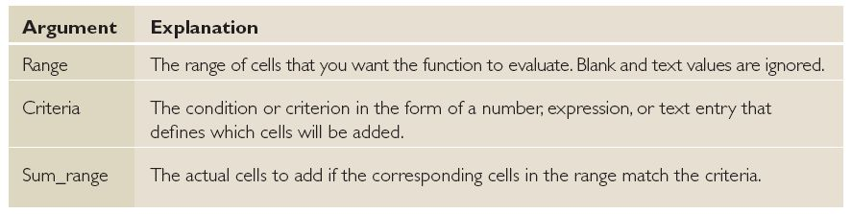
Using SUMIF
Table 9-1 explains the meaning of each argument in the SUMIF syntax.
Note that if you omit Sum_range from the formula, as you will do in the first calculation in the following exercise, Excel evaluates and adds the cells in the range if they match the criterion.

Slide 8
Step-by-Step: Use SUMIF
Before you begin these steps, LAUNCH Microsoft Excel.
OPEN the Fabrikam Sales file for this lesson.
Select cell A20 and key Sum of sales over $200,000. Press Enter. If necessary, select A20 and click Wrap Text in the Alignment group on the Home tab. You have now formatted the cell to wrap the text that will be keyed.
Select C20. Click the Formulas tab and in the Function Library group, click Insert Function. The Insert Function dialog box opens. Within the dialog box, key SUMIF in the Search for function text box and click Go. The SUMIF function will appear at the top of the function list and will be selected by default in the Select a Function window.

Slide 9

Step-by-Step: Use SUMIF
Click OK to close the Insert Function dialog box; the Function Arguments dialog box now opens automatically because you selected a formula. This dialog box allows you to edit the formula you selected.
In the Function Arguments dialog box, click the Collapse Dialog button and select the cell range C5:C16. Press Enter. By doing this, you are applying the cell range that the formula will use in the calculation.

Slide 10
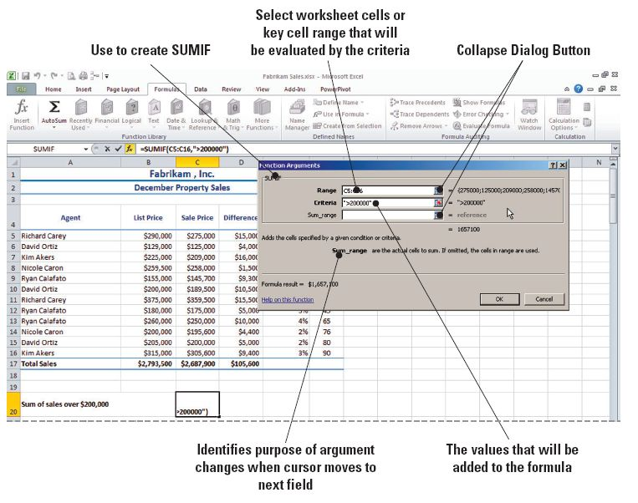
Step-by-Step: Use SUMIF
In the Criteria box, key >200000, as shown in Figure 9-2. You do not have to enter the range in the Sum_range box. If you leave the range blank, Excel sums the cells you enter in the Range box. You have now
applied your criteria
to sum all values
greater than
$200,000.
Notes:
Troubleshooting: It is not necessary to key dollar signs or commas when entering dollar amounts in the Function Arguments dialog box. If you key them, Excel removes them from the formula and returns an accurate value.

Slide 11
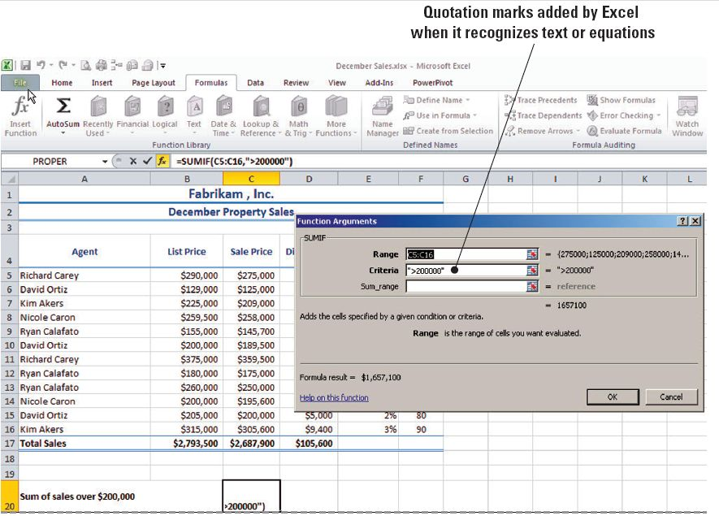
Step-by-Step: Use SUMIF
Click OK to accept the changes and close the dialog box. You see that $1,657,100 of Fabrikam’s December revenue came
from properties
valued in excess
of $200,000 (see
figure).
Notes:
Take Note: The result of the SUMIF formula in C20 does not include the property value in C15 because the formula specified values greater than $200,000. To include this value, the criterion would have to be >= (greater than or equal to).

Slide 12
Step-by-Step: Use SUMIF
Select cell C21, click Recently Used in the Function Library group, and click SUMIF to once again open the Function Arguments dialog box. The insertion point should be in the Range box.
Select E5:E16 in the Range field. The selected range is automatically entered into the text box. Press Tab.
Key <3% in the Criteria box and press Tab. You are entering the criteria to calculate all values less than 3%.
Select C5:C16 in the Sum_range field. Click OK to accept your changes and close the dialog box. Excel returns a value of $1,134,200.
Notes:
Take Note: When you click Recently Used, the last function that you used appears at the top of the list. Similarly, when you click Insert Function, the Insert Function dialog box opens with the last-used function highlighted.

Slide 13
Step-by-Step: Use SUMIF
Click the File tab and select Save As. Create a Lesson 9 folder.
SAVE the workbook as December Sales in the Lesson 9 folder.
LEAVE the workbook open for use in the next exercise.

Slide 14
Using SUMIFS
The SUMIFS function adds cells in a range that meet multiple criteria.
It’s important to note that the order of arguments in this function is different from the order used with SUMIF. In a SUMIF formula, the Sum_range argument is the third argument; in SUMIFS, however, it is the first argument.
In the following exercise, you will create and use two SUMIFS formulas, each of which analyzes data based on two criteria.
The first SUMIFS formula will add the selling price of the properties that Fabrikam sold for more than $200,000 and that were on the market 60 days or less. The second formula adds the properties that sold at 98% (<3%) of their listed price within 60 days.

Slide 15
Step-by-Step: Use SUMIFS
USE the workbook from the previous exercise to perform the following actions:
Select C22. Click Insert Function in the Function Library group on the Formulas tab.
Key SUMIFS in the Search for a Function box and click Go. SUMIFS will be highlighted in the Function box.
Click OK to accept the function.
In the Function Arguments dialog box, select C5:C16 in the Sum_range box. This adds your cell range to the argument of the formula.

Slide 16
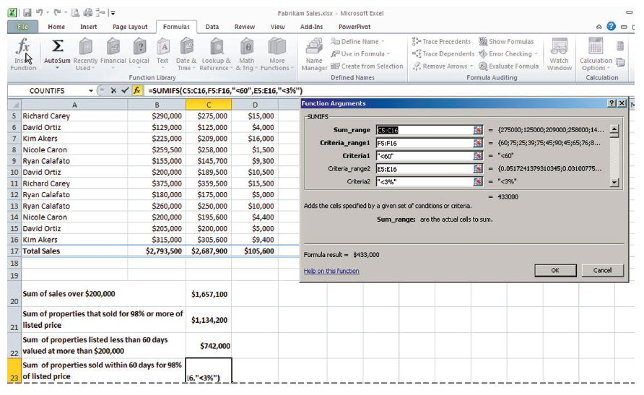
Step-by-Step: Use SUMIFS
In the Criteria_range1 box, select F5:F16. In the Criteria1 box, key <=60. This specifies that you want to calculate only those values that
are less than or
equal to 60. When
you move to the
next text box,
notice that Excel
places quotation
marks around your
criteria. It applies
these marks to let
itself know that this is a criterion and not a calculated value.

Slide 17
Step-by-Step: Use SUMIFS
In the Criteria_range2 box, select C5:C16. You are now choosing your second cell range.
In the Criteria2 box, key >200000. Click OK. You have now applied a second criterion that will calculate values greater than 200,000. Excel calculates your formula, returning a value of $742,000.
Select C23 and click Recently Used in the Function Library group.
Select SUMIFS. In the Sum_range box, select C5:C16.
In the Criteria_range1 box, select F5:F16. Key <60 in the Criteria1 box.

Slide 18
Step-by-Step: Use SUMIFS
In the Criteria_range2 box, select E5:E16. Key <3% in the Criteria2 box. Your Function Arguments dialog box should look like the figure on Slide 16. Click OK. After applying this formula, Excel returns a value of $433,000.
SAVE the workbook.
LEAVE the workbook open to use in the next exercise.

Slide 19
Using SUMIFS
The formulas you used in the previous exercise analyzed the data on two criteria. You can continue to add up to 127 criteria on which data can be evaluated.
Because the order of arguments is different in SUMIF and SUMIFS, if you want to copy and edit these similar functions, be sure to put the arguments in the correct order (first, second, third, and so on).

Slide 20
Using COUNTIF
When used in a conditional formula, the COUNTIF function counts the number of cells in a given range that meet a specific condition.
The syntax for the COUNTIF function is COUNTIF(range, criteria); the range is the range of cells to be counted by the formula, and the criteria are the conditions that must be met in order for the cells to be counted. The condition can be a number, expression, or text entry.
In the following exercise, you practice using the COUNTIF function to calculate values >=200,000. The range you will specify in this COUNTIF formula is the selling price of homes sold during the specified period. The criterion selects only those homes that sold for $200,000 or more.

Slide 21
Step-by-Step: Use COUNTIF
USE the workbook from the previous exercise.
Select C24. Click Insert Function in the Function Library group.
Key COUNTIF in the Search for a Function box and click Go. COUNTIF will be highlighted in the Function dialog box.
Click OK to accept the function and close the dialog box. This opens the Function Arguments dialog box.
In the Function Arguments dialog box, select B5:B16 in the Range box. You have now selected your range for calculation.

Slide 22
Step-by-Step: Use COUNTIF
In the Criteria box, key >=200000. Click OK. You have set your criteria of values greater than or equal to $200,000. Excel returns a value of 9.
Select C25 and click Recently Used in the Function Library group.
Select COUNTIF. In the Functions Arguments box, in the Range box, select C5:C16.
In the Criteria box, key >=200000. Click OK. Excel returns a value of 7 when the formula is applied to the cell.
SAVE the workbook.
LEAVE the workbook open to use in the next exercise.

Slide 23
Using COUNTIFS
The COUNTIFS formula counts the number of cells within a range that meet multiple criteria.
The syntax is COUNTIFS(range1, criteria1, range2, criteria2, and so on). You can create up to 127 ranges and criteria.
In the following exercise, you will perform calculations based on multiple criteria for the COUNTIFS formula.
A cell in the range you identify in the Function Arguments box is counted only if all of the corresponding criteria you specified are true for that cell. If a criterion refers to an empty cell, COUNTIFS treats it as a 0 value.
Notes:
Take Note: When you create formulas, you can use the wildcard characters question mark (?) and asterisk (*) in your criteria. A question mark matches any single character; an asterisk matches any sequence of characters. If you want to find an actual question mark or asterisk, type a grave accent (`) preceding the character. You will apply this technique later in this lesson.

Slide 24
Step-by-Step: Use COUNTIFS
USE the workbook from the previous exercise.
Select C26. Click Insert Function in the Function Library group.
Key COUNTIFS in the Search for a function box and click Go. COUNTIFS will be highlighted in the Function box.
Click OK to accept the function and close the dialog box.
In the Function Arguments dialog box, select F5:F16 in the Criteria_range1 box. You have selected your first range for calculation.

Slide 25
Step-by-Step: Use COUNTIFS
In the Criteria1 box, key >=60. The descriptions and tips for each argument box in the Function Arguments dialog box are replaced with the value when you navigate to the next argument box, as illustrated in Figure 9-5 on the next slide.
The formula result is also displayed, enabling you to review and make corrections if an error message occurs or an unexpected result is returned. You have now set your first criterion. Excel shows the calculation up to this step as a value of 8.

Slide 26
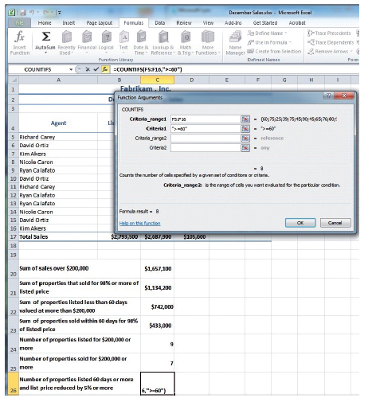
Step-by-Step: Use COUNTIFS

Slide 27
Step-by-Step: Use COUNTIFS
In the Criteria_range2 box, select E5:E16. You have selected your second range to be calculated.
In the Criteria2 box, key >=5%. Click OK. You have set your second criterion. When you click OK, Excel returns a value of 2.
SAVE the workbook.
LEAVE the workbook open to use in the next exercise.

Slide 28
Using AVERAGEIF
The AVERAGEIF formula returns the arithmetic mean of all the cells in a range that meet a given criteria.
The syntax is AVERAGEIF (range, criteria, average_range). In the AVERAGEIF syntax, range is the set of cells you want to average.
For example, in the following exercise, you use the AVERAGEIF function to calculate the average number of days properties valued at $200,000 or more were on the market before they were sold.

Slide 29
Using AVERAGEIF
The range in this formula is B5:B16 (cells that contain the listed value of the homes that were sold).
The criterion is the condition against which you want the cells to be evaluated (>=200000).
Average_range is the actual set of cells to average—the number of days each home was on the market before it was sold.

Slide 30
Step-by-Step: Use AVERAGEIF
USE the workbook from the previous exercise.
Select C27 and click Recently Used in the Function Library group.
Click AVERAGE. Key B5:B16 in the Number1 box and click OK. A mathematical average for this range is returned.
Select C28 and click Insert Function in the Function Library group.
Select AVERAGEIF from the function list or use the function search box to locate and accept the AVERAGEIF function; the Function Arguments dialog box now opens.
In the Function Arguments dialog box, select B5:B16 in the Range box.

Slide 31
Step-by-Step: Use AVERAGEIF
In the Criteria box, key >=200000.
In the Average_range box, select F5:F16. Click OK to close the dialog box. Excel returns a value of 63.33, as illustrated in the figure on the next slide.
SAVE the workbook.
LEAVE the workbook open to use in the next exercise.

Slide 32
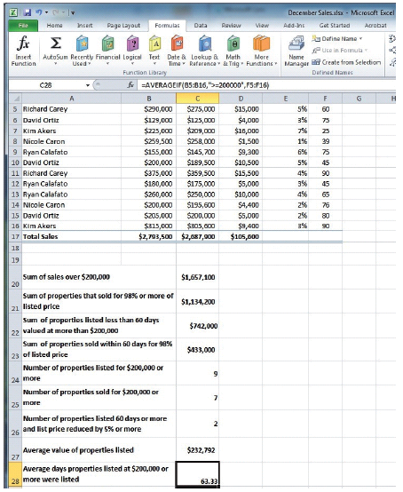
Step-by-Step: Use AVERAGEIF

Slide 33
Using AVERAGEIFS
An AVERAGEIFS formula returns the average (arithmetic mean) of all cells that meet multiple criteria. The syntax is AVERAGEIFS(average_range, criteria_range1, criteria1, criteria_range2, criteria2, and so on).
You will learn to apply the AVERAGEIFS formula in the following exercise.
In the following exercise, you will enter only two criteria for the SUMIFS, COUNTIFS, and AVERAGEIFS formulas you created in the previous exercises.
However, in very large worksheets, you often need to use multiple criteria in order for the formula to return a value that is meaningful for your analysis.

Slide 34
Using AVERAGEIFS
You can enter up to 127 conditions that data must match in order for a cell to be included in the conditional summary that results from a SUMIFS, COUNTIFS, or AVERAGEIFS formula.
The following statements summarize how values are treated when you enter an AVERAGEIF or AVERAGEIFS formula:
  If Average_range is omitted from the function arguments, the range is used.
  If a cell in Average_range is an empty cell, AVERAGEIF ignores it.

Slide 35
Using AVERAGEIFS
  If a range is blank or contains a text value, AVERAGEIF returns the #DIV0! error value.
  If a cell in a criterion is empty, AVERAGEIF treats it as a 0 value.
  If no cells in the range meet the criteria, AVERAGEIF returns the #DIV/0! error value.
Notes:
Take Note: You can reference another worksheet in the same workbook in a conditional formula, but you cannot use references to another workbook.

Slide 36
Step-by-Step: Use AVERAGEIFS
USE the workbook from the previous exercise.
Select C29. Click Insert Function in the Function Library group.
Key AVERAGEIFS in the Search for a function box and click Go. AVERAGEIFS will be highlighted in the Function box.
Click OK to accept the function and close the dialog box.
In the Function Arguments dialog box, select F5:F16 in the Average_range box. Press Tab.
In the Criteria_range1 box, select B5:B16 and press Tab. You have selected your first criteria range.
In the Criteria1 box, key <200000. You have set your first criteria.

Slide 37
Step-by-Step: Use AVERAGEIFS
In the Criteria_range2 box, select E5:E16 and press Tab. You have now selected your second criteria range.
In the Criteria2 box, key <=5%. Click OK. Excel returns a value of 60.
SAVE and CLOSE the workbook.
LEAVE Excel open to use in the next exercise.

Slide 38
Using Formulas to Look Up Data in a Workbook
When worksheets contain long and sometimes cumbersome lists of data, Excel’s lookup functions provide a quick way to find specific information within these lists.
Lookup functions are an efficient way to search for and insert a value in a cell when the desired value is stored elsewhere in the worksheet or even in a different workbook.
VLOOKUP and HLOOKUP are the two lookup formulas that you will be using in this section.
These functions can return cell references identifying where certain information is found, or they can return the actual contents of the found cell.
Notes:
Take Note: As you work through the following exercises, note that the term table refers to a range of cells in a worksheet that can be used by a lookup function.

Slide 39
Using VLOOKUP
The V in VLOOKUP stands for vertical.
This formula is used when the comparison values are located in a column to the left of the data that you want to find. The VLOOKUP function syntax is LOOKUP(lookup_value, table_array, col_index_num).
An array is used to build single formulas that produce multiple results or that operate on a group of arguments.
You create and use array constants whenever you need to add sets of values that don't change (such as month names or pi) to your array formulas.
Constants in your formulas process faster because they reside in memory and not in the workbook.

Slide 40
Using VLOOKUP
The data in a table array must be arranged in rows and columns. It can be a constant or a formula.
The VLOOKUP function searches for a value in the first column of a table array on the worksheet and then returns a value from a specific column, in the same row as the value it found, into a different location in the worksheet.
In the following exercise, you will apply this formula to calculate employee bonuses.
When working with VLOOKUP and HLOOKUP functions and arguments, there are several key points to keep in mind:
  If lookup_value is smaller than the smallest value in the first column of table_array, VLOOKUP returns the #N/A error value.

Slide 41
Using VLOOKUP
  Table_array values can be text, numbers, or logical values. Uppercase and lowercase text is equivalent.
  The values in the first column of the table_array selection must be placed in ascending sort order, otherwise VLOOKUP may not give the correct value. The lookup table you use in this exercise lists years of service in ascending order.
  If the Range_lookup argument is True or omitted, an exact or approximate match is returned. If VLOOKUP cannot find an exact match, it returns the next largest value that is less than the value you have specified in lookup_value.
  If Range_lookup is False, VLOOKUP will find only an exact match. If an exact match is not found, the error value #N/A is returned.

Slide 42
Step-by-Step: Use VLOOKUP
LAUNCH Microsoft Excel if it is not already open.
OPEN the Fabrikam Bonus data file for this lesson.
With the Bonus sheet active, select C15:F24 in the worksheet. Click the Formulas tab, and then click Define Name in the Defined Names group. The New Name dialog box opens.
Key Bonus in the Name box on the New Name dialog box. Click OK to close the dialog box. You have defined the range name.
Select E5 and click Insert Function.
In the Search for a Function box, key VLOOKUP and click OK.
Notes:
Take Note: Arguments used in VLOOKUP or HLOOKUP are not case sensitive, so you can key them in uppercase, lowercase, or any combination of uppercase and lowercase characters. Also, the VLOOKUP and HLOOKUP function names are not case sensitive.

Slide 43
Step-by-Step: Use VLOOKUP
The Function Arguments dialog box opens with the cursor in the Lookup_value box.
Key D5 and press Tab. The insertion point moves to the Table_array box.
In the Table_array box, click the Collapse Dialog box button. In the Defined Names group, click Use in Formula and select Bonus. Press Tab. The insertion point moves to the next text box.
In the Col_index_num box, key 2, the column containing the standard bonus amounts. Press Tab.
Notes:
Take Note: Arguments used in VLOOKUP or HLOOKUP are not case sensitive, so you can key them in uppercase, lowercase, or any combination of uppercase and lowercase characters. Also, the VLOOKUP and HLOOKUP function names are not case sensitive.

Slide 44
Step-by-Step: Use VLOOKUP
In the Range_lookup box, key True; the same bonus is paid for a range of years, so you enter True in the Range_lookup box so that a value will be returned for all agents who have been with the company more than one year. Your Function Arguments dialog box should look similar to the one shown in Figure 9-7. Click OK. Excel returns a value of $750.

Slide 45
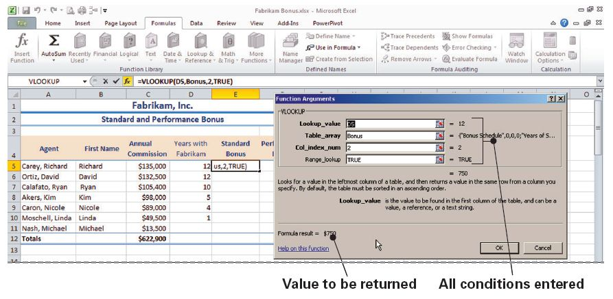
Step-by-Step: Use VLOOKUP

Slide 46
Step-by-Step: Use VLOOKUP
Using the fill handle in E5, copy the formula to the range E6:E11. This will calculate bonuses for the other sales agents. The N/A error message appears in E11 because a value is not available for agents who have been employed for less than one year. (Agents become eligible for a bonus only after a full year of service.) You will change this error message in another exercise.
SAVE the workbook as Employee Bonus.
LEAVE the workbook open to use in the next exercise.
Table 9-2 (see next slide) shows the argument components used in the VLOOKUP and HLOOKUP lookup formulas.
Notes:
Take Note: True in the Range_lookup box will return the closest value. False returns only an exact value. If you leave the Range_lookup box empty, Excel will enter True when you click OK.

Slide 47
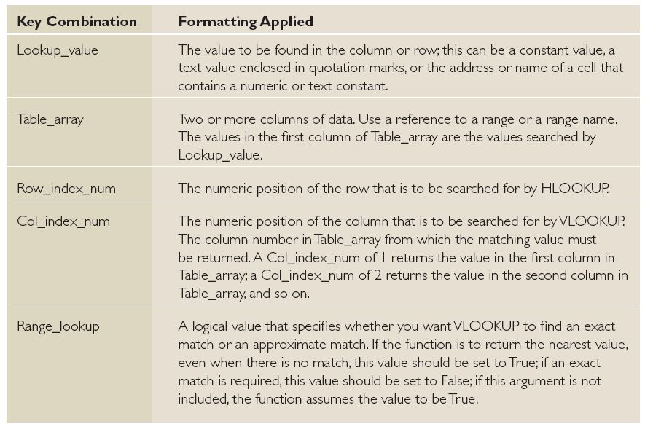
Table 9-2: Function Syntax for VLOOKUP

Slide 48
Using HLOOKUP
HLOOKUP searches for a value in the top row of a table or an array and then returns a value in the same column from a row you specify in the table or array.
Use HLOOKUP when the comparison values are located in a row across the top of a table of data and you want to look down a specified number of rows.
In the following exercise, you will use an HLOOKUP formula to determine who is eligible for the performance bonus.
It may be difficult to remember the syntax for an HLOOKUP or VLOOKUP function.

Slide 49
Using HLOOKUP
Remember, you can always use the Function Arguments dialog box to help you remember the order of the arguments for any and all formulas.
When you click in each field, review the tips that appear on the right side of each box, as well as the explanation below the argument boxes that tells the purpose of each argument in the formula.

Slide 50
Step-by-Step: Use HLOOKUP
USE the workbook from the previous exercise.
Select F5 and click Insert Function in the Function Library group.
In the Search for a Function box, key HLOOKUP and click OK. The Function Arguments dialog box opens with the cursor in the Lookup_value box.
Enter the HLOOKUP formula =HLOOKUP(“performance award”,F16:F24,7,true) in the argument boxes, as shown in the figure on the next slide.

Slide 51
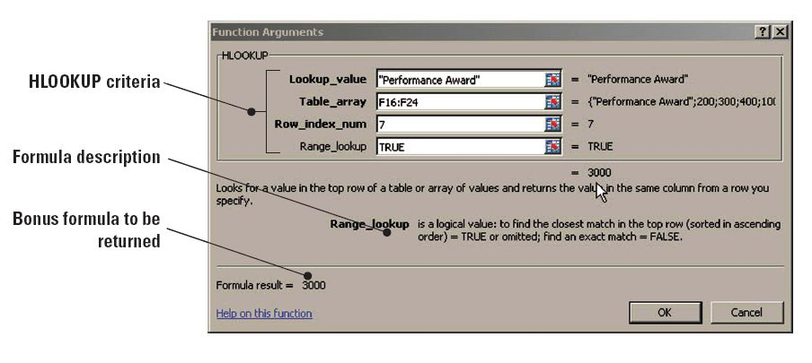
Step-by-Step: Use HLOOKUP
Click OK. The performance bonus of 3000 is entered into the cell.
SAVE the workbook.
LEAVE the workbook open to use in the next exercise.

Slide 52
Adding Conditional Logic Functions to Formulas
You can use the AND, OR, and NOT functions to create conditional formulas that result in a logical value, that is, True or False.
Such formulas test whether conditions are true or false and make logical comparisons.
In addition, you can use the IF, AND, and OR functions to create a conditional formula that results in another calculation or in values other than True or False.

Slide 53
Using IF
The result of a conditional formula is determined by the state of a specific condition or the answer to a logical question.
An IF function sets up a conditional statement to test data.
An IF formula returns one value if the condition you specify is true and another value if it is false.
The IF function requires the following syntax: IF(logical_test, value_if_true, value if false).
In the following exercise, you will use an IF function to determine who is eligible for the performance bonus.

Slide 54
Step-by-Step: Use IF
USE the workbook you saved in the previous exercise.
Click the Performance worksheet tab to make it the active worksheet.
Select D5. Click Logical in the Function Library group and click IF. The Function Arguments dialog box opens.
Key C5>=B5 in the Logical_test box. This component of the formula determines whether the agent has met his or her sales goal.
Key Yes in the Value_if_true box. This is the value returned if the agent met his or her goal.
Key No in the Value_if_false box and click OK.
Notes:
Take Note: Keep in mind as you enter these values that they aren’t case sensitive. Keying yes will therefore yield the same results in the formula. The output text in the cell will directly reflect what you have keyed.

Slide 55
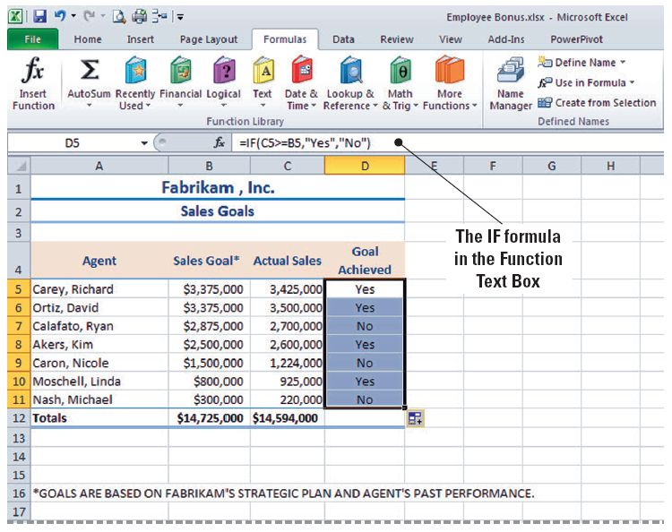
Step-by-Step: Use IF
With D5 still selected, use the fill handle to copy the formula to D6:D11. Excel returns the result that four agents have earned the performance award by displaying Yes in the cells. (See
the figure.)
SAVE the workbook.
LEAVE the workbook
open to use in the next
exercise.

Slide 56
Using AND
The AND function returns True if all its arguments are true and False if one or more arguments are false.
The Syntax is AND(logical1, logical2, and so on).
In the following exercise, you will use the AND function to determine whether Fabrikam’s total annual sales met the strategic goal and whether the sales goal exceeded the previous year’s sales by 5 percent.

Slide 57
Step-by-Step: Use AND
USE the workbook from the previous exercise.
Click the Annual Sales sheet tab.
Select B5. Click Logical in the Function Library group and click the AND option. The Function Arguments dialog box opens with the cursor in the Logical1 box.
Select B3, key <=, select B16, and press Enter. This argument represents the first condition: Did actual sales exceed the sales goal? Because this is the first year, only one logical test will be entered.
Select C5, click Recently Used, and click AND. In the Logical1 box, key C3<=C16.

Slide 58
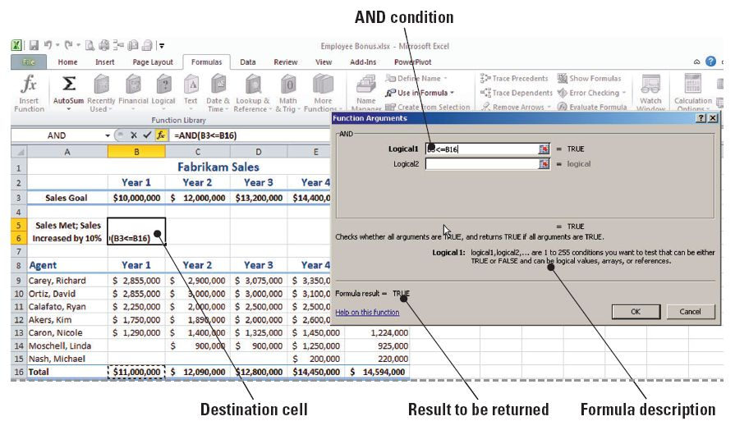
Step-by-Step: Use AND
In the Logical2 box, key C16>=B16*1.05. Click OK. The formula returns True, which means that both conditions in the formula have been met. The AND function arguments are illustrated
in this figure.

Slide 59
Step-by-Step: Use AND
Select C5 and copy the formula to D5:F5.
SAVE the workbook.
LEAVE the workbook open to use in the next exercise.

Slide 60
Using OR
The syntax for an OR formula is similar to that for an AND formula; however, OR returns True if any argument is True, and returns False only when all arguments are False.
With this formula, the arguments must evaluate to logical values such as True or False or to arrays or references that contain logical values.
In the following exercise, you will create a formula that evaluates whether sales increased each year during two different data periods.
The OR formula will return True if any of the periods increased.

Slide 61
Step-by-Step: Use OR
USE the workbook from the previous exercise.
With the Annual Sales worksheet active, select A18 and click Logical in the Function Library group.
Click OR. The Function Arguments dialog box opens. You will create a formula that answers the following question: Did Carey’s sales increase by 3% in year 3 or year 4?
In the Logical1 box, key D9>=C9*1.03 and press Tab. This argument will answer the first half of the question: Did Carey’s sales increase by 3% in the first time period?
In the Logical2 box, key E9>=D9*1.03. This argument will answer the second half of the question: Did Carey’s sales increase in the second time period?

Slide 62
Step-by-Step: Use OR
Click OK to close the dialog box.
The formula returns True, indicating that Carey’s sales increased by 3 percent in at least one of the identified years. A False finding is returned only when both logical arguments are false. In this case, Mr. Carey’s sales increased less than 3 percent from year 2 to year 3 but increased by more than 3 percent from year 3 to year 4. Because OR returns a False result only if all conditions are false, at least one of the arguments in this case equates to true.
SAVE the workbook.
LEAVE the workbook open to use in the next exercise.
Notes:
Take Note: As you add arguments, the Value fields on the Function Arguments dialog box expand to allow you to enter multiple arguments.

Slide 63
Using NOT
The NOT function reverses the value of its arguments.
Use NOT when you want to make sure a value is not equal to one particular value.
If the logical value is false, NOT returns True.
In the following exercise, you will use the NOT function to answer the following question: Did Calafato’s year 5 sales exceed his year 4 sales by 3 percent?

Slide 64
Step-by-Step: Use NOT
USE the workbook from the previous exercise.
On the Annual Sales worksheet, select A19 and click Logical in the Function Library group.
Select NOT from the list of logical formulas.
In the Function Arguments dialog box, key F11>=E11*3% and click OK.
False is returned by the formula. Thus, Calafato’s year 5 sales were at least 3 percent greater than his year 4 sales. Notice that the NOT formula returns the opposite response of what would be returned by an IF formula. For example, if an IF formula returned the value of “top,” then NOT would return the value of “bottom.”

Slide 65
Step-by-Step: Use NOT
SAVE the workbook.
LEAVE the workbook open to use in the next exercise.

Slide 66
Using IFERROR
An error message is returned when a formula does not contain sufficient arguments to return a value.
Use the IFERROR function to trap and handle errors in a formula.
This function returns a value you specify if a formula evaluates to an error; otherwise, it returns the result of the formula.
The syntax is IFERROR(value, value_if_error).
In the IFERROR syntax, value is the argument that is checked for an error.
In the following exercise, you will use this formula to determine eligible bonuses.
Notes:
Take Note: IFERROR will recognize and evaluate the following errors: #N/A, #VALUE!, #REF!, #DIV/0!, #NUM!, #NAME?, or #NULL!.

Slide 67
Step-by-Step: Use IFERROR
USE the workbook you saved in the previous exercise.
Click the Bonus worksheet tab. Select E11 and click to place the insertion point after the = in the formula bar to edit the formula. You are going to add the IFERROR formula to correct the formula error that gave the N/A result in a previous exercise.
Key IFERROR( before VLOOKUP. Leave the existing formula intact. Press End. This will take you to the end of the formula.
At the end of the original formula, key ,“Not Eligible”). As shown on the next slide, the complete formula is =IFERROR(VLOOKUP(D11,Bonus,2,True),“Not Eligible”).
Notes:
Take Note: You will notice that we write formulas such as IFERROR and VLOOKUP in all uppercase. These terms are not case sensitive, but Microsoft always writes them in uppercase in the formula lists and Help system because doing so makes reading formulas much easier. Thus, it is best to get in the habit of using formulas in uppercase.

Slide 68
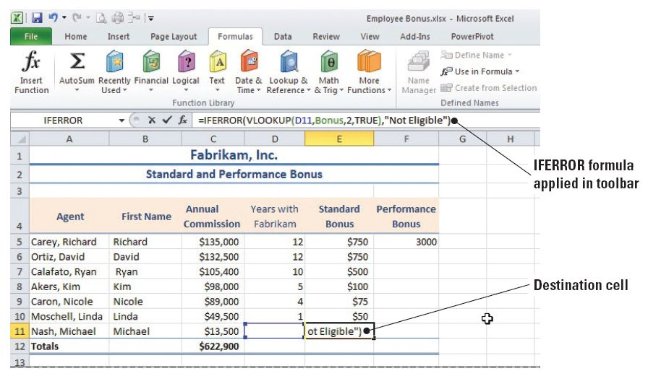
Step-by-Step: Use IFERROR
Be sure to
include the
closing
parenthesis
and the
preceding
comma or
Excel will
return an
error that the
formula is incorrect.

Slide 69
Step-by-Step: Use IFERROR
Press Enter.
The #N/A error message is replaced with the message that the agent is not eligible for the bonus. If you select E11 and click the Insert Function button next to the formula bar, you will see that the original VLOOKUP formula appears in the Value box (first argument) in the IFERROR formula. As illustrated in the figure shown on the next slide, that argument returned a #N/A error. The Value_if_error box contains the text to replace the error message.

Slide 70
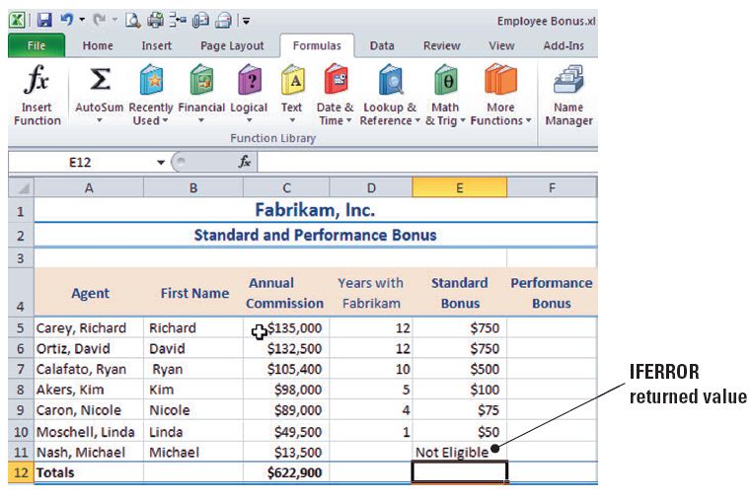
Step-by-Step: Use IFERROR
SAVE the workbook.
LEAVE the workbook open to use in the next exercise.

Slide 71
Using Formulas to Format Text
You may be familiar with Microsoft Word’s Convert Text command that enables you to change the capitalization of text.
Similarly, in Excel, you can use PROPER, UPPER, and LOWER formulas to capitalize the first letter in a text string or to convert uppercase to lowercase or vice versa.

Slide 72
Using PROPER
The PROPER function capitalizes the first letter in a text string and any other letters in text that follow any character other than a letter.
All other letters are converted to lowercase. In the PROPER(text) syntax, text can be text enclosed in quotation marks, a formula that returns text, or a reference to a cell containing the text you want to capitalize.
In the following exercise, you will use PROPER to change uppercase or lowercase text to title case text.

Slide 73
Step-by-Step: Use PROPER
USE the workbook from the previous exercise.
Click the Performance worksheet tab. Select A17 and click Text in the Function Library group on the Formulas tab.
Scroll down the list and click PROPER. The Function Arguments dialog box opens.
Select A16 and click OK. The uppercase text in A16 is entered in A17 in title case.
Note that all the text in the cell changes to proper case except for the S at the end of the word Fabrikam’S. Do not panic—you will address this in another step. (See the figure on the next slide.)

Slide 74
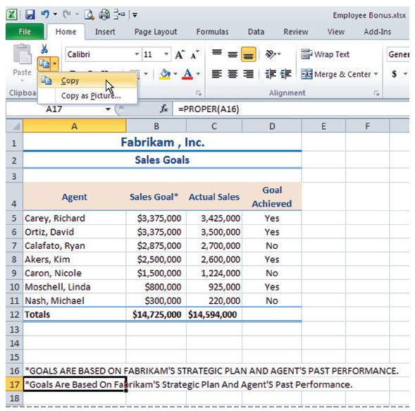
Step-by-Step: Use PROPER

Slide 75

Step-by-Step: Use PROPER
With A17 still selected, click Copy in the Clipboard group on the Home tab.
Select A14 and click the arrow under Paste in the Clipboard group.
Click Paste Values, then click Values. The text appears in A14. Click A14 and change the letters following the apostrophes to lowercase text.
Select A16:A17 and press Delete. The duplicate lines of text are removed.
SAVE the workbook.
LEAVE the workbook open to use in the next exercise.
Notes:
Take Note: Notice that the s letters following the apostrophe in Fabrikam’s and Agent’s are capitalized. Text that follows any character other than a letter is capitalized when you use the PROPER formula. Thus, you will need to proofread carefully when you convert capitalization.

Slide 76
Using UPPER
The UPPER function allows you to convert text to uppercase (all capital letters).
The syntax is UPPER(text), with text referring to the text you want converted to uppercase.
Text can be a reference or a text string. Converting capitalization in text is a two-step process.
You cannot enter the formula in the text’s present location, so after the text has been converted, you must cut and paste the text to the desired location.
The Paste Values command pastes the contents without the formula so that you can remove the duplicate data.

Slide 77
Step-by-Step: Use UPPER
USE the workbook you saved in the previous exercise.
With the Performance worksheet still active from the previous exercise, select A13 and click Text in the Function Library group.
Scroll down the list of functions, if necessary, and select UPPER. The Function Arguments dialog box opens.
Select A14 as the text to convert and click OK. The text from A14 is entered in A13 in uppercase letters.
Click the Home tab. Select A13 and click Copy in the Clipboard group.
With A13 still selected, click the arrow under Paste. Click Paste Values and click Values.

Slide 78
Step-by-Step: Use UPPER
With this action, you replaced the UPPER function in A13 with the actual result (value) of the function.
Select A14 and press Delete. SAVE the workbook.
LEAVE the workbook open to use in the next exercise.

Slide 79
Using LOWER
The LOWER function converts all uppercase letters in a text string to lowercase.
LOWER does not change characters in text that are not letters.
You will use the LOWER formula in the following exercise to apply lowercase text.
Notes:
Take Note: It is important that you always review text after you have changed its case

Slide 80
Step-by-Step: Use LOWER
USE the workbook from the previous exercise.
Click the Annual Sales worksheet tab. Select B20 and click Text in the Function Library group.
Scroll down the list of functions to select the LOWER formula.
Select B19 as the text to convert and click OK. The text from B19 is converted to lowercase, and it is displayed in B20 below the original uppercase text in B19. Your workbook should resemble the workbook shown on the next slide.

Slide 81
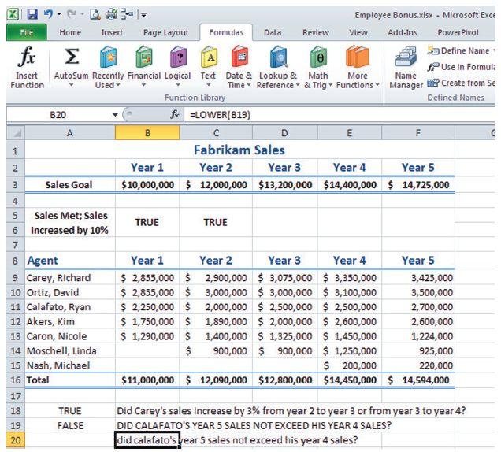
Step-by-Step: Use LOWER

Slide 82
Step-by-Step: Use LOWER
SAVE the workbook.
LEAVE the workbook open to use in the next exercise.

Slide 83
Using SUBSTITUTE
Excel’s SUBSTITUTE function is especially useful when you need to edit data and you want to substitute new text for existing text in a text string.
Use SUBSTITUTE when you want to replace specific text in a text string; use REPLACE when you want to replace any text that occurs in a specific location in a text string, such as when a name change occurs.

Slide 84
Step-by-Step: Use SUBSTITUTE
USE the workbook from the previous exercise.
Click the Annual Sales worksheet tab if necessary. Select B22, click Text in the Function Library, and click SUBSTITUTE; the Functions Arguments dialog box opens.
Select B18 in the Text box.
Key 3 in the Old_text box. This is the text you want to replace.
Key 5 in the New_text box.
Key 1 in the Instance_num box (the Function Arguments settings are explained in Figure 9-16). Click OK.
SAVE the workbook.
LEAVE the workbook open to use in the next exercise.

Slide 85
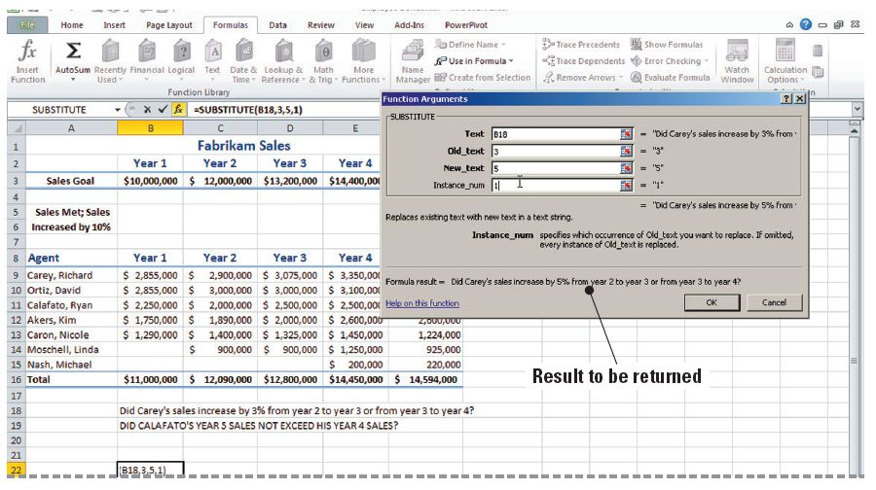
Step-by-Step: Use SUBSTITUTE
The figure below shows the function arguments that result in changing 3% to 5% in the new text. The number 3 occurs three
times in
the
original
text. The
last
function
argument
indicates
which
occurrence should be replaced.

Slide 86
Converting Text to Columns
You can use the Convert Text to Columns Wizard to separate simple cell content, such as first names and last names, into different columns.
Depending on how your data is organized, you can split the cell contents based on a delimiter (divider or separator), such as a space or a comma, or based on a specific column break location within your data.
In the following exercise, you will convert the data in column A to two columns.

Slide 87
Step-by-Step: Convert Text to Columns
USE the workbook from the previous exercise.
Click the Performance worksheet tab. Select any cell in column B. Right-click to open the shortcut menu. Click Insert and click Entire Column. Click OK.
Select A5:A11. Click the Data tab and click Text to Columns in the Data Tools group.
The Text Wizard opens with Delimited selected as the default because Excel recognized that the data in the selected range is separated by a comma. Click Next to move to the next step in the wizard.
Select Comma as the delimiter. If other delimiters are checked, deselect them and click Next.

Slide 88
Step-by-Step: Convert Text to Columns
Select Text as the Column data format and click Finish. A warning window opens to confirm you want to replace the contents of the destination cells. Click OK. The first names of the agents are moved to column B. (See the figure on the next slide.)
Select A4, key Last Name, and press Tab.
With B4 selected, key First Name and press Tab.
SAVE the workbook with the same name. CLOSE the workbook.
CLOSE Excel.
Notes:
Another Way: You can also use text functions such as LEFT, MID, and RIGHT to convert text data from one column to multiple columns.

Slide 89
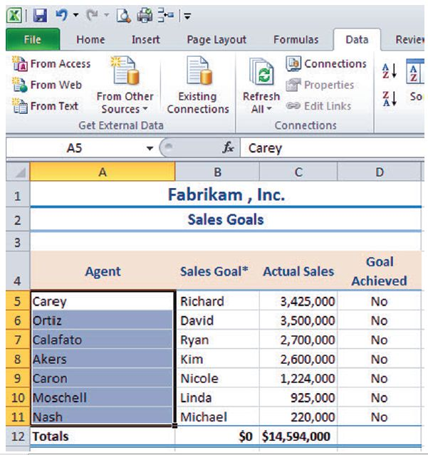
Step-by-Step: Convert Text to Columns

Slide 90
Software Orientation
Excel provides several layers of security and protection that allow you to control who can access and change your Excel data. Commands on the Review tab (see figure on next slide) enable you to protect an entire workbook file so that only authorized users can view or modify your data (the highest level of protection).
You can also protect certain worksheet or workbook elements to prevent users from accidentally or deliberately changing, moving, or deleting important data.
Data protection is especially important when files are shared and edited by multiple users.

Slide 91
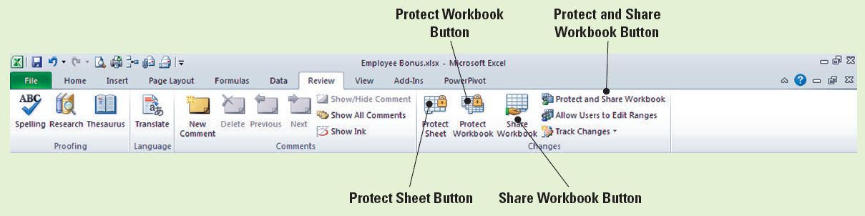
Software Orientation
Use this illustration as a reference throughout this lesson as you learn to share and edit files using Excel’s security and protection options.

Slide 92
Securing Your Work Before Sharing It with Others
A password is text that must be keyed before a user can access a workbook, worksheet, or worksheet elements.
You can secure an entire workbook by restricting who can open and/or use the workbook data and by requiring a password to view and/or save changes to the workbook.
You can also provide additional protection for certain worksheets or workbook elements with or without applying a password.

Slide 93
Protecting a Worksheet
In a work environment, workbooks are frequently used by more than one employee.
When you create a worksheet that will be accessed by multiple users, you often need to protect it so that a user does not accidentally or intentionally change, move, or delete important data. In the next exercise, you will use the RAND and RANDBETWEEN formulas to create unique ID numbers.
Excel has two random number functions: RAND and RANDBETWEEN.

Slide 94
Protecting a Worksheet
RAND does not require function arguments, so you cannot specify the number of digits you want in the number returned by a RAND formula.
In contrast, RANDBETWEEN allows you to determine the beginning and ending numbers.

Slide 95
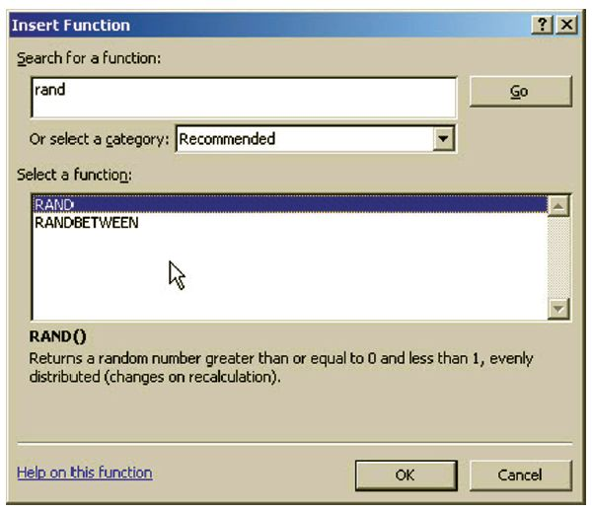
Step-by-Step: Protect a Worksheet
Before you begin these steps, LAUNCH Microsoft Excel.
OPEN Employee Data from the data files for this lesson.
Select G4 on the SSN worksheet. On the Formulas tab, click Insert Function. The Insert Function dialog box is displayed.
Key Rand in the Search for a
function box and click Go. As
shown here, two random
number functions are
displayed in the Select a
function box.

Slide 96
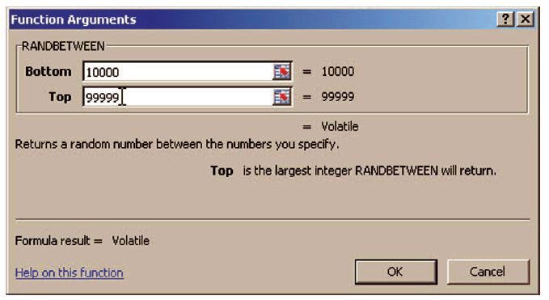
Step-by-Step: Protect a Worksheet
Select RANDBETWEEN and click OK. This formula will create a random number for each employee that can be used for identification purposes.
In the Function Arguments dialog box, key 10000 in the Bottom box and 99999 in the Top box, as shown in this figure.

Slide 97
Step-by-Step: Protect a Worksheet
Click OK. As one of the first steps in information security, employees are usually assigned an Employee ID number that can replace Social Security numbers on all documents. Your formulas returned a five-digit number for each employee.
Copy the formula in G4 to G5:G33. Each employee is now assigned a random five-digit ID number.
With the range G4:G33 already selected, on the Home tab, click Copy. Click the Paste arrow, click Paste Values, and then click Values.
Notes:
Troubleshooting: The RANDBETWEEN formula generates a new random number each time a workbook is opened. To retain the Employee ID numbers created by the formula, you must replace the formula with the values.

Slide 98
Step-by-Step: Protect a Worksheet
With G4:G33 selected, click Format and then select Format Cells; the Format Cells dialog box opens.
On the Protection tab of the dialog box, make sure that Locked is selected and click OK. This prevents employee ID numbers from being changed when the worksheet has been protected.
On the Review tab, in the Changes group, click Protect Sheet.
Key L11!e01 in the Password to unprotect sheet box. The password is not displayed in the Password to unprotect sheet box. Instead, round dots () are displayed. Click OK.

Slide 99
Step-by-Step: Protect a Worksheet
You are asked to confirm the password. Key L11!e01 and click OK.
You have just created and confirmed the password that will lock the worksheet. Passwords are meant to be secure. This means that all passwords are case sensitive. Thus, you must key exactly what has been assigned as the password—uppercase and lowercase letters, numbers, and symbols.
SAVE the workbook as Payroll Data. CLOSE the workbook.
LEAVE Excel open to use in the next exercise.
Notes:
Take Note: Workbook and worksheet element protection should not be confused with workbook-level password security. Element protection cannot protect a workbook from users who have malicious intent.

Slide 100
Protecting a Workbook
Assigning a password is an effective way to prevent any user who does not know the password from opening a workbook.
To protect an entire workbook, you can require a password to open and view the workbook.
You can also require one password to open and view the workbook and a second password to modify workbook data.
Passwords that apply to an entire workbook provide optimal security for your data.
Currently, the Payroll Data workbook you saved in the previous exercise can be viewed by anyone who has access to the computer system.

Slide 101
Protecting a Workbook
You restricted the modification of the file, but you did not restrict access to the data.
In the following exercise, you will limit access to the workbook by requiring a password to open the document.
Excel passwords can contain up to 255 letters, numbers, spaces, and symbols.
Passwords are case sensitive, so you must type uppercase and lowercase letters correctly.
If possible, select a strong password that you can remember so that you do not have to write it down.

Slide 102
Protecting a Workbook
A strong password is one that combines uppercase and lowercase letters, numbers, and symbols—consider the example password of L11!e01 that you used in the previous exercise.
A password that uses 14 or more characters, however, is considered to be more secure.
Passwords that use birthdates, house numbers, pet names, etc. provide little protection.
When you protect a worksheet, you can hide any formulas that you do not want to be visible.
Notes:
Take Note: It is vitally important that you remember passwords assigned to workbooks or worksheets. If you forget your password, Microsoft cannot retrieve it. If necessary, write down passwords and store them in a secure place away from the information you want to protect.

Slide 103
Step-by-Step: Protect a Workbook
LAUNCH Excel if it is not already running.
OPEN the Payroll Data file that you saved and closed in the previous exercise.
Click D11 and try to key a new value in the cell. A dialog box informs you that you are unable to modify the cell because the worksheet is protected. Click OK to continue.
Click the Performance worksheet tab and select D6.
On the Home tab, in the Cells group, click the Delete arrow, and click Delete Sheet Rows. Dr. Bourne’s data is removed from the worksheet because this worksheet was left unprotected.

Slide 104
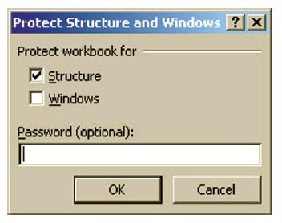
Step-by-Step: Protect a Workbook
Click the SSN worksheet tab. Click Unprotect Sheet in the Changes group on the Review tab.
Key L11!e01 (the password you created in the previous exercise) and click OK.
D11 is still selected. Key 25, press Tab, and key 17000. Press Tab.
On the Review tab, in the Changes
group, click Protect Workbook. The
Protect Structure and Windows
dialog box shown here opens. Click
the Protect workbook for
Structure and Windows options in
the dialog box.

Slide 105
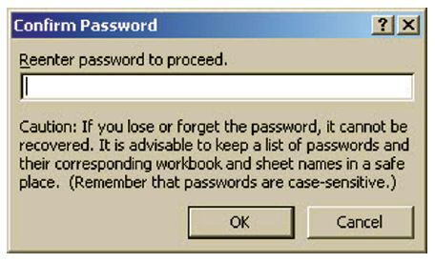
Step-by-Step: Protect a Workbook
Key L11&E02 in the password box and click OK. Confirm the password as shown the figure here and click OK.
Click the File tab and
select Save As.
In the Save As dialog
box, click Tools and
General Options in the
Tools drop-down menu,
as shown in the figure
on the next slide; the
General Options dialog box opens.
Notes:
Take Note: The workbook password is optional, but if you do not supply a password, any user can unprotect the workbook and change the protected elements.

Slide 106
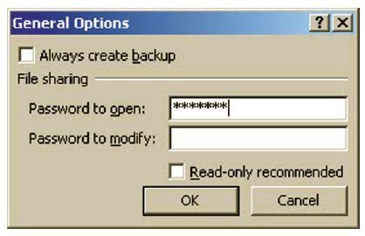
Step-by-Step: Protect a Workbook
In the General Options dialog box shown below, in the Password to open box, key L11&E02 and click OK.
Reenter the password on
the Confirm Password
dialog box and click OK.
The passwords must
match exactly.
Click Save. Select Yes to
replace the existing
file.

Slide 107
Step-by-Step: Protect a Workbook
Because the document is now saved, anyone who has the password can open the workbook and modify data contained in the Performance worksheet because that worksheet is not protected. However, to modify the SSN worksheet, the user must also know the password you used to protect that worksheet in the first exercise.
LEAVE the workbook open to use in the next exercise.
Notes:
Troubleshooting: When you confirm the password to prevent unauthorized viewing of a document, you are reminded that passwords are case sensitive. If the password you enter on the Confirm Password dialog box is not identical to the one you entered in the previous dialog box, you will receive an error message. Click OK to close the error message and reenter the password in the Confirm Password dialog box.

Slide 108
Allowing Multiple Users to Edit a Workbook Simultaneously
Creating and updating workbooks is frequently a collaborative process.
A worksheet or workbook is often routed to other employees so that they can verify data or make changes.
In Excel, you can create a shared workbook, or one that is set up to allow multiple users on a network to view and make changes at the same time.
When a user opens a shared workbook, he or she can see the changes made and saved by other users.
The Protect and Share Workbook command prevents a user from disabling the change-tracking option.

Slide 109
Allowing Multiple Users to Edit a Workbook Simultaneously
For example, the workbook you will create in the following exercise will be used by the medical assistants, who will record all sample medications the physicians prescribe for patients.
Sharing this workbook means that more than one medical assistant can access the workbook and enter data at the same time.
In the exercise, you will learn how to allow users to simultaneously edit workbooks.
Notes:
Take Note: In a shared workbook, information is maintained about changes made in past editing sessions. The change history includes the name of the person who made each change, when the change was made, and what data was changed.

Slide 110
Step-by-Step: Allow Multiple Users to Edit a Workbook Simultaneously
LAUNCH Excel if it is not already running.
CREATE a new blank workbook.
Select A1:D1 and click Merge & Center in the Alignment group on the Home tab.
Key Sample Drugs Dispensed in the newly merged cell and press Enter.
Select A1, click Cell Styles, and then click Heading 1 in the Cell Style gallery that appears.

Slide 111
Step-by-Step: Allow Multiple Users to Edit a Workbook Simultaneously
Begin in cell A3 and enter the following data.
Medical Assistant Drug Patient
Delamore, Luca Cipro Chor, Anthony
Hamilton, David Ketek Brundage, Michael
Hoeing, Helge Lipitor Charles, Matthew
Hamilton, David Altace Bishop, Scott
Esteves, Janeth Zetia Anderson, Nancy
Esteves, Janeth Cipro Coleman, Pat
Hagens, Erin Avelox Nayberg, Alex
Hagens, Erin Norvasc Kleinerman, Christian
Click on cell D3 and key Date. In the Date column, apply today’s date to all the above records.

Slide 112
Step-by-Step: Allow Multiple Users to Edit a Workbook Simultaneously
Select A3:D3 and apply the Heading 3 style.
SAVE the workbook as Sample Medications.
Click the Review tab, then click Share Workbook in the Changes group.
In the Share Workbook dialog box, click Allow changes by more than one user at the same time. This also allows workbook merging. Your identification will appear in the Who has this workbook open now box. Click OK.

Slide 113
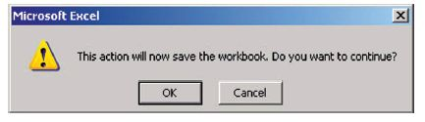
Step-by-Step: Allow Multiple Users to Edit a Workbook Simultaneously
Click OK when the dialog box shown here opens.
Click Protect Shared Workbook in the Changes group. Select the Sharing with track changes check box in the Protect Shared Workbook dialog box. Click OK.
Notice that [Shared] appears in the title bar.
SAVE and CLOSE the workbook.
LEAVE Excel open to use in the next exercise.
Notes:
Troubleshooting: If you want to assign a password to a shared workbook, you must assign it before the workbook is shared. You can also unshare a workbook and add the password. However, when you unshare a shared workbook, the change history is lost.

Slide 114
Using the Document Inspector
Before you share an important document with colleagues or individuals outside your organization, you should always spell check, proofread, and review the contents to ensure that everything is correct and the document does not contain anything you do not want to share with others.
You should also review the document for hidden data or personal information that might be stored in the workbook or in the document properties.
In Excel, the Document Inspector displays several different Inspectors that enable you to find and remove hidden data and personal information that is specific to Excel workbooks.

Slide 115
Using the Document Inspector
Document Inspector will also locate custom XML data, hidden worksheets, and invisible content.
Several types of hidden data and personal information can be saved in an Excel workbook.
This information might not be immediately visible when you view the document, but it still may be possible for others to view or retrieve the information. This information includes the following:
  Comments and annotations: This information would enable other people to see the names of people who worked on your workbook, their comments, and changes that were made to the workbook.

Slide 116
Using the Document Inspector
  Document properties and personal information: Document properties include the author, subject, and title, as well as the name of the person who most recently saved the workbook and the date the workbook was created.
  Headers and footers: Headers and footers may include the author’s name, the date the file was created, etc.
  Hidden rows, columns, and worksheets: Columns D and E were hidden in the SSN worksheet to protect salary data. Before removing hidden rows or columns, be sure that their removal will not change calculations in your worksheet.

Slide 117
Step-by-Step: Use the Document Inspector
OPEN Employee ID from the data files for this lesson.
Click the File tab, click Save As, and key Employee ID Copy in the File name box to save a copy of the workbook. Click the Save button.
In the copy of your original workbook, click the File tab. Then, with Info clicked, click the Check for Issues button in the middle pane of the Backstage view window. Next, click Inspect Document. The Document Inspector dialog box opens, as shown in the figure on the next slide.
Notes:
Troubleshooting: It is a good idea to perform an inspection on a copy of your worksheet because you might not be able to restore hidden content that you remove in the inspection process. If you attempt to inspect a document that has unsaved changes, you will be prompted to save the document before completing the inspection.

Slide 118
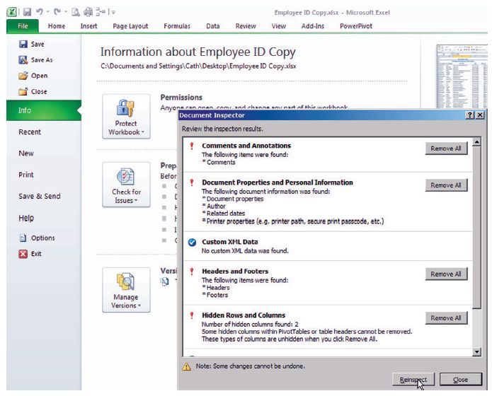
Step-by-Step: Use the Document Inspector

Slide 119
Step-by-Step: Use the Document Inspector
Click Inspect. The Document Inspector results shown in Figure 9-27 are returned.
Click Remove All for Comments and Annotations.
Click Remove All for Document Properties and Personal Information.
Click Remove All for Hidden Rows and Columns. Headers and Footers should be the only hidden item remaining (as shown in the figure on the next slide). Click the Close button to close the Document Inspector results dialog box.
Notes:
Take Note: You must remove each type of hidden data individually. You can re-inspect the document after you remove items.

Slide 120
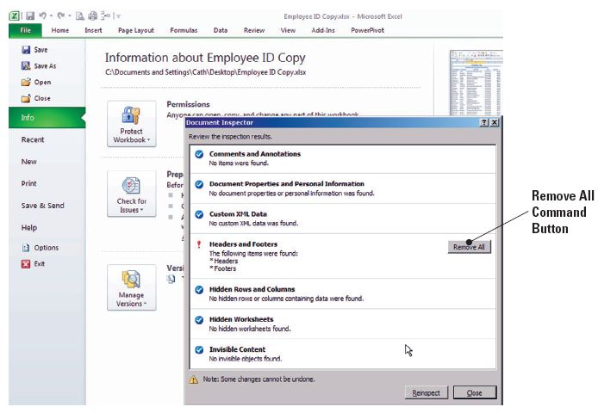
Step-by-Step: Use the Document Inspector

Slide 121
Step-by-Step: Use the Document Inspector
SAVE the workbook.
LEAVE the workbook open to use in the next exercise.
When you opened the data file in this exercise, it contained hidden columns as well as other information that you didn’t want to share with others.
You first created a copy of your original worksheet because it’s not always possible to restore data that the Document Inspector removes.
So you removed sensitive information from the copy; the complete data is retained in the original workbook. If the original workbook was protected, the copy will also be protected, and Read-Only will display in the title bar.

Slide 122
Signing a Workbook Digitally
You can digitally sign a document for many of the same reasons you would sign a paper document.
A digital signature is used to authenticate digital information using computer cryptography.
Authentication refers to the process of verifying that people and products are who and what they claim to be. To digitally sign a workbook, you must have a current digital certificate.
A digital certificate is a means of proving identity and authenticity.
Digital certificates make it possible for digital signatures to be used as a way to authenticate digital information.

Slide 123
Signing a Workbook Digitally
You can get a digital ID from a Microsoft partner, or you can create your own digital ID. A digital signature is not visible within a document’s contents.
If you plan to exchange digitally signed documents, you should obtain a digital certificate from a reputable certificate authority. A certificate authority (CA) is a third-party entity that issues digital certificates to be used by others, keeps track of who is assigned to a certificate, signs certificates to verify their validity, and tracks which certificates are revoked or expired.
Many organizations issue their own certificates, as you did in the exercise on behalf of Contoso, Ltd

Slide 124
Signing a Workbook Digitally
If you select the Get a digital ID from a Microsoft Partner option when you want to add a digital signature, you will be redirected to the Microsoft Office Marketplace where you can purchase a certificate.
If you don’t want to purchase a digital certificate from a CA, you can create your own digital certificate as you did in this exercise. However, other people cannot verify the authenticity of your digital signature. It can be authenticated only on the computer on which you created the certificate.
When you review a signed document, you should look at the signature details and the certificate used to create that signature to find out if there are potential problems. When a workbook contains a signature, a Signature icon displays in the Status bar.

Slide 125
Step-by-Step: Sign a Workbook Digitally
USE the workbook from the previous exercise.
Click the File tab, click Info, then click Protect Workbook; when the Protect Workbook drop-down menu appears, click Add a Digital Signature. A dialog box opens that explains digital signatures. Read the message and click OK. If you or your organization does not have a valid digital certificate, the Get a Digital ID dialog box shown on the next slide opens.
Click OK. In the Get a Digital ID dialog box, click Create your own Digital ID and click OK.
Notes:
Take Note: The Get a Digital ID dialog box opens only if you select Add a Digital Signature and you do not have a digital certificate. If the document contains unsaved changes, the file is automatically saved when you click Add a Digital Signature. If one or more digital certificates are available on your computer or network, a Sign dialog box opens so that you can sign the document.

Slide 126
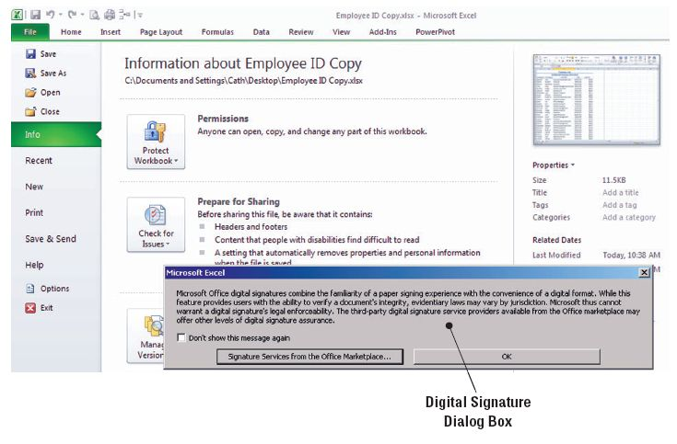
Step-by-Step: Sign a Workbook Digitally

Slide 127
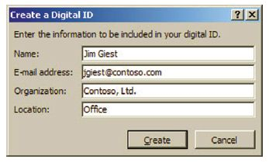
Step-by-Step: Sign a Workbook Digitally
Enter the information shown
in this figure and click Create.
In the Purpose for signing this
document box that appears, key
Transmission to CPA for tax
purposes. Click Sign. A message
is displayed indicating that your signature has been successfully saved with the document. If the document is changed, the signature will become invalid. Click OK.
Backstage view now displays two new orange highlighted buttons in the middle of the Info screen. They are View Signatures with a title of Signed Workbook and Protect Workbook with a title of Permissions. See the figure on the next slide.

Slide 128
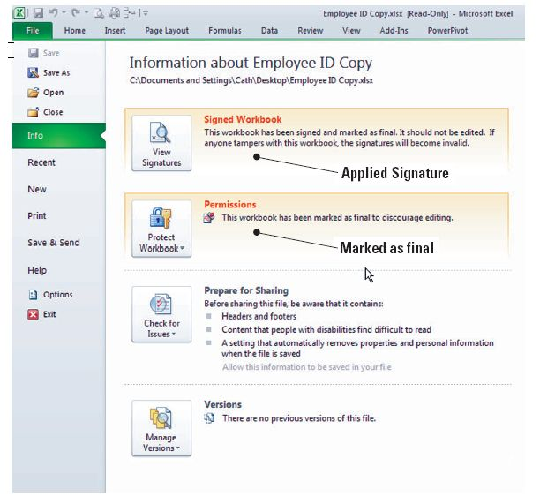
Step-by-Step: Sign a Workbook Digitally
Click the Home tab.
On the Status bar, in
the bottom-left corner
of the Excel window,
point to the Signature
icon. A ScreenTip
stating This document
contains signatures is
displayed.

Slide 129
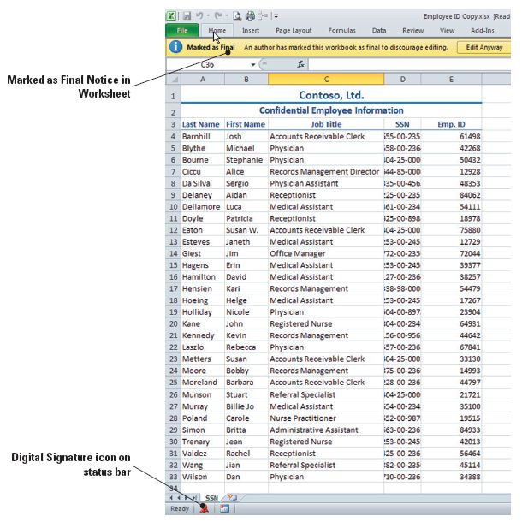
Step-by-Step: Sign a Workbook Digitally
Note at the top of the
worksheet that a notice
indicates that An author
has marked this workbook
as final to discourage
editing, as illustrated in
this figure.
Click the File tab. Click
View Signatures. The
Signatures pane opens
and the signature and
date are displayed. Your
name and today’s date should be visible in the pane.

Slide 130
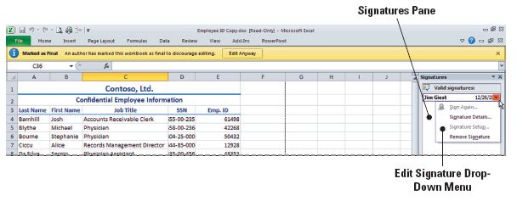
Step-by-Step: Sign a Workbook Digitally
In the Signatures pane, select the signature and click the arrow to display the drop-down menu. Refer to this figure.
Click Signature Details. The Signature Details dialog box indicates that the signature and the signed content have not been modified since the signature was applied.
Notes:
Another Way: You can also click the Signatures icon on the Status bar to display the Signatures task pane.

Slide 131
Step-by-Step: Sign a Workbook Digitally
The worksheet is now protected so that the signature can be authenticated. Click the Close button to close the dialog box.
SAVE the workbook. (Remember, you named this file in the beginning of this section.)
CLOSE the workbook. LEAVE Excel open to use in the next exercise.
Notes:
Take Note: The workbook was saved when you created the signature. There is no need to save again. If you use the Save As command after a signature has been added to a document, the signature will become invalid.

Slide 132
Marking a Document as Final
Before you share a workbook with other users, you can use the Mark as Final command to make the document read-only and prevent changes to the document.
Marking a document as final communicates that you are sharing a completed version of the document, and it helps prevent reviewers or readers from making inadvertent changes to the document.
The Mark as Final command is not a security feature. Anyone who opens a workbook that has been marked as final can edit the document by removing the Mark as Final status from the document.

Slide 133
Marking a Document as Final
Documents marked as final in an Excel 2007 workbook will not be read-only because Mark as Final was not an option in previous Excel versions.
To enable editing for a document that is marked as final, click the File tab, click on Protect Workbook, and click Mark as Final to deselect that option. The Read-Only designation will be removed from the workbook

Slide 134
Distributing a Workbook By Email
The most common ways to share Excel data are by sending workbooks through email, by faxing workbooks, and by printing and distributing hard copies.
Email allows you to share a workbook by routing it to one user who can make changes or add comments and then route the workbook it to the next user.
Changes can then be incorporated into a final document. You can email a workbook as an attachment from Excel or from your email program.
You can also send a worksheet as an email message rather than as an attachment.

Slide 135
Distributing a Workbook By Email
The option to send a worksheet as an email message is available only from the Send to Mail Recipient command on the Quick Access Toolbar.
When you add this command to the toolbar, you can use this option as a shortcut to send a workbook as an attachment.
In the next set of exercises, you will learn how to send a workbook from Excel, send a worksheet as an email, and send a workbook as an attached file.

Slide 136
Step-by-Step: Distribute a Workbook by Email
USE the workbook you saved in the previous exercise. Note that you must have an email program and Internet connection to complete the following exercises.
To send a workbook from Excel:
Click the File tab and click Save & Send in the navigation bar. Click Send Using E-mail in the Save & Send window. Click the Send as Attachment button. When you have Office 2010 installed, this feature will open Outlook by default. If you have changed your environment, your own personal email program will open. Notice that Excel automatically attaches the workbook to your email message.

Slide 137
Step-by-Step: Distribute a Workbook by Email
Key your instructor’s email address in the To field.
In the subject line, key Employee Final Attached as per request.
In the email message body, key The Employee ID Final workbook is attached.
Click Send. Your email with the workbook attached to it will now be sent to your instructor.
CLOSE the workbook. LEAVE Excel open for the next exercise.

Slide 138
Step-by-Step: Distribute a Workbook by Email
To send a worksheet as an email message:
OPEN the Employee ID file from the student data files for this lesson. SAVE the file as Employee ID Recipient.
Click the File tab, Click on Protect Workbook, and click Mark as Final.
Click the File tab and click Options in the Navigation bar. The Excel Options Window opens.
Click Customize Quick Access Toolbar. In the Choose Commands From field, click on E-mail to highlight. In the center bar between the left and right fields click Add. This step adds the email button to the Quick Access Toolbar.

Slide 139

Step-by-Step: Distribute a Workbook by Email
In the Choose Commands drop-down box, click All Commands. Scroll and find Send to Mail Recipient and click to highlight it. In the center bar between the left and right fields, click Add. This step will add this command to the Toolbar.
Click OK to save both commands to the Toolbar.
On the Quick Access Toolbar, click Send to Mail
Recipient.
The E-mail dialog box opens, as described in the first exercise in this group. Since the document is marked as final, Send to Mail Recipients is disabled. To disable Final, return to the Home tab and click the Edit Anyway button that appears at the top of the screen.

Slide 140
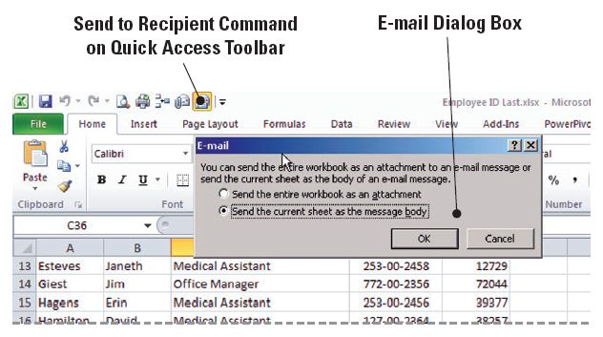
Step-by-Step: Distribute a Workbook by Email
Click the Send the current sheet as the message body option, as shown in this figure, then click OK. The email window is now embedded in your Excel screen with the current worksheet visible as the body of the email.
Key your instructor’s
email address in the
To field.
Key Worksheet ready
to e-mail in the subject
line.

Slide 141
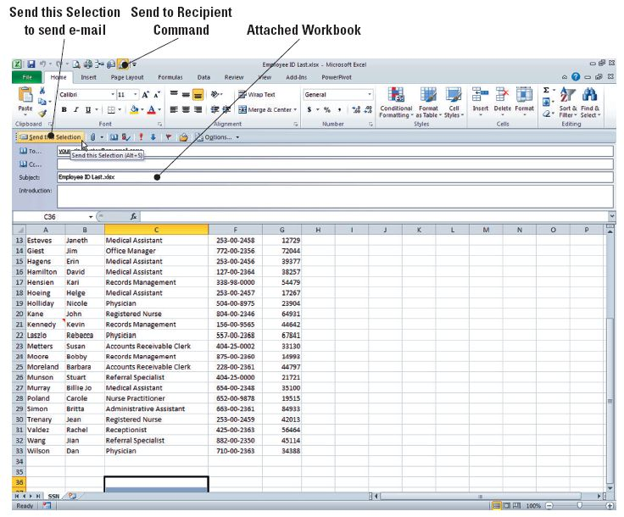
Step-by-Step: Distribute a Workbook by Email
Click the Send this
Selection button on
the email message
toolbar above the
email information,
as illustrated in this
figure. Click OK.
SAVE the workbook.
CLOSE the workbook.
LEAVE Excel open for
the next exercise.

Slide 142
Step-by-Step: Distribute a Workbook by Email
To send a workbook from your email program:
LAUNCH your email program. Create a new email message.
Key your instructor’s email address in the To field.
Key Employee ID Final ready to send in the subject line.
Click Attach File.
Navigate to the Lesson 9 folder where you saved Employee ID Final. Click the filename, then click Open.
In the message area, key The Employee ID Copy workbook is attached in the email message.
Click Send.
CLOSE the workbook.
Notes:
Troubleshooting: Some email programs will not send a document as an attachment if the document is open on your computer. If you receive such a message, close the document and click Send again.

Slide 143
Tracking Changes to a Workbook
Tracking changes is the ability to mark and track changes that have been made to a workbook.
The ability to track changes is especially helpful in a workbook that is shared and modified by multiple users.
When you turn on Track Changes, the workbook automatically becomes a shared workbook.
You can customize the change-tracking feature to track specific types of changes, you can allow the feature to be turned on and off at will by various users, or you can specify a password to protect the changes.
You also can decide whether to accept or reject changes to your original workbook data.
When you turn off change tracking, the workbook is no longer a shared workbook.

Slide 144
Turning Track Changes On and Off
You can turn on change tracking using the Track Changes command, the Share Workbook command, or the Protect and Share Workbook command (all located on the Review tab).
The Protect and Share Workbook command provides the highest level of security.
When workbooks are shared, it is often important to know what changes were made by each user.
The owner (creator) of the workbook can use change-tracking functions to manage the data in a shared workbook.

Slide 145
Turning Track Changes On and Off
The owner can use the change history record to manage the shared workbook by adding or removing users and resolving conflicting changes.
In the next exercise, you will learn to track changes.

Slide 146
Step-by-Step: Turn Track Changes On and Off
LAUNCH Excel if it is not already running.
OPEN the Sample Medications data file for this lesson.
SAVE the workbook as Samples in the Lesson 9 folder.
On the Review tab, in the Changes group, click the Protect and Share Workbook button. The Protect Shared Workbook dialog box opens.
In the dialog box, click Sharing with track changes. When you choose this option, the Create Password text box becomes active. You can assign a password at this time, but it is not necessary. Click OK.
Notes:
Take Note: Turning off Track Changes removes the change history and removes the shared status of the workbook, but changes already shown in the document will remain until you accept or reject them.

Slide 147
Step-by-Step: Turn Track Changes On and Off
Click OK when asked if you want to continue and save the workbook.
You have now marked the workbook to save tracked changes.
LEAVE the workbook open to use in the next exercise.

Slide 148
Setting Track Change Options
The Advanced tab of the Share Workbook dialog box allows you to customize the shared use of the workbook.
These options are normally set by the workbook author before the workbook is shared.
In the following exercise, you will modify these options.

Slide 149
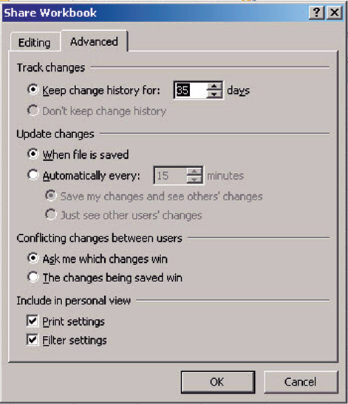
Step-by-Step: Set Track Change Options
USE the workbook from the previous exercise.
On the Review tab, in the Changes group, click Share Workbook; the Share Workbook dialog box opens.
Click the Advanced tab. See the
figure.
In the Keep Change History For
box, click the scroll arrow to
display 35.
Click OK to accept the default
settings in the remainder of the
options.
LEAVE the workbook open.

Slide 150
Step-by-Step: Set Track Change Options
The Advanced tab contains four options:
Track changes determines whether a change history is kept and the length of time it is kept. In a shared workbook, the change history documents changes made in past editing sessions. The information includes the name of the person who made each change, when the changes were made, and what data was changed. The default setting is 30 days. Contoso maintains a monthly record of the distribution of samples. Setting the change history to 35 days ensures that the office manger has sufficient time to review the workbook and resolve any conflicting changes before the change history is deleted.

Slide 151
Step-by-Step: Set Track Change Options
Update changes controls when changes made to the shared workbook are incorporated into the workbook.
Conflicting changes between users determines whose edits become part of the file if two or more people are attempting to edit at the same time. The workbook owner’s changes usually take precedence.
Include in personal view enables each user who edits the workbook to see a personal view of the workbook.

Slide 152
Inserting Tracked Changes
When you open a shared workbook, change tracking is automatically turned on.
In most cases, the workbook owner will have entered a password to prevent a user from turning off change tracking. Thus, any text you key in the workbook will be tracked.

Slide 153
Step-by-Step: Insert Tracked Changes
USE the workbook from the previous exercise.
On the Review tab, in the Changes group, click Track Changes; in the drop-down list that appears, click Highlight Changes. The Highlight Changes dialog box appears.
The Track changes while editing box is inactive because change tracking was activated when you shared the workbook. As shown in the figure on the next slide, in When, click the down arrow and then select All. In Who, select Everyone. If the Highlight changes on screen option is not already selected, then select it. Click OK. A warning box appears; click OK to accept the warning as there are no current changes and you will make changes in the steps to follow.

Slide 154
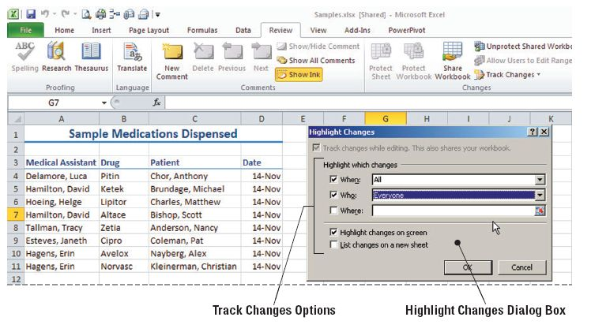
Step-by-Step: Insert Tracked Changes

Slide 155
Step-by-Step: Insert Tracked Changes
Click the File tab and click Options in the navigation bar. The Excel Options window opens.
In the General category, under Personalize your copy of Microsoft Office, in the User name box, key Luca Delamore. Click OK. You have changed the document user name that will be listed in the track changes.
Select A12 and enter the following information in A12, A13, and A14:
Delamore, Luca Avelox LaMee, Brian 14-Nov
Delamore, Luca Ketek Miller, Ben 14-Nov
Delamore, Luca Cipro Kearney, Bonnie 14-Nov

Slide 156
Step-by-Step: Insert Tracked Changes
As you enter these changes, a colored triangle and comment box appear for each entry made. This makes it easy to view the changes later.
Click Save on the Quick Access Toolbar to save the changes you made under the user name Luca Delamore.
Click the File tab and select Options.
In the User name box, key Billie Jo Murray. Click OK. You are once again changing the user name and applying it to the document.

Slide 157
Step-by-Step: Insert Tracked Changes
Key the following data in A15, A16, and A17:
Murray, Billie Jo Zetia Peters, James 15-Nov
Murray, Billie Jo Cipro Smith, Samantha 15-Nov
Murray, Billie Jo Ketek Ruth, Andy 15-Nov
Note your changes to the worksheet, as illustrated in the figure shown on the next slide
Notes:
Take Note: Make a note of the name that you remove. You will restore the original user name at the end of this lesson.

Slide 158
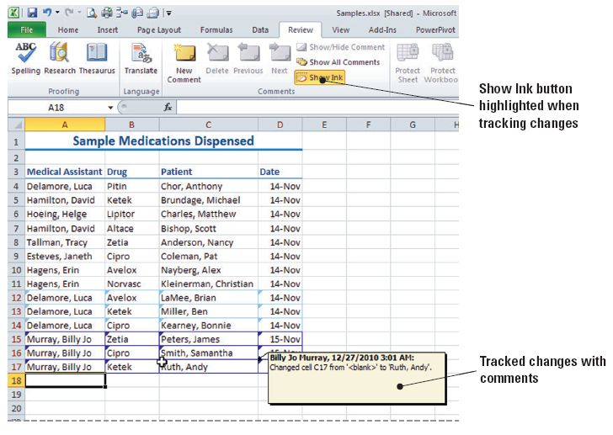
Step-by-Step: Insert Tracked Changes

Slide 159
Step-by-Step: Insert Tracked Changes
Point to the colored triangle in the upper-left corner of one of the cells in which you entered data. A box opens with information about the changes made to that cell.
Click Save on the Quick Access Toolbar to save the changes you made under the user name Billie Jo Murray.
LEAVE the workbook open to use in the next exercise.

Slide 160
Deleting Your Changes
As noted previously, the changes you make in a shared workbook are not visible to other users until you save your work.
Changes thus become a part of the change history only when you save.
If you change your mind before saving, you can edit or delete any change.
Changes must be saved before you can accept or reject them.
If you don’t save, Excel displays a message that the workbook must be saved before you can accept or reject changes.

Slide 161
Deleting Your Changes
When you have saved your workbook and you want to delete a change, you can either enter new data or reject the change you made before saving.
If you replace another user’s data and you want to restore the original data, you should reject your change.
If you instead delete text you entered as a replacement for other text, you will leave the cell or range blank.
Rejecting your change restores the entry that you replaced.

Slide 162
Step-by-Step: Delete Your Changes
USE the workbook from the previous exercise.
Click the File tab and click Options.
In the General category, under Personalize your copy of Microsoft Office, in the User name box, key Erin Hagens. Click OK. You have again changed the user of the workbook for change tracking purposes.
Select A17 and enter the following data in A17, A18, and A19. You will replace data in row 17.
Hagens, Erin Cipro Berry, Jo 15-Nov
Hagens, Erin Norvasc Corets, Eva 15-Nov
Hagens, Erin Altace Beebe, Ann 15-Nov
SAVE the changes.
Notes:
Take Note: Undo is inactive in a shared workbook. If you accidentally replace your data or another user’s, you will need to reject the change to restore the data you replaced.

Slide 163
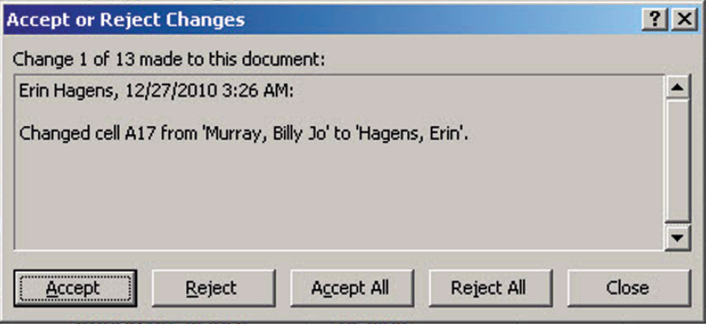
Step-by-Step: Delete Your Changes
Click Track Changes and click Accept/Reject Changes from the drop-down menu that appears. Excel displays a message box confirming that you want to save the workbook; click OK. The Select Changes to Accept or Reject Dialog box opens.
On the Select Changes
to Accept or Reject dialog
box, click the Who
drop-down arrow and
select Erin Hagens, then
click OK. You have just
asked Excel to return only
the tracked changes
made by Erin Hagens. (See the figure above.)

Slide 164
Step-by-Step: Delete Your Changes
A17 is selected on the worksheet and the change you made to A17 is displayed. Click Reject. A17 displays the text you replaced and the cell selector moves to B17.
Reject the changes to B17, C17, and D17. Click Close.
Key the following information, beginning in A20:
Hagens, Erin Cipro Berry, Jo 15-Nov
SAVE the workbook.
LEAVE the workbook open to use in the next exercise.

Slide 165
Accepting Changes from Another User
After a shared workbook has been edited, you can easily identify which cells have been changed and determine whether you want to keep or reject the changes.
You can choose to accept or reject all changes at one time without reviewing each change, or you can accept or reject them individually.
In the following exercise, you will learn how to accept changes from other users.

Slide 166
Step-by-Step: Accept Changes from Another User
USE the workbook from the previous exercise.
Click the File tab and click Options.
In the General category, under Personalize your copy of Microsoft Office, in the User name box, key Jim Giest. Click OK.
Click Track Changes and select Accept/Reject Changes from the drop-down list.
Not yet reviewed will be selected by default. In the Who box, select Luca Delamore. Click OK. The Accept or Reject Changes dialog box is displayed.

Slide 167
Step-by-Step: Accept Changes from Another User
Click Accept as each change is tracked and displayed. The Accept or Reject Changes dialog box closes when you have accepted all changes made by Luca Delamore.
LEAVE Excel open to use in the next exercise.

Slide 168
Rejecting Changes from Another User
As the owner of the Samples workbook, the office manager in the following exercise has the authority to accept or reject changes by all users. Rejecting changes, however, does not prohibit a user from changing the data again.
When all users have made the necessary changes, the owner can remove users and unshare the workbook.
When you have the opportunity to work with a shared workbook that is saved on a network, you will likely encounter conflicts when you attempt to save a change that affects the same cell as another user’s changes.

Slide 169
Rejecting Changes from Another User
In the Resolve Conflicts dialog box, you can read the information about each change and the conflicting changes made by another user.
The options set on the Advanced tab of the Share Workbook dialog box determine how conflicts are resolved.

Slide 170
Step-by-Step: Reject Changes from Another User
USE the workbook from the previous exercise.
Click Track Changes and click Accept/Reject Changes.
Click the Collapse Dialog button on the right side of the Where box.
Select the data in row 16 and click the Expand Dialog button. Click OK to close the Select Changes to Accept or Reject dialog box. The Accept or Reject Changes dialog box is displayed.
Click Reject for each cell containing data in the row. The data is removed and row 16 is now blank.
SAVE the workbook as Samples Edited.
LEAVE the workbook open to use in the next exercise.

Slide 171
Removing Shared Status from a Workbook
Before you stop sharing a workbook, make sure that all other users have completed their work and that you have accepted or rejected all changes.
Any unsaved changes will be lost when you stop sharing and the history worksheet will be deleted. Thus, before you remove the shared status from a workbook, you should print the history worksheet and/or copy it to another workbook.
In the following exercise, you will remove shared status from a workbook.

Slide 172
Step-by-Step: Remove Shared Status from a Workbook
USE the workbook from the previous exercise.
On the Review tab, in the Changes group, click Track Changes, and then click Highlight Changes.
In the When box, All is selected by default. This tells Excel to search through all tracked changes made to the worksheet.
Clear the Who and Where check boxes if they are selected.
Click the List Changes On a New Sheet check box. Click OK. A History sheet is added to the workbook.

Slide 173



Step-by-Step: Remove Shared Status from a Workbook
On the History worksheet, click the Select All button in the corner of the worksheet adjacent to the first column and first row.
Click the Home tab, and then click the Copy button
in the Clipboard group.
Press Ctrl+N to open a new workbook.
In the new workbook, in the Clipboard group on the Home tab, click Paste.
SAVE the new workbook as Medications History. CLOSE the workbook.
In the shared workbook, on the Review tab, click Unprotect Shared Workbook.
Notes:
Take Note: It is a good idea to print the current version of a shared workbook as well as the change history, because cell locations in the copied history may no longer be valid if additional changes are made.

Slide 174
Step-by-Step: Remove Shared Status from a Workbook
Click Share Workbook. The Share Workbook dialog box is displayed. On the Editing tab, make sure that you (Jim Giest) are the only user listed in the Who Has This Workbook Open Now list.
Clear the Allow Changes By More Than One User At The Same Time option. This also allows the workbook merging check box to become active. Click OK to close the dialog box.
A dialog box opens to prompt you about removing the workbook from shared use. Click Yes to turn off the workbook’s shared status. Shared is removed from the title bar.
SAVE and CLOSE the workbook.
LEAVE Excel open to use in the next exercise.

Slide 175
Adding Comments to a Workbook
In Excel, you can add a note to a cell by inserting a comment.
You can also edit the text in comments and delete any comments that you no longer need.
Comments are marked by a red triangle in the upper-right corner of the cell. When you point to this triangle, the comment appears in a box next to the cell, along with the name of the user logged on to the computer at the time the comment was created.

Slide 176
Inserting a Comment
Comments are a useful technique for calling attention to important or significant data and providing insights from the user that explain more about the data.
For example, say that Contoso’s employees are evaluated on three performance measures. The manager uses comments to note incidents related to these measures.
In the following exercise, you will learn how to insert comments.

Slide 177
Step-by-Step: Insert a Comment
LAUNCH Excel if it is not already running.
OPEN the Personnel Evaluations data file for this lesson.
Select cell F11. On the Review tab in the Comments group, click New Comment. The comment text box opens for editing.
Key Frequently to work late. Then, click outside the comment box. See the figure on the next slide.

Slide 178
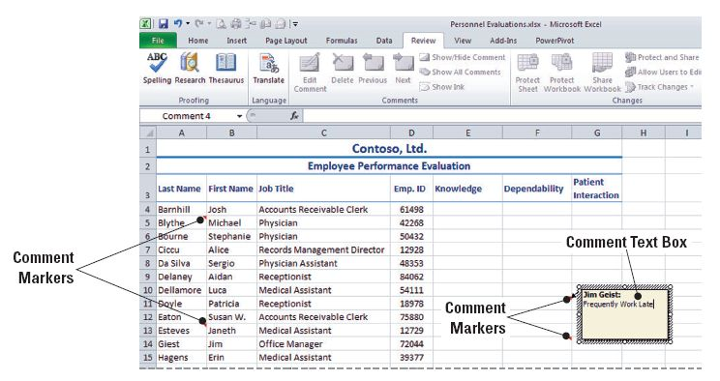
Step-by-Step: Insert a Comment

Slide 179
Step-by-Step: Insert a Comment
Select E8. Click New Comment and key Currently completing Masters degree program for additional certification. Click outside the comment box. The box disappears and a red triangle remains in the upper-right corner of the cell the comment was placed in.
Select F20. Click New Comment and key Adjusted hours for family emergency. Click outside the comment box.
Select G4. Click New Comment and key Consider salary increase. Click outside the comment box.
SAVE the workbook as Performance Evaluations.
LEAVE the workbook open to use in the next exercise.

Slide 180
Viewing a Comment
When you rest your pointer over the red triangle that indicates that a cell has a comment attached to it, the comment is displayed.
You can keep selected comments visible as you work, or you can display all comments using commands in the Comments group on the Review tab.
The Show/Hide Comment and Show All Comments commands allow you to display or hide comments as needed.
The Previous and Next commands allow you to move from one comment to another without selecting the cells.

Slide 181
Step-by-Step: View a Comment
USE the workbook you saved in the previous exercise.
Select E8 and click Show/Hide Comment in the Comments group on the Review tab. Note that the comment remains visible when you click outside the cell.
Select G4 and click Show/Hide Comment. Again, the comment remains visible when you click outside the cell.
Select E8 and click Show/Hide Comment. The comment is hidden.
In the Comments group, click Next twice to navigate to the next available comment. The comment in cell F11 is displayed.

Slide 182
Step-by-Step: View a Comment
In the Comments group, click Show All Comments. Both your comments and those entered by others are displayed.
In the Comments group, click Show All Comments again to hide all comments and make sure they are no longer displayed. SAVE the workbook.
LEAVE the workbook open to use in the next exercise.

Slide 183
Editing a Comment
Comments can be edited and formatted as needed.
You can format a comment using most of the formatting options on the Home tab in the Font group. However, the Fill Color and Font Color options are not available for comment text.
To edit a comment, select the cell containing the comment and click Edit Comment.

Slide 184
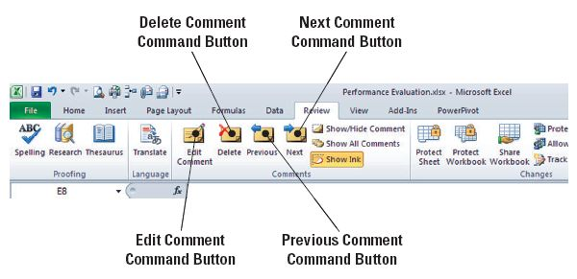
Step-by-Step: Edit a Comment
USE the workbook from the previous exercise.
Select cell F11 and click the Edit Comment button on the Review tab. (See the figure below.)
Following the existing
comment text, key
Placed on probation.
Then click any cell
between F11 and E8.
Click Previous. The
comment in E8 is displayed.
Select the comment text in E8 and key MA completed; can now prescribe medications.

Slide 185
Step-by-Step: Edit a Comment
Select G4 and click Edit Comment.
Select the text in the comment attached to G4. On the Home tab, click Bold.
Select F14, click the Review tab, and click Edit Comment.
Select the name and the comment text. Right-click and select Format Comment.
In the Format Comment dialog box, click the arrow in the Color box and click Red. Click OK to apply the format and close the dialog box.
SAVE the workbook.
LEAVE the workbook open to use in the next exercise.

Slide 186
Deleting a Comment
Of course, you can delete comments from a workbook when they are no longer needed.
Unless the workbook is protected, any user can delete comments—so you should consider protecting a workbook that contains sensitive or confidential information.
In the following exercise, you will learn to delete a comment.

Slide 187
Step-by-Step: Delete a Comment
USE the workbook from the previous exercise.
Select F20. The comment for this cell is displayed.
On the Review tab, click Delete in the Comments group.
SAVE the workbook with the same name.
LEAVE the workbook open to use in the next exercise.
Notes:
Another Way: To delete a comment, you can click Show/Hide on the Review tab to display the comment and then double-click the comment text box and press Delete. You can also right-click on the comment and choose Delete from the drop-down menu that appears.

Slide 188
Printing Comments in a Workbook
Anyone with access to a workbook can view the comments made by all users.
As you learned in a previous exercise, comments can be removed from a workbook before the workbook is shared or copies are distributed.
Comments can also be printed as they appear in the worksheet or on a separate page following the workbook.
When you print comments as they appear on the worksheet, the data in some cells may be covered.
To print comments on a separate page, select At end of sheets in the Comments box on the Sheet tab of the Page Setup dialog box.

Slide 189
Step-by-Step: Print Comments in a Workbook
USE the workbook from the previous exercise.
On the Review tab, click Show All Comments. Notice that the comment in E8 slightly overlaps the comment in F11, and the comment in F11 slightly overlaps the comment in F14.
Click the border of the comment box in E8. Select the center sizing handle at the bottom of the box and drag upward until the comment in F11 is completely visible. Repeat this process with the F11 comment. (See the figure on the next slide.)

Slide 190
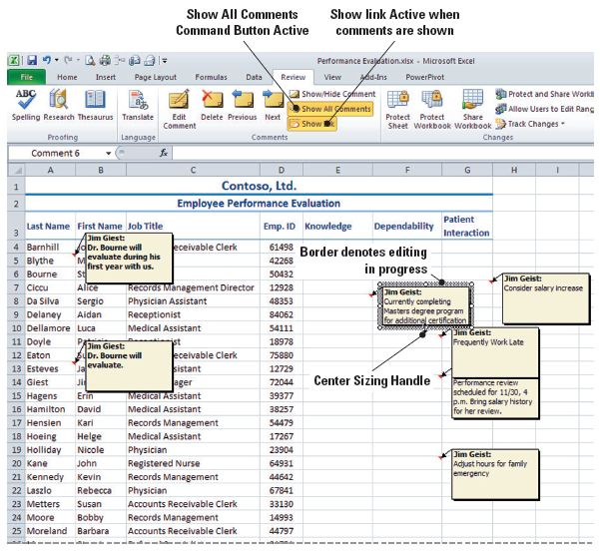
Step-by-Step: Print Comments in a Workbook

Slide 191
Step-by-Step: Print Comments in a Workbook
On the Page Layout tab in the Page Setup group, click Orientation. Confirm that Landscape is the orientation.
In the Page Setup group, click the Page Setup dialog box launcher.
On the Sheet tab in the Comments box, by default As displayed on sheet is selected. Click Print Preview. The Print Options window in Backstage opens. In the Print Options screen, click the Next arrow at the bottom of the window to view Page 2, and notice that it contains one line.
In the Print Settings, for Scaling, choose Fit Sheet on One Page.

Slide 192
Step-by-Step: Print Comments in a Workbook
Click Print.
SAVE and CLOSE the workbook.
CLOSE Excel.

