Slide 1
Configure Network Access
Lesson A: Network Connection Types

Slide 2
Computer Networks
A computer network is a group of computers that are connected together to communicate and share network resources such as files, applications, and devices.
No two computer networks are alike in size or in configuration.
Each network, however, includes common components that provide the resources and communications channels necessary for the network to operate.

Slide 3
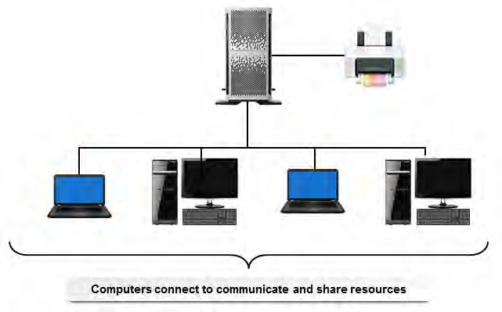
Example Network

Slide 4
Network Components
Devices
  Hardware such as computers, servers, printers, fax machines, switches, and routers.
Physical Media
  Media that connects devices to a network and transmits data between the devices.
Network Adapter
  Hardware that translates data between the network and a device.
Network Operating System
  Software that controls network traffic and access to common network resources.

Slide 5
Network Types
A local area network (LAN) is a group of computers and associated devices that share the resources of a single processor or server within a small geographic area.
  A LAN may serve as few as two or three users or as many as thousands of users.
  A network set up between the computers in a home would be an example of a LAN.
A wide area network (WAN) is a network of computers that are spread across a large geographic area.
  An example of a WAN would be a company that has offices in several different cities or nations; the company's computers would be connected by a WAN.

Slide 6
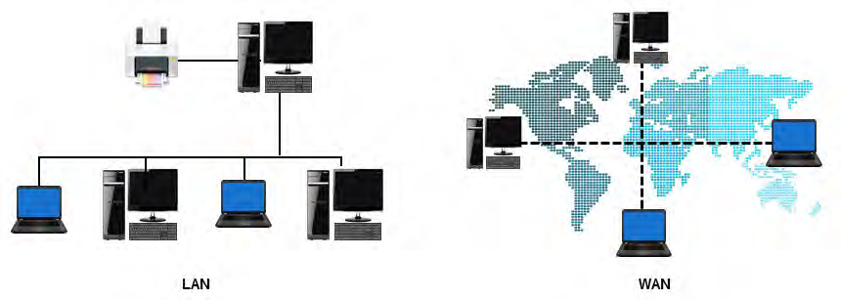
LAN vs WAN

Slide 7
Network Connection Methods
Connecting various devices to a network can be done in a number of ways.
How devices will communicate with one another is determined by the connection method:
  Wireless
  Wired
  Cellular
Each method has its own advantages and disadvantages when it comes to certain important characteristics in networking.
These characteristics describe a connection from several different perspectives.

Slide 8
Network Characteristics
Mobility
  The ability to transport a device from one physical location to another without interrupting the connection
Availability
  A connection that stays up and operational as long as possible without interruption, as well as the ability for that connection to recover quickly should it go down.
Throughput
  Throughput is the actual amount of data that is transmitted over a medium in a given time.
Bandwidth
  Bandwidth is the maximum amount of data that is possible to transmit over a medium in a given time.
  Note: You can think of bandwidth as theoretical, whereas throughput is a more practical description. There are many factors that could prevent a connection from reaching its maximum speeds.

Slide 9
Network Characteristics (cont.)
Reliability
  A connection that transmits data without causing connection delays or corrupting the data.
Concurrent Connections
  How many users or devices can be connected to the same network at one time.
Security
  How safe the network is from attack

Slide 10
Wired Network Connections
Wired computer networks use a technology called Ethernet.
Ethernet is a set of networking technologies and media access methods specified for LANs.
It allows computers to communicate over small distances using a wired medium.
Networks both large and small use Ethernet to provide both backbone and end-user services.

Slide 11
Wireless Network Connections
A wireless computer network is a network in which computers use wireless connections to link with other computers.
Wireless connections transmit data by using radio frequency waves.
Wireless networks can connect a few devices over short distances, such as within a home or an office, or can be set up to connect computers over large distances through the Internet.
Wireless networks offer affordability, ease of use, and greater mobility for the user.
The most common wireless computer networking protocol is Wi-Fi, which is a LAN technology used by many different kinds of devices.

Slide 12
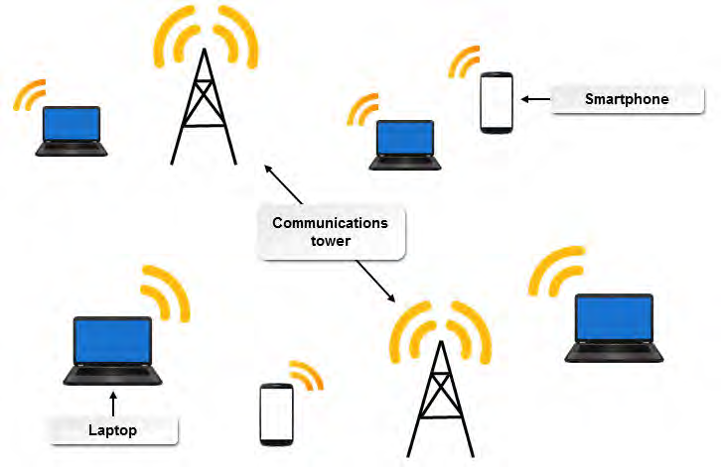
In a wireless network, each computer has a wireless adapter device attached, which converts digital data into radio waves and also receives radio waves and converts them into digital data.
To connect to other wireless or wired networks, wireless devices called wireless access points (WAPs) or wireless routers are required.

Slide 13
Cellular Network Connections
A cellular network, otherwise known as a mobile network, is a radio network.
This network consists of different areas called cells, each of which has a transceiver, known as a base station (BS) or a cell site, and all of these cells put together allow for communication over a very large geographic area.
Each cell operates on a slightly different frequency so there will be no interference between cells.
The result is that mobile devices can communicate with any other mobile device on the network via the BSs in each cell.

Slide 14
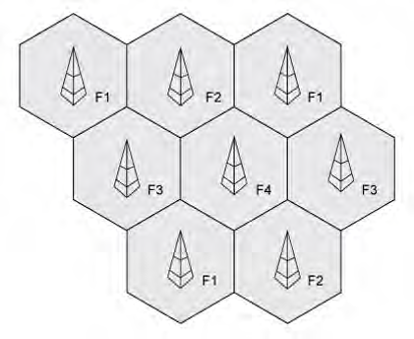

Slide 15
Mobility
Network | Mobility Level | Explanation
Wired | Little to none | By definition, a wired network requires computers and other devices to be physically attached to the network. Network devices are mobile only within the reach of the cables.
Wireless | Medium | With the use of a wireless router, network devices can travel outside of the reach of a cable but must stay within reach of the router signal. Some router signal strength requires the devices to be within the same building (such as a home router), whereas other routers are strong enough to broadcast across a university campus.
Cellular | High | The mobility of devices on a cellular network are limited only by their proximity to a cellular tower, as long as the device can receive a signal from the base station.

Slide 16
Availability
Network | Availability Level | Explanation
Wired | Medium to high | A wired network's availability depends upon the health of its network devices and its cabling infrastructure.
Wireless | Medium to high | A wireless network's availability depends upon the health of its network devices.
Cellular | High | Large telecommunications companies have many backups in place to ensure that their networks are always up and running.
There are two primary ways to ensure high availability: resilience and redundancy.
Resilience is the key to maintaining the availability of the network. Resilience simply means the ability of the network to survive disaster or avoid it in the first place.
Redundancy provides an alternate way in which to keep the network operating. Think of redundancy as having a backup system in place.

Slide 17
Bandwidth and Throughput
Network | Bandwidth/ Throughput Level | Explanation
Wired | High | Ethernet technology provides bandwidth up to 100 Gb/s, but is more commonly provided at 10 Gb/s and 1 Gb/s for enterprise LANs.
Wireless | Medium | Wi-Fi technology provides bandwidth up to 7 Gb/s, but is more commonly provided at 1.3 Gb/s and 600 Mb/s for enterprises LANs.
Cellular | Low | 4G networks typically deliver bandwidth up to 100 Mb/s.

Slide 18
Reliability
Network | Reliability Level | Explanation
Wired | High | Wired connections do not suffer from the interference issues that wireless connections do. As long as the physical cable is healthy, the connection should stay highly reliable.
Wireless | Medium | Wireless connections are susceptible to interference from other devices and phenomena that operate in the electromagnetic spectrum, which can interrupt connectivity and cause corruption of data in transit.
Cellular | Low | Cellular networks are also susceptible to interference. Additionally, despite their wide coverage, cellular networks often see a degradation in performance or a complete lack of connection in certain locations.

Slide 19
Concurrent Connections
Network | Concurrent Connection Level | Explanation
Wired | Medium | The high bandwidth of Ethernet connections means that more people can connect at once without losing significant performance. However, the number of people connected simultaneously is physically limited by the cabling infrastructure of the network.
Wireless | Medium | The lower bandwidth and small coverage of wireless networks means that few users and devices can connect to a single access point. For example, a 600 Mb/s Wi-Fi signal shared among 100 people would reduce each person's bandwidth to 6 Mb/s. Some wireless routers have a built-in limit to the amount of connections they can handle.
Cellular | High | Although they offer low bandwidth, cellular networks are intended to support millions of connections at once.

Slide 20
Security Levels
Network | Security Level | Explanation
Wired | High | Because a wired LAN isolated from other networks requires physical access, it is much more secure from a remote breach into the network. Without this physical connection, an attacker will be unable to intercept communications.
Wireless | Medium | Attackers can intercept wireless communications without needing to be physically plugged in. The attacker just needs to be within range of the wireless network in order to monitor its transmissions. To protect against this, most modern Wi-Fi transmissions are encrypted. However, some older or poorly implemented technology may use weak encryption or none at all.
Cellular | Low | Like wireless networks, cellular transmissions are susceptible to attackers monitoring and intercepting data remotely. This is compounded by the large coverage of cellular networks and their high mobility. Many carriers implement some form of encryption, but this encryption may not be suitably strong.

Slide 21
Network Connections Method Comparisons
Characteristic | Wired | Wireless | Cellular
Mobility | Little to none | Medium | High
Availability | Medium to high | Medium to high | High
Bandwidth / Throughput | High | Medium | Low
Reliability | High | Medium | Low
Concurrent Connections | Medium | Medium | High
Security | High | Medium | Low

