Slide 1
Identifying Computer
Hardware
Topic B: Identify Internal Computer Components

Slide 2
Lesson Objectives
In this lesson, you will identify computer hardware. You will:
Identify internal computer components.
Compare common computer connector types.
Identify common peripheral devices.

Slide 3
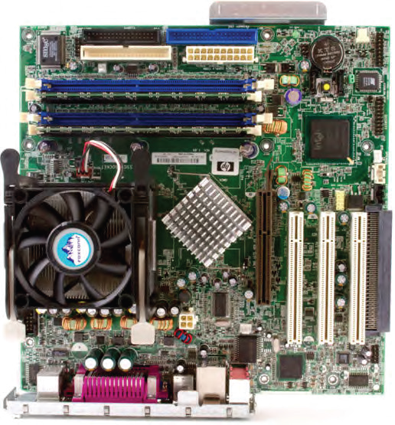
Motherboards
The motherboard is the personal computer component that acts as the backbone for the entire computer system.
Sometimes called the system board or mainboard
Consists of a large, flat circuit board with chips and other electrical components on it using various connectors.
Some components are soldered directly to the board, and some components connect to the board by using slots or sockets.

Slide 4
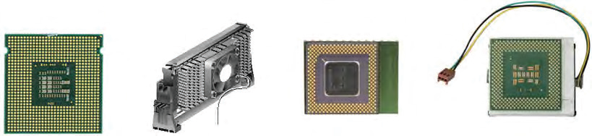
CPUs
The central processing unit (CPU) is a computer chip where most of the computing calculations take place. On most computers, the CPU is housed in a single microprocessor module that is installed on the system board in a slot or a socket.
Most current processors are built with two or more individual CPUs mounted in a single chip, working in parallel. Multiple individual processors can share the workload more efficiently than a single processor. Dual-core and quad-core processors are engineered to include two to four cores on a single chip, while hexa- and octa-core processors include six and eight cores, respectively.
Before multicore processors were available, some hardware manufacturers provided additional processing power by using motherboards with sockets for additional CPUs. These are rarely used in personal computers anymore, but you will find them in server class computers.

Slide 5
Power Supplies
A power supply is an internal computer component that converts line voltage AC power from an electrical outlet to the low-voltage direct current (DC) power needed by system components.
The power supply is a metal box in the rear of the system unit that is attached to the computer chassis and to the system board.
Although the power supply is not itself a component of the system board, it is required in order for system components to receive power. The power supply contains the power cord plug and a fan for cooling because it generates a great deal of heat.
Some power supplies have a voltage selector switch that enables you to set them to the voltage configurations used in different countries.
AC adapters are generally built into the power supply for desktop systems and are external for laptops and other mobile systems power supplies.
Note: Another commonly used term for the power supply is the power supply unit (PSU).

Slide 6
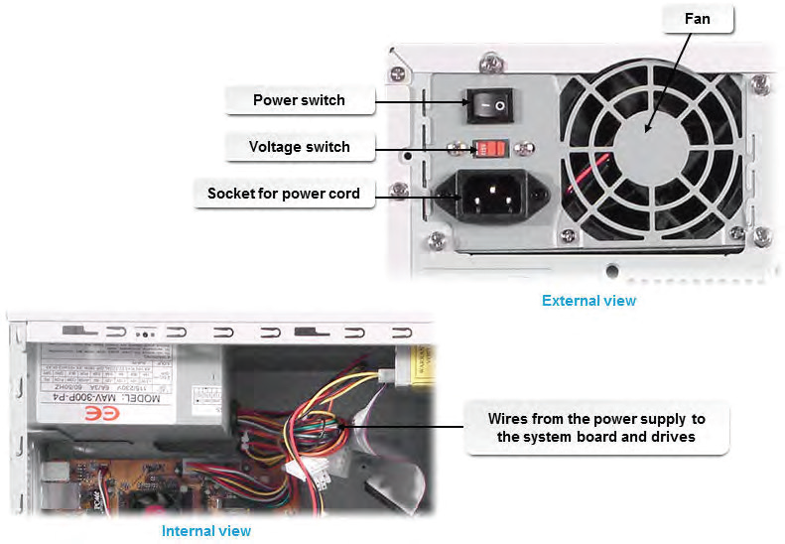
Power Supply Diagram

Slide 7
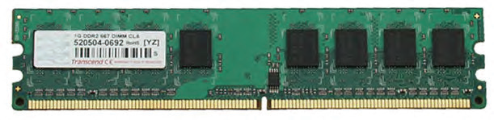
RAM
Memory is the component that provides the workspace for a processor.
Random access memory (RAM) is volatile memory.
Requires a constant source of electricity to keep track of the data stored in it. When the power is no longer available, the data stored in RAM is lost.
The computer can both read the data stored in RAM and write different data into the same RAM.
Any byte of data can be accessed without disturbing other data, so the computer has random access to the data in RAM.

Slide 8
RAM Storage
RAM is measured in small groups of data called bytes. A byte is the fundamental unit of measure for computer data. One typed character is about one byte. Each byte consists of eight bits, which are individual ones and zeros. Due to each byte being very tiny, other terms are often used to measure larger amounts of memory.
Memory Unit | Description
Byte | One character (letter, number, space, punctuation mark) 8 bits
Kilobyte (KB) | 1,024 bytes
Megabyte (MB, Meg, M) | 1,048,576 bytes or 1,024 KB
Gigabyte (GB) | 1,073,741,824 bytes or 1,024 MB
Terabyte (TB) | 1,099,511,627,776 bytes or 1,024 GB

Slide 9
DIMM Vs. SODIMM
Dual in-line memory modules (DIMMs) are found in many systems, and they have a 64-bit data path. DIMMs generally have 16 or 32 chips per module.
Small outline dual in-line memory modules (SODIMMs) are half the size of DIMMs and therefore cannot fit into a DIMM slot. SODIMMs are most often seen in laptops, small networking devices (such as routers), and PCs with smaller system boards. They have either 32- or 64-bit data paths.

Slide 10
Storage
Information and data in RAM is stored only as long as power is applied to the memory. If you turn off the device, then the information in RAM is lost.
If you want to keep the information and data you have been working with, you need to save it to some type of storage device. The information previously saved to a storage device can be retrieved (or read) into computer memory.

Slide 11
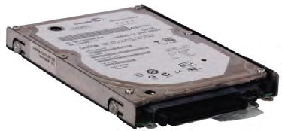
Hard Drive
Hard disk drives (HDDs) are common storage devices. They are generally non-removable disks.
Almost all computers use hard disk drives to store data. Hard disks store data digitally on circular platters. A platter’s surface is highly polished and is magnetically charged. Digital data is stored on these platters in small magnetic domains. A computer’s storage capacity can be expanded by adding additional hard disks.
Today, the storage capacity of hard disk drives is expressed in gigabytes (GBs) and terabytes (TBs).
The speed at which the disk in a hard drive rotates is measured in rotations per minute (RPM).

Slide 12
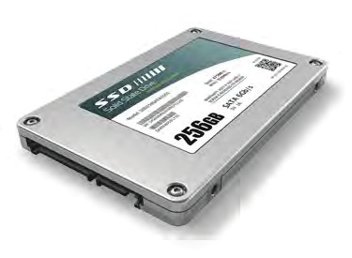
Solid State Drive
Solid state storage is a personal computer storage device that stores data in special types of memory instead of on disks or tape.
Common types of solid state storage include the USB devices that are commonly known as jump drives or thumb drives; flash memory cards; and secure digital (SD) memory cards.
Solid state storage uses non-volatile memory to emulate mechanical storage devices, but solid state storage is much faster and more reliable than mechanical storage because there are no moving parts.

Slide 13
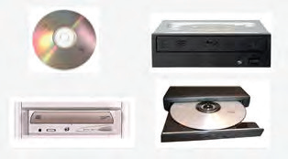
Optical Drive
Optical disks are personal computer storage devices, such as CDs, DVDs, or Blu-ray™ discs, that store data optically rather than magnetically.
The removable plastic discs have a reflective coating and require an optical drive to be read.
In optical storage, data is written by either pressing or burning with a laser to create pits (recessed areas) or lands (raised areas) in the reflective surface of the disc.
A laser in the optical drive then reads the data off the disc.
Optical drives can be internal or external, and they generally have a 5.25-inch form factor.

Slide 14
Optical Disc Type | Full Name | Data Type
CD-ROM | Compact Disc Read-Only memory | Data is permanently burned onto the disc during its manufacture
CD-R | CD-Recordable | Data can be written to the disc only once
CD-RW | CD-Rewritable | Data can be written to the disc multiple times
DVD-ROM | Digital Versatile Disc Read-Only Memory | Data is permanently burned onto the disc during its manufacture
DVD-R / DVD+R | DVD-Recordable | Data can be written to the disc only once
DVD+R DL | DVD Recordable Double Layer | A higher-capacity double-layer format to which data can be written only once.

Slide 15
Optical Disc Type | Full Name | Data Type
DVD-RW | DVD-Rewritable | Data can be written to the disc multiple times
DVD-RAM | DVD-Random Access Memory | Data can be written to the disc multiple times

Slide 16
Blu-Ray Discs
BD-ROM
Blu-ray discs are intended for high-density storage of high-definition video as well as data storage.
They use blue laser light to read and store data. The blue laser has a shorter wavelength than other CD and DVD laser technologies, which enables the system to store more data in the same amount of physical space. Current Blu-ray discs hold 50 GB total. However, companies such as Sony are testing experimental discs that have storage capacities of up to 200 GB.

Slide 17
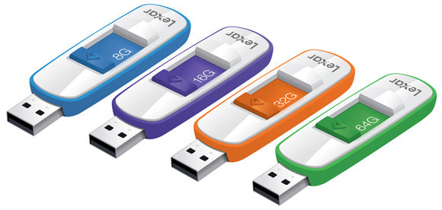
USB Drives
USB drive refers to small solid-state devices such as thumb drives.
Other drives can also be connected to the computer by using a USB connection.
Some tape drives, which use magnetic tape that can be accessed and written to sequentially only (rather than jumping directly to the storage location for the desired data) can be connected via a USB connection.
Hard drives enclosed in a case or placed in a hard drive dock can also be connected via USB connections.

Slide 18
Multi-Card Readers and Writers
A wide variety of solid state memory cards are used in various devices such as phones and cameras. The device can usually be connected via a cable or wirelessly to the computer.
Some computers also contain one or more slots in which you can insert the memory card after it has been removed from the phone or camera.
Some of these multi-card readers allow you to insert SD, microSD, CompactFlash, or MS/MS Duo (Sony’s Memory Stick) memory card. The reader/writer might be internal or connected via a USB port on the computer.

Slide 19
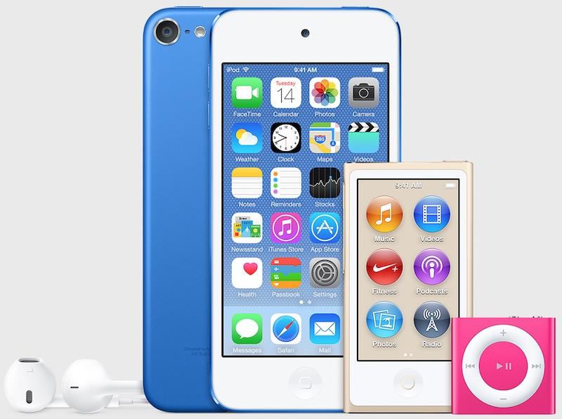
Mobile Media Devices
Mobile media devices such as music players use memory cards or solid state memory to store data. These features are also incorporated into eReaders and smartphones.

Slide 20
Expansion Cards
An expansion card is a printed circuit board that you install into a slot on the computer’s system board to expand the functionality of the computer.
Each card has a connector that fits into a slot on a system board and circuitry to connect a specific device to the computer.
Some expansion cards connect to the system bus instead of a peripheral bus, use different slot types, or are built into the system circuitry instead of being separate physical boards.
Includes Video Cards, Audio Cards, Network Cards, and Modems
Note: An expansion card is also known as an adapter card, I/O card, add-in, add-on, or simply a board.

Slide 21
Video Card
If your motherboard doesn’t have a built-in video port, or if you want to use a better video adapter than what is on your motherboard, you can use a video card.
Video cards typically have their own bank of memory to improve the rate at which the images on screen can be updated.
Video cards can have a variety of connectors on them for connecting video display devices. Some of the video adapters include VGA, DVI, and HDMI.
Most video cards also include their own cooling fan.

Slide 22
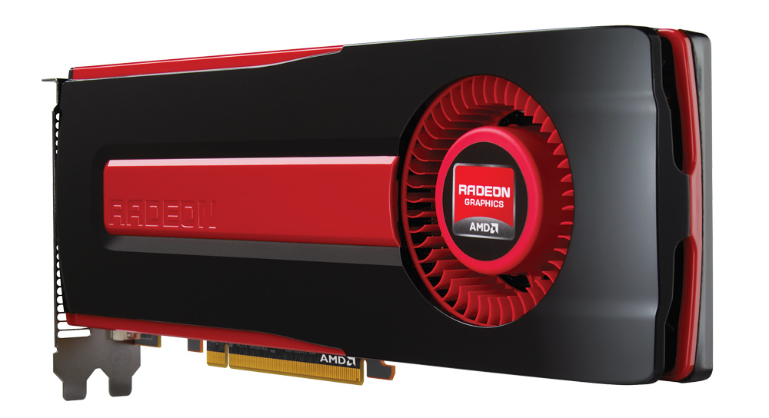
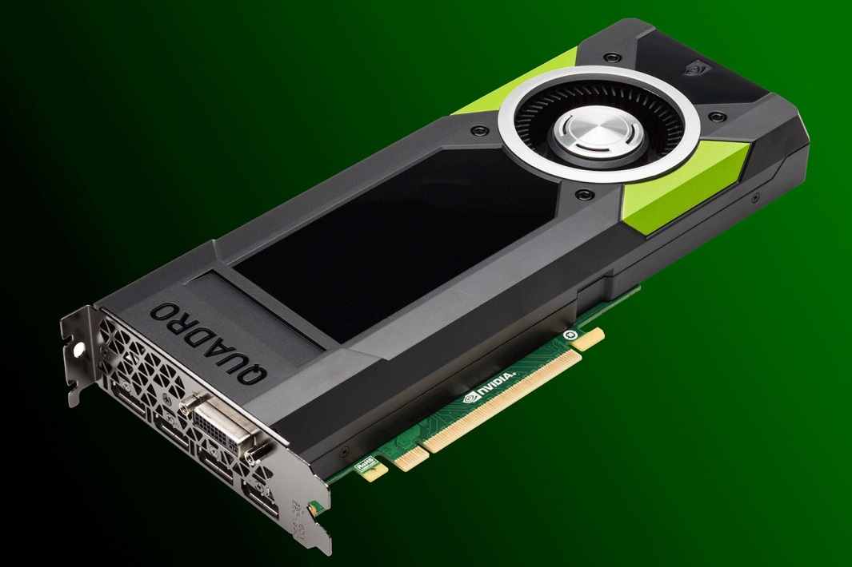
Video Card

Slide 23
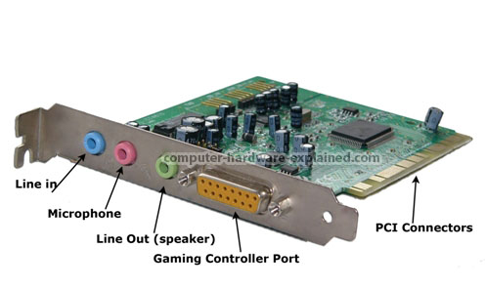
Audio Card
Audio connections might be built into your motherboard, or they might be placed on an expansion card.
An audio card typically includes ports to connect speakers, a microphone, and headphones.

Slide 24
Network Card
A network adapter allows your computer to connect to other computers over a wired or wireless connection.
The functionality might be contained on your motherboard or it might be on a separate network card.
The Ethernet cable connects to a port on the network card, allowing you to access servers, other computers, and the Internet.
A wireless network card may or may not have an external antenna.

Slide 25
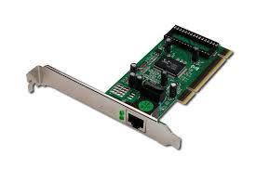
Network Card

Slide 26
Modem
A modem allows your computer to connect to other computers and the Internet by using an analog phone line.
This feature used to be the only way a home user could connect to online services.
With the advent of cable networks and DSL, the slower rates of phone lines fell out of favor. Modems are still included in some computers, but not all. If you find you need this feature, you might need to install a modem card in your system.
Note: Not to be confused with external modem

Slide 27
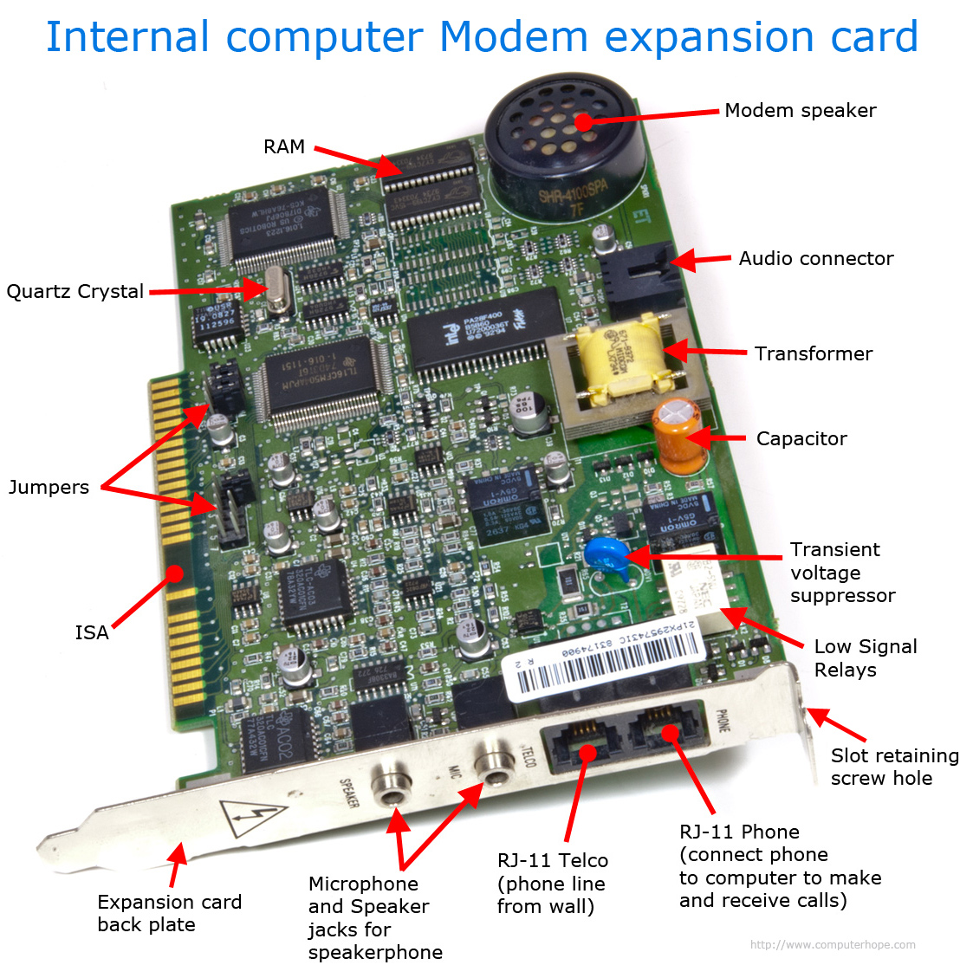
Modem

Slide 28
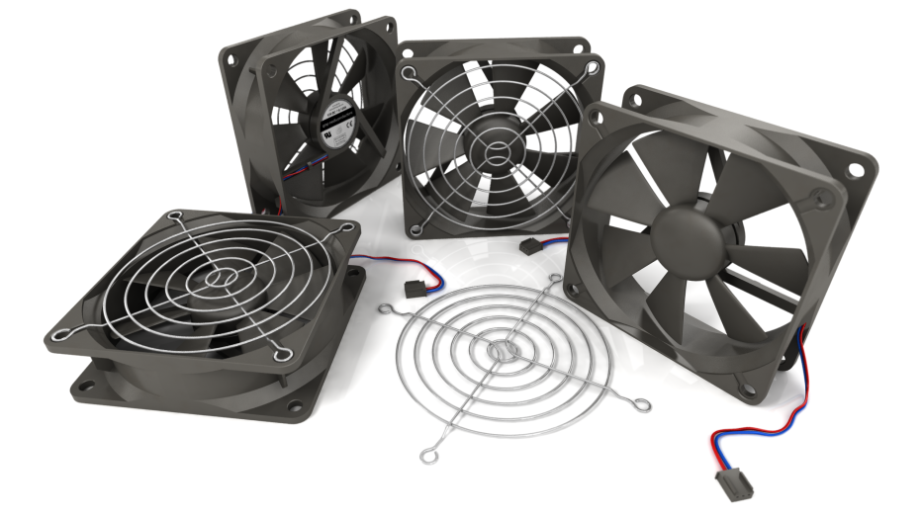
Cooling Systems: Fans
Computers get very hot when they are running. For this reason, there are a number of cooling strategies employed within a computing device.
Fans are located on: the power supply, the video card, and the CPU. In addition, you might have one or more fans built into the computer case.
Be sure not to block air flow for these fans. If the computer cannot be properly cooled, it will overheat, causing damage to chips, components, and the motherboard.

Slide 29
Cooling Systems: Liquid Cooling
Some systems have a liquid cooling system inside the case. These cooling systems use tubes filled with a coolant, connected to a radiator, and a pump to circulate the liquid coolant through the inside of your computer case.
Fans move the air as well. The thermal conductivity of the liquid is higher than that of air, so the heat can be moved away from components more quickly than just relying on fans to move the air, and thus the heat, away from components.
The components to be cooled are connected to the tube with water blocks (a flat copper or aluminum piece) with thermal paste to help transfer the heat between the water block and the component

Slide 30
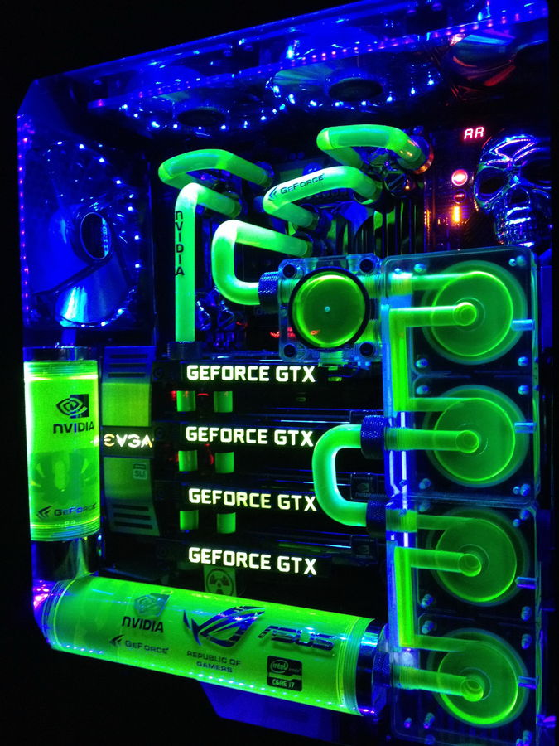
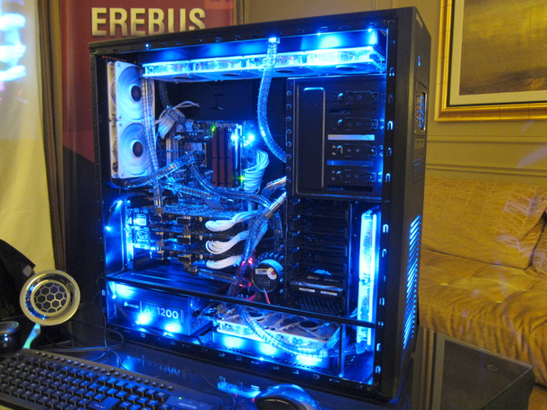
Liquid Cooling

Slide 31
Cooling Systems: Heat Sinks
Heat sinks are metal, usually formed into ridges, and installed on components.
The heat sink transfers the heated air from the component to the fan (or liquid cooling system), which then moves the heated air out of the computer case, keeping the inside of the case and the components cooler.

Slide 32
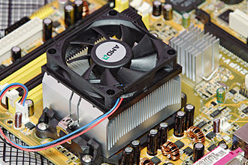
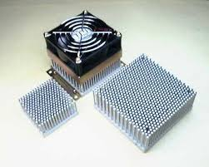
Heat Sinks

Slide 33
Identify the Components
Motherboard and CPU
Power Supply
Memory
Storage Devices
Locate and identify each expansion card
Locate and identify each of the cooling strategies employed

Slide 34
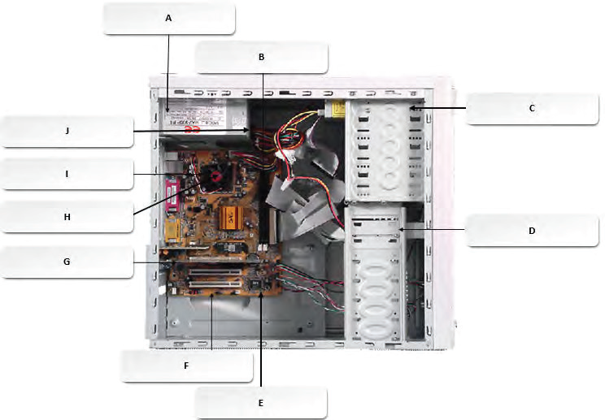

Slide 35
Answers
Motherboard and CPU
  Motherboard: E
  CPU: I
Power Supply: A
Memory: B
Storage Devices
  Hard Drive: C
  CD-ROM: D
Locate and identify each expansion card
  Expansion card is G; it is a network interface card
Locate and identify each of the cooling strategies employed
  CPU fan is H
  Power supply fan is J

