Slide 1
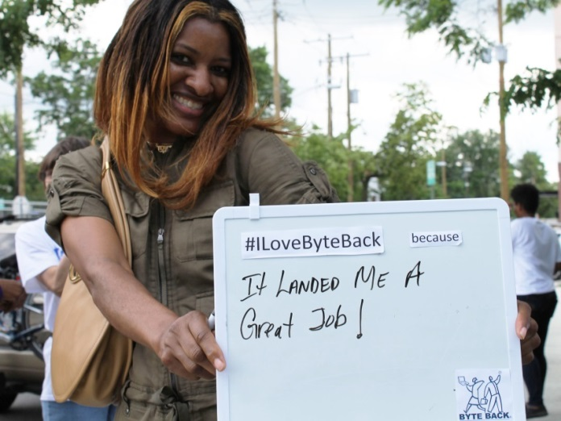
HDI Desktop Support Technician Training
Quiz 1 & 2 Review

Slide 2
In the evolution of the support center, which would you most likely see in the first phase?
E-mail
Paper and pen
DOS-Based Systems
Web-Based Systems
Competency 2.3.3:
Past | Present | Future
Paper Based Systems Reactive Environment Little Technology at user location | Service Management Systems replace paper-based Improved Hardware Expanded amount of technology supported | Technology Based Systems Proactive Environment Increased technology, including self-healing Continued growth in amount of technology supported

Slide 3
Which of the following is a benefit of teamwork?
Showing up on time
Being responsive to feedback
Increased motivation
Helping and defending one another
Competency 3.1.4: The benefits of teamwork include-
Enhanced communication
Synergy
Increased motivation and job satisfaction
Flexibility and adaptability
Team with collective knowledge, collaboration, and resourcefulness
More committed team members
NOTE: Notice how all benefits are nouns, while the other choices are verbs. The other choices better relate to actions to take to good team member.

Slide 4
The main objective of teamwork is:
Getting contribution from every member
Making sure everyone shares the work
Complete each and every task asked, no matter what
Being popular
Referenced in the online course (Support Center Overview, Unit 1_3 @ 2:13), the objectives of teamwork include:
Gain participation and contribution of all team members
Share ideas
Assist other team members
Not take advantage of others on the team

Slide 5
What is NOT a technique to best manage your work life?
Approaching your manager with solutions, not problems
Acknowledging those around you for dedication
Trusting your manager
Taking on as many projects as possible
Competency 1.1.3: To manage your work life-
Always approach your manger with solutions, not problems.
Be on time or early.
Trust your manager.
Take good physical care of yourself.
Acknowledge those around you.
Identify ways to assist your manager with new projects to build trust.

Slide 6
The number one goal of desktop support is:
User satisfaction
Customer Satisfaction
Networking as much as possible
Completing every request asked of you
NOTE: While not referenced in a specific competency, customer satisfaction is a main theme of being a DST. You are the user, and your goal is to satisfy the person you’re helping (the customer). You do not need to complete every request asked, only those that are offered through the SLA.

Slide 7
A documented agreement between a customer and service provider that sets expectations would best be described as a(n):
Service Level Agreement (SLA)
Operational Level Agreement (OLA)
Underpinning Contract (UC)
Mission Statement
Competency 5.5.7: An operational level agreement documents the agreements between the IT service provider and other parts of the organization which support the delivery of services to the business.
NOTE:
SLA= Between Support Center and Customer
OLA= Between Support Center and Internal Departments to support SLA
UC- Between Support Center and 3rd parties to support SLA

Slide 8
Which two metrics should a support center use to help determine the priority level of an issue? (There are 2 correct answers)
Business processes impacted
Acceptable delay to use or business process in resolving incident
Speed of last resolution for a similar issue
Knowledge of issue at hand
Competency 5.5.8: Priority levels are normally based on
Impact | Urgency
Extent of deviation from normal service level in terms of: # Users affected Business process impacted Stipulations in SLA Business or revenue | Acceptable delay to user or business process in resolving incident

Slide 9
Standard Operating Procedures are most directly governed by:
Strategy Statements
Service Level Agreements
Best Practices
Information Technology In Infrastructure Library (ITIL)
NOTE: Referenced in the online class (Strategic Framework, Unit 2_2 @ 0:17). Review the following pyramid:
Strategy Statements
Service Level Agreement (SLA)
Standard Operating Procedures (SOP)

Slide 10
What topic is always covered in a service level agreement?
Escalation procedures
Professional Development
Certification Requirements
Procedures for hiring new helpdesk staff
Competency 5.5.6: The basic components of an SLA include:
NOTE: A good way to think of this is an SLA covers what BOTH the employee and customer need to know. Only escalation procedures should be relevant to both customer and employee, everything else only relates to the employee.
Service description and scope Stakeholder information Contact information Hours of service/applicability Availability and capacity targets Priority matrix Signature and review dates | Response and restore targets Identification of change windows Metrics and review information Escalation paths and procedures Penalties and or chargeback information Costs of service

Slide 11
The future of desktop support services will likely include:
Self-healing technologies
Paper-based systems
Reactive solutions
Little technology at user location
Competency 2.3.3:
Past | Present | Future
Paper Based Systems Reactive Environment Little Technology at user location | Service Management Systems replace paper-based Improved Hardware Expanded amount of technology supported | Technology Based Systems Proactive Environment Increased technology, including self-healing Continued growth in amount of technology supported

Slide 12
Which of the following is NOT a way to establish relationships with coworkers?
Being empathetic
Establishing rapport
Displaying confidence
Treating others as they treat you
Competency 5.18.1: To establish & maintain effective relationships with others-
Manage expectations
Build rapport
Be empathetic.
Provide consistent service
Understand your systems and technology
Publicize support center accomplishments
Meet customer psychological needs first, then business needs
Take ownership
Display confident attitude
NOTE: Think through the scenarios of the answer. Treating othersas they treat you sounds nice in theory, but if they treat you poorly, it would not be a good idea to throw that back at them.

Slide 13
Which of the following would not be referenced in an Operational Level Agreement (OLA)?
Response Time Commitments
Resolution Time Commitments
Escalation Procedures
Average Speed of Answer metrics
Note: Though not referenced in a specific frequency, it’s important to note, metrics are mainly included in SLA agreements with the customer, as it’s already assumed the support center will have access to response metrics.

Slide 14
Which best describes the role of a support center?
Act as a single point of contact for the customer.
Provide the lowest cost solutions for the customer.
Direct customers o self-service solutions.
Implement new IT policies.
Note: As described in Unit 1, the Support Center needs to fulfill a variety of roles, therefore acting as the Single Point of Contact for all IT issues, as opposed to you having to call multiple agencies to address similar issues.

Slide 15
Which best describes your role as a desktop support technician?
Provide consistent support to business through following procedures
Do whatever the customer asks of you effectively and quickly
Resolve all issues logged by the support center
Escalate high priority issues to management
Competency 1.6.2: The primary responsibilities of the desktop support technician include:
Following desktop support policies and procedures
Representing desktop support in a professional manner
Understanding mission and goals of the support organization
Communicating issues/concerns to support center management
  While this is a potential answer, your main, overarching role is to follow company policies and procedures

