Slide 1
Using Backstage
Lesson 2

Slide 2
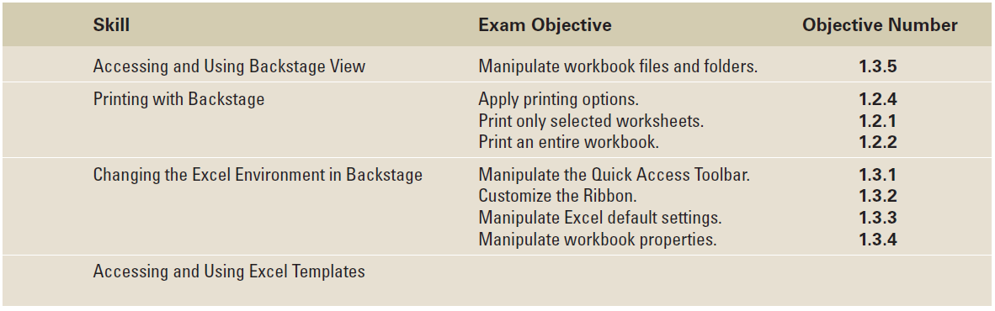
Objectives

Slide 3
Software Orientation: Backstage View
Backstage view’s left-side navigation pane (see figure on the next slide) gives you access to workbook and file-related commands, including Save, Save As, Open, and Close.
The navigation pane also holds a series of tabs—Recent, Info, New, Print, Save & Send, Help, and Options—that you can click to access groups of related functions and commands.
The Exit button on the navigation pane closes Excel.

Slide 4
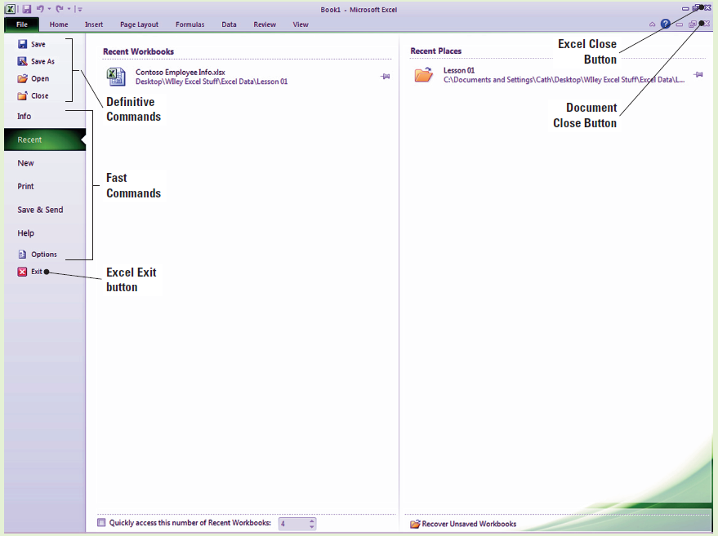
Software Orientation: Backstage View

Slide 5
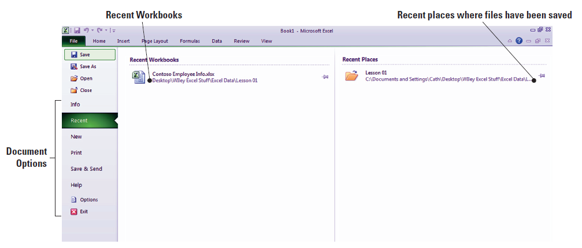
Step-by-Step: Access Backstage View
LAUNCH Microsoft Excel 2010. A new blank workbook should appear. Within the workbook, follow these steps:
Click the File tab in the upper-left corner of the Ribbon.
You have now accessed Backstage view (see below).
Familiarize yourself with this view and the tools in the navigation pane.
Notes:
Another Way: If you use Print Preview quite often, you can save yourself time and steps by adding it to the Quick Access Toolbar in order to create a shortcut to Backstage view. This process will be explained in greater depth later in this lesson.

Slide 6
Step-by-Step: Save a Document in Backstage
LAUNCH Microsoft Excel 2010; a new blank workbook opens. Then follow these steps:
In the new workbook, cell A1 should be the active cell. Key Recipe in this cell, and notice that the text appears in both the cell and the Formula Bar as you type.
Press Tab; the text is entered into cell A1, and B1 becomes the active cell.
Now key Recipe Description and press Tab. The text is entered into B1, and C1 becomes the active cell. Note that the text from B1 is flowing over into cell C1.
Notes:
Another Way: You can also click Ctrl + N to open a new workbook and activate the Backstage area.

Slide 7
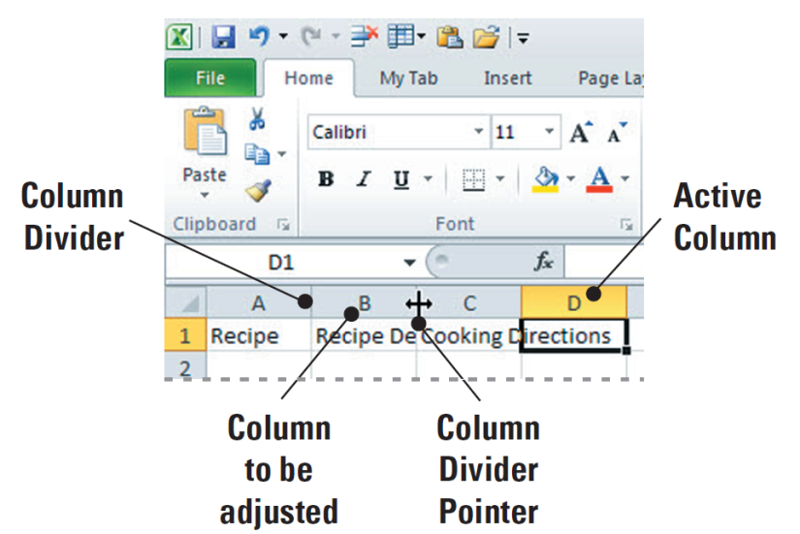
Step-by-Step: Save a Document in Backstage
Key Cooking Directions into C1 and press Tab.
Note that the text in cell B1 has now been hidden behind cell C1, and the contents of cell C1 are seen flowing into cell D1. In order to view the data in the column, you must double-click the column divider. Place your cursor on the divider between column B and C and double click.
Note that the column resizes
to accommodate the data.
Refer to the figure shown here.
Key Main Ingredients into
cell D1, then press Tab.

Slide 8
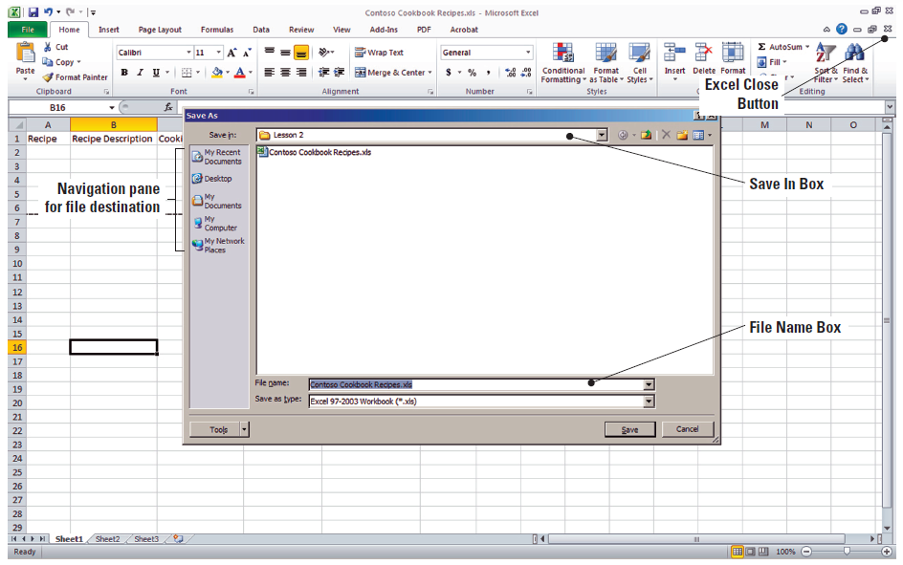
Step-by-Step: Save a Document in Backstage
Key Alternate Ingredients into cell E1 and press Tab.
Key Serving Size into F1 and press Tab.
Repeat the process explained in Step 4 to adjust all columns to fit
the data.
Refer to the
figure shown
here as needed.

Slide 9
Step-by-Step: Save a Document in Backstage
Click the File tab to open Backstage view.
Click the Save option.
When the Save As dialog box opens, create a Lesson 2 folder in My Documents and save your worksheet as Contoso Cookbook Recipes.
Your window should appear as shown in the figure on the previous slide. Your view may differ slightly from the figure if the default settings in your Windows environment have been altered.
Click the Exit button. This will close both your workbook and Excel.
Notes:
Note: In Excel, the AutoRecover feature is installed by default. It will automatically save your workbook every 10 minutes. This can be customized to suit your needs. You can review and change these features in Excel Options.

Slide 10
Step-by-Step: Print and Print Preview
LAUNCH Microsoft Excel 2010; Then follow these steps:
Click the File tab in the upper-left corner of the Ribbon to access Backstage.
Click the Recent command in the Backstage view navigation pane.
You should now see your recently created and used workbooks. Click on Contoso Cookbook Recipes to open the file. Your view should resemble the figure shown in Figure 2-5 on the next slide.
Notes:
Another Way: You can also Click Ctrl+O to open a workbook on your computer. This keystroke activates the Open dialog box, which allows you to navigate to the file you want to open.

Slide 11
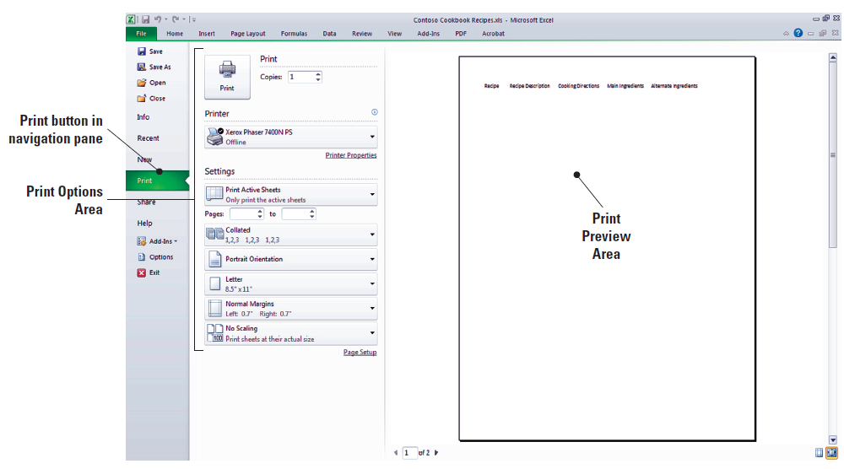
Figure 2-5: Document Preview

Slide 12
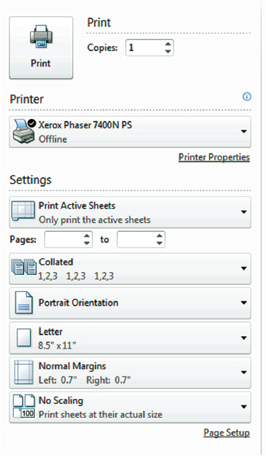
Step-by-Step: Print and Print Preview
Click the File tab to open Backstage. In the
Navigation Pane, click Print. Note that this
opens the Print options page of Backstage.
Take a moment to preview the workbook
in the Print Preview section in the right
pane and to read through the Print options
listed in the center section of the page. The
printing options section of the window is
shown in this figure.
To print your worksheet, click the Print icon
in the top of the Print options screen.
LEAVE the worksheet open to use in the
next exercise.
Notes:
Another Way: You can also activate Backstage and access Print options by pressing Ctrl+P.

Slide 13
Step-by-Step: Quick Print a Worksheet
USE the open workbook from the previous exercise to complete these steps:
Click Quick Print on the Quick Access Toolbar.
Retrieve the printed copy of the workbook from your printer.
Click the File tab, then click Print. From this pane, you can quick print or preview the printout before sending it to the printer.

Slide 14
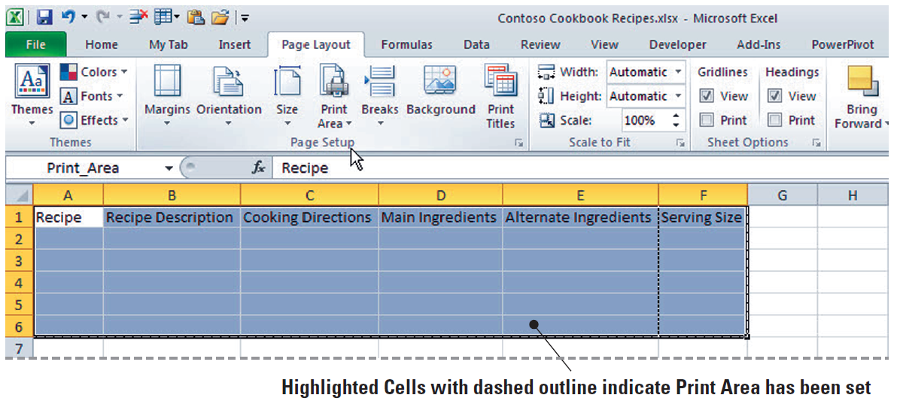
Step-by-Step: Set a Print Area
With Contoso Cookbook Recipes open, follow these steps:
Mouse over the Print Area button on the Ribbon in the Page Setup area. Note the tool tip that pops up defining the task to be completed.
On the worksheet,
click cell A1, hold
the mouse button,
and drag the
cursor to cell F6.
Your cells should
highlight in blue,
as shown here.

Slide 15
Step-by-Step: Set a Print Area
With these cells highlighted, click the Print Area button drop-down arrow and choose Set Print Area from the menu that appears. You have now set the print area.
Click the File tab to access Backstage.
In the Print Preview pane on the right pane of the Print window, you should see the highlighted cells of your print area. You will not print at this time.
SAVE the workbook.
CLOSE Excel.

Slide 16
Step-by-Step: Print Selected Worksheets
LAUNCH Excel 2010. Then perform these steps:
Open Backstage view and click the Recent tab in the navigation pane; in the list of Recent workbooks, click Contoso Cookbook Recipes to open the file.
Press Ctrl+P to activate Print options in the Backstage navigation pane.
In the Settings section of the center pane in Print options, click the Print Active Sheets drop-down arrow. In the drop-down menu that appears (shown in Figure 2-8 on the next slide), you can choose several printing options for your workbook or worksheet.

Slide 17
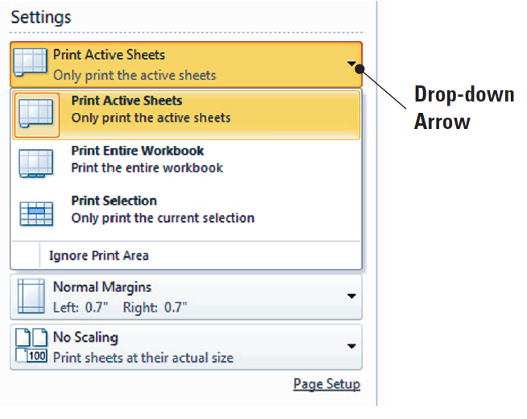
Figure 2-8: Worksheet Print Options

Slide 18
Step-by-Step: Print Selected Worksheets
Click Print Selection in the Print Active Sheets drop-down menu; this option enables you to print only your current selection.
Once again click the Print Active Sheets drop-down arrow, then choose the Print Active Sheets option. You have now reselected the default option.
Click the Print icon at the top-left corner of the Print window.
CLOSE the workbook. LEAVE Excel open for the next exercise.

Slide 19
Step-by-Step: Print Selected Workbooks
With Excel open from the previous exercise, perform these actions:
Click the File tab to produce Backstage view. Click the Recent command in the navigation pane.
In the Recent Workbooks section, open Contoso Cookbook Recipes.
Click the Print command in the navigation pane.
In the Print window Settings Options, click the Print Active Sheets drop-down arrow and choose Print Entire Workbook. Refer to the figure shown in the next slide.

Slide 20
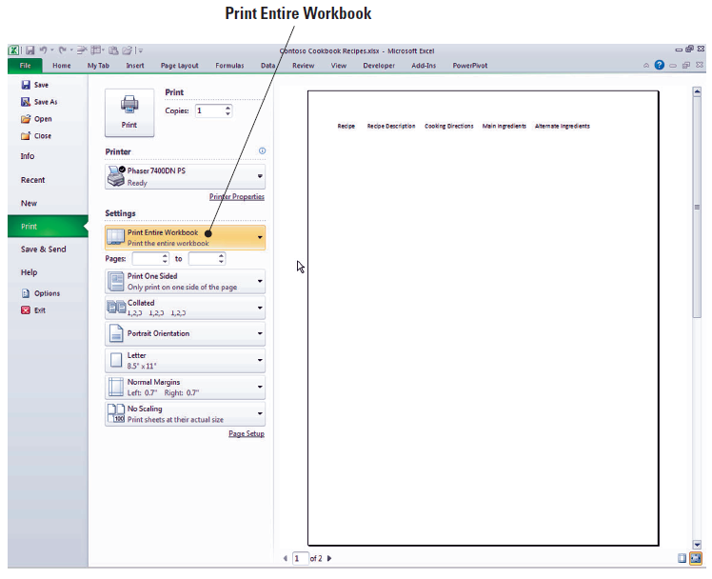
Step-by-Step: Print Selected Workbooks
You will not print at this time.
LEAVE Excel open for the next exercise.

Slide 21
Step-by-Step: Apply Printing Options
With Excel already open, carry out these steps:
OPEN Contoso Cookbook Recipes.
Click the File tab to access Backstage view.
Click the Print command on the left-hand navigation pane.
In the Settings section of the Print window (shown in Figure 2-10 on the next slide), click the Portrait Orientation drop-down arrow. Notice that there are two options: Portrait (default) and Landscape. Choose Landscape.
In the Settings section, click the Margins drop-down arrow to produce a drop-down menu with four options: Normal, Wide, Narrow, and Custom. Choose Wide.

Slide 22
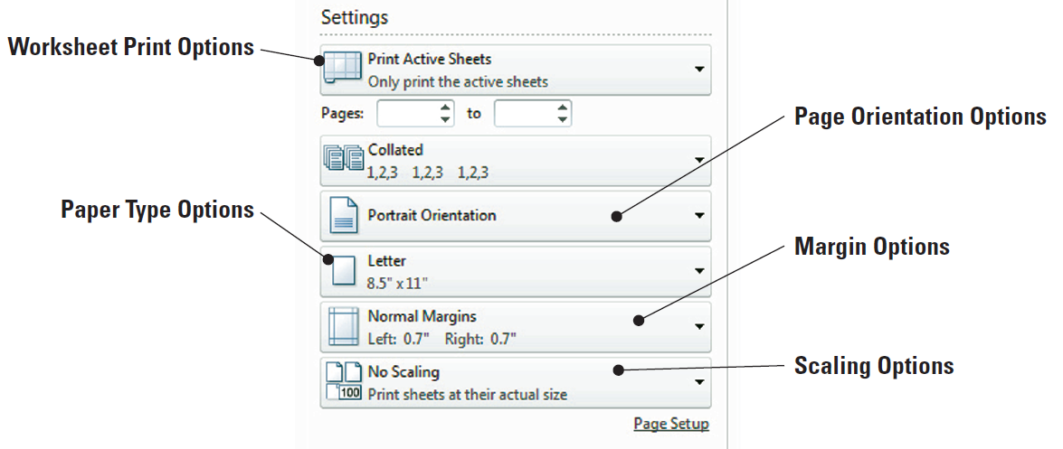
Figure 2-10: Print Settings and Options

Slide 23
Step-by-Step: Apply Printing Options
In the Settings section, click the Scaling drop-down arrow to produce the five options in this area: No Scaling, Fit Sheet on One Page, Fit All Columns on One Page, Fit All Rows on One Page, and Custom. Choose Fit all Columns to One Page.
Take note of the changes displayed in the Print Preview Pane.
Click Print.
PAUSE. CLOSE your workbook. When prompted to save changes to your document, choose Don’t Save.
CLOSE Excel.
Notes:
Another Way: You can customize the workbook settings and options from the Page Layout tab within the Page Setup, Scale to Fit, and Sheet Options command groups.

Slide 24
Step-by-Step: Change a Printer
LAUNCH Microsoft Excel 2010 and then follow these steps:
Click the File tab to access Backstage.
Click the Recent button in the navigation pane.
In the list of recently opened workbooks, click on Contoso Cookbook Recipes.
Click Ctrl+P to activate the Print options.
Your current default printer is displayed in the Printer options section of the Printer window.

Slide 25
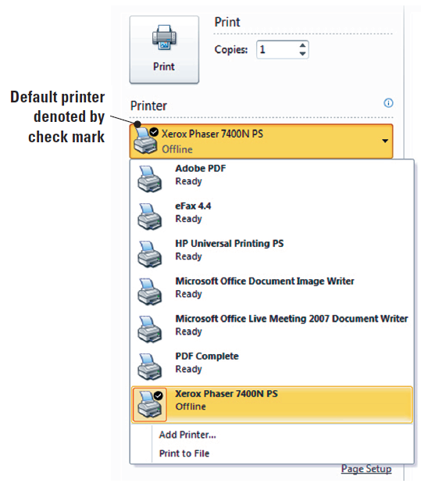
Step-by-Step: Change a Printer
Click the drop-down arrow to
produce a menu of installed
printers, similar to the one
shown in this figure. Note
that the computer will let
you know which printers are
available (active or not
active) for you to choose
from.

Slide 26
Step-by-Step: Change a Printer
Click on a printer (other than your default printer) in the printer list. This printer should now be visible as your active printer. Should you attempt to print at this time with an inactive printer, you will likely get an error.
Once again, click the drop-down arrow next to the active printer and choose your default printer.
PAUSE. CLOSE your workbook. When prompted to save changes to your workbook, choose Don’t Save.
CLOSE Excel.

Slide 27
Step-by-Step: Customize the Quick Access Toolbar
LAUNCH Excel 2010. Then, follow these steps:
Click the File tab to access Backstage view.
Locate and click the Options button in the navigation pane. The Excel Options window opens (see the figure on the next slide).
In the left pane of the window, click Quick Access Toolbar item to open the Quick Access Toolbar Options dialog box. Refer to Figure 2-12 shown on the next slide.

Slide 28
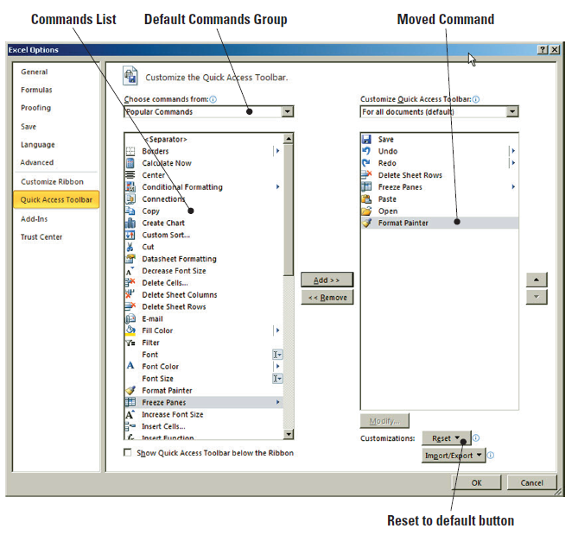
Step-by-Step: Customize the Quick Access Toolbar
The left pane of
this dialog box lists
the commands that
you could possibly
add to the toolbar
and the right pane
shows the
commands that
are currently
included on the
toolbar.

Slide 29
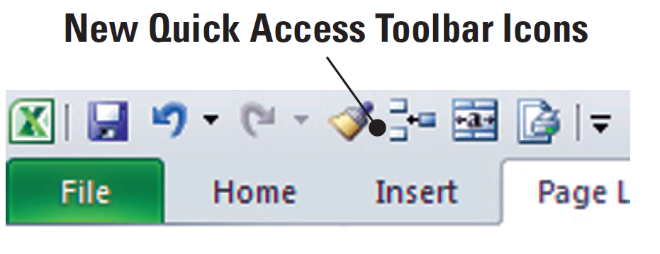
Step-by-Step: Customize the Quick Access Toolbar
In the left pane, click Format Painter, then Click the Add button in the center of the pane to move Format Painter to the Quick Access Toolbar.
Using the same process, move five more commands of your choice to the Quick Access Toolbar. When done, click OK to apply your changes (the changes don’t take effect until you click OK).
Your Quick Access Toolbar
should now include
additional command
buttons, much like the
example shown in this figure.

Slide 30
Step-by-Step: Customize the Quick Access Toolbar
Similarly, you can remove any command that you add to the toolbar. Note that default commands cannot be removed. At any time you can reset the toolbar to its default settings. (Refer to the figure on Slide 40.)
Because your document was not affected by the toolbar changes, you will not be prompted to save any workbook changes.
CLOSE Excel.
Notes:
In Lesson 1, in Using Onscreen Tools, you were shown how to customize the Quick Access Toolbar by using the drop-down arrow to add commands.

Slide 31
Step-by-Step: Customize the Ribbon
LAUNCH Excel 2010 and then follow these steps:
Click the File tab to access Backstage view.
Click the Options button in the navigation pane.
In the Excel Options window, click Customize Ribbon in the left-side menu. The Customize the Ribbon window opens, as shown in Figure 2-14 on the next slide.
By default, Popular Commands is selected in the Choose Commands From drop-down box in the left pane; the list of Popular Commands appears in the list below the drop-down box. Also by default, the Main Tabs option appears in the Customize the Ribbon box in the right pane, with the Ribbon’s main tabs listed below.

Slide 32
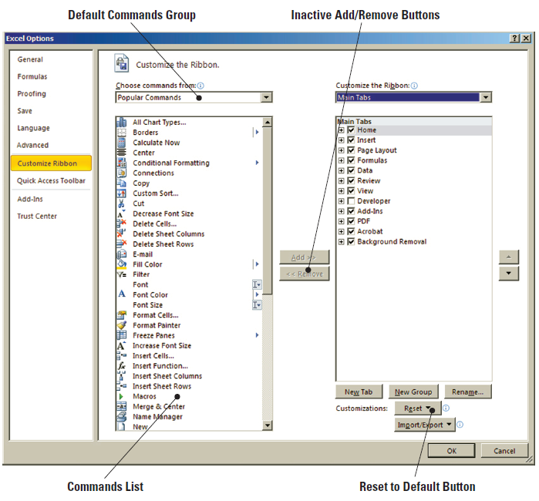
Figure 2-14: Customize the Ribbon Window
By default, Popular
Commands is selected
in the Choose
Commands From
drop-down box in the
left pane; the list of
Popular Commands
appears in the list
below the drop-down
box. Also by default,
the Main Tabs option
appears in the Customize the Ribbon box in the right pane, with the Ribbon’s main tabs listed below.

Slide 33
Step-by-Step: Customize the Ribbon
Click Format Painter in the list of Popular Commands to highlight; note the Add button in the center of the screen is now active.
In the Customize the Ribbon window on the right, click the + preceding Home to expand the list of command groups within the Home tab if it isn’t already expanded.
Click the New Tab button below the Customize the Ribbon options (shown in Figure 2-15 on the next slide) to insert a new blank tab into the Customize the Ribbon list. When you create a New Tab, a New Group is automatically created inside that New Tab.

Slide 34
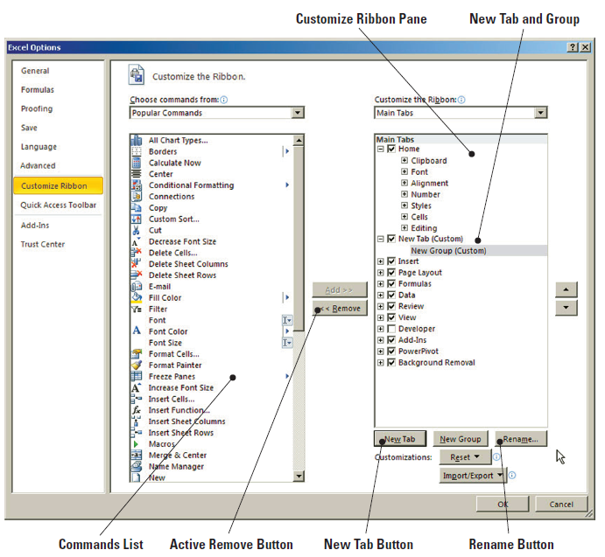
Figure 2-15: Customize the Ribbon

Slide 35
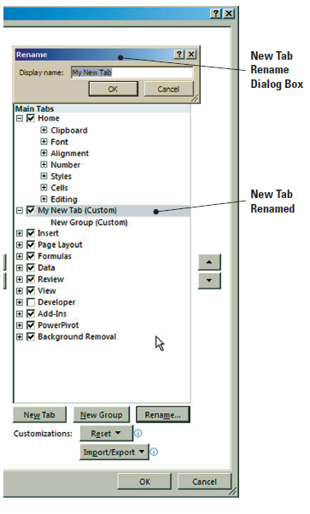
Step-by-Step: Customize the Ribbon
Click the New Tab list item on the
right in the Customize Ribbon
pane to highlight it, then click
the Rename button on the bottom
right. In the Rename dialog box
that appears, Key My New Tab,
as shown in this figure.
Click New Group below your new
tab to highlight it. Click the
Rename button again, and Key
My New Group in the Rename
dialog box. You will see the New
Group renamed.

Slide 36
Step-by-Step: Customize the Ribbon
In the Customize the Ribbon list on the right side of the pane, click the My New Group list item to highlight. In the command list on the left side of the pane, click on a command of your choice, then click the Add button.
You have now successfully moved the command to the Ribbon. Repeat this two more times, choosing other commands from the command list.
Your view should look similar to Figure 2-17 (shown on the next slide).

Slide 37
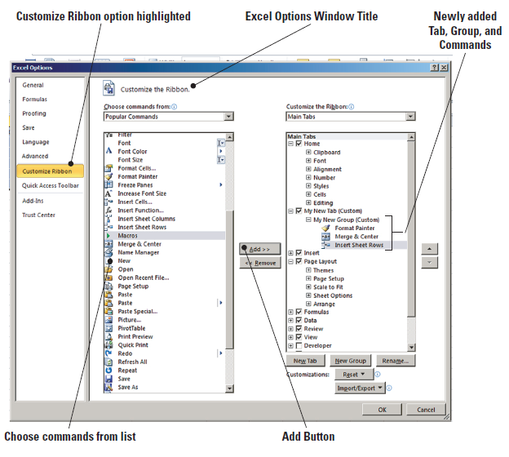
Figure 2-17: Added Commands

Slide 38
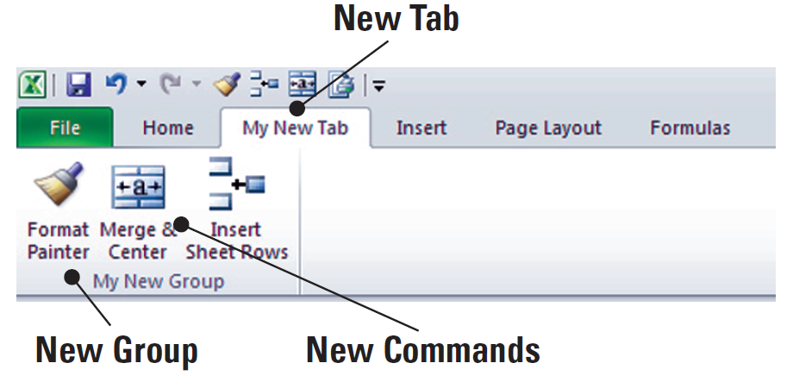
Step-by-Step: Customize the Ribbon
Click OK to exit the Customize the Ribbon window. When you exit, you will see your My New Tab tab appear on the Ribbon.
Click the My New Tab tab on the Ribbon. Note that your commands are now in the tab’s My New Group command group, as shown this
figure.
Click New Tab and New
Group within that tab to
view your changes.
LEAVE Excel open for the next exercise.

Slide 39
Step-by-Step: Customize the Default Settings
With Excel already open, follow these steps:
Click the File tab to access Backstage.
Click Options listing in the navigation pane; by default, the Options window opens with the General options displayed.
In the Creating New Workbooks section of the General options window, click in the Include This Many Sheets option box and Key 2 to change the number of worksheets that appear by default in new workbooks.

Slide 40
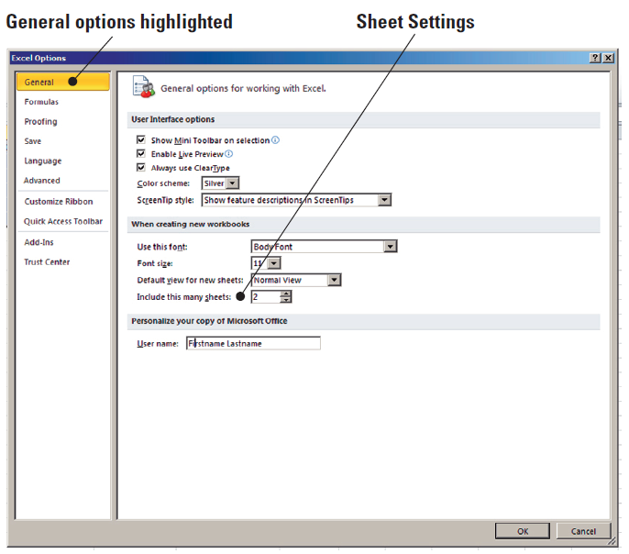
Step-by-Step: Customize the Default Settings
Click the User Name
box in the Personalize
your copy of Microsoft
Office section and
Key your first and
last name in the text
box (see the figure).
Click OK.

Slide 41
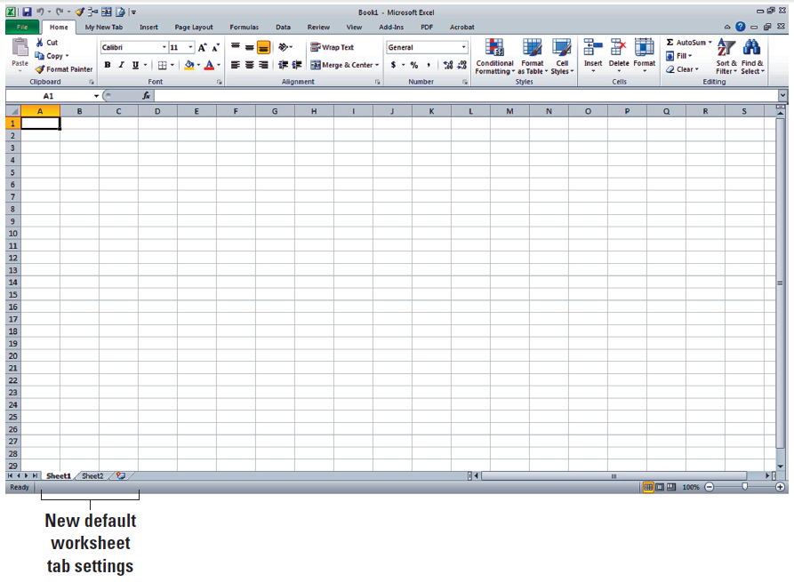
Step-by-Step: Customize the Default Settings
EXIT and RESTART
Excel. Note that
instead of three
worksheet tabs, you
now have two in
your workbook, as
shown in this figure.
CLOSE Excel.

Slide 42
Step-by-Step: Alter Document Properties
LAUNCH Microsoft Excel 2010 and follow these steps:
Click the File tab to access Backstage; in the navigation pane, click Recent, to view your recent workbooks.
Open Contoso Cookbook Recipes from the list of recently opened workbooks.
Click Info in the navigation pane to open the Info window, as shown in Figure 2-21 on the next slide. The right pane of the window lists the workbook properties of the currently opened file.

Slide 43
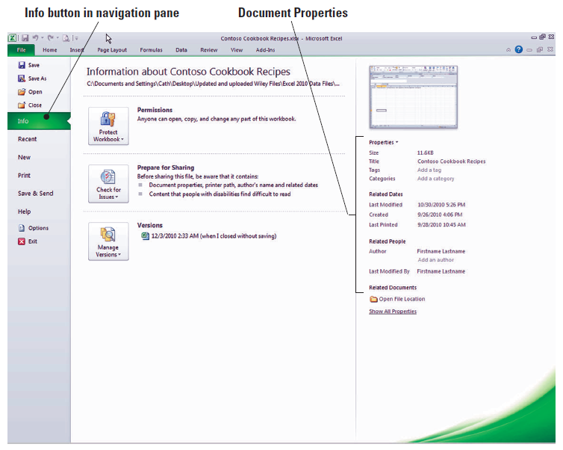
Figure 2-21: Document Properties

Slide 44
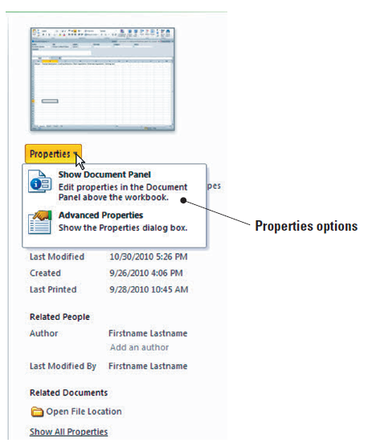
Step-by-Step: Alter Document Properties
Click the Properties
drop-down arrow to
produce the drop-down
menu shown in this figure.
Click Show Document
Panel to open the
document panel.

Slide 45
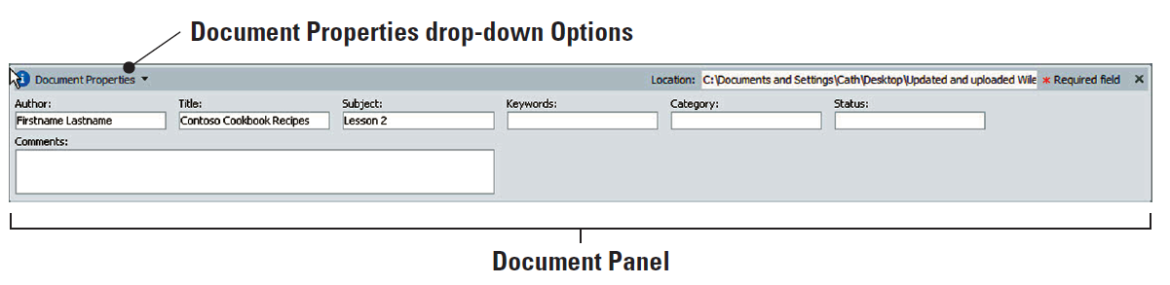
Step-by-Step: Alter Document Properties
In the document panel’s Author text box, key your name. Key Contoso Cookbook Recipes in the Title text box, and Lesson 2 in the Subject text box. The document panel should resemble the one shown here.
Click the X button in the upper-right corner of the document panel to close and save your changes.

Slide 46
Step-by-Step: Alter Document Properties
Click the File tab to access Backstage, then click Info in the navigation pane. The workbook changes have been made.
LEAVE Excel open for the next exercise.
NOTE: We will address more advanced document properties in later lessons.

Slide 47
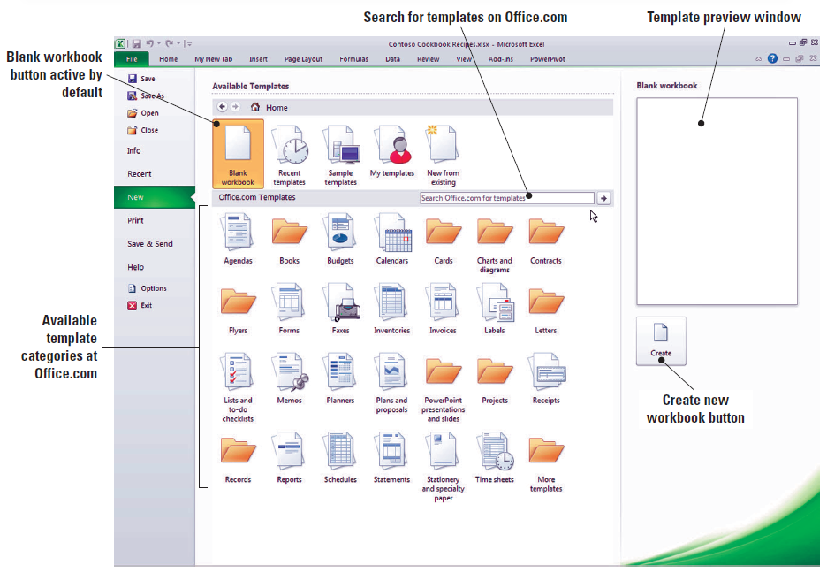
Step-by-Step: Access Excel Templates
USE the open worksheet from the previous exercise, then perform these steps:
In Backstage view,
click the New tab
in the navigation
pane to open the
Available Templates
window, as shown
in this figure.

Slide 48
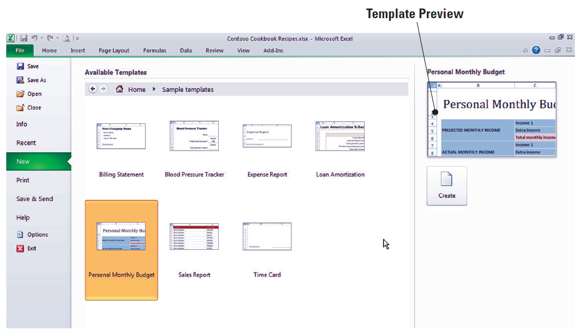
Step-by-Step: Access Excel Templates
Click the Sample Templates icon in the top-row gallery. The collection of sample templates included in Excel 2010 appears in the window.
Click the Personal
Monthly Budget
template listing; a
preview of the
template appears in
the Preview pane.
Your view should
resemble the figure
shown here.

Slide 49
Step-by-Step: Access Excel Templates
Click the Create button. The document properties panel opens, giving you the option to edit the properties before you begin working in the template.
In the document panel’s Author text box, key your name. Key Using Templates in the Title text box and Lesson 2 in the Subject text box. Close the document properties pane.
CLOSE the worksheet. When prompted to save changes, save the worksheet as First Template.
LEAVE Excel open for the next exercise.

Slide 50
Step-by-Step: Access Excel Templates Online
USE the open worksheet from the previous exercise to complete the following steps:
In Backstage view, click the New tab in the navigation pane to open the Available Templates window. This will give you an overview of the categories offered on Office.com as shown in Figure 2-26 on the next slide.

Slide 51
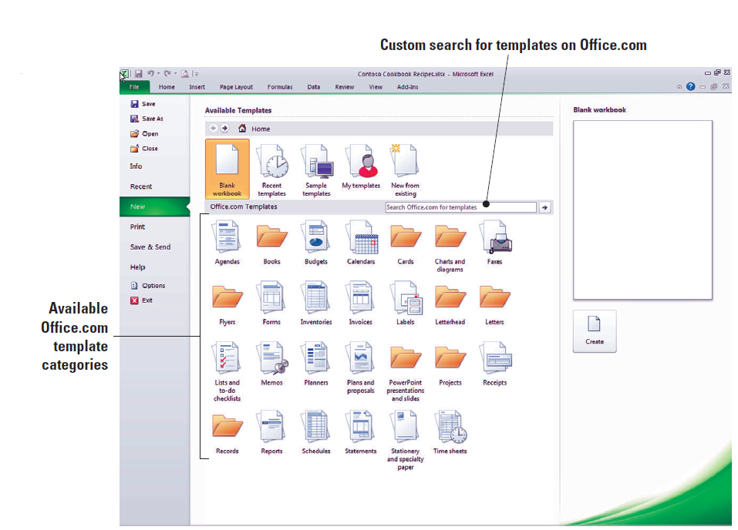
Figure 2-26: Template Categories

Slide 52
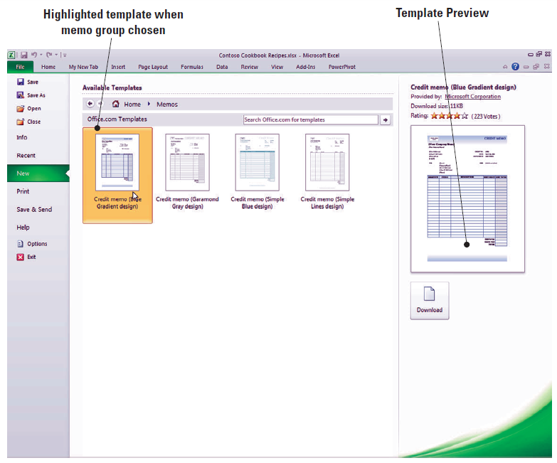
Step-by-Step: Access Excel Templates Online
Click the Memos button to access the available templates in that category. You should see something similar to this figure. The templates
are organized
alphabetically and the
first template should
be Credit memo
(Blue Gradient design).

Slide 53
Step-by-Step: Access Excel Templates Online
Before you implement a template, you have the option to preview the look and feel of it. You can actually see whether it fits your needs. In previous versions of Office, you had to go to the website to search for templates. This isn’t the case with Office 2010. The preview is instantaneous. This means a much easier and simpler decision and download.
Click the Download button below the preview of the Credit Memo template. Note this instantly downloads the Memo and opens it as a new workbook.
SAVE the workbook as First Online Template in the Lesson 2 folder.
CLOSE Excel.

Slide 54
Lesson Summary

